Slide 1
2018 Legislative Conference
Morning Session: Federal Partners
Tuesday March 6, 2018

Slide 2
INVOCATION
TBD

Slide 3
WELCOME REMARKS

Slide 4
NATIONAL CONGRESS OF AMERICAN INDIANS

Slide 5
HOUSING AND URBAN DEVELOPMENT
Dr. Benjamin S. Carson, Sr. MD,
Secretary of the US Department of Housing and Urban Development

Slide 6
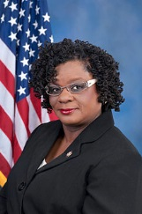
REPRESENTATIVE OF WISCONSIN
Representative Gwen Moore (D-WI)

Slide 7
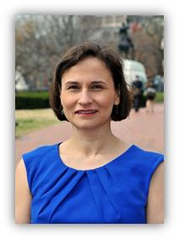
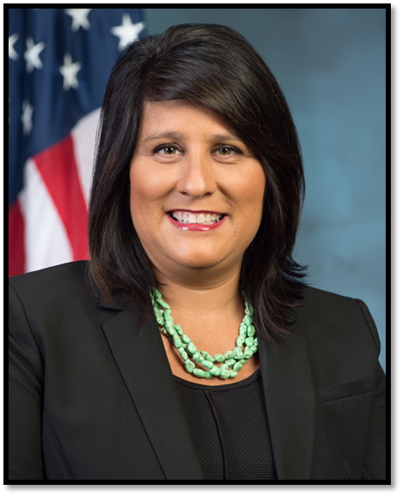
PANEL DISCUSSION
Stephanie Birdwell, Director of Office of Tribal Government Relations
Heidi Frechette, Deputy Assistant Secretary for Office of Native American Programs
Deana O’Hara, Senior Advisor to the Deputy Assistant

Slide 8
VA & HUD: Legislative & Funding Issues Affecting Indian Country- Focus on Housing and Community Development
8

Slide 9
Tribal HUD-VASH
Tribal HUD-VASH has been authorized since December 2014
It started implementation in 2016
There have been 3 Technical Assistance meetings with tribal members and housing authorities, case managers, HUD’s Office of Native American Programs staff, VA Central Office Program staff, and contractors

Slide 10
Status
As of February 20, 2018:
312 Veterans in Case Management
3 Veterans Entered into Case Management only
22 Veterans Referred to the TDHE
37 Veterans Approved for Subsidy, in Housing Search
250 Veterans Housed
93 Veterans Exited
16 Veterans Exited from Housing

Slide 11
Case Management Status
21 permanent case managers are working (as of January 31, 2018)
20 case managers are permanent VA employees
1 case manager is through a contract with the tribal housing authority (Tohono O’odham)

Slide 12
Case Management Open Positions
Alaska VA Health Care System (HCS) for Association of Village Council Presidents (AVCP) - expected to start work April 15
Montana VA HCS –
Many recruits, but not accepting final position offer
Continues to recruit
3 open positions - case managers took other positions or retired
Lumbee with Fayetteville (NC) VAMC
Turtle Mountain Chippewa with Fargo VA HCS
Oglala (Pine Ridge) with Black Hills VA HCS
Montana, Fayetteville, Fargo and Black Hills VAs have interim case managers

Slide 13
Case Managers
Three of the case managers are members of the tribe
Four of the case managers are American Indian ancestry and with the exception of 1 case manager who grew up in the area of the tribe they are serving
Most case managers’ ancestry is not known – candidates voluntarily provided the information

Slide 14
Mental Health and SUD
Case Managers are licensed clinical professionals that can directly provide therapeutic services to Veterans to address Mental Health and Substance Use Disorders
Some Case Managers utilize a “Wellbriety” approach that incorporates culturally meaningful, holistic elements with evidence based therapies

Slide 15
Care Coordination
Case Managers also help with ensuring that Veterans are able to access other needed services, such as medical care
Referrals to other service providers for other services that the case managers cannot provide (such as family care)

Slide 16
Employment
VA recognizes the importance of employment
We are working with VA Homeless Veterans Community Employment Services to help increase employment opportunities for Tribal HUD-VASH Veterans
Working with community employment services
Many Tribal HUD-VASH Veterans are employed

Slide 17
Increase Income
The case manager is able to help the Veteran to apply for fiscal benefits that the Veteran family may be eligible for
This includes Veterans Benefits, Social Security benefits, TANF, SNAP and other fiscal or real supports that helps the family’s income stretch further

Slide 18
Housing Stability
Case managers’ role is to help the Veteran to sustain housing stability
Work to address those areas that may threaten sustained housing
Learning process, not perfection
Important element is regular, clear communication between the Veteran, case manager, TDHE and landlord – identify concerns early

Slide 19
Tenancy
Case Managers teach tenancy skills
Money Management
Housing Responsibilities
Meeting Rules
Safety
Advocacy
Address problematic behaviors such as hoarding

Slide 20
Questions?
20

Slide 21
US CENSUS
Vincent Osier
Assistant Division Chief for Geographic Standards, Criteria, Research, and Quality

Slide 22
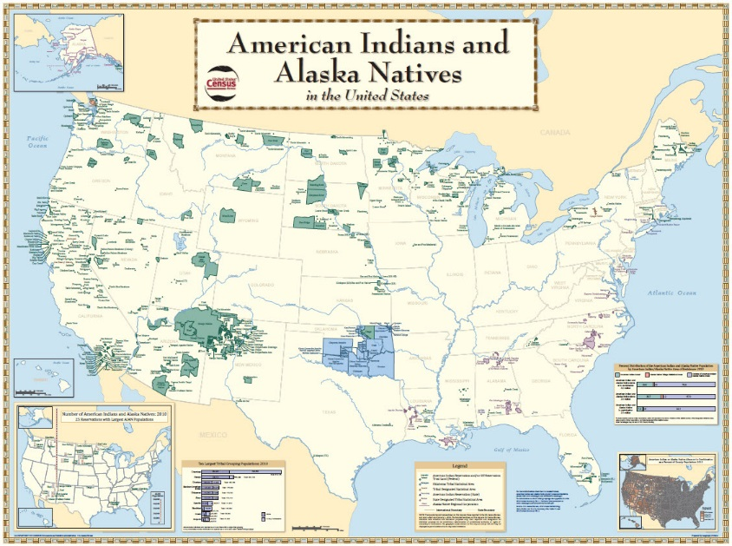
Tribal Tracts and Tribal Block Groups:
Small Geographic Areas for Analysis
National American Indian Housing Council
March 5, 2018
Michael Ratcliffe
Geography Division
U.S. Census Bureau

Slide 24
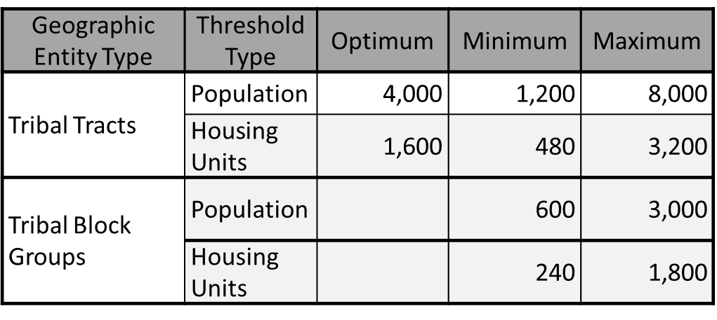
Tribal Tracts and Tribal Block Groups
Subdivide federally recognized American Indian Reservations and Off-Reservation Trust Lands into small statistical geographic areas for tabulating and disseminating data.
Adhere to the same population and housing thresholds as standard, county-based census tracts and block groups.
Can cross state and county boundaries.
Provide an alternative to census tracts and block groups to meet tribal needs for small area data within the boundaries of federally recognized American Indian Reservations and Off-Reservation Trust Lands.

Slide 25
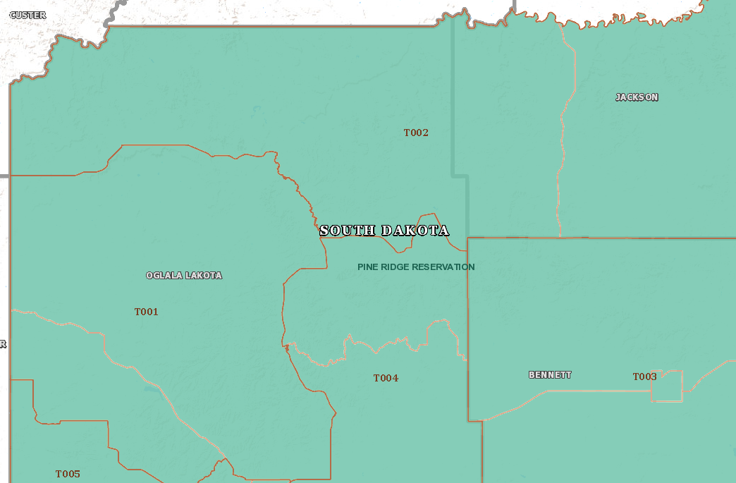
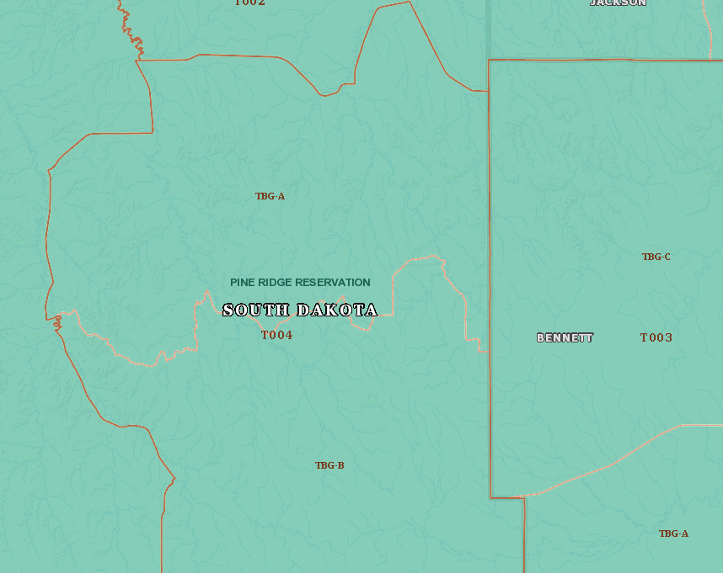
Tribal Tracts and Tribal Block Groups Statistical subdivisions of federally recognized reservations
Notes:
Federally-recognized American Indian Reservations are subdivided into one or more tribal tracts, each containing one or more tribal block groups. Like standard census tracts, tribal tracts have a minimum population of 1,200, a maximum population of 8,000, and an optimum population of 4,000. However, tribal tracts differ in that they can cross state and county boundaries within a reservation as those geographic areas are ignored in the American Indian Area hierarchy. Tribal tract codes start with “T” and contain up to 5 numbers, three to the left of the suffix and two to the right.
Tribal block groups also adhere to the same minimum and maximum population thresholds as standard block groups and, like tribal tracts, can cross state and county boundaries. Tribal block groups are identified by letters (“A,” “B,” “C,” etc.) assigned within a tribal tract.

Slide 26
Median Housing Value by Tribal Tract, Pine Ridge Reservation 2012-2016 ACS 5-Year Data
 | Median Housing Value
 | Estimate | Margin of Error
Tribal Tract T001 | $22,700 | +/- 5,923
Tribal Tract T002 | $33,100 | +/- 14,294
Tribal Tract T003 | $60,900 | +/- 9,613
Tribal Tract T004 | $19,100 | +/- 8,723
Tribal Tract T005 | $17,700 | +/- 9,313

Slide 27
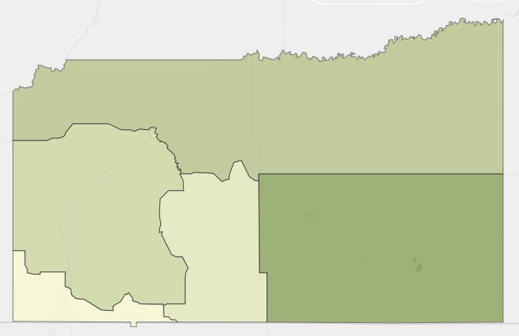
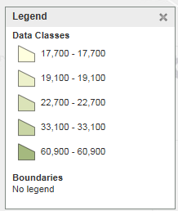
Median Housing Value by Tribal Tract, Pine Ridge Reservation 2012-2016 ACS 5-Year Data
T002
T001
T004
T003
T005
Tribal Tract

Slide 28
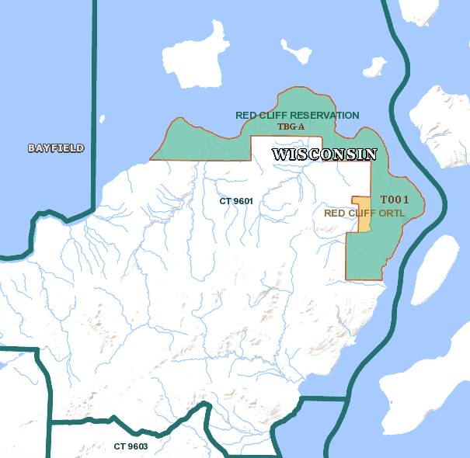
Tribal Tracts and Tribal Block Groups Statistical subdivisions of federally recognized reservations
Tribal Tract T001 within Red Cliff Reservation and Off-Reservation Trust Lands, provides an alternative small area geography to Census Tract 9601 in Bayfield County, Wisconsin.
Notes:
Tribal tract T001 and tribal block group A each cover the entirety of Red Cliff Reservation and Off-Reservation Trust Lands. While data for the tribal tract and tribal block group are the same as data for the reservation and off-reservation trust lands, the tribal tract offers a more appropriate small area geographic unit for analysis for tribal population when tract-level analysis and tract-level data are required.

Slide 29
Comparison of Data by Tribal Tract and Census Tract, Red Cliff Reservation and Bayfield County, Wisconsin
 | Tribal Tract T001, Red Cliff Reservation and Off-Reservation Trust Lands |  | Census Tract 9601, Bayfield County, Wisconsin
 | Estimate | Margin of Error | Estimate | Margin of Error
Median Home Value | $73,900 | +/- 12,996 | $165,100 | +/- 9,787
Percentage of Persons Below Poverty Level (for whom poverty is calculated) | 25.6% | +/- 4.9 | 18.3% | +/- 2.6
Although, in this example, Tribal Tract T001 covers the entirety of Red Cliff Reservation and Off-Reservation Trust Lands, if a program calls for data by tract, the tribal tract offers a comparable geographic unit for analysis and decision-making.

Slide 30
Contact Information
Thank you!
Michael Ratcliffe
michael.r.ratcliffe@census.gov

Slide 31
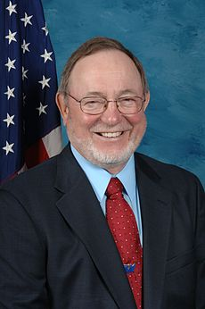
REPRESENTATIVE OF ALASKA
Representative Don Young (R-AK)

Slide 32
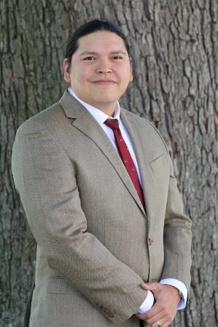
CLOSING REMARKS

