Slide 1
IHBG-ARP IMPLEMENTATION TRAINING

Slide 3
YES
NO
I have completed an IHBG-CARES Abbreviated IHP
I have completed an IHBG-ARP Abbreviated IHP
I have a resolution authorizing alternative approaches
I have a policy re use of Cares & ARP
I want to learn about the
Waivers
Eligible activities
Program descriptions for the Abbrv. IHP

Slide 4
TRAINING COMPONENTS
Training Purpose
ARP Act Background
Purpose of ARP
Eligible Activities
Waivers and Alternatives
Applying for IHBG-ARP
Sample Policy Statements
Resources

Slide 5
Training Purpose
Indian Housing Block Grant (IHBG) [Formula] Funding Provided Under the Coronavirus Aid, Relief, and Economic Security Act (CARES Act) and the American Rescue Plan Act (ARP) IHBG-CARES Grants
Develop a practical understanding of the:
ARP Background
ARP Purpose
PIH Notice - 2021-14 COVID-19 Statutory and Regulatory Waivers and Alternative Requirements
PIH Notice 2021-11 IHBG-ARP Implementation Notice
Waivers and Alternative Requirements
Eligible Activities
Review of Abbreviated IHP/APR
Sample Completed IHBG-ARP Application
Sample Program Activities
Sample Policy Statements
Reporting
FAQ
Resources

Slide 6
ARP BACKGROUND

Slide 7
American Rescue Plan Act of 2021 (ARP) (Public Law 117-2) Background
March 11, 2021, President Biden signed the American Rescue Plan (ARP) into law.
Additional $450,000,000 in IHBG formula funding for eligible Indian tribes and TDHEs
All funding through the IHBG program
Allocated based on the 2021 Formula
Prevent, prepare for, and/or respond to COVID-19, including maintaining normal operations and funding eligible NAHASDA activities during recipient’s impact period
Authority to waive or specify alternative statutory/regulatory requirements to facilitate or expedite the use of IHBG-ARP grant funds
IHBG-ARP grants will be awarded as separate IHBG grants. On March 25, 2021, HUD published IHBG-ARP grant allocations for all Indian tribes that are eligible to receive funding. These allocations are available at: https://www.hud.gov/sites/dfiles/PIH/documents/IHBG-ARP_for_Codetalk3.24.21.pdf
Notes:
An outbreak of a respiratory disease caused by a novel (new) coronavirus, COVID-19, was detected world-wide, including in the United States.

Slide 8
IHBG-ARP grant allocations are available at: https://www.hud.gov/sites/dfiles/PIH/documents/IHBG-ARP_for_Codetalk3.24.21.pdf
ARP Implementation Resources
COVID-19 Related Frequently Asked Questions (FAQs) for Tribes and Tribally Designated Housing Entities (TDHEs)
PIH Notice 2021-11 IHBG-ARP Implementation Notice: Provides Recipients with instructions on how to apply for IHBG Program funding under ARP and other program requirements
Notes:
The IHBG-ARP funds seek to prevent, prepare for, and respond to coronavirus, including to maintain normal operations and fund eligible affordable housing activities under NAHASDA, as amended, during the period that the program is impacted by coronavirus. IHBG-ARP funds may also be used, as necessary, to cover or reimburse allowable costs to prevent, prepare for, and respond to coronavirus that are incurred by a recipient, including for costs incurred after January 21, 2020.

Slide 9
REMEMBER
PIH Notice 2021-14 Supersedes:
Notices PIH 2020-33;
PIH 2020-13;
PIH 2020–05
This notice consolidates into a single document all previously established waivers and alternative requirements, including those not being extended at this time.

Slide 10
WAIVERS AND ALTERNATIVE REQUIREMENTS

Slide 11
Waivers and Alternative Requirements
HUD waives various IHBG rules in order to
Expedite the delivery of services
Reduce administrative burden associated with normal operations.(PIH Notice 2021-22, COVID-19 Statutory and Regulatory Waivers)
Notes:
Some critical functions for Indian tribes and TDHEs
include but are not limited to ensuring low-income Native American families remain housed,
alleviating severe overcrowding, and carrying out eligible affordable housing activities.

Slide 12
Authority for Waivers
Waivers and alternative requirements are established under the authority of the
CARES Act,
ARP Act, and
Secretary’s finding that all waivers provided under this notice are necessary to expedite or facilitate the use of IHBG and Indian Community Development Block Grant (ICDBG) funds.
Use of funds MUST
Prevent,
Prepare for, and
Respond to the coronavirus.
Recipients are encouraged to submit additional waiver requests.
Notes:
to area ONAPs. HUD will consider all requests and determine whether to approve additional relief.

Slide 13
Applicability of Waivers
The following waivers and alternative requirements apply to IHBG funding provided
Under the CARES Act, ARP Act, and
FY 2020 IHBG formula funds under the Further Consolidated Appropriations Act, 2020.
In applying these waivers and alternative requirements, IHBG recipients must ensure that they are doing so only with respect to IHBG-CARES and IHBG-ARP and FY 2020 IHBG grants.
These waivers and alternative requirements do not apply to IHBG funds appropriated in any other prior year.

Slide 14
Date Began Preparing for COVID-19
Waivers are effective as of the date an Indian tribe or TDHE began preparing for COVID-19.
Waivers and alternative requirements apply retroactively to the date that the respective IHBG recipient began preparing for COVID-19.

Slide 15
Term of Waivers
Period of Availability: The period of availability of each IHBG waiver and alternative requirement ends when funds subject to the waiver and alternative requirement are
Expended, unless otherwise specified under each waiver and alternative requirement (e.g., Indian Housing Plan (IHP) / Annual Performance Report (APR) deadline extensions).
Notes:
Period of Availability: Any waivers granted by HUD are deemed to be effective as
of the date the Indian tribe or TDHE began preparing for COVID-19, but after January 21,
2020. Accordingly, the relief provided by the following waivers and alternative requirements
will apply retroactively to the date that an Indian tribe or TDHE began preparing for COVID-
19, but after January 21, 2020. Additionally, IHBG-ARP grants may also be used to cover or
reimburse any costs incurred by an IHBG recipient that are otherwise eligible and allowable
under the IHBG- ARP grant, including costs incurred after January 21, 2020. See Section 9,
entitled “Reimbursement of Costs.”
Indian tribes and TDHEs should retain
In accordance with ARP, this waiver relief is available only for IHBG funding provided
under ARP and is generally available until ARP funds are expended, unless otherwise noted
under specific waivers. HUD is allowing waivers and alternative requirements to remain
available to Indian tribes and TDHEs until IHBG-ARP grant funds are expended because all

Slide 16
IHBG-ARP Purpose of Eligible Activities
Prepare For
Examples include housing activities designed to reduce severe overcrowding, providing food delivery services to eligible families (including the elderly, disabled, and other high-risk populations) to allow them to shelter in place, and public health campaigns designed to educate families on how to prepare for a possible outbreak in the community and ways to minimize community spread.
Prevent
Examples include distributing Personal Protective Equipment to housing maintenance staff, residents, and members of the community, using IHBG-ARP funds to clean common areas to prevent infections, using IHBG-ARP funds to facilitate the vaccination of IHBG assisted residents and IHBG recipient staff, and etc.
Respond to:
Examples include to provide care for those infected and to limit the exposure and spread of the virus, rent assistance to eligible families that cannot pay rent, carrying out activities to reduce severe overcrowding, prevent homelessness to ensure families are stably housed, and operations.
Notes:
The IHBG-ARP funds seek to prevent, prepare for, and respond to coronavirus, including to maintain normal operations and fund eligible affordable housing activities under NAHASDA, as amended, during the period that the program is impacted by coronavirus. IHBG-ARP funds may also be used, as necessary, to cover or reimburse allowable costs to prevent, prepare for, and respond to coronavirus that are incurred by a recipient, including for costs incurred after January 21, 2020.

Slide 17
IHBG-ARP Purpose of Eligible Activities
One example of maintaining normal operations is using
IHBG-ARP funds to carry out eligible IHBG activities that the recipient initially planned to carry out with its regular IHBG funds but did not because it had to use its regular IHBG funds to carry out an unplanned activity to prevent, prepare for, or respond to COVID-19.
In this scenario, the IHBG- ARP grant funds can be used to carry out the original IHBG activity that the recipient planned on carrying out but did not due to COVID-19.
Notes:
The IHBG-ARP funds seek to prevent, prepare for, and respond to coronavirus, including to maintain normal operations and fund eligible affordable housing activities under NAHASDA, as amended, during the period that the program is impacted by coronavirus. IHBG-ARP funds may also be used, as necessary, to cover or reimburse allowable costs to prevent, prepare for, and respond to coronavirus that are incurred by a recipient, including for costs incurred after January 21, 2020.

Slide 18
Activities Tied to IHBG-ARP Purposes
Use of IHBG-ARP grants MUST be tied to preventing, preparing for, and responding to COVID-19, including maintaining normal operations and funding eligible affordable housing activities under NAHASDA during the period the program is impacted by COVID-19.
Compliance with this requirement, all activities must be tied to at least one of the following three eligible purposes:
1. Activities, Projects, or Programs to Prevent COVID-19
2. Activities, Projects, or Programs to Prepare for COVID-19
3. Activities, Projects, or Programs to Respond to COVID-19
Notes:
The IHBG-ARP funds seek to prevent, prepare for, and respond to coronavirus, including to maintain normal operations and fund eligible affordable housing activities under NAHASDA, as amended, during the period that the program is impacted by coronavirus. IHBG-ARP funds may also be used, as necessary, to cover or reimburse allowable costs to prevent, prepare for, and respond to coronavirus that are incurred by a recipient, including for costs incurred after January 21, 2020.

Slide 19
ELIGIBLE ACTIVITIES

Slide 20
Eligible Purposes
Prevent, Prepare for, and/or Respond to COVID-19
Including maintaining normal operations and funding eligible NAHASDA activities during recipient’s impact period
Grant funds may also be used to cover or reimburse allowable costs incurred by the recipient provided: the funds to be reimbursed were
used to prevent, prepare for, and/or respond to COVID-19;
costs to be reimbursed were paid with non-Federal funds; and
costs incurred “after January 21, 2020” (i.e., from 1/22/2020)

Slide 21
Eligible Activities Examples
Carrying out activities eligible under IHBG provided those activities will prevent, prepare for, and respond to COVID-19;
Providing essential housing services to shelter residents including childcare, education services, employment assistance, outpatient health services, legal services, mental health services, and transportation, provided such services are not duplicative of other Federally-funded services;
Working with resident groups to help educate residents on social distancing and other practices designed to minimize the risk of community spread of COVID-19;
Acquiring, constructing, converting, or rehabilitating structures to reduce and prevent homelessness, and reduce vulnerability to COVID-19;
Notes:
These descriptions are designed to provide general guidance to recipients and are not intended to limit the range of eligible IHBG-ARP grant activities that can be carried out.

Slide 22
Eligible Activities Examples (Continued)
Carrying out activities eligible under IHBG provided those activities will prevent, prepare for, and respond to COVID-19;
Payment of tenant and homebuyer utilities;
Installing a lockbox or other method for collecting rent payments without the need for personal contact;
Supporting laundry facilities to assist residents with eliminating the spread of COVID-19;
Paying for IHBG operating costs due to a significant reduction in rent receipts caused by COVID-19;
Notes:
These descriptions are designed to provide general guidance to recipients and are not intended to limit the range of eligible IHBG-ARP grant activities that can be carried out.

Slide 23
Eligible Activities Examples (Continued)
Emergency Response (Continued)
Carrying out activities that would prevent individuals from becoming homeless and rapidly rehousing homeless individuals;
Acquiring, constructing, converting, or rehabilitating structures that can serve as temporary emergency shelters, or converting existing facilities for this purpose, to ensure homeless persons are provided safe shelter and to minimize the risk of community spread of COVID-19;

Slide 24
Eligible Activities Examples (Continued)
Emergency Response
Providing short- term rental assistance to homeless persons in hotel/motels to minimize infection and spread of COVID-19;
Providing units or other space for temporary quarantine purposes as a result of COVID-19;
Providing emergency housing for health care workers;
Purchasing Telehealth equipment to allow assisted residents access to health care providers from home;
Purchasing and distributing personal protective equipment (PPE) such as gloves, surgical masks and goggles, hand hygiene products, soap, paper towels, hand sanitizer, hand wipes, tissues, and thermometers;

Slide 25
Eligible Activities Examples (Continued)
Administrative Activities
Preparing housing or TDHE staff and Board of Commissioners to conduct business in a remote working environment, and providing them with necessary supplies to carry out the IHBG program;
Setting up web-based communication options for program participants and staff;
Implementing policies, procedures, and other measures to protect vulnerable populations; and
Revising the approval process for policies and procedures in order to limit person-to-person contact;
Notes:
We have been flexible when it comes to charging items in these categories to programs (e.g., operations and maintenance) rather than administration and planning. So, if asked, it may be appropriate to charge some or all of these costs to a program rather than Planning and Administration – which is limited to 20 or 30 percent depending on level of IHBG funding.

Slide 26
Eligible Activities Examples (Continued)
Administrative Activities (Continued)
Paying staff salaries including the salaries of employees who must shelter in place or are otherwise prohibited from interacting with community members due to COVID-19;
Paying hazard pay for essential workers that are managing or maintaining units, or staffing emergency or isolation centers, provided such costs are considered necessary and reasonable under 2 C.F.R. Part 200;
Paying transportation costs of staff to perform IHBG program functions or assist tenants in accessing food, medical care, or prescriptions.
Notes:
We have been flexible when it comes to charging items in these categories to programs (e.g., operations and maintenance) rather than administration and planning. So, if asked, it may be appropriate to charge some or all of these costs to a program rather than Planning and Administration – which is limited to 20 or 30 percent depending on level of IHBG funding.

Slide 27
WAIVERS AND ALTERNATIVE REQUIREMENTS

Slide 28
Waivers: Reduced IHP/APR Application Requirements for Recipients
Alternative processes
Electronic transmission of information to families,
Conducting briefings online,
Conducting conference calls, or
Using self-service features on the Recipient’s website,
Providing business-reply envelopes,
Providing drop-box apparatuses for document submission
Notes:
ALTERNATIVES: Alternative processes may include electronic transmission of information to families,
conducting briefings online, conducting conference calls, or using self-service features on the
PHA’s, Indian tribe’s, or TDHE’s website if available, and providing business-reply
envelopes or secure drop-box apparatuses for document or rent submission for assisted
families that do not have access to the Internet.

Slide 29
Recipient’s Application Process
IHBG-ARP recipients may deviate from their current written admissions and occupancy policies, and may allow less frequent income recertifications; and
IHBG-ARP recipients may carry out intake and other tasks necessary to verify
income of applicants and residents remotely if the IHBG recipient or eligible families chooses to do so, including allowing income self-certification over the phone (with a written record by the IHBG recipient’s staff), or through an email with a self-certification form signed by the family.
Notes:
Given the COVID-19 related challenges facing families seeking IHBG assistance,
families currently receiving IHBG assistance that are due for income
recertification, and Tribal and TDHE staff charged with verifying income and
maintaining documentation, HUD is establishing the following alternative
requirement under 24 C.F.R. § 1000.128:

Slide 30
Sample Income Verification Policy
Recipient Plan: During the COVID-19 pandemic, the Recipient's staff will make every effort to abide by the requirements cited in the Recipient's admissions and occupancy policy. However, when the situation is urgent and time is of the essence, any of the following efforts will be accepted:
Self-certification by mail,
Email,
First party verification,
In person if feasible for the family and the recipient, or
Over the phone.
When and if time permits, efforts to obtain additional verification of information.

Slide 31
Income Limits
All low-income families will be assisted regardless of
Income and
Classification of unit, meaning FCAS or NAHASDA unit.
Notes:
Should this read “All families…” rather than “All low-income families…” in light of the first bullet. With certain exceptions, non-low income families may be assisted with CARES and ARP funding.

Slide 32
Low-Income, Non-Low-Income, and Non-Indian Families
Provide assistance to all affected and threatened people without regard to income limits for services such as:
Temporary shelter-in-place,
Isolation centers,
Purchasing and making medical testing kits available,
Purchasing and distributing masks and other personal protection equipment, emergency food preparation and distribution,
Cleaning and decontamination, and other directly related activities.

Slide 33
Justification for Assisting Non-Low-Income and Non-Indian Families
JUSTIFICATION
Persons infected with the virus, regardless of income or tribal membership, pose a health risk to the entire community, and low-income families are especially vulnerable given the severe overcrowding in Indian Country, infrastructure challenges, and the lack of access to running water and readily available health care services in many remote communities.
TERM
Provided during the COVID-19 pandemic; if it is designed to protect the health and safety of low-income Native American families; if it is provided on an urgent basis (as documented by the IHBG recipient); and if it is temporary in nature.
Notes:
Given this, HUD is waiving Section 201(b) and its implementing regulations, and establishing alternative requirements to the extent necessary to allow IHBG funds to be used by recipients to prevent, prepare for, and respond to COVID-19 through the following limited activities that provide assistance to all affected and threatened people without regard to income limits or Indian status: temporary shelter-in-place, isolation centers, purchasing and making medical testing kits available, purchasing and distributing masks and other personal protection equipment, emergency food preparation and distribution, cleaning and decontamination, and other directly related activities. Permanent rental assistance, mortgage assistance, housing rehabilitation, and new housing construction may not be provided for the benefit of such otherwise ineligible families under this waiver and alternative requirement. This assistance may only be provided to such otherwise ineligible families if: it is provided during the COVID-19 pandemic; if it is designed to protect the health and safety of low-income Native American families; if it is provided on an urgent basis (as documented by the IHBG recipient); and if it is temporary in nature. When providing this assistance, IHBG recipients must maintain records documenting that these criteria were met at the time that such assistance was provided.

Slide 34
Prohibited Non-Low-Income and Non-Indian Families
Permanent rental assistance, mortgage assistance, housing rehabilitation, and new housing construction will not be provided except under all of the following conditions:
It is provided during the COVID-19 pandemic.
It is designed to protect the health and safety of low-income Native American families.
It is provided on an urgent basis (as documented by the Recipient).
AND
It is temporary in nature.
Notes:
I don’t care for this slide. The intro says “Permanent” and the last bullet says “temporary”. These items just aren’t available to non-low income families under any condition. I don’t see this caveat in the Waiver Notice either. So unless I’m missing something, this slide should probably be omitted or just list those items that non-low income families are not eligible for.

Slide 35
Allowable Assistance for Non-Low-Income and Non-Indian Families
Purchasing and making medical testing kits available,
Purchasing and distributing masks and other personal protection equipment,
Emergency food preparation and distribution,
Cleaning and decontamination, and
Other directly related
Notes:
I think the last bullet is missing something.

Slide 36
Public Health Services
Facilitate access to vaccination such as
Paying the transportation costs to get IHBG-assisted families and staff to and from a vaccination site;
Coordinating with health clinics to provide on-site vaccinations;
Paying the costs of providing public health information to staff and residents so they can learn about the benefits of getting vaccinated and how to get vaccinated; and
Supporting IHBG-assisted families and staff with online registration for vaccination appointments and keeping them informed as vaccination efforts continue

Slide 37
Useful Life
Useful life requirements (period of affordability) are waived if assistance is related to cleanup of pandemic contamination and temporary use dwelling units for purposes of housing and quarantining families to inhibit the spread of disease to low-income Indian families and the Tribal community.
This waiver only applies during the period that a unit is being temporarily used to prevent, prepare for, or respond to COVID-19.
Useful life restrictions are required for other housing activities conducted with IHBG-ARP funding and are also required after a unit is no longer needed to temporarily quarantine families and is no longer needed for other COVID-19 purposes.
Notes:
This waiver only applies during the period that a unit is being temporarily used to
prevent, prepare for, or respond to COVID-19. Useful life restrictions are required for
other housing activities conducted with IHBG-ARP funding. For example, if a unit is
acquired for the purpose of quarantining families, no useful life restriction will apply
to the unit during this temporary period when the unit is being used for COVID-19-
related purposes. However, after the unit is no longer needed to temporarily
quarantine families, and is no longer needed for other COVID-19 purposes, the
recipient must either place useful life restrictions on the property and continue to
make it available for NAHASDA-eligible families for an affordability period set by
the recipient consistent with its IHBG program, or dispose of the unit.

Slide 38
Total Development Costs
TDC maximum limits may be exceeded by 20 percent without HUD review or approval which applies to:
Dwelling and non-dwelling units developed, acquired, or assisted to prevent, prepare for, and respond to COVID-19.
Notes:
Because of the long-term need to prevent, prepare for,
and respond to COVID-19, IHBG recipients may find it appropriate to use IHBG-ARP
grant funds to acquire or construct new housing units with the goal of reducing
severe overcrowding in Indian Country that leave Native American populations,
particularly the elderly and persons with disabilities, especially vulnerable to COVID-
19. Accordingly, HUD is establishing an alternative requirement relating to
limitations on cost or design standards and TDC with respect to dwelling and nondwelling
units developed, acquired, or assisted with funding provided to be used by
recipients to prevent, prepare for, and respond to COVID-19. An IHBG recipient may
exceed the current TDC maximum by 20 percent without HUD review or approval if
the purpose of the development, acquisition or assistance is to prevent, prepare for,
and respond to COVID-19. The recipient, however, must maintain documentation
that indicates the dwelling and non-dwelling units developed, acquired, or assisted
with this funding will, after this crisis, be for IHBG eligible families and the design,
size, and amenities are moderate and comparable to housing in the area. The TDC
limits can be exceeded by more than 20 percent if the recipient receives written
approval from HUD Headquarters. This waiver applies to both single-family and
multi-family housing, as well as non-dwelling structures supporting an activity to
prevent, prepare for, and respond to COVID-1

Slide 39
Prohibition Against Investment of ARP Grant Funds
Statutory Authority: Section 204(b) of NAHASDA
Regulatory Authority: 24 C.F.R. § 1000.58
HUD is prohibiting the investment of any IHBG funding provided under the ARP Act.
Notes:
This goes for CARES, too.

Slide 40
IHBG-ARP Funds Not Counted in Undisbursed Funds Factor
Regulatory Authority: 24 C.F.R. § 1000.342
HUD will exclude IHBG-ARP funds from counting towards an Indian tribe’s undisbursed
IHBG funds from prior years under the Undisbursed Funds Factor (UDFF).
Notes:
This might just be an ARP thing but it probably also applies to CARES.

Slide 41
Continued Operations During the COVID-19 Pandemic
Waiver is intended to provide administrative relief, and
Allow for alternative approaches to various aspects of recipient operations that are necessary to expedite or facilitate the use of the IHBG-ARP funds.
Alternative processes may include:
electronic transmission of information to families,
conducting briefings online,
conducting conference calls, or using self-service features of an Indian tribe’s or TDHE’s website, and
providing business-reply envelopes or secure drop-box apparatuses for document or rent submission for assisted families that do not have access to the Internet.

Slide 42
Reimbursement of Costs
IHBG-ARP grant funds may cover or reimburse any eligible and allowable costs to Prevent, Prepare for, and/or Respond to COVID-19 paid by the IHBG recipient with other non-Federal funds, and dating from January 21, 2020 and later (date of first confirmed case of COVID-19)
Section 1 of the Abbreviated IHP/APR identifies the date recipient began preparing for COVID-19
There should be a program in the Abbreviated IHP/APR specific to reimbursement costs
Unique Identifier (Line 1 of Section 3) must be titled COVID-19 reimbursement costs
Recipients should maintain:
Start date documentation
Documentation to support any costs the recipient plans to reimburse with grant funding
Must show what is being reimbursed (must be non-federal funds, cannot be program income)

Slide 43
FCAS Units
24 C.F.R. §§ 1000.312 and 1000.314 identifies FCAS units as low rent, Mutual Help, and Turnkey III housing units owned and operated by an IHBG recipient. 24 C.F.R. § 1000.318 establishes when these units can be considered FCAS for purposes of the IHBG formula. These regulations are also waived and modified to the extent necessary to not impact the FCAS eligibility of FCAS units used for this purpose of addressing COVID-19 regardless of income or Indian status, provided such units are operated as low-income housing dwelling units once no longer needed to shelter-in-place persons, and upon a determination that such units are safe to be occupied again by low-income families not infected with COVID-19.

Slide 44
Duplication of Benefits
Before expending IHBG-ARP grant funds on any eligible activity, recipient must conduct a duplication of benefits analysis.
Ensure that no insurance proceeds or other financial assistance has been received or is available to pay costs INTENDED TO BE charged to the IHBG-ARP grant.
Recipient retains a copy of the duplication of benefits analysis for monitoring purposes.

Slide 45
Applying for the IHBG-ARP Grant

Slide 46
Indian Tribes Eligible to Receive IHBG-ARP Funds
On March 25, 2021, HUD published IHBG-ARP grant allocations for all Indian tribes that are eligible to receive funding. These allocations are available at: https://www.hud.gov/sites/dfiles/PIH/documents/IHBG-ARP_for_Codetalk3.24.21.pdf
Indian tribes or TDHEs that did not submit a FY 2021 IHP (or whose IHP was not approved) may still take advantage of this funding opportunity by preparing and submitting an Abbreviated IHP/APR.

Slide 47
Waivers: Reduced IHP/APR Application Requirements for Recipients
IHBG-ARP grants will be awarded as separate IHBG grants.
HUD has streamlined the application process while ensuring IHBG-ARP grant funds will be used only to prevent, prepare for, and respond to COVID-19,
The Abbreviated IHP/APR is a streamlined fillable PDF version of the regular IHP/APR and reduced as follows:
Form has been reduced from 15 sections to 7 sections
Section 1 (Cover Page),
Section 3 (Programs),
Section 5 (Budget),
Section 7 (IHP Certification of Compliance),
Section 8 (IHP Tribal Certification),
Section 9 (Tribal Wage Rate Certification), and
Section 12 (Audits).
Must be submitted electronically via email to ONAP

Slide 48
Applying for IHBG-ARP Grant
Indian tribe or TDHE must first submit an Abbreviated Indian Housing Plan/Annual Performance Report (IHP/APR) (Form: HUD-52737) to its Area Office of Native American Programs (AONAP).
Except for a single check box, it is identical in format to the Abbreviated IHP/APR used by recipients of IHBG-CARES funding.
IHBG-ARP recipients will not be required to use the Energy and Performance Information Center (EPIC) to submit the Abbreviated IHP.
Specific instructions on how to use and complete the form are included in the form.

Slide 49
Formal Adoption of IHBG-ARP Grant
To help minimize unnecessary administrative burden, HUD is providing regulatory waiver relief pertaining to the Abbreviated IHP.
HUD will accept any Abbreviated IHP that cannot be formally adopted by the recipient in accordance with their normal policies and procedures for adopting IHPs, provided an official or principal provides a statement indicating that it is not practical or safe for the Indian tribe or TDHE to assemble a board or other governing body to conduct business to secure required approvals due to the impact of COVID-19 on operations of the recipient (or the beneficiary Indian tribe of the TDHE).

Slide 50
IHP Certification
IHBG recipients are required to provide HUD with all required IHP certifications in their Abbreviated IHPs. If an authorized official of an Indian tribe or TDHE provides a statement to HUD indicating that it is not practical or safe for the Indian tribe or TDHE to secure new certifications due to the impact of COVID-19 on its operations HUD will accept all IHP certifications that were previously submitted and accepted by HUD for FY 2022 IHBG grants (or for FY 2021 IHBG grants for those IHBG recipients that have not yet submitted their FY 2022 IHP), in lieu of requiring new tribal certifications to be submitted.
Notes:
I updated the parentheses to reference 2022 and 2021 since about ½ of all 2022 IHPs have been submitted.

Slide 51
IHP Submission and Review
HUD will review all Abbreviated IHPs and will make a determination as to whether an Abbreviated IHP is in compliance with ARP and NAHASDA.
If an IHBG-ARP recipient fails to adequately describe how the proposed activities are tied to preventing, preparing for, or responding to COVID-19, or meet other Abbreviated IHP requirements, HUD will reject the Abbreviated IHP and notify the IHBG-ARP recipient of any deficiencies in the Abbreviated IHP.
IHBG-ARP recipients should amend and resubmit rejected Abbreviated IHP for further consideration.
AONAP will provide any necessary technical assistance to help the IHBG-ARP recipient modify its Abbreviated IHP, as appropriate, to help ensure that it can be found in compliance with the ARP, NAHASDA, and any requirements specified by HUD

Slide 52
Follow-up Actions
ONAP will email the IHBG-ARP grantee an award letter and a grant agreement package to sign and return via email once the Abbreviated IHP is found in compliance.
Funds will be available to draw down from the Line of Credit Control System (LOCCS) when the fully executed grant agreements are returned by the recipient and processed by HUD.
Documents such as the grant agreement must be signed, scanned, and sent back to ONAP electronically.
The IHBG-ARP recipient should maintain all documents with wet signatures in their records.

Slide 53
ABBREVIATED IHP/APR FORM

Slide 54
Abbreviated IHP/APR Form
Submit an Abbreviated IHP to the ONAP Area Office electronically (via email) to receive the IHBG-ARP grant,
You must click IHBG CARES checkbox in Section 1 in order to access the Abbreviated IHP
Abbreviated IHP/APR
Modified version of the regular IHP/APR
Requesting less information
Amended certain data fields
Fillable PDF – open with free version of Adobe Acrobat reader
Abbreviated Indian Housing Plan (IHP):
how the IHBG recipient will carry out activities or projects that meet the requirements of the ARP Act
If no FY 2021 IHP submitted: submit Abbreviated IHP
may be required to submit additional information
Notes:
I would take out the second to last bullet because it’s confusing. We’ve already said in a prior slide that even grantees that have not submitted their latest formula IHP can still submit an abbreviated IHP for ARP funding. I don’t know if they have this somewhere or not, but they will only submit one abbreviated IHP and possible amendments but not a new abbreviated IHP each year. However, they will submit an annual APR each year that includes just the activities undertaken and funds spent the prior program year. That even goes for the final APR. GE is supposed to look at all the APRs and decide if the full grant was properly undertaken. A little cumbersome in my opinion, but that’s how they agreed to handle it. Also, we have found that it’s best to submit an editable version of this document along with scanned sections that are signed (submitter and tribal certification, if needed). That way if the ONAP office needs edits, that can be handled fairly quickly and efficiently.

Slide 55
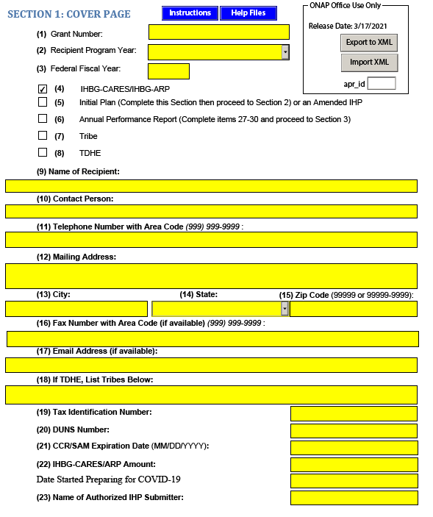
Abbreviated IHP/APR Form
NOTE: You must check the IHBG-CARES-ARP box to populate the Abbreviated IHP
You must enter the IHBG-ARP amount
You must enter the date you are preparing for COVID

Slide 56
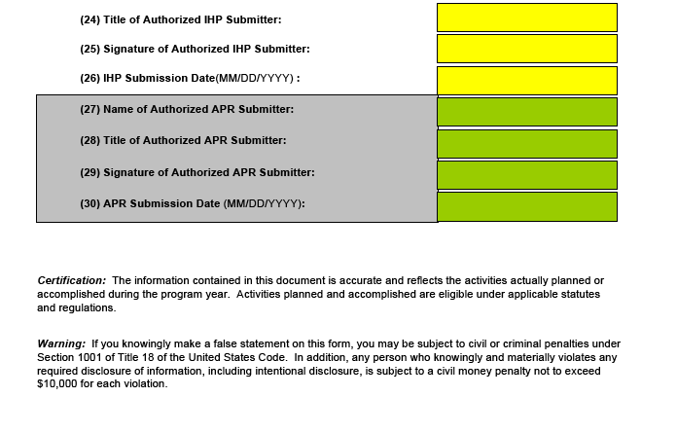

Slide 57
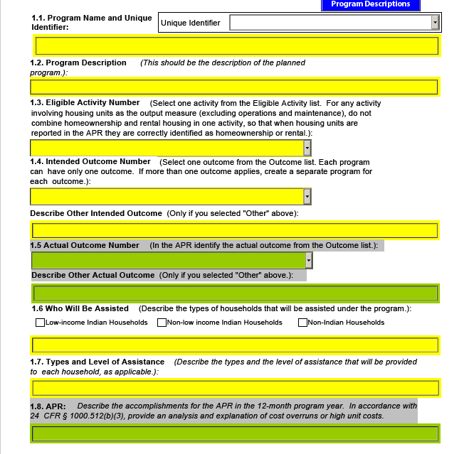
PROGRAM DESCRIPTIONS

Slide 58
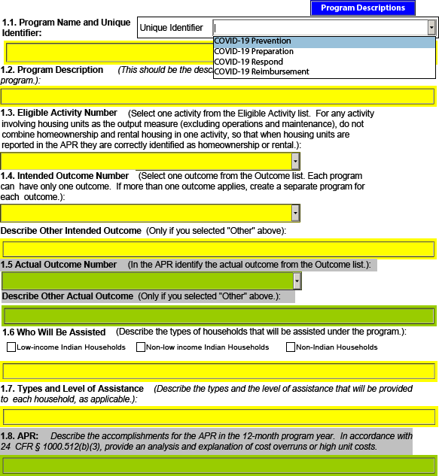
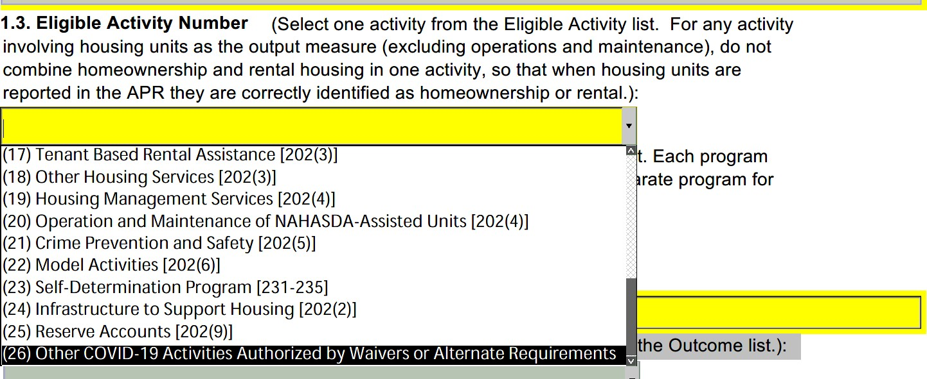
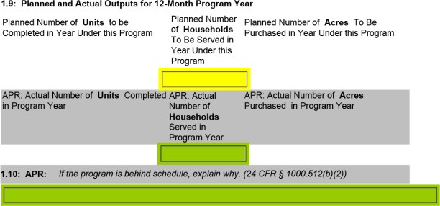
Abbreviated IHP/APR Form (Continued)
Program Descriptions

Slide 59
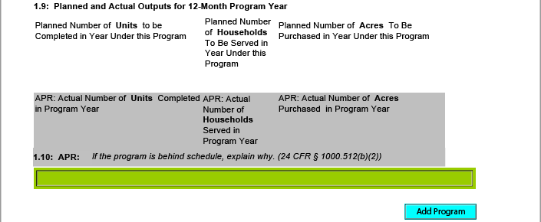
Abbreviated IHP/APR Form (Continued)

Slide 60
Requirements B & C of Section 15011 of the CARES Act The amount of large covered funds that were expended or obligated for each project or activity, cont’d. For IHBG-ARP – Eligible Activity Number from IHP

Slide 61
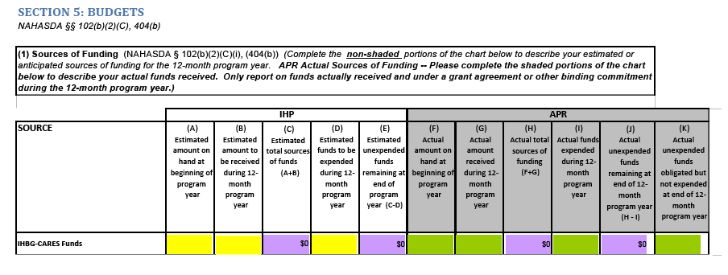
Abbreviated IHP/APR Form (Continued)
SOURCES OF FUNDS

Slide 62
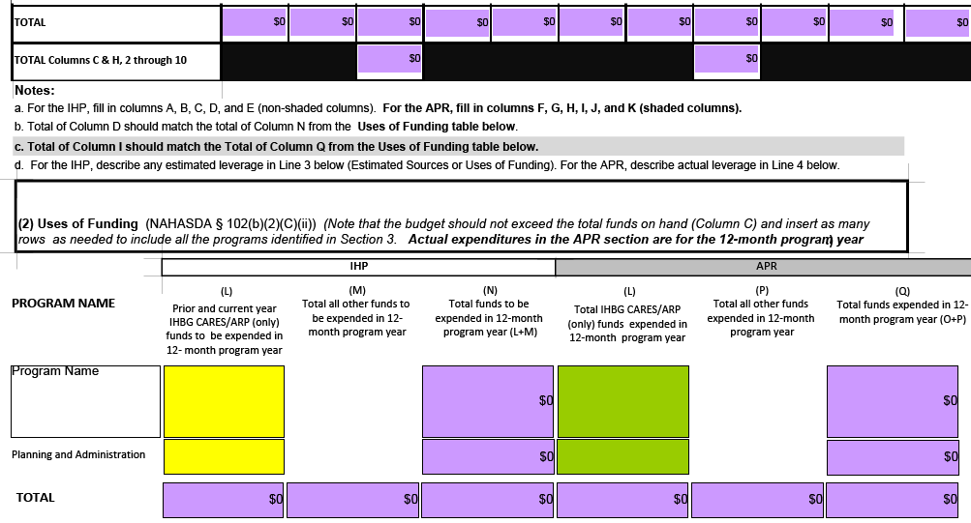
Abbreviated IHP/APR Form
(Continued)
USES OF FUNDS

Slide 63
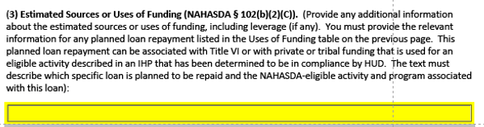
SECTION 9: SOURCES & USES OF FUNDS (Continued)

Slide 64
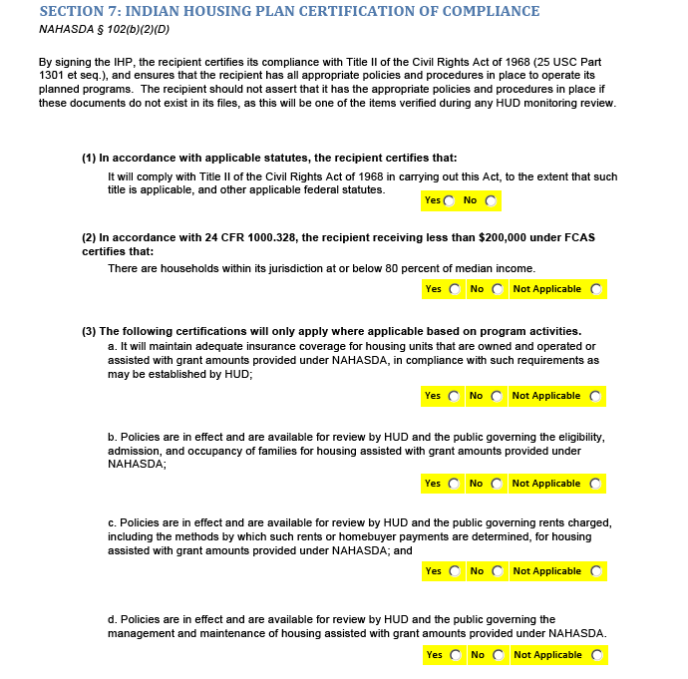
Section 7: Certification of Compliance

Slide 65
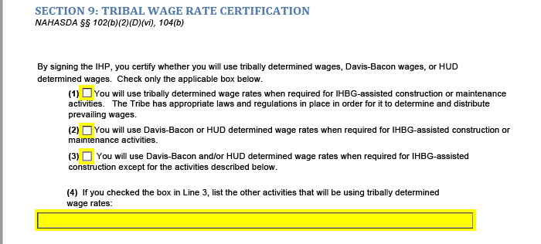
SECTION 9: TRIBAL WAGE RATE

Slide 66
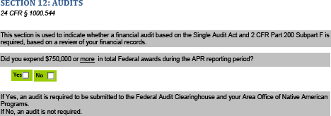
Abbreviated IHP/APR Form (Continued)
Audits

Slide 67
Use of FY 2020 IHBG for COVID-19
The alternative requirements in Notice PIH 2020-05 apply to FY2020 IHBG formula funds only
Other years of IHBG formula funds can be used for COVID-19 purposes, but the alternative requirements do not apply
Notify Area ONAP before using regular IHBG formula funds for COVID-19 purposes, and how much
Area ONAP will move the identified amount of FY 2020 funds to the new COVID-19 Budget Line Item (BLI) in LOCCS
Recipient can then select the COVID-19 BLI when in LOCCS to pay for COVID-19 activities
PIH Notice 2020-06 describes FY2020 IHBG amendment requirements and how to reprogram FY 2020 IHBG funds
Amendments don't have to be submitted before using funds for COVID-19 purposes, but you must notify Area ONAP before using funds so that they can move the funds to the COVID-19 BLI
Investment Funds
If recipient has invested FY 2020 funds, invested funds can be used for COVID-19 purposes with the alternative requirements
ONAP to provide more guidance on tracking and reporting of invested FY 2020 funds
Notes:
It would be interesting to see how many of the trainees have opted to use FY 2020 IHBG funding for COVID-19 related expenditures in order to take advantage of the waivers and alternative requirements. We had very few (maybe 1). Also good to know that if they go this route, then they can’t turn around and ask for reimbursement under CARES or ARP.

Slide 68
COVID-19 Budget Line Item (BLI)

Slide 69
Abbreviated IHP Review
Determine if Abbreviated IHP complies with the ARP Act and NAHASDA
Will be done as quickly as possible.
If IHP is noncompliant
Recipient will be asked to revised and resubmit ASAP
Area ONAP will provide technical assistance to modify Abbreviated IHP, as appropriate
Ensure compliance with the ARP Act
Abbreviated IHP may be amended to adjust any planned eligible activities or programs
Notes:
I removed the 15 day turnaround for HUD review. We omitted this on purpose for ARP due to workload considerations.

Slide 70
Grant Agreement and Award Letter
After Abbreviated IHP is found in compliance
Area ONAP emails the recipient an award letter and grant agreement package to sign and return via email
Grant agreement package
Grant Agreement
Grant Addendum
Grant agreement is signed, scanned, and sent back to Area ONAP electronically
Recipient maintains all documents with wet signatures in their records
Funds available in LOCCS once the fully executed grant agreement is returned and processed by HUD

Slide 71
Keep Accounts Separated
Due to the number of different funding sources, it is critical that the recipient keeps accounts separated as much as possible.
Separate coding.
Bank accounts.
Keep documentation for all expenditures (as usual).
Plan ahead for reporting.

Slide 72
Reporting Requirements
Quarterly Federal Financial Reports (SF-425)
account for the receipt and disbursement of grant funding
IHBG ARP will be reported cumulatively for the life of the grant
Abbreviated Annual Performance Report (APR) (Form: HUD-52735)
information regarding recipient expenditure of grant funding
separate from IHBG Formula APR
covers the recipient’s typical reporting period
due to Area ONAP within 90 days of the end of the recipient’s program year unless otherwise specified
Additional ARP Act Reporting: Recipients of $150,000 or more in IHBG-ARP funding must submit a soon to be developed OMB form
amount of funds received
amount of funds obligated or expended for each project or activity
detailed list of all such projects or activities, including a description of the project or activity
detailed information on any subcontracts or subgrants awarded by the recipient.
Data to be reported is identified on the following slides and are subject to change as COVID-19 evolves
Notes:
The quicker they spend these funds, the better. It’s my understanding that the additional reporting doesn’t apply to grants that have been closed out.

Slide 73
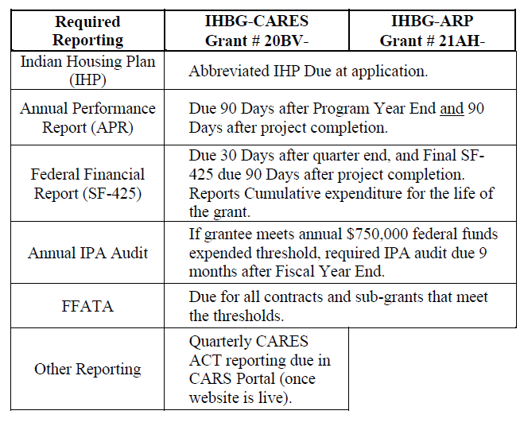
Summary of Reporting
Requirements

Slide 74
Reporting Requirements
Abbreviated APR (continued)
Total amount of IHBG-ARP grant funding received from HUD.
Total amount of IHBG-ARP grant funding that was expended or obligated during the tribal program year to:
(a) prevent COVID-19
(b) prepare for COVID-19; or
(c) respond to COVID-19
List of all activities for which IHBG-ARP grant funds were expended or obligated under each of the above eligible purpose categories, including:
description of the activity, including whether the activity is:
(i) eligible under the IHBG program; or
(ii) an eligible activity pursuant to a waivers and alternative requirement set forth in PIH Notice 2021-14 related to prevention, preparation for, and response to COVID-19.

Slide 75
Reporting Requirements
Abbreviated APR (continued)
an explanation of how the activity addresses one or more of the eligible purposes identified in (2), above;
an evaluation of the completion status of the activity;
an estimate of the number of eligible families that were assisted by this activity, including the number of low-income Indian families, non-low-income Indian families, and non-Indian families that were assisted by the activity; and
the name of the person to contact at the Tribe or TDHE if there are concerns with or questions about the activity.

Slide 76
SAMPLE POLICY STATEMENTSPOLICY STATEMENTS

Slide 77
Income Verification – Sample Policy
Income Verification
K/S TDHE may deviate from their current written admissions and occupancy policies and may allow less frequent income recertifications; and
K/S TDHE will carry out intake and other tasks necessary to verify income remotely including allowing income self-certification over the phone (with a written record by the IHBG recipient’s staff), or through email with a self-certification form signed by the family.
Notes:
I don’t think I’m familiar with the 6th bullet regarding the limitation on security deposit plus 1st and last month’s rent. Do you know where that came from? Also not sure about delinquent taxes. Usually, IHBG funds can only pay user fees or payments in lieu of taxes. But maybe this was waived. Mortgage payments typically include escrowed tax obligations but I’m just not sure about a delinquent taxes only scenario.

Slide 78
Alternative Approach – Sample Policy
When the situation is urgent and time is of the essence, the TDHE may adopt alternative approaches and/or documentation concerning the following;
Proof of homeownership
A completed W-9 Form from financial institution
Evidence of unit as primary residence
Proof of established Alaska Residency within K/S TDHE's services area (i.e., eligible for AK PFD, vehicle registration, photo ID, federal tax form, etc.)
Proof of income information to the greatest extent feasible.
Completion of self-certification in extreme circumstances
Notes:
I don’t think I’m familiar with the 6th bullet regarding the limitation on security deposit plus 1st and last month’s rent. Do you know where that came from? Also not sure about delinquent taxes. Usually, IHBG funds can only pay user fees or payments in lieu of taxes. But maybe this was waived. Mortgage payments typically include escrowed tax obligations but I’m just not sure about a delinquent taxes only scenario.

Slide 79
Possible Uses – Sample Policy
Mortgage payment for a home already occupied by the applicant family
Rental assistance occupied by the applicant family.
Prepayment of rental assistance to homeless families
Late fees
Delinquent taxes
Security deposit plus first and last month’s rent on a unit where the lease payment does not exceed 70% of the combined deposit;
Utility assistance
Housing services related to the provision of self-sufficiency in accordance with IHBG regulations.
Notes:
I don’t think I’m familiar with the 6th bullet regarding the limitation on security deposit plus 1st and last month’s rent. Do you know where that came from? Also not sure about delinquent taxes. Usually, IHBG funds can only pay user fees or payments in lieu of taxes. But maybe this was waived. Mortgage payments typically include escrowed tax obligations but I’m just not sure about a delinquent taxes only scenario.

Slide 80
Eligible Circumstances – Sample Policy
Emergency housing assistance may be provided for circumstances that are beyond the family’s control such as, but not limited, to the following situations:
An inability to earn income as the result of a loss of childcare due to a pandemic or other catastrophic incident;
An inability to earn income as the result of mandated isolation and quarantine due to contracting an infectious disease during a pandemic;
An inability to secure goods and services as the result of mandated isolation and quarantine due to a pandemic or other catastrophic incident;
A catastrophic illness resulting in inability to maintain essential housing costs;
A natural disaster recognized by the state of Alaska proclamation
An event which means the death of, or mental incapacity of or abandonment of the home by all of the persons who have executed the agreement as lessees.
Inadequate housing
Temporary housing
Cost burden - paying more than 50% of gross income
At risk of homelessness or homeless

Slide 81
Assistance Amount – Sample Policy
Amount
Participants will receive no more than $3,000.00 in a two (2) year period, subject to the availability of funds
Factors
The factors used to determine the amount of assistance to be awarded on behalf of the participant are:
Present annual income of the household
Family budget
Fair Market Rent (FMR) for area in the State of________ as determined by HUD.
Family circumstances
Type of assistance needed

Slide 82
Rental Assistance – Sample Policy
Commencement
Once the lease and the unit have been approved, and the landlord has signed the agreement to abide by the landlord obligation statement, the Recipient's staff will sign a contract with the landlord for the assistance payment amount showing the effective date of payments and the amount of the monthly payment.
Proration
If a participant moves into a unit during the month rather than at the beginning of the month, the assistance payment will be pro-rated for the remaining days left in the month and a check will be issued within three working days. The assistance payment will be made thereafter on or before the first day of each month. The participant is not responsible for the approved assistance payment made by the Recipient's staff.

Slide 83
Payment of Assistance – Sample Policy
At no time will assistance be made directly to the family. NAHASDA program staff will develop procedures regarding the process for disbursing emergency assistance funds. The following cites typical examples of payment disbursement:
Directly to a landlord
Directly to a vendor
Directly to a financial institution
Other as determined by NAHASDA program staff
Notes:
This would be a good place to talk about the general prohibition on gift cards, store vouchers, etc. In some cases, grantees have made arrangements with local vendors (grocery stores) to allocate funding for specific types of purchases, but this can be pretty hard to keep track of and heavy on documentation from the vendor.

Slide 84
Costs – Sample Policy
Allowable Costs
Administrative costs are allowable, but limitations on the amount are set by the grantor.
Impermissible Use of Funds
Assistance will not be provided to pay rent to an immediate family member (i.e., father, mother, son, daughter, husband, wife, sibling, or grandparent) with whom the applicant resides, unless the there is a documented history of prior payments.
Assistance may not be used for which duplicate assistance exists.
Homeownership assistance may not be used simultaneously with a rental assistance for a boarder in the homeowner’s home.

Slide 85
Service Area – Policy Sample
Assistance will be provided to eligible applicants who have established residence within the Recipient's Service Area: ______________

Slide 86
SAMPLE ABBREVIATED IHP

Slide 87
Notes:
A NPONAP example.

Slide 88
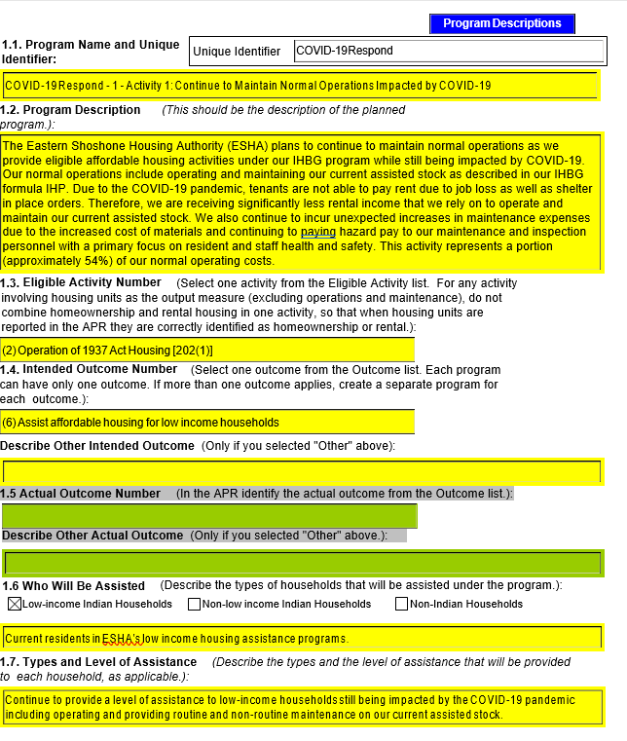

Slide 89
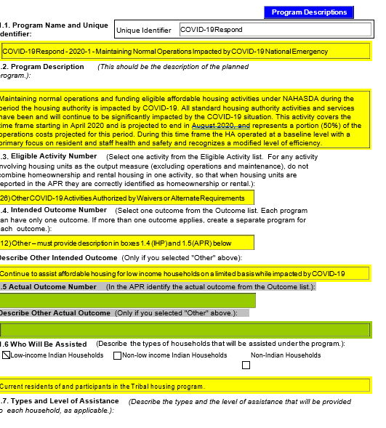

Slide 90
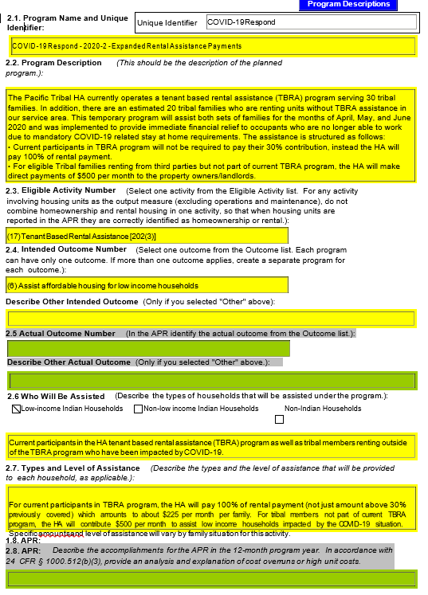

Slide 92
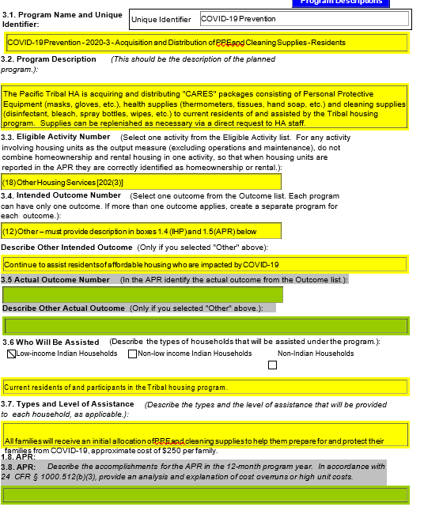

Slide 93
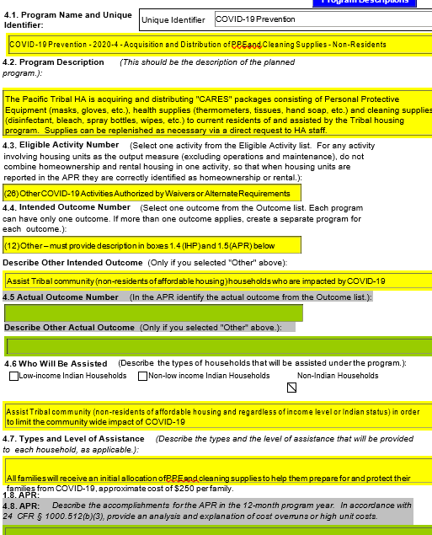

Slide 94
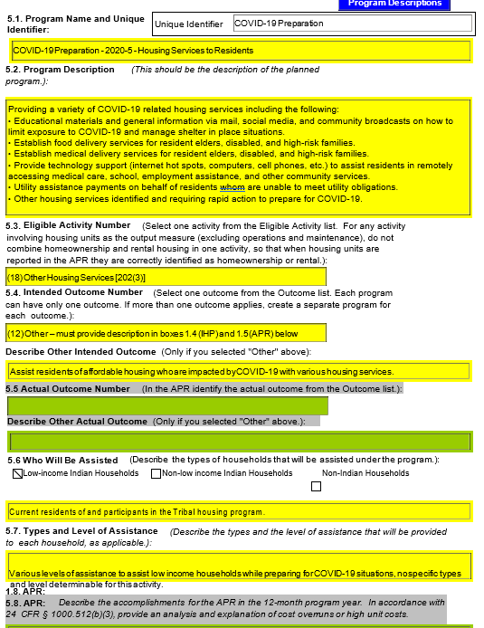

Slide 95
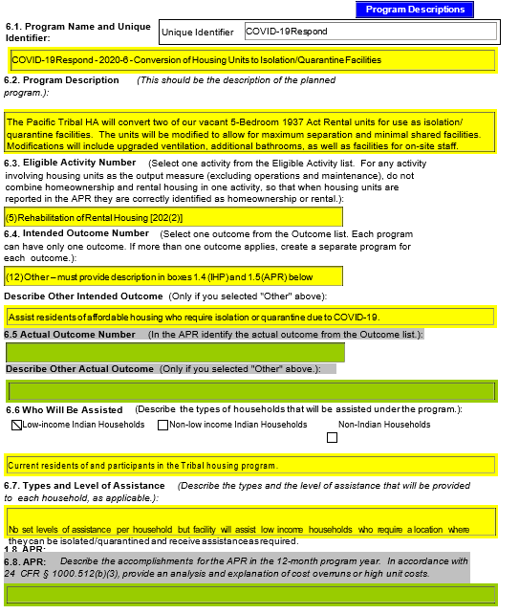

Slide 96
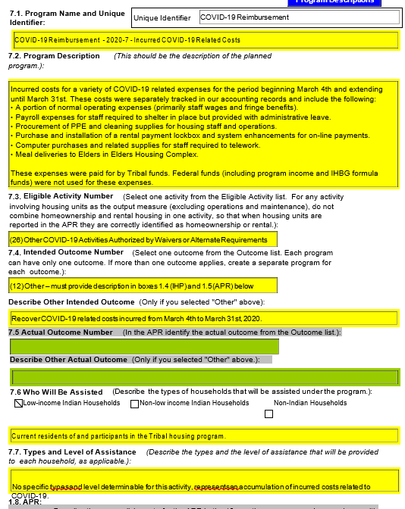

Slide 97
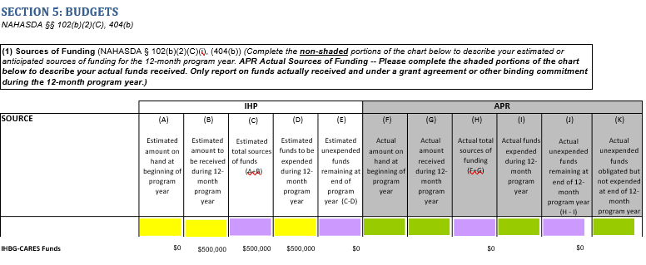
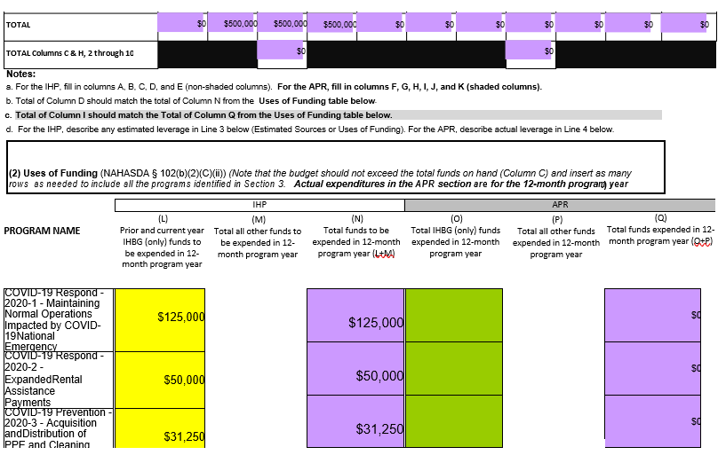
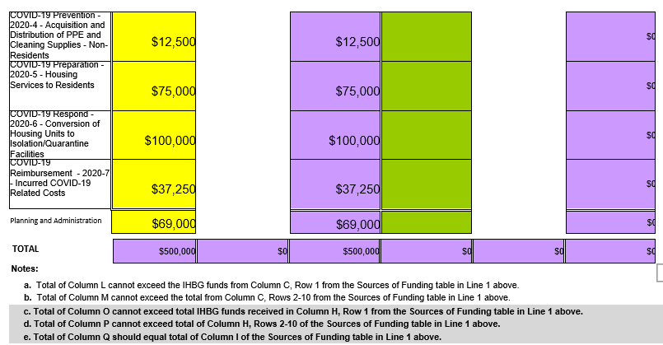

Slide 98
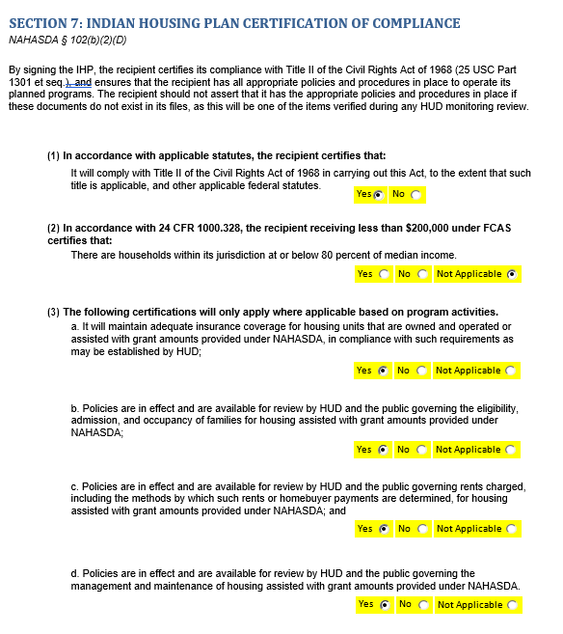

Slide 99
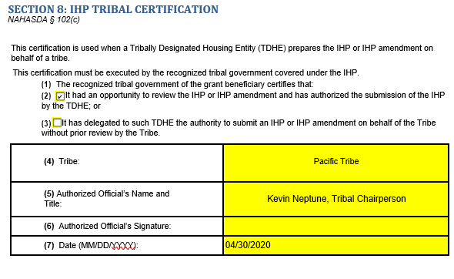

Slide 100
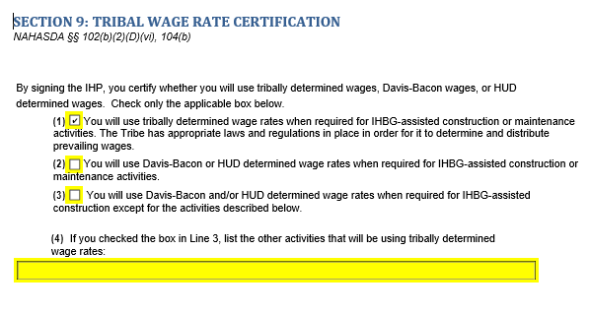

Slide 101
SAMPLE PROGRAM DESCRIPTIONS

Slide 102
The Crow Creek Housing Authority (CCHA) plans to maintain normal operations and fund eligible affordable housing activities under NAHASDA during the period CCHA is impacted by COVID-19. All standard CCHA activities and services have been and will continue to be significantly impacted by the COVID situation. This activity covers the time frame starting June 2020 and is projected to end June 2021. This activity represents a portion (22%) of the operation costs projected for this period. During this time frame, the CCHA will operate at a baseline level at a modified level of efficiency with a primary focus on resident and staff health and safety.
Provide temporary shelter-in-place rental assistance to protect Indian families from the further spread of COVID-19.
CCHA

Slide 103
CCHA plans to acquire and distribute "CARES" packages consisting of Personal Protective Equipment (PPE) (masks, gloves, etc.), health supplies (thermometers, tissues, hand soap, hand sanitizer, etc.) and cleaning and disinfecting supplies (disinfectant, bleach, spray bottles, disinfectant wipes, etc.) to current participants in our housing assistance programs as well as the CCHA employees. Supplies will be replenished as necessary if requested.
All families will receive an initial allocation of PPE and cleaning supplies to help them prepare for and protect their families from COVID-19 with an approximate cost of up to $250 per family. Any remaining funds for this activity will be used for replenish requests. CCHA plans to provide up to 500 CARES packages throughout the 12 months covered by this plan.
CCHA

Slide 104
Provide temporary shelter-in-place rental assistance to protect Indian families from the further spread of COVID-19.
CCHA plans to provide temporary shelter-in-place rental assistance to a member or members of an Indian family who have to isolate infected persons from others. CCHA will provide temporary assistance to families in facilities designed to shelter-in-place including privately owned units, hotels, and similar facilities designed to shelter-in-place or isolate infected persons from others. It's anticipated that up to 20 families will need this assistance over the 12-month period covered by this plan with an estimated cost of up to $1,000 per family.
CCHA

Slide 105
In 2018 ESHA was awarded a $690,000 Indian Community Development Block Grant (ICDBG) to construct infrastructure that will support the development of affordable housing in Fort Washakie, WY. The infrastructure will consist of installing water, sewer, and power lines as well as constructing roads on a 15-acre parcel of land for the development of 24 units of low-income rental housing. In 2020, ESHA was awarded a $4,200,000 Competitive Indian Housing Block Grant (IHBG) to construct the units. These projects represent a continuation of our long range affordable housing assistance program to provide safe and healthy homes for eligible tribal families. The development of the infrastructure followed by development of the new homes will alleviate homelessness and overcrowded conditions and will prevent the spread of COVID-19 by protecting the health and safety of our low-income families. ESHA is committing $230,000 in leverage for the ICDBG project. This COVID-19 prevention activity consists of using IHBG-ARP funds as 45% percent of our committed leverage amount ($103,500), which will be spent during the period covered by this plan.
(24) Infrastructure to Support Housing [202(2)]
ESHA

Slide 106
(24) Infrastructure to Support Housing [202(2)]
The type of assistance that will be provided consists of using our IHBG-ARP funds as leverage for the development of infrastructure during this plan year, which will help us prevent the spread of COVID-19 by providing healthy and safe homes for our tribal families who are currently homeless or living in overcrowded, unsafe, and unhealthy living conditions. The level of assistance will be using $103,500 of IHBG-ARP funds as leverage.
ESHA

Slide 107
ESHA plans to modernize up to 14 low-income rental units during this plan year using FY 2019-20
ICDBG funds. The modernization of the homes will help prevent the spread of COVID-19 because the homes will provide a healthier and safer living environment for our low-income tribal families that reside in our rental units. An integral part of our modernization program is repairing and replacing the HVAC systems in each unit with more energy efficient components that will provide better air filtration and circulation systems that keep the families safer and healthier in an effort to prevent the spread of COVID-19. ESHA has committed $250,000 in leverage for this project. This COVID-19 prevention activity consists of using IHBG-ARP funds as approximately 40% of our committed leverage amount ($94,500) for this modernization project during this plan year.
The type of assistance that will be provided consists of using our IHBG-APR funds as leverage to accomplish the modernization activities, which will help us prevent the spread of COVID-19 by providing healthier and safer homes.
ESHA

Slide 108
ESHA was awarded an IHBG competitive grant of $4.2 million to construct 24 single-family houses in Fort Washakie, WY. The project will include the construction of 8-2 bedroom houses, 8-3 bedroom houses, and 8-4 bedroom houses on a 15-acre parcel of land that the ESHA has leased from the Eastern Shoshone tribe. This project is a continuation of our long range affordable housing assistance program to provide safe and healthy homes for our tribal families. The construction of the new homes will alleviate homelessness and overcrowded conditions and will prevent the spread of COVID-19 by protecting the health and safety of our low-income families. ESHA is committing $1.4 million as leverage for this project. This COVID-19 prevention activity consists of using IHBG-ARP funds as 25% percent of our committed leverage amount ($350,000), which will be spent during the period covered by this plan.
ESHA

Slide 109
Pacific Housing Authority (PHA) plans to continue to maintain normal operations as we provide eligible affordable housing activities under our IHBG program while still being impacted by COVID-19. Our normal operations include operating and maintaining our current assisted stock as described in our IHBG formula IHP. Due to the COVID-19 pandemic, tenants are not able to pay rent due to job loss as well as shelter in place orders. Therefore, we are receiving significantly less rental income that we rely on to operate and maintain our current assisted stock. We also continue to incur unexpected increases in maintenance expenses due to the increased cost of materials and continuing to paying hazard pay to our maintenance and inspection personnel with a primary focus on resident and staff health and safety. This activity represents a portion (approximately 54%) of our normal operating costs.
Continue to provide a level of assistance to low-income households still being impacted by the COVID-19 pandemic including operating and providing routine and non-routine maintenance on our current assisted stock.
(2) Operation of 1937 Act Housing [202(1)]
ONAP

Slide 110
In 2018 PHA was awarded a $690,000 Indian Community Development Block Grant (ICDBG) to construct infrastructure that will support the development of affordable housing in Fort Washakie, WY. The infrastructure will consist of installing water, sewer, and power lines as well as constructing roads on a 15-acre parcel of land for the development of 24 units of low-income rental housing. In 2020, PHA was awarded a $4,200,000 Competitive Indian Housing Block Grant (IHBG) to construct the units. These projects represent a continuation of our long-range affordable housing assistance program to provide safe and healthy homes for eligible tribal families. The development of the infrastructure followed by development of the new homes will alleviate homelessness and overcrowded conditions and will prevent the spread of COVID-19 by protecting the health and safety of our low-income families. PHA is committing $230,000 in leverage for the ICDBG project. This COVID-19 prevention activity consists of using IHBG-ARP funds as 45% percent of our committed leverage amount ($103,500), which will be spent during the period covered by this plan. (24) Infrastructure to Support Housing [202(2)]
The type of assistance that will be provided consists of using our IHBG-ARP funds as leverage for the development of infrastructure during this plan year, which will help us prevent the spread of COVID-19 by providing healthy and safe homes for our tribal families who are currently homeless or living in overcrowded, unsafe, and unhealthy living conditions. The level of assistance will be using $103,500 of IHBG-ARP funds as leverage. (24) Infrastructure to Support Housing [202(2)]
ONAP

Slide 111
PHA plans to modernize up to 14 low-income rental units during this plan year using FY 2019-20
ICDBG funds. The modernization of the homes will help prevent the spread of COVID-19 because the homes will provide a healthier and safer living environment for our low-income tribal families that reside in our rental units. An integral part of our modernization program is repairing and replacing the HVAC systems in each unit with more energy efficient components that will provide better air filtration and circulation systems that keep the families safer and healthier in an effort to prevent the spread of COVID-19. PHA has committed $250,000 in leverage for this project. This COVID-19 prevention activity consists of using IHBG-ARP funds as approximately 40% of our committed leverage amount ($94,500) for this modernization project during this plan year.
The type of assistance that will be provided consists of using our IHBG-APR funds as leverage to accomplish the modernization activities, which will help us prevent the spread of COVID-19 by providing healthier and safer homes.
(1) Modernization of 1937 Act Housing [202(1)]
ONAP

Slide 112
PHA was awarded an IHBG competitive grant of $4.2 million to construct 24 single-family houses in Fort Washakie, WY. The project will include the construction of 8 2-bedroom houses, 8 3-bedroom houses, and 8 4-bedroom houses on a 15-acre parcel of land that the PHA has leased from Pacific tribe. This project is a continuation of our long-range affordable housing assistance program to provide safe and healthy homes for our tribal families. The construction of the new homes will alleviate homelessness and overcrowded conditions and will prevent the spread of COVID-19 by protecting the health and safety of our low-income families. PHA is committing $1.4 million as leverage for this project. This COVID-19 prevention activity consists of using IHBG-ARP funds as 25% percent of our committed leverage amount ($350,000), which will be spent during the period covered by this plan.
The type of assistance will be using $350,000 of IHBG-ARP funds as leverage to complete the preliminary project activities and begin the construction of the single-family homes on Shipton Lane in Fort Washakie during this plan year. The infrastructure work on the project site is being completed by PHA using funding from an ICDBG grant.
ONAP

Slide 113
RESOURCES
General Resources:
Office of Native American Programs COVID-19 Recovery Programs website:
https://www.hud.gov/program offices/public indian housing/ih/COVID Recovery
IHBG-ARP Waivers and Alternative Requirements, PIH Notice 2020-
33: https://www.hud.gov/sites/dfiles/PIH/documents/PIH2020-33.pdf
Office of Native American Programs website, including updated COVID-19
related Frequently Asked Questions: https://www.hud.gov/codetalk
HUD COVID Resources and Fact Sheets: https://www.hud.gov/coronavirus

Slide 114
DEAR TRIBAL LEADER LETTERS
CARES Act Reporting Update (June 28, 2021) CARES Act Reporting Update (March 26, 2021) CARES Act Quarterly Report not required for January 10, 2021. Publication of IHBG-CARES Implementation Notice (April 22, 2020) IHBG-CARES Formula Allocation Letter (April 3, 2020) For more information on how your Tribe’s IHBG-CARES formula allocation was calculated, please see: View IHBG-CARES Formula Allocation Chart If you have any questions about your IHBG allocation under the CARES Act, please contact the IHBG Formula Customer Service Center at: Phone: 1-800-410-8808 or IHBGformula@firstpic.org | CARES Act Reporting Update (June 28, 2021) CARES Act Reporting Update (March 26, 2021) CARES Act Quarterly Report not required for January 10, 2021. ​ICDBG-CARES Implementation Training (May 19, 2020) ​ICDBG-CARES Implementation Notice (May 15, 2020) Input Requested on ICDBG-CARES Act Grant Ceilings (April 15, 2020)

