Slide 1
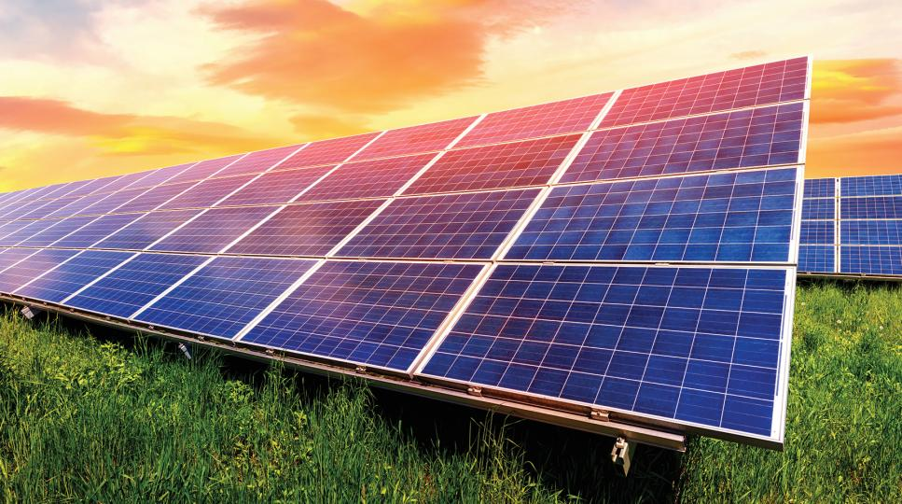
USDA Loan Programs for Tribal Energy Sovereignty & Economic Independence

Slide 2
Loan guarantee program offered by private banks and lenders nationwide.
Eligible for Federally-Recognized Indian Tribes, Tribal-Owned Businesses, and Alaska Native Villages/Corporations.
Administered by USDA Rural Development (“USDA-RD”) to promote economic development, job creation, and ensure the long-term sustainability & vitality of rural and underserved communities in the United States.
There are more than $3 billion in loan guarantees appropriated annually for USDA loan programs.
USDA OneRD Program – What is it?

Slide 3
Loan amounts range from $1MM to $100MM, depending on the program.
Loan terms may go up to 40-years.
Eligible uses of USDA proceeds include ground-up construction, acquisition of land or existing real estate, machinery & equipment, furnishings & fixtures, working capital, and debt refinancing.
Projects may also be divided into four categories: Rural Businesses, Community Facilities, Renewable Energy, and Water & Waste Disposal Systems.
Eligible Borrowers can include non-profits, for-profits, public bodies, Tribes, and cooperatives.
USDA OneRD Program – Continued

Slide 4
What makes USDA Loan Guarantees unique for Tribes and Tribal businesses?
Longer terms and competitive rates compared to conventional financing.
Interest-only period available up to 36-months for ground-up construction.
Loans are fully amortizing with no balloon payments.
Minimum equity required, with 100% financing available for community facility projects up to $100MM.
Priority points are awarded to projects located within the boundaries of a federally recognized Tribe’s reservation, within Tribal trust lands, or within land owned by an Alaskan Native Regional or Village Corporation.
Projects on tribal trust lands can be secured with a revenue pledge in lieu of tangible collateral like real estate.

Slide 5
USDA OneRD Loan Programs
Business & Industry (B&I)
Community Facilities (CF)
Water & Waste Disposal (wep)
Rural Energy for America (REAP)

Slide 6
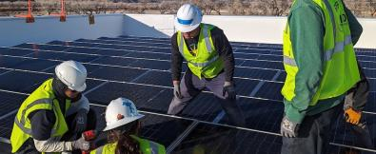
Business & Industry (B&I) Program
The B&I Program is the most widely-known and utilized USDA program nationally.
B&I loans are often used to buy or develop land, buildings, and associated infrastructure for commercial or industrial use.
Loan Amounts range from $1MM to $25MM per Borrower.
Common tribal projects financed by B&I loans include:
Hotels
Convenience Stores/Gas Stations
Microgrids/Renewable Energy
Other Commercial/Industrial Projects

Slide 7
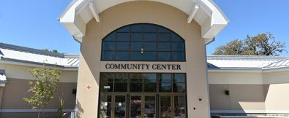
Community Facilities (CF) Program
The CF Program is intended to finance the development of essential community facilities in rural areas.
An essential community facility is a public improvement, operated on a not-for-profit basis, needed for the orderly development of a rural community.
Examples include Tribal Administration Buildings, Cultural Resource Centers, Healthcare Facilities (Hospitals), Long-Term Care Facilities, Schools, Fire Stations (Public Safety), Community Parks, and Activity Centers.
Loan amounts range from $1MM to $100MM per Borrower.
No equity requirements. (100% financing available)
Projects are eligible to receive IHS 105(l) Lease Payments from the Department of Interior, which can cover all future debt service payments and be used as collateral for USDA CF Loans.

Slide 8
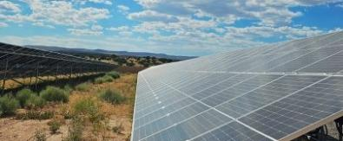
Rural Energy for America (REAP)
The REAP Program is primarily intended to finance the development, installation, or purchase of renewable energy systems (RES), such as solar, wind, hydroelectric, geothermal, hydrogen, and bioenergy.
Funds may also be used to finance energy efficiency improvements (EEI) to existing buildings, or finance energy efficiency equipment (EEE) for agricultural producers.
Technology must be commercially available to qualify for USDA funding.
Loan amounts range from $1MM to $25MM per Borrower.

Slide 9
REAP Program – Types of Solar Projects
A Utility-Scale Solar facility is one which generates solar power that ties into the grid, supplying energy to a utility.
A Community Solar facility is a solar facility shared by multiple community subscribers who received credit on their electricity bills for their share of the power produced.
Commercial & Industrial (C&I) Solar projects are solar facilities that support commercial and industrial businesses, such as rooftop solar panels.
Microgrids are localized energy systems that can operate independently or in conjunction with the main power grid. It integrates various energy sources like renewable energy, storage systems, and traditional generators to provide reliable power to Tribal communities.

Slide 10
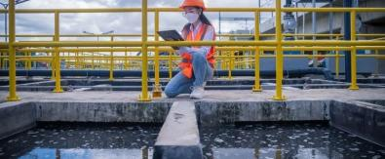
Water & Waste Disposal (WEP) Program
The WEP Program is intended to improve access to clean, reliable water and waste disposal systems for Tribal communities and businesses in rural areas.
Eligible projects include drinking water, sanitary sewer, solid waste disposal, and stormwater disposal or drainage facilities.
Loan amounts range from $1MM to $50MM per Borrower.
No equity requirements. (100% financing available)

Slide 11
Other Tribal Loan Guarantee Programs
The Bureau of Indian Affairs (BIA) Guaranteed Loan Program encourages private lenders to provide funding for economic development projects in Indian Country. These projects can include businesses, infrastructure, renewable energy, and community facilities.
The Depart of Energy (DOE) Tribal Energy Loan Guarantee Program (TELGP) is exclusive for Tribal Nations and incentives private lenders to provide funding for renewable energy projects both on and off Tribal reservations nationwide.
New Market Tax Credits (NMTC) provide outside tax equity investment (or private capital) to projects that help economically distressed communities. NMTC equity is often paired with loan guarantees (like USDA or BIA) to complete the capital stack.

Slide 12
Information Needed for Loan Pre-Qualification
Executive Business/Project Summary
Project Address
Borrower Information and Ownership Structure
Project Budget (Capital Expenditures)
Pro-Forma Financial Forecast (Minimum of 5-Years)
Historical Tribal Audits and Current YTD Financials
General Contractor (G.C.) Information & Draw Schedule

Slide 13
FDIC-insured Bank headquartered in Sioux Falls, South Dakota with just under $8B in assets.
Multi-State, OneRD Lender for USDA Rural Development.
2021 USDA REAP/B&I Top National Lender.
Approved Lender for USDA, BIA and DOE Loan Programs.
Learn more at Pathward.com.
Pathward, National Association

Slide 14
Thank you
Matt Peeler
Managing Director, USDA & Tribal Lending
(336) 225-2246
mpeeler@pathward.com

