Slide 1
Tribal Nations Housing Development Assistance
Wednesday, June 26, 2024
2:05 p.m. to 3:35 p.m.

Slide 2
Introductions
Grand Traverse Band of Ottawa and Chippewa Indians
National American Indian Housing Council
BeauxSimone Consulting

Slide 3
Program Overview
Tribal Nation Housing Development Assistance

Slide 4
Tribal Nations Housing Development Assistance
Brings together government-to-government collaboration between Michigan Tribal Nations/TDHEs, Michigan State Housing Development Authority (MSHDA), and the Federal Home Loan Bank of Indianapolis (FHLBI) since January 2024.
Seeks to provide the federally recognized tribal nations/TDHEs in Michigan with the financial, knowledge, and technical resources needed to develop affordable housing programs and projects that respond to the needs of your diverse communities.
Intends to build on tribal nations’/TDHEs’ existing affordable housing capacity and provide the supports needed to expand their affordable housing activities.

Slide 5
Addressing the Need
What can MSHDA do to support tribal housing?
Tribal Housing Directors in Michigan, including Nicki Basch, Grand Traverse Band of Ottawa and Chippewa Indians, participated on a joint committee selecting NAIHC and its technical assistance providers who will be having one-on-one conversations with Michigan’s tribes/TDHEs starting in January.

Slide 6
Building the Program
Michigan created its first statewide housing plan in 2022 (Michigan.gov/HousingPlan)
Governor Gretchen Whitmer announced the Michigan Statewide Housing Partnership to oversee implementation, including tribal representation
Michigan State Housing Development Authority created 15 Regional Housing Partnerships responsible for regional housing action plans
MSHDA launched the Tribal Nations Housing Development Assistance Program in January 2024 to assist with tribal citizen housing needs
Federal Home Loan Bank of Indianapolis providing funds
National American Indian Housing Council hired as Consultant

Slide 7
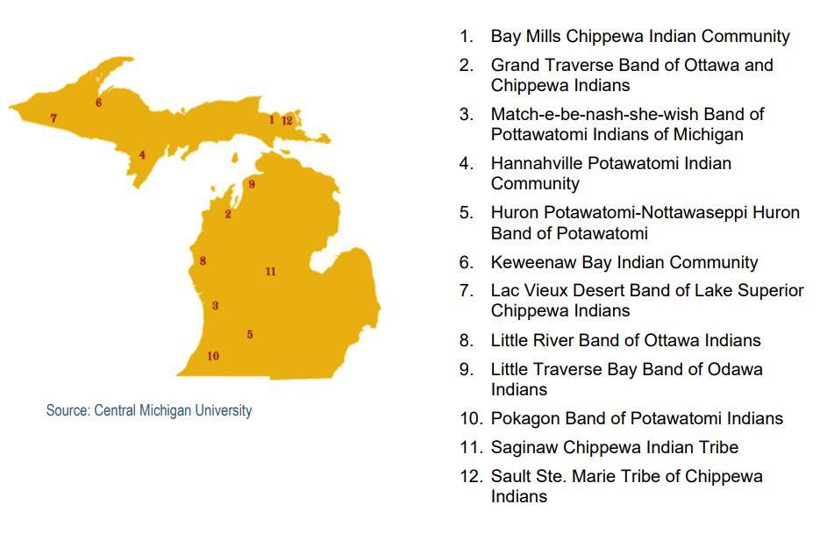
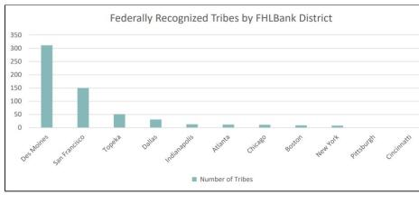
Tribal Nations Context

Slide 8
The TNHDA focuses on all affordable housing models!
Preventing Homelessness
Shelter Options
Rapid Rehousing
Transitional Housing
Supportive Housing
Affordable Rental Housing
Rental Housing
Home Ownership

Slide 9
TNHDA Scope of Work
Phase 1: Outreach and identifying the needs to build toolkit
Phase 2: Toolkit
Phase 3: One-on-one technical assistance
Program Timeline
Formally launched in January 2024
Program funds will be fully expended by the end of the third quarter in 2026 (if not sooner)

Slide 10
Phase 1: Outreach and Identifying Needs
Outreach to 12 federally recognized tribal nations that share geography in Michigan
Traveling on-site to each tribe to assess the needs of each tribe
11 tribes/TDHEs confirmed participation
Identification of needs
Need was determined by reviewing existing data that a participating nation has and/or has access to
There were needs for affordable housing options, homeownership, developing on tribally owned trust land, developing wrap around services, gap funding sources, and more.
This phase informed the creation of the toolkit, tailored to the unique opportunities and challenges in tribal nations

Slide 11
Phase 2: Toolkit
Four 2-day in-person sessions combined with direct training, concept planning technical assistance, peer-to-peer learning, and case studies.
Topics include
Affordable housing models
Identification of needs
Development process
Development team
Financing programs and structures
Operations budgeting
Property management
Culturally relevant design
Homeownership programs

Slide 12
1. Sault Ste Marie
2. Grand Traverse
3. Saginaw Chippewa

Slide 13
Phase 3: One-on-One Technical Assistance
Technical assistance is offered between each session and after the completion of the training series
Assistance will cover project finance (identification of sources, supporting applications) and development (advancing project plans, predevelopment activities)
The provision of technical assistance will commence in 2024 and through 2026.
Additional technical assistance from HUD

Slide 14
Support from Federal Home Loan Bank
FHLBank is funding up to $3MM in grants to provide flexible funding to:
help remove barriers to program participation
cover critical predevelopment expenses
respond to additional capacity building needs and opportunities, and
help bridge project financing gaps.
MSHDA is administering these funds.

Slide 15
FHLBank additional efforts
Financial Institution Member Survey
Series Engagement
AHP & QAP Scoring Incentives
Affordable Housing Advisory Council Tribal Representative
Additional resources made available to participants
The Federal Home Loan Bank of Indianapolis provided financial resources available to participating tribal nations/TDHEs including
Travel Stipend
Project-specific Pre-development funding grants
Project-specific subsidy

Slide 16
What is going well so far?
We have participation from 11 of the 12 Michigan tribes/TDHEs
All participants have identified 1 or more affordable housing projects
High level active participation MSHDA, Federal Home Loan Bank, and Eastern Woodlands ONAP
Early identification of barriers within existing housing systems

Slide 17
What are the outcomes we’re anticipating?
Healthy, high-quality units!
Changes to the existing housing systems to make them more accessible to tribes/TDHEs
Coordinated effort to change the housing systems
Improve and strengthen relationships between the state and tribes/TDHEs
To have more equitable access to funding
Creating a blueprint for other states, tribes/TDHEs, and Federal Home Loan Bank systems

Slide 18
Grand Traverse Band Kchi-noodin Kaamdaakiing
LIHTC PROJECT #1 PROGRESS

Slide 21
Townhouse 1 (foundation for 2 in background)
Notes:
Quick run through of the construction of Townhouse 1

Slide 22
November 2, 2022

Slide 23
December 14, 2022

Slide 24
January 6, 2023

Slide 25
January 16, 2023

Slide 26
FEBRUARY 1, 2023

Slide 27
FEBRUARY 14, 2023

Slide 28
FEBRUARY 28, 2023

Slide 29
MARCH 19, 2023

Slide 30
APRIL 3, 2023

Slide 31
APRIL 20, 2023

Slide 32
MAY 4, 2023

Slide 33
MAY 16, 2023

Slide 34
JUNE 2, 2023

Slide 35
JUNE 15, 2023

Slide 36
JUNE 29, 2023

Slide 37
JULY 21, 2023

Slide 38
APRIL 20, 2023 – Front view

Slide 39
MAY 4, 2023 – Front view

Slide 40
MAY 16, 2023 – Front view

Slide 41
JUNE 2, 2023 – Front view

Slide 42
JUNE 15, 2023 – Front view

Slide 43
JUNE 29, 2023 – Front view

Slide 44
JULY 21, 2023 – Front view

Slide 45
May 30, 2024– Front view
Notes:
Photos of established households May 30
Families started moving in Sept 2023
Getting to this point wasn’t easy

Slide 46
May 30, 2024
Notes:
GTB teamed up with RTHawk back in August of 2019 (entered into the contract)
Applied in 2019, 2020 unsuccessfully
2021 a Tribal Set Aside was established by MSHDA and GTB was successful in obtaining that award

Slide 47
Townhouse 2

Slide 48
MAY 30, 2024
Notes:
To get to the point of a set aside took a lot of work and dedication by RTHawk participating along with GTB in consultation talks regarding the QAP

Slide 49
MAY 30, 2024

Slide 50
Townhouse 3

Slide 51
May 30, 2024
Notes:
We also paired this funding with the Competitive IHBG grant funding (again in this case…3rd time was a charm)

Slide 52
May 30, 2024

Slide 53
Apartment 5

Slide 54
May 30, 2024
Notes:
You can apply on your own, I highly suggest using a consulting firm that has the knowledge and expertise in assisting you with your application efforts

Slide 55
May 30, 2024

Slide 56
Apartment 6

Slide 57
May 30, 2024

Slide 58
May 30, 2024

Slide 59
Cottages

Slide 60
May 30, 2024

Slide 61
May 30, 2024
Notes:
GTEC, RTHawk, Competitive IHBG, surveys, land!, master plan, BIA roads, Water/Sewer, congressional funds

Slide 62
May 30, 2024

Slide 63
Questions? Nicki Basch Grand Traverse Band nicki.basch@gtb-nsn.gov 231.534.7449

Slide 64
Thank you for joining us!
Zoe LeBeau
CEO, Consultant
BeauxSimone Consulting
(218) 491-4018
Zoe@beauxsimone.com
Brigid Korce
Consultant
BeauxSimone Consulting
(970) 764-4581
BrigidKorce@gmail.com
Erla Sagg
Training & Technical Assistance Program Director
NAIHC
(202) 454-0913
ESagg@naihc.net
Nicki Basch
Housing Director/Development Manager
Grand Traverse Band of Ottawa and Chippewa Indians
(231) 534-7449
Nicki.Basch@gtb-nsn.gov

