Slide 1
Supportive Housing An Overview
Wednesday, June 26, 2024
2:05 – 3:35 p.m. ET (1.5 hours)
NAIHC Annual Convention
Notes:
Katie

Slide 2
Supportive Housing Consulting business by partners CEO Zoe LeBeau and CFO Katie Symons
Over 40 years of collective experience working with Tribes, rural and urban communities
Experience from direct homeless services to affordable housing development
Offer “PSH Toolkit” in Colorado, Project Management and Technical Assistance
Notes:
Katie

Slide 3
Introductions
Who is in the room with us?
Notes:
Katie

Slide 4
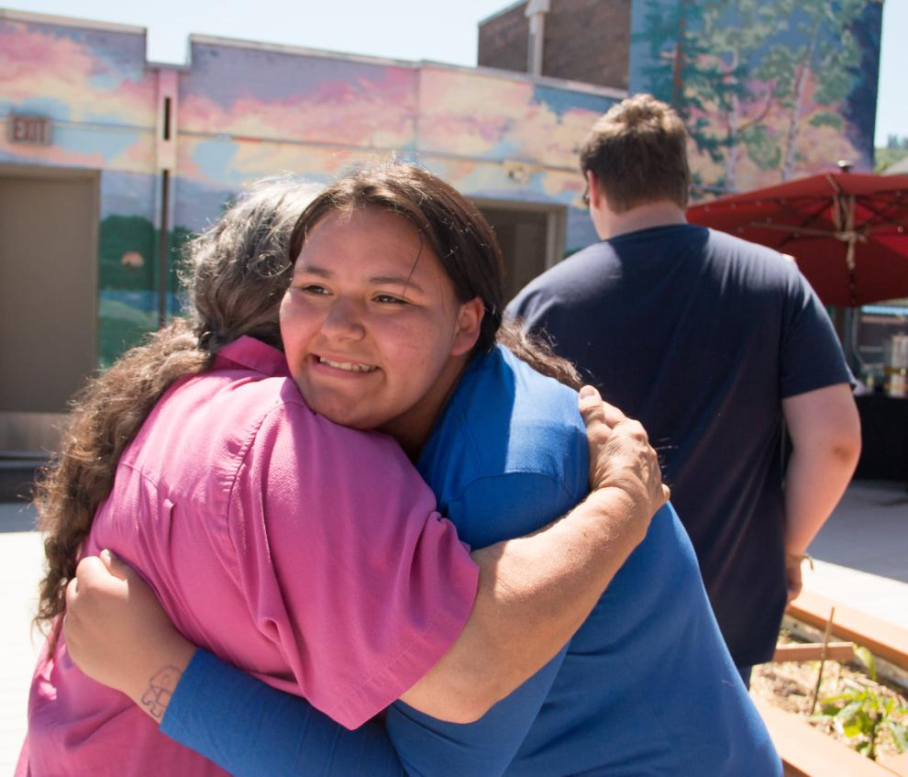
Causes of Homelessness
Lack of affordable housing
Poverty
Domestic Violence
Chemical, mental and physical health disabilities
Lack of social and familial supports
Restrictive or “high” barrier housing
Trauma including generational trauma
Photo by Ivy Vainio
Notes:
Zoe

Slide 5
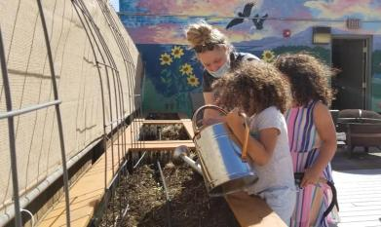
Solution to Ending Homelessness
Supportive Housing
A cost-effective, outcome-driven, and more humane solution to ending homelessness
Serves families and individuals struggling with untreated trauma, addiction, mental health and/or other disabilities
Provides subsidized housing with supportive services
Photo by Ivy Vainio

Slide 6
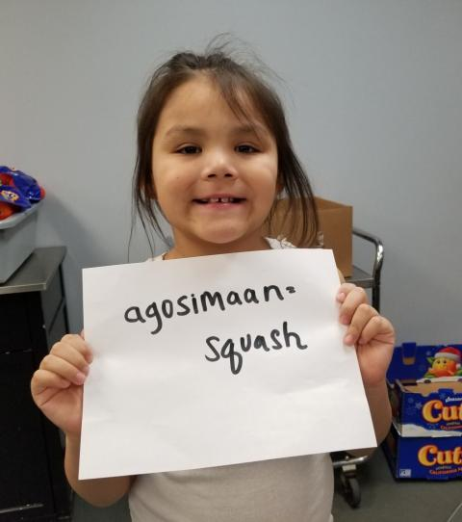
Combining affordable housing with access to support services like care management, employment training, and mental health treatment.
Supportive housing is a nationally recognized best practice which gives vulnerable individuals and families the opportunity to live stable, autonomous, and dignified lives.
Photo by Ivy Vainio

Slide 7
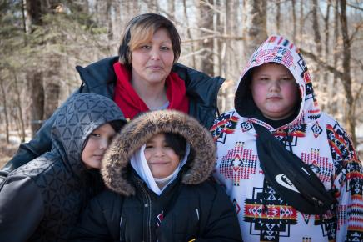
Services in Supportive Housing
Services are flexible
Services should range from clinical services to community building and socialization to basic life skills
Photo by Ivy Vainio

Slide 8
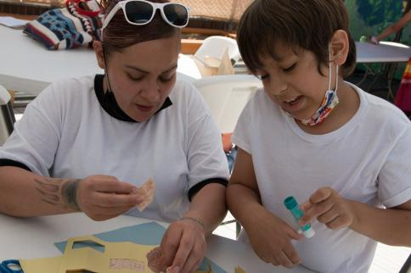
Supportive Housing is Permanent
Allows for open-ended stay, not time-limited
Minimizes chances of repetitive displacement
Focuses on long-term housing stability
Provides long-term housing options that clients get to decide when they’re ready
Photo by Ivy Vainio

Slide 9
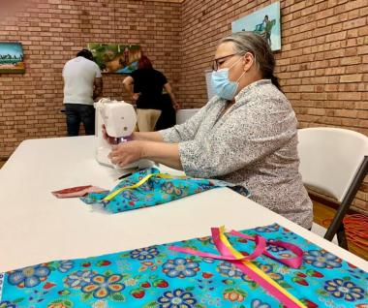
Supportive Housing is Affordable
Requires rent payments to be no more than 30 percent of income
Funded by an operating subsidy
Subsidies must be attached to the Supportive Housing Unit or a tenant
Photo by Ivy Vainio

Slide 10
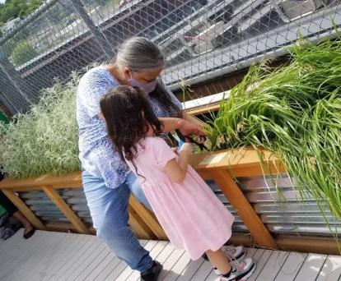
Supportive Housing is Independent Living
Provides tenants with a lease for their unit
Focused on helping tenants adjust to living in a housed environment
Supports tenants in treating past traumas
Photo by Ivy Vainio

Slide 11
Who does Supportive Housing serve?
Individuals and families who are
Homeless, including those living on the streets and in shelters
Living in overcrowded conditions and/or couch-surfing
Being discharged from prison or other systems of care
Living in places not meant for human habitation, i.e., cars, garages, abandoned buildings, etc.
Photo by Ivy Vainio

Slide 12
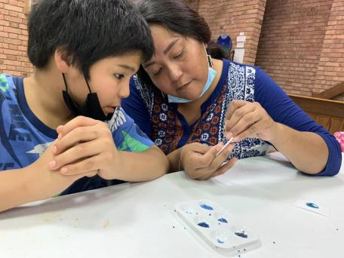
Who Lives Here in Supportive Housing?
Individuals and families who have
Experienced various past traumas, including Adverse Childhood Experiences
Serious chemical dependency and/or mental health issues who need supportive services to maintain stable housing
Frequently utilized emergency services in the community because they lack stable housing
Photo by Ivy Vainio

Slide 13
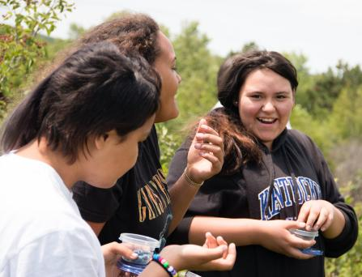
Benefits of Supportive Housing
Reduces stress caused by doubled-up and overcrowding
Reduces use of crisis and institutional services
Produces better outcomes than the more expensive crisis care system
Significantly reduces recidivism rates
Ends cycles of homelessness
Photo by Ivy Vainio

Slide 14
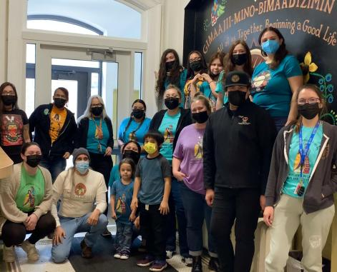
Service Models & Philosophies
Comprehensive
Tenant-Driven Philosophy
Focus on Housing Stability
Effective Engagement Strategies
Staffing and Supervision
Service Partners and Linkages
Cultural Competency
Collaborative relationship with Property Management is critical!
Photo by Ivy Vainio

Slide 15
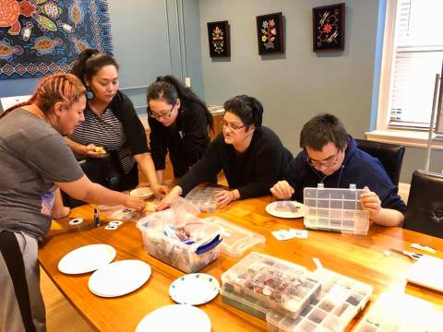
The Housing First Model
Offers permanent, affordable housing as quickly as possible then provides supportive services and connections to community-based supports
Provides foundation from which services and supports for stability can be achieved
Housing is a basic human right
Homelessness is an ineffective treatment plan
Photo by Ivy Vainio

Slide 16
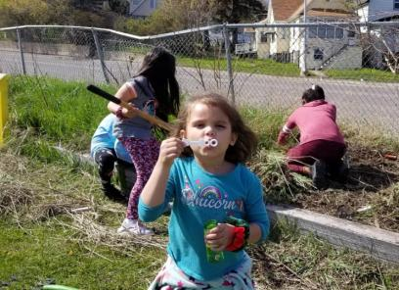
Five Principles of Housing First
No pre-conditions to be considered “housing ready”
Self-determination in participating in services
Harm Reduction and recovery
Client-drive supports
Social integration and community building
Photo by Ivy Vainio

Slide 17
Services Philosophy
An overview
Notes:
Brigid

Slide 18
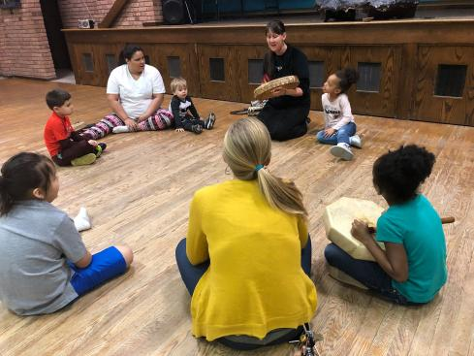
Services are the key
Targeted: Based on populations served
Flexible: Responsive to residents’ needs
Voluntary: Participation is not a condition of residency
Independent: Focus is on housing stability
Photo by Ivy Vainio

Slide 19
The Keys to Working Services
Services should be comprehensive, culturally relevant, and tenant-drive
Services focus on Housing Stability
Services must have effective engagement strategies, staffing and supervision, service partners and linkages and collaborative relationship with Property Management
Photo by Ivy Vainio

Slide 20
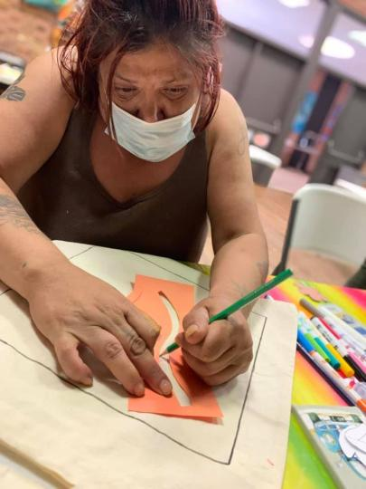
Tenant Centered Services
Services are individualized, not “cookie cutter”
Tenants involved in the design, development, and implementation of their plans – empowered
Strengths-based approach to goal setting
Assessments and service plans updated regularly
Photo by Ivy Vainio

Slide 21
Tenant Centered Services
Ideally: 15:1 tenant to care manager ratio
Services staff may include front desk staff, care managers, housing advocates, traditional language teachers, cultural and spiritual practitioner, mental health professionals, mentors, peer specialists or navigators, activities coordinator, children’s program staff, property management or leasing assistant, maintenance technician, program or housing manager
Photo by Ivy Vainio

Slide 22
Harm Reduction
An overview

Slide 23
Harm Reduction Framework
Accepts that licit and illicit chemical use is part of our world
Chooses to minimize its harmful effects rather than ignore, stigmatize, or condemn chemical use
Uses motivational interviewing to strengthen personal motivation for and commitment to a specific goal identified by the tenant
Incorporates strengths-base programming
Photo by Ivy Vainio

Slide 24
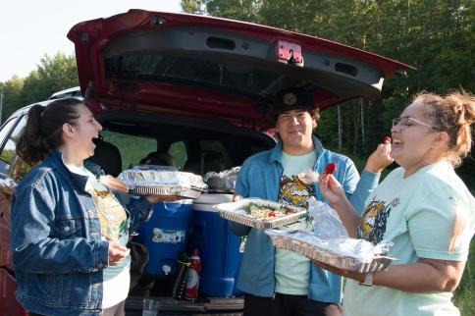
Supportive Housing uses Harm Reduction Approaches
Staff should not go out of their way to catch tenants in an act of big behaviors
Find a balance between maintaining safety without eliminating trust
Allow tenants to make their own choices
Photo by Ivy Vainio

Slide 25
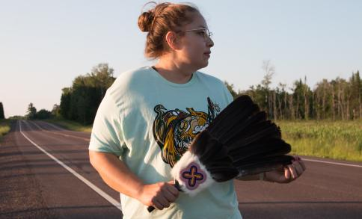
Harm Reduction Framework
Recognizes abstinence and changed behavior is an ideal outcome
Accepts alternative solutions that reduce harm
Promotes low-threshold access to services as an alternative to traditional high-threshold approaches
Helps tenants reach goals they’ve created for themselves
Understands that substance use is a coping mechanism for other issues
Focuses on quality of life and well-being, not reduction in use or behaviors
Photo by Ivy Vainio

Slide 26
Trauma Informed Care
An overview

Slide 27
Trauma Informed Care
People living supportive housing have experienced trauma
Supportive housing works to understand what trauma is, what trauma responses look like, and how staff can respond appropriately
Photo by Ivy Vainio

Slide 28
Trauma “wears a groove”
Trauma is not just an event that took place, but it is also the physiological changes in the brain, body, and mind.
It changes how we think, what we think about, and our capacity to think
The stress hormone released in the body of traumatized people take longer to return to baseline and spike quickly in response to stress

Slide 29
Trauma Fear Responses
Fight
Expressing anger
Yelling
Lashing out
Flight
Avoiding
Fidgeting
Pacing
Panicking
Freeze
Shutting down
Holding breath
Struggling with speech
Tensing up muscles
Fawn
Struggling with saying “no”
People pleasing
Putting others’ needs before your own
Faint
Shutting down
Loosening up of the muscles

Slide 30
Common Effects of PTSD
Expressions of anger | Flashbacks
Irritability | Nightmares
Sleeplessness | Difficulty concentrating
Feelings of grief or sadness | Hard time making decisions
Difficulty feeling happy | Dissociation/spacing or zoning out
Fatigue, exhaustion | Memory problems
Lowered immune response | Headaches
Easily startled | Over protectiveness
Feelings of guilt | Social Withdrawal
Feelings of helplessness | Alcohol/Drug use
Big behaviors are not caused by bad character, it’s caused by actual changes in the brain.
Notes:
Katie

Slide 31
It’s not: WHY ARE YOU DOING THIS??
It’s: What happened to you in the past to cause you to react this way?

Slide 32
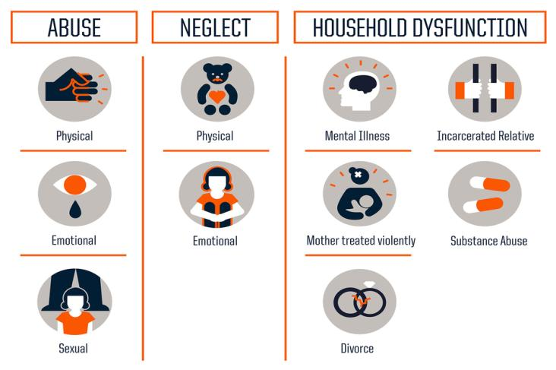
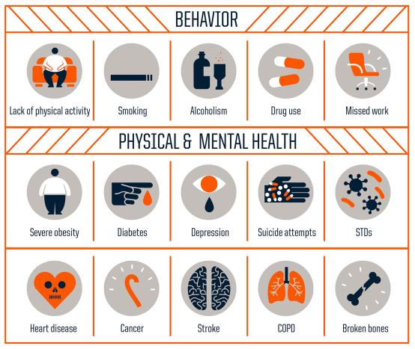
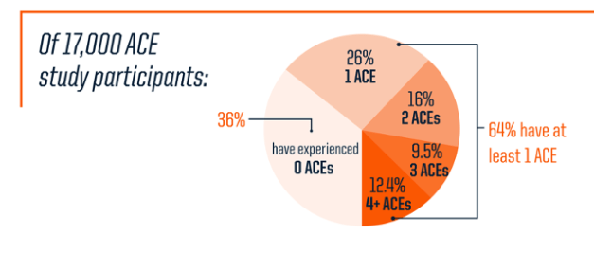
EMPHYSEMA
DEPRESSION
TUBERCULOSIS
2x
60%
More likely to experience feelings of sadness or hopelessness
40%
As likely to have emphysema
More likely to have tuberculosis
LIVER DISEASE
HEART DISEASE
2x
15%
As likely to die from liver disease or cirrhosis
More likely to have heart disease
STOMACH CANCER
OBESITY
15%
60%
More likely to die of stomach cancer
More likely to be obese
DIABETES
HIV
2x
As likely to be diabetic
30%
More likely to be diagnosed with HIV
60%
10%
More likely to have end- stage renal disease
More likely to die
From HIV
90%
More likely to die from diabetes
Native American Health Statistics
Trauma as a Public Health Issue
Notes:
Steve
Mental Illness and co-occurring disorders
Boarding Homes- generational
Veterans
Overwhelming rates of suicides – 3.5 x higher in native American people

Slide 33
General Population
AI/AN Population
Trauma as a Public Health Issue
Native American physical, behavioral and mental health
2018 National Survey on Drug Use and Health (NSDUH), Substance Abuse and Mental Health Services Administration (SAMHSA)

Slide 34
Healing in Possible

Slide 35
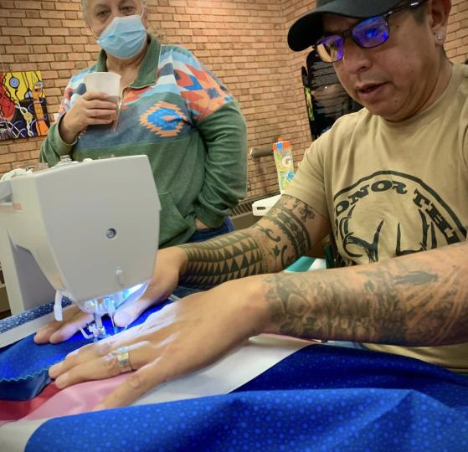
Trauma-Informed Care
Realizes the widespread impact of trauma & understands potential paths for recovery;
Recognizes the signs and symptoms of trauma in clients, families, staff & others involved with the system;
Responds by fully integrating knowledge about trauma into policies, procedures & practices; and
Seeks to actively resist re-traumatization.
Photo by Ivy Vainio
Notes:
According to the Substance Abuse & Mental Health Services Administration (SAMHSA),

Slide 36
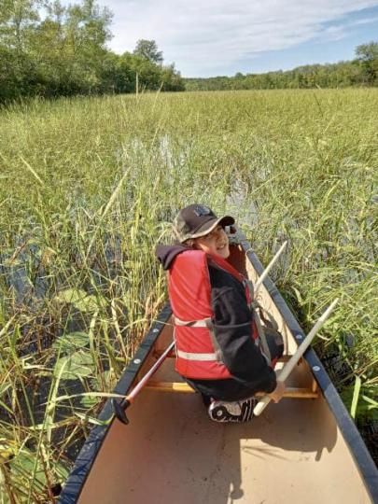
Culturally Relevant Services
Programs and services are centered in cultural practices or are culturally responsive
Examples:
Teaching tenants fishing
Engage tenants in ricing traditions
Programs and services are culturally informed and appropriate for the tribe
Photo by Ivy Vainio

Slide 37
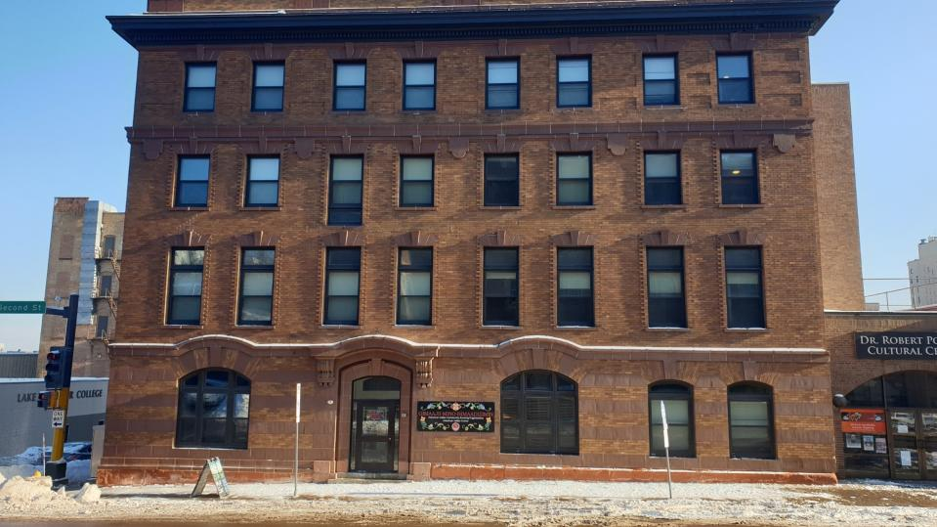
Gimaajii Mino Bimaadizimin
We Are, All of Us Together, Beginning a Good Life
The following photos are taken by various AICHO staff members, including Ivy Vainio
Notes:
Zoe
- 29 units, mix of efficiency, 1-3 bedrooms
- 9 million
- Duluth Indian Commission was the catalyst
- Significant contribution and on-going partnership with tribes
- More than housing: an American Indian Center, offices for tribal partners, rooftop gardens, art galleries

Slide 38
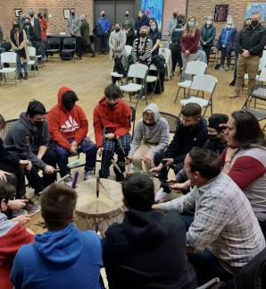
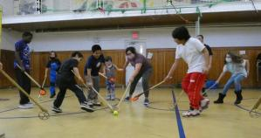
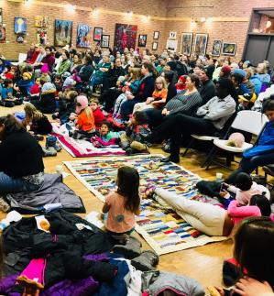
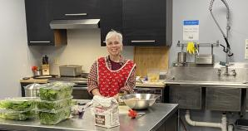
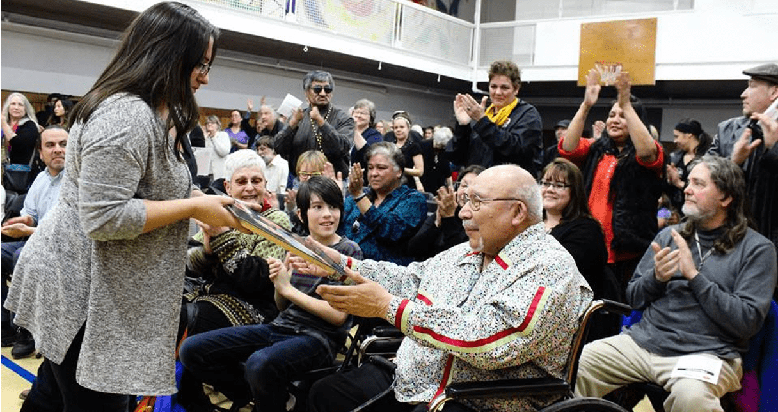
Community Spaces
Photos courtesy of AICHO
Community Spaces
Notes:
Community spaces: the gym, lobby, kitchen, Dr. Robert Powless Cultural Center, urban gardens

Slide 39
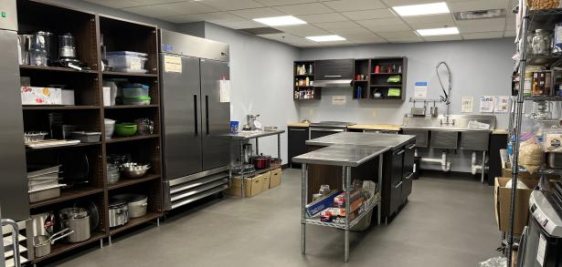
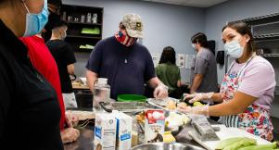
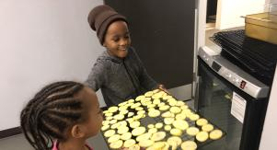
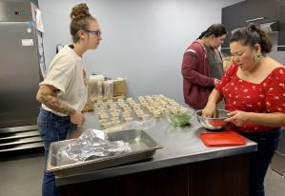
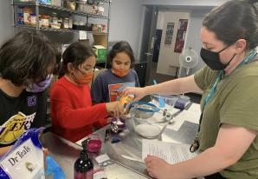
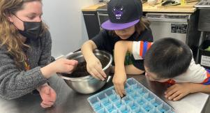
Photos courtesy of AICHO
Notes:
The kitchen space is used to prep tenant meals, engage children, and tenant and youth cooking classes.

Slide 40
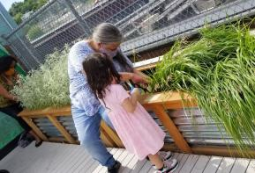
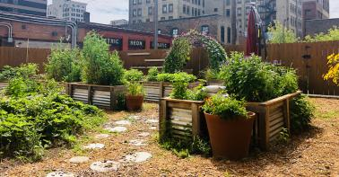
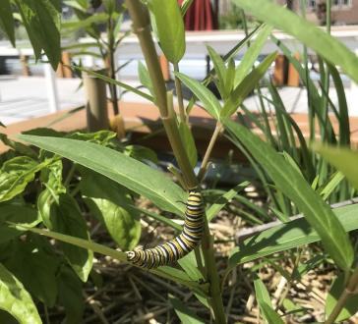
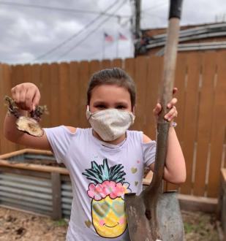
Urban Gardens
Nutritious food for tenants
Connecting and healing with nature
Family activities
Opportunities to learn how to garden
Photos courtesy of AICHO

Slide 41
The Development Process
An overview

Slide 42
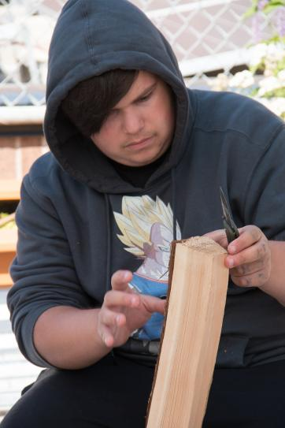
The Development Process
Affordable Housing development takes along time
This is a complex process involving multiple partners across disciplines
Two or three budgets are involved
Funding sources are convoluted, competitive and often inflexible
Can be difficult to convey the process to “civilians”
It’s a lot of work and you all have full time jobs!
Photo by Ivy Vainio

Slide 43
Key Phases of Development
Concept and visioning (who, what, why, where, when and how)
Predevelopment (site selection, putting together development team, selection of development partner, selecting and hiring architect)
Feasibility (building development and operating budgets, funding applications submitted)
Deal making (contract negotiations, legal review)
Construction (hiring owner’s representative, managing construction budget, draws, Owner, Architect, Contractor meetings, inspections)
Pre-lease up and opening planning (review tenant selection plans, operating budget updates, waiting list and referral/outreach, property management and operations plans finalized)
Lease up and Operations
Stabilization and long term survival of staff/residents/neighbors and the building

Slide 44
Pre-Development Activities
Consists of the initial project steps taken prior to the beginning of construction
Typical predevelopment activities include items such as:
Finalizing the project team and roles
Securing site control
Completing preliminary architectural drawings
Conduct environmental reviews
Conduct market study (depending on source of financing)
Submitting applications for permanent financing
Photo by Ivy Vainio

Slide 45
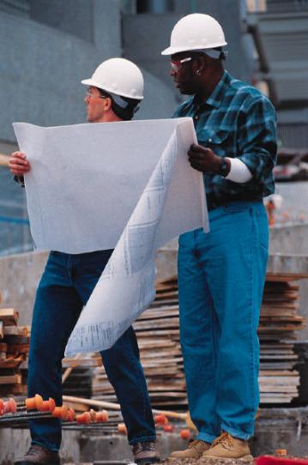
Development Team
owner
sponsor
development
property management
architecture
construction
asset management
accounting
legal

Slide 46
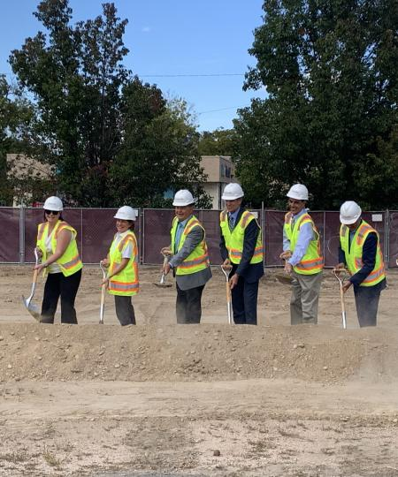
Development Team
Housing authorities
Environmental assessors
Market study analyst
Planning department
Other tribal departments (roads, elders, language, behavioral health, ect…)
Bureau of Indian Affairs
Service providers (if doing supportive or service enriched housing)

Slide 47
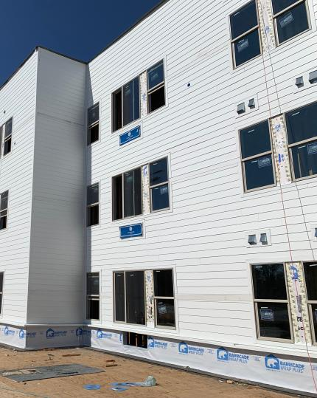
Selecting Your Development Partner
Affordable housing development is complex and time consuming, most owners/sponsors will hire a development partner
There are a variety of options an owner/sponsor can choose to get a project to completion
Each project is unique and may require a different structure
How will procurement work with your chosen structure

Slide 48
Development Consultant
Specializes in managing all aspects of the development process including developing the funding applications, getting local approvals, overseeing the architect, short term award compliance-any aspect of the development you identify in your contract
Can be your “work horse”: grant writing, putting together budgets, closing documents, anything you identify in your contract
Does not play a role as owner or guarantor of the LIHTC
May work for experienced tribes or tribal entities who have staff with development experience but have other full-time jobs
Usually exits after project is constructed, complete and leased up

Slide 49
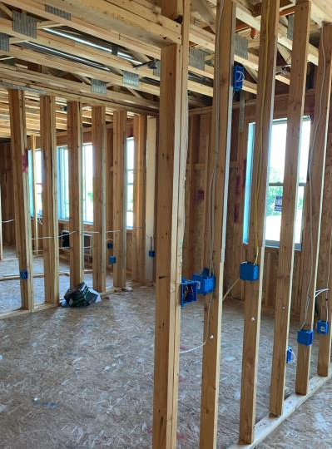
Partnering with a Development Consultant
Experience in projects similar in scale and nature
Experience working with Tribes and/or tribal entities
Experience working with potential funding sources
Involvement in any projects that were not completed and why
Capacity to take on the proposed project on proposed timeline
Fees and contract terms structure
Funder Requirements

Slide 50
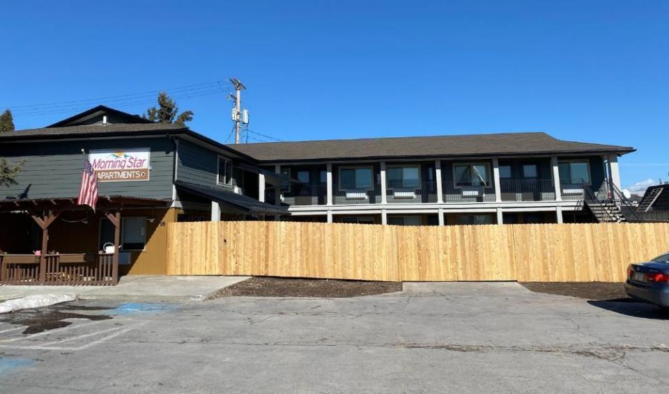
Morning Star Apartments | Confederated Salish & Kootenai Tribes (CSKT)
Notes:
Opened in 2014
21 units of PSH
Makah Housing Authority are the lead service provider (with other tribal departments), the property manager, and the developer.

Slide 51
Background
CARES Act: $8 billion dollars allocated to tribal governments to address COVID-19.
CSKT did not have emergency housing to address self-quarantine, homelessness, or overcrowded living situations.
CSKT purchased an existing motel for supportive housing project with CARES Act funding
Notes:
Stress permanent, independent, affordable housing for people with disabilities who are homeless or at risk of homelessness; services are provided as part of the normal operation of the housing as a way of helping residents maintain the maximum possible level of independence, stability and participation in the general community.
Like other forms of housing – it typically looks and functions exactly the same way as any kind of permanent housing except that tenants have access to supportive services as one of the benefits of living there.
Enables families and individuals to live independently, with improved health, and greater participation in work and community
Saves public money by shifting resources from costly emergency services toward cost-effective, long-term solutions

Slide 52
Project Team
Owner/Developer | Confederated Salish & Kootenai Tribes (CSKT)
Voucher Administrator | Salish & Kootenai Housing Authority (SKHA)
Service Provider | CSKT Tribal Public Defenders Office
Property Manager | Outside Local PM Company

Slide 53
Consultants & Contractors
Development Consultant | RTHawk Housing Alliance
Supportive Housing Consultant | BeauxSimone Consulting
Architect and Engineering | Jackola Engineering and Architecture
Motel Rehab Contractor | R&R Building Productions

Slide 54
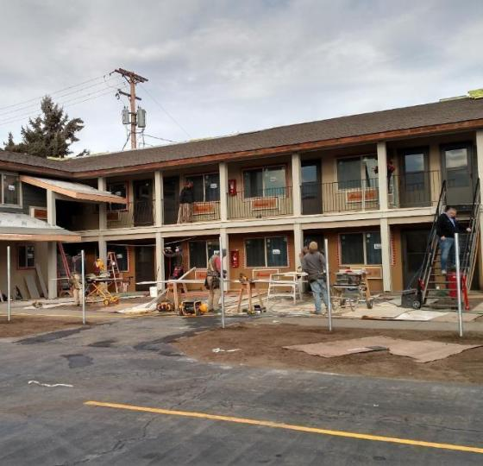
Acquisition & substantial rehab of an old motel on the Flathead Indian reservation
Focus population: homeless, returning citizens & immunocompromised individuals

Slide 55
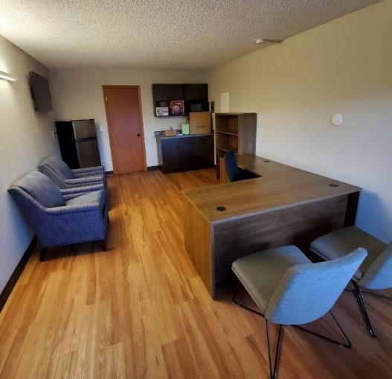
14 units of PSH, 1 caretaker unit, 1 laundry room & 1 unit converted to a staff office, small service space for lease up and/or tele-mental health/probation hearings
Services on site and referrals processes in place to off site health, behavioral health, employment and other services the Tribes provide.

Slide 56
Project-based Section 8 vouchers
Tribes committed funding for Tribal Public Defenders Office to hire 1 full time case manager and 1 caretaker who live on site.

Slide 57
Development budget
$1.8 million Includes:
Acquisition of the building
Rehab of the building
Appraisal, inspections, environmentals
Architect and engineering fees
IT
Furnishing and supplies
Housing and supportive housing consultants

Slide 58
Operations & services budgets
Annual Operating Budget: $99,200
This includes management fees, utilities, repairs and maintenance
Annual Services Budget: $163,000
This includes salary and fringe (services coordinator and caretaker). Budget also includes supplies, travel, training, and vehicle gas/maintenance
TOTAL ANNUAL BUDGET = $262,200

Slide 59
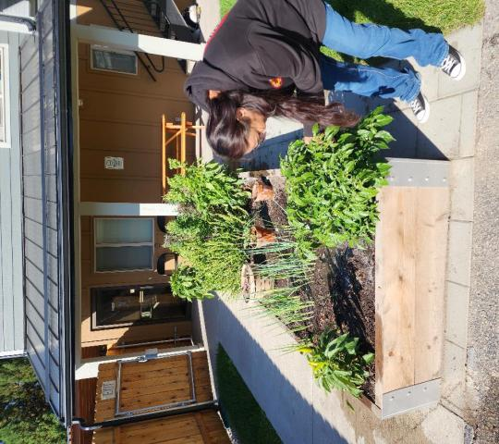
Positive Effects
Research has shown supportive housing has a positive effect on:
School attendance
Employment retention
Improved physical and mental health
Housing stability
Reduced substance use
Supportive Housing
Improves and Saves Lives!

Slide 60
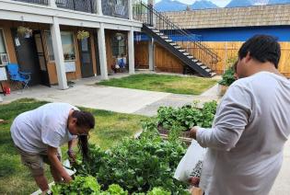
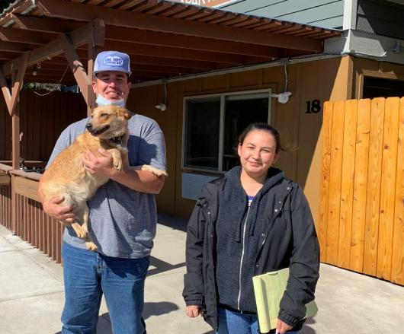
Notes:
Katie

Slide 61
Client Driven Services
Case Management
Reentry Intake and Assessment Tool
Case management tool identifying needs & strengths
Assistance with housing, transportation, social & financial services, employment, parole assistance, referrals, reducing barriers
Mental Health Services
Screenings, assessments, psychological-educational groups
Legal Services
Collateral consequences, offender registration issues, expungement
Jail Services
Engage clients during incarceration
Psychology, mental health screeners, chemical dependency evaluations, case management, facilitate referrals, treatment, medications, Anger & Irritability Group

Slide 62
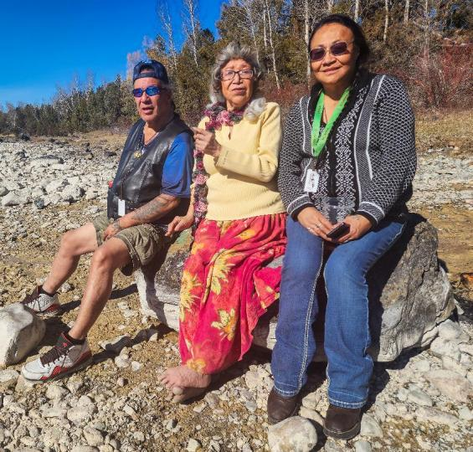
Being A Good Relative
Understanding Trauma
Basic Needs
Safe Space
Showing Up
Service Connecting
Cultural Resourcing
Self Care

Slide 63
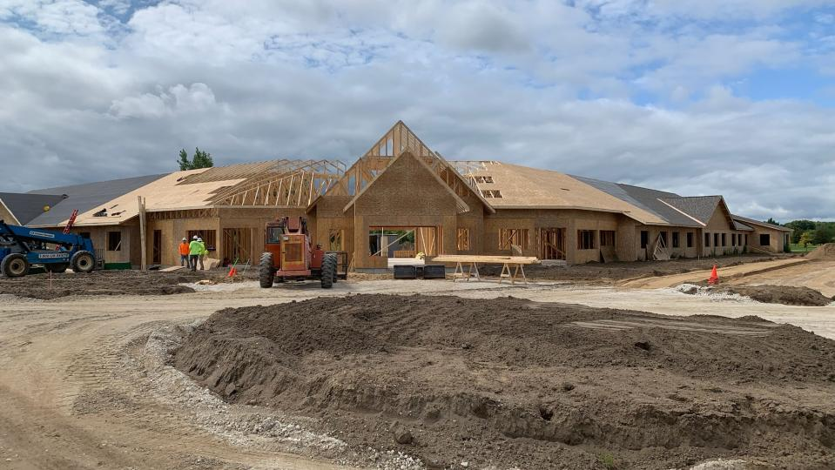
Ongoing Project | Saginaw Chippewa
Notes:
Katie

Slide 64
Notes:
Katie

Slide 65
Makah Sail River Heights Longhouse Apartments
Notes:
Opened in 2014
21 units of PSH
Makah Housing Authority are the lead service provider (with other tribal departments), the property manager, and the developer.

Slide 66
Sail River Longhouse Makah Reservation, Neah Bay, WA
Safe and secure Front Door Entrance
Lobby with open space for sitting, standing by fire, offices
Trauma-Informed, secure courtyard
Entrance into individual apartments from Courtyard, Balconies

Slide 67
Sail River Longhouse
serves formerly homeless Makah Tribal members and their families, many of whom have disabilities and who would not be able to maintain housing without the services provided.

Slide 69
Supportive Housing works
It’s best practice
On average, 85% of people remain in PSH for more than one year
Emergency room and hospital visits decrease by between 62-81%
Tenants use county medics 72% less than they would if they were unhoused
Total hospital billing decrease by $2.4 million—that’s a 70 percent reduction
Tenants are more likely to see improved health and overall wellness, improved self-confidence, healing, re-connection to family and culture, and in some cases, increased income.
Photo by Ivy Vainio

Slide 70
Contact Information
Zoe LeBeau, CEO
BeauxSimone Consulting
zoe@beauxsimone.com
218.491.4018
Katie Symons, CFO
BeauxSimone Consulting
katie@beauxsimone.com
303.883.4326

