Slide 1
Greenhouse Gas Reduction Fund
Finance clean energy projects to create community impact

Slide 2
Agenda
IRA and GGRF overview
About Solar for All
About Clean Communities Investment Accelerator (CCIA)
How we help clients
Open Q&A

Slide 3
Meet the team
Bill Cornelius
Director
Development Advisory
E: bill.cornelius@bakertilly.com
Rob Dicke
Senior Manager Development Advisory
E: rob.dicke@bakertilly.com
Serena Walters
Senior Consultant Development Advisory
E: Serena.Walters@bakertilly.com
Notes:
joel

Slide 4
The team’s background
TOP 10 accounting and advisory firm
80+ energy development advisory subject matter experts
Deep financial structuring capabilities and federal fund compliance expertise
Dedicated team with a 20-year history of advising CDFIs
10+ years with a dedicated Tribal Services Practice
Industry-specific, energy transition and tax credit
qualifications
Community engagement experience
Notes:
joel

Slide 5
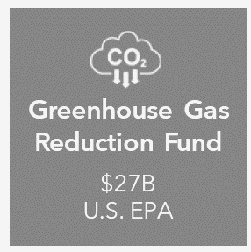
IRA appropriates $370B for clean energy
Energy tax credits
Section 48 clean energy investment tax credit ​
Section 45 clean energy production tax credit​
Section 30C Installation of EV chargers tax credit​
179D commercial and multifamily tax deduction
$27 billion in Greenhouse Gas Reduction Fund appropriation
$14 billion in National Clean Investment Fund
$7 billion in Clean Communities Investment Accelerator
$6 billion in Solar for All

Slide 6
IRA tax credits “101”
The Act provides for a direct offset to federal tax liability in the form of a tax credit.
Three ways credits bring value to projects:
Owner(s) can simply use the tax credit against their own tax liability, in most case back three years and forward 22 years.
If owner(s) doesn’t have tax liability or taxable income, they can now sell certain credits to another taxpayer* (“Transferability”).
Tax-exempt owners can receive a “direct payment” in the form of cash payment from the IRS. These include state and local governments, not-for-profits, tribes and others (“Direct Pay”) for certain credits.
Essentially, the act is enabling ALL entities to utilize this legislation regardless of tax status.
Real estate
Manufacturers
Housing
Local
government
Healthcare and life sciences
Not-for-profits
Fuels and refineries
Colleges and universities
Individual households

Slide 7
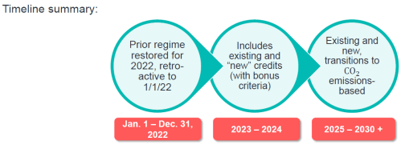
Inflation Reduction Act
Over 70 separate property types eligible for credits in IRA regime
All but a few of these credits are entitlement credits
Most credits are effectively good thru 2032 – the longest U.S. “energy policy” timeframe ever

Slide 8
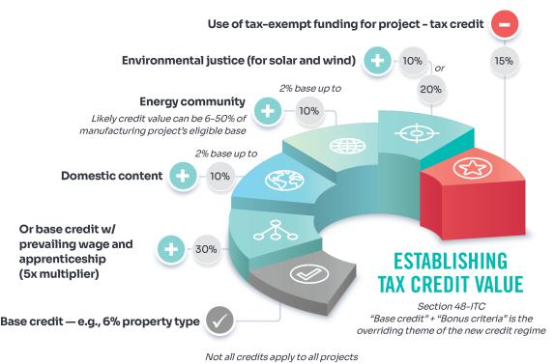
Section 48 – Investment Tax Credit
Eligible project examples
Combined heat and power property
Solar and wind
Energy storage technology
Waste energy recovery property
Geothermal energy
Biogas property
There is a 10% reduction in the tax credit beginning in year 2024, 15% in 2025, and 100% in 2026 for direct pay projects not meeting DC requirements
Projects under 1 megawatt can achieve the 5x multiplier without prevailing wage and apprenticeship requirements.
Projects that completed construction after 1/1/23 may be eligible. Not all credits apply to all projects.

Slide 9
Credit build up
30%​
10%​
10%​
20%​
Base credit (prevailing wage met)​
Domestic content
Energy community
Low income/ environmental justice​
70%​
Potential total maximum credit amount​

Slide 10
What is the GGRF?
The Greenhouse Gas Reduction Fund (GGRF) provides states, investors, developers, Community Development Financial Institutions (CDFIs), community lenders, tribes and tribal entities an opportunity to bring renewable energy, net-zero buildings and zero-emission transportation to disadvantaged communities.
The GGRF has a $27 billion allocation through the Environmental Protection Agency (EPA). This initiative aims to increase options for structuring capital for clean energy projects in low-income or disadvantaged communities and be a catalyst for the emergence of green banks.
Of the $27 billion, $14 billion is available through the National Clean Investment Fund, $6 billion through the Clean Communities Investment Accelerator and $7 billion through Solar for All.

Slide 11
GGRF overview
National Clean Investment Fund (NCIF)
Clean Communities Investment Accelerator (CCIA)
Solar for All (SFA)
Recipients
3 “Green Banks”
5 hub not-for-profits
Up to 60 incl States, AIAN rec, multi-state non-profits
Sub-recipients
Borrowers (developers, contractors, not-for-profits)
Community lenders
Contractors, Tribes, and not-for-profits
Uses
Distributed energy generation and storage
Net-zero emissions buildings
Zero-emissions transportation
Residential rooftop solar
Residential-serving community solar
Associated storage
Enabling upgrades

Slide 12
Solar for All - Reading the tea leaves
Summer 2024
Summer 2024 - Spring of 2025
Summer of 2025
2025 – 2030
Recipients negotiate and finalize funding awards with EPA
Recipients onboard capacity for program execution, finalize program plans
Most programs should be launched with funding available
Program execution and funding deployment

Slide 13
“Qualified projects”
NCIF Qualified Project
The six-part definition requires each project to
Reduce greenhouse gas emissions
Reduce other air pollutants
Deliver benefits to communities
Meet the requirement that it may not have otherwise been financed
Mobilize private capital
Support only commercial technologies
CCIA Qualified Project
Meet the six-part definition of a “qualified project”
AND at least one of three “priority project categories:”
Distributed energy generation and storage
Net-zero emissions buildings
Zero-emissions transportation
Notes:
serena

Slide 14
Leading with impact
Climate and air pollution benefits
Equity and community benefits
Market transformation benefits
Project approval and monitoring
What is the EPA looking at?
Requirements flow down from Recipient to Sub-recipient to Vendor
Notes:
serena

Slide 15
Solar for All
GREENHOUSE GAS REDUCTION FUND

Slide 16
Solar for All overview
Through financial assistance (i.e., grants, subsidies, rebates, loans or other incentives) and technical assistance, communities, developers and homeowners can transition residential properties to be powered by solar energy. Solar for All programs will be operating in all 50 states.
Investment amount: $7 billion
Eligible entities: 60 state and not-for-profits including housing authorities, not-for-profits, developers, local governments and tribes
Qualified projects: residential rooftop solar, residential-serving community solar, associated storage and enabling upgrades
Eligible projects must meet the following criteria:
Must be a qualified project
Must be in a low-income and disadvantaged community. Use the Climate and Economic Justice Screening tool (CEJST) to identify eligible Justice40 communities.
Notes:
States that opted out include: Florida, Idaho, Montana, North Dakota, Nevada and South Dakota. However, projects within these states can receive funding through the funding for American Indian and Alaskan Native Program and the Multi-State Program managed by Solar for All recipient not-for-profits or municipalities serving the area.

Slide 17
Tribal focused awardees
Solar for all
Awardee | Award | Service Area
Tanana Chiefs Conference | $62.5 MM | AK
Midwest Tribal Energy Resources Assn. | $62.3 MM | MI, MN, WI
GRID Alternatives – Western Indigenous Network | $62.5 MM | AZ, CO, NV, NM, UT
Oweesta Corporation | $156 MM | National
Hopi Utilities Corporation | $25.1 MM | Hopi Tribe
Northern Plains Tribal SFA | $136 MM | ND, SD, MT, WY, WI
Total | $442 MM
Notes:
serena

Slide 18
State awardees – known Tribal specific goals
State | Award
Washington | $156 MM
Montana | $43.7 MM
Wyoming | $30.3 MM
Idaho | $56.5 MM
Nebraska | $62.5 MM
Nevada* | $156 MM
North Carolina | $156 MM
Arizona | $156 MM
Minnesota | $62.5 MM
North Carolina | $156 MM
Notes:
serena

Slide 19
Non-Tribal awardees with Tribal set asides
Bonneville Environmental Foundation (MT) | $43.7 MM
Bonneville Environmental Foundation (WY) | $30.3 MM
Bonneville Environmental Foundation (ID) | $56.5 MM
Nevada Clean Energy Fund (NV) | $156 MM
Notes:
serena

Slide 20
Solar for All takeaways
Tribes, Tribal Housing Authorities
Feasibility
Preliminary design to “construction ready”
Operations/asset management plan
Understand and plan for compliance
Monitor status of SFA prime awardees
CDFIs/Community Lenders/Philanthropy
How will this fit with other sources of capital
Understand mechanics of SFA and elective pay tax credits
Work with awardees to develop efficient “turnkey” financial products that work for residential solar
Go big, go home, or stay on the porch with SFA?
Notes:
Jim

Slide 21
Solar for All takeaways
Vendors/Installers
Prepare to be pre-qualified
Understand compliance
Workforce development
Supply chain
Relationship building
All stakeholders
“Abundance mindset”
What is best for the project, Tribe, and homeowner
Efficient execution while being inclusive to all participants
Notes:
Jim

Slide 22
Clean Communities Investment Accelerator (CCIA)
GREENHOUSE GAS REDUCTION FUND

Slide 23
CCIA organizational structure
Environmental Protection Agency (EPA)
Administers all Greenhouse Gas Reduction Fund programs
$6 billion
Clean Communities Investment Accelerator
Hub recipient
Hub recipient
Hub
recipient
Hub recipient
Hub recipient
Community lender
Community lender
Community lender
Community lender
Community lender
Community lender
Community lender
Community lender
Community lender
Community lender
Qualified projects
Qualified projects
Qualified projects
Qualified projects
Qualified projects
Qualified projects
Qualified projects
Qualified projects
Qualified projects
Qualified projects

Slide 24
CCIA awardees
Opportunity Finance Network - $2.29 billion
(10% Tribal Set Aside - $229 MM)
Inclusive- $1.87 billion
(Allocation for 91 Tribal Projects)
Native CDFI Network- $400 MM – 100% Tribal
Justice Climate Fund - $940 MM
Appalachian Community Capital $500 MM
Notes:
Joel

Slide 25
CCIA – roles
Name | Overview
Hub recipients | Five non-profit entities were selected as Hub recipients to provide funding and technical assistance to community lenders to finance distributed energy, net-zero buildings and zero-emissions transportation projects in low-income and disadvantaged communities. Hub Recipients can provide up to $1 million of technical assistance and up to $10 million of grant capital to a community lender. Hubs are responsible for ongoing monitoring and reporting associated with the activity of the community lender and related qualified projects.
Community lenders | New or existing public, quasi-public, not-for-profit, or nonprofit entity that provide financial assistance to qualified projects at the state, local, territorial, or Tribal level or in the District of Columbia, including community- and low-income-focused lenders and capital providers. community lenders could include community development financial institutions (including Certified Native CDFIs), credit unions, green banks, housing finance agencies, minority depository institutions, and other types of lenders. Community lenders can obtain up to $1 million of technical assistance and $10 million of capital to provide below market loans to qualified projects.
Qualified projects | Project must be: 1) a “Qualified Project” as defined under GGRF which includes 6 specific elements 2) a priority project category and 3) Must be in a low-income and disadvantage community.

Slide 26
Our services – Hub recipients
Name | Amount | Overview
Opportunity Finance Network | $2,290,000 | OFN is a CDFI intermediary with a network of 400+ members with 95% of members being CDFIs and the remaining members being emerging CDFIs. OFN will focus on providing capital and technical assistance to support its CDFI members.
Inclusiv | $1,870,000 | Inclusiv is a CDFI intermediary with a network of 900+ mission driven, regulated credit unions, which include CDFIs and financial cooperatives in Puerto Rico. Inclusiv will focus on providing capital and technical assistance to its credit union members.
Justice Climate Fund | $940,000,000 | Justice Climate Fund is a collation of members including the CDFI Bankers Association (Community Bankers National Association) and MDI Bankers Association (National Bankers Association) that will focus on providing capital and technical assistance to predominately CDFI and MDI Banks.
Appalachian Community Capital (ACC) | $500,000,000 | ACC is a CDFI focused on launching green bank for rural America. ACC will use the CCIA funds to finance CDFIs and other Community Lenders focused on rural America.
Native CDFI Network | $400,000,000 | Coalition of members focused on advocacy for certified Native CDFIs, of which there are approximately 60 in 27 states throughout the country. Native CDFI network will provide capital and technical assistance to its members focused on bringing renewable energy projects to Native communities.

Slide 27
Bringing together a capital stack CCIA amplification opportunity
8x amplification for CCIA
10x amplification for Philanthropy
CCIA Alone |  | CCIA Amplified
$1,000,000 | CCIA | $125,000
 | Elective Pay Tax Credits | $500,000
 | Federal Grants, Solar for All, NCIF | $275,000
 | Philanthropic Funds | $100,000
$1,000,000 | Total Capital | $1,000,000
Notes:
Joel

Slide 28
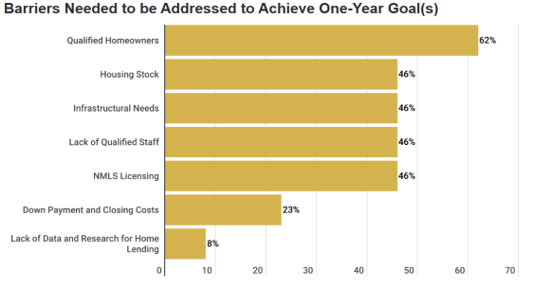
Lending pipeline/deal flow Tribal net zero homes
Critical need for Tribal Housing.
A $10 million tribal housing project might be a $15 million tribal “net-zero” housing project that is now eligible for CCIA funding.
Meets a clear need and complements many existing Tribal CDFI core underwriting competencies.
Source: Oweesta 2021 Housing Report
40
Notes:
Joel

Slide 29
A look at program compliance
Build America, buy America
Davis-Bacon wages
Justice40 initiative
Allowable and eligible expense
Financial management
Performance tracking
Reporting
Elective Pay Tax Credits:
Prevailing wage + apprenticeship
Energy communities / low-income
Domestic content
Project capital stack
Greenhouse Gas Reduction Fund
Other HUD, DOE, USDA, Treasury Sources
State-level Sources
Private funding
Inflation Reduction Act tax credits
43
Notes:
Serena

Slide 30
A misnomer – “Community lenders”
The regulations provide for a broad definition of Community Lenders:
New or existing public, quasi-public, not-for-profit, or nonprofit entity that provide financial assistance to qualified projects at the state, local, territorial, or Tribal level or in the District of Columbia, including community- and low-income-focused lenders and capital providers. Community Lenders could include community development financial institutions (including Certified Native CDFIs), credit unions, green banks, housing finance agencies, minority depository institutions, and other types of lenders
The Hub recipients have determined that banks which do not fall within one of the identified categories are not “community lenders”
The Hub recipients are predominately focused on the following groups:
CDFIs (Banks, credit unions and non-bank CDFIs)
Credit Unions
Minority Depository Institutions (MDI)
There are roughly 1,500 CDFIs made up of 39% are loan funds, 36% are credit unions, 13% are banks and 12% are other institutions.
Outside of the Appalachian Community Capital, all other Hub Recipients will focus on providing capital to Community Lenders that are members of its organization/association.

Slide 31
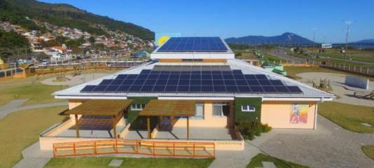
CCIA eligible projects: distributed energy generation and storage
Solar
Battery storage
Wind
Hydroelectric
Fuel cells
Any clean energy technology

Slide 32
CCIA eligible projects: net zero emissions buildings
Residential (single and multifamily), Commercial, Retrofits or new builds, Industrial, “Other”
“An efficient, all electric building that is designed and operated so scope 1 and scope 2 greenhouse gas emissions from all facility energy use equal zero on an annual basis, when connected to on-site renewable energy or a regional grid that provides 100 percent carbon-free electricity on a net annual basis”
At a minimum, a building that achieves zero operational emissions from energy use must be:
Energy efficient
Free of on-site emissions from energy use
Powered solely from clean energy

Slide 33
CCIA eligible projects: zero emissions transportation
Electric vehicle charging infrastructure
Light duty vehicles
Small scale infrastructure to promote walking, biking

Slide 34
Interplay between IRA tax credits and CCIA
Energy credits
Pre 2025 ITC/PTC Credits are based on qualifying property types
Post 2025 ITC/PTC is based on greenhouse gas emissions standards for qualifying property
Projects required to have Prevailing wage and apprenticeship programs for 5x multiplier of credit
Bonus credits for energy communities, domestic content
CCIA fund
Project must be in low-income or disadvantaged community
Priority project type
Distributed energy and storage
Net Zero Emissions Buildings
Zero Emissions Transportation
Projects likely need to meet labor and equitable workforce development plan
Meets Good Job Principals
Meets Building America, Buy America Act and Davis-Bacon
Must be a qualified project
Reduce greenhouse gas (GHG) emissions and other air pollutants
Delivers additional benefits (climate change, clean energy, housing workforce training, reduces pollution)
Need for financing
Attracts other private capital
Supports commercial technology

Slide 35
Compare and contrast
Similarities
Project Types under Accelerator Fund will generally be eligible for IRA Credits
IRA projects will generally meet qualified project criteria.
Both IRA and Accelerator require additional capital to come in to support the project.
All IRA projects seek to earn the PWA bonus helping to meet workforce development plan criteria
Differences
IRA projects are not required to be in low-income or disadvantaged communities
IRA Projects do not have to demonstrate need for credits to be eligible
IRA projects can be larger in size than the targeted Accelerator Fund projects (10 mega watts and under)
PVA is similar but not the same requirements as Davis Bacon
IRA gives bonus but does not require domestic content whereas Accelerator may require Build America Act compliance
IRA credits are not required to use proven commercial technologies

Slide 36
The opportunity
For projects and project developers
Project eligibility: Identify eligible projects and begin community-wide planning
Capital access: help projects obtain below market capital through CCIA, substantiate and monetize energy tax credits
Equity and community impact: Workforce development and capacity building for Tribal clean energy and construction workforce
MBE/ WBE: Procurement incentivizes working with local minority- and/ or women- owned businesses
Financial infrastructure: Invest in relationships with Native CDFIs serving your area.

Slide 37
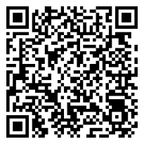
Help your clients take advantage of the GGRF today
Connect with Baker Tilly energy development and capital structuring specialists to secure funding and maximize community impact.
GGRF webpage

Slide 38
Meet the team
Bill Cornelius
Director
Development Advisory
E: bill.cornelius@bakertilly.com
Rob Dicke
Senior Manager Development Advisory
E: rob.dicke@bakertilly.com
Serena Walters
Senior Consultant Development Advisory
E: Serena.Walters@bakertilly.com
Notes:
joel

Slide 39
Questions?
The information provided here is of a general nature and is not intended to address the specific circumstances of any individual or entity. In specific circumstances, the services of a professional should be sought. Tax information, if any, contained in this communication was not intended or written to be used by any person for the purpose of avoiding penalties, nor should such information be construed as an opinion upon which any person may rely. The intended recipients of this communication and any attachments are not subject to any limitation on the disclosure of the tax treatment or tax structure of any transaction or matter that is the subject of this communication and any attachments. Baker Tilly US, LLP, trading as Baker Tilly, is a member of the global network of Baker Tilly International Ltd., the members of which are separate and independent legal entities. © 2024 Baker Tilly US, LLP

