Slide 1



Homeownership on & off Reservations
By: Maria Cohen
Real Estate Broker/ Consultant

Slide 2


Introduction
Started real estate career in January 2007
Trained and participated in helping homebuyers in Arizona using the Neighborhood Stabilization Program (NSP) federal housing program during the foreclosure housing crisis 2009- 2012
Assisted in multiple capacities in completing a full homeownership mixed income project of 23 townhomes and oversight of 26 single family lots for the Navajo Housing Authority that used NAHASDA and TERA funding to develop 2012- 2015
Assisted in writing housing and/or loan policies for tribal housing authorities and tribal economic development departments
Represented the Navajo Nation in purchasing 28,000+ acres of aboriginal lands in Colorado, equitable land exchange with the New Mexico State Land Office 90,000+ acres, transferred a domestic violence shelter from a non-profit in Utah to the Navajo Nation

Slide 3
Benefits of Homeownership
Financial Stability
Family & Community Enrichment
Tax Benefits
Long Term Investment

Slide 4

Presentation Topics
Real Estate Market
Land Status
Funds & Financing
Preparation & Steps to Homeownership

Slide 5

Why is there so much less housing and development on Reservations?
On Reservations
Off Reservations
Land Status is comprised of Indian Trust Land, Allotted Land and Fee Simple Land
  - No Title Insurance or ownership on Trust or Allotted Land
  - Limits lending opportunities
Received less funding, offer fewer funding programs
  - Hinders housing
  - Hinders employment
Restricted primarily to Low Income households
  - Suppresses neighborhoods from developing
Low Incomes, lack of collateral, bad credit
Lack of developable land
Lack to infrastructure access
Land is mostly Fee Simple Land
  - Enables an easier development process
  - Provides Title Insurance, real estate services
  - Creates lending opportunities
Receive more funding, offer more funding programs
  - Creates more housing options both rental or homeownership
  - Spurs employment development
In time of crisis assisted Low to Medium Income Households (80%-120% AMI)
  Stabilized neighborhood nationally after housing foreclosure crisis with the Neighborhood Stabilization Program (NSP)
More developable land options
Access to infrastructure

Slide 6

Land Status Definitions
Tribal Trust Land: Land or interest in land held in trust by BIA for the Tribe may not be encumbered or alienated (leasehold)
- Land cannot be sold, given or willed only the structure
Allotted Land: Land or interest in land held in trust by the BIA for an individual Indian(s) (leasehold)
- Tribe had no interest in land
- Subject to restrictions against alienation or encumbrance
- Land cannot be sold, given or willed only the structure
Fee Simple Land: Estate in land that is absolute or unrestricted (freehold)
- Located on reservation or within Tribe’s operating area for housing off reservation
- Owner can sell, give or will land
  The sale of home and/or foreclosure; land and home sold together

Slide 7


Land Status
Financing & Title
Tribal Trust Land
Loan Types: Section 184 Loan, USDA, VA
Title Process: BIA
Allotted Land
Loan Types: Section 184 Loan, USDA, VA
Title Process: BIA
Fee Simple Land
Loan Types: Section 184 Loan, USDA, VA, FHA, Conventional, CDFI
Title Process: County Recorder

Slide 8

MORTGAGE LENDING PROCESS BASED ON LAND STATUS
Fee Simple | Tribal Trust | Allotted
No restriction against alienation or encumbrance; land serves as collateral | Restrictions against alienation or encumbrance; leasehold interest in land serves as collateral | Individual Trust: Restrictions against alienation or encumbrances; allottee must document interest in land to serve as collateral
Fee Simple Mortgage Approval: | Leasehold Mortgage Approval on Tribal Trust Land: | Trust Mortgage Approval on Allotted Individual Trust Land:
Lender: Receives loan application Provides loan pre-qualification • Prepares credit package • Orders Title Insurance Company • Orders appraisals • Pre-approves borrowers • Submits underwriting package to HUD • Receives HUD commitment • Closes loan | Lender: • Receives loan application Provides loan pre-qualification Lender/Borrower contacts BIA to obtain certified TSR to verify interest in land, legal description, and existing encumbrances • Borrower applies for a Homesite Lease • Borrower obtains an Environmental Review or a Categorical exclusion • BIA Realty Officer provides approved lease and commitment for Mortgage/deed of trust approval | Lender: • Receives loan application Provides loan pre-qualification Lender/Borrower contacts BIA to obtain a certified TSR to verify applicant’s interest in land, legal description, and existing encumbrances.
Lender files loan documents with County Recording Clerk. | Lender: • Reviews executed lease by Tribe, BIA, and borrower for program compliance • Prepares credit package • Orders appraisal • Pre-approves borrower • Submits underwriting package to HUD for approval • Receives HUD commitment • Closes loan | Lender: • Prepares credit package • Orders Appraisals • Pre-approves borrower • Submits Mortgage documents to HUD and BIA for approval • BIA Credit Officer and/or Realty Officer approves credit package Lender: • Receives HUD/BIA commitment • Closes loan
 | Lender files loan documents with BIA and County/Tribal Recording Clerk as required. | Lender files loan documents with BIA and County/Tribal Recording Clerk as required.
 | BIA issues the final TSR and/or BIA endorsement and certificate of approval to lender with recorded Mortgage and lease. | BIA issues the final TSR and/or BIA endorsement ad certificate of approval to lender with recorded Mortgage.
Time frame: 30-90 days to close | Time frame: Unknown could be years | Time frame: Unknown could be years

Slide 9

BIA’s Role & Responsibilities
Serves as a trustee for tribal trust land
Approves lease/mortgage
- Approves lease if tribe has not received approval to
utilize the HEARTH Act to approve leases
        Provides/updates certified title status report (TSR)
        Records mortgage/lease on to TSR
Underwrite/review loan package (allotted land)
Authority to approve a Land Consolidation Plan

Slide 10

Funding for Housing
Community Development Block Grant (CDBG) Indian Community Block Grant (ICDBG) 1% of CDBG
  Congress recently increased the CDBG-DR 30% to $1.34 Billion with Sen. Brian Schatz efforts and other senators from both sides of the isle to pass a bipartisan bill
Neighborhood Stabilization Program (NSP) created to address the foreclosure housing crisis
  HUD provided grants to communities hardest hit by foreclosures and delinquencies to purchase, rehabilitate or redevelop homes to stabilize neighborhoods.
Native American Housing Assistance and Self Determination Act (NAHASDA) enacted in 1996, U.S. Congress enacted to put tribes in control of meeting communities’ housing needs that previous programs failed to do.
  Created opportunity for mortgage-based homeownership in Indian Country.
  Encouraged tribes to partner with lenders to develop first-time homebuyer programs.

Slide 11

How Much Monthly Income does a family need to Make Monthly Payments

Slide 12
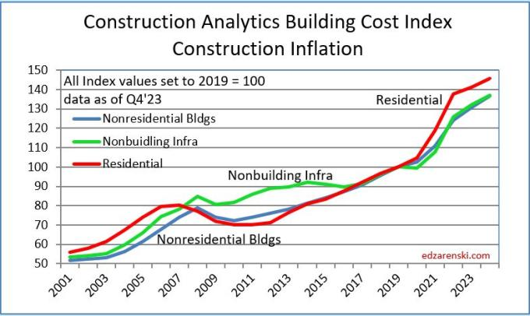

Construction Costs Off Reservations
Source: National Association of Homebuilders

Slide 13

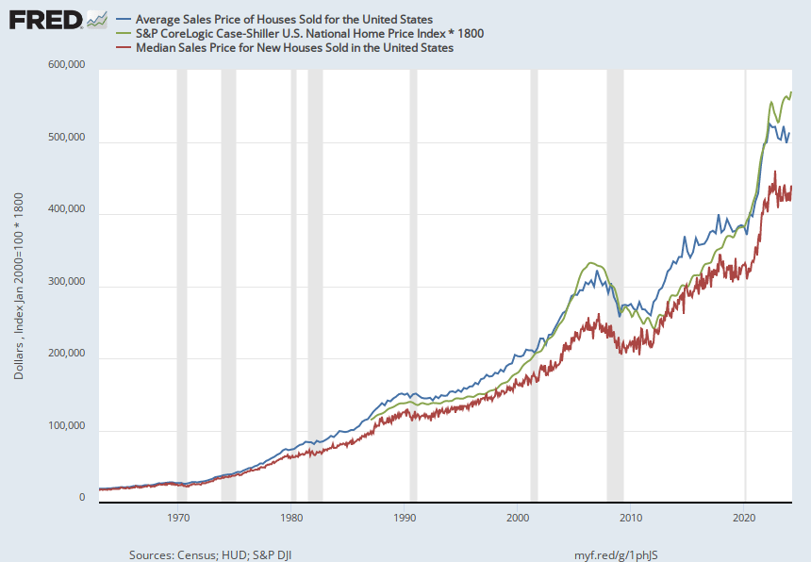
Home Prices Off Reservations

Slide 14

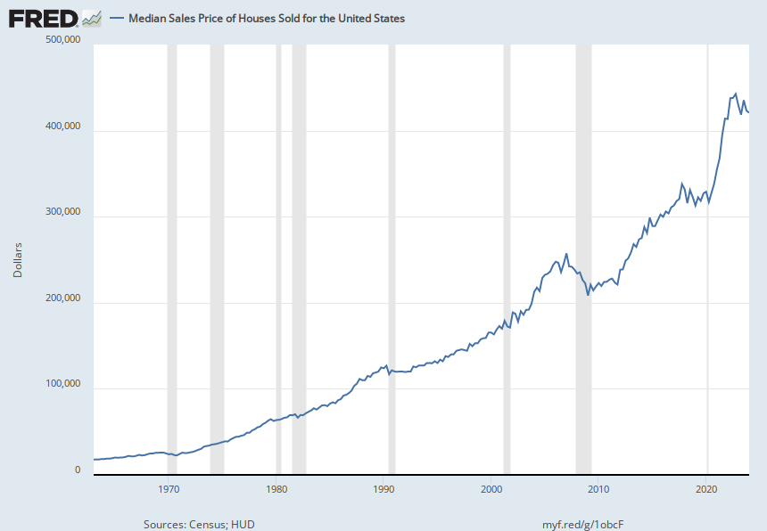
National Median Sales Price of Houses Sold
$420,800 May 2024

Slide 15
Down Payment and Closing Costs Example with a 6.5% interest rate
Loan Amount = $420,800
Down Payment Percentage = 2.25%
Down Payment = $9,468
Closing Costs = $12,624
Monthly Principal & Interest Payments= $2,599.90

Slide 16

Construction Prices and
Monthly Payments

Slide 17

Monthly Income
80 % of the US Median Income
Family of 4
Salary of $77,000
100% of the US Median Income
Family of 4
Salary $96,200
Max Housing Payment of 30%
$1,925
Estimated max Purchase Price without Down Payment Assistance
$282,000
*Estimating insurance
Loans for pre-existing home purchases off Reservations range between $380,000 and $580,00
Max Housing Payment of 30%
$2,250
Estimated max Purchase Price without Down Payment Assistance
$330,000
*Estimating insurance
*Assuming Section 184 Loan at 6.5% interest with Mortgage Insurance, no property taxes, no hazard insurance

Slide 18

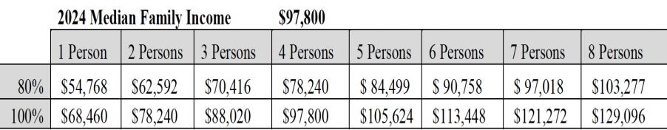
NAHASDA INCOME LIMITS

Slide 19


Home Purchase Steps
Work on credit and save money
Choose a lender and real estate agent (if applicable)
Request information on down payment assistance programs
Buyer obtains pre-qualification amount from lender by providing required documentation to lender to determine affordability.
5) Home searches are created and sent by email to Buyer.
6) Buyer selects homes to view.
7) Buyer selects home to put an offer on.
8) Purchase Contract is written by Buyer’s agent and presented to Seller’s agent.

Slide 20

Home Purchase Steps Cont…
9) Buyer and Seller agree on price and terms and sign Purchase Contract.
Buyer’s agent opens Escrow and deposits Buyer’s Earnest Money.
Title company provides Title Commitment (equivalent of a TSR. This step is first on Reservations)
Buyer may hire a home and termite inspector to inspect home.
Lender sends disclosures to be singed by buyer.
Appraisal is ordered by lender.
Appraisal is received then Loan package is submitted to Underwriter for Loan Approval.

Slide 21

Home Purchase Steps Cont…
Lender approves loan and sends closing disclosures to Buyer and loan documents to Title Company.
Title Company schedules Buyer to sign loan documents and Buyer signs.
Lender funds the loan.
Buyer receives keys after title company records sale with the County

Slide 22


Thank you!!
Questions & Answers
Maria Cohen
maria@azmaria.com
(928) 970-2057

