Slide 1
Mastering Project Planning for Housing Development and Community Needs
Native American Indian Housing Council 2024 Annual Conference – 50th Anniversary

Slide 2
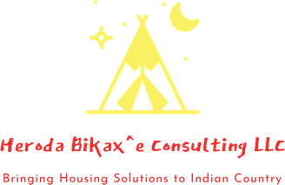
Getting to know us…
The Luak Group is the holding company of subsidiaries, Heroda Bikax^e Consulting LLC, Morning Star Consultants LLC, and Ugisa Tribal Consultants LLC. With over 15 years of professional experience in Indian Country, The Luak Group is dedicated to ensuring a nation building approach that tribal communities can assert to for capacity growth, strategic orientation, cultural collaboration, while protecting tribal sovereignty through all of our services and businesses. Our teams of subject matter experts will ensure your mission and vision is incorporated into your goals and objectives at every level of the services we provide.
The Luak Group has one vision in mind…Bringing Solutions to Indian Country.

Slide 3
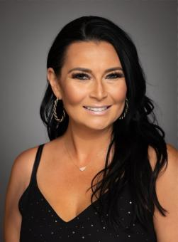
Brandi Liberty Iowa Tribe of Kansas and Nebraska/United Houma Nation
Brandi Liberty, a proud member of the Iowa Tribe of Kansas and Nebraska and descendant of the United Houma Nation, is a distinguished professional in the field of tribal consulting. As the owner and CEO of The Luak Group, she brings over 15 years of expertise to her work with Tribes and Tribal entities. Miss Liberty's career is marked by an impressive track record, securing over $81.1 million in grants from federal and state sources, earmarked for enhancing tribal communities. Her expertise encompasses business development, Indian housing, grant writing and management, tribal housing, human resources, technical assistance, economic development, policy development, compliance, and strategic planning.
In the literary world, Miss Liberty is the co-author of the book "Womanhood: Identity to Intimacy and Everything in Between," published in 2023. Her thought leadership extends to speaking engagements, including the notable keynote at the Healing the Circle in Our Tribal Communities Symposium by the Seminole Tribe of Florida in 2019 and participating in the Families Are Sacred Summit hosted by the Cherokee Nation in 2023. Her insights are sought after, with features in High Country News and the Associated Press. Miss Liberty's monthly column for Verite News provides readership in New Orleans with insights into the culture, challenges, and events that shape the lives of the Tribes in Louisiana and across Indian Country.
Miss Liberty's role as an MBDA Enterprising Woman of Color highlights her commitment to the advancement of women of color in business. She has been a vital member of various boards, including those for the Iowa Tribe of Kansas and Nebraska, and the IPAI Community Loan Fund for the San Pasqual Band of Mission Indians. She currently serves on the Board of Directors for the National Indigenous Women's Resource Center and Research Wild.
Miss Liberty holds a BA in History from the University of Nebraska-Lincoln and a master's degree from the University of Kansas' Center of Indigenous Nations Studies, where she specialized in Tribal Human Resources. She obtained an Executive Leadership Certificate from Harvard Business School's program on Leading People and Investing to Build Sustainable Communities, in collaboration with the Native American Finance Officers Association (NAFOA).

Slide 4
Affordable Housing Project Development
Complicated and challenging process, typically 4-7 years
Site challenges, financing requirements, and community support impact timeline and cost
Requires a team of stakeholders with specialized expertise

Slide 5
Affordable Housing Development Phases
1. Project Concept
2. Project Feasibility
3. Project Dealmaking
4. Construction and Lease-Up
5. Operations

Slide 6
Project Concept Phase
Setting project goals and conducting zoning analysis
Assessing organizational capacity and identifying team roles
Securing a project site

Slide 7
Project Feasibility Phase
Feasibility analysis: appraisal, zoning, environmental analyses
Community support and preliminary financial feasibility
Due diligence to ensure site developability

Slide 8
Dealmaking Phase
Applying and securing financial commitments
Finalizing project design and securing approvals
Closing on construction financing

Slide 9
Operations Phase
Professional property management
Ongoing compliance and financial performance monitoring
Long-term planning for capital improvements

Slide 10
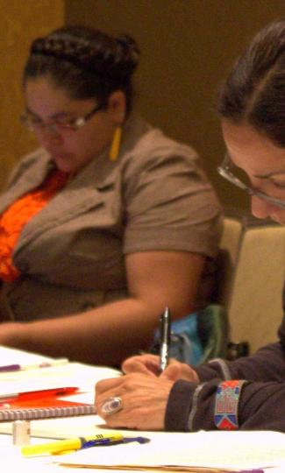
Community Involvement
Before projects begin, it is essential to create a successful community development process.
The community development process should be built upon the foundation of community involvement followed by planning.
Needs are identified and prioritized, strategies for using identified resources can be developed into potential projects that address the communities needs.

Slide 11
Community Involvement
Communities with successful community planning and development systems share the following features
Community involvement and support
Strong planning capacity
Realistic goals
Multiple approaches to achieve goals
Strong organizational and management capacity
Descriptions of project concepts
Geographic distribution of projects
Systems for overcoming obstacles
Systems of accountability
Partnerships and collaborations to meet goals
Funding for projects

Slide 12
Community Involvement
To identify the community’s current and future needs it is critical to use a variety of information-gathering methods:
Input from Tribal organizations
Community meetings
Need surveys
Interviews with elders and tribal leaders
Focus groups
Steering Committees

Slide 13
Strategic Planning

Slide 14
Introduction
Strategic Planning:” Why?
Provides a road map for the organization
Allows everyone to be part of building the map
Used to measure progress against goals
Budgeting and fundraising tools
Communication tool
Accountability

Slide 15
Strategic planning includes:
Developing and Reviewing Guiding Principles
Vision and Mission
Where are we now?
Target Market, Trends, Accomplishments
Look internally and externally
Discussion
Develop Initiatives over a set time period
Working Session

Slide 16
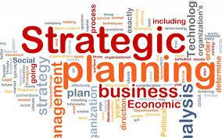
Strategic Planning
Responsibility to serve as a long-range strategic visionary in unison with the vision, mission, and goals of the community.
Responsibility to ensure Tribal Council buy-in as well as their engagement and implementation of strategic plans, where needed.
Responsibility to provide for strategic thinking on problem-solving and decision-making.
Responsibility to challenge all stakeholders to view strategic planning as a process that needs to be regularly evaluated, monitored, and updated.

Slide 17
1. Strategic Planning and Policy Making
- Establish Vision and Goals: Define the overall vision and goals for housing within the tribal community.
- Develop Policies: Create and enforce policies that govern housing development, including land use, zoning, and housing standards.
- Long-term Planning: Engage in long-term strategic planning to anticipate future housing needs and opportunities.
2. Resource Allocation and Funding
- Budgeting: Approve budgets for housing projects and ensure funds are appropriately allocated.
- Securing Funding: Identify and secure funding sources, including federal, state, and private grants and loans.
- Financial Oversight: Monitor financial performance and ensure fiscal responsibility.
3. Governance and Oversight
- Regulatory Compliance: Ensure that housing projects comply with all applicable tribal, federal, and state regulations.
- Project Approval: Review and approve housing development proposals and plans.
- Monitoring Progress: Oversee the progress of housing projects to ensure they are completed on time and within budget.
- Risk Management: Identify and mitigate risks associated with housing projects.
Remember… Tribal Council and or
Board of Commissioner responsibility

Slide 18
4. Community Engagement and Support
- Stakeholder Engagement: Engage with community members to gather input and support for housing projects.
- Communication: Maintain open lines of communication with the community to keep them informed about housing plans and developments.
- Advocacy: Advocate for the housing needs and interests of the tribal community.
5. Capacity Building and Support
- Support Development Teams: Provide support to the development team, including the Housing Authority, developers, and service providers.
- Capacity Building: Invest in capacity-building initiatives to enhance the skills and capabilities of those involved in housing development and management.
- Training and Education: Ensure that staff and community members receive training on housing-related issues and opportunities.
6. Legal and Ethical Responsibilities
- Land Management: Manage tribal lands effectively to support housing development.
- Ethical Conduct: Uphold ethical standards in all housing-related activities and decisions.
- Conflict Resolution: Address and resolve any conflicts or disputes that arise in the housing development process.
7. Post-Development Management
- Maintenance Oversight: Ensure that housing properties are well-maintained and managed sustainably.
- Resident Services: Support the provision of necessary services and programs for residents.
- Ongoing Evaluation: Continuously evaluate the effectiveness of housing programs and make improvements as needed.
Remember… Tribal Council and or
Board of Commissioner responsibility

Slide 19
Strategic Leadership and Planning
- Vision and Strategy: Develop and implement the strategic vision and long-term plans for housing development and management in alignment with the tribe's goals and policies.
- Policy Development: Contribute to the creation and revision of housing policies and ensure their implementation.
Operational Management
- Project Oversight: Oversee all stages of housing development projects, from planning and design to construction and occupancy.
- Daily Operations: Manage the daily operations of the housing authority, including staff supervision, resource allocation, and operational efficiency.
Financial Management
- Budgeting and Finance: Prepare and manage the organization's budget, ensuring financial stability and accountability.
- Funding and Grants: Identify and secure funding from various sources, including federal, state, and private grants. Ensure compliance with funding requirements and manage grant reporting.
- Financial Oversight: Monitor financial performance, manage expenditures, and ensure accurate financial reporting.
Regulatory Compliance
- Legal Compliance: Ensure that all housing projects comply with federal, state, tribal, and local laws and regulations.
- Reporting: Oversee the preparation and submission of required reports to funding agencies and regulatory bodies.
Remember… executive director responsibility

Slide 20
Community and Stakeholder Engagement
- Community Relations: Build and maintain strong relationships with the tribal community, residents, and other stakeholders. Facilitate community involvement and feedback in housing projects.
- Public Relations: Represent the housing authority in public forums, meetings, and with the media to communicate goals, progress, and achievements.
Staff and Capacity Management
- Human Resources: Recruit, train, and supervise staff. Foster a positive and productive work environment.
- Professional Development: Promote ongoing training and professional development opportunities for staff to enhance their skills and capabilities.
Risk Management
- Risk Assessment: Identify and mitigate risks associated with housing projects and operations.
- Crisis Management: Develop and implement plans for handling emergencies and unexpected challenges.
Maintenance and Property Management
- Property Management: Ensure that housing properties are well-maintained, safe, and comply with all regulations.
- Maintenance Oversight: Develop and oversee maintenance plans and schedules for all properties.
Remember… executive director responsibility

Slide 21
Program and Service Delivery
- Resident Services: Oversee the development and delivery of services and programs for residents, such as support services, educational programs, and community activities.
- Quality Assurance: Ensure that all services provided meet the needs of residents and maintain high standards of quality.
Performance Evaluation and Improvement
- Monitoring and Evaluation: Continuously monitor and evaluate the performance of housing programs and projects. Use data and feedback to improve processes and outcomes.
- Reporting and Accountability: Provide regular reports to the Tribal Council, Board of Commissioners, and other stakeholders on the progress and performance of housing initiatives.
Innovation and Development
- Best Practices: Stay informed about best practices and emerging trends in affordable housing development and management.
- Innovation: Promote and implement innovative solutions to address housing challenges and improve service delivery.
Remember… executive director responsibility

Slide 22
Developing Your Grant Writing Team

Slide 23
Team Size and Selection
It is important to establish your team as early as possible in the grant conception phase. The number of people on the team will depend on the following variables:
- Nature, size and complexity of the project
- Amount of experience and level of expertise within the tribe
- Availability of time to commit to the project

Slide 24
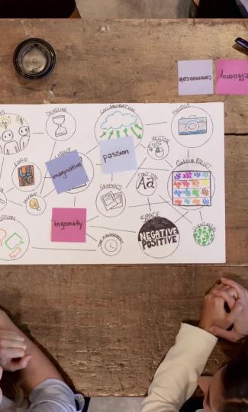
Team Size and Selection
Team members should be selected to represent the following areas of expertise:
1. Project Planning
2. Project Management
3. Financial Management
4. Staffing Coordination
5. Governing Body Communication
6. Grant Writing
7. Project Outcome Design

Slide 25
Project Team Role & Responsibilities
Project Role | Who | Responsibilities
Project Planning | Planning Director | Assists in planning project Ensures project addresses community needs and goals
Project Management | Project Manager | Manages all aspects of the funded project
Financial Management | Finance Director | Develops project budget Manages receipt and distribution of funds Supervises procurement activities Submits financial reporting

Slide 26
Project Team Role & Responsibilities
Project Role | Who | Responsibilities
Staffing Coordination | Human Resources Director | Creates job descriptions for project positions Ensures timely hiring of staff
Governing Body Communication | Executive Director or Departmental Director | Provides regular updates on project status to Tribal Council and or Boards
Grant Writing | Grant Writer/Grant Reviewer | Creates or reviews all documents required for grant submission
Project Outcomes Design | Planner or Departmental Director | Ensures grant application has realistic outcomes Designs and implements evaluation activities to determine success of project outcomes

Slide 27
Strategic Planning Process
Step 1:
Situational
SWOT or PESTLE Analysis with Key Stakeholders

Slide 28
SWOT Analysis
Strengths
Weaknesses
Opportunities
Threats

Slide 29
Conducting a SWOT Analysis
What are the Strengths of your organization?
Think internal or inside the organization.
What are the Weaknesses of your organization?
Also think internal or inside the organization.
What Opportunities exist in your environment?
Think external or outside the organization.
What Threats exist in your environment?
Also think external or outside the organization.

Slide 30
Conducting a SWOT Analysis
Strengths | Weaknesses | Opportunities | Threats
Strong alignment with tribal values and community support. | Dependence on uncertain external funding. | Access to government programs and grants. | Unstable and competitive funding sources.
Ability to design culturally reflective housing. | Limited internal funds. | Potential for job creation and economic development. | Potential cuts to housing programs.
High level of community involvement. | Lack of in-house expertise. | Partnerships with HUD and other agencies. | Economic downturns and inflation.
Access to tribal land. | Complex regulations and approval processes. | Sustainable and green building practices. | Regulatory changes affecting project viability.
Eligibility for specific grants. | Inadequate existing infrastructure. | Collaborative opportunities with other organizations. | Community opposition

Slide 31
PESTLE ANALYSIS
A PESTLE analysis is a framework used to understand the macro-environmental factors that might impact an organization, community, or project. It stands for Political, Economic, Social, Technological, Legal, and Environmental factors. PESTLE analysis provides a broad overview of the external factors that a tribal community might need to consider in strategic planning and day-to-day operations.

Slide 32
Political
Government Policies: Influence of federal, state, and tribal housing policies on project approvals and funding.
Regulatory Environment: Compliance with regulations and laws specific to tribal lands and housing.
Political Stability: Impact of political stability within the tribe and surrounding jurisdictions on project continuity.
Funding Programs: Availability and changes in government funding programs like HUD grants and LIHTC (Low-Income Housing Tax Credit).

Slide 33
Economic
Economic Conditions: Impact of local and national economic conditions on funding availability and project costs.
Employment Rates: Influence of local employment rates on housing demand and economic development.
Funding Sources: Availability and competitiveness of grants, loans, and other funding sources.
Construction Costs: Fluctuations in material and labor costs impacting project budgets.

Slide 34
Social
Community Needs: Understanding and addressing the housing needs of the tribal community.
Cultural Considerations: Incorporation of tribal traditions and values in housing design and development.
Population Demographics: Demographic trends and their impact on housing demand (e.g., age, family size).
Community Support: Level of support and involvement from tribal members in housing projects.

Slide 35
Technological
Construction Technology: Adoption of modern construction technologies to improve efficiency and sustainability.
Infrastructure Development: Development of necessary infrastructure (e.g., roads, utilities) using advanced technologies.
Building Standards: Compliance with current building standards and integration of smart home technologies.
Information Systems: Use of information systems for project management, financial tracking, and resident services.

Slide 36
Legal
Land Use Regulations: Navigating tribal, federal, and state land use regulations.
Housing Standards: Compliance with housing quality standards and building codes.
Contract Law: Managing contracts with developers, contractors, and service providers.
Tenant Rights: Ensuring protection of tenant rights and fair housing practices.

Slide 37
Environmental
Sustainability: Incorporation of sustainable building practices and materials.
Environmental Impact: Assessment and mitigation of environmental impact during construction and operation.
Climate Change: Addressing climate resilience in housing design and location.
Resource Management: Efficient use of natural resources such as water and energy in housing projects.

Slide 38
Strategic Planning Process
Step 2:
Goal Development with Logic Model and SMART System

Slide 39
Goal Development

Slide 40
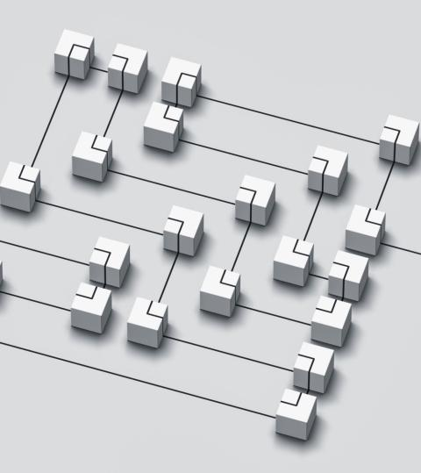
Goal Development
The definition of a Logic Model is a pictorial or graphic diagram based on your organization’s mission that shows the relationship between Initiatives (also called Focus Areas or Major Objectives) and Goals (also called Inputs or Steps) with short-term Outcomes and long-term Results/Outputs.
It is a visual way to present and share your understanding of the relationships among the initiatives you have chosen for your organization, the goals you plan to implement, and the outcomes and results you hope to achieve.
Also, it is a mechanism to help the organization measure its success and challenges.

Slide 41
Goal Development – Logic Model
Define
Define major Initiative(s)
Develop
Develop measurable Goal(s)
Calculate
Calculate short-term Outcome(s) as a number (#)
Project
Project long-term Result(s) as a percentage (%)
Logic Model
Initiative | Goal | Outcome (ST) | Result (LT)
Secure Funding | - Apply for grants and loans ; - Allocate tribal funds | $2 million - Funding secured | Sustainable financial management – 80% of projects within budget
Prepare 10 Acres | - Conduct land surveys ; - Clear and grade land | Land ready for construction - (10 acres prepared) | Efficient use of tribal land - (90% of land utilized effectively)
Assemble Project Team | - Hire architects, contractors, and project managers | Skilled team in place - (15 team members hired) | High-quality construction and management - (95% project quality)
Build Homes and Infrastructure | - Prepare land (grading, utilities installation) ; - Construct homes and infrastructure | Construction progress on track - (50% completed in 12 months) | Completed homes and infrastructure - (100% homes completed)
SMART: Specific, Measurable, Attainable, Realistic, and Tangible

Slide 42
Goal Development
Goal Statement: Develop 10 single-family homes with infrastructure to improve housing for tribal members.
Specific:
Develop 10 homes and infrastructure on 10 acres.
Secure funding and approvals within 6 months.
Measurable:
Complete construction within 24 months.
Hold at least 5 community meetings.
Achievable:
Use tribal land and secure grants/loans.
Engage experienced professionals.
Relevant:
Address housing shortage and align with strategic goals.
Time-Bound:
Secure funding/permits in 6 months.
Begin construction in 9 months, complete in 24 months.
Occupy homes within 3 months of completion.

Slide 43
Strategic Planning Process
Step 3:
Put together a Strategic Planning document for Approval

Slide 44
Strategic Plan - Action Plan by Quarters/Years
Year | Quarter | Initiative (Focus Area/Major Objective) | Goals (Inputs/Steps) | SMART Goal | Outcome | Long-Term Result/Output
Year 1 | Q1 | Secure Funding | - Apply for grants and loans; > - Allocate tribal funds | Secure $2 million in funding within 6 months | Funding secured ($2 million) | Sustainable financial management (80% of projects within budget)
 |  | Assemble Project Team | - Hire architects, contractors, and project managers | Assemble a team of 15 professionals within 3 months | Skilled team in place (15 team members hired) | High-quality construction and management (95% project quality)
 | Q2-Q4 | Prepare 10 Acres | - Conduct land surveys; - Clear and grade land | Prepare 10 acres of land within 3 months | Land ready for construction (10 acres prepared) | Efficient use of tribal land (90% of land utilized effectively)
Year 2 | Q1-Q2 | Build Homes and Infrastructure | - Prepare land (grading, utilities installation); - Begin construction of homes and infrastructure | Complete 50% of construction within 12 months | Construction progress on track (50% completed) | Completed homes and infrastructure (100% homes completed)
 | Q3-Q4 | Track Project Progress | - Regular updates and meetings; - Address issues promptly | Resolve 90% of issues on time | Timely issue resolution (90% issues resolved on time) | Successful project completion (100% project completion rate)
Year 3 | Q1 | Build Homes and Infrastructure | - Continue and complete construction of homes and infrastructure | Complete 100% of construction by end of Q1 | Completed homes and infrastructure (100% homes completed) | Completed homes and infrastructure (100% homes completed)
 | Q2 | Develop Necessary Infrastructure | - Install roads, water, sewage, and electricity | Install infrastructure on 10 acres by end of Q2 | Infrastructure in place (10 acres with infrastructure) | Functional and durable infrastructure (95% infrastructure uptime)
 |  | Hold Community Meetings | - Conduct final community meetings to gather feedback and ensure satisfaction | Conduct 3 community meetings by end of Q2 | Community feedback integrated (3 meetings conducted) | Strong community relations (85% positive feedback)
 | Q3 | Improve Living Conditions | - Prepare homes for occupancy; - Ensure all homes meet quality standards | House 10 families within 3 months | Enhanced quality of life (10 families housed) | Sustainable community development (90% satisfaction rate)
 |  | Increase Community Engagement | - Involve community in final inspections and move-in process | Achieve 70% increase in community engagement by end of Q3 | Increased satisfaction (70% increase in engagement) | Stronger community bonds (80% community participation)
 | Q4 | Promote Sustainable Practices | - Implement sustainable materials and methods in homes | Implement 10 sustainable practices by end of Q4 | Environmentally friendly development (10 green practices implemented) | Long-term sustainability (85% reduction in environmental impact)

Slide 45
Strategic Planning Process
Step 4:
Implementation
Operational Plan

Slide 46
Project Planning

Slide 47
Statement of Work
The Statement of Work (SOW) is a formal project management document that establishes expectations and agreements about the project. It is not a contract; it is a tool for clarifying responsibilities and working relationships among project stakeholders.
The usual minimum of a SOW includes the following elements:
Defined Purpose
Statement of Scope
Project Deliverables
Goals and Objectives
Cost and Schedule Estimates
Authority Levels

Slide 48
Critical Elements for Success
Some items you will want to gather before starting the scheduling process include:
Schedules of people who will be working on the project, including outsourced vendors.
Vacation time for staff on the project.
Other projects that team members are involved in that may conflict with this project.
Schedules for materials and resources that will be required.

Slide 49
Critical Elements for Success continued
Gathering Resources
Estimating is not exact; it is a guess. If you or someone on your project team has completed a similar task before, then you should have a better idea of how long it will take to complete the task.
Activity List
Once you know all of the activities involved with a task, you are able to estimate how long it will take to complete the activities, and thus roll up the estimation to the event level.

Slide 50
Critical Elements for Success continued
Estimating Task Times
This formula is considered the standard for estimating time (Te):
Tm = probable time | To = optimistic time
Tp =pessimistic time | Te =calculated time

Slide 51
Tips for Increasing Estimation Accuracy
Document all of the assumptions and factors that went into creating the estimate.
Involve as many people as you can in estimating activity durations.
Create an activity list from the strategic work plan and follow it.
Be aware that people often underestimate activity durations.
Track actual completion times for all projects and tasks.
Be aware of the time of year during which your project will be carried out.

Slide 52
Developing a Funding Strategy
Developing your project idea
Assessing your capability to seek funding
Researching potential funding sources and developing a relationship with them
Developing credibility

Slide 53
What Is a Funding Strategy and Why Is One Needed?
An effective funding strategy:
Helps identify needs and resources
Builds upon overall mission and goals
Addresses the gaps in resources

Slide 54
Leveraging Resources
Consider the skills and resources that strategic partners can provide:
Financial Resources – Cash or financial accounting services
Human Capital Resources – Expertise in performing project activities to complete the project
Federal, state, tribal, or other local organizations can be great project partners.

Slide 55
Conclusion
Affordable housing development is challenging but achievable with the right team and partnerships
Organizations must be committed and strategic
Long-lasting impact on community and property

Slide 56
Q & A

Slide 57
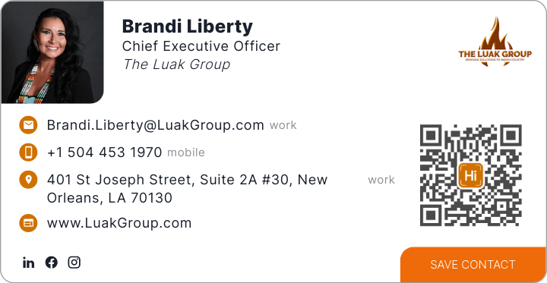
Contact Info

