Slide 1
Accessing Federal Home Loan Bank Affordable Housing Program Funds
NAIHC Annual Convention and Tradeshow
Hollywood, Florida
June 26, 2024
Notes:
Catherine

Slide 2
Agenda
Introductions
FHLBank System – What is it?
Affordable Housing Programs (AHP) of the FHLBanks
General Fund
Homeownership Set-aside down payment program
Programs for Native Tribal Communities
Your Feedback, Next Steps, Q&A
Key Contacts
Notes:
Catherine

Slide 3
Today’s Presenters
FHLBank Atlanta
Catherine Sterba, Strategic Initiatives Manager, Community Investment Services
FHLBank Boston
Theo Noell, Affordable Housing Program and Outreach Manager
FHLBank Indianapolis
Rori Chaney, Community Investment Department Manager
FHLBank New York
Neela Hanuman, Community Investment Specialist
FHLBank San Francisco
Alyssa Thunberg, Managing Director, Affordable Housing Program
Freddie Mac
Kimberley Carr, Duty to Serve Affordable Lending Manager, Rural Market Lead
Notes:
Catherine

Slide 4
FHLBanks’ Role in Financial Services
The System is composed of 11 regional banks, each privately financed and owned by their members as cooperatives.
Members are banks, credit unions, CDFIs and or Insurance Companies with headquarters in the district of the respective FHLB.
The FHLBanks' mission is to provide reliable funding to member institutions to increase and expand the availability of funds for residential mortgage and community development lending nationwide and to support affordable housing and community development.
Loans to support members’ community lending efforts
Grants and subsidies for production and preservation of affordable housing
Down payment and closing cost assistance programs for home buyers
Our regional distribution enables each FHLBank to focus on the distinct needs of their members and communities.
Notes:
Catherine

Slide 5
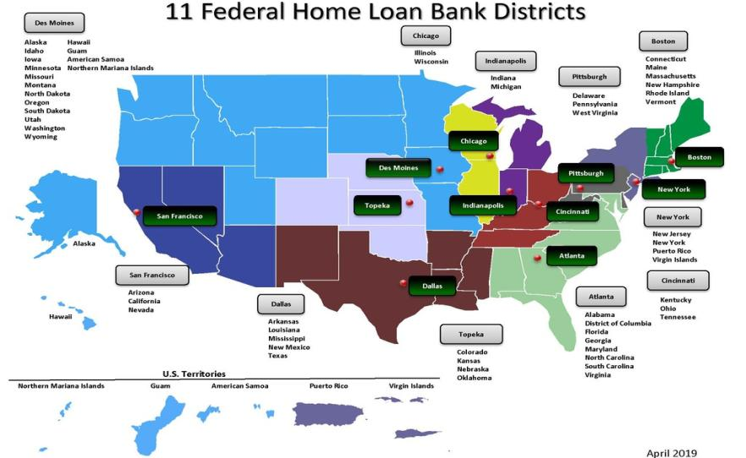
FHLBank System
Notes:
Catherine

Slide 6
FHLBank Members
1.1% CDFIs
25% Credit Unions
8.9% Insurance Companies
8.5% Savings Banks
Credit Unions
Insurance Companies
Savings Banks
Commercial Banks
Community Development
Financial Institutions
56.5% Commercial Banks
Notes:
Catherine

Slide 7
A Unique Offering to Tribes and the Community
FHLBanks offer AHP subsidies in two distinct funding mechanisms:
AHP General Fund
AHP Homeownership Set-aside Program
AHP
General
Fund
FHLBank
Products
10%
Community
Dividend
Earnings
AHP
Homeownership
Set-aside
Minimum of 10 percent of net earnings
Funds support homeownership, residential development and/or rehabilitation
From 1990, when AHP was authorized, through 2023, the FHLBanks have awarded approximately $8 Billion in funding, supporting approximately 1.1 million housing units
FEDERAL HOME LOAN BANK OF ATLANTA
Notes:
Catherine

Slide 8
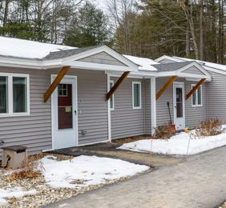
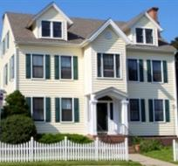
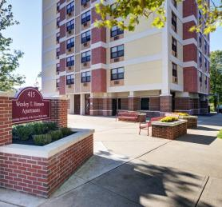
FHLBank System - Reliable Funding, Strategic Partners
Loans to members of FHLBanks, supporting their community lending
Grants and subsidies for affordable housing production and preservation
Down payment and closing cost assistance programs for first time and low to moderate income home buyers
Targeted and discounted financing and grant programs for economic development and a wide range of community initiatives
AH
General
Fund
AHP
Homeownership
Set-aside
FEDERAL HOME LOAN BANK OF ATLANTA
Notes:
Catherine

Slide 9
Affordable Housing Programs of the FHLBanks
Notes:
Alyssa

Slide 10
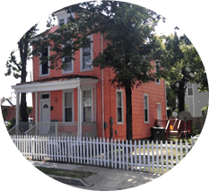
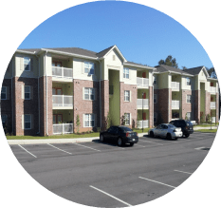
Products Overview
Rental and Ownership Development
Home Purchase
General Fund
Homeownership Set-aside
Use for rental or ownership development projects
Competitive application
Each FHLBank has its own scoring criteria
Down payment, closing costs, and principal reduction funding for home purchase or home rehabilitation
Generally first come, first served
Developer/Builder Driven
New construction
Rehabilitation
Multifamily
Single-family
Acquisition
Construction and/or permanent financing
Mortgage Professional Driven
Owner-occupied purchase:
First-time Homebuyer
Community Partners
Community Rebuild and Restore
Notes:
Alyssa

Slide 11
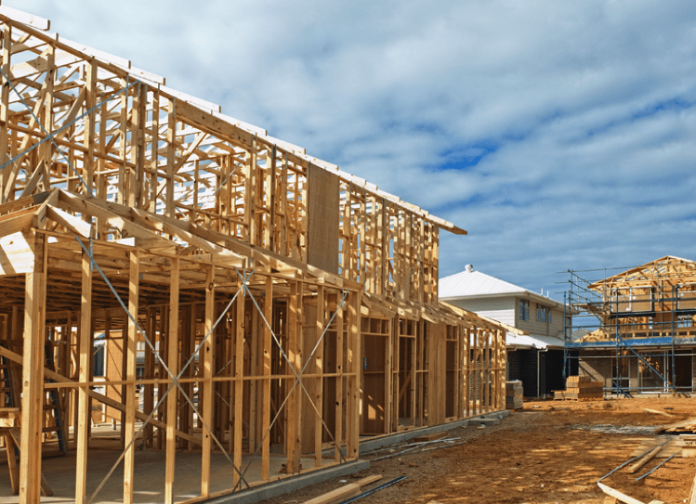
AHP General Fund Overview
A record $1 billion in available funds across the system in 2024
Notes:
Alyssa

Slide 12
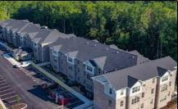
AHP General Fund Overview
Grant funds awarded in competitive application cycles each year
Flexible source of gap funding designed to help develop affordable owner-occupied and rental housing for very low-income to moderate-income families and individuals
May be used to fill funding gaps created by cost overruns
Layers well with other funding programs:
NAHASDA, USDA, ICBDG, HUD, LIHTC
Notes:
Alyssa

Slide 13
AHP General Fund Overview
What Makes AHP Different from Other Sources of Funds?
Equity-like funding
No interest accrues
No expectation of repayment if the project continues to provide housing as committed in the application
Secured with a note and security instrument to ensure compliance through the affordability period
15 years for rental projects
5 years for ownership projects that include a transfer of ownership
Mortgage is not required for owner-occupied units which are being rehabbed
Notes:
Alyssa

Slide 14
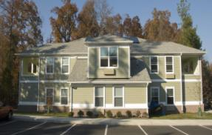
AHP General Fund Overview
Eligible Project Types:
Rental | Ownership
New Construction | Rehabilitation
Supportive Housing | Mixed Used
Owner-occupied Rehabilitation | Down payment assistance
Notes:
Alyssa

Slide 15
AHP General Fund: Getting Started
‘Sponsors’ are housing developers, public entities, contractors, community builders, and other organizations engaged in development and rehabilitation of affordable rental or owner-occupied housing
Sponsors drive the application process and submit applications
Members review and approve applications
100-point scoring system (varies by FHLBank)
Tribes score well in areas such as:
Native Housing
Rural
Large Units (3+ bedrooms)
All applications include a ‘Member’
Financial institutions that are part of FHLBank
FHLBank can assist you in finding a member
Notes:
Alyssa

Slide 16
AHP General Fund – LIHTC Project Example Example: 9% LIHTC Deal
Example: 52-unit, Senior Rental Project
 | Total Sources | AHP | Member First Mortgage | Other Sources*
Acquisition | $180,000 | $157,800 |  | $22,200
Construction | $5,131,407 | $310,200 | $180,000 | $4,641,207
Soft Costs | $706,376 |  |  | $706,376
Other Costs | $1,010,059 |  |  | $1,010,059
Total Development Budget | $7,027,842 | $468,000 | $180,000 | $6,379,842
Borrowing the Amount of AHP from the Member
Total Member First Mortgage | $648,000
AHP | $0
Member Loan-to-Value (LTV)/cost | 9.2%
Debt Coverage Ratio | 0.56
Using AHP Funds
Total Member First Mortgage | $180,000
AHP | $468,000
Member Loan-to-Value (LTV)/cost | 2.6%
Debt Coverage Ratio | 2.14
Making Lending Possible and Projects Feasible
*Other sources include subordinate and soft debt and equity
Notes:
[This is an animated slide with a total of 6 clicks]
This is an example of a 52-unit, senior rental project with 9 percent low-income housing tax credits.
The total development budget of $7 million was funded in part by AHP General Fund and the member bank’s 1st mortgage.
[clicks 2 and 3] Based on the project’s income/expense statement or pro forma, the member LTV would have been 9.2% and the DCR would have been 0.56 if hard debt was used instead of the AHP equity infusion. This is clearly not a feasible project.
[clicks 4 and 5] Because of the AHP, the member LTV went down to 2.6% and the DCR went up to 2.14 which is very possible to get a funder interested in. Note that for projects with DCR above the Bank’s AHP guideline of 1.50, an alternate need for subsidy test may be used.
[click 6]
Internal notes:
10A04028 Savannah Gardens, Boaz, AL

Slide 17
AHP General Fund – Non-LIHTC Rental Example
Example: 8-unit, Senior Rental Project, Housing Authority Sponsor
 | Total Sources | AHP | Member First Mortgage | Other Sources*
Acquisition | $25,000 |  | $25,000 | $0
Construction | $1,028,578 | $83,000 | $209,328 | $819,250
Soft Costs | $52,030 | $17,000 | $7,950 | $44,080
Other Costs | $70,000 |  | 62,360 | $7,640
Total Development Budget | $1,175,608 | $100,000 | $304,638 | $870,970
Borrowing the Amount of AHP from the Member
Total Member First Mortgage | $404,638
AHP | $0
Member Loan-to-Value (LTV)/cost | 34.4%
Debt Coverage Ratio | 1.14
Using AHP Funds
Total Member First Mortgage | $304,638
AHP | $100,000
Member Loan-to-Value (LTV)/cost | 25.9%
Debt Coverage Ratio | 1.51
Improves Project Feasibility
*Other sources include subordinate and soft debt and equity
Notes:
[This is an animated slide with a total of 6 clicks]
This is another sample rental project, this time with 8-units.
The total development budget of $1,175,608 was funded in part by AHP General equity and the shareholder’s 1st mortgage.
[clicks 2 and 3] Based on the project’s income/expense statement or pro forma, the member LTV would have been 34.4% and the DCR would have been 1.14 if hard debt was used instead of the AHP equity infusion.
[clicks 4 and 5] Because of our AHP equity, the member LTV decreased to 25.9% and the DCR improved to 1.51, thus making the project more feasible.
[Click 6]
Internal notes:
15A04028 Carver Grove
First-Citizens Bank & Trust Company
Myrtle Beach Housing Authority
Myrtle Beach, SC

Slide 18
AHP General Fund – Homeownership Example
Example: 8-unit, Homeownership Project, 100% Very Low-Income
 | Total Sources | AHP | Member First Mortgage | Other Sources*
Acquisition | $50,214 |  | $50,214 | $0
Construction | $2,131,295 | $748,400 | $852,568 | $530,327
Soft Costs | $164,692 |  |  | $164,692
Other Costs | $84,444 | $1,600 |  | $82,844
Total Development Budget | $2,430,645 | $750,000 | $902,782 | $777,863
First Mortgage without AHP
Purchase Price | $303,831
AHP | $0
First Mortgage** | $206,598
First Mortgage LTV (mortgage / purchase price) | 68%
Monthly Homebuyer P&I Payment | $1,291
Using AHP Funds
Purchase Price | $303,831
AHP | $750,000
First Mortgage** | $112,848
First Mortgage LTV (mortgage / purchase price) | 37%
Monthly Homebuyer P&I Payment | $705
Improves Homebuyer Affordability
-45%
*Other sources include subordinate and soft debt and equity
**First Mortgage based on 7.5% interest rate / 30-year amortization
Notes:
[This is an animated slide with a total of 6 clicks]
This is an ownership project with 8 units
The total development budget of $2,430,645 was funded in part by AHP General Fund equity
[clicks 2 and 3] Without the AHP funds the first mortgage for this homebuyer, the LTV would be 68% and the mortgage amount would be $206,598, Based on market terms the mortgage payment would be $1,291 per month,
[clicks 4 and 5] When adding in the AHP the LTV would go down to 37%, and the mortgage would be only $705, 45% reduction in the homebuyer’s mortgage payments.
[Click 6]
Internal Notes:
22A04012 Wells Street Neighborhood Project
Bay Vanguard Bank
Habitat for Humanity Choptank
Cambridge, MD

Slide 19
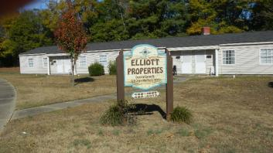
AHP General Fund – Success Story – FHLBank Atlanta
Project | Elliott Properties
Project Type | Rental
Sponsor | North Carolina Indian Housing Authority
Member | Lumbee Guaranty Bank
Location | Gastonia, North Carolina
Grant Amount | $53,000
Description | Rehabilitation of 8 multifamily affordable housing units with a total development cost of $866,214 Seven of the units targeted for very-low income tenants
Notes:
Alyssa

Slide 20
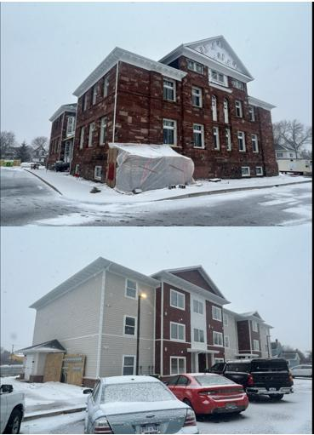
AHP General Fund – Success Story – Indianapolis
Project | Garfield Landing
Sponsor | Community Housing Network
Member | Central Savings Bank
Location | Sault Ste. Marie, Michigan
Grant Amount | $100,000
Description | The adaptive reuse of Garfield School, creating 36 units of affordable housing with 9 units dedicated to those below 50% AMI. $12.9 million development budget. Capital Stack includes: LIHTC Historic/Brownfield credits
Notes:
Pause for questions after GF before transition

Slide 21
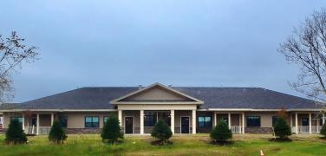
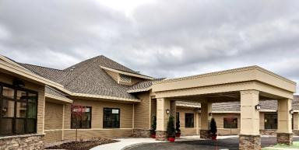
AHP General Fund – Success Story – FHLBank New York
Project | Sunrise Acres III Supportive Housing Project
Sponsor | Akwesasne Housing Authority
Member | Glen Fall NB & Trust Company
Location | Hogansburg, NY
Grant Amount | $464,089
Description | Construction of an 18-unit supportive housing project that will serve homeless veterans and senior citizens with special needs.
Notes:
Alyssa

Slide 22
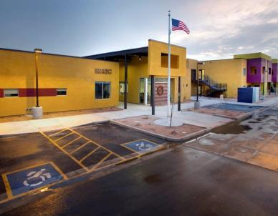
AHP General Fund – Success Story – San Francisco
Project | Landmark Senior Living
Project Type | Rental
Sponsor | Native American Connections
Member | Raza Development Fund, Inc.
Location | Glendale, AZ
Grant Amount | $574,373
Description | Urban infill development will create affordable one-bedroom apartments for seniors. All units adaptable for accessibility. Project features multipurpose room, computer room, library, and private office space for supportive services staff. Situated along public transit routes that offer access to additional supportive services, community resources, and other important amenities. LEED certified with community garden and dog park.
Photos courtesy of Native American Connections: www.nativeconnections.org
Notes:
Pause for questions after GF before transition

Slide 23
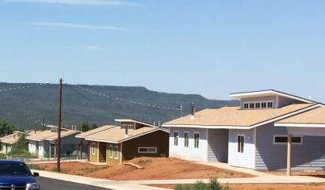
AHP General Fund – Success Story – San Francisco
Project | White Mountain Apache Housing Authority Homes VI
Project Type | Rental
Sponsor | White Mountain Apache Housing Authority (WMAHA)
Member | National Bank of Arizona
Location | Whiteriver, AZ
Grant Amount | $460,000
Description | Located on the Fort Apache reservation, this award helped fund the second phase of a larger development and built 23 new construction and 23 rehabilitated single-family homes. All units are highly energy-efficient, with separate landscaped yards that provide space for play areas and gardens for families. Project serves ten households of families that had been living in overcrowded conditions, six senior households, and four households with special needs.
Photos courtesy of Travois: www.travois.com
Notes:
Pause for questions after GF before transition

Slide 24
AHP Homeownership Program Overview
Notes:
Rori

Slide 25
AHP Homeownership Program Overview
FHLBank's Affordable Housing Program (AHP) Homeownership Program provides funds for down payment assistance for the purchase or rehabilitation of a home.
Eligible Homebuyer(s)/ Homeowner(s) include low- and moderate- income households
Funds Can Be Used to reduce principal and assist in down payments, closing costs, and/or rehabilitation costs
Available on a first-come, first-served basis
Notes:
Rori

Slide 26
2024 FHLBank Programs Ideal for Native Tribal Communities
Notes:
Neela

Slide 27
FHLBank Atlanta - Workforce Housing Plus+
FHLBank Atlanta announced an additional $10 million available through our new Workforce Housing Plus+ Program, supporting affordable housing for households with incomes between 80% - 120% AMI, as is the case for many tribal members.
Workforce Housing Plus+
Household income must be 80.01 percent of area median income and shall not exceed 120 percent of (AMI)
Properties must be located within the Bank’s district (AL, DC, FL, GA, MD, NC, SC, VA)
All funding must be extended exclusively via FHLBank Atlanta member financial institutions with access up to $500,000 funding limit
Applications submitted via FHLBAsap® online portal
Notes:
Neela

Slide 28
FHLBank Atlanta – General Fund
In April, FHLBank Atlanta announced a record $55 million in available funds through our 2024 Affordable Housing Program General Fund!
Applicants may apply for up to $1 million per project maximum direct subsidy.
Scoring in 2024 includes points for Native American Tribal Areas as part of the Underserved Communities and Population Category:
Housing for Homeless Households (3 points)
Native American Tribal areas* (3 points)
Senior Housing (3 points)
*Native American Tribal areas:
Some or all the project must be located in an area owned or otherwise controlled by a Native American Tribe. Must be federally or state recognized and located in the Bank’s district.
Notes:
Neela

Slide 29
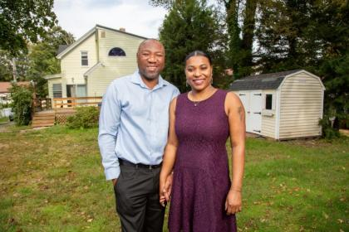
FHLBank Boston: Lift Up Homeownership
Downpayment and closing cost assistance
For Native Americans and People of Color
Created to help reduce intergenerational wealth and homeownership gaps
50% - 120% of Area Median Income
Up to $50,000 grant
First- time homebuyers
Notes:
Neela

Slide 30
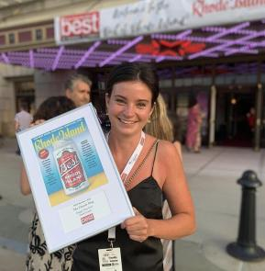
FHLBank Boston: Jobs For New England
Below-market rate small business loans supported by FHLBank 0% funding
Supports job creation/retention and community investment
Streamlined application
Notes:
Neela

Slide 31
FHLBank Dallas – Native American Housing Opportunities Fund
Purpose:
The Native American Housing Opportunities (NAHO) Fund Pilot Program is designed to provide grants to Native American tribal nations, Pueblos, Native American Housing Entities and to support housing of tribal members.
Uses:
Provide grants of up to $150,000 to the organizations listed above to help meet the housing needs of tribal populations.
Advantages:
Grants will serve the needs of tribal organizations to meet the housing needs of their underserved population.
This will be a dedicated source of funds for tribal housing needs offered by the Bank.
Provide members with an additional avenue to support the needs of tribal populations.
Notes:
Neela

Slide 32
FHLBank Dallas – Native American Housing Opportunities Fund
Size:
2024 Total Program Allocation: $1,000,000
Individual Grant Size - $50,000 to $150,000
Eligibility:
Applications can be submitted by Federally Recognized Tribes or a Tribally Designated Housing Entity (TDHE).
The grant awardees must provide housing services to Tribal members residing in Arkansas, Louisiana, Mississippi, New Mexico or Texas.
Application must be submitted in partnership with an FHLB Dallas member institution.
Availability:
Application Period: 6/3/2024 - 7/12/2024
Applications will be reviewed on a first-come, first-served basis.
Award Announcement will occur on or about 08/30/2024
Notes:
Neela

Slide 33
FHLBank Dallas – Native American Housing Opportunities Fund
Uses for these funds include housing-related activities such as:
Down payment/closing cost assistance for home purchases by tribal members
Repairs to owner-occupied homes for tribal members
Rental assistance for tenants
New construction or rehabilitation of existing housing for tribal members
New program or product development
Enhancements to information technology and systems used for housing programs
Consultant cost (non-employees, separately invoiced)
Predevelopment costs
Ineligible uses include:
Any non-housing related expenses or programs
Litigation costs/expenses
Lobbying
Notes:
Neela

Slide 34
FHLBank Des Moines – Home$tart
2024 Home$tart funded at $11,000,000 – funded quarterly*
Grant amount: per household $15,000.
Hawaii households grant amount: $25,000.
First time Homebuyers – Households who haven’t owned a home in the last three years – some exceptions apply.
Income: Not to exceed 80% of AMI HUD County/State or NAHASDA for native buyers (whichever is highest)
May be used on or off Native lands
Purchase Ready – signed purchase agreement which does not exceed purchase price limits
Homeownership Ready – One household member on the loan to complete an approved homebuyer education course
Funds must be used in the acquisition of a primary residence for down payment and closing cost funding.
Home$tart funds are secured with a recorded Deed Restriction/Lease Addendum with a term of five years, fully forgivable after the term has been met.
Manufactured homes on permanent foundations and Community Land Trusts are eligible
Notes:
Neela

Slide 35
FHLBank Des Moines – Native American Homeownership Initiative (NAHI)
2024 NAHI funded at $1,000,000 – funded quarterly*
Maximum grant amount per household $25,000.
Native American, Native Alaskan, Native Hawaiian – at least one adult member on the title must be:
Enrolled member of a U.S. federally recognized tribe
Member or shareholder of an Alaska Village or Regional Corporation
Native Hawaiian acquiring property on Hawaiian Home Lands
Income: Not to exceed 80% of AMI HUD County/State or NAHASDA for native buyers (whichever is highest)
May be used on or off Native lands
Purchase Ready – signed purchase agreement which does not exceed purchase price limits
Homeownership Ready – One household member on the loan to complete an approved homebuyer education course
Funds must be used in the acquisition of a primary residence for down payment and closing cost funding.
NAHI funds are secured with a recorded Deed Restriction/Lease Addendum with a term of five years, fully forgivable after the term has been met.
Manufactured homes on permanent foundations and Community Land Trusts are eligible
Notes:
Neela

Slide 36
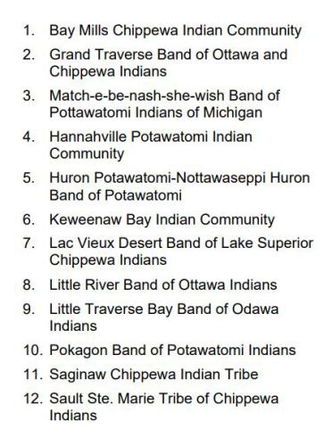
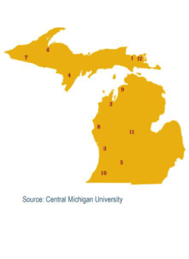
FHLBank Indianapolis – Tribal Nations Housing Development Assistance Program
Funding up to $3MM in grants in addition to MSHDA’s $1MM to provide flexible funding to:
Help remove barriers to program participation
Cover critical predevelopment expenses
Respond to additional capacity building needs and opportunities, and
Help bridge project financing gaps.
Notes:
Neela

Slide 37
FHLBank Indianapolis – Tribal Nations Housing Development Assistance Program
The Michigan State Housing Development Authority (MSHDA), in partnership with FHLBank Indianapolis, launched the Tribal Nations Housing Development Assistance Program in January 2024 to support tribal capacity building initiatives focused on housing.
The National American Indian Housing Council (NAIHC) has designed a tribal housing toolkit as well as offer a training series and technical assistance to all 12 tribes.
Notes:
Neela

Slide 38
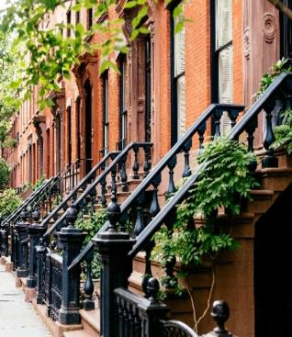
FHLBank New York HDP Plus
HDP Plus Round opened on March 18, 2024, offering $10.3M in grant funds
Provides down payment and closing cost assistance to first-time homebuyers
Grant up to $19,500 per household with an additional $500 towards defrayment of nonprofit counseling agency costs for a maximum amount of $20,000
Total household income requirements:
NY and NJ - must be above 80% and less than or equal to 120% of the Area Median Income for the county in which the household is purchasing
PR and USVI - must be above 80% and less than or equal to 150% of the Area Median Income for the county/ municipality in which the household is purchasing
Program administered through participating members as an annual Round
Notes:
Neela

Slide 39
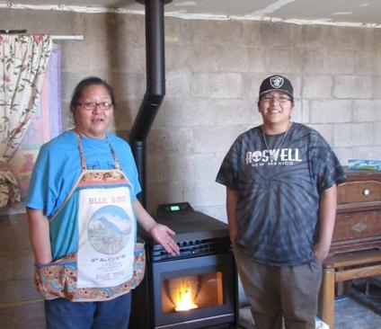
FHLBank San Francisco – Tribal Nations Program
Pilot program launched in 2023 with $1 million allocation
Developed in consultation with tribal housing authorities, CA tribal technical assistance providers, and nonprofit housing coalitions in Arizona, California, and Nevada
Provides funding for training and technical assistance to tribes to apply for AHP and federal and state affordable housing funding
Funding committed to the California Coalition for Rural Housing in partnership with the Arizona Housing Coalition and Nevada Housing Coalition
$500,000 spent to date, remainder by end of 2024
FHLBSF AHEAD Program Grant – Supporting Coal-Impacted Communities Navajo Nation & Hopi Tribe – Flagstaff, AZ Photo courtesy of Red Feather Development Group
Notes:
Neela

Slide 40
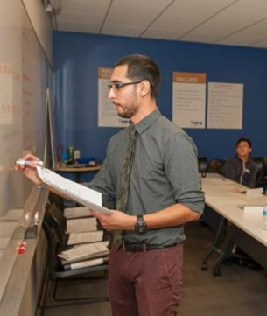
FHLBank San Francisco – Access to Housing and Economic Assistance for Development (AHEAD)
Funding for economic development and social service projects
Projects must serve communities at or below 115% of HUD Area Median Income
One competitive application round annually
$100,000 maximum grant amount per project
Members support applications from sponsors - includes Native American tribes and nonprofits
Since 2004, FHLBSF awarded over $1.1 million to 32 projects in Native American communities
Project must be located in AZ, CA or NV
Light-to-moderate documentation requirements for applications, disbursements, and compliance
Grant funds must be used within 18-months of award date
Notes:
Neela

Slide 41
FHLBank San Francisco – Success Story – Native American Connections
Member: Western Alliance Bank
Sponsor: Native American Connections (NAC)
Award: $20,000
Location: Phoenix, AZ
NAC works to improve the lives of individuals and families through Native American culturally appropriate behavioral health, affordable housing, and community development services. AHEAD supported the Phoenix Indian School Visitor Center and commercial kitchen incubator program, a partnership between NAC and the City of Phoenix to transform a former American Indian boarding school into a multifaceted community resource. A licensed commercial kitchen inside the Visitor Center is used by local chefs and food vendors, many promoting Indigenous foods and education. The AHEAD grant helped staff create the kitchen programming and complete the build-out.
Notes:
Neela

Slide 42
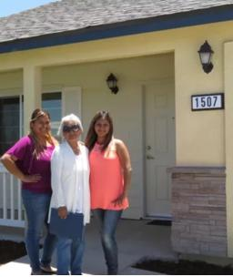
FHLBank San Francisco – Success Story – California Coalition for Rural Housing
Member: MUFG Union Bank, N.A.
Sponsor: California Coalition for Rural Housing (CCRH)
Award: $25,000
Location: CA Statewide
CCRH works to ensure affordable housing opportunities for low income and rural households in California, as well as to provide financial education and resources to enable long-term economic progress. AHEAD supported the expansion of the Asset-Building Program to Native American communities.
In partnership with Northern Circle Indian Housing Authority, CCRH led workshops for older adults on financial literacy, fraud prevention, and online/mobile banking. CCRH also trained three tribal partners on IDAs to help communities save for college or buy a home. The AHEAD grant helped cover personnel costs to deliver trainings and workshops.
Notes:
Neela

Slide 43
FHLBank Topeka – Native American Housing Initiatives Grants (NAHI)
Provides Native American Tribes and Tribally Designated Housing Entities access to grant funds intended to support housing for tribal members in our district. Grants with flexibility to apply funds for various purposes
$3.6 Million
Funds accessed in partnership with FHLBank members
Focusing on housing initiatives in Colorado, Kansas, Nebraska and Oklahoma
Application period open June 3 – July 12 with awards announced by November 1
Notes:
Neela

Slide 44
FHLBank Topeka – Native American Housing Initiatives Grants (NAHI)
Grants are intended to strengthen a Recipient’s ability to provide housing for Native Americans
Funds will be deployed as grants through FHLBank member institutions
Maximum grant is $500,000/ Minimum $100,000
Size of the grant depends on alignment with purpose of the program
Outcomes and impact reporting will be requested
Members partner with an Eligible Recipient
Notes:
Neela

Slide 45
Freddie Mac – Heritage One
HeritageOne is a conventional financing solution designed to meet the borrowing needs of enrolled members of federally recognized American Indian and Alaska Native (AIAN) tribes living within tribal areas
Borrowers have access to financing for homes located in various types of Native tribal lands such as:
Tribal trust land,
Allotted trust land
Unrestricted or restricted fee simple land
Notes:
Neela

Slide 46
Freddie Mac – Heritage One
Key Benefits
Financing for multiple residential property types, including condominiums and manufactured homes
No area median income (AMI) limits
Make homeownership more affordable and accessible by combining with other financing options including Affordable Seconds®, CHOICEHome®, CHOICERenovation® and GreenCHOICE Mortgages®, FHLBank AHP Down Payment Assistance
Zero credit fee caps
Notes:
Neela

Slide 47
Freddie Mac – Heritage One
Key Benefits
Gain more home financing options
Attain homeownership with a conventional mortgage solution
Make a down payment as low as 3%
Use funds from various sources for the down payment, reserves, and closing costs
Receive a credit to offset appraisal costs
For first-time homebuyers, take advantage of homeownership education programs
Notes:
Neela

Slide 48
Your Feedback, Next Steps, Questions
Notes:
Theo

Slide 49
Notes:
Theo

Slide 50
FHLBank Contacts
FHLBank | Contact | Email
Atlanta | Catherine L. Sterba, Strategic Initiatives Manager ShaDonte Butler, Community Investment Relationship Manager Joel Brockman, Senior Multi-Family Portfolio Analyst | csterba@fhlbatl.com sbutler@fhlbatl.com jbrockmann@fhlbatl.com
Boston | Tobi Goldberg, Senior Community Investment Manager Theo Noell, AHP and Outreach Manager | tobi.goldberg@fhlbboston.com theodore.noell@fhlbboston.com
Chicago | Karen Liu-Yates, Community Investment Programs Specialist | kyates@fhlbc.com
Cincinnati | Laura Overton, Systems and Reporting Manager | OvertonLK@fhlbcin.com
Dallas | Steven Matkovich, AHP Rental Projects Manager Bruce Hatton, Community Marketing and Outreach Manager | AHP@fhlb.com
Des Moines | Mary Jo Vogl, Homeownership Manager Melody Dawe, Down Payment Products Manager | mvogl@fhlbdm.com mdawe@fhlbdm.com
Indianapolis | Anna Shires, Community Investment Outreach Partner - Michigan Megan Coler-Hasser, Community Investment Outreach Partner - Indiana | ashires@fhlbi.com mcoler@fhlbi.com
New York | Neela Hanuman, Community Investment Specialist II Jacob Day, Community Investment Business Development Officer | Neela.Hanuman@fhlbny.com Jacob.Day@fhlbny.com
Pittsburgh | Fred Banuelos, Community Investment Business Development Manager | Fred.Banuelos@fhlb-pgh.com
San Francisco | Tom Dapice, Managing Director, Homeownership and Economic Development Programs | dapicet@fhlbsf.com
Topeka | Kylie Mergen, First Vice President, Community Investment Officer, Director of Housing and Community Development | kylie.mergen@fhlbtopeka.com
Notes:
Theo

