Slide 1
U.S. DEPARTMENT OF THE TREASURY
AN OVERVIEW OF
Treasury’s Housing Programs
October 2023

Slide 2
OFFICE OF TRIBAL & NATIVE AFFAIRS
Fatima Abbas (Director)
Fatima.Abbas@treasury.gov
Member of the Haliwa-Saponi Indian Tribe Location: Washington, DC
Josh Jackson Joshua.Jackson@treasury.gov Member of the Cherokee Nation Location: Washington, DC
James Colombe James.Colombe2@treasury.gov Member of the Rosebud Sioux Tribe Location: Plano, TX
Emery Real Bird Emery.RealBird@treasury.gov Member of the White Mountain Apache Tribe
Location: Washington, DC
Jennifer Parisien Jennifer.Parisien@treasury.gov Member of the Turtle Mountain Band of Chippewa
Location: San Diego, CA
Garrett Lankford Garrett.Lankford@treasury.gov Member of the Little Shell Tribe of Chippewa Indians
Location: Washington, DC

Slide 3
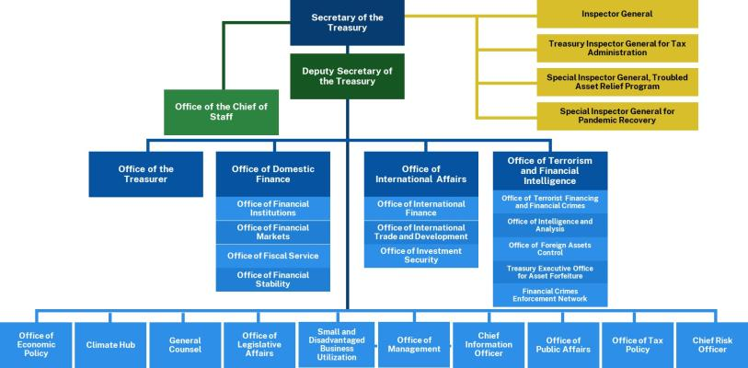

Slide 4
Disclaimer
4
This presentation is designed to give an overview of the Homeowner Assistance Fund program, and other Treasury recovery programs, for educational purposes. It should not be construed as legal advice or a statement of binding policy guidance from the Treasury.
For official Treasury guidance, go to: www.Treasury.gov/HAF

Slide 5
OVERVIEW OF FUNDS
TRIBAL RECIPIENTS
5
State and Local Fiscal Recovery Funds (SLFRF)
Local Assistance and Tribal Consistency Fund
Homeowner Assistance Fund (HAF)
Capital Projects Fund (CPF)
State Small Business Credit Initiative
SSBCI-Technical Assistance
SSBCI-SBOP
Tribal Set-Aside
$450MM
$20B
$500MM
$498MM
$100MM
$35.73
N/A
Additional Funds Available
YES
$33,417
YES
YES
$21,820
YES
N/A
N/A
YES
Recipients
579
571
341 *
~540
~283
~82
N/A
Mitigate the fiscal effects of the COVID-19
pandemic
Provide funding to eligible governments for use on any governmental purpose except lobbying activity.
Emergency aid for homeowners to prevent mortgage delinquencies, defaults, foreclosures, loss of utilities and displacement through qualified expenses
provide legal, accounting, and financial advisory services to qualifying small businesses applying for SSBCI or other jurisdiction small business programs
SBOP is a competitive TA grant program designed to assist regions in helping small businesses connect to opportunities related to the Investing in America Agenda
Funding for critical capital projects that enable work, education, and health monitoring
Establish credit and investment opportunity for Tribal enterprises and small business owners
Purpose
Affordable housing, access to water, food security, job training, childcare, small business grants, and economic recovery
Governments have the discretion to use the funds for “any governmental purpose other than a lobbying
activity.”
Assist homeowners on and off Tribal lands with mortgage, gas, electric, internet, water, and homeowner insurance costs, and cover home repair costs that make the
Broadband infrastructure projects, multi- purpose community facilities, and connectivity technologies and
Provide access to capital via loan and investment programs for Tribal enterprises and small businesses
Provide legal advisory services to Tribal member owned businesses seeking SSBCI loans or investments
Provide legal, accounting, and financial advisory services to small businesses (as defined in the NOFO)
Example Uses of Funds
home habitable.
devices
*

Slide 6
Homeowner Assistance Fund (HAF)
6
Purpose: The American Rescue Plan Act makes nearly $500 million in Homeowner Assistance Funds (HAF) available to Tribal governments or Tribal Designated Housing Entities (TDHE to aid households struggling to pay mortgages and utilities.
Part of a broad response to coronavirus-related housing risks across all of government.
Key objectives of HAF:
Prevent mortgage delinquencies and defaults, foreclosures, loss of utilities or home energy services, and displacement of homeowners experiencing financial hardship after January 21, 2020.
Provide funds for mortgage payments, homeowner’s insurance, utility payments, and other
specified purposes.
Requires at least 60% of funds go to homeowners with income at or below 100% AMI or
US MI to cover qualified expenses; prioritization of remaining funds for socially disadvantaged individuals.

Slide 7
HAF Program Implementation
7
Allocations
$498 million set aside for Indian Tribes/TDHEs and DHHL
Allocations to Tribes or TDHEs are based on the Indian Housing Block Grant Formula
Over 200 Tribes and TDHE’s submitted a Notice of Funds Request (NFR)
Initial Payments
Eligible entities received an initial payment from the HAF in an amount equal to 10% of their total allocations.
Treasury encouraged HAF participants to use these initial payments to create or fund pilot programs serving targeted populations and focused on activities likely to deliver resources quickly (e.g., mortgage reinstatement programs).
HAF Plans
HAF Recipients must submit a HAF plan in order to receive the remaining 90% of their allocation
– There is currently no deadline to submit a HAF plan
All funds must be obligated by September 30, 2026
Tiered tribal reporting due 45 days after the end of the reporting period.
Tribal recipients allocated at least $5 million must report quarterly.
Tribal recipients allocated under $5 million must report annually – first report was due November 15, 2022.
Allocation Adjustment
HAF funding initially allocated to Tribes that declined to participate in the HAF program have been redistributed among Tribes participating in the HAF program
Additional HAF allocations to Tribes from this pool will be determined by calculating each participating Tribe’s initial share of the
total of all participating Tribes’ initial HAF allocations and multiplying the share by the amount available for adjustment.
Each Tribe or TDHE will receive an email from Treasury with information about the amount of additional HAF funds available to
it, when the funds will be made available, and how to request the additional HAF funds.

Slide 8
Helping Homeowners: Qualified Expenses
8
Eligible expenses may vary depending upon the HAF participant’s program design
In general, HAF funds may be used for the following:
Mortgage Assistance
Payment assistance
Reinstatement of mortgage or other housing-related costs
Principal reduction
Facilitating interest rate reductions
Other Payment assistance for -
Delinquent property taxes to prevent tax foreclosure
Utilities, Energy, and Broadband Internet
Homeowner’s insurance, flood insurance, and mortgage insurance
Homeowner’s association fees or liens, condominium association fees, or common charges
Down payment assistance loans provided by nonprofit or government entities
Other Measures to Prevent Displacement
For example, repairs to maintain a home’s habitability or assistance to enable households to obtain
clear title to their properties.

Slide 9
State and Local Fiscal Recovery Funds
9
Purpose: Resources to respond to the pandemic, support families and businesses with the public health emergency and its negative economic impacts, maintain vital public services amid declines in revenue resulting from the COVID- 19 pandemic, and support tools for long-term growth and recovery.
Tribal Set Aside and Disbursements
$20 billion Tribal set aside
Allowable Uses
Replace lost revenue, using funds to provide government services
Respond to the public health emergency and its negative economic impacts
Invest in water, sewer and broadband Infrastructure
Provide premium pay to essential workers - for work conducted prior to April 10, 2023
Emergency relief from natural disasters
Certain transportation, HUD/CDBG infrastructure projects
Deadline for Use of Funds:
Obligate funds no later than December 31, 2024
Expend funds no later than September 30, 2026 (transportation and CDBG)
Expend funds no later than December 31, 2026 (all other uses)
9

Slide 10
Local Assistance and Tribal Consistency Fund
10
Purpose: Recipients may use funds for any governmental purpose, except lobbying activities.
Tribal Set Aside and Disbursements
A total of $500 million Tribal set aside, with $250 million for each of fiscal years 2022 and 2023 for payments to eligible Tribal governments.
Allowable Uses
Any governmental purpose other than a lobbying activity – including investing in activities undertaken by Tribal enterprises.
Generally, non-federal match or cost-share requirements of other federal programs.
Funds may be used towards expenditures beginning on March 15, 2021 – there is no deadline on the use of funds.
NOTE: Debt service payments funded by LATCF are permissible. However, LATCF may only be used for costs incurred on or after March 15, 2021. Therefore, LATCF cannot be used for obligations on debt issued before this date.
10

Slide 11
SUMMARY OF COMPLIANCE AND REPORTING REQUIREMENTS
TRIBAL RECIPIENTS
11
State and Local Fiscal Recovery Funds (SLFRF)
Local Assistance and Tribal Consistency Fund
Homeowner Assistance Fund (HAF)
Capital Projects Fund (CPF)
State Small Business Credit Initiative
SSBCI-Technical Assistance
SSBCI-SSBOP
Obligation
12/31/2024
No Deadline
09/30/2026
12/31/2026
- - -
- - -
Deadline
- - -
Expenditure
12/31/2026
Title I & Surface Transportation Projects:
9/30/2026
Deadline
No Deadline
01/28/2027
12/31/2026
- - -
- - -
- - -
Yes Exceptions to the Revenue Loss category – see FAQs for a
detailed list.
Uniform Guidance
Sections
Yes
Yes
Generally No
Yes
Yes
Quarterly: Allocated Over
$30mm
Annually Due April 30: Allocated Under $30mm
Quarterly: Allocated Over
$5mm
Annually Due Nov 15: Allocated Under $5mm
Quarterly and Annually – see SSBCI guidelines for schedule of deadlines
Semiannually and Annually – see SSBCI TA reporting guidelines
Semiannually and Annually – see SBOP NOFO
Reporting
Annually Due
March 31
Annually Due
July 31
Frequency
Due Date After End of Reporting Period
End of the calendar month following reporting period
See SSBCI
guidelines for reporting deadline schedule
End of the calendar month following reporting period
See NOFO –
anticipated to be consistent with formula TA program
Last Day of the Month
90 Days
45 Days
Single
Audit
Yes – ACEE
Option
Yes
Yes
Yes
No
Yes
Yes
*

Slide 12
Financial Assistance Award Agreement
12
What is it?
A legally binding document that outlines the terms and conditions of the Federal award, including the executive orders, federal statutes, regulations, and program guidance that apply to the Federal award. Prior to disbursement of award funds, a Tribal recipient must sign the financial assistance award agreement, which indicates its acceptance of the terms and conditions of the award being issued by Treasury.
Everyone must read it!

Slide 13
Typical Components of Financial Assistance Agreements
13
Date Awarded
Awarding Agency Address Information
Period of Performance
Method of Payment, as applicable
Allowable Costs
Terms and Conditions of the Award
Restrictions on Use of Funds
Required Reporting Procurement
Special Provisions
Awarding agency
Assistance Type
Award number
Amendment number, as
applicable
Award Authority
Approved Budget
Award Computation (Cost Sharing)
Federal Award Amount
Assistance Listing Number (FKA CFDA Number)

Slide 14
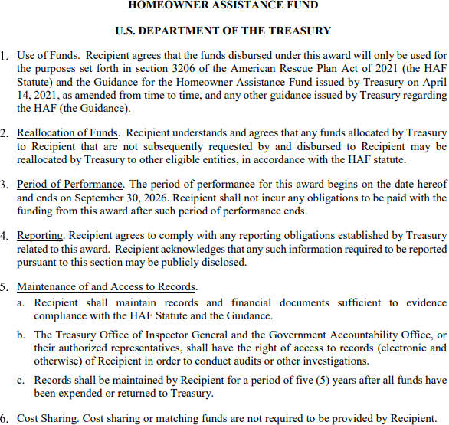
Example: Homeowner Assistance Fund
14

Slide 15
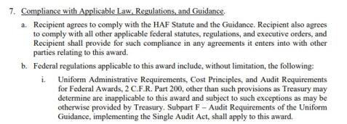
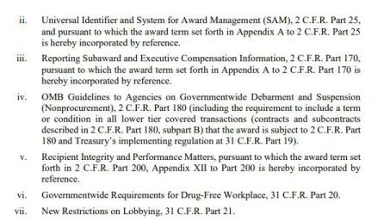
Example: Homeowner Assistance Fund
15

Slide 16
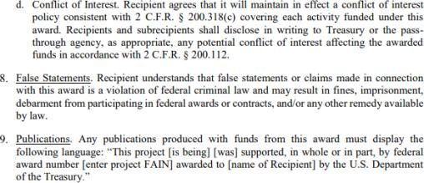
Example: Homeowner Assistance Fund
16

Slide 17
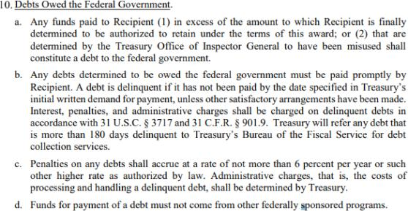
Example: Homeowner Assistance Fund
17

Slide 18
Example Closeout Process and Timeline: HAF
18
See the HAF: Closeout Resource for more information

Slide 19
Reporting: Upcoming Deadlines
19
Portal Access: Login.gov or ID.Me
LATCF
SLFRF
Under $30mm
April 30
SLFRF
Over $30mm
April 30
HAF
November 15
March 31
Reporting Period:
January 1, 2023 –
December 31, 2023
Reporting Period:
April 1, 2023 – March
31, 2024
Reporting Period:
January 1, 2024 –
March 31, 2024
Reporting Period:
October 1, 2023 –
September 30, 2024

Slide 20
Call Center Resources
20
State and Local Fiscal Recovery Funds: SLFRF@treasury.gov or call (844) 529-9527
Local Assistance and Tribal Consistency: LATCF@treasury.gov or call (844) 529-9527
Emergency Rental Assistance: EmergencyRentalAssistance@treasury.gov or (877) 398-5861
Homeowner Assistance Fund: HAF_Tribal@treasury.gov or (877) 398-5861
Coronavirus Capital Projects Fund: CapitalProjectsFund@treasury.gov
Coronavirus Relief Fund: CARES@oig.treas.gov
Office of Tribal and Native Affairs: tribal.consult@treasury.gov

Slide 21
21
For More Information:
Please visit Treasury’s HAF website at
www.Treasury.gov/HAF
Thank you!
For Program Inquiries:
Please contact the Homeowner Assistance
Fund at HAF_Tribal@treasury.gov.

