Slide 1
Department of Energy Grants: Clean Energy Funds for Tribal Housing
June 2024

Slide 2

1. Office of Indian Energy
2. Tribal Home Rebates
3. Energy Efficiency and Conservation Block Grant (EECBG) Program
4. Panel Discussion
5. Audience Q&A
Agenda

Slide 3
Technical Assistance Overview
Mike Stevenson, Lead Engineer, Technical Assistance Team Lead
June 26th, 2024
Notes:
Great, Thank you, very much!
It is a pleasure to have the opportunity to present about our technical assistance offerings today.
We have many available resources and I feel incredibly blessed to be able to talk with Tribes daily about advancing your energy projects and goals with this program.
Let’s get into it.
Next slide please.

Slide 4
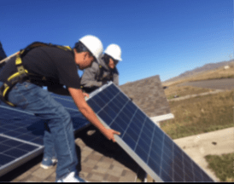


Office of Indian Energy
The DOE Office of Indian Energy is charged by Congress under the Indian Tribal Energy Development and Self Determination Act of 2005 (Title V of the Energy Policy Act of 2005) to “provide, direct, foster, coordinate, and implement energy planning, education, management, conservation, and delivery programs that –
(1) promote Indian tribal energy development, efficiency, and use;
(2) reduce or stabilize energy costs;
(3) enhance and strengthen Indian tribal energy and economic infrastructure relating to natural resource development and electrification; and
(4) bring electrical power and service to Indian land and the homes of tribal members located on Indian lands or acquired, constructed, or improved (in whole or in part) with Federal funds.”
Clockwise from right: Seneca Nation’s (NY) 1.5-MW wind turbine, Sokaogon Chippewa Community (WI) Housing Project, and Chippewa Cree Tribe’s (MT) Residential Solar.

Slide 5
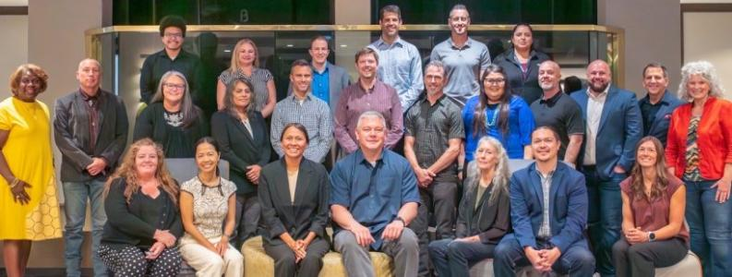
Meet the Team

Slide 6

Deployment Program
Financial Assistance
Technical Assistance
Education and Capacity Building
Provides funding and financing to support tribal energy development
Offers no-cost technical assistance to advance tribal energy and infrastructure projects
Supports internal capacity building to develop energy projects and navigate energy markets

Slide 7
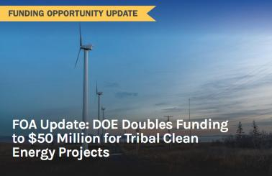
Funding Opportunity
Clean Energy Technology Deployment on Tribal Lands - 2024
The DOE Office of Indian Energy is soliciting applications from Indian Tribes, which include Alaska Native Regional Corporations and Village Corporations, Intertribal Organizations, and Tribal Energy Development Organizations to:
(1) install clean energy generating system(s) and energy efficiency measure(s) for Tribal Building(s) (Topic Area 1); or,
(2) deploy community-scale clean energy generating system(s) or community energy storage on Tribal Lands (Topic Area 2); or,
(3) install integrated energy system(s) for autonomous operation (independent of the traditional centralized electric power grid) to power a single or multiple Essential Tribal Buildings during emergency situations or for tribal community resilience (Topic Area 3); or,
(4) provide electric power to unelectrified Tribal Buildings (Topic Area 4)
DOE funding per individual award will range from $100,000 to $2,500,000 or from $250,000 to $5,000,000, depending on the Subtopic Area.
A 20% recipient cost share of the total project costs is required, however, a cost share reduction from 20% to 10% may be requested which is based on poverty rate and median household income.
Applications closed May 30, 2024
See the Funding Opportunity Announcement on IE-Exchange at https://ie-exchange.energy.gov
Send FOA related questions to TribalGrants@hq.doe.gov

Slide 8
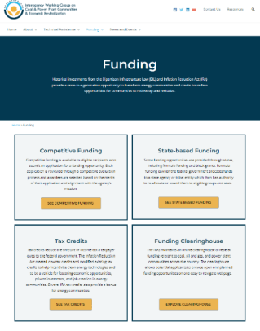


Funding Resources
https://www.energy.gov/indianenergy/current-funding-opportunities
https://www.energy.gov/clean-energy-infrastructure/clean-energy-infrastructure-program-and-funding-announcements
https://energycommunities.gov/funding-opportunities/

Slide 9

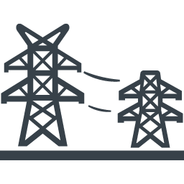

Technical Assistance
Goal:
Address a specific challenge or fulfill a need that is essential to a current project’s successful implementation.
Intended result:
A tangible product or specific deliverable designed to help move a project forward.
Notes:
Technical Assistance – It’s quite the federal agency buzzword these days. Everyone is talking about technical assistance, and it means something very different to everyone.
The Office of Indian Energy has been providing no cost technical assistance to Tribes for many years.
To us, technical assistance addresses a specific challenge or fulfills a need that is essential to advancing a clean energy project. The output of this effort is a tangible product or specific deliverable. We work with you to create a very specific scope of work and deliverable to get you closer to a go/no go decision.
That is what technical assistance means to us.
Next slide please

Slide 10

What We Do – TA that is within our typical scope
We will provide a tangible deliverable that helps advance a current or theoretical energy project towards a go/no-go decision
Clean Energy Planning
Energy Efficiency Assessments
Resource Assessments
Clean Energy Project Planning
Building Codes and Utility Formation
Notes:
We have five main areas that we can provide no cost technical assistance.
Clean Energy Planning
Energy Efficiency Assessments
Resource Assessments
Clean Energy Project Planning
And Building Codes and Utility Formation
We will take a deeper dive into each of these areas in the next few slides
The graphic on the slide is from a recently completed energy plan and options analysis report for Nulato Village, completed by Elan from the Alaska Native Tribal Health Consortium. This effort was completed through our TA, which is to say, Elans time was sponsored by the Office of Indian Energy at no cost to Nulato Village.
Next slide please

Slide 11
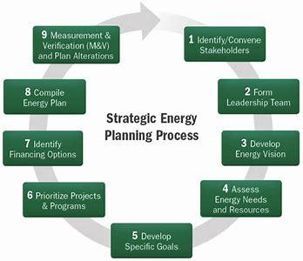
What We Do – Clean Energy Planning
Energy Vision
Energy Options Analysis
Project Prioritization
Energy Resilience Planning
Notes:
Clean Energy Planning is one of our most popular areas of assistance.
Clean energy planning acts as the foundation for transitioning to a clean energy future. Support is designed to assist in understanding energy resources, identifying an energy vision, understanding energy options and priorities and developing a viable roadmap for the successful completion of a project.
There’s a reason this is one of our most popular services. Strategic energy plans, if done well and right, can be cornerstones for tribes as they pursue clean energy deployment. For this to be the case, there needs to be significant Tribal stakeholder participation in the process. This includes Tribal leadership / IHS healthcare / representatives from the school district / emergency services / housing authority / water/wastewater folks / the list goes on and on… anyone with a large commercial load, gaming, etc. these efforts need fingerprints all over them from the entire community to be adopted and bought into allowing them to survive administration changes and truly represent the Tribe’s long term energy vision.
That is the goal of this effort. Please know going into requesting this service that it requires significant time and attention from key folks in the community. However, if you are willing to make that investment, you’ll have a great plan to build from.
Next slide please

Slide 12
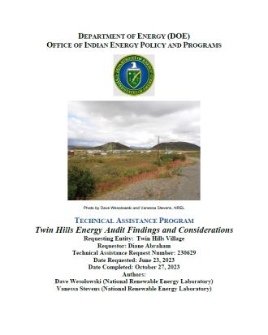
What We Do – Energy Efficiency Assessments
Building Efficiency Assessments
  Categorize and assess the energy use of Tribal buildings and homes and identify options for increased efficiency and cost savings
Process Efficiencies
  Assessment of heat use in a Tribal building or community and/or other heating options such as waste heat recovery, air source heat pumps, etc.
Notes:
We also provide energy efficiency assessments.
Energy Efficiency Assessments assist with quantifying current energy usage in individual buildings or community-wide systems and identifying potential efficiency solutions and cost savings.
The graphic is from a recent energy audit completed through our technical assistance by Dave and Ness with NREL AK for Twin Hills Village.
Next slide please

Slide 13
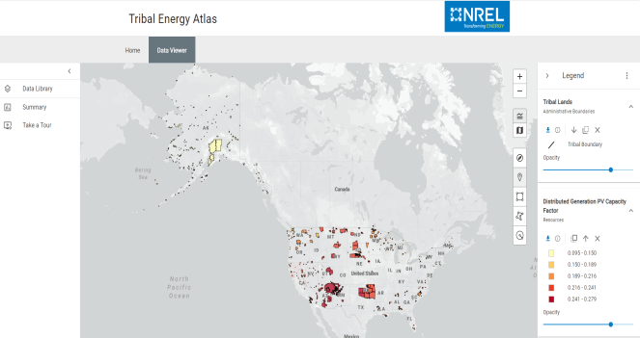
What We Do – Resource Assessments
Solar
Wind
Biomass
Hydropower
Geothermal
https://maps.nrel.gov/tribal-energy-atlas/data-viewer/
Notes:
We also provide resource assessments.
Resource Assessments review which renewable energy resources are available and viable to best meet your energy goals. Resources include, but are not limited to, solar, wind, water, biomass, and geothermal.
I have also attached a link on the slide to the Tribal Energy Atlas, which Indian Energy sponsors and is a great resource online that you can experiment with to see the different resource potential for your community. You can also simply google “Tribal Energy Atlas” and it should be the first link that pops up.
Next slide please.

Slide 14
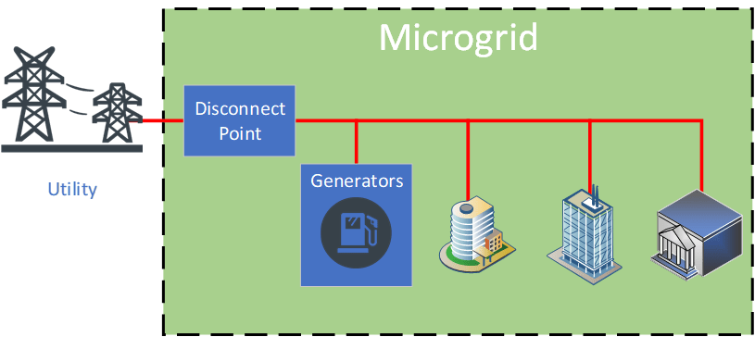
What We Do – Clean Energy Project Planning
Modeling and Analysis
Third-party Independent Reviews
Technology Options Assessment
Economic Analysis
Other Project Specific Assessments
Notes:
Another popular service is Clean Energy Project Planning.
Clean Energy Project Planning provides expert guidance and analysis to address specific barriers that you may face during clean energy project development. Types of support offered includes modeling and analysis, third-party reviews, technology options advice, economic evaluations, and other project specific assessments. We have a lot of communities take advantage of the microgrid modeling through either reopt or Homer as part of this offering.
Next slide please.

Slide 15
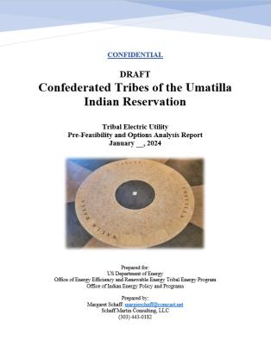

What We Do – Building Codes and Utility Formation
Notes:
Finally, we also offer building codes and utility formation services.
Building Codes and Utility Formation can help you navigate through governance questions relevant to project development..
The graphic on this slide is from a recent Pre-Utility Feasibility report completed for the Confederated Tribes of the Umatilla Indian Reservation by Margie Schaff. This work was completed through our technical assistance at no cost to the tribe.
This is as good a time as any to mention that the findings of these studies are not made available to the public. All technical assistance efforts are confidential as they are pre-development activities and we do not share any findings. Held in confidence between the requestor, DOE and our TA partners executing the effort.
Next slide please

Slide 16

What We Do – We Collaborate and are Flexible
We collaborate with other DOE and federal and local partners in their effort to provide TA to tribes
We will consider each request and try our best to accommodate even if it falls outside normal TA offerings, provided it aligns with the mission.
Notes:
We talk with other DOE offices, we talk with other federal offices, we talk with anyone who is in the tribal energy development arena and have a very vast contact list.
Probably the best service we provide is the initial scoping call where we discuss where you are in the development process and point you towards the most appropriate resources available. We pride ourselves in wanting to be your first phone call and helping you navigate the tremendous amount of funding and assistance available to you.
Next slide please

Slide 17




What We Do – We Leverage Partnerships
Notes:
We simply have the best partnerships to allow us to complete some beneficial work towards Tribal clean energy deployment.
Whether it’s Aaron Cooke, David or Ness at NREL AK, or Sandra Begay at Sandia, or Dustin, Elan and Katya at ANTHC, or Liz Weber and her amazing team at NREL, and of course Ms. Katie Conway at the great team at the Denali Commission, we are incredibly blessed to work with some wonderful partners who make our projects a priority; enabling us to provide tribes with quality deliverables in a timely manner. We are incredibly fortunate to collaborate with this group. There are others as well, these folks complete the lion’s share of the work though.
Next slide please.

Slide 18

What We Don’t Do
Provide funding
Provide legal advice
Detailed engineering designs
Prepare grant applications
Notes:
Now to the stuff we don’t do.
We do not provide funding. There is no money that flows from DOE to the tribes for technical assistance. We sponsor the subject matter expert’s time and any associated travel to complete the efforts.
We do not provide legal advice; this includes tax advice.
We do not provide detailed engineering designs. There needs to be a third-party consultant/contractor between our TA efforts and our deployment grant that completes detailed design. We can connect you with offices that have resources available for this type of work.
We do not prepare grant applications as part of our technical assistance.
Aside from these four major bullets, we really do our best to accommodate requests and ensure folks aren’t leaving empty handed, we can usually connect tribes to other resources if they have a request that we can not entertain because it is too far outside of our scope. That’s pretty rare, we can usually find one of our many services that will provide some benefit to advancing a project.
Next slide please.

Slide 19


Request Technical Assistance
Eligibility
The following tribal entities are eligible for on-request technical assistance:
Federally recognized Indian Tribes, including Alaska Native regional and village corporations (hereafter referred to as Tribes)
Tribal entities, such as tribal energy development organizations, intertribal organizations, and other organized tribal groups.
Types of On-Request Technical Assistance
Clean Energy Planning
Energy Efficiency Assessments
Resource Assessments
Clean Energy Project Planning
Building Codes and Utility Formation
Notes:
How to apply for the technical assistance.
We try to make this as easy to access as possible. You simply must click the “Click here to request technical assistance” button on our webpage and it will open an email with a few very simple questions. Who you are, what tribe or tribal entity you are requesting for. What is the request and any pertinent past related efforts as well as timeframe needed for the deliverable.
This starts the ball rolling, and we try to then schedule a follow-on scoping call within a couple of weeks. That scoping call is really beneficial. At this point we really dig into what the need is and how we can provide effective assistance. We get a much better sense for where the project is at and talk through together the available resources, we have for you to utilize and form a plan for how we get from current state to where you want to be.
Next slide please.

Slide 20
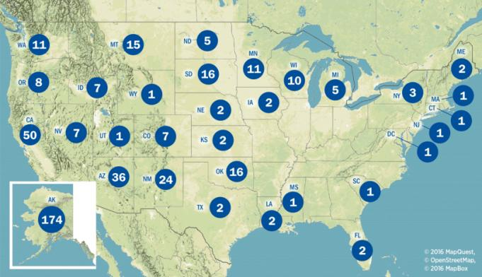
Completed Technical Assistance Requests (2010-2022)
Notes:
This slide is showing the geographic distribution of our technical assistance efforts. As you can see, we have completed many requests across the country. This map is outdated, and I need to work to get updated numbers. We’ve had a very busy couple of years. And I expect the numbers will increase significantly
Next slide please.

Slide 21
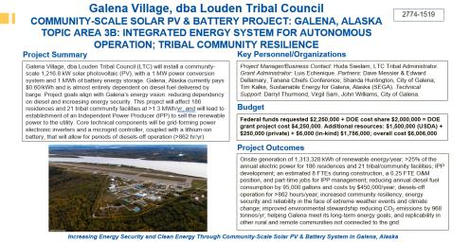
Case Study – Louden Tribe (Galena Village)
“I would say the technical assistance was very successful...This was not only key to secure funding, but also in the decision making moving forward.”
– Luis Echenique, Grants Director, Louden Tribe (Galena Village)
Notes:
As I mentioned earlier, we don’t typically talk much about technical assistance success stories as the efforts are confidential. I do have a great example today to share and it is one of many that has greatly benefitted a tribe as they pursued a significant clean energy project.
We do have permission to highlight some technical assistance we did for the Louden Tribe in Galena Village. Thank you, Luis for allowing me to highlight this effort today, and for your kind words that you may not have known I was going to quote on the slide…
The Louden Tribe approached Indian Energy TA for a solar resource assessment and then to review an initial design, heavily influenced by Tesla, which NREL staff completed and gave the thumbs up for the sanity check. This led to partnership efforts with Galena and the Tribe and other stakeholders, Tanana Chiefs Conference’s Energy Dept., and private consulting firms developing the final design as I mentioned previously, we do not sponsor with TA. But this then led to a successful DOE Indian Energy Deployment grant for $3.25 Million dollars, as well as significant funding from USDA Rural Development, Alaska Energy Authority, and the tribal solar accelerator fund. All to develop a 1.5MW solar project in the community of Galena, AK.
Additionally, when I was talking with Luis about this project, he mentioned that a different effort we completed for him just last year – to assess solar and battery and EV charging at the tribal admin building and the final report provided by NREL staff has been very useful for him as he’s applied to different funding sources to make that project a reality.
Again, I want to thank Luis, the Louden Tribe and the city of Galena for allowing me to talk to their project. We have many very similar success stories from our TA program. We bring fantastic, experienced partners to the table to add credibility to the effort as it progresses towards completion. We feel very fortunate and blessed to be able to fill this space.
Next slide please

Slide 22
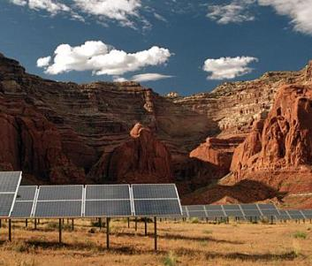


Engage With Us to Learn More
Mike Stevenson, Technical Assistance Team Lead
(240) 805-7356 (cell)
michael.stevenson@hq.doe.gov
ie-ta@hq.doe.gov
energy.gov/indianenergy
Subscribe to get our email updates
energy.gov/indianenergy/contact-us-and-staff
Social Media
facebook.com/DOEIndianEnergy
twitter.com/DOEIndianEnergy
Notes:
That’s my time. This is my contact information. Please don’t hesitate to connect with me. I love talking to folks about energy projects, and I’m happy to talk with you about how we can help yours.
Thank you for the opportunity to present today.
Much appreciated

