Slide 1
National American Indian Housing Council
Ginnie Mae Presentation
June 26, 2024
@GinnieMaeGov
/GinnieMaeGov
Ginnie Mae

Slide 2
Introduction to Ginnie Mae
OOTP
About Ginnie Mae
Government National Mortgage Association (Ginnie Mae) is a wholly-owned U.S. Government corporation within the Department of Housing and Urban Development (HUD).
Ginnie Mae links the U.S. housing market to the global capital markets and supports the liquidity and scalability of federal housing finance programs.
For over 55 years, Ginnie Mae has worked to make affordable homeownership and rental housing a reality for millions of Americans by providing liquidity and stability in the housing finance market.
2

Slide 3
Ginnie Mae About Us
OOTP
What?
Ginnie Mae guarantees investor’s timely payment of Principal & Interest (P&I) due on Mortgage-Backed Securities (MBS) backed by federally insured or guaranteed loans from:
Federal Housing Administration (FHA)
Public and Indian Housing (PIH)
Department of Veterans Affairs (VA)
U.S. Department of Agriculture’s (USDA’s) Rural Development (RD)
Why?
Ginnie Mae supports HUD's larger mission of increasing homeownership by providing lenders the ability to securitize loans that allow them to scale their work.
Ginnie Mae provides the guaranty to attract domestic and global capital to the nation’s housing finance markets, as well as to improve the ability to trade mortgage investments.
Ginnie Mae securities are the only MBS to carry the full faith and credit guarantee of the U.S. government.
3

Slide 4
Ginnie Mae Who We Serve
OOTP
As a Government Corporation, Ginnie Mae is inherently a social enterprise. Our MBS borrower profile is unique for each of our programs.
MBS Types | Who We Serve
Single Family MBS | First-time home buyers Veterans Low- and moderate-income borrowers Emerging or repairing credit households Racially and ethnically diverse borrowers Underserved borrowers of rural and tribal communities Borrowers economically affected by the pandemic Borrowers that live in areas where credit access is limited Borrowers who can afford a low or no downpayment
Multifamily MBS | People that need access to: Affordable apartment units Hospitals Senior care facilities
Reverse Mortgage/HECM HMBS | Senior Citizens
4

Slide 5
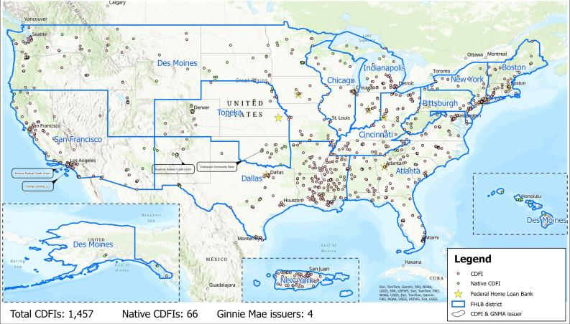
Community Development Financial Institutions by FHLBank Region

Slide 6
Ginnie Mae
Borrower Demographics

Slide 7
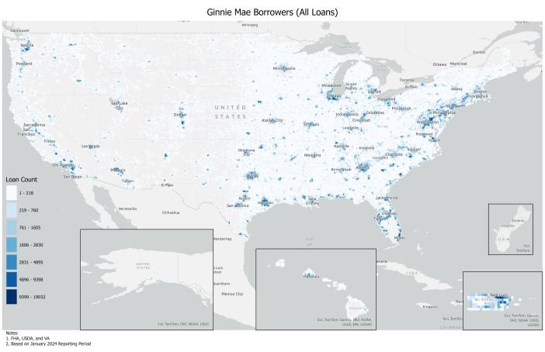
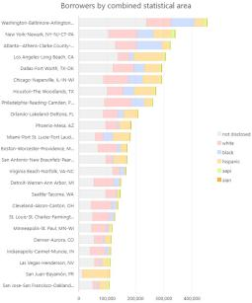
Where are our borrowers located?
Shows highest borrower density inside 10 km² squares (hotspots).
Source: Ginnie Mae internal data

Slide 8
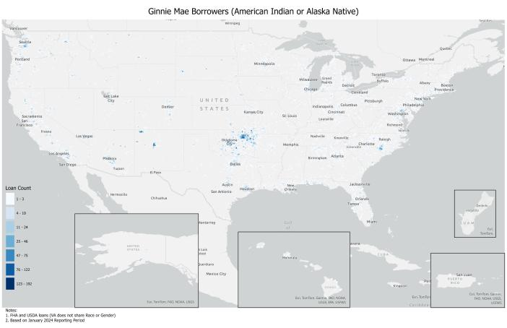
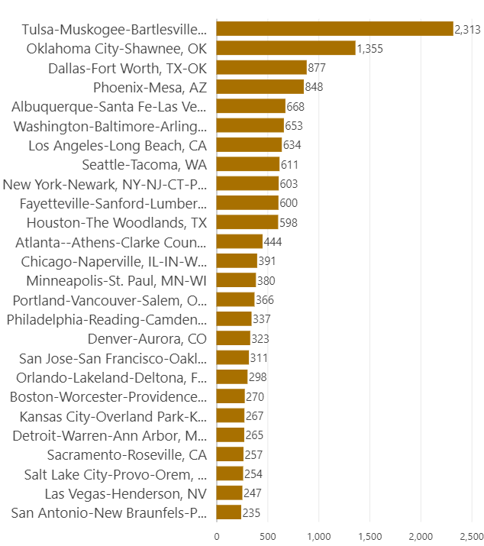
American Indian or Alaska Native (AIAN) Borrowers
Source: Ginnie Mae internal data

Slide 9
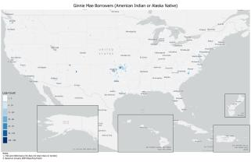
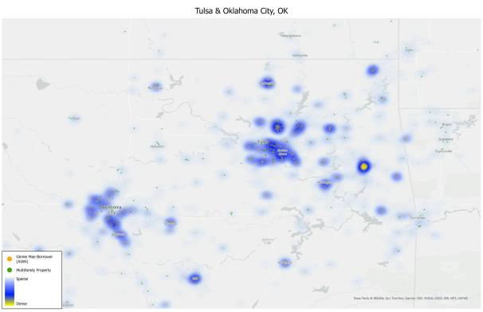
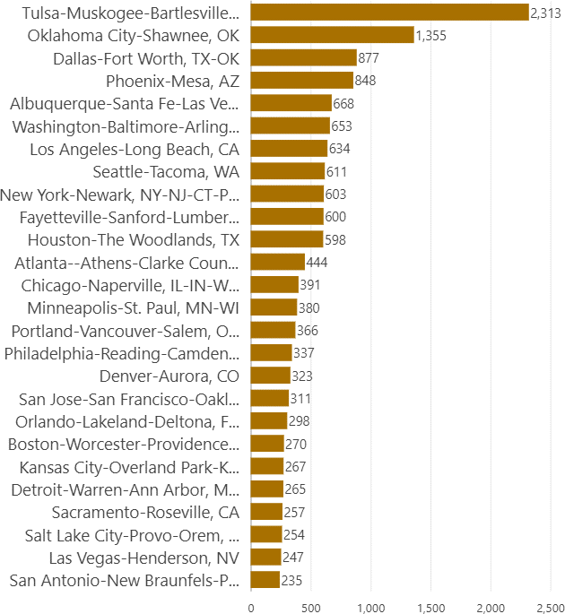
AIAN Borrowers – Metro area example
Source: Ginnie Mae internal data

Slide 10
Becoming a Ginnie Mae Issuer
Organizations interested in becoming Ginnie Mae Issuers must meet the minimum eligibility requirements and submit a complete application. Each potential Issuer is evaluated on an individual basis and approval is granted at Ginnie Mae discretion.

Slide 11
Eligibility Requirements
OOTP
Ginnie Mae requires its Issuers to meet the following minimum criteria:
Be approved FHA mortgagees in good standing.
Possess demonstrated experience and management capacity in the underwriting, origination, and servicing of mortgage loans.
Have fidelity bond and a "mortgagee errors and omissions" policy in effect.
Have a quality control plan in place for underwriting, originating, and servicing mortgage loans as well as for secondary marketing.
Meet and maintain financial requirements as specified in the MBS Guide, Chapter 3.
Each Issuer applicant is evaluated on an individual basis and approval is granted at Ginnie Mae’s sole discretion. Therefore, approval is not guaranteed by simply meeting our minimum eligibility requirements. See Chapter 2 of the Ginnie Mae MBS Guide.

Slide 12
Application Process
OOTP
Applicants are required to file applications for Ginnie Mae Issuer approval electronically via Ginnie Mae's new Application Connection portal, which can be accessed here: New Issuer Application. All applicants will need to submit the information listed in the Ginnie Mae Issuer Application Checklist.
Once an applicant has registered on Application Connection, the applicant will have thirty days to complete the application.
Issuer Application Resources
Ginnie Mae Issuer Application Checklist
Ginnie Mae MBS Guide

Slide 13
Issuer Responsibilities
OOTP
Document Custodian
Obtaining an eligible Document Custodian. All documents for a pool or loan package must be held by one Document Custodian
Providing the required loan, pool, and loan package documents to the Document Custodian
While custodial documents are in the Issuer’s possession, maintaining such documents in compliance with the same document safekeeping standards that apply to Document Custodians
Loan Eligibility
Acquiring or originating eligible mortgages and forming eligible pools or loan packages
Servicing and Investor Reporting
Establishing and maintaining proper P&I and escrow custodial accounts and, if elected or required, disbursement and clearing accounts for the pools and loan packages and handling properly all payments and other funds pertaining to the pooled mortgages. Issuers must also establish and maintain a central P&I custodial account
Servicing the mortgages in the pool or loan package or, where permitted by the MBS Guide, contracting with a subservicer to service them
Administering outstanding securities with the Ginnie Mae I MBS Program and Ginnie Mae II MBS Program
Submitting required monthly, quarterly, and other reports and certifications to Ginnie Mae
Marketing
Marketing or holding the securities backed by the pool or loan package
13

Slide 14
Finding Other Ways into the Secondary Market

Slide 15
MPF® Program Ginnie Mae MBS
$3.31B
Scale of the Ginnie Mae – MPF Program
June 2024
The Mortgage Partnership Finance® (MPF) Government Loans project is a joint initiative between the Federal Home Loan Bank of Chicago and Ginnie Mae initiated in 2014.
Through this partnership, as an Issuer, the FHLBank Chicago purchases loans from approved members (Participating Financial Institutions, or “PFIs”) for pooling.
15,393
Number of loans pooled
The MPF Government MBS product provides mortgage lenders, particularly smaller institutions, direct access to the secondary mortgage market with competitive pricing and lower costs.
15

Slide 16
Government Lending through the MPF Program
OOTP
2 Products:
MPF Traditional Government Product
MPF Government MBS Product
Loans Eligible within Products:
USDA Rural Housing Development (Section 502 Guaranteed Mortgages)
FHA
VA
Section 184 Indian Home Loan Guarantee Program (not eligible for the MPF Government MBS product)

Slide 17
The Interagency Community Investment Committee

Slide 18
ICIC Agency Action #2
OOTP
Support community finance market development through access to secondary markets
In support of Agency Action #2 throughout the calendar year 2023, HUD, through Ginnie Mae (GNMA), utilized a joint initiative with the Federal Home Loan Bank of Chicago which provides financial institutions access to various secondary mortgage market products, including a product that pools government loans that are securitized into GNMA-backed securities.
This joint initiative included an outreach/education campaign focused on helping smaller financial institutions expand the origination of government-backed mortgages in underserved communities.
HUD, USDA, and Treasury’s CDFI Fund worked together to encourage more community-based lending institutions to participate in the program.

Slide 19
ICIC Agency Action #2 Partnership
OOTP
Facilitate and coordinate ICIC Agency Action #2 agencies and FHLBanks to ensure consistency in content creation, identify opportunities for external engagement, and measure key performance indicators (KPIs) of outreach efforts. Continue collaboration with MPF Program on government
lending.
Work with FHLBank member institutions across the nation to provide financing options to underserved borrowers and communities through government lending, while working with these ICIC collaborators to enable broader usage of products by community lenders.
U.S. Department of Housing and Urban Development and
Ginnie Mae
FHLBanks and the MPF Program
ICIC
Agency Action #2
U.S. Department of Agriculture
U.S. Department of Treasury CDFI Fund
Manage and maintain relationships with USDA approved lenders and conduct outreach focused on the most underserved rural areas, especially tribal
communities.
Manage and maintain relationships with CDFI Fund- certified mortgage lenders and encourage more CDFIs to participate in the program through direct outreach.

Slide 20
ICIC Agency Action #2 Goals 2024
OOTP
1. Increase participation by community lending institutions through outreach opportunities for Tribal Lenders via conferences
Select goals for 2024:
2. Develop online awareness campaigns to create specialized educational opportunities
20

Slide 21
Find Out More
OOTP
Want to know more about the ICIC?
White House Fact Sheet: FACT SHEET: Vice President Harris Announces New Public and Private-Sector Efforts to Advance Racial Equity at Freedman’s Bank Forum | The White House
Action Plan: The Interagency Community Investment Committee ICIC 2023 Action Plan (treasury.gov)
Want to know more about your FHLBank Region?
Regions outlined in the Community Development map (slide 5)
Who We Are – FHLBanks
Want to know more about Ginnie Mae?
Contact: GinnieMaeCommunications@hud.gov
Becoming a Ginnie Mae Issuer: How to Become an Issuer (ginniemae.gov)
Interested in a specialized webinar on government lending? Please reach out to the Ginnie Mae contact above.

Slide 22
Thank you!

Slide 23
@GinnieMaeGov
/GinnieMaeGov
Ginnie Mae

