Slide 1


ALL HAZARD PLANS FOR TRIBAL HOUSING
SAFETY FIRST: PROTECTING TRIBAL HOMES AND PREPARING TRIBAL MEMBERS FROM EVERY HAZARD
JUNE 25, 2024
Copyright © 2024 Native Peacekeeper Consulting Group - All Rights Reserved

Slide 2


Law Enforcement Subject Matter Experts under IACP and Bureau of Justice Assistance
Certified Woman Owned Public Safety Consulting Firm
60+
Years of Experience
NATIVE PEACEKEEPER CONSULTING GROUP
ABOUT US
MISSION STATEMENT
TO EMPOWER TRIBAL PUBLIC SAFETY PROGRAMS BY PROVIDING COMPREHENSIVE AND SUSTAINABLE SAFETY SOLUTIONS AND FOSTERING COMMUNITY PARTNERSHIPS THAT ENHANCE SAFETY EFFECTIVENESS WITHIN THE TRIBAL COMMUNITY BY APPLYING OUR PHILOSOPHY OF OUR SLOGAN: “ELEVATING PUBLIC SAFETY TODAY FOR A SAFER TOMORROW: PROMOTING NATIVE AMERICAN PUBLIC SAFETY.”
SERVICE SOLUTIONS
PROGRAM DEVELOPMENT, COMMUNITY PARTNERSHIPS, LEADERSHIP DEVELOPMENT, POLICY DEVELOPMENT, E.M. PLANNING, VULNERABILITY ASSESSMENTS, COMPREHENSIVE PUBLIC SAFETY PLANNING, RESEARCH SERVICES, RISK AND MANAGEMENT ASSESSMENTS, SCHOOL SAFETY SOLUTIONS, EXECUTIVE COACHING AND MENTORING, MENTAL HEALTH AND WELLNESS, AND CRISIS MANAGEMENT ASSISTANCE
Certified Woman Owned Public Safety Consulting Firm

Slide 3

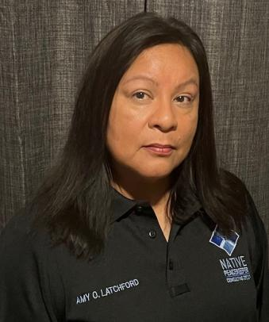
OWNERSHIP
AMY OSCEOLA LATCHFORD SEMINOLE TRIBE OF FLORIDA
“PUBLIC SAFETY IS THE FOUNDATION OF TRUST AND HARMONY IN EVERY COMMUNITY. AT NATIVE PEACEKEEPER CONSULTING GROUP, WE ARE DEDICATED TO EMPOWERING EVERY COMMUNITY BY :
ELEVATING PUBLIC SAFETY TODAY FOR A SAFER TOMORROW”
AMY O. LATCHFORD
“Otter Clan”

Slide 4
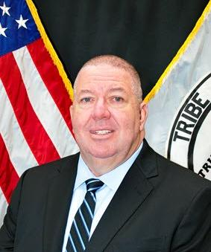
RETIRED EXECUTIVE DIRECTOR OF PUBLIC SAFETY/CHIEF OF POLICE WILLIAM R. LATCHFORD

Slide 5

RETIRED CHIEF OF POLICE
DAVID L.PERRY

Slide 6




NATIVE PEACEKEEPER CONSULTING GROUP
TIME TO GET STARTED:
INTRODUCTION TO ALL HAZARD PLANS FOR TRIBAL HOUSING
Tribal housing authorities play a crucial role in safeguarding their communities against natural and human-caused disasters. All hazard plans help these authorities prepare, respond, and recover from a wide range of emergencies, ensuring the safety and well-being of tribal members.

Slide 7




NATIVE PEACEKEEPER CONSULTING GROUP
CELLPHONE –POLL EVERYWHERE
WE WANT TO HEAR FROM YOU

Slide 8
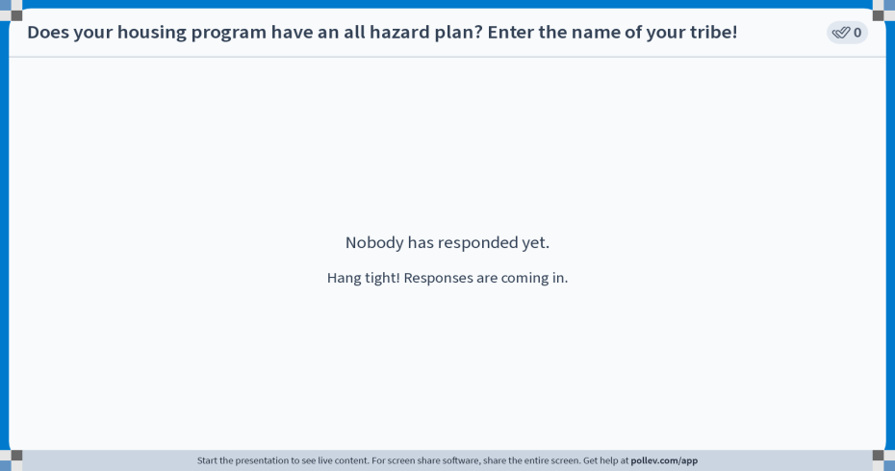
Notes:
Poll Title: Do not modify the notes in this section to avoid tampering with the Poll Everywhere activity.
More info at polleverywhere.com/support
Does your housing program have an all hazard plan? Enter the name of your tribe!
https://www.polleverywhere.com/free_text_polls/xiSo0dJ1RdP9sLsd0XivZ

Slide 9
THE IMPORTANCE OF ALL HAZARD PLANS FOR TRIBAL HOUSING
All hazard plans are crucial for tribal housing authorities to safeguard their communities against a wide range of natural and human-caused disasters. These comprehensive plans help ensure the resilience and continuity of essential housing services, protecting vulnerable populations and critical infrastructure during times of crisis. By proactively identifying risks, developing mitigation strategies, and coordinating emergency response, tribal housing authorities can minimize the impact of emergencies and expedite recovery efforts.
Protect Vulnerable Populations:
All hazard plans prioritize the safety and well-being of tribal members, especially the elderly, disabled, and low-income residents who may face disproportionate challenges during disasters.
Maintain Continuity of Operations:
These plans ensure that tribal housing authorities can continue to provide essential services, such as housing and maintenance, even in the face of disruptions caused by emergencies.
Enhance Community Resilience
By investing in preparedness and resilience-building measures, tribal housing authorities can help their communities better withstand and recover from disasters, ultimately strengthening the tribe’s overall well-being.

Slide 10
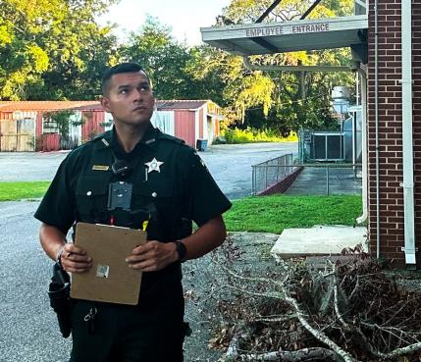
DEFINITION OF ALL HAZARD PLAN
All hazard plans are comprehensive emergency preparedness frameworks that enable tribal housing authorities to address a wide range of natural and human-caused disasters. These plans provide a structured approach to identify potential threats, assess risks and vulnerabilities, and develop coordinated strategies to protect tribal communities, their housing, and critical infrastructure. All hazard plans encompass mitigation, preparedness, response, and recovery measures to ensure the continuity of essential housing services and the safety of tribal members, especially the most vulnerable populations.
At the core of an all-hazard plan is the recognition that no single type of disaster can be predicted with certainty. These plans adopt an "all-inclusive" approach, preparing tribal housing authorities to respond effectively to a diverse range of emergencies, from severe weather events and wildfires to disease outbreaks and cyber-attacks. By anticipating and planning for a broad spectrum of hazards, tribal communities can enhance their overall resilience and minimize the impact of any potential crisis.
PHOTO OF:
DEPUTY BRADY LATCHFORD
SANTA ROSA COUNTY SHERIFFS OFFICE
SEMINOLE TRIBE OF FLORIDA TRIBAL MEMBER

Slide 11



TYPES OF DISASTER COVERED IN ALL HAZARD PLANS
HUMAN-CAUSED EMERGENCIES
NATURAL DISASTER
PUBLIC HEALTH EMERGENCIES
All hazard plans for tribal housing authorities must account for a range of natural disasters, including severe storms, floods, wildfires, earthquakes, and extreme temperature events. These plans outline strategies to protect vulnerable infrastructure, safeguard residents, and ensure the continuity of essential housing services during and after such catastrophic events.
In addition to natural disasters, all hazard plans also address human-caused emergencies, such as hazardous material spills, infrastructure failures, cyber-attacks, and even acts of terrorism. These plans detail emergency response protocols, evacuation procedures, and coordination with relevant tribal and external agencies to mitigate the impact of such crises.
All hazard plans for tribal housing authorities must also be prepared to respond to public health emergencies, including disease outbreaks, pandemics, and other infectious disease threats. These plans outline measures to protect vulnerable populations, ensure access to medical resources, and maintain essential housing operations during such public health crises.

Slide 12

ROLE OF TRIBAL HOUSING AUTHORITY IN ALL HAZARD PLANS
Tribal housing authorities play a pivotal role in crafting and implementing all hazard plans for their communities. As the stewards of critical housing infrastructure, these authorities are responsible for leading the development and execution of comprehensive emergency preparedness strategies. Their key responsibilities include assessing risks, prioritizing vulnerable populations, establishing communication protocols, and coordinating with various tribal and external agencies to ensure a coordinated response during times of crisis.
Risk Assessment and Mitigation: Tribal housing authorities must conduct thorough risk assessments to identify potential hazards, evaluate vulnerabilities, and implement targeted mitigation strategies to protect their communities.
Vulnerable Population Protection: These authorities prioritize the safety and well-being of their most vulnerable residents, including the elderly, disabled, and low-income households, during emergencies.
Emergency Response Coordination: Tribal housing authorities play a crucial role in coordinating with tribal emergency management, public safety, and social services departments to ensure a seamless and effective response to disasters.
Continuity of Operations: Housing authorities are responsible for developing and testing business continuity plans to ensure the uninterrupted provision of essential housing services, even in the face of disruptions.
Collaboration with Stakeholders: Tribal housing authorities must engage with various stakeholders, both within the tribe and externally, to leverage resources, expertise, and funding for all-hazard planning and implementation.

Slide 13

COLLABORATION WITH TRIBAL ORGANZITIONS
“PATCHWORK PARTNERSHIPS”
Effective all hazard planning for tribal housing requires a collaborative approach, leveraging the expertise and resources of various tribal organizations. Tribal housing authorities must forge strong partnerships with emergency management, public safety, social services, and other key departments to ensure a coordinated and comprehensive response to disasters. By aligning their efforts and sharing critical information, these entities can develop holistic strategies that address the unique needs and challenges faced by the tribal community.
Beyond internal collaboration, tribal housing authorities should also engage with external tribal organizations, such as cultural preservation groups, elders' councils, and youth programs. These stakeholders can provide invaluable insights into the community's values, traditions, and vulnerable populations, helping to shape all hazard plans that are culturally appropriate and responsive to the tribe's specific needs. Regular communication and joint training exercises further strengthen these cross-organizational relationships, enhancing the overall resilience of the tribal housing community.

Slide 14

Developing effective all hazard plans for tribal housing requires a deep understanding of the resources and capabilities available within the tribe. Tribal housing authorities must work closely with various tribal departments and organizations to identify and leverage existing assets that can support emergency preparedness and response efforts.
This includes mapping out the tribe's critical infrastructure, such as emergency shelters, communication networks, and medical facilities. It also involves cataloging the skills and expertise of tribal members, from first responders and healthcare providers to cultural preservation specialists and traditional knowledge keepers. By recognizing and integrating these valuable resources, tribal housing authorities can create comprehensive all hazard plans that are tailored to the unique needs and strengths of the community.
IDENTIFYING TRIBAL RESOURCES FOR ALL HAZARD PLANS
TRIBAL ASSETS
ALL RESOURCES AVAILABLE-LOCAL, STATE, TRIBAL, FEDERAL, AND COMMUNITY RESOURCES
INFRASTRUCTURE MANAGEMENT

Slide 15

ASSESSING RISK AND VULNERABILITES
RISK IDENTIFICATION
01
Tribal housing authorities must conduct thorough risk assessments to identify potential natural, human-caused, and public health hazards that could threaten their communities. This includes analyzing historical data, consulting with experts, and engaging the community to understand the unique risks facing the tribe.
VULNERABILITY ANALYSIS
Alongside risk identification, tribal housing authorities must evaluate the vulnerabilities of their infrastructure, critical systems, and populations. This involves assessing the physical condition of housing units, the resilience of communication networks, and the accessibility of emergency resources for the most vulnerable residents.
02
03
PRIORITZING RISKS
With a comprehensive understanding of risks and vulnerabilities, tribal housing authorities can prioritize their focus and resources on the most pressing threats. This allows them to develop targeted mitigation strategies and allocate funds effectively to strengthen the community's overall resilience.

Slide 16


DEVELOPING MITIGATION STRATEGIES
IDENTIFY HAZARD
Pinpoint the most pressing natural, human-caused, and public health threats.
Developing effective mitigation strategies is crucial for tribal housing authorities to strengthen the resilience of their communities. This process begins by thoroughly identifying the hazards that pose the greatest threats, from severe weather events to disease outbreaks. By assessing the vulnerabilities of critical infrastructure, housing units, and vulnerable populations, authorities can prioritize the most pressing risks and allocate resources accordingly.
Mitigation strategies may include strengthening building codes, retrofitting existing structures, investing in backup power systems, and enhancing early warning capabilities. Tribal housing authorities must work closely with various stakeholders to implement these measures, ensuring that the community is better prepared to withstand and recover from future disasters.
ASSESS VULNERABILITIES
Evaluate the susceptibility of housing, infrastructure, and populations.
PRIORITIZE RISK
Focus resources on the highest-priority threats to the community.
IMPLEMENT STRATEGIES
Develop and Execute Targeted Mitigation Measures to Reduce Risk

Slide 17

Preparing for emergency response is a critical component of all hazard plans for tribal housing authorities. By establishing a dedicated command center, stockpiling essential supplies, and training specialized emergency teams, tribal housing communities can ensure a coordinated and swift response to a wide range of crises. This proactive approach helps minimize the impact on vulnerable residents and supports the quick restoration of vital housing services.
PREPARING FOR EMERGENCY RESPONSE
ESTABLISH COMMAND CENTER-DESIGNATE A CENTRAL HUB TO CORRDINATE EMERGENCY OPERATIONS
STOCKPILE SUPPLIES-MAINTAIN ESSENTIAL RESOURCES FOR IMMEDIATE RESPONSE
TRAIN EMERGENCY TEAMS-EQUIP STAFF WITH SKILLS FOR EFFECTIVE CRISIS MANAGEMENT

Slide 18

ESTABLISHING COMMUNICATION PROTOCOLS
IDENTIFY COMMUNCIATION CHANNELS
Tribal housing authorities must establish reliable and redundant communication channels to ensure seamless information sharing during emergencies. This includes traditional methods like emergency broadcast systems as well as modern technologies like emergency alert apps and social media platforms.
DEFINE NOTIFICATION PROCEDURES
Clear protocols must be in place to rapidly disseminate critical information to tribal members, including evacuation orders, shelter-in-place instructions, and updates on the status of emergency response efforts. Authorities should regularly test these notification procedures to ensure their effectiveness.
FACILITATE INTERAGENCY COORDINATION
Effective communication during crises requires close collaboration between the tribal housing authority, emergency management, public safety, and other key agencies. Authorities should establish regular information-sharing mechanisms and joint communication drills to maintain a coordinated response.

Slide 19
ENSURING CONTINUITY OF OPERATIONS
1. Identify Critical Functions
Tribal housing authorities must pinpoint the essential housing services and operations that must be maintained during emergencies. This includes managing housing units, providing temporary shelter, and ensuring access to utilities and other vital resources.
2. Develop Redundancy
To safeguard critical functions, authorities should establish backup systems and redundancies, such as alternative communication channels, emergency power supplies, and offsite data storage. This redundancy helps ensure the continuity of operations even when primary systems are disrupted.
3. Create Business Continuity Plans
Comprehensive business continuity plans outline the strategies, protocols, and resources necessary to maintain essential housing services during and after a disaster. These plans address personnel, facilities, technology, and supply chain considerations to ensure a swift recovery.

Slide 20


PROTECTING CRITICAL INFRASTRUCTURES
Protecting the critical infrastructure is a vital component of all hazard plans for tribal housing authorities. These authorities must first identify the essential facilities, utility networks, and communication systems that are crucial for maintaining housing services and community resilience during emergencies. By assessing the vulnerabilities of these critical assets, they can prioritize the implementation of robust safeguards to mitigate the impact of natural disasters, cyber-attacks, and other threats.
01
IDENTIFY CRITICAL ASSETS
02
ASSESS VULNERABILITIES
03
IMPLEMENT SAFEGUARDS
Notes:
Identify Critical Assets Pinpoint the essential housing facilities, utility networks, and communication systems.
Assess Vulnerabilities Evaluate the resilience of critical infrastructure to withstand various threats.
3. Implement Safeguards Develop and deploy protective measures to harden critical assets.

Slide 21
SAFEGUARDING VULNERABLE POPULATIONS
Identify Vulnerable Groups
Tribal housing authorities must proactively identify the populations within their communities that are most vulnerable during emergencies, such as the elderly, individuals with disabilities, low-income families, and those with limited mobility or access to resources.
Develop Targeted Strategies
By understanding the unique needs and challenges faced by these vulnerable groups, tribal housing authorities can develop tailored strategies to ensure their safety and well-being during disasters. This may include establishing specialized emergency shelters, providing transportation assistance, and implementing early warning systems.
Engage Community Partners
Collaborating with tribal social services, healthcare providers, and community-based organizations is crucial for effectively safeguarding vulnerable populations. These partnerships can help identify at-risk individuals, coordinate the delivery of essential services, and foster trust and communication within the community.

Slide 22
COORDINATING WITH EXTERNAL AGENCIES
IDENTIFY KEY PARTNERS
Establish relationships with government agencies, NGOs, and other organizations that can provide support.
DEFINE ROLES AND RESPONSIBILITIES
Clearly outline the specific contributions and tasks each partner will undertake during emergencies.
DEVELOP JOINT ACTION PLANS
Collaborate to create comprehensive, coordinated emergency response and recovery strategies.
Notes:
Effective coordination with external agencies is essential for tribal housing authorities to ensure a comprehensive and well-resourced all hazard plan. By identifying key partners, such as federal and state emergency management agencies, public health organizations, and local NGOs, tribal housing authorities can leverage a wider range of expertise, equipment, and funding to bolster their community's resilience. Clearly defining the roles and responsibilities of each partner, and developing joint action plans, will foster seamless collaboration during times of crisis, enabling a more efficient and impactful emergency response.

Slide 23
SECURING FUNDING FOR ALL HAZARD PLANS
Identify Funding Sources
Tribal housing authorities must proactively research and apply for federal, state, and tribal government grants, as well as private foundation funding opportunities, to support the development and implementation of their all-hazard plans. These funding sources can help cover the costs of risk assessments, mitigation strategies, emergency response capabilities, and other critical preparedness initiatives.
Leverage Partnerships
Collaborating with external agencies, such as emergency management organizations and public safety departments, can open up additional funding streams. By aligning their all-hazard plans with tribal, regional or statewide initiatives, tribal housing authorities may be able to secure joint funding and share resources to strengthen their community's resilience.

Slide 24
TRAINING AND CAPACITY BUILDING
Assess Training Needs
Identify the specific skills and knowledge gaps within the tribal housing authority staff to determine the most critical training requirements for effective all hazard planning and response.
Develop Training Programs
Design comprehensive training programs that cover topics such as emergency management, disaster recovery, crisis communication, and community engagement. Ensure the training is tailored to the unique needs and cultural context of the tribal housing community.
Implement Capacity Building
Invest in building the long-term capabilities of the tribal housing authority staff by providing ongoing professional development, mentorship opportunities, and access to specialized resources and subject matter experts. This will strengthen the organization's resilience and adaptability.

Slide 25
CONDUCTING DRILLS AND EXERCISES
Develop Scenario-Based Drills
Tribal housing authorities should create realistic emergency scenarios, such as natural disasters, fires, or security incidents, to test their all-hazard plans. These drills will help identify gaps, refine response protocols, and ensure staff preparedness.
Engage the Entire Community
The effectiveness of emergency drills is greatly enhanced when the entire tribal housing community participates, including residents, local organizations, and emergency responders. This promotes a shared understanding of roles and responsibilities during a crisis.
Evaluate and Incorporate Lessons
After each drill or exercise, the tribal housing authority should carefully evaluate the results, document lessons learned, and implement necessary improvements to the all-hazard plan. This continuous learning process ensures the plan remains relevant and effective.

Slide 26
MONITORING AND EVALUATING ALL HAZARD PLANS
ESTABLISH METRICS
CONDUCT ASSESSMENTS
INCORPORATE FEEDBACK
IMPLEMENT CHANGES
Define clear and measurable indicators to track the effectiveness of the all-hazard plan.
Regularly review and evaluate the plan's implementation, identifying areas for improvement.
Actively solicit input from staff, residents, and partner organizations to refine the plan.
Adapt the all-hazard plan based on assessment results and incorporate lessons learned.
Notes:
Effective monitoring and evaluation are crucial for ensuring the ongoing relevance and effectiveness of the tribal housing authority's all hazard plan. By establishing clear metrics and key performance indicators, the authority can track the plan's implementation and measure its success in protecting the community during emergencies. Regular assessments, both internal and with partner organizations, will help identify areas for improvement and inform necessary plan updates. Incorporating feedback from staff, residents, and other stakeholders will further strengthen the plan's alignment with the community's evolving needs and priorities.

Slide 27
INCORPORATING LESSONS LEARNED
1. Analyze Outcomes
Thoroughly review the successes and failures of the all-hazard plan's implementation.
2. Document Lessons
Capture key learnings and insights to inform future plan updates.
3. Update the Plan
Incorporate lessons learned to enhance the plan's effectiveness and relevance.
Notes:
Continuous improvement is essential for ensuring the long-term effectiveness of the tribal housing authority's all hazard plan. By analyzing the outcomes of past emergencies and drills, the authority can document valuable lessons that will guide future plan updates. This process of adaptation and refinement, based on real-world experiences and community feedback, will strengthen the plan's ability to protect the tribal housing community and enhance its overall resilience in the face of diverse threats.

Slide 28
ENSURING COMPLIANCE WITH REGULATIONS
Tribal housing authorities must ensure their all-hazard plans comply with a range of federal, state, and tribal regulations. This includes adhering to emergency management standards, building codes, environmental protection laws, and accessibility requirements. By maintaining regulatory compliance, the authorities can access critical funding sources, obtain necessary permits, and demonstrate their commitment to safeguarding the community.
Identify Relevant Regulations
Thoroughly research and catalog the various laws, codes, and guidelines that apply to all-hazard planning for tribal housing.
Conduct Compliance Reviews
Regularly assess the all-hazard plan to verify it aligns with the latest regulatory requirements and make necessary adjustments.
Engage Subject Matter Experts:
Collaborate with legal professionals, emergency management specialists, and tribal officials to ensure the plan meets all applicable compliance standards.
Notes:
Continuous improvement is essential for ensuring the long-term effectiveness of the tribal housing authority's all hazard plan. By analyzing the outcomes of past emergencies and drills, the authority can document valuable lessons that will guide future plan updates. This process of adaptation and refinement, based on real-world experiences and community feedback, will strengthen the plan's ability to protect the tribal housing community and enhance its overall resilience in the face of diverse threats.

Slide 29
PROMOTING COMMUNITY AWARENESS
“PATCHWORK PARTNERSHIPS”
Fostering community awareness is a crucial component of the tribal housing authority’s all-hazard planning efforts. By educating and engaging the residents, the authority can ensure everyone understands the importance of disaster preparedness and their individual roles in emergency response. This can be achieved through a multi-faceted approach, including public awareness campaigns, community forums, and targeted outreach to vulnerable populations. The goal is to empower the community, equip them with the necessary knowledge and resources, and cultivate a shared sense of responsibility for the overall resilience of the tribal housing area.

Slide 30

ENGAGING TRIBAL LEADERSHIP
Effective engagement with tribal leadership is crucial for the success of the tribal housing authority’s all-hazard planning efforts. By actively involving tribal leaders, the authority can ensure their plans align with the community's priorities, address cultural considerations, and secure the necessary support and resources to protect the housing community.
Foster Open Communication: Establish regular meetings and dialogues with tribal leaders to discuss the all-hazard plan, gather their feedback, and address any concerns or questions they may have.
Highlight the Importance: Emphasize the critical role that tribal leadership plays in safeguarding the housing community and build a shared understanding of the all-hazard plan's significance.
Seek Endorsement and Backing: Obtain the formal endorsement and ongoing support of tribal leaders, as their influence and advocacy can help mobilize the community and secure necessary resources.

Slide 31

FOSTERING PARTNERSHIPS OF STAKEHOLDERS
Establishing strong partnerships with key stakeholders is essential for the tribal housing authority’s all-hazard planning efforts. By collaborating with a diverse range of organizations and individuals, the authority can leverage their expertise, resources, and networks to strengthen the community's resilience. This includes partnering with emergency management agencies, local government entities, non-profit organizations, and even private sector businesses that can provide critical support during times of crisis.
Through these partnerships, the tribal housing authority can coordinate emergency response protocols, access specialized equipment and training, secure additional funding sources, and enhance communication channels. Fostering a shared understanding of roles and responsibilities among stakeholders ensures a cohesive and coordinated approach to disaster preparedness and recovery. Regular meetings, joint exercises, and information-sharing sessions can help maintain these vital partnerships and keep all parties aligned with the all-hazard plan's objectives.

Slide 32

ADDRESSING CULTURAL CONSIDERATIONS
When developing all-hazard plans for tribal housing, it is crucial to address the unique cultural needs and traditions of the community. The tribal housing authority must maintain a deep understanding of the indigenous customs, beliefs, and values that shape the lives of the residents. This includes respecting traditional decision-making processes, incorporating indigenous knowledge, and ensuring the plan aligns with the community's spiritual and ceremonial practices.
By incorporating cultural considerations, the authority can build trust, foster community engagement, and develop emergency response strategies that are sensitive to the tribe's history, identity, and way of life. This may involve collaborating with tribal elders, incorporating traditional emergency response methods, and adapting communication channels to align with the community's preferred modes of interaction. Ultimately, the all-hazard plan must reflect the unique identity and resilience of the tribal housing community, ensuring its long-term effectiveness and sustainability.

Slide 33

SUSTAINABILITY AND RESILIENCE
Ensuring the long-term sustainability and resilience of the tribal housing community is a crucial aspect of the all- hazard planning process. The tribal housing authority must adopt a comprehensive approach that not only addresses immediate disaster threats, but also promotes the community's ability to withstand and recover from future challenges. This involves integrating sustainable design principles, implementing renewable energy solutions, and fostering a culture of self-reliance and mutual support among the residents.
By prioritizing sustainability, the authority can reduce the community’s environmental all-hazard planning process. The tribal housing authority must adopt a comprehensive approach that not only addresses immediate disaster threats impact, lowers operational costs, and enhances its preparedness for climate-related disruptions. Resilience, on the other hand, is about cultivating the community's capacity to adapt, recover, and thrive in the face of adversity. This requires building strong social networks, strengthening critical infrastructure, and empowering residents to take an active role in disaster response and recovery efforts.

Slide 34

CONTINUOUS IMPROVEMENT OF ALL HAZARD PLANS
Maintaining the long-term effectiveness of the tribal housing authority's all hazard plan requires a commitment to continuous improvement. By regularly reviewing and updating the plan based on lessons learned, changing regulations, and evolving community needs, the authority can ensure the plan remains relevant, adaptable, and capable of protecting the tribal housing community.
Establish Regular Review Cycles: Implement a schedule for periodically reviewing and updating the all-hazard plan, incorporating input from stakeholders, subject matter experts, and the community.
Analyze Performance and Outcomes: Thoroughly evaluate the plan's performance during drills, exercises, and actual emergency events, identifying strengths, weaknesses, and opportunities for enhancement.
Incorporate Lessons Learned: Document key insights and lessons learned from past experiences and incorporate them into the plan to improve its effectiveness and responsiveness.

Slide 35



QUESTION AND ANSWERS

Slide 36

NATIVE PEACEKEEPER CONSULTING GROUP
SAFETY AND SOLUTIONS
1. Program Development and Compliance Review
2. Community Partnership Programs
3. Patchwork Partnership-Public Safety Approach
4. Leadership Development, Training and Education
5. Policy and Procedure Development
6. Emergency Management Planning
Key Focus Areas
7. Vulnerability Assessments
8. Comprehensive Public Safety Planning
9. Research Services
10. Technical Assistance
11. Management Assessment
12. Public Safety Law Enforcement Liaison

Slide 37

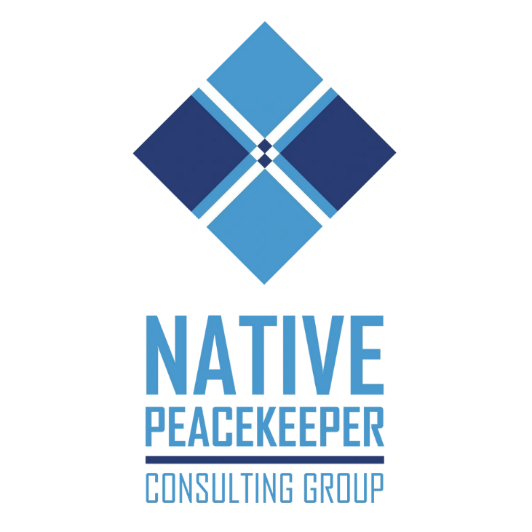
YOU ARE IMPORTANT!!!
THANK YOU FOR YOUR SERVICE!!!

