Slide 1
opioids in Community Housing Units What you need to know and prepare for
By Mike Andrews
Sr. Vice President, McGuireWoods, LLC
NAIHC Summer Conference- Hollywood, Florida.
June 25th, 2024

Slide 2
Agenda
What is Fentanyl?
Why is it so Dangerous?
How do you clean this mess up?
Is it expensive?
What happens if you don’t clean this up?
Funding Opportunities

Slide 4
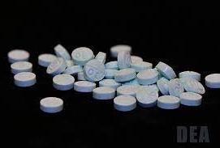

Slide 9
Facts on Fentanyl
Fentanyl is a Schedule II controlled substance that is similar to morphine but about 100 times more potent.
Illicit fentanyl, primarily manufactured in foreign clandestine labs and smuggled into the United States through Mexico.
7 out of every 10 pills seized by the DEA contain the lethal dose of 2mg of fentanyl.
Source: U.S. Drug Enforcement Administration

Slide 10
Facts on Fentanyl - continued
According to the CDC, synthetic opioids (like fentanyl) are the primary driver of overdose deaths in the United States.
From 2020 to 2021, overdose deaths involving opioids rose 38.1 percent and overdose deaths involving synthetic opioids rose 55.6 percent.
Drug trafficking organizations typically distribute fentanyl by the kilogram. One kilogram of fentanyl has the potential to kill 500,000 people.
Source: U.S. Drug Enforcement Administration

Slide 11
Facts on Methamphetamine
Methamphetamine (meth) is a schedule II-controlled substance that has high potential for abuse.
Mexican drug trafficking organizations are the primary meth manufacturers in the United States.
Meth use can result in paranoia that leads to homicidal or suicidal thoughts. As much as 50% of dopamine producing cells in the brain can be damaged.
Source: U.S. Drug Enforcement Administration

Slide 12
Fentanyl Seizures at Border
CBP has reported that in 2022, 92 percent of U.S. border authorities’ fentanyl seizures have occurred at ports of entry.
In fiscal year 2023, 26,718 pounds of fentanyl were seized along the Mexican border which were detected by officers of the U.S. Customs and Border Protection enough fentanyl to kill every single American.
It is important to note that the number of seizures may not reflect the total amount of fentanyl that is smuggled into the United States, as many shipments may go undetected.

Slide 13
Fentanyl Seizures at Border (Recent History)
According to the DEA 2024 National Drug Threat Assessment report, fentanyl seizures at the U.S.-Mexico border increased significantly from 2021 to 2023.
In 2023, there were 32,996 pounds of fentanyl seized by the U.S. Customs and Border Protection along the U.S.-Mexico border, compared to 15,853 pounds in 2021. This represents a 48% increase in fentanyl seizures from 2021 to 2023.

Slide 14
States with the highest Drug overdose rate
West Virginia 80%
New Mexico 50%
Arizona 40%
Maine 47%
Louisiana 48%
Connecticut 43%

Slide 15
Frustrations within Indian Country
“Cartels infiltrating native reservations with fentanyl”
-Tribal leader
Underfunded police overwhelmed by drug running, violence on tribal lands.
"They know we're short-staffed,” the Fort Belknap president said.
"$95 billion to kill people overseas but can't spare pennies" – Tribal leader

Slide 16
Fentanyl In Indian country
Senate Committee on Indian Affairs held 2 hearing and 1 roundtable in 2023-2024
“The Deputy Bureau Director of the Office of Justice Services (OJS) within the BIA, explained that methamphetamine and fentanyl are the biggest emerging drug threats to Tribal communities. 1,590 overdose deaths occurred in Indian Country during FY 23 and 899 non-fatal overdoses in the same year.”
“Fatal Fentanyl Overdose in Indian Country Lands Four Defendants in Federal Prison for More Than 33 Years Collectively.”

Slide 17
Fentanyl Use in Public Housing
While there is limited data on the use of fentanyl in public housing, several studies have been conducted over the past couple of years.
A recent study conducted by the Corporation for Supportive Housing found that 63% of state public housing agencies have reported significant opioid-involved overdose cases from their tenants.
In 2019, at least 142 suspected opioid-involved overdoses, fatal and nonfatal, occurred among supportive housing tenants across 46 different state public housing agencies.

Slide 18
Fentanyl Cleanup Costs
In addition to the danger and uncertainties of fentanyl, the process of handling fentanyl is further complicated by the cost of cleaning it up.
Clean-up jobs can cost $400 per hour, with a total price tag ranging from $30,000 to $50,000 per job. The work requires breaks every 20 minutes due to the heat associated with wearing hazmat suits.
A high efficiency vacuum needed to remove tiny particles cost an additional $1,200 and must be incinerated afterwards.

Slide 19
Cost of Cleaning Up Meth comparatively
The cost of contamination can vary widely depending on the size of the home, the level of contamination, and if it was used for smoking meth or a meth lab.
Average is between $15,000 and $20,000.
Cleaning and remediating a meth site can also cost more than $200,000, depending on the magnitude of contamination. State and local governments that incur expenses cleaning a site can apply to the U.S. Environmental Protection Agency (EPA) for reimbursement, up to $25,000 per incident. Alternatively, rather than incur costs and apply for a capped reimbursement, state and local governments can notify DEA of a site, and DEA will perform and pay for cleaning. In addition, funds have been available from the Department of Housing and Urban Development (HUD) to redevelop a former meth production site.

Slide 20
IHGB Example: Tribe with $4.7M in formula funding will spend on average $940K on clean up

Slide 21
EPA Guidelines as of 2021
As of August 2021, there are currently no state or federal standards in the United States for determining when the site of a closed fentanyl drug laboratory has been successfully remediated.
While many of the remediation considerations and techniques for fentanyl are similar to those for the remediation of meth, the particle size, toxicity and production of fentanyl means a few different procedures should be followed.

Slide 23
Voluntary Guidelines for Laboratory Cleanup

Slide 24
Epa voluntary guidelines for methamphetamine and fentanyl laboratory cleanup
The Voluntary Guidelines for Methamphetamine and Fentanyl Laboratory Cleanup provides technical guidance for state and local personnel responsible for methamphetamine (meth) and fentanyl lab cleanup.
The Guidelines are based on an extensive review of the best available science and practices and addresses general cleanup activities, identifies best practices for specific items or materials, discusses sampling procedures, and provides additional technical resources. EPA recognizes the emerging threat of fentanyl, and the significant hazards fentanyl poses to the public and updated this document to include a new chapter on fentanyl remediation.

Slide 25
Epa voluntary guidelines for methamphetamine and fentanyl laboratory cleanup
Who should use these guidelines?
The guidelines are geared towards, tribal state and local government personnel charged with remediating or otherwise addressing former methamphetamine (meth) and fentanyl labs. This document helps disseminate the best available knowledge and research on meth and fentanyl lab remediation and will also prove useful to cleanup contractors and could be a resource for homeowners.

Slide 26
Epa voluntary guidelines for methamphetamine and fentanyl laboratory cleanup
A new chapter about fentanyl cleanup is included due to increasing clandestine fentanyl lab encounters in the United States.
Properties may be contaminated by hazardous chemicals used or produced in the manufacture or packaging of fentanyl where those chemicals remain and where the contamination has not been remediated.

Slide 27
The physical cost associated with Fentanyl
Lockport officers fall ill after exposure to suspected fentanyl during arrest
2 SWAT officers sick after exposure to heroin, fentanyl during raid
Viral video of San Diego deputy's fentanyl exposure raises questions
Sheriff's body camera video of a deputy apparently passing out after a superior cautioned him that the drugs he had seized were "super dangerous" went viral with national news coverage, but not before some experts expressed doubts about the scenario.

Slide 28
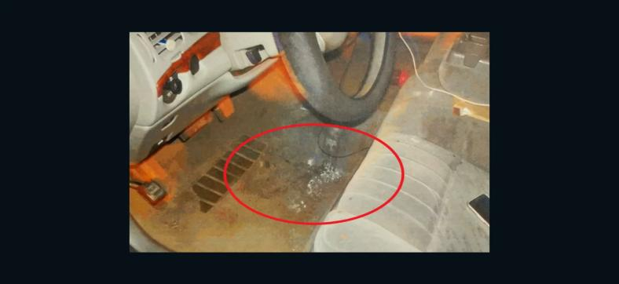
Police Officer Overdoses after Brushing Fentanyl Powder Off His Uniform

Slide 29
Physical cost associated with Fentanyl- continued
On June 7, 2019, a victim of fentanyl poisoning is found seated in front of a TV with the remote still in-hand in his 2,800-square-foot residence in Northern California. The potent dose of the illicit opioid hit this victim so fast he had no time to call for help as his life came to a tragic end.
Local police and the Coroner’s Office examine the death site. After a brief inspection, they conclude it was a run-of-the-mill overdose or cardiac arrest. No crime was involved. Case closed. The autopsy was minimal, and the lab tests were sent to a testing site in Pennsylvania, but the results were not readily available.
A week after his death, the case is reopened after an unsuspecting house cleaner loses her life while vacuuming the site where he died. It was later discovered that fentanyl was the source of the original overdose as well as the cause of death of the house cleaner.
After the home is red tagged by local authorities, testing begins by a Certified Industrial Hygienist which shows that traces of fentanyl is found throughout the home.

Slide 30
Fentanyl Cleanup
Cleaning up fentanyl at a contaminated property is a daunting challenge riddled with complex issues. Making a place safe again entails adhering to strict safety protocols, including testing, hiring a certified industrial hygienist and a qualified hazmat trained cleanup crew.
The most important factor is to hire a crew of professionals to make certain that the remediation is done safely. That’s the main challenge companies in the remediation business face.
Such a substantial cost for a hotel, for example, means loss of rental income. If a site is red tagged, the law states no further occupation is allowed until the remediation is completed. The whole process could easily take up to 90 or more days.
Once a site has been red tagged due to fentanyl, a Preliminary Site Assessment is created by a trained professional such as a certified industrial hygienist. The hygienist takes samples of the site and provides recommendations on cleaning. If it isn’t done correctly, it can lead to a much higher cleanup cost.

Slide 31
Tenant Use of Opioids from the Corporation Supportive Housing Survey
Agencies were asked to approximate what percentage of their agency’s total supportive housing tenants “used illicit opioids including heroin, fentanyl, or prescription opioids other than as prescribed” (43.8%) estimated their tenants used illicit opioids, (43.8%) estimated that their tenants used them, and (6.3%) estimated that over 50% of their tenants used them.

Slide 32
Fentanyl Related Fatalities
Agencies were asked to estimate the total number of fatal and nonfatal suspected overdoses involving opioids among their supportive housing tenants in 2021.
Overall, (63.3%) agencies reported at least one opioid-involved overdose among supportive housing in that year. Across agencies responding that there was an overdose, at least 42 suspected opioid-involved overdoses were reported, including fatal and nonfatal, among tenants in 2021.
Overall, (47.9%) agencies reported between 1-5 opioid-involved overdoses among tenants in the past year, while (16.7%) agencies reported more than five overdoses among their tenants in that year

Slide 33
Tribal leaders sound the alarm after fentanyl overdoses spike at Blackfeet Nation
Overdose deaths disproportionately affect Native Americans. The overdose death rate among Indigenous people was the highest of all racial groups in the first year of the pandemic — and was about 30% higher than the rate among white people, according to a March study published in JAMA Psychiatry, co-authored by Joe Friedman, a researcher at the University of California, Los Angeles.
In Montana, the opioid overdose death rate for Indigenous people was twice that of white people from 2019 to 2021, according to the state's Department of Public Health and Human Services.

Slide 34
Overdose Rates among native Americans in states with high fentanyl usage
North Dakota: The overdose rate for American Indian population was 8.42 per 10,000 compared to the white population at 1.12 per 10,000 from 2019-2022.
Arizona: The rate of opioid overdose deaths among American Indian was 22.1 per 100,000 in 2022.
New Mexico: The rate of overdose deaths among American Indians was 37.2 per 100,000 persons in 2021.
South Dakota: 28% of unintentional overdose deaths were American Indian from 2020-2022.

Slide 35
California Tribal Roundtable Findings
Roundtable explores solutions to fentanyl crisis in California Native American communities
Native American overdose deaths are above the national average and [Native people] are disproportionately impacted, per capita-wise,” “Drug related activity in Indian Country is a major contributor to violent crime and imposes serious health and economic hardships on tribal communities.”
For the past decade, illicitly manufactured fentanyl, which is often combined with heroin or cocaine, has fueled a surge in the opioid epidemic and in related overdoses and deaths.
According to data from the California Department of Public Health, there were 7,175 opioid-related overdose deaths in the state in 2021; 5,961 of these deaths were related to fentanyl. In 2020, American Indian and Alaska Native people were the demographic with the highest opioid-related overdoses, with 26.2 people overdosing per 100,000. Although the state doesn’t have complete data from 2022 or 2023, information shared by some counties during the roundtable showed fentanyl usage has surged even higher in some tribal regions over the past year.

Slide 36
Fentanyl in Alaska
An influx of fentanyl into Alaska in the last few years has vexed law enforcement, overwhelmed health systems and deeply affected struggling Native communities.
In 2020 and 2021, the synthetic opioid was a major contributor in a spike in overdoses – the nation's largest, according to Alaska's public health department. In 2021, overdose deaths jumped by 74% in one year, with fentanyl deaths spiking by 150%, the report said.

Slide 37
Emerging Threat
The White House has declared that the powerful synthetic opioid fentanyl combined with xylazine – an animal tranquilizer that’s increasingly being used in illicit drugs – is an “emerging threat” facing the United States due to its role in the ongoing opioid crisis.
This drug, which is an animal sedative, is being mixed with fentanyl and is being found in almost all 50 states now,” Gupta said Tuesday. “It’s become an important part for us to make sure that we’re declaring it an emerging threat.”
Xylazine is not an opioid. It is approved by the US Food and Drug Administration for use as a tranquilizer in veterinary medicine, typically in horses, but it is not approved for use in humans. And xylazine can do major damage to the human body, including leaving drug users with severe skin ulcers, soft-tissue wounds and necrosis – sometimes described as rotting skin – that can lead to amputation.

Slide 38
Funding Opportunities
Department of Health and Human Services
Dept of Indian Health Service for rehabilitation services related to opioid addiction.
Environmental Protection Agency
Grant money for hazardous material clean up. Fentanlyl and Meth would fall into these categories.
Department of Justice, DEA has an Opioids Clean Up Division
Department of Housing and Urban Development
Indian Community Development Block Grant (ICDBG) Funding- eligible use.
Indian Housing Block Grant (IHBG) Program- eligible use
Opioid Settlements
State and local funding

Slide 39
Funding Opportunities
The Biden Administration says it is investing in overdose and addiction efforts; $1.5 billion is being distributed throughout all states for opioid and addiction issues, with $104 million to expand substance abuse prevention in rural communities. In 2023 the CDC increased its original investment of $13 million to $17 million to continue assisting with overdose prevention efforts in tribal communities.

Slide 40
Fentanyl Test Strips
What are fentanyl test strips?
Fentanyl test strips (FTS) are a low-cost method of helping prevent drug overdoses and reducing harm. FTS are small strips of paper that can detect the presence of fentanyl in all different kinds of drugs (cocaine, methamphetamine, heroin, etc.) and drug forms (pills, powder, and injectables). FTS provide people who use drugs and communities with important information about fentanyl in the illicit drug supply so they can take steps to reduce risk of overdose

Slide 41
Fentanyl Test Strips
How to Use Fentanyl Test Strips?
In order to use fentanyl test strips:
Dissolve a small amount of drug supply in water, and then dip the test strip into the liquid for 15 seconds. Because the test strips are highly sensitive, a minimal amount of drug residue is sufficient to obtain a result.
Set the test strip on a flat surface until results appear, typically within 5 minutes.
One line indicates fentanyl is present in the sample; two lines indicate a negative result.

Slide 42
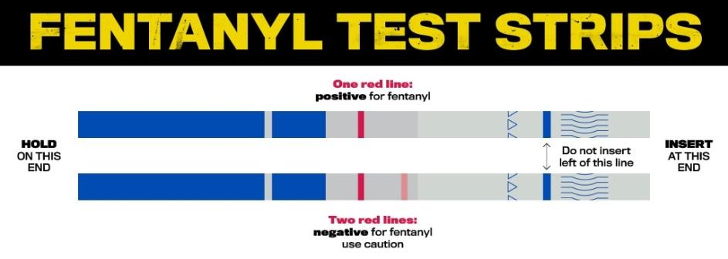

Slide 43
Fentanyl Legislation Introduced in the 118th Congress
H.R. 467 - HALT Fentanyl Act
Sponsor: Rep. Griffith (R-VA-09)
The HALT Fentanyl Act would:
Place fentanyl-related substances on the Controlled Substances Act Schedule I list.
Establish a new registration process for Schedule I drug research that is funded through the Department of Health and Human Services (HHS), Department of Veterans Affairs (VA), or Food and Drug Administration (FDA).
Make additional changes to controlled substance research registration requirements.
H.R. 335 - STOP Fentanyl Act
Sponsor: Rep. Grothman (R-WI-06)
The STOP Fentanyl Act would:
Reduce the threshold for mandatory minimum penalties for fentanyl-related offenses. It would do so by reducing the 10-year mandatory minimum threshold for fentanyl offenses from 400 grams to 5 grams and fentanyl analogue offenses from 10 grams to 0.05 grams.
Reduce the 5-year mandatory minimum threshold for fentanyl offenses from 40 grams to 0.5 grams and fentanyl analogue offenses from 10 grams to 0.005 grams.
Create a mandatory minimum sentence of 20 years imprisonment for importing any amount of fentanyl and analogues across the Southern border.

Slide 44
Fentanyl Legislation Introduced in the 118th Congress
H.R. 568 – SAFE Act
Sponsor: Rep. Pappas (D-NH-01)
The SAFE Act would:
Amend Section 202(c) of the Controlled Substances Act and permanently schedule all fentanyl-substances as Schedule I drugs unless it is listed in another schedule or granted an exemption.
Specifically defines the compound and molecular variations of a fentanyl analogue.
Require the Attorney General to publish a list of fentanyl-related substances on the Federal Register within 60 days of their determination.
H.R. 801 – Securing the Border for Public Health Act of 2023
Sponsor: Rep. Lesko (R-AZ-08)
The Securing the Border for Public Health Act would:
Authorize the Department of Health and Human Services (HHS) to restrict migration and imports from foreign countries if HHS determines that the introduction of certain controlled substances such as opiates, stimulants, or fentanyl-related substances from those countries pose a risk to the public health of the U.S.

Slide 45
Fentanyl Legislation Introduced in the 118th Congress
H.R. 1401 – END FENTANYL Act
Sponsor: Rep. Guest (R-MS-03)
The END FENTANYL Act would:
Require the Commissioner of the U.S. Customs and Border Protection to regularly review and update policies and manuals related to inspections at U.S. ports of entry, to identify the manners in which illegal drugs and humans are being smuggled into the country.
H.R. 1210 – Stop Fentanyl Border Crossings Act
Sponsor: Rep. DesJarlais (R-TN-04)
The Stop Fentanyl Border Crossing Act would:
Authorize the Department of Health and Human Services (HHS) to restrict migration and imports from foreign countries if HHS determines that these countries are importing illicit drugs into the U.S. that place the public health of Americans at risk.

Slide 46
Final thoughts
If you suspect Opioids such as Meth and Fentanyl use in a Tribal home or rental unit.
STOP
Call in the experts
Wear protective equipment at all times
Use test strips
Hire professionals to clean up the toxic and deadly substances.

Slide 47
Questions??
Mike Andrews
202 531-3346
mandrews@mwcllc.com

