Slide 1
Urban Native American Housing At the River’s Edge Chicago

Slide 2
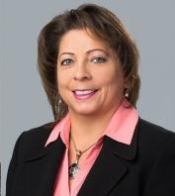
Introduction
Shelly J. Tucciarelli
Owner and CFO of Turtle Clan Development Services, LLC
Founder and Executive Director of Visionary Ventures NFP Corporation
Tribal Member of the Oneida Nation of Wisconsin – Reservation near Green Bay
Previously worked for 20 years at Illinois Housing Development Authority (IHDA) State Housing Finance Agency
Board Member of an affordable housing nonprofit
Advisory Board Member for 5 New Market Tax Credit – Community Development Entities (CDE)
In affordable housing for over 30 years

Slide 3
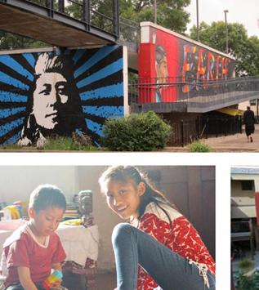
Session Introduction
One of the most marginalized communities yet a vibrant part of Chicago’s landscape. The Native American community has struggled with homelessness and a lack of affordable housing since the Indian Relocation Act of 1956. While many returned to the reservations, those that remained in Chicago lived in poverty, poor health, homelessness, and a loss of connection to tribal and cultural identities. Focusing on case studies and the history of Urban Native Americans in the Chicagoland area, we will discuss community engagement and the design/development process that seeks to enhance the connection to tribal and cultural identities while providing trauma informed designed housing for a vastly underserved and historically ill-treated community

Slide 4
History of Native American’s in Illinois
Major Misconception
All Native Americans live on reservations – reality is that only 30% of Native Americans live on reservations and the other 70% live in cities and suburban areas.
Treaty of Chicago of 1833 - Treaties removed remaining Native American from Chicago/Illinois – very few remained (1833-1950s)
1950’s
Termination – Cancel of all treaties and relations with Native American tribes
Relocation Act – Encouraged Native Americans to relocate from reservation to major cities like Chicago.
Were given $100 and a one-way bus ticket with a promise of housing, jobs, services and education.
Once they arrived there was no housing, services and few jobs.
We are now in the 3rd and 4th generations of Native Americans in Chicago.
We have over 100,000 Native Americans in Illinois and over 60,000 in the Chicagoland area.
Chicago represents over 150 different tribal nations.

Slide 5
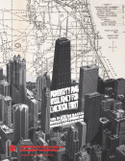
UIC Report – Adversity and Resiliency for Chicago’s First – The State of Racial Justice for American Indian Chicagoans
Report shows that over 60% of Native Americans in Chicago are renters and 50% are rent burdened, meaning they are living paycheck to paycheck and on the verge of homelessness if any major event were to happen.
When it comes to homelessness Native Americans do not often label themselves homeless because extended family will help with an extra room or couch to help out during rough times.
No one knows homelessness and displacement more than the Native American community.
https://uofi.app.box.com/s/a6bmexkq3nad7h579in5v3wwrw3exlrg

Slide 6
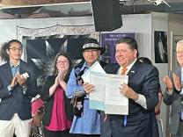
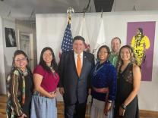
Advocacy For Our Native American Community
Governor signs 3 Bills for the Native Americans in Illinois
HB1633 – Mandates Native American History
SB1446 – Dress Code Policy (allows culturally appropriate attire at school ceremonies)
HB3413 – Remains – Native Americans

Slide 7
Advocacy For Our Native American Community
Chicago American Indian Community Collaboartive (CAICC)
Network of 16 Native American organizations and programs
Visionary Ventures is a board member
VV worked with CAICC on a grant for homelessness in our community
Received approval for a 2-year grant ($50,000 each year) for our Native American community

Slide 8
Mayor’s Lightfort’s Press Conference Announcing our Project

Slide 9
2907 W IRVING PARK DEVELOPMENT PROPOSAL
PREPARED BY:
2907 W IRVING PARK DEVELOPMENT

Slide 10
Development Team
Visionary Ventures (VV) is partnering with Full Circle Communities (FCC) to offer high-quality, affordable housing for Chicago’s Native American residents that reflects Indigenous culture and addresses the urban Native community’s unique needs.
Visionary Ventures
Full Circle Communities
Visionary Ventures’ mission is to work with community members to advocate and promote affordable housing, economic development and services to Native American, underserved and low-income communities. In providing these opportunities it helps bring stability and hope to individuals and families.
Full Circle’s mission is to expand access to quality affordable housing through preservation and development, thoughtful design, and the provision of significant and targeted supportive services to our residents and the surrounding communities. To achieve this mission, we dedicate 75% of our economics to services for our residents.
Architecture + Design
2907 W IRVING PARK DEVELOPMENT

Slide 11
Building Community: More than just housing
Full Circle dedicates 75% of project economics to providing supportive services
Services will be individually focused on each household’s needs and can range from case management to health care referrals, to youth programming
FCC partners with service organizations already working in the communities we serve
Full Circle Management is FCC’s in-house property management group
On-site property manager
On-site maintenance technician
Blended Management approach
2907 W IRVING PARK DEVELOPMENT

Slide 12
Outreach Findings
Advisory Council + Health Action Plan
Strong Connection to Nature Convey connection to river Include rooftop deck and garden beds Native plants and grasses | Incorporate Native Themes in Design Inspiration from Native jingle dancers in design colors Balcony orientation and view Façade conveys Chicago River | Amenities/Features Spaces for Native cultural practices, traditional gardening, and cooking classes Community programs and spaces for business development | Culturally Responsive Supportive approach Services & activities to counter isolation Connections to Mental health services and traditional healing programs
2907 W IRVING PARK DEVELOPMENT
2907 W IRVING PARK DEVELOPMENT

Slide 13
Local Need
Irving Park Community Stats
348 Units
Lost to Single Family Homes (2013-2019)
51.1%
39.6%
Distribution of Total Lost 2 to 4s to Vacant Land in the City of Chicago by Top 10 Community Areas, 2013 to 2019
Households are Renters
Renters are Cost-Burdened
$1,325
42.3%
No. 6 of all community areas for loss of 2-4 unit buildings
Low-Income Households in Unaffordable Units
Median Monthly Rent
2907 W IRVING PARK DEVELOPMENT

Slide 14
Citywide Efforts
As a Department of Housing supported development, 2907 W Irving Park responds to the goals of several citywide initiatives:
We Will Chicago (City Plan): Ensuring that every Chicago neighborhood is safe, inclusive, and vibrant, has healthy, affordable and accessible housing, and connects residents to what they need to thrive
DOH Qualified Allocation Plan: Ensure LIHTC developments serve residents most in need and address the overall deficits in affordable housing and the insufficiencies in units for specific subpopulations.
Connected Communities Ordinance: Create Equitable Transit Oriented Development (eTOD) by adding affordable housing units in a Transit-Served Location (TSL).
2907 W IRVING PARK DEVELOPMENT

Slide 15
Project Site
Location: 2907-17 W Irving Park Rd.
2907 W IRVING PARK DEVELOPMENT

Slide 16
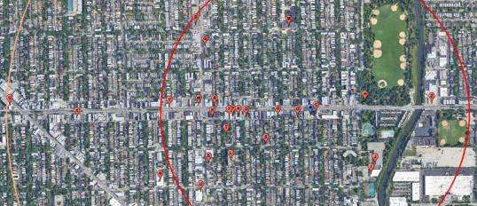
Project Site
AMENITIES
Location: Amenity Map
T﻿he development proposal is intentionally located to serve the Native American community, offering convenient access to community resources such as:
American Indian Center
Saint Kateri Center
American Indian Health Service of Chicago
Parks/trails, grocery stores, public schools, restaurants, and transportation
2907 W. Irving Park
0.5 mile
1 mile
—
A | Grocery Store | 0.26 mi
B | Grocery Store | 0.48 mi
C | Public Transportation | 0.01 mi
D | Retail Store | 0.20 mi
E | Retail Store | 0.37 mi
F | Retail Store | 0.26 mi
G | Government Services | 0.10 mi
H | Recreational Facilities/Park | 0.18 mi
I | Recreational Facilities/Park | 0.27 mi
J | Recreational Facilities/Park | 0.27 mi
K | Pharmacy | 0.30 mi
L | School | 0.27 mi
M | School | 0.30
N | School | 0.52
O | Restaurant | 0.05
P | Restaurant | 0.25
Q | Hospital/Health Clinic | 0.41
R | Hospital/Health Clinic | 0.30
S | Religious Institution | 0.17
T | Religious Institution | 0.28
U | Library | 0.97
V | Postal Service | 0.43
W | Banking Institution | 0.35
X | Banking Institution | 0.75
Y | Daycare Facility | 0.48
Z | Daycare Facility | 0.39
—
2907 W IRVING PARK DEVELOPMENT

Slide 17
Eligibility
All units will be affordable to households earning at or below 60-percent of the Area Median Income (AMI), currently $43,800 per year for an individual, and $62,520 per year for a family of four.
Native residents face unique affordability challenges — three out of every five Native American households are renters, and half are rent-burdened
Renters in general in the neighborhood face tough affordability challenges. 40% are cost-burdened, 10% higher than their owner counterparts.
The proposal is targeted and will be affirmatively marketed to Chicago’s Native community, but it is not restricted. All are welcome to apply
2907 W IRVING PARK DEVELOPMENT

Slide 18
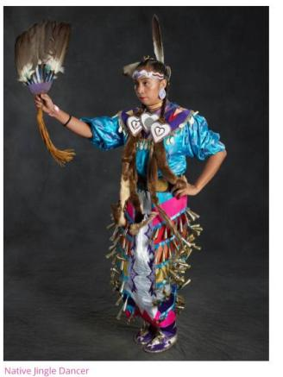
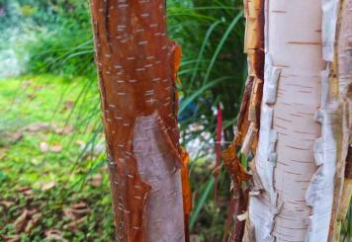
Inspiration
Nature & Culture
N
2907 W IRVING PARK DEVELOPMENT

Slide 19
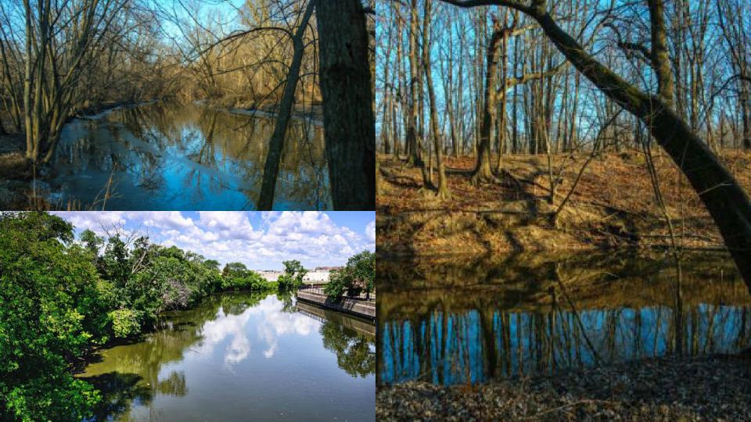

Slide 20
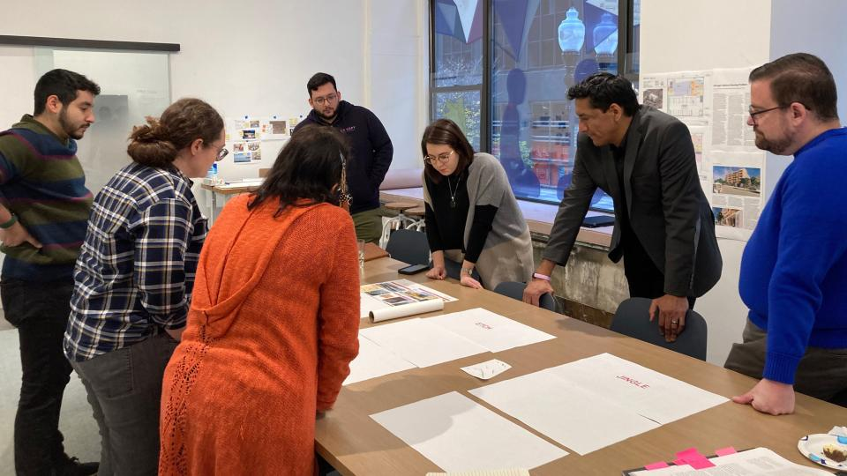

Slide 21
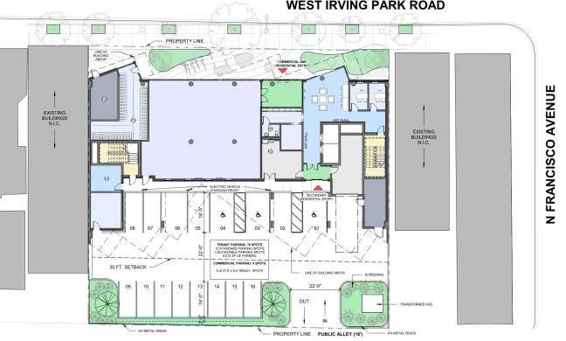
Level 1
Mixed Use
LOBBY
MEP
BIKE
ROOM
VESTIBULE
PM
SUPPORT
FUTURE
TENANT
BUILD-OUT
MAILBOXES
PACKAGE
ELEV
ELEV
WATER
HEATER
TRASH
STORAGE
ELEC
N
2907 W IRVING PARK DEVELOPMENT

Slide 22
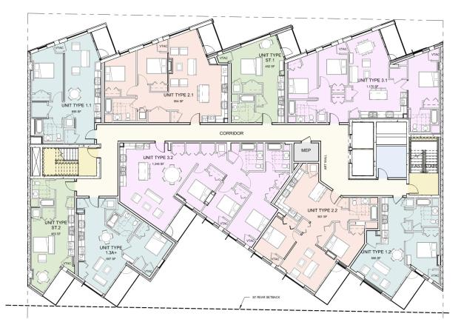
Levels 2-6
Residential
N
2907 W IRVING PARK DEVELOPMENT

Slide 23
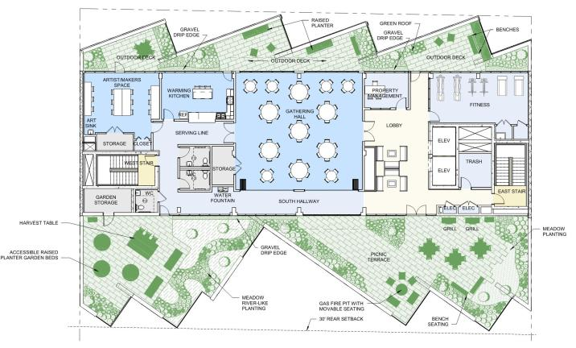
Level 7
Amenities
N
2907 W IRVING PARK DEVELOPMENT

Slide 24
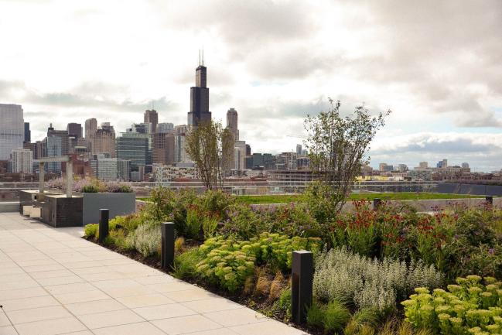
Level 7
Green Roof
N
2907 W IRVING PARK DEVELOPMENT

Slide 25
Youth Fence Art Installation
Native American youth art project
Important to get our youth involved and make the part of the project
Art was digitized
Will use art in community room when project complete

Slide 26
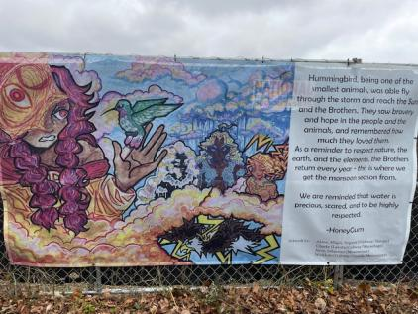
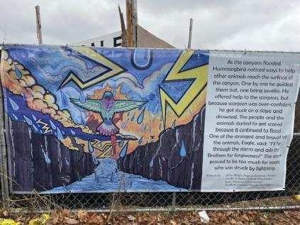

Slide 27
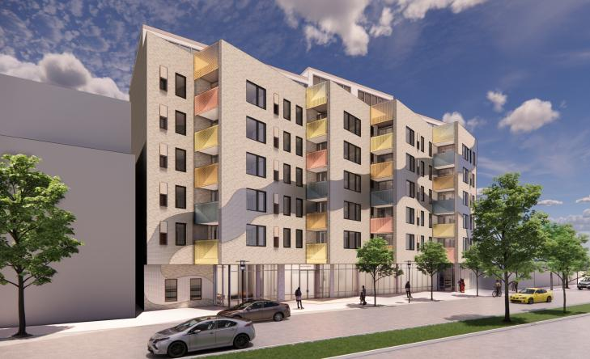
N
2907 W IRVING PARK DEVELOPMENT

Slide 28
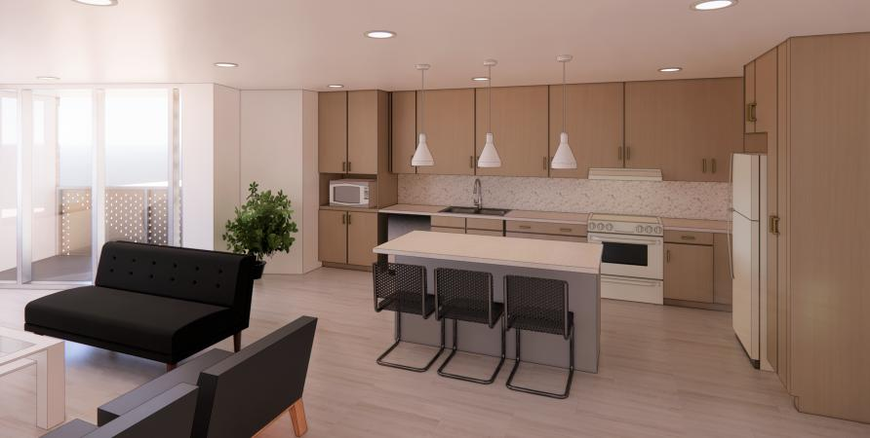
N
2907 W IRVING PARK DEVELOPMENT

Slide 29
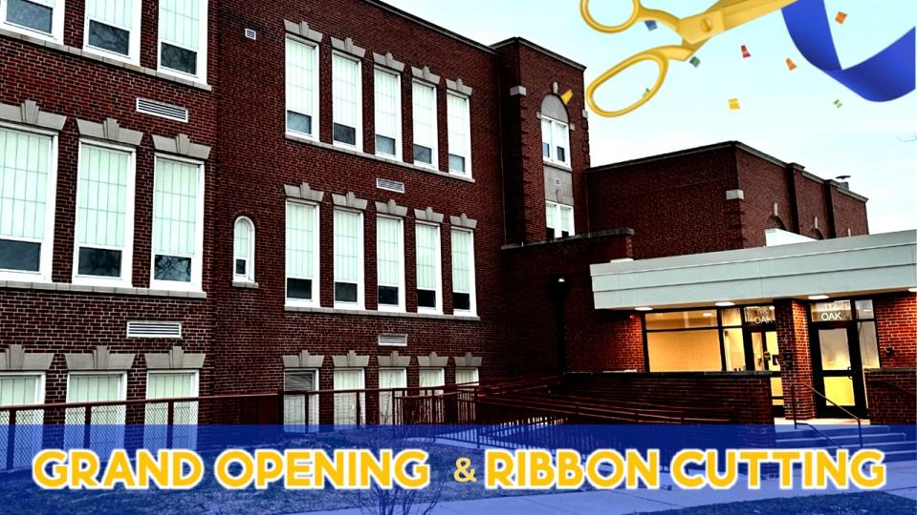

Slide 30
Fox Valley Apartments Aurora, IL – 47 Units
Sources of Funds
Low Income Housing Tax Credits
Illinois State Donation Tax Credits (school donated to the City/City donated to Visionary Ventures)
IHDA – Covid funds ($1.7 million) due to increased construction costs
City of Aurora Home Funds
City of Aurora Community Development Block Grant funds (For the VNA Clinic)
Federal Historic Tax Credits
State Historic Tax Credits
Rivers Edge Tax Credits
Construction Loan
Permanent mortage

Slide 31
The Werner & The Werner Bros – Rogers Park-Chicago
Project Summary
88 Units of Workforce housing
Twinning deal – 9% & 4%
The Werner Bros Storage building – on the seven most endangered building to be demolished
Federal Historic Tax Credits
Studio, one, two and three bedroom units
Commercial Space
Currency Exchange & Post Office to return to new building

Slide 32
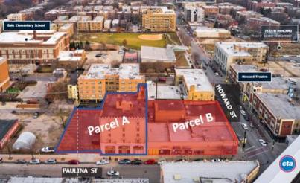

Slide 33
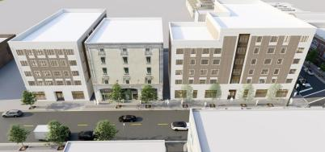

Slide 34
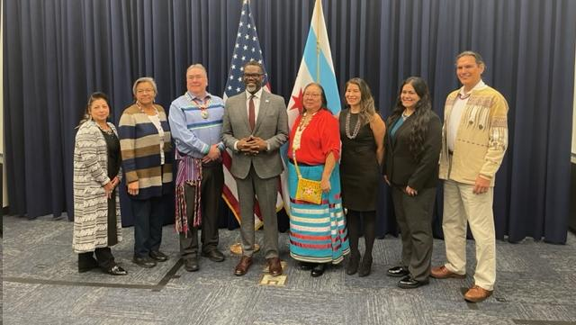

Slide 35
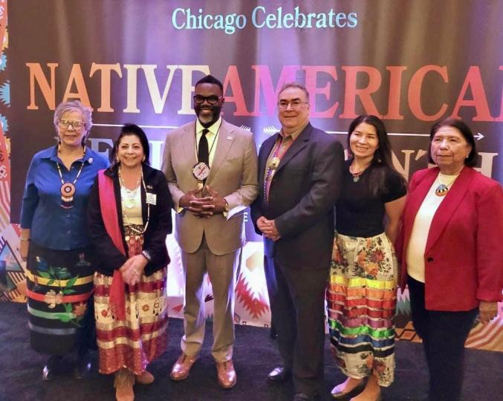

Slide 36
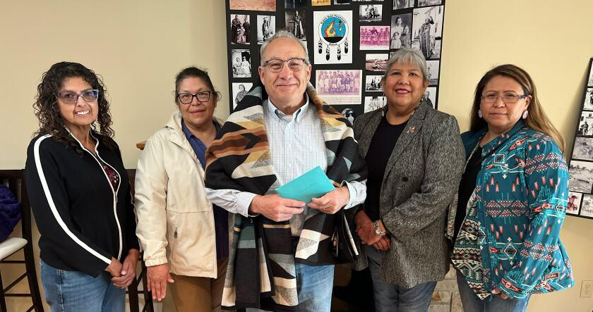

Slide 37
Prairie Band of the Potawatomi – First Federal Recognized Tribal Nation in Illinois
The Prairie Band of the Potawatomi
Reached a major milestone – reclaimed ancestral land in Illinois
Stolen land in 1849 – U.S. Government illegally auctioned off land in Southern Dekalb
Potawatomi – Spent millions to repurchase stolen land
U.S. Department of Interior – places portions of the Shab-eh-nay Reservation land into trust for the Potawatomi Nation
After 175 years – Illinois 35th state with a federally recognized Indian reservation

Slide 38
Questions & answers
Do you have any questions on what was covered today?
THANK YOU FOR ATTENDING!!
Contact information:
Shelly Tucciarelli, Visionary Ventures NFP Corporation
Stucciarelli.vvnfp@gmail.com
(312) 286-1737

