Slide 1
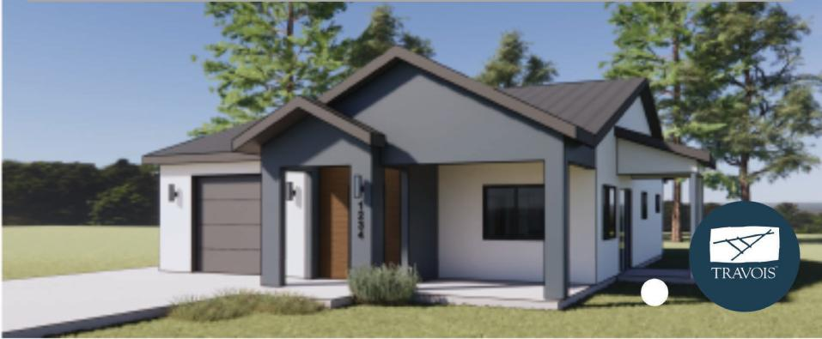
New Markets Tax Credits for Homeownership
(another funding tool in the toolbox)

Slide 2
New Markets Tax Credits ( MTC)
An Important Too to Access More Capital
a funding resource for community and economic development projects
•

Slide 3
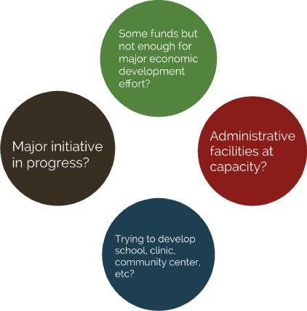
Addressing your community's economi•c development needs
•

Slide 4
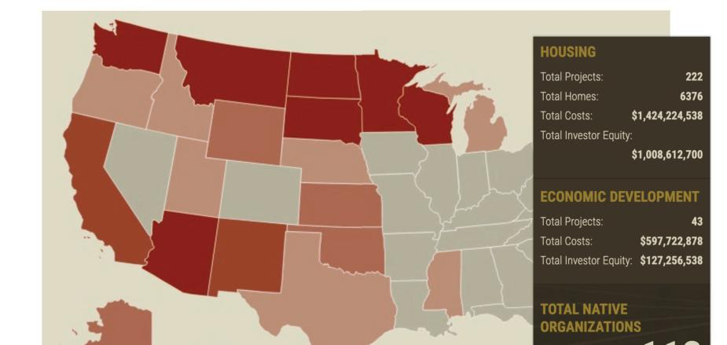

Slide 9
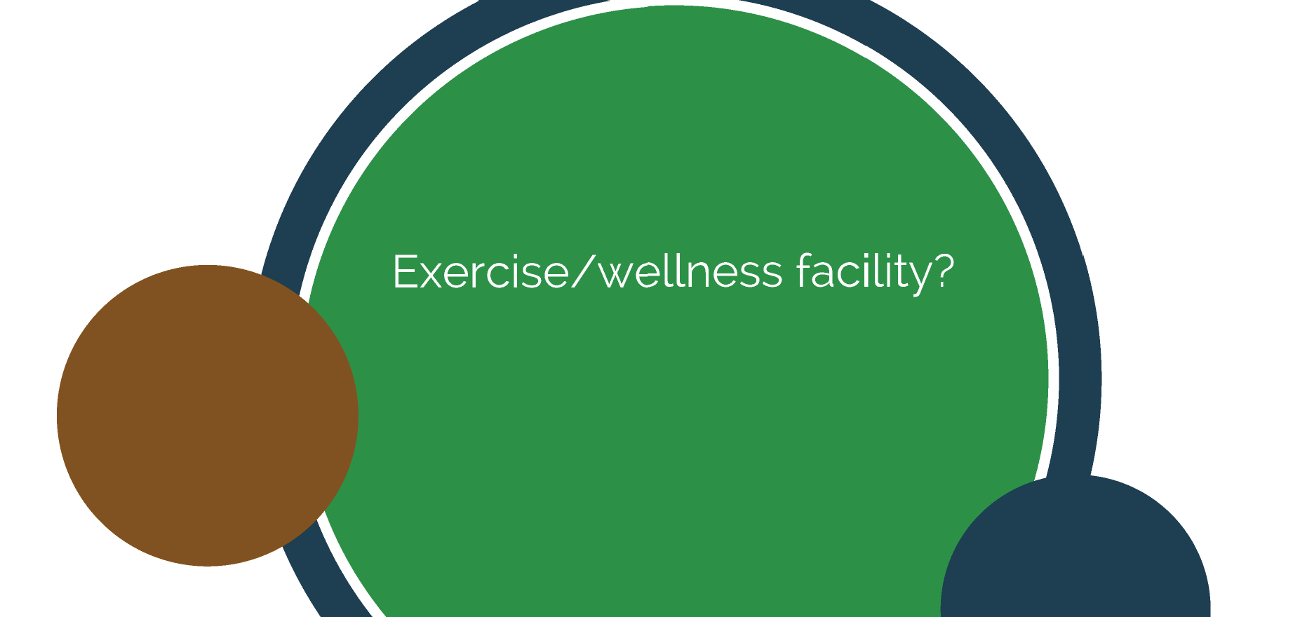

Slide 13
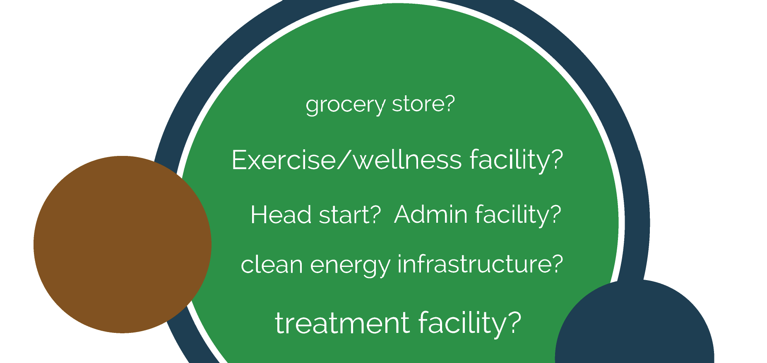

Slide 14
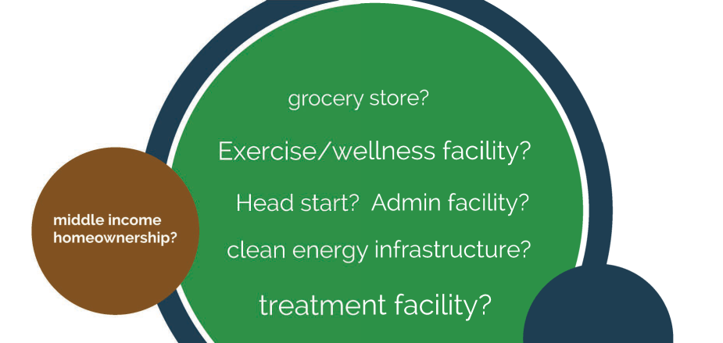

Slide 18
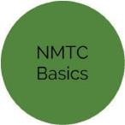
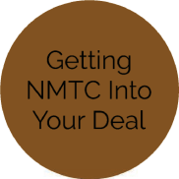
Real World Examples
FAQs
Add New Market Tax Credits to your toolbox
Eligibility
Hypothetical Project

Slide 19
Overview
US Department of Treasury
Community Development Financial Institutions Fund (CDFI)
39% tax credit on total development cost
7 year compliance period
$3.5 billion in allocation per year awarded to Community Development Entities (CDEs)
CDEs deploy credits to qualifying projects
Each CDE has different service area. investment goals
NMTCs can pay for 20-25% of total cost of development

Slide 20
Overview
US Department of Treasury
Community Development Financial Institutions Fund (CDFI)
39% tax credit on total development cost
7 year compliance period
$3.5 billion in allocation per year awarded to Community Development Entities (CDEs)
CDEs deploy credits to qualifying projects
Each CDE has different service area. investment goals
increased to $5B
NMTCs can pay for 20-25% of total cost of development

Slide 22
Community Dev,elopment Entities (CDEs)

Slide 23
Community Dev,elopment Entities (CDEs)
* Travois is a CDE

Slide 24
Community Dev,elopment Entities (CDEs)
* Travois is a CDE
*Collaboration with Chickasaw Nation CDE

Slide 25
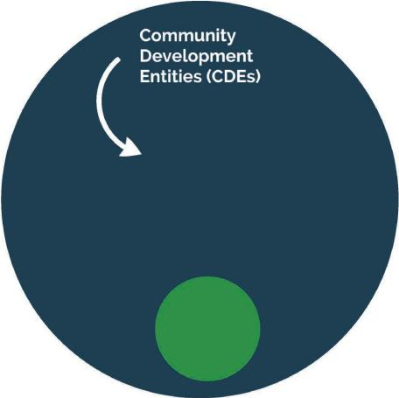
* Travois is a CDE
*Collaboration with Chickasaw Nation CDE

Slide 26
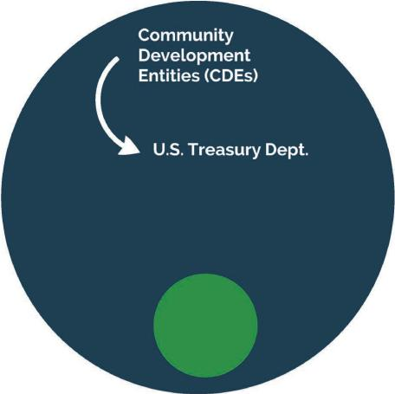
* Travois is a CDE
*Collaboration with Chickasaw Nation CDE

Slide 27
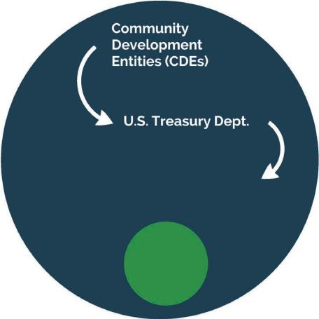
* Travois is a CDE
*Collaboration with Chickasaw Nation CDE

Slide 28
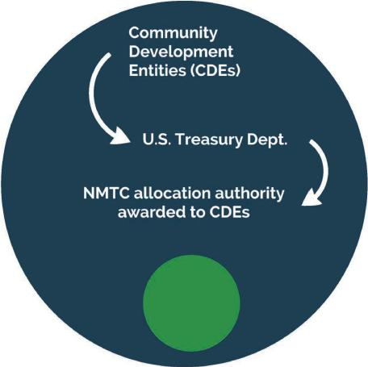
* Travois is a CDE
*Collaboration with Chickasaw Nation CDE

Slide 29
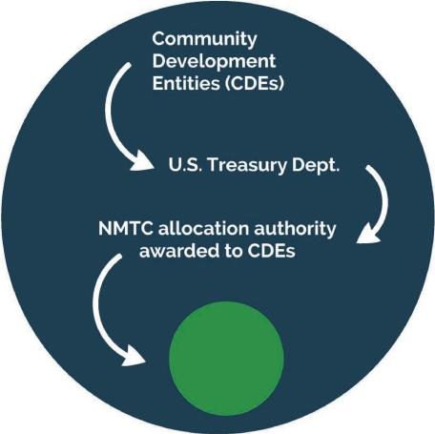
* Travois is a CDE
*Collaboration with Chickasaw Nation CDE

Slide 30
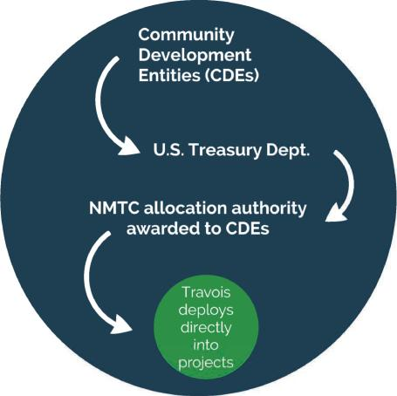
* Travois is a CDE
*Collaboration with Chickasaw Nation CDE

Slide 31
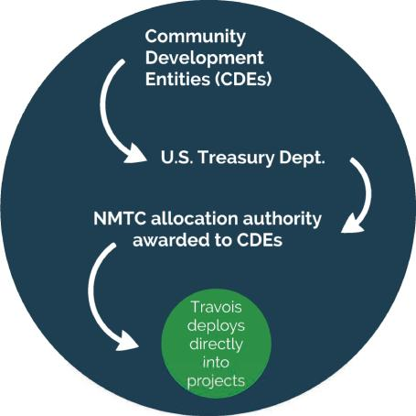
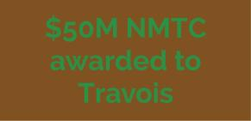
* Travois is a CDE
*Collaboration w·th
Chickasaw Nation CDE

Slide 32
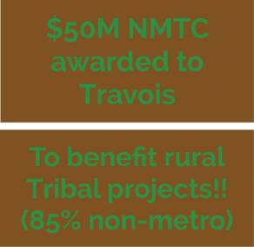
* Travois is a CDE
*Collaboration w·th
Chickasaw Nation CDE

Slide 35
San Poil Treatment Facility (Colville)
s

Slide 36
Native O ganization: Confederated Tribes of the Colville Reservation
Date Closed with Investor: 2019
Date C.ompleted:
Develop.ment Type:
Project Status: Under Construction
Total Investor Equity. $5,300,000
Total Project Cost: $19,700,000
ealth Care

Slide 37
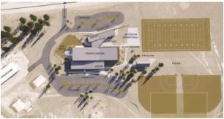
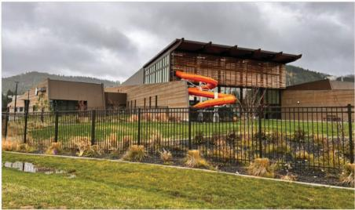
Coeur d'Alene Tribe and Marimn Health Youth Center
AT A GLANCE
Native Organization: Marimn Health
Date Closed with Investor: 2019
Date Completed:
Development Type: Community Center
Project Status: Under Construction
Total Investor Equity: $6,400,000
Total Project Cost: $20,000,000
s

Slide 38
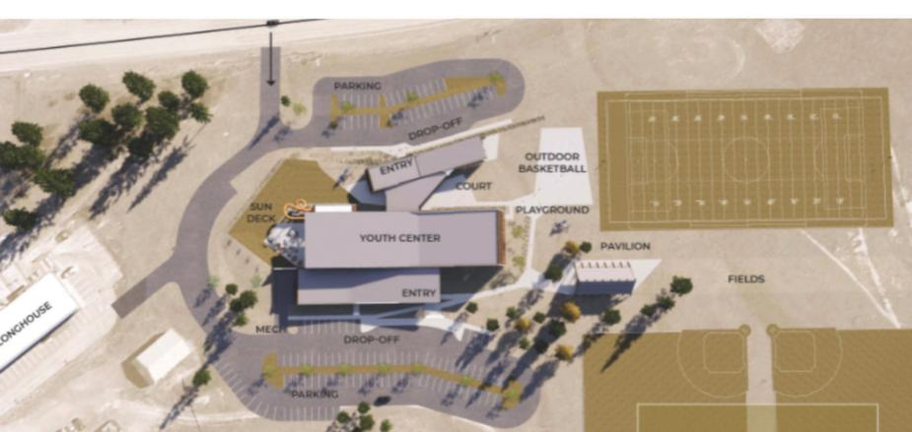

Slide 39
•
D
•
I
e

Slide 40
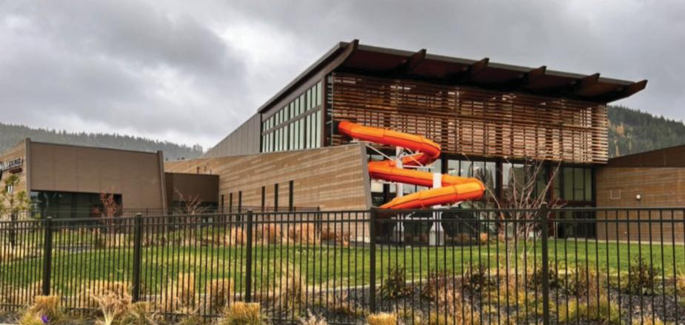

Slide 42
Current Allocation Commitments
(2024)

Slide 43
Current Allocation Commitments
(2024)
Grocery store/food sovereignty (CA)

Slide 44
Current Allocation Commitments
(2024)
Grocery store/food sovereignty (CA)
Education (HA)

Slide 45
Current Allocation Commitments
(2024)
Grocery store/food sovereignty (CA)
Education (HA)
Headstart
I
community
center (CA)

Slide 46
Current Allocation Commitments
(2024)
Grocery store/food sovereignty (CA)
Education (HA)
Headstart
I
community
center (CA)
Hospitality (OK)

Slide 47
Current Allocation Commitments
(2024)
Grocery store/food sovereignty (CA)
Education (HA)
Headstart
I
community
center (CA)
Hospitality (OK)
Admin/domestic violence services (AK)

Slide 49
Chickasaw Nation CDE Planned
NMTC
Investments
(2024)

Slide 50
Chickasaw Nation CDE Planned
NMTC
Investments
(2024)
Sovereignty/culture (AZ)

Slide 51
Chickasaw Nation CDE Planned
NMTC
Investments
(2024)
Sovereignty/culture (AZ)
Healthcare (WA)

Slide 52
Chickasaw Nation CDE Planned
NMTC
Investments
(2024)
Sovereignty/culture (AZ)
Healthcare (WA)
Childcare (NE)

Slide 53
Chickasaw Nation CDE Planned
NMTC
Investments
(2024)
Sovereignty/culture (AZ)
Healthcare
(WA)
Childcare
(NE)
Education/language (Ml)

Slide 54
Chickasaw Nation CDE Planned
NMTC
Investments
(2024)
Sovereignty/culture (AZ)
Healthcare
(WA)
Childcare
(NE)
Education/language (Ml)
Homeownership (AZ)

Slide 57
e Eligibility
Geographic
Project must be lo,cated in a low-income census tract
Business Type
Flexible for both real estate and non-real estate projects
Prohibited activities
Gaming
Golf courses
Farming
Liquor stores
Massage/hot tub parlors
Single family, residential rental properties

Slide 58
e Eligibility
Geographic
Project must be lo,cated in a low-income census tract
Business Type
Flexible for both real estate and non-real estate projects
Prohibited activities
Gaming
Golf courses
Farming
Liquor stores
Massage/hot tub parlors
Single familyJ residential rental properties

Slide 59
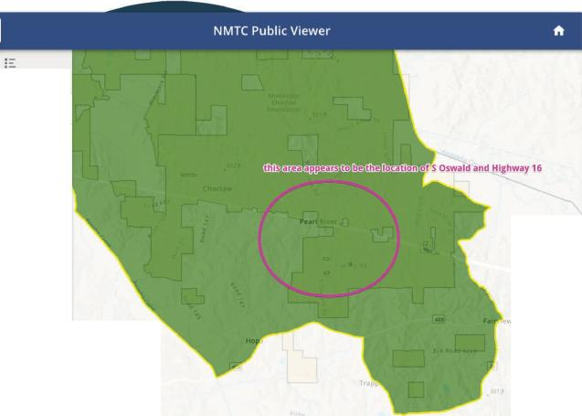
south oswald road cho, X
D •AILS
LAYERS
LEGEND
2020 NMTC Tract: 28099940100
MetroDesignation
on-metro
PovertyRate
30.00
PctMedianFamilylncome
60.00
UnemploymentRate
9.70
PovertyRateQualified
Yes
16
MedianlncomeQualified
CountyCode
28099
StateName
Waldo
Goocl H.o

Slide 60
NMTC to benefit
Tribal community
d v lopm nt projects
Every economic development project is unique. but there are two things common to all:
They a e all a mix of equity and debt.
They all have a gap

Slide 61
investment fund
Homeownership project
Tribe/TD HE
NMTC Investor
NMTC provider

Slide 62
Tribe
Tribe/Other
Competitve
NAHASDA
IHBG
investment fund
Homeownership project
Tribe/TD HE
NMTC Investor
NMTC provider

Slide 63
Tribe
Tribe/Other
Competitve
NAHASDA
IHBG
(leverage loan: -$6.4M)
investment fund
Homeownership project
Tribe/TDHE
NMTC Investor
NMTC provider

Slide 64
Tribe
Tribe/Other
NMTC investor funds
Competitve
NAHASDA
IHBG
(leverage loan: -$6.4M)
investment fund
Homeownership project
Tribe/TDHE
NMTC Investor
NMTC provider

Slide 65
Tribe
Tribe/Other
NMTC investor funds
Competitve
NAHASDA
IHBG
(NMTC enters via Community Dev Entity (aka entity that has NMTC aka Travois)
(leverage loan: -$6.4M)
investment fund
Homeownership project
Tribe/TDHE
NMTC Investor
NMTC provider

Slide 66
Tribe
Tribe/Other
NMTC investor funds
Competitve
NAHASDA
IHBG
(NMTC enters via Community Dev Entity (aka entity that has NMTC aka Travois)
(leverage loan: -$6.4M)
investment fund
(leverage loan: ~$6.4M)
Homeownership project
Tribe/TDHE
NMTC Investor
NMTC provider

Slide 67
Tribe
Tribe/Other
NMTC investor funds
Competitve
NAHASDA
IHBG
(NMTC enters via Community Dev Entity (aka entity that has NMTC aka Travois)
(leverage loan: -$6.4M)
investment fund
NMTC net benefit to Tribe: ~$1.4M
(leverage loan: ~$6.4M)
Homeownership project
Tribe/TDHE
NMTC Investor
NMTC provider

Slide 68
Other ways to understand this funding tool:

Slide 69
Other ways to understand this funding tool:
Example equates to $9.45M NMTC transaction

Slide 70
Other ways to understand this funding tool:
Example equates to $9.45M NMTC transaction
•
Investor
claims 39% tax credit over seven years of
NMTC transaction (-$3,7M in credits)

Slide 71
Other ways to understand this funding tool:
Example equates to $9.45M NMTC transaction
Investor
claims 39% tax credit over seven years of
NMTC transaction (-$3,7M in credits)
Investor
puts an amount less than that
into
the
transaction up front

Slide 72
Other ways to understand this funding tool:
Example equates to $9.45M NMTC transaction
Investor
claims 39% tax credit over seven years of
NMTC transaction (-$3,7M in credits)
Investor
puts an amount less than that
into
the
transaction
up front
Travois structure: assumes repayment not necessary because investor is getting benefit of tax credits

Slide 73
Other ways to understand this funding tool:
Example equates to $9.45M NMTC transaction
Investor
claims 39% tax credit over seven years of
NMTC transaction (-$3,7M in credits)
Investor
puts an amount less than that
into
the
transaction up front
Travois structure: assumes repayment not necessary because investor is getting benefit of tax credits
Win for Tribe/TDHE: another strategic funding tool that can enable homeownership programs to be scaled up

Slide 75
And the seven years of compliance?
Different from LIHTC where compliance function of the tenant living in the unit
is a

Slide 76
And the seven years of compliance?
Different from LIHTC where compliance function of the tenant living in the unit
is a
Shorter period (7 years) compared to LIHTC

Slide 77
And the seven years of compliance?
Different from LIHTC where compliance function of the tenant living in the unit
is a
Shorter period (7 years) compared to LIHTC
NMTC
=>
compliance
focus is on Tribe operating
an active, qualifying business (which in this case is a business of creating homeownership homes)

Slide 78
And the seven years of compliance?
Different from LIHTC where compliance function of the tenant living in the unit
is a
Shorter period (7 years) compared to LIHTC
NMTC
=>
compliance
focus is on Tribe operating
an active, qualifying business (which in this case is a business of creating homeownership homes)
Only 20% of units have to be sold to families <80% AMI

Slide 79
And the seven years of compliance?
Different from LIHTC where compliance function of the tenant living in the unit
is a
Shorter period (7 years) compared to LIHTC
NMTC
=>
compliance
focus is on Tribe operating
an active, qualifying business (which in this case is a business of creating homeownership homes)
Only 20% of units have to be sold to families <80% AMI
COE (Travois) site visit; not investor or state

Slide 80
And the seven years of compliance?
Different from LIHTC where compliance function of the tenant living in the unit
is a
Shorter period (7 years) compared to LIHTC
NMTC
=>
compliance
focus is on Tribe operating
an active, qualifying business (which in this case is a business of creating homeownership homes)
Only 20% of units have to be sold to families <80% AMI
COE (Travois) site visit; not investor or state
Business must remain "Active"; business must build at least one home for the remaining years of compliance

Slide 82
Getting NMTC
into Your Deal

Slide 83
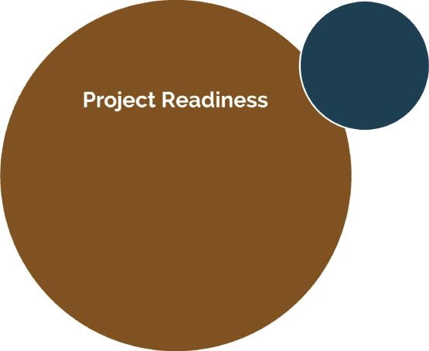
Getting NMTC into Your Deal

Slide 84
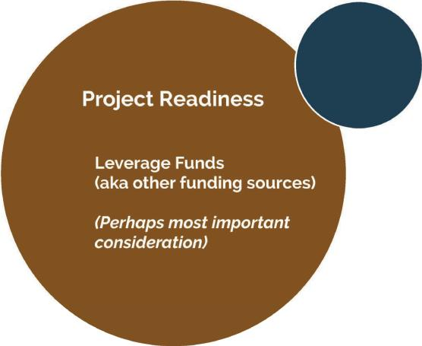
Getting NMTC into Your Deal

Slide 85
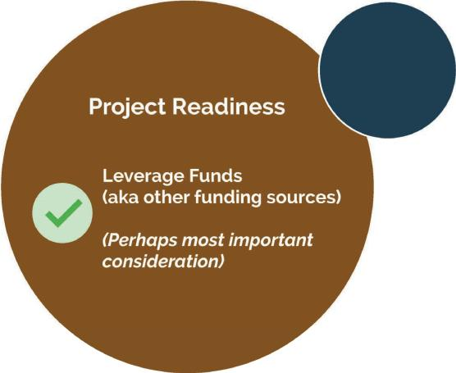
Getting NMTC into Your Deal

Slide 87
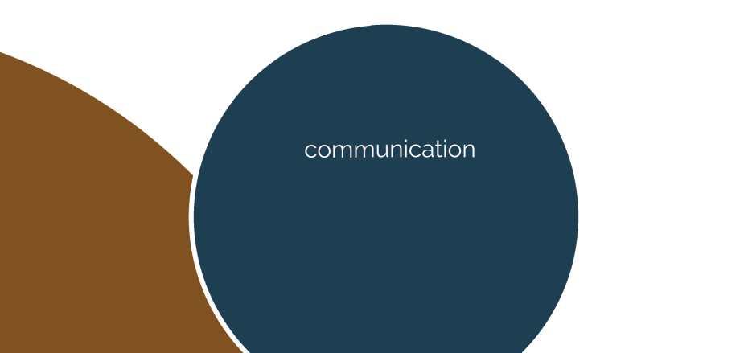

Slide 88
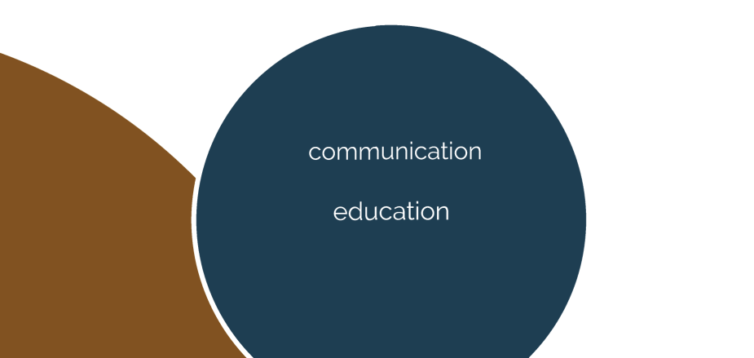

Slide 90
Frequently Asked Questions
Q: Can I use NMTCs in conjunction with other economic development programs?
A: Yes. State or federal economic development grants and loans can be combined with NMTC equity. Tribal funds or inter-Tribal cooperation funding programs can be blended with NMTC financing.
Q: What is the minimum project size for Travois New Markets?
A: $5 million
Q: What is the timeline for accessing this funding?
A: Program timeline vs development timeline...

Slide 91
Total Projects:
222
Total Homes:
6376
Total Costs:
$1,424,224,538
Total Investor Equity:
$1,008,612,700
Total Proje | ,cts:
Total Costs | :
Total Investor Equity:
43
$597,722,878
$127,256,538
112

Slide 92
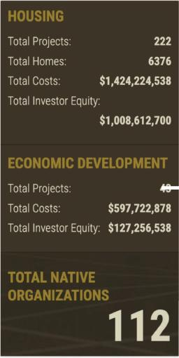
₄₋₋₋ Tribes Leveraging
NMTC with Travois
'

Slide 93
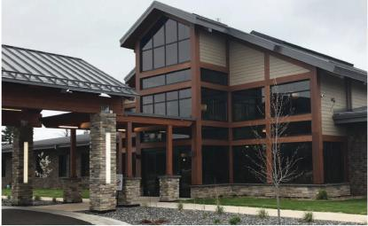
Lac Vieux Desert Health Center
Medical and dental care
$13.5M total cost
$3.5M investor equity
Provides high-quality public servi^{I} ces
Creates jobs and boosts local economy

Slide 94
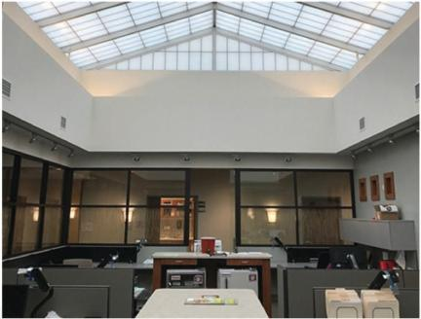
Lac Vieux Desert Health Center
Medical and dental care
$13.5M total cost
$3.5M investor equity
Provides high-quality public servi^{I} ces
Creates jobs and boosts local economy

Slide 95
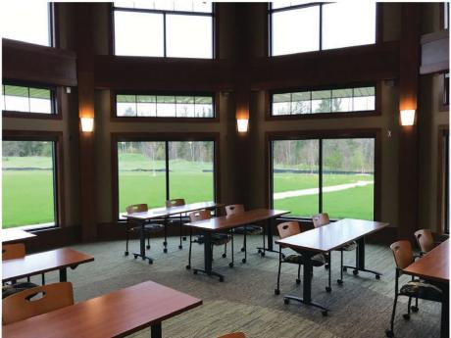
Lac Vieux Desert Health Center
Medical and dental care
$13.5M total cost
$3.5M investor equity
Provides high-quality public servi^{I} ces
Creates jobs and boosts local economy

Slide 96
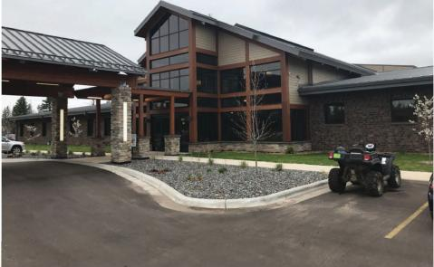
Lac Vieux Desert Health Center
Medical and dental care
$13.5M total cost
$3.5M investor equity
Provides high-quality public servi^{I} ces
Creates jobs and boosts local economy

Slide 97
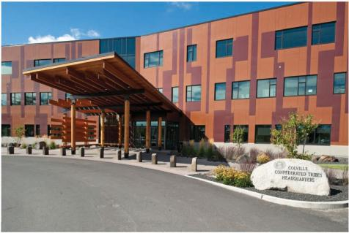
Colville Government Services Center
Lucy F. Covington Government Center
$44M total cost
$6M investor equity
Unification of service providers

Slide 98
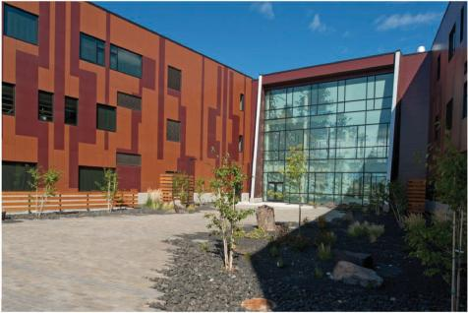
Colville Government Services Center
Lucy F. Covington Government Center
$44M total cost
$6M investor equity
Unification of service providers

Slide 99
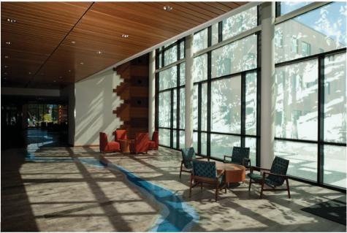
Colville Government Services Center
Lucy F. Covington Government Center
$44M total cost
$6M investor equity
Unification of service providers

Slide 100
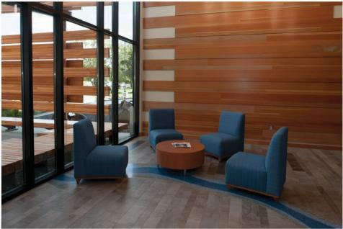
Colville Government Services Center
Lucy F. Covington Government Center
$44M total cost
$6M investor equity
Unification of service providers

Slide 101
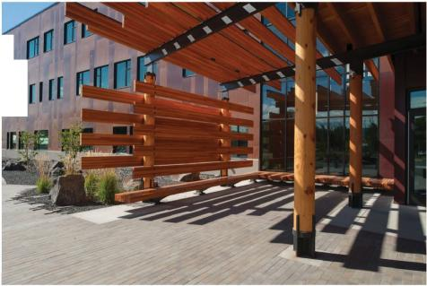
Colville Government Services Center
Lucy F. Covington Government Center
$44M total cost
$6M investor equity
r
[[[
Unification of service providers

Slide 102
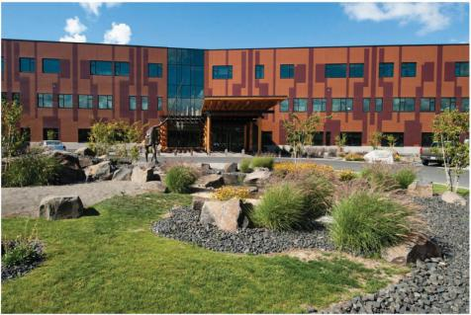
Colville Government Services Center
Lucy F. Covington Government Center
$44M total cost
$6M investor equity
Unification of service providers

Slide 103
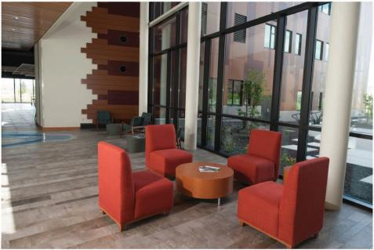
Colville Government Services Center
Lucy F. Covington Government Center
$44M total cost
$6M investor equity
Unification of service providers

Slide 104
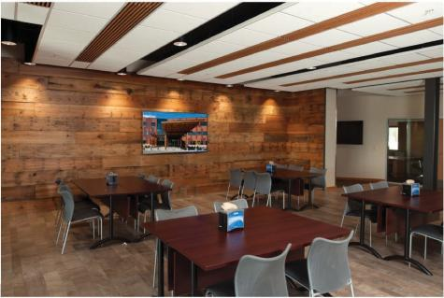
Colville Government Services Center
Lucy F. Covington Government Center
$44M total cost
$6M investor equity
Unification of service providers

Slide 105
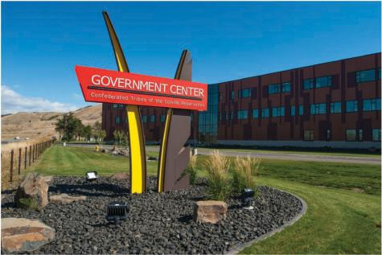
Colville Government Services Center
Lucy F. Covington Government Center
$44M total cost
$6M investor equity
Unification of service providers

Slide 106
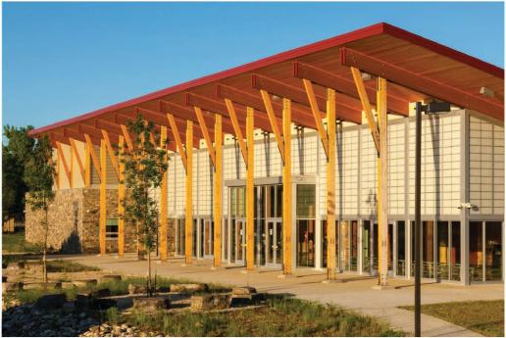
Little Big Horn College Health and Wellness Center
35,000-square-foot Health and Wellness Center
$10.3M total cost
$2.36M investor equity
Heath and wellness education programs and exercise facilities
i s

Slide 107
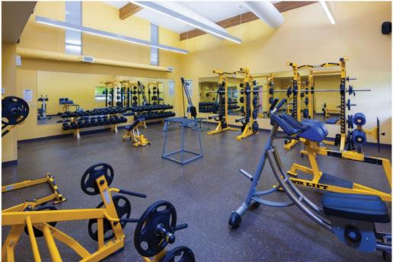
Little Big Horn College Health and Wellness Center
35,000-square-foot Health and Wellness Center
$10.3M total cost
$2.36M investor equity
Heath and wellness education programs and exercise facilities
i s

Slide 108
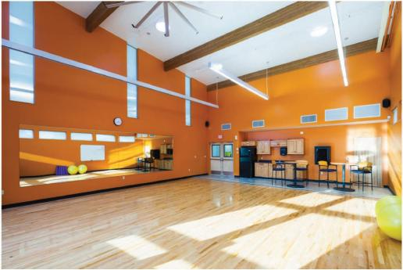
Little Big Horn College Health and Wellness Center
35,000-square-foot Health and Wellness Center
$10.3M total cost
$2.36M investor equity
Heath and wellness education programs and exercise facilities
i s

Slide 109
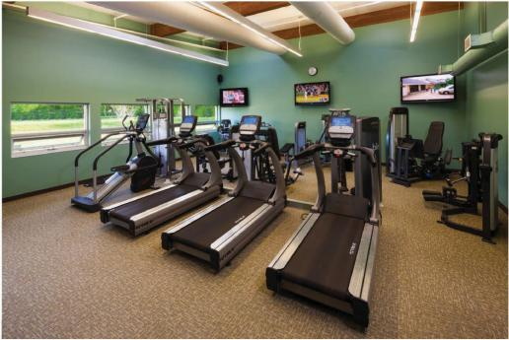
Little Big Horn College Health and Wellness Center
35,000-square-foot Health and Wellness Center
$10.3M total cost
$2.36M investor equity
Heath and wellness education programs and exercise facilities
i s

Slide 110
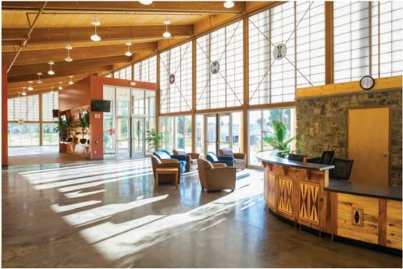
Little Big Horn College Health and Wellness Center
35,000-square-foot Health and Wellness Center
$10.3M total cost
$2.36M investor equity
Heath and wellness education programs and exercise facilities
i s

Slide 111
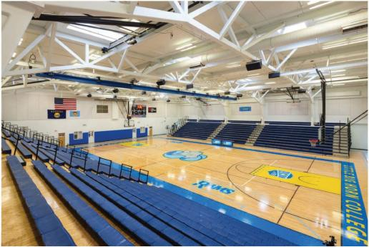
Little Big Horn College Health and Wellness Center
35,000-square-foot Health and Wellness Center
$10.3M total cost
$2.36M investor equity
Heath and wellness education programs and exercise facilities
i s

Slide 112
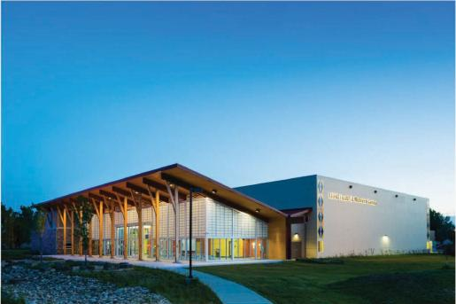
Little Big Horn College Health and Wellness Center
35,000-square-foot Health and Wellness Center
$10.3M total cost
$2.36M investor equity
Heath and wellness education programs and exercise facilities
i s

Slide 113
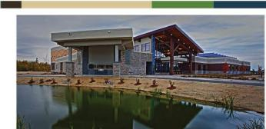
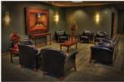
Bois Forte Community and Government Services Center
48,852-square-foot Community and Government Services Facility
$12.SM total cost
$3.75M investor equity
Credit union. home health care, emergency services. governmental services and meeting space
Energy efficient

Slide 114
Educare Winnebago
Early childhood education program
$11.4M total cost
$3.55M investor equity through New Markets Tax Credit program
Created 59 full time jobs and 73 constructio,n jobs
Estimated to serve 191 students and families
I s

Slide 115
Educare Winnebago
Early childhood education program
$11.4M total cost
$3.55M investor equity through New Markets Tax Credit program
Created 59 full time jobs and 73 constructio,n jobs
Estimated to serve 191 students and families
I s

Slide 116
Educare Winnebago
Early childhood education program
$11.4M total cost
$3.55M investor equity through New Markets Tax Credit program
Created 59 full time jobs and 73 constructio,n jobs
Estimated to serve 191 students and families
I s

Slide 117
Educare Winnebago
Early childhood education program
$11.4M total cost
$3.55M investor equity through New Markets Tax Credit program
Created 59 full time jobs and 73 constructio,n jobs
Estimated to serve 191 students and families
I s

Slide 118
Educare Winnebago
Early childhood education program
$11.4M total cost
$3.55M investor equity through New Markets Tax Credit program
Created 59 full time jobs and 73 constructio,n jobs
Estimated to serve 191 students and families
I s

Slide 119
Educare Winnebago
Early childhood education program
$11.4M total cost
$3.55M investor equity through New Markets Tax Credit program
Created 59 full time jobs and 73 constructio,n jobs
Estimated to serve 191 students and families
I s

Slide 120
Yukon-Koyukuk Elder Assisted Living Facility
Assisted living and health care servi^{I} ces
$7.8M total cost
$2.12M investor equity
Solar panels and biomass furnace

Slide 121
Yukon-Koyukuk Elder Assisted Living Facility
Assisted living and health care servi^{I} ces
$7.8M total cost
$2.12M investor equity
Solar panels and biomass furnace

Slide 122
Yukon-Koyukuk Elder Assisted Living Facility
Assisted living and health care servi^{I} ces
$7.8M total cost
$2.12M investor equity
Solar panels and biomass furnace

Slide 123
Yukon-Koyukuk Elder Assisted Living Facility
Assisted living and health care servi^{I} ces
$7.8M total cost
$2.12M investor equity
Solar panels and biomass furnace

Slide 124
Coeur d'Alene Tribe and Marimn Health Youth Center
SUN 0EO, / NATATORIUM
AT A GLANCE
Native Organization: Marimn Health
Date Closed with Investor: 2019
Date Completed:
Development Type: Community Center
Project Status: Under Construction
Total Investor Equity: $6,400,000
Total Project Cost: $20,000,000
s

Slide 127
at·ve O ganizat·on. Mar m Hea
Da e Cosed • h Investor 2019
Da e Comple ed:
eve o m nt y e. Community Ce e
oject S atus. Unde
Tota Inves o E u· · . $6,400,000
To a Pro·ect Cost. $2 ,000,000
Cons rue 10

Slide 128
Coeur d'Alene Tribe and Marimn Health Youth Center
SUN 0EO, / NATATORIUM
AT A GLANCE
Native Organization: Marimn Health
Date Closed with Investor: 2019
Date Completed:
Development Type: Community Center
Project Status: Under Construction
Total Investor Equity: $6,400,000
Total Project Cost: $20,000,000
s

Slide 129
San Poil Treatment Facility (Colville)
Native Organization: Confederated Tribes of the Colville Reservation
Date Closed with Investor: 2019
Date Completed:
Development Type: Health Care
Project Status: Under Construction
Total Investor Equity: $5,300,000
Total Project Cost: $19,700,000
s

Slide 130
San Poil Treatment Facility (Colville)
Native Organization: Confederated Tribes of the Colville Reservation
Date Closed with Investor: 2019
Date Completed:
Development Type: Health Care
Project Status: Under Construction
Total Investor Equity: $5,300,000
Total Project Cost: $19,700,000
s

Slide 131
Native Organization: Confederated Tribes of the Colville Reservation
Date Closed with Investor: 2019
Date C.ompleted:
Develop.ment Type: Health Care
Project Status: Under Construction
Total Investor Equity. $5,300,000
Total Project Cost: $19,700,000

Slide 132
San Poil Treatment Facility (Colville)
Native Organization: Confederated Tribes of the Colville Reservation
Date Closed with Investor: 2019
Date Completed:
Development Type: Health Care
Project Status: Under Construction
Total Investor Equity: $5,300,000
Total Project Cost: $19,700,000
s

Slide 133
Timeline/next steps

Slide 134
New Markets Tax Credits for Homeownership
(another funding tool in the toolbox)

Slide 135
Adam Rose
c) 816-506-4459
arose@travois.com
TRAVOIS™

Slide 136
New Markets Tax Credits for Homeownership
(another funding tool in the toolbox)

