Slide 2
Innovations in Homeownership
Increasing Homeownership in Native Communities
Tyler Baker, Program Manager
MT Native Homeownership Coalition
Notes:
Introduce self

Slide 3
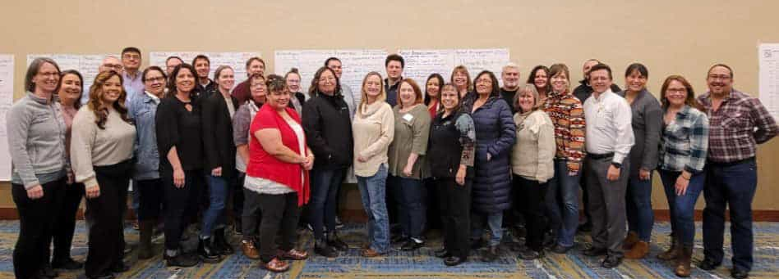
Introduction to the Coalition
We create equitable homeownership opportunities for Native Americans in Montana by providing a collaborative space where diverse stakeholders join together to formulate sustainable solutions.
Notes:
Introduce Coalition, history

Slide 4
Introduction to the Coalition
Steering Committee
Mortgage Lending Committee
Infrastructure and Housing Development
Education and Counseling Committee
We envision thriving Native American communities with robust economies led by abundant Native homeownership. This is supported by well-developed infrastructure, quality housing stock, affordable financing options, and multiple homebuyer resources.
Notes:
Discuss meeting frequencies and overview of what each does and how they got started. Also note that they are all comprised of individuals across Montana and external states that are all volunteers.

Slide 5
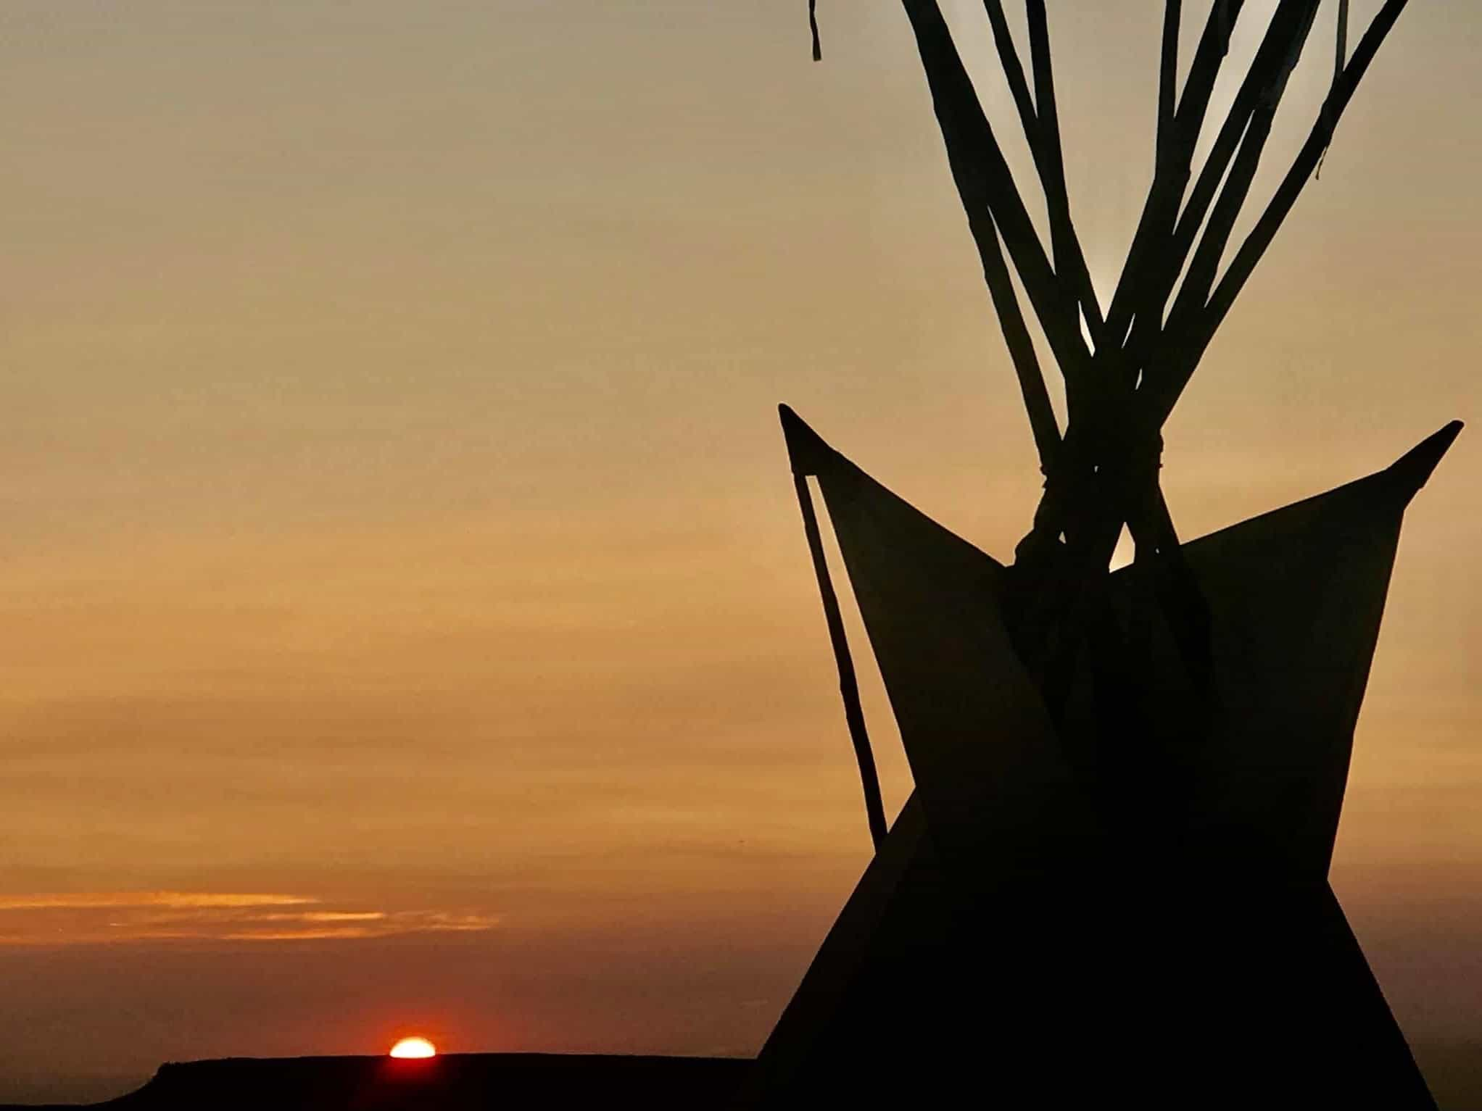
The Importance of Homeownership
Why Homeownership Matters
Cultural
Economic
Social Impacts
Text goes here.
Current Homeownership Challenges
Limited Housing Stock
Land and Legal Processes
Financing Barriers

Slide 6
Innovative Financing Solutions
Mortgage Lending Committee
Milestones
CDFI involvement/support
HUD/USDA program collaboration
Tribal Specific Lending options and partnerships with financial institutions
Myth busting
Creative Lending
Increasing CDFI Capital
Asset Mapping and understand local nuances
Map Leasehold Mortgage Process
Identify BIA-related issues
Identify current and potential lending products/partners
Develop and Connect Lending Tools
Create Lending Matrix Tool
Training for Lenders and Practitioners
Secondary Market Opportunities

Slide 7
Innovative Housing Models
Infrastructure and Housing Development Committee
Milestones
Identify Infrastructure Landscape on each reservation
Educational component for organizations/tribes
Identify innovative construction/development opportunities
Identify landscape of infrastructure resources
Gauthier Lane, Pablo MT
Highlighting each process component
Tribal-specific housing designs
Roofing machinery – Blackfeet
3-D Printing
Shipping Container Homes
Tiny Homes
Sustainable energy solutions
Notes:
Bob Gauthier Lane in pablo, discuss the story and the work put into it as well as highlighting each step of the process and having everyone present at the ribbon cutting ceremony from housing officials to contractors and homebuyers that all played a vital role in the process.
Talk about the differences from tribe to tribe, and the differences in areas within each tribe, microclimates, insurance requirements, infrastructure access.

Slide 8
Education and Counseling
Identify and map existing services on each reservation
Bring additional training opportunities to Montana
Financial support for certification and services
Expand network and Tribal participation
Promote positive stories
Financial literacy and homebuyer readiness programs
Homebuyer Scholarships
Tribal visits
Community workshops
Support

Slide 9
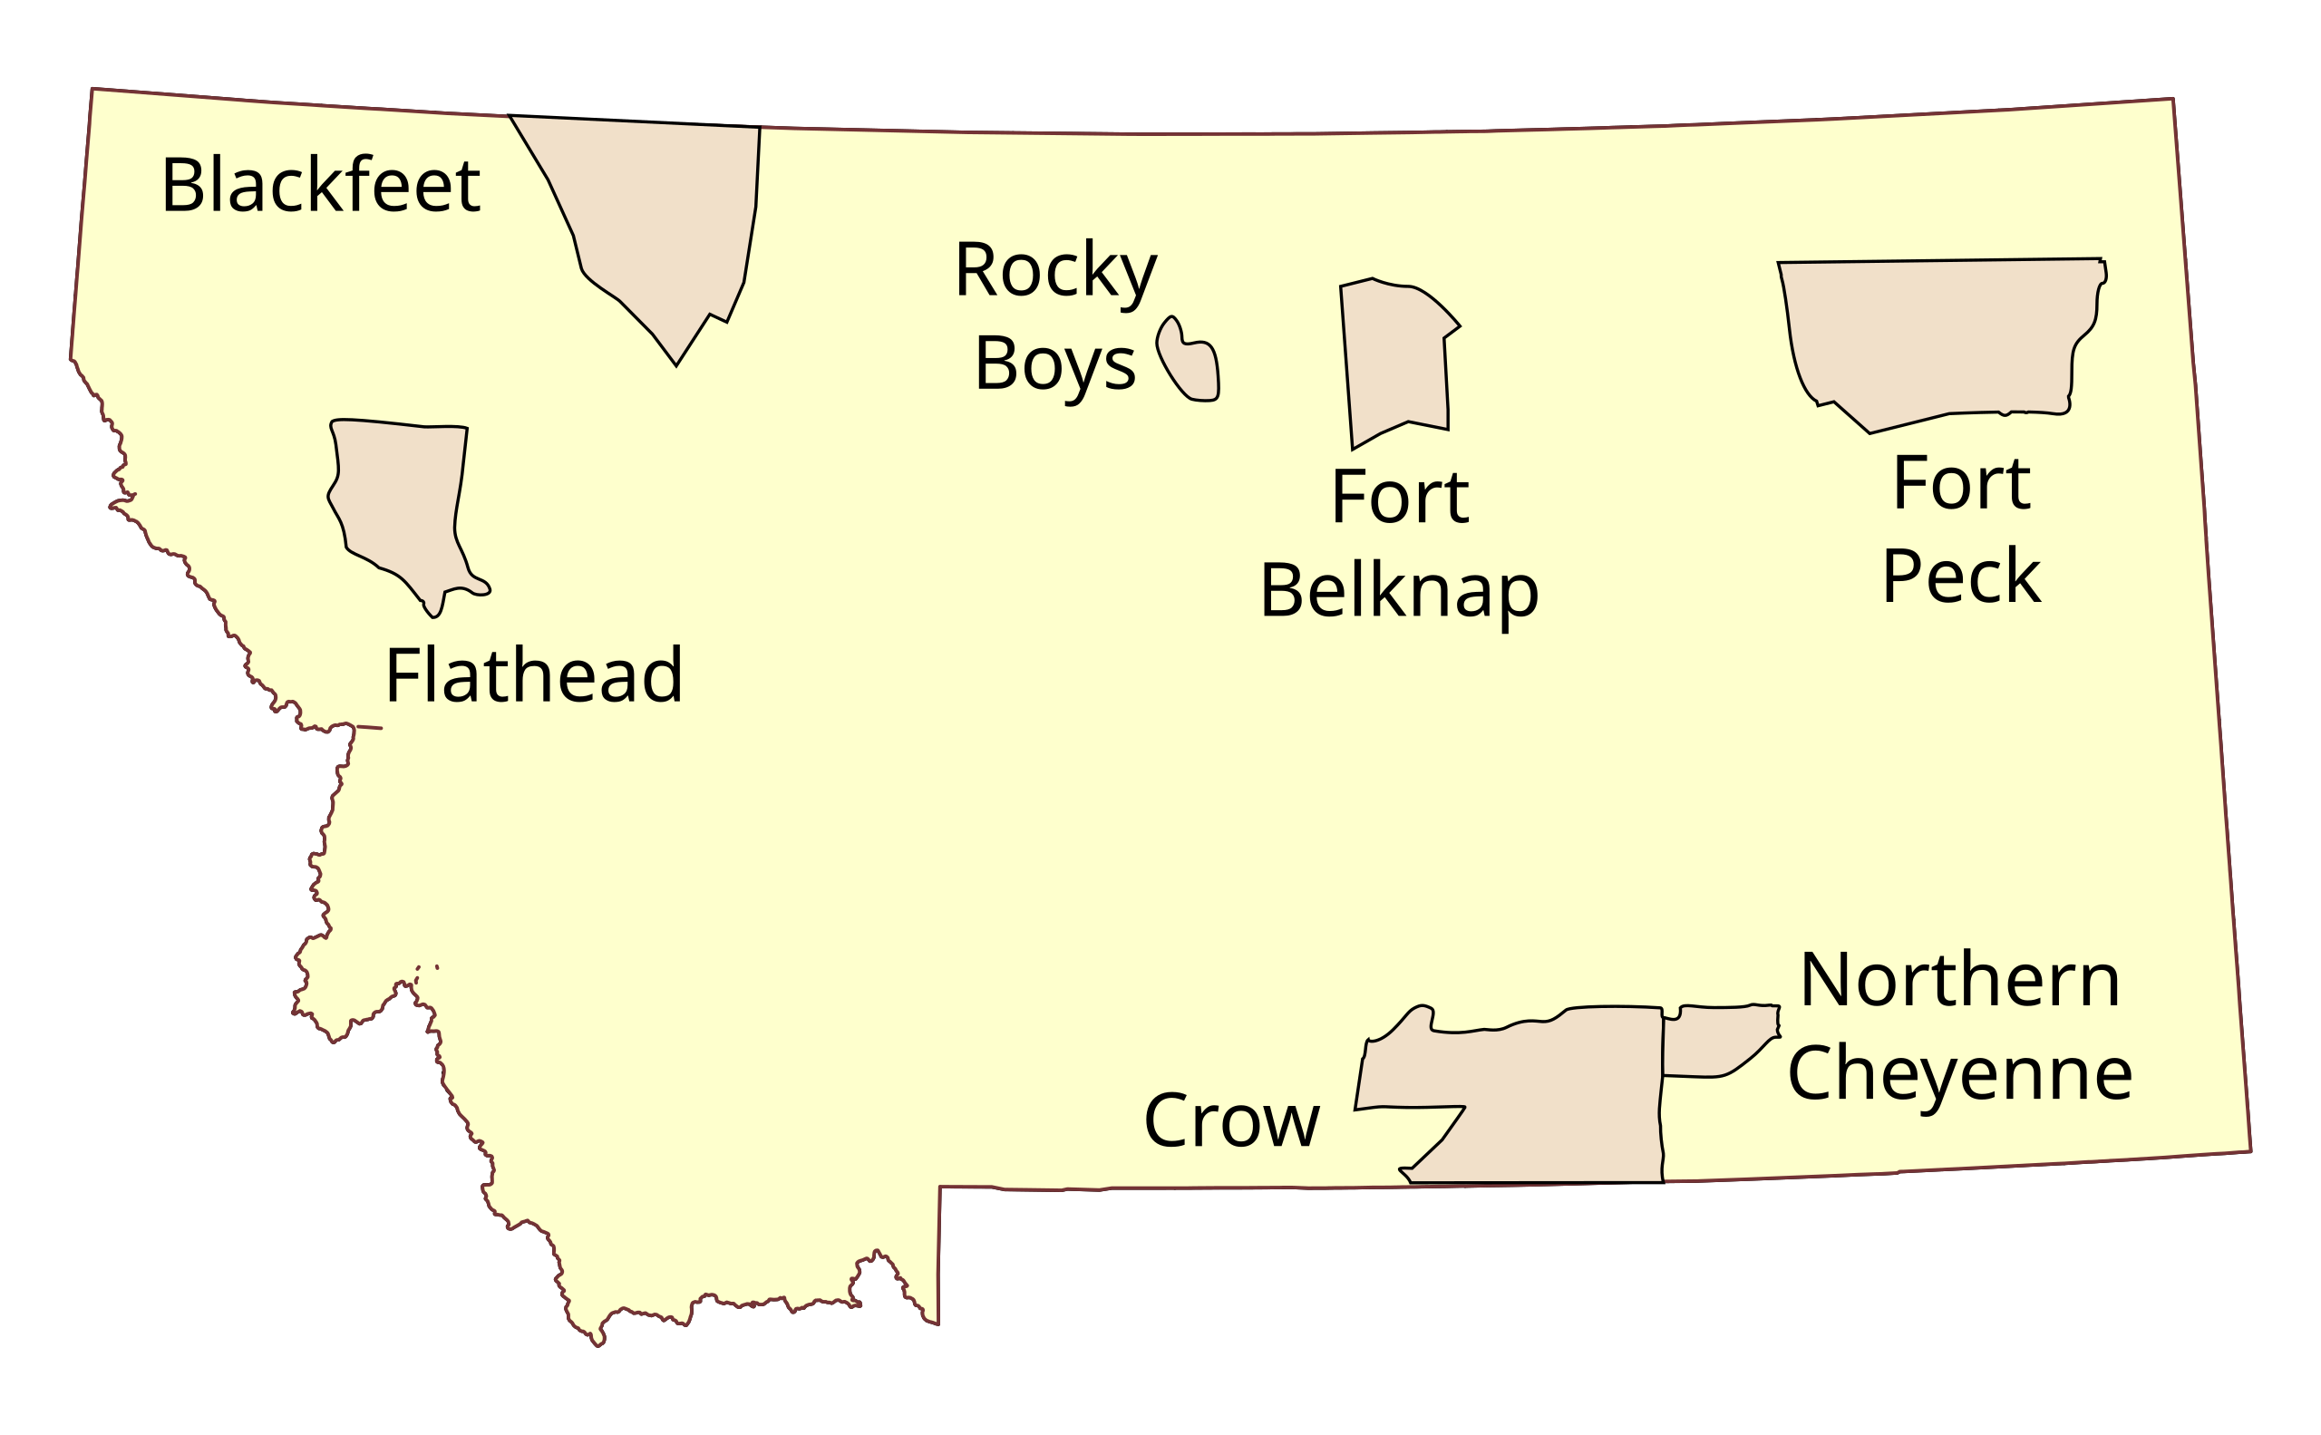
Asset Mapping for Informed Development
What is Asset Mapping?
Comprehensive Inventory
Mortgage Lending
Infrastructure and Housing Development
Education and Counseling
Along with Needs Assessment
Helps Identify:
Gaps
Bottlenecks
Opportunities
Notes:
Recent Examples and findings from site visits

Slide 10
Community Partnerships and Engagement
Grassroots Initiatives: Building Trust and buy-in
Collaborations with tribal leaders and local entities
Inter-tribal knowledge sharing
Notes:
8 Tribes, NACDC, Plenty Doors Community Development

Slide 11
The Future of Native Homeownership
Long-Term Vision:
We envision thriving Native American communities with robust economies led by abundant Native homeownership. This is supported by well-developed infrastructure, quality housing stock, affordable financing options, and multiple homebuyer resources.
Notes:
Going back to our vision. More often we get stuck in the mindset of big picture objectives, sometimes it is best to step back and look at things in a different way. Homeownership is one of the foundations for building strong economies, maintaining strong health, etc.

Slide 12
Thank you
Montana Native Homeownership Coalition
Tyler Baker
tbaker@nwmt.org
406-833-1090
Notes:
Before opening up for questions take a moment to thank everyone for listening as well as all the work that they are doing for our shared goals. Also building our website and encourage anyone interested to reach out to explore ideas or visit.

