Slide 2
Investing in Future Generations
Seth Fairchild
Executive Director of Cultural Services
Choctaw Nation
Megan Cruz
Research Officer
Federal Reserve Bank of St. Louis
(Osage Nation)

Slide 3
The views expressed in this presentation do not necessarily reflect the Federal Reserve Bank of St. Louis or the Federal Reserve System.

Slide 4
What is the Federal Reserve?
MONETARY POLICY
SUPERVISION AND REGULATION
PAYMENT SERVICES
“The Fed” is the central bank of the United States.

Slide 5
Federal Reserve District Map
BOSTON
NEW YORK
PHILADELPHIA
CLEVELAND
RICHMOND
ATLANTA
CHICAGO
ST. LOUIS
MINNEAPOLIS
KANSAS CITY
DALLAS
SAN FRANCISCO
BOARD OF GOVERNORS
BRANCH OFFICES
Text goes here
9I
1A
4D
2B
7G
3C
12L
10J
8H
5E
6F
11K

Slide 6
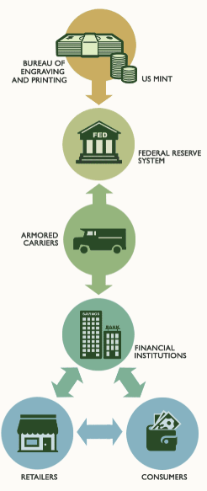
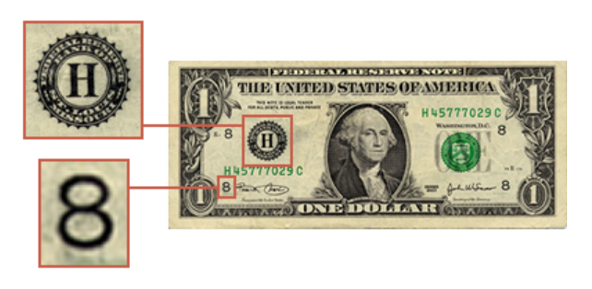
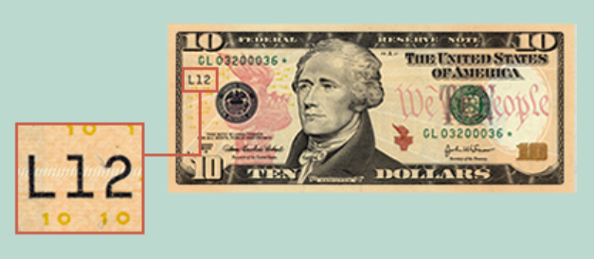
St. Louis
San Francisco

Slide 7
NEFEE supports the financial and economic well-being of tribal nations and Native communities across the United States by strengthening access to economic and personal finance education.

Slide 8
Investing in Future Generations
What’s important in your community?
Perspectives on investing in youth initiatives
Culture and language
Financial education
Career exploration and leadership development
Building community partnerships and networks
How to start?
Q&A session

Slide 9
What’s important in your community?
Value: what is important in life (Oxford dictionary).
Identify the values you want to impart to youth in your community.
Knowing what’s important guides direction on how to invest in youth initiatives.

Slide 10
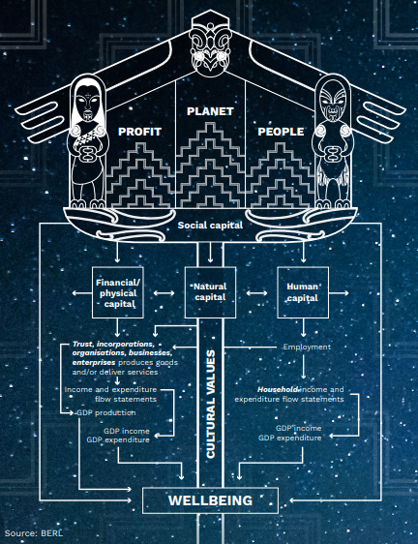
Values applied to economic wellbeing: Māori framework
Taking care of one another
What does individual need to fully participate in society?
Skills, knowledge, financial, mental and physical health
Connections between people and communities
Protecting environment and natural resources
Text goes here.

Slide 11
Our Approach
Engage tribal leadership and Native educators to better understand the unique financial education needs of their communities.
Understand lived experiences and cultures of communities we serve to develop a tailored financial plan.
Devise ways to ensure access to financial education despite broadband limitations.
Empower tribal staff and Native educators to conduct financial education programming with the communities they serve.

Slide 12
How We Can Help
Provide free financial education resources for tribal programs and classrooms focused on PreK – 12 and post-secondary education.
Develop tailored syllabus and financial education plan for tribal program or classroom.
Provide free, professional development and training for educators and program staff..

Slide 13
Challenges and Common Themes
Generational poverty and lack of opportunities for youth to develop personal finance knowledge.
Distrust of financial system and lack of exposure to financial institutions.
Insufficient personal finance knowledge to plan for life after high school (higher education, per cap, etc.)
Limited capacity within tribal communities to teach personal finance.

Slide 14
Opportunities
Many areas to incorporate financial education within tribal programs and schools (start in early childhood!)
Align initiatives with community value systems.
Impact on family, extended family and broader community.
Provide program staff and educators training to build confidence in teaching and facilitating personal finance lessons.
Identify trusted partners to help support initiatives.

Slide 15
Integrating learning opportunities across programs
Workforce development
Early childhood
Elementary
High school outreach
College freshmen

Slide 16
Increasing Financial Capability
NEFEE conducts research in partnership with tribal nations on financial capability and efficacy of personal finance resources.
Research shows correlation between being unbanked and the level of financial capability.
Those who are unbanked have lower financial capability scores.

Slide 17
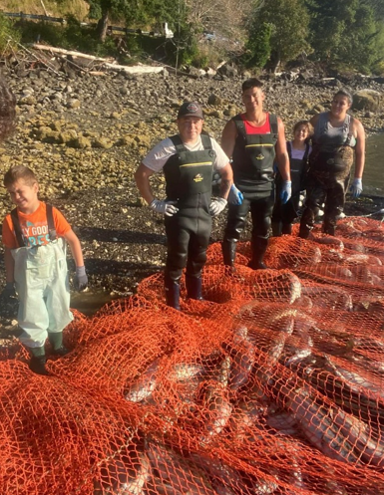
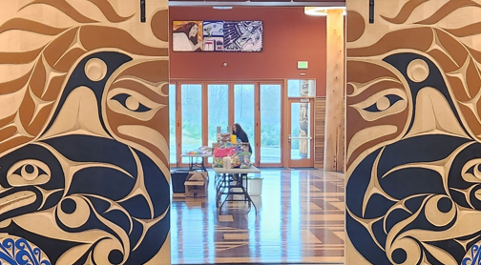
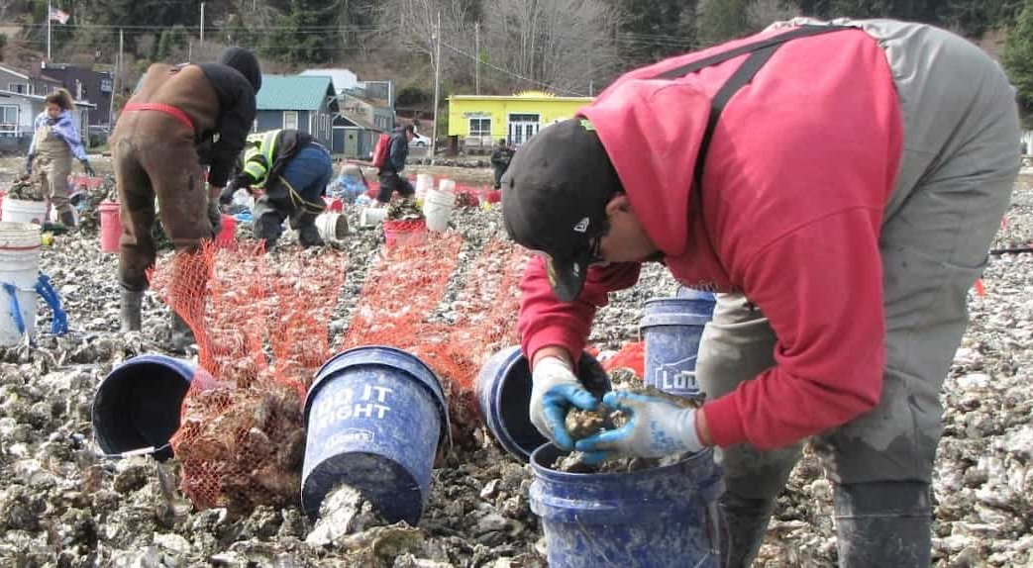
Honoring Culture
Investing in future
Early Childhood
Coastal Salish Curricula Development

Slide 18
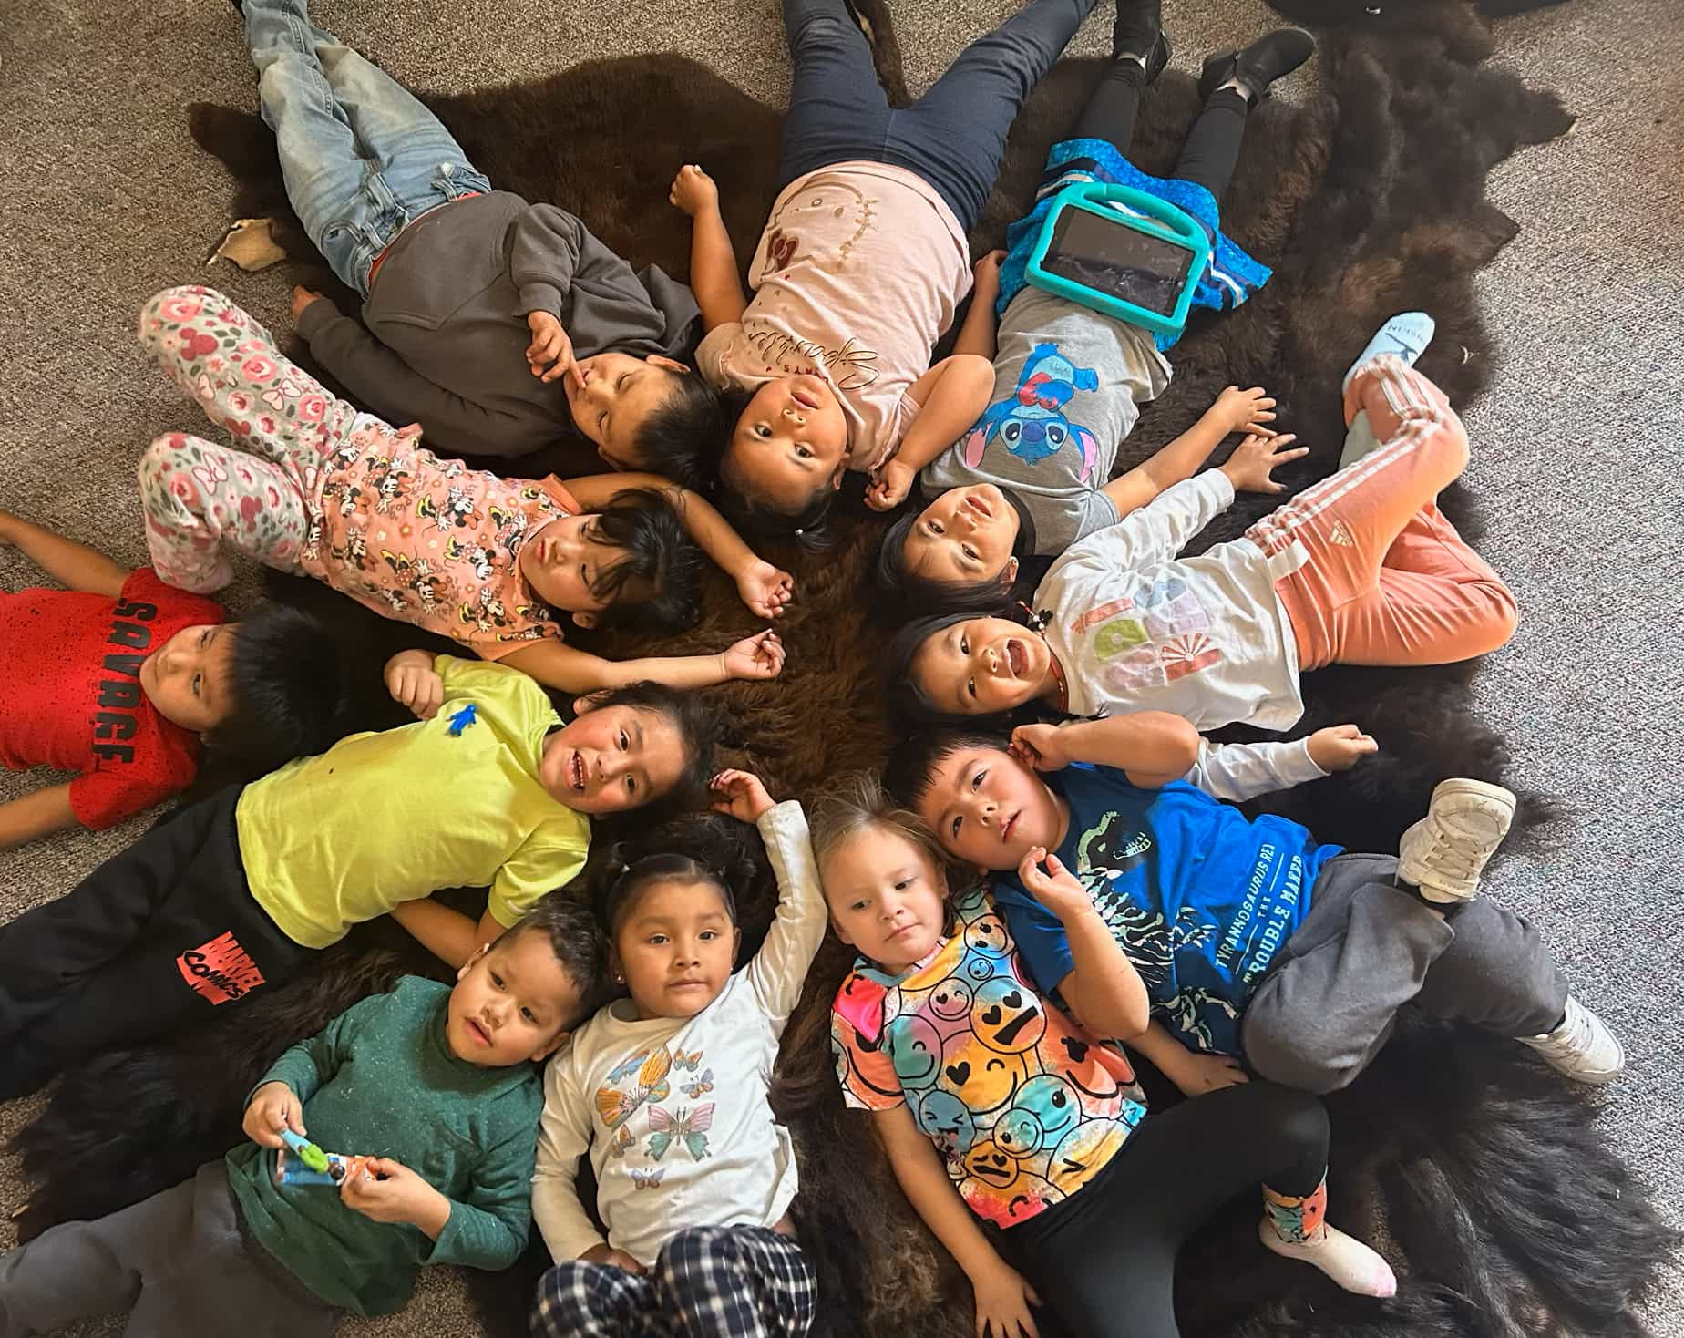
Partnering with Native CDFI
Developing personal finance programs for early childhood and high schools across Pine Ridge Indian Reservation.

Slide 19
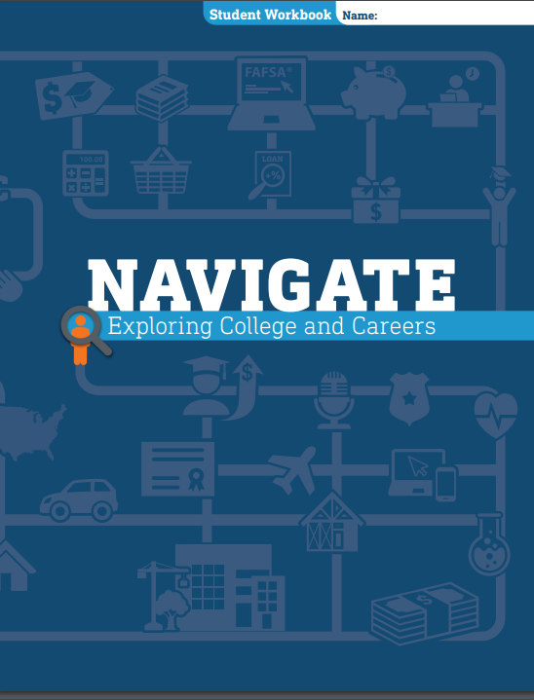
Preparing for life after high school
Examine careers and educational requirements
Identify academic choices and extracurricular activities to enhance applications;
Research cost of postsecondary education
Explore types of financial aid

Slide 20
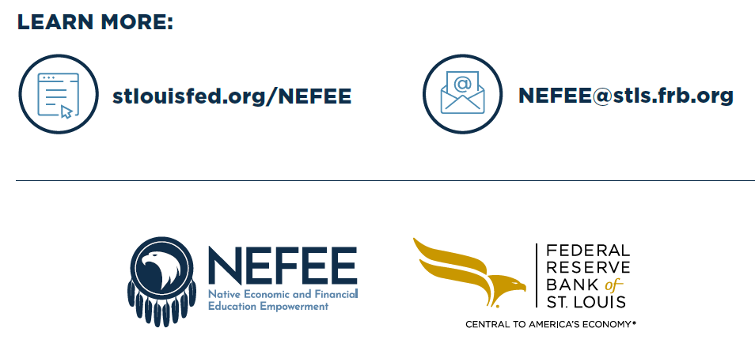
megan.cruz@stls.frb.org

