Slide 2
The Emotional Cost of Wealth: Understanding Financial Trauma
Shawn Spruce
Programs Consultant
First Nations Development Institute
agoyopi@gmail.com
Lanalle Smith Owner, BlackSheep Insight Consulting & Coaching
lanalle@blacksheepinsight.com
Mytegia Lee
Executive Director
Southwest Native Assets Coalition
https://swnativeassets.com
Notes:
Each presenter will introduce themselves

Slide 3
Introduction
Objective:
To explore the intersection of wealth, financial trauma, and emotional well-being within Native communities.
To highlight SWNAC’s efforts in addressing financial barriers and promoting economic resilience.
Opening Thought:
“Wealth is not just about numbers—it carries emotional and cultural significance that can either empower or burden families and communities.”

Slide 4
Early Money Memory
What is one early memory you have about money, and how did it make you feel?

Slide 5
Understanding Trauma

Slide 6
Understanding Financial Trauma
Definition:
financial trauma stems from chronic stress, insecurity, or negative experiences around money, often passed down intergenerationally.
In Native Communities:
Historical disenfranchisement, forced relocations, and systemic inequities have created deep-rooted financial barriers.
Distrust in financial systems due to exploitative practices.
Key Emotional Costs:
Guilt or shame associated with financial success.
Fear of exploitation by family/community.
Anxiety over sustaining wealth or breaking generational cycles of poverty.

Slide 7
What is Trauma?
Definition: A deeply distressing or disturbing experience.
Text goes here.

Slide 8
Historical Context of Trauma
In a trauma state, every response is an action in survival instead of a cognitive choice.
Notes:
Indigenous Communities:
Colonization and Economic Displacement
Govt Policies an dFinancial Marginalization
Generational Impact

Slide 9
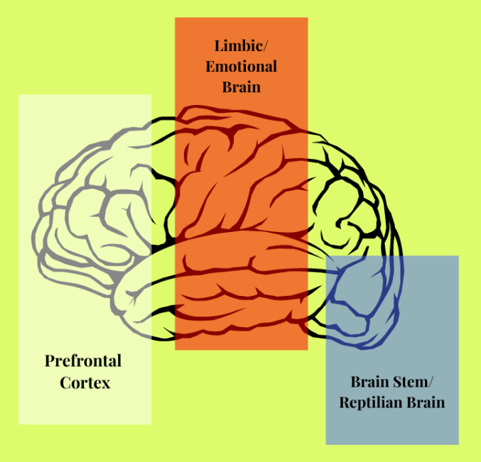
The Effects of Trauma
Text goes here
Brain, Body, Mind

Slide 10
Financial Trauma Symptoms and Behaviors
Avoidance Behaviors
Fear and Anxiety
Impulsive or Compulsive Spending
Difficulty Planning for the Future
Shame and Guilt
Financial Dependence
Poor Financial Decision Making
Inconsistent Financial Behaviors
Physical and Emotional Symptoms
Limited Financial Education
Text goes here.

Slide 11
Personal Experiences
Emotional and Psychological Aspects of Money

Slide 12
SWAC Personal Stories: Voices from the Community
Notes:
A Navajo Nation enrolled member faced significant challenges consolidating debt due to opposition from predatory lenders in Gallup, NM, who refused to provide pay-off statements. Overwhelmed and ready to give up, the client believed his journey to financial freedom was impossible.
SWNAC staff intervened, contacting the Auditor General, CFPB, and corporate offices, ultimately securing the required statements after persistent efforts. The client, initially with a 99% DTI ratio and a 580 credit score, consolidated his debts, reducing his DTI to 26% and increasing his credit score to 720.
With SWNAC’s continued support through bi-weekly follow-ups, the client now sustains a debt-free lifestyle, has secured a second job, and is actively building long-term financial stability. This success reflects SWNAC’s commitment to relationship-based methods and financial empowerment.
Client “I can enjoy my life with my family now, and be happy knowing my bills are paid, credit is fix, and my stress is gone.”

Slide 13
Mystery Tax Shopper Study
2012 analysis of paid tax preparers in McKinley County and other areas of New Mexico.
Illegal, deceptive, and abusive financial practices targeted vulnerable consumers.
Resulted in 2015 civil suit by the Navajo Nation and the Consumer Financial Protection Bureau against S/W Tax Loans, Inc. in Gallup, NM.
Demanded $438,000 in total consumer redress and required defendants to pay $438,000 in civil penalties.
Defendants illegally steered taxpayers to high-cost products and illegally and grossly understated the loans annual percentage rates.
Defendants failed to disclose to more than 1,500 consumers that tax refunds had already been received by IRS and instead persuaded them to take out additional refund anticipation loans resulting in over $254,000 in interest and fees.

Slide 14
Challenges and Opportunities
Money culture and family history
Personal experiences and events
Multi-generational financial disparities and setbacks
Per Capita and lump sum windfalls
“You’ll always be in debt, so why bother trying to improve your finances”
“Rich people’s children, are seldom rich people’s parents”
“Money and finance are not Native concepts”

Slide 15
Challenges Faced by SWNAC Clients
Overcoming fear of financial institutions/distrust
Balancing cultural values (communal sharing) with individual financial goals.
Emotional toll of navigating systems that aren’t designed with Native values in mind.

Slide 16
Would you take this bet on a coin toss?
Heads You win $200
Tails You lose $100

Slide 17
Loss Aversion Coefficient
Example
$500 ÷ $100 = 5
(Average Loss Aversion Coefficient is just over 2)

Slide 18
Healing Financial Trauma

Slide 19
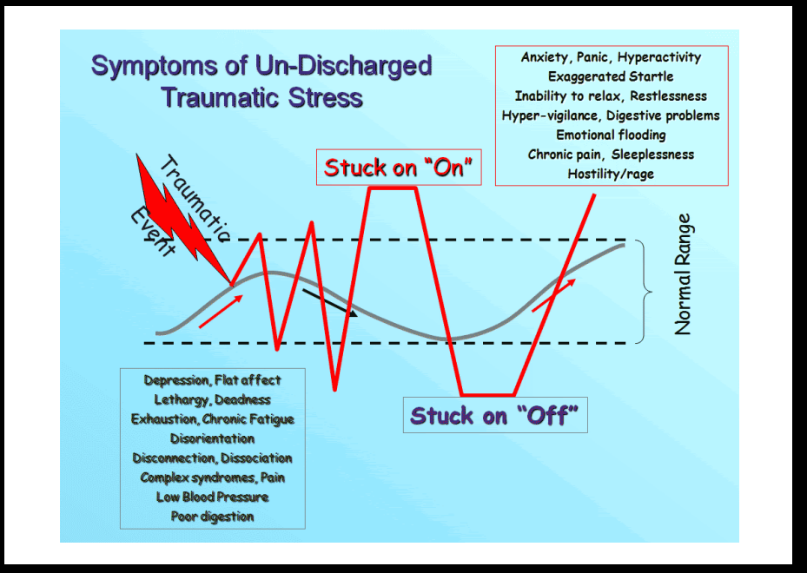
Understanding the Nervous System Helps Us Understand Trauma
Notes:
Put the Graph on a Flipchat with a moveable sticky note or dot

Slide 20
Importance of Self - Care
How To Return to a Restorative State.
Somatic
Artistic
Spiritual
Emotional
Intellectual
Nature
Relational
Material
Psychological
Notes:
1. Somatic Responses:
- Engaging in activities like yoga, walking, breathing exercises, or pushing against a wall can activate the parasympathetic nervous system (PNS), which helps regulate stress and promote relaxation. These activities help calm the body's physiological responses to stress, reducing feelings of anxiety or overwhelm related to money.
2. Artistic Responses:
- Activities such as drawing, journaling, knitting, or appreciating art can stimulate creativity and self-expression, activating areas of the brain associated with emotional processing and regulation. Artistic expression can provide a cathartic outlet for processing emotions related to financial stress, helping individuals gain perspective and cope with challenging situations.
3. Spiritual Responses:
- Turning to spiritual practices or connecting with a higher power through activities like attending church, temple, or engaging in prayer or meditation can provide a sense of comfort, support, and perspective. Spiritual beliefs and practices can help individuals find meaning and purpose amidst financial challenges, offering a source of solace and hope.
4. Emotional Responses:
- Expressing emotions through crying, laughing, or recalling positive memories can engage the limbic system, which plays a central role in emotional regulation and processing. Allowing oneself to experience and express a range of emotions related to money can facilitate emotional healing and resilience, fostering a sense of empowerment and self-awareness.
5. Intellectual Responses:
- Engaging in activities that stimulate the intellect, such as reading books or listening to podcasts about personal finance or financial literacy, can activate the prefrontal cortex and other areas of the brain involved in critical thinking and problem-solving. Intellectual engagement can help individuals gain knowledge and skills to manage their finances effectively, empowering them to make informed decisions and take control of their financial well-being.
6. Material Responses:
- Addressing practical concerns related to money, such as budgeting, managing housing expenses, or addressing clothing needs, can help alleviate tangible sources of stress and uncertainty. By addressing material needs, individuals can create a sense of stability and security, which can positively impact a sense of well-being and reduce physiological stress responses associated with financial worries.
7.Psychological- thinking of a positive memory
8.Nature – being outside, the ocean, woods, or even memories of those things
9. Relational – relationships with therapist, family (healthy and stable), pets
What else?
In summary, engaging in a variety of coping strategies related to money can directly impact the nervous system and help regulate stress responses. By addressing physiological, emotional, spiritual, and practical aspects of financial stress, individuals can cultivate resilience and promote overall well-being in the face of financial challenges.

Slide 21
Supporting Others Through a Trauma Informed Lens
Empathy and Active Listening
Providing Support
Creating a trusting and safe environment
Cultural Sensitivity

Slide 22
SWNAC’s Approach
Healing-Centered Engagement:
Acknowledge historical traumas that impact financial behaviors.
Create safe spaces for participants to share experiences and learn without judgment while taking accountability and control of their finances.
Cultural Integration:
Infuse traditional values, such as storytelling, into financial education.
Emphasize collective wealth-building that aligns with community-centric values.

Slide 23
SWNAC Strategies to Address Financial Trauma
For Individuals:
Normalize conversations about money and emotions.
Set healthy boundaries with family/community expectations.
For Organizations:
Provide tailored financial education that respects cultural values.
Advocate for systemic changes to make financial systems more inclusive.
For Policy-Makers:
Address disparities in resource access for Native communities.
Support community-driven financial solutions.

Slide 24
Tools and Resources
Building Native Communities materials and training programs
$pending Frenzy consumer awareness simulation
Ask Dr. Per Cap personal finance column
FINRA Investor Education Foundation co-branded informational packets
Trauma of Money Certification TRAUMA OF MONEY™
Oweesta Corporation www.Oweesta.org/training-calendar

Slide 25
Support for Romance Scam Survivors
FREE Peer Support Program for Romance Scam Victims by Cybercrime Support Network:
1-hour weekly sessions for 10 weeks
A licensed counselor to facilitate the groups
Guidance to support mental well-being
Education on cybercrime and online safety
Closed, monitored group communications
fightcybercrime.org

Slide 26
SWNAC’s Role in Addressing Financial Trauma
Our Mission: Empower Native communities through culturally relevant financial education, resource building, and advocacy.
Financial Literacy Programs
Asset Development
Community Reinvestment Act (CRA) Partnerships
Outcomes
Increased financial confidence among participants.
Breaking cycles of financial insecurity by creating new pathways to generational wealth.

Slide 27
Call to Action
Collaborate: Partner with SWNAC to expand financial education and resources.
Advocate: Support initiatives that address financial inequities in Native communities.
Empower: Invest in programs that help individuals heal from financial trauma and build sustainable wealth.

Slide 28
Closing
“Wealth is not just about what you own; it’s about how you feel and what you can give.” Aditya Jha, a Canadian entrepreneur and philanthropist
In all Tribal communities we do not measure wealth by what we own, but by what we can give back to our elders, children, grandchildren, family, and community. At SWNAC, we honor this understanding of wealth by empowering individuals to achieve financial well-being and strengthen the bonds of generosity that sustain our culture and heritage.

Slide 29
The Emotional Cost of Wealth: Understanding Financial Trauma
Shawn Spruce
Programs Consultant
First Nations Development Institute
agoyopi@gmail.com
Lanalle Smith Owner, BlackSheep Insight Consulting & Coaching
lanalle@blacksheepinsight.com
Mytegia Lee
Executive Director
Southwest Native Assets Coalition
https://swnativeassets.com

