Slide 1
Financing Native Homeownership with HeritageOne®
December 3, 2024

Slide 2
Freddie Mac’s Role in the Housing Market
Freddie Mac was chartered by Congress in 1970 with a mission to promote housing market liquidity, stability and affordability – nationwide and in all economic conditions
A continuous cycle involving trillions of dollars to make home possible
Notes:
Freddie Mac was chartered by Congress in 1970 with a mission to promote housing market liquidity, stability and affordability – nationwide and in all economic conditions.
But we do not lend directly to consumers, rather, we operate in the U.S. secondary mortgage market by buying loans from our approved lenders based on the standards we set in our Guide. Freddie Mac then pools the mortgages it buys into securities, which they sell to investors around the world. And those approved lenders are then, in turn, able to provide more loans to qualified borrowers and keep capital flowing into the housing market.

Slide 3
What Is HeritageOne?
HeritageOneSM is a conventional financing solution, designed to help enrolled members of federally recognized Native American tribes living in tribal areas attain and sustain affordable homeownership.
Notes:
Historically, the only real mortgage options in Indian Country have been HUD 184 and certain VA products. Well, what about the borrowers who do not meet that criteria?
Freddie Mac developed HeritageOneSM as a conventional mortgage product to support members of federally recognized Native American tribes in Indian country. This product also addresses the need for greater access to mortgage financing options within these communities.

Slide 4
Key Borrower Benefits
Make a down payment as low as 3%, 5% for standard manufactured homes
Gain more home financing options
Attain homeownership with a conventional mortgage solution
Use funds from various sources for the down payment, reserves, and closing costs
Receive a credit to offset appraisal costs
For first-time homebuyers, take advantage of homeownership education programs
Notes:
For market areas without a sufficient number of comparable sales to develop a credible report, an appraisal that relies solely on the cost approach is acceptable under certain conditions.
If an appraisal is obtained Freddie Mac will issue an appraisal cost offset credit, which must be passed to the borrower. - another benefit of HeritageOne

Slide 5
HeritageOne Participation – Land & Property Types
Property Eligibility
The mortgaged premises must be located in an eligible tribal area
Eligible Land Types
Eligible Property Types
Tribal trust lands
Allotted trust lands
Fee-simple lands
1- to 4 unit primary residence
Manufactured home including CHOICEHome®
Condominium unit
Unit in a planned unit development (PUD)
Property with an accessory dwelling unit (ADU)
Notes:
And now, let me move into land and property types that are eligible for HeritageOne mortgages:
Eligible land types include:
Tribal trust lands;
Allotted trust lands; and
Fee-simple lands.
And eligible properties include:
Ones that are located in the tribal area of an eligible Native American tribe;
A 1- to 4-unit primary residence;
A manufactured home;
A condominium unit;
A unit in a planned unit development (PUD); and
And a property with an accessory dwelling unit (ADU).

Slide 6
How Can HeritageOne Be Used?
Factor | Requirement
Borrower income | No maximum income limit
Loan type | Fixed rate Purchase, no cash-out refinance Construction and renovation transactions No second homes, investment properties, or cooperative units
Loan-to-Value Ratio | Up to 97% for mortgages secured by a 1-unit property, including CHOICEHome Up to 95% LTV for mortgages secured by a 2- to 4-unit property or a manufactured home
Occupancy | At least 1 borrower must occupy as primary residence Non-occupying co-borrower allowed
Property ownership | Borrower may own up to 2 financed properties including subject property
Underwriting | Loan Product Advisor® Accept May be manually underwritten
Notes:
No income limits ---- There are no Area Median Income limits or AMI - typically WE DO place income limits on our other affordable offerings but for HeritageOne we did not. We wanted as may tribal members as possible to take advantage of this product
LTV Ratios - you can have up to 97% LTV for mortgages secured by a 1-unit property including CHOICEHomes
Up to a 95% LTV ration for mortgages secured by a 2-4 unit property or a manufactured home
For those that might be unfamiliar with a CHOICEHome, it is a specific type of manufactured home that the industry refers to as a cross mode home and has many similar features to a site-built home. It must be a multi section home, sometimes referred to as a double wide, it will have a higher roof pitch, parameter masonry blocking, energy efficient features, drywall throughout the home and a combination of other features such as dormers, a porch, attached or detached garage or carport.
Property Type is for 1-4 unit primary residence
Loan Type – must be a fixed rate, purchase, no cash-out refinance mortgages which is inline with our other affordable mortgage products, can also be for construction and renovation mortgages
So it can be pared with our renovation products such as CHOICERenovation which is designed for larger scale remodeling projects or Renovation eXPress for smaller projects.
Occupancy – at lease one borrower must occupy the home as their primary residence, we also allow non-occupying co-borrowers
*****For 2- to 4-unit properties, all Borrowers must occupy the Mortgaged Premises as their Primary Residence.
Property Ownership – Borrowers can own up to 2 financed properties which includes the HeritageOne property, so not more than 2 financed properties, It was not developed to bolster the availability of rental income properties
Underwriting – When you run the loan through Loan Product Advisor it should be an Accept risk class or can be manually underwritten
Loan Product Advisor is our automated underwriting system and provides you with greater certainty that the loan meets Freddie Mac eligibility requirements.

Slide 7
Homebuyer Education
Homebuyer
At least one borrower must complete a homebuyer education program when all occupying borrowers are first-time buyers
May be provided a Native CDFI, even if it is the originating lender and/or the seller
Landlord (2-4 units)
At least one qualifying borrower must either
complete a landlord education program or
have at least one year of previous landlord experience
Notes:
Homebuyer education
At least one borrower must complete a homebuyer education program when all occupying borrowers are first-time buyers
May be provided the Native CDFI, even if it is the originating lender and/or the seller - * Typically, Homeownership education must not be provided by an interested party to the transaction, the originating lender or by the Seller are excluded, a third party usually provided the HBE. This is another enhancement for HeritageOne
Examples of homebuyer education include Freddie Mac’s Homebuyer U, as well as NAIHC’s Pathways program.
Landlord education (for 2- to 4-unit properties)
At lease one qualifying borrower must complete a landlord education program
Or have at least one year of previous landlord experience

Slide 8
HeritageOne Servicing: Two Options
Servicing Released
Servicing Retained
The lender transfers servicing of HeritageOne mortgages to a Freddie Mac-designated servicer
or
The lender retains servicing of HeritageOne mortgages with Freddie Mac’s explicit approval
Notes:
For Servicing, there are two overarching options:
Option #1 is that the seller/servicer may transfer Servicing to a Servicer designated by Freddie Mac; or
Option #2 is that the seller/servicer may retain servicing of HeritageOne mortgages with Freddie Mac’s explicit approval.

Slide 9
HeritageOne Servicing: If Foreclosure Is Unavoidable
The tribe has right of first refusal
The servicer must complete all required communications and notifications
Foreclosure processing may proceed in the court that holds jurisdiction, which may include tribal court
Notes:
Regarding foreclosures:
Prior to referring to foreclosure, Servicers must complete all required communication and notification requirements.
Necessary contact information for the Tribe will be obtained for Servicers and Freddie Mac to work with the Tribal contacts and to operationalize the additional servicing requirements.
Foreclosure processing may proceed in the court that holds jurisdiction, which may include Tribal court.
And the Tribe has right of first refusal, in accordance with the mortgage documents.
And it’s important for us to note that the original lender can provide post-purchase counseling at the time of delinquency.

Slide 10
Key Lender Benefits
Expand your reach and grow your business
Use standardized mortgage guidance
Offer financing for multiple residential property types
Eliminate credit fee caps
Pair with other Freddie Mac financing options to provide additional support:
Affordable Seconds®
CHOICEHome®
CHOICERenovation®
GreenCHOICE Mortgages®
Make homeownership more affordable and accessible for more Native Americans

Slide 11
Resources

Slide 12
For More Information
Check out our resources on the Freddie Mac Single-Family web site
HeritageOne mortgage product page
Native American Homeownership Preparedness page
Contact us
Kim Carr: Kimberley_Carr@FreddieMac.com
Erin Persons: Erin_Persons@FreddieMac.com

Slide 13
HeritageOne Participation - Lender
Lender Eligibility:
For Freddie Mac approved lenders:
Obtain Freddie Mac’s Term of Business and approval to sell HeritageOne mortgages to us: HeritageOneSM Seller Eligibility Application
Complete the HeritageOneSM training tutorial
Contact a Freddie Mac representative or Customer Support Contact Center (800-FREDDIE) for more information
Notes:
If you are a lender in the room and are interested in selling HeritageOne mortgages, you must first obtain Freddie Mac’s written approval before selling HeritageOne mortgages to Freddie Mac.
For a seller to be approved, they must have experience originating similar mortgage products in Indian Country and must receive counterparty credit risk approval.
For those interested, simply call 1-800-FREDDIE to start the process or your account representative.

Slide 14
Next Steps Toward Offering HeritageOne
If you’re an approved Freddie Mac seller/servicer
Obtain Freddie Mac’s term of business and approval, starting with the HeritageOne Seller Eligibility Application: https://sf.freddiemac.com/docs/pdf/heritageone-seller-eligibility-form_fillable.pdf
Complete the HeritageOne Mortgage tutorial at Freddie Mac Learning: https://sf.freddiemac.com/tools-learning/freddie-mac-learning/overview
Contact your Freddie Mac representative or the Customer Support Contact Center at (800-FREDDIE)
If you’re not an approved Freddie Mac seller/servicer
To start the process, go to https://sf.freddiemac.com/working-with-us/become-a-seller-servicer/overview
Sell loans through an aggregator as a third-party originator; if you’re not already a registered TPO, call the Customer Support Contact Center at (800-FREDDIE)

Slide 15
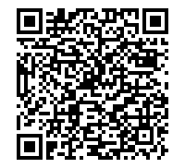
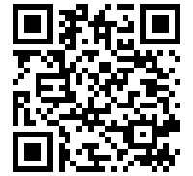
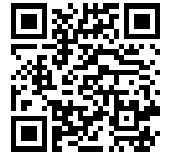
Check out our on-line resources
Native American Homeownership Preparedness
CreditSmart® Homebuyer U
Housing Counselor Resource Center
HeritageOne web page: sf.freddiemac.com/HeritageOne
HeritageOne Guide Bulletin: guide.freddiemac.com/app/guide/bulletins

Slide 16
Consider Completing and/or Recommending the Appraisal Institute Curriculum for Appraising Homes on Tribal Lands
https://www.appraisalinstitute.org/education/search

Slide 17
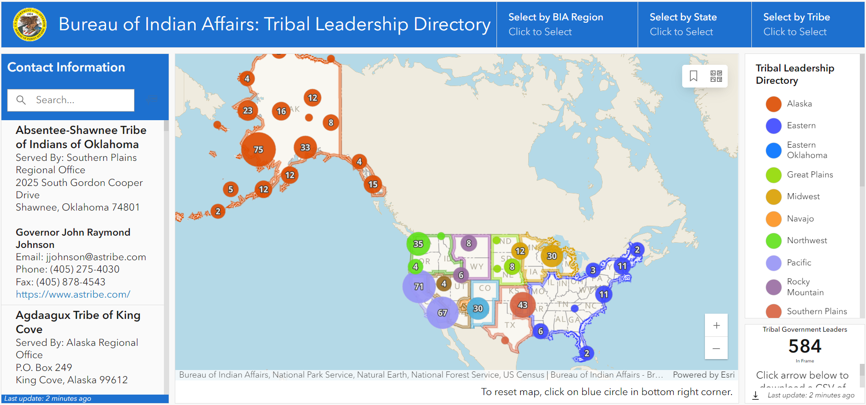
To Find Contact Information for Federally Recognized Tribes
Visit the Bureau of Indian Affairs’ Tribal Leaders Directory
https://www.bia.gov/service/tribal-leaders-directory

