Slide 1
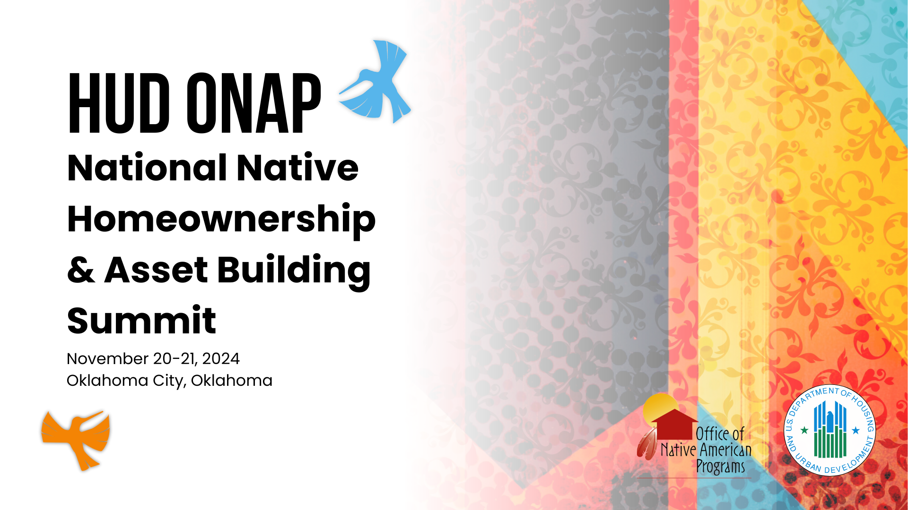

Slide 2

Pathways to Homeownership
Native Homeownership & Asset Building Summit
Oklahoma City, OK
Rose M. Cook & Ben Navarro, Presenters
November 2024

Slide 3
An important note about the seminar content
While every effort has been made to ensure the reliability of the session content, Fannie Mae’s Selling and Servicing Guides and their updates, including Guide Announcements and Release Notes, are the official statements of Fannie Mae’s policies and procedures and control in the event of discrepancies between the information in this seminar and the Guides.

Slide 4

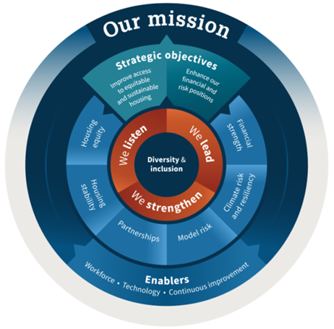
Fannie Mae
Fannie Mae is a leading provider of mortgage financing in the U.S. We purchase mortgages from lenders to free up the money they need to make other mortgage loans, therefore ensuring the ongoing availability of affordable mortgages.
Fannie Mae’s Mission and Corporate Strategy Prioritize Housing Stability
2023 BY THE NUMBERS*
Strategic Objective 1: Improve access to equitable and sustainable housing
1.5 M
Households bought, refinanced, or rented a home
984,000
Single family loans purchased or refinanced
482,000
Multifamily rental housing units financed
Priority 2: Increase and preserve housing stability by addressing obstacles to borrower and renter financial and property resilience and by helping communities prepare for and respond to climate related risks.
$369 Billion
In Liquidity Provided in 2023
86th Year
Supporting Homeowners & Renters
*Source: Annual Housing Activities Report 2023
Notes:
As a trusted housing industry leader, Fannie Mae works to provide security and stability to the U.S. mortgage market and facilitates the 30-year fixed-rate mortgage.
Through our Single-Family and Multifamily business lines, we provide lenders with the liquidity they need to give homeowners and homebuyers across the country access to affordable mortgage financing, in all markets, at all times.
We also drive responsible innovation to make homebuying and renting easier, fairer, and more accessible.

Slide 5
Who and where are we trying to help?
Fannie Mae's commitment to serve the needs of homeowners and renters in underserved markets has never been stronger. Our Duty to Serve efforts are focused on reaching low- and moderate-income families in challenged markets.
− Jeffery Hayward,
Former Executive Vice President
and Chief Administrative Officer,
Fannie Mae
We’re leading the way in providing access to affordable housing across America
Nationwide – We’re serving families at or below 100% AMI in each of the three underserved housing markets.
Rural Housing Market – We’re targeting specific high-needs populations and regions, including:
  Middle-Appalachia, Lower Mississippi Delta, and Colonias
  Rural tracts in persistent poverty counties
  Native Americans and agricultural workers
  Small Financial Institutions (SFIs) that serve these rural areas
Notes:
SPEAKER NOTES
The Duty to Serve requirement, established in the Housing and Economic Recovery Act of 2008 (HERA), reinforces our mission to facilitate equitable and sustainable access to homeownership and quality, affordable rental housing across America. The rule focuses efforts on very low-, low-, and moderate-income families in three underserved markets: Manufactured Housing, Affordable Housing Preservation, and Rural Housing
The markets covered by Duty to Serve are all over the United States.
Nationwide, very low- to moderate-income families in urban and rural communities in every state, and the challenges of creating better markets for manufactured housing and affordable housing preservation exist in nearly every community in the U.S.
At the same time, some of these underserved markets are region-specific. In the rural housing market in particular, the most underserved communities tend to me in three regions:
Middle-Appalachia, the Lower Mississippi Delta and the Colonias regions of the Southwest.
A number of rural tracts in persistent poverty counties in a number of states.
And in markets that serve housing for Native Americans and agricultural workers

Slide 6


Loan Products and Resources
Loan products and resources
6
Notes:
SPEAKER NOTES

Slide 7
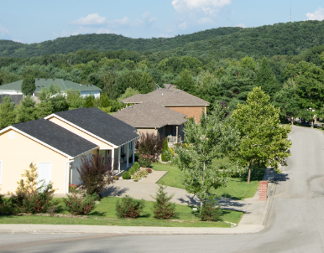



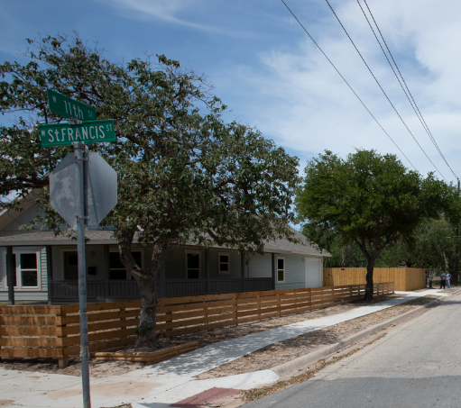
Creating more options for more homebuyers
Tackling access to credit and housing affordability challenges
HomeStyle ® Renovation HomeStyle Energy
HFA Preferred™
97% LTV
HomeReady®
MH Advantage® and Standard MH
Helps serve low- to moderate-income first-time homebuyers
Includes innovative income flexibilities to help low-income borrowers qualify for an affordable mortgage with a down payment as low as 3%.
See how our innovative offerings, including MH Advantage, can support affordable alternatives to site-built homes.
Opens up housing opportunities, making fixer-uppers an affordable option, by combining financing of improvements as part of the purchase or refinance mortgage
Pairs features of HomeReady with the flexibilities from local housing finance agencies (HFAs),
Notes:
SPEAKER NOTES

Slide 8
Reach more borrowers with new solutions and policies that simplify the process and provide more certainty
Latest solutions to support lenders and responsibly expand opportunities for homeownership
Amidst rising interest rates, increased home prices, and limited supply of affordable housing, we are dedicated to reducing homeownership barriers.
Our journey toward a more equitable housing market has pushed us to help lenders reach more borrowers through innovations that simplify and create more certainty.
Notes:
Fannie Mae is continually focused on modernizing the mortgage finance experience and exploring new ways to help our lenders open more doors for aspiring homeowners in a responsible and sustainable ways.
***IMPORTANT TO NOTE: If speaking to an HFA audience, make sure to acknowledge that we understand that they do not necessarily use/have access to DU and so would not be the ones to sign up for some of these new enhancements; we know it is their correspondent lenders who originate the loans that use DU. Our objective is to educate HFAs on the powerful benefits of these new solutions so that they can promote and educate their network of correspondent lenders. If their lenders use the tools, it will increase the ability for more of their borrowers to be approved.

Slide 9
Summary
DU Early Assessment
With an early assessment, lenders can pre-qualify borrowers with no impact to a consumer’s credit score
Income Calculator
Maximize and easily determine a borrower’s income before submitting to DU
Positive Rent Payment History
Consider consistent rent payment data when looking to qualify first-time homebuyers for mortgages
Income and Employment Validation Using an Asset Report
Leverage a single asset report to validate assets, income, and employment that also includes positive rent and cashflow history analysis
Enhancements for Borrowers without Credit Scores
Increasing homeownership opportunities and simplify the underwriting process for loans where no borrower has a credit score
Updated Underwriting Policies
Several new policies aimed to add ease of qualifying more eligible borrowers while improving certainty for lenders
Down Payment Assistance Tool
Provide borrowers with additional resources to find funding for down payment and closing costs
To continue the conversation and learn more about these solutions, please reach out to your Relationship Manager.

Slide 10
How We Can Support You
We can provide tools that can help you better meet the needs of your borrowers.
Products
Marketing Materials
Homebuyer Education
Fannie Mae offers:
Low down payment mortgages
Mortgages to fund renovations and energy improvements
Mortgages for manufactured homes
New construction mortgages
Help your customers understand the value of homeownership:
Fannie Mae’s Marketing Center is a free online tool lenders and other housing professionals can use to access and customize a variety of marketing and informational materials to support your purchase and refinance-related outreach to consumers.
Some affordable mortgage products may require homebuyer education
At Fannie Mae, we believe quality homebuyer education and counseling are key to successful homeownership.
An educated borrower is better informed with a clearer understanding of their housing needs and household budget. Our homeownership education course, Fannie Mae HomeView™, satisfies the education requirement on some of our affordable mortgage products.
Notes:
SPEAKER NOTES

Slide 11

Native American Conventional Lending Initiative (NACLI)
Loan products and resources
11
Notes:
SPEAKER NOTES

Slide 12
Native American Conventional Lending Initiative (NACLI)
NACLI is not a specific loan product; rather, NACLI allows a participating lender to utilize the entirety of the Fannie Mae Selling Guide on tribal trust or restricted lands. To be utilized:
Tribes interested in participating must enter into a Memorandum of Understanding (MOU) with Fannie Mae.
Lenders interested in participating must obtain approval by Fannie Mae to participate in NACLI. Upon approval, the lender will be provided the relevant tribal ordinances, which will vary for the specific tribal communities.
Notes:
Thank you to Enterprise and Freddie Mac
Many familiar faces, will keep it brief
Conventional loans are a great option that feature:
Automated underwriting systems that are efficient and predictable for lenders
No borrower income limits
Relatively high loan limits
No mortgage insurance below 80% LTV
High-level distinguishing characteristics of our strategy, NACLI (noted on this slide):
Not just one product; any Fannie Mae loan type
Applies specifically to tribal trust and restricted land. Fee simple land, on and off reservation, would utilize existing options
Foundational agreements are required, which includes an MOU between Fannie Mae and a participating tribe and a variance between Fannie Mae and the lender
5. We purchase loans under NACLI every year, in very small quantities. We are committing to significant increases over the next three years as part of our Public Duty to Serve Plan. (Significant as a percentage, the numbers are very small)

Slide 13
Current Tribal Partners
At present, Fannie Mae has established relationships with six tribes located in Michigan and New Mexico with others pending. Those tribes are as follows:
Bay Mills Indian Community
Sault St Marie
Pueblo of Acoma
Pueblo of Jemez
Pueblo of San Ildefonso
Pueblo of Santa Ana
Fannie Mae is actively discussing MOUs with tribes nationwide and would welcome any new discussions.
Notes:
As you might imagine, the biggest limiting factor in Fannie Mae providing more liquidity for homeownership on the reservation is a lack of tribal MOUs. You can see what tribal agreements we have in place here. It is not a long list, but it took a lot of work to get to this point and we are proud of it. One of my goals for this conference is to explore more opportunities for Fannie Mae to partner with tribes.
In addition to this, we are exploring other strategies to serve native homeowners, such as targeted products available off-reservation, for example
But I am not the only one at Fannie Mae thinking of tribal housing. Some of my colleagues are here to learn more about what we can do to innovate our approach beyond what I have discussed so far:
Sergio – appraiser diversity
Corliss – understanding the needs of CDFIs and HFAs and helping manage risk
Artesia – working with lenders that want to pursue affordable housing, including novel strategies

Slide 14
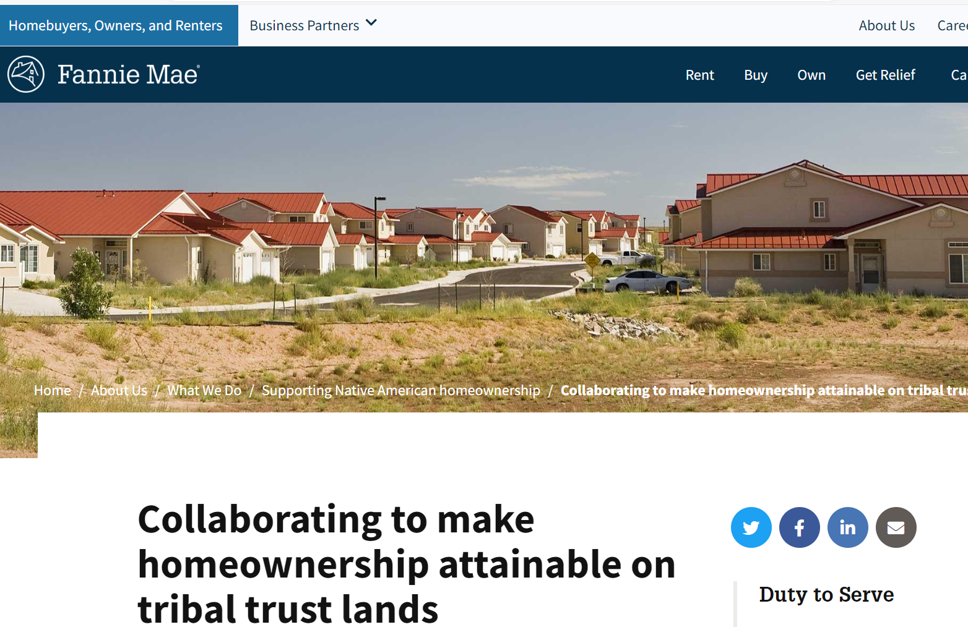
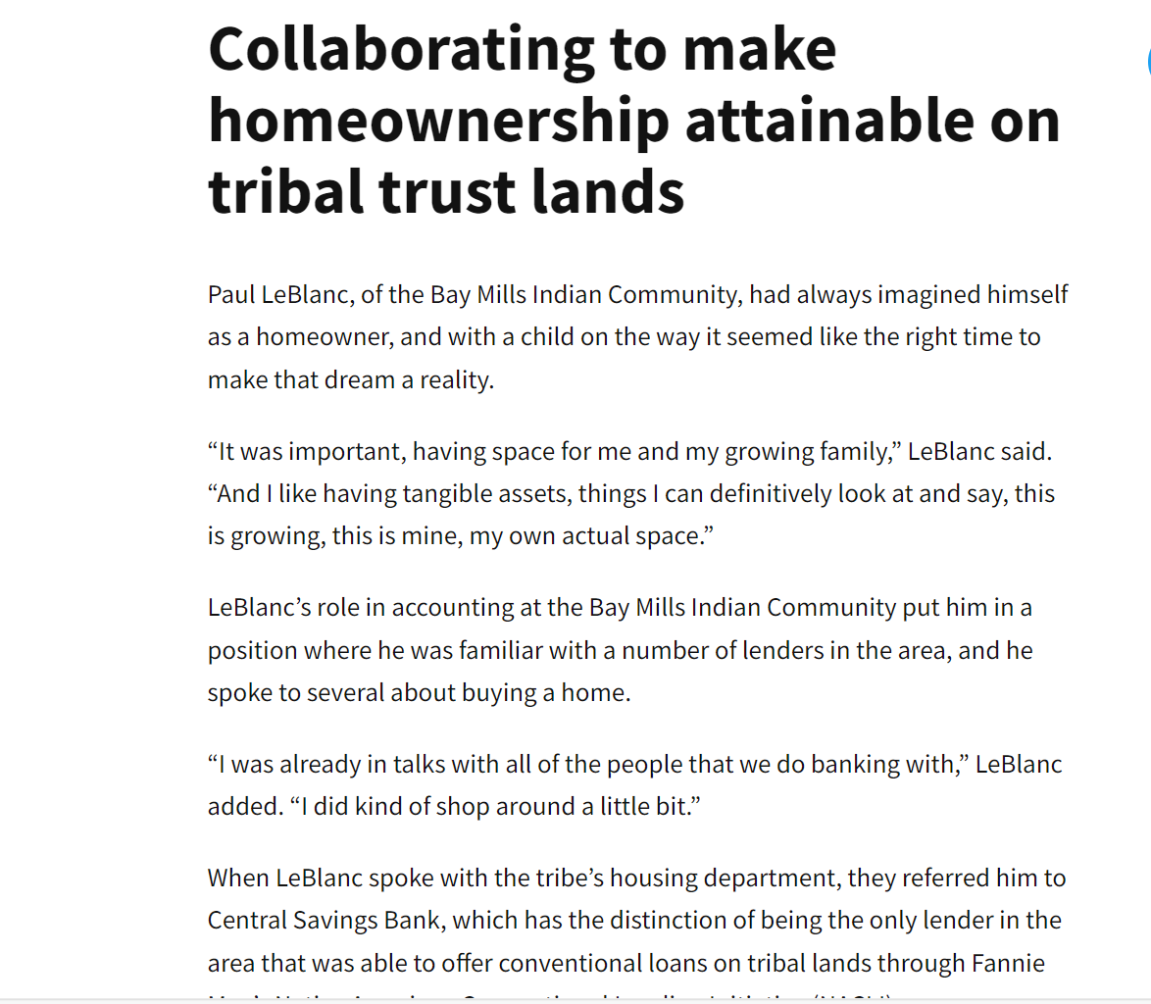

Slide 15
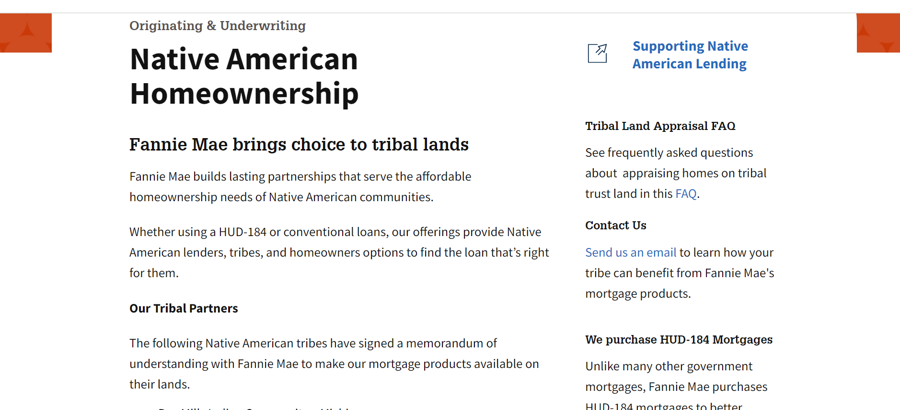
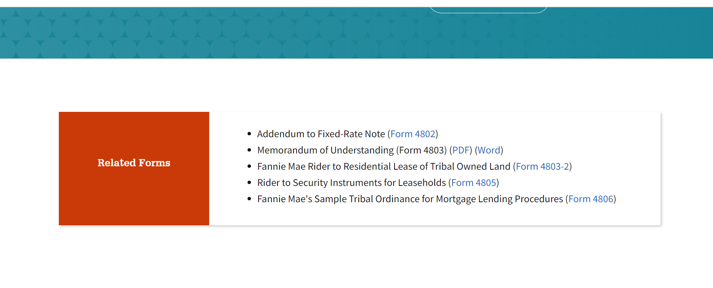
Notes:
As you might imagine, the biggest limiting factor in Fannie Mae providing more liquidity for homeownership on the reservation is a lack of tribal MOUs. You can see what tribal agreements we have in place here. It is not a long list, but it took a lot of work to get to this point and we are proud of it. One of my goals for this conference is to explore more opportunities for Fannie Mae to partner with tribes.
In addition to this, we are exploring other strategies to serve native homeowners, such as targeted products available off-reservation, for example
But I am not the only one at Fannie Mae thinking of tribal housing. Some of my colleagues are here to learn more about what we can do to innovate our approach beyond what I have discussed so far:
Sergio – appraiser diversity
Corliss – understanding the needs of CDFIs and HFAs and helping manage risk
Artesia – working with lenders that want to pursue affordable housing, including novel strategies

Slide 16
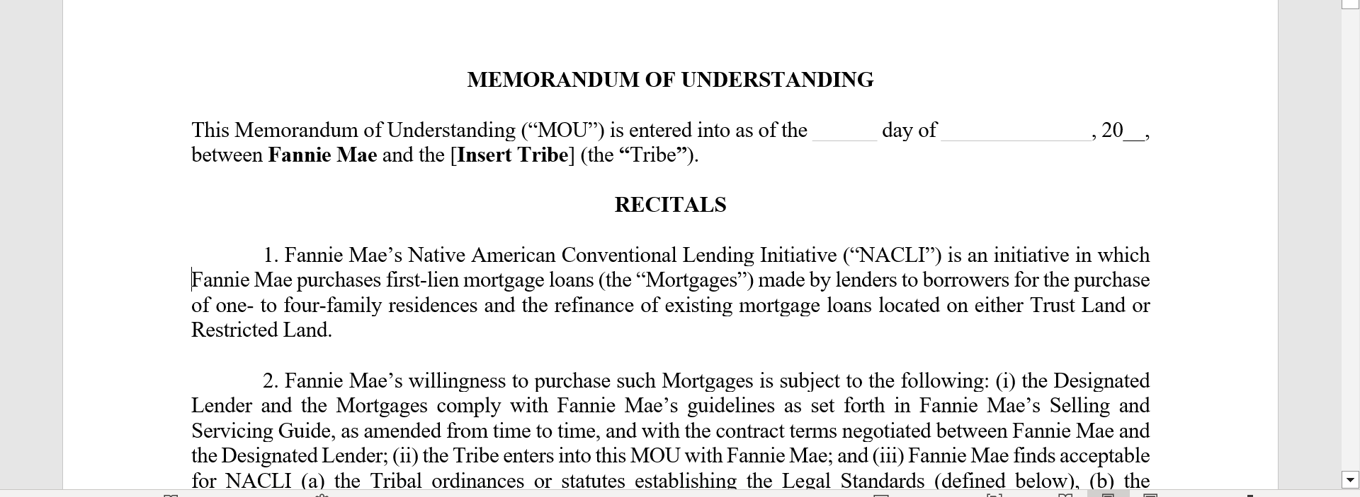
Notes:
As you might imagine, the biggest limiting factor in Fannie Mae providing more liquidity for homeownership on the reservation is a lack of tribal MOUs. You can see what tribal agreements we have in place here. It is not a long list, but it took a lot of work to get to this point and we are proud of it. One of my goals for this conference is to explore more opportunities for Fannie Mae to partner with tribes.
In addition to this, we are exploring other strategies to serve native homeowners, such as targeted products available off-reservation, for example
But I am not the only one at Fannie Mae thinking of tribal housing. Some of my colleagues are here to learn more about what we can do to innovate our approach beyond what I have discussed so far:
Sergio – appraiser diversity
Corliss – understanding the needs of CDFIs and HFAs and helping manage risk
Artesia – working with lenders that want to pursue affordable housing, including novel strategies

Slide 17
To learn more, contact us and explore NACLI resources
My email: Benjamin_Navarro@fanniemae.com
Native Homeownership landing page (with details on NACLI): Native American Homeownership | Fannie Mae
Blog Post about borrower from Bay Mills Indian Community: Collaborating to make homeownership attainable on tribal trust lands | Fannie Mae
Notes:
As you might imagine, the biggest limiting factor in Fannie Mae providing more liquidity for homeownership on the reservation is a lack of tribal MOUs. You can see what tribal agreements we have in place here. It is not a long list, but it took a lot of work to get to this point and we are proud of it. One of my goals for this conference is to explore more opportunities for Fannie Mae to partner with tribes.
In addition to this, we are exploring other strategies to serve native homeowners, such as targeted products available off-reservation, for example
But I am not the only one at Fannie Mae thinking of tribal housing. Some of my colleagues are here to learn more about what we can do to innovate our approach beyond what I have discussed so far:
Sergio – appraiser diversity
Corliss – understanding the needs of CDFIs and HFAs and helping manage risk
Artesia – working with lenders that want to pursue affordable housing, including novel strategies

Slide 19
Q&A

