Slide 2
FHLBank – Who We ARE AND WHAT WE DO
FHLBank Topeka provides needed liquidity and funding to our diverse financial members throughout Colorado, Kansas, Nebraska and Oklahoma.
Because we’re owned by our member banks, thrifts, insurance companies, credit unions and community development financial institutions, we’re able to provide the products and services that give them a competitive advantage in their markets.

Slide 3
What is the Federal Home Loan Bank (FHLBank)?
FHLBank System is:
Government-Sponsored Enterprise
enacted in 1932
11 FHLBanks Nationwide separated by Districts
Created by Congress
Updated to include Housing Mission
in 1989
Each FHLBank is operated independently
and receives no taxpayer assistance
Owned as a cooperative by members
(local financial institutions)

Slide 4
Text goes here.

Slide 5
WHO WE ARE AND WHAT WE DO
Housing and Community Development (HCD)
With funding from FHLBank’s income, we support and sustain affordable housing and community lending in our District through our programs.

Slide 6
HCD – WHO WE ARE AND WHAT WE DO
Affordable Housing Program (AHP)
The FHLBank system’s Affordable Housing Program is the largest privately funded housing grant program in the United States. FHLBank members, in partnership with public and private housing development organizations, prepare a detailed application for this competitive program.
TurnKey (HSP, HSP+, HOPE)
TurnKey, FHLBank’s new suite of products designed to provide assistance and address the challenges of attaining homeownership in Colorado, Kansas, Nebraska and Oklahoma.
Community Housing Program (CHP)/Community Development Program (CDP)
CHP and CDP provide advances priced below FHLBank’s regular advance rates to help members finance housing in their communities, and finance qualifying commercial loans, farm loans and community and economic development initiatives in the areas they serve.
Voluntary Programs
Programs funded beyond the regulatory requirement to assist with housing or community lending related initiatives within our district that are not met through our regulatory programs.

Slide 7
2024 Program fUNDING

Slide 8
VOLUNTARY COMMITMENT
Voluntary programs will be funded in partnership with FHLBank members.
Beginning in 2023, we committed to increasing voluntary funding over the next three years:
At least $1 million in funding for voluntary grants in 2023
At least 2.5% of our 2023 net income before our AHP assessment for voluntary grants in 2024 and
5% of our 2024 net income before our AHP assessment for voluntary grants in 2025 and thereafter
As a cooperative, FHLBank Topeka’s success is a shared success for members and their communities.

Slide 9
2024 Programs and Funding
Voluntary commitment of at least 2.5% in 2024
Homeownership Possibilities Expanded (HOPE) – 40%
NAHI Grants program – 35%
AHP Extra – 25%
Text goes here.

Slide 10
AFFORDABLE HOUSING PROGRAM (AHP)

Slide 11
Competitive AHP
Supports the finance, acquisition, construction, and rehabilitation of both single family and multi-family housing.
Projects should include a member, sponsor (community-based organizations), and owner entity
Applications are submitted and scored using criteria listed in the AHP Implementation Plan
Funds are available through one competitive round each year
100 points possible
Units must be occupied by households at or below 80% of the Area Median Income
Commitments agreed to in the application will be verified later in the project lifecycle
Used by community organizations; public housing authorities, non-profit agencies, city & state government agencies, housing developers, Native American Tribes, etc.

Slide 12
2024 AHP OVERVIEW
To get the maximum subsidy per unit, the application would need to include 20 units
AHP subsidy available – at least $26.7 million
Round opened – July 1, 2024
Round closed – August 16, 2024
Announcement of awards – No later than December 31, 2024
Maximum subsidy per project - $1,500,000
Maximum subsidy per unit - $75,000
If awarded, money is set aside specifically for your organization to use

Slide 13
Scoring Criteria for Native American projects
AHP Criteria designed to support
Sponsorship by Federally Recognized Tribes or Tribally Designated Housing Entities (Up to 5 points)
Serving or targeting a percentage of Native American households (Up to 5 points)
Text goes here.

Slide 14
NATIVE AMERICAN HOUSING INITIATIVES (NAHI) GRANTS PROGRAM
Provides Native American Tribes and Tribally Designated Housing Entities access to grant funds intended to support housing for tribal members in our district. Grants with flexibility to apply funds for various purposes.
Funds accessed in partnership with FHLBank members
Focusing on housing initiatives in Colorado, Kansas, Nebraska and Oklahoma

Slide 15
Where did it start?
We researched.
District with the highest percentage of the population per capita of Native Americans
Nearly 50 tribes in our district including the largest tribe in the nation
Great need in the Native American community for support
Native American projects have not actively participated in our traditional programs
High poverty rates & low incomes
Lack of infrastructure & high development costs
Overcrowding & poor living conditions

Slide 16
Where did it start?
We listened.
Discussions with our Affordable Housing Advisory Council and Board of Directors
FHLBank System at 100 Roundtables
FHLBank support for Native American communities
Oklahoma City, OK (from the tribal perspective)
Washington, D.C. (from the CDFI and nonprofit perspective)

Slide 17
What we heard
“Larger amounts. We need to look at larger amounts that’s available to help meet those needs.”
“Make it administratively accessible…all these regs are written, great intention, but in the end, it negates the intent of the program itself because it’s not accessible.”
“The biggest barrier we have… is the regulatory burden.”
“Prescribe something specifically for Tribes, so they don’t have such a hard time competing to get these necessary funds.”
“We (Tribes) are capable and already have programs.”
“Learn more about what the specific needs are in those communities.”
“Let’s not create another layer of complexity for the Tribes.”
“It’s not just putting more resources into tribal communities. It’s actively listening and collaborating with those parties.”

Slide 18
Where did it start?
We took action.
We created NAHI and designed the program:
Low barrier
Letting Tribes do what they do best
Partnership and collaboration
Remove complexity
Sensitive to the unique needs
Larger amounts

Slide 19
Where did it start?
We connected.
Narrative application
Marketing materials and communications
Presented at conferences and roundtables
Built relationships with members and recipients

Slide 20
NAHI
Members partner with an Eligible Recipient
More about the program:
Grants are intended to strengthen a Recipient’s ability to provide housing for Native Americans
Funds will be deployed as grants through FHLBank member institutions
Maximum grant is $500,000
Minimum grant is $100,000
Size of the grant depends on alignment with purpose of the program
Outcomes and impact reporting will be requested
Text goes here.

Slide 21
ELIGIBLE RECIPIENTS
Federally Recognized Tribes (Tribes)
Tribally Designated Housing Entity (TDHE)
Must provide housing services to Tribal members residing in Colorado, Kansas, Nebraska or Oklahoma
Definitions can be found on our website
Native American Housing Initiatives Grants Program - Federal Home Loan Bank Topeka (fhlbtopeka.com)

Slide 22
WHAT CAN THE GRANT BE USED FOR?
Grants are intended to strengthen a Recipient’s ability to provide housing for Native Americans
Eligible Uses*
Eligible Uses, cont.
Down payment assistance for home purchases
Repairs to owner-occupied homes
Rental assistance for tenants
New construction or rehabilitation of existing housing
New housing program or product development
Market research to expand existing programs
Professional development of staff and/or board(s)
Creation or improvement of lending policies and procedures
Creation or expansion of strategic plan
Enhancements to information technology and systems
Improvements to lending, financial, and/or mission-related reporting
Marketing and branding
Consultant (non-employees, separately invoiced)
Lending capital
Loan loss reserves
Salaries, wages, stipends, and/or benefits for new or existing interns and/or staff
Internal cost allocations (e.g., administrative overhead)
*include, but are not limited to

Slide 23
What can the grant not be used for?
Grants are intended to strengthen a Recipient’s ability to provide housing for Native Americans
Ineligible Uses*
Grant funds are expected to impact the provision of housing by strengthening the Recipient’s financial position, operational efficiency, and/or human capital.
Any non-housing related expenses or programs
Litigation costs/expenses
Lobbying
*include, but are not limited to

Slide 24
Program timeline
Application Period
Member Certification
Application Evaluation
FHLBank evaluates applications
Submitted following application submission
Awards Announced
Disbursement
Opened on June3, 2024 and closed on July 12, 2024
Impact Reporting
Notified by October 31, 2024
Funds disbursed by end of year
Nine to twelve months after disbursement
Text goes here.

Slide 25
Our commitment
Committed $1,000,000 in 2023
Awarded $3,000,000 in 2023
Committed $3,628,140 in 2024
Awarded $5,313,498 in 2024

Slide 26
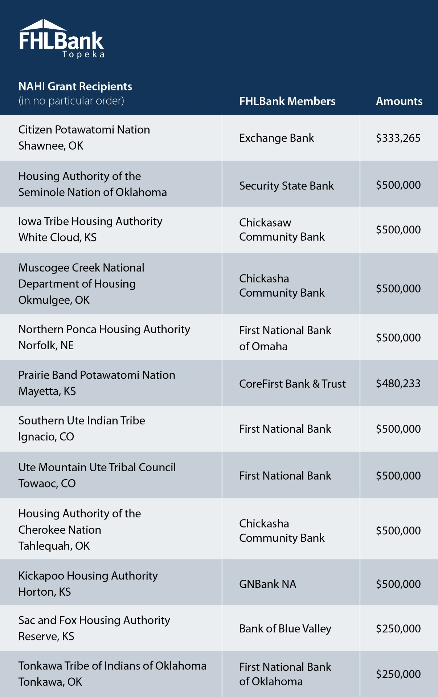
2024 NAHI AWARD RECIPIENTS
Awards announced October 31, 2024
12 recipients totaling $5,313,498
2 awards in Colorado
4 awards in Kansas
1 award in Nebraska
5 awards in Oklahoma
Text goes here.

Slide 27
Questions?

Slide 28
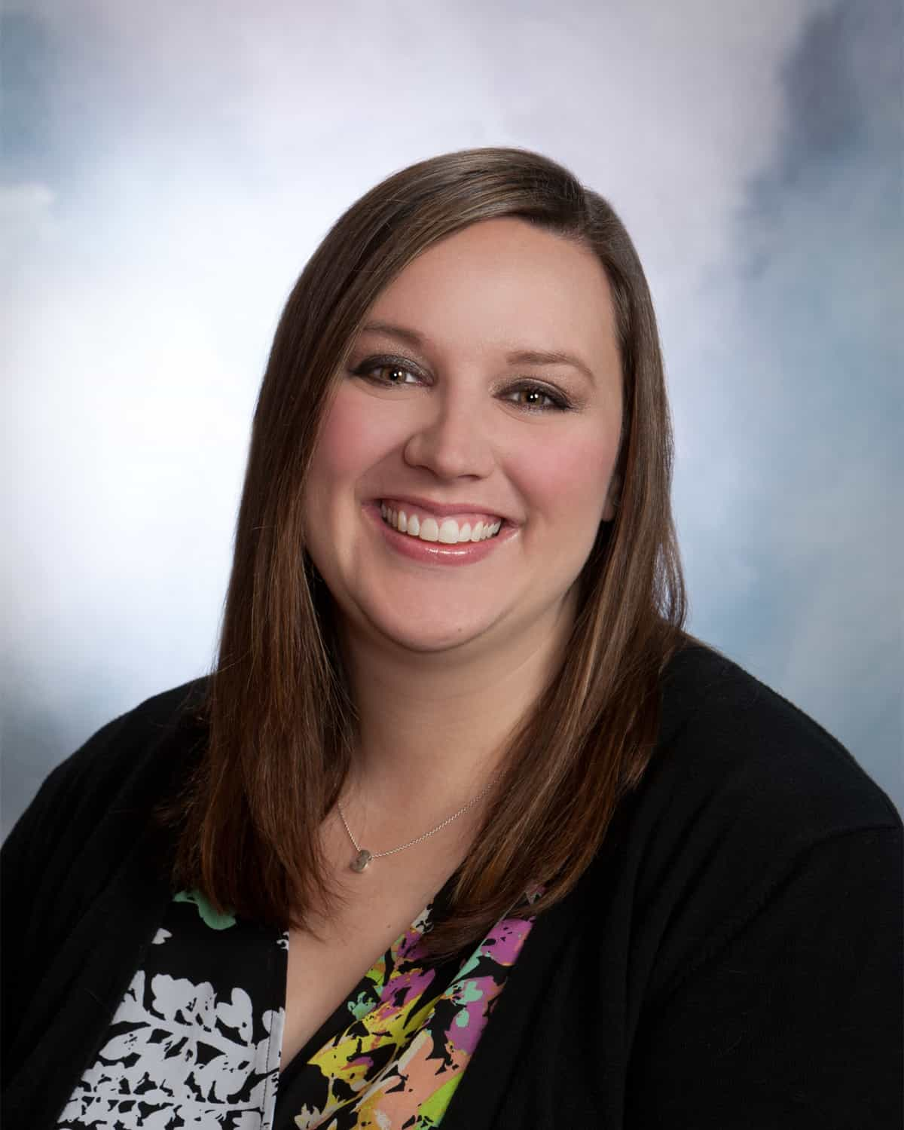
Kylie Mergen
785.478.8056
kylie.mergen@fhlbtopeka.com

