Slide 1
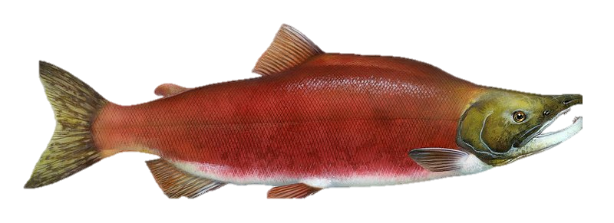
Nez Perce Tribe CPRG Implementation Grant Housing Upgrades
Anna Lawrence
Nez Perce Tribal Housing Authority
November 2024
Notes:
Hello, I’m Anna Lawrence and I’ve worked for the NPTHA for over 25 years. Although I’m the one speaking today there is a team of people that have been working on housing and climate and issues for a long time.
In July and August 2024, the Environmental Protection Agency selected the Nez Perce Tribe to receive $37 million from the Climate Pollution Reduction Implementation Grant – General Competition and over 7 million from the Tribes & Territories Competition over the next 5 years. Over 18 million of funding will go towards Climate Ready Housing upgrades. Today, I will discuss how the groundwork was laid for the 2 applications, the collaboration with project partners, and summarize the proposed Housing project activities. We are humbled by our selection as we know the need is large for all of us to address the climate crisis.

Slide 2
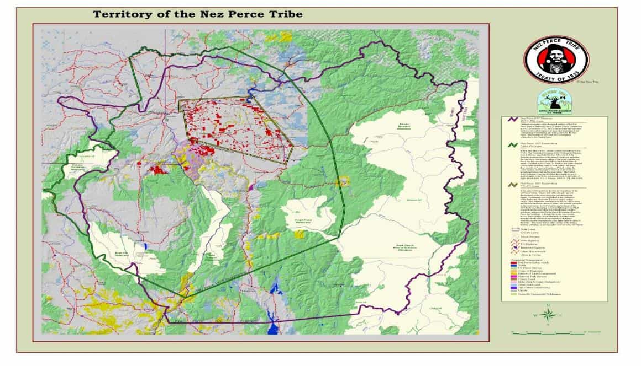
Notes:
Here is a map of the territory of the Nez Perce Tribe or the Nee mee poo. The current 1863 reservation is in present day North Central Idaho in the yellow outline shape in the center of the map. The tribal headquarters are in Lapwai, Idah. I’ll start from the outside line and then move in.
The red/purple outline reflects the area defined as the “aboriginal territory of the Nez Perce Tribe” where the Tribe has exclusive use and occupancy since time immemorial and it contains important hunting and fishing areas for the Nez Perce Tribe. These Aboriginal lands are over 13.3 million acres and include portions of Washington, Oregon, Idaho, and Montana.
The green outline reflects the 1855 Reservation of 7.8 million ( 7,880,470 acres) which was a cessation by the Tribe to the U.S. of some 5.5 million acres of land, but the treaty reserved certain rights including the rights to hunt, gather, and graze animals on “open and unclaimed’ lands within the ceded territory and the right to take fish at all usual and accustomed places outside the reservation. These rights are not a grant of rights to the Tribe, but a reservation by the Tribe of rights they already held.
The yellow outline reflects the 1863 Nez Perce Reservation of 770,470 acres or 1200 square miles. These are the exterior boundaries of the Nez Perce Reservation that are federally recognized today. The topography consists mainly of the Clearwater River valley and a plateau or prairie, known as the Camas Prairie. The Reservation is predominately agricultural and forested lands.
Tribal population; 3,000 on or near Reservation; Total Reservation population: 19,500
Tribe and/or members own 93,940 acres 12.3%
Discovery of gold on portions of the 1855 reservation eventually resulted in a new treaty sought by the U.S. Although this treaty was resisted by Nez Perce leaders, it was ultimately executed based upon the threats of federal representatives that there would be serious consequences if the Tribe failed to agree to the treaty. This treaty had no effect on any of the fishing, hunting, gathering, or grazing rights reserved in the 1855 Treaty.

Slide 3
“I have heard talk and talk, but nothing is done. Good words do not last long unless they amount to something . . . Good words will not get my people a home where they can live in peace and take care of themselves. I am tired of talk that comes to nothing. It makes my heart sick when I remember all the good words and all the broken promises . . .Treat all men alike. Give them all the same law. Give them all an even chance to live and grow. All men were made by the same Great Spirit Chief. They are all brothers. The earth is the mother of all people, and all people should have equal rights upon it.”
- Chief Joseph
Notes:
This is a reminder that Tribes including the Nez Perce have been calling for care and stewardship for a long time. We are all responsible for our Home– the land, the air, the water, the animals like salmon and orca for instance, and the people.

Slide 4
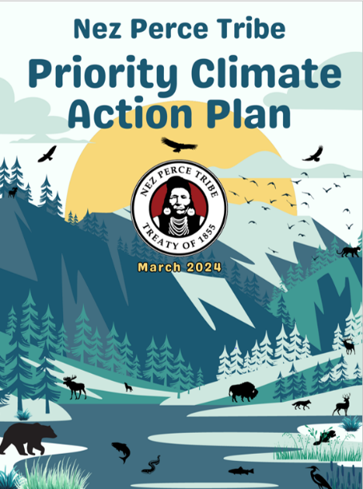
Required to be eligible for Climate Pollution Reduction (CPRG) Implementation Grants
Two (CPRG) Implementation Grants Submitted and selected for funding:
General Competition
Tribes & Territories Competition
PCAP: www.epa.gov/system/files/documents/2024-04/nez-perce-tribe-pcap.pdf
EPA grant award info:
www.epa.gov/inflation-reduction-act/cprg-implementation-grants-general-competition-selections
www.epa.gov/inflation-reduction-act/cprg-implementation-grants-tribes-and-territories-competition-selections#map
Notes:
To be able to apply for the CPRG Implementation Funding, the Nez Perce Tribe submitted a proposal and received an EPA CPRG Planning Grant in 2023 of $120,000 to coordinate
meetings with tribal community and staff from Housing, Social Services, Natural Resources, Transportation, Enterprises, Education and many other programs. There were multiple meetings covering a gamut OF topics to gather input about climate issues impacting the Nez Perce Community.
From these meetings, the team worked with a contractor on the development of the Priority Climate Action Plan or P-CAP including emissions reductions/greenhouse gas calculations.
A P-CAP was required to apply for the CPRG Implementation Grants
Every action/measure in the grant applications had to be linked to specific calculations to reduce emissions. These reductions will be reported during the five years of the grants.
If you’ve like to review our entire P-CAP or summaries of grant projects please refer to the links on the slides.

Slide 5
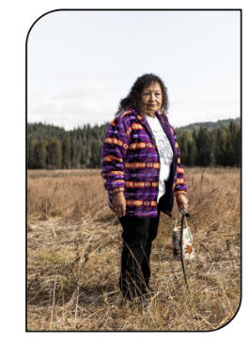
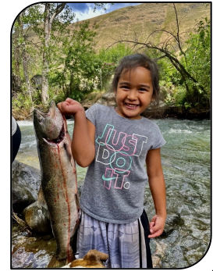
Priority Climate Action Plan
Priority Measures
#
Sector
Measure description
MTCO₂e*
$/MT
Based on most cost effective and ready-to-implement actions.
Comprehensive Plan developed over next several years will include more actions
1
Built Environment (Commercial & Residential)
Energy audits and upgrades for Tribal government facilities, enterprises, and residences
53,084
$3,775
2
Electric Power (Electricity)
Rapidly deploy renewable energy (primarily solar) and battery/energy storage capability at Tribal facilities and residences
33,390
$3,354
3
Transportation
Convert the Tribe’s fleet to EVs, hybrids, and PHEVs and install electric charging infrastructure
3,279
$3,993
4
Transportation
Increase the fleet of e-bikes used by staff at remote field facilities
19
$2,660
5
Transportation
Improve public transit services and infrastructure
841
$1,189
6
Natural & Working Lands
Sequester carbon through land restoration, forest management, and afforestation projects
142,023**
$84
7
Waste & Materials Management
Lower barriers to adopting biodegradable packaging for events, restaurants, and schools
6
$16,595
8
Waste & Materials Management
Divert food and biological waste from landfill to composting facilities
70
$35
Notes:
The grants will fund Priority Measures of the Nez Perce Tribe aimed to reduce greenhouse gas emissions across multiple sectors, focusing on residential energy efficiency retrofits, renewable energy, electric vehicle transportation networks, and large scale tree plantings. On the slide, you can see the sectors and descriptions, amount of emissions reduced per Measure. Our two grant applications divided the Priority Measures. They were not repeat applications. Also, not all the Measures presented in the P-CAP were included in the applications. Housing upgrades will protect Nez Perce communities on the 1863 Reservation in Idaho. Renewable energy and transportation projects will occur at tribally-owned property in Idaho and Oregon.
If asked about other projects:
The Tribe also received a Tribal only competition grant that will provide energy audits and weatherization in a few tribal administrative fisheries buildings.
Energy Sovereignty and Resiliency Centers, EV Charging: 1) solar to power the Clearwater River Casino with 2 megapacks for an off-grid resiliency center 2) A new roof, rooftop solar, and a parking lot solar array for the Joseph Fisheries office to power the building and EV charging stations to expand EV charging in the ICC 3) Funds to install an EV charging in Kamiah, 4) Staff to have the capacity to build the Tribe’s Energy Program
Location of Grant Activities: 1863 Nez Perce Reservation and Joseph, OR
GHG Emission Sectors Targeted: Buildings, Electric Power, Transportation
Estimated Cumulative GHG Reductions for 2025-2030 (in metric tons): 7,683 Estimated Cumulative GHG Reductions for 2025-2050 (in metric tons): 65,820

Slide 6
Nez Perce Tribe CPRG
General Competition Grant
Climate Ready Housing
650 Homes
Conduct energy audits
Weatherization and energy efficiency upgrades
Electric air source heat pumps (mini-splits)
HEPA air cleaners
350 Homes
Replace and upgrade wood stove to new EPA-certified stoves
Provide stove thermometers, moisture meters, tarps and straps, carbon monoxide alarms, and fire starters
300 Homes
Solar power infrastructure upgrades at residences
Increase Tribal Capacity and Workforce Training
Provide on-the-job training for the Tribal workforce and create well-paid jobs
6
Notes:
We will improve residential environment on the Nez Perce Reservation by creating resilient climate-ready homes that combat wildfire smoke and extreme heat and cold weather events.
650 homes will receive
energy audits to identify areas to seal and insulate and then weatherization to address those areas.
electric air source heat pumps or mini-splits to provide heating and cooling.
Many tribal homes do not have AC or the costs for both heating and cooling are so high per month that many families go without. Our communities regularly have 100plus degree days in the summer and this past winter we had multiple below zero days.
350 homes will have their existing wood stoves replaced with new EPA-certified stoves. Pairing a wood stove with a heat pump has been an effective strategy in other communities.
Burning firewood is a cultural practice for Tribal members and a traditional and primary source of heat for many homes on the Reservation. Removing stoves and replacing them with non-wood burning heat sources is not a viable option. Extreme weather events and power outages are common, and families rely on their stove for heat and cooking.
Additionally, the Reservation is a high risk/high priority fire shed in the National Wildfire Crisis Strategy. With increased fuels reduction planned in nearby forests in the coming years, using locally sourced firewood through the Tribe’s firewood bank program and replacing uncertified stoves is a way to reduce fuel in forests and reduce emissions by having wood burn more efficiently in an EPA-certified wood stove instead of in a wildfire.
Homes will also receive a supply of tools to reduce firewood moisture and improve stove efficiency.
300 homes will receive solar power infrastructure upgrades – specifically home-based battery systems. The actual solar arrays were funded from other sources.
Increase Tribal Capacity of hiring new employees and providing workforce trainings.

Slide 7
NPTHA Related Work & Partnerships
80 Ductless heat pump installations
Energy audits and weatherization with Community Action Partnership
Training and funding through Bonneville Power Administration
Community energy education (Home Fair and Lunch Class)
Indoor environment education with NPT Air Quality Program
Support of indoor environment projects
Photo credit: Maria Lacey
Notes:
We’ve created strong bonds between tribal programs and entities and non-tribal partners to learn about and improve built environments. This collaborative work was the foundation for our CPRG Climate Ready Housing Upgrades. This slide shares some of those activities:
Anything you want to add.
We’ve partnered with Nez Perce Tribe Air Quality Program on community education for 20 years to assist in the improvement of indoor environments through classes like weatherization & energy savings, green cleaning, mold, HEPA-filter and DIY air cleaners, radon, and maintaining firewood and wood stoves including woodshed building.
We’ve supported the Air Quality Program, Nimiipuu Health, and their partners indoor environment research projects with 120 families. Nearly all homes heating with wood heat.

Slide 8
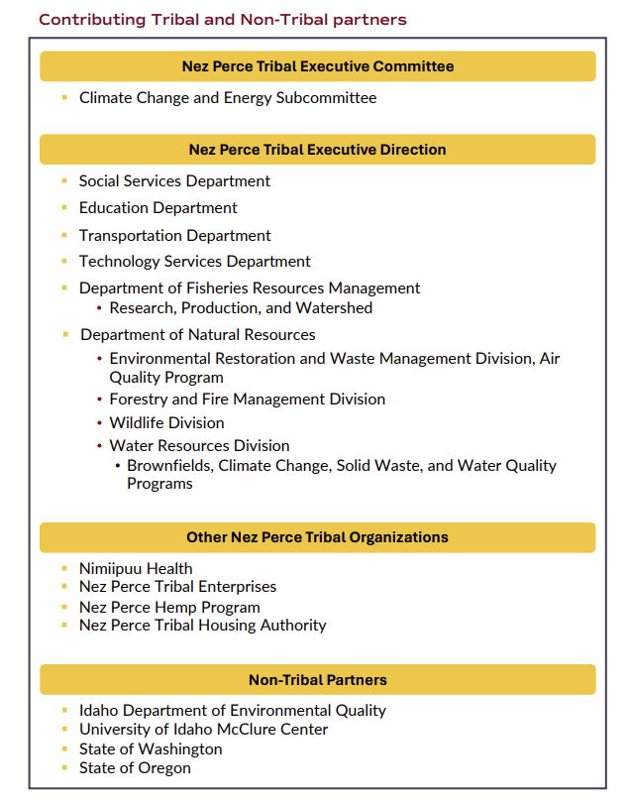
Qe'ci'yew'yew'
Many thanks to all of the staff, partners, and friends who helped with the Priority Climate Action Plan and the CPRG Implementation Grant applications!
Special Thanks:
Measure Meant, LLC
The Nature Conservancy
Agnew Beck
Idaho Climate Forum
Tribal Healthy Homes Network
Travis Knudsen, Lane Regional Air Partnership
Dan Smith, Idaho Department of Environmental Quality
National Residential Wood Smoke Work Group for States, Locals, & Tribes
Notes:
Thankful for all that helped with the plans and grant applications.
We’re fortunate to have relatively low turnover in personnel among partners, which has allowed us to build relationships, trust, knowledge of community needs, and effective solutions over the years.
We really had a rare team of experienced folks that all contributed their own critical pieces to the applications. It was a total “whole is greater than the sum of its parts” scenario.
The Tribe needed all those who worked on the applications for the applications to be successful”
ANNA IS THE BEST.

