Slide 1
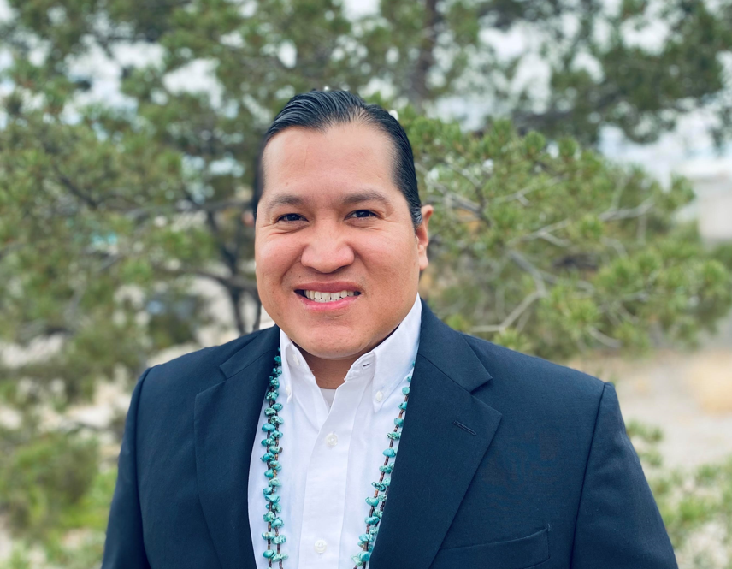
Partnerships
Jeremiah Powless,
Program Officer

