Slide 1
USDA Rural Development Introduction to Programs for Tribes
October 2024

Slide 2
3 Agencies – One RD
Rural Development
Rural Business-Cooperative Service
Rural Housing Service
Rural Utilities Service
Leadership: www.rd.usda.gov/about-rd/leadership
Notes:
At the national level, programs and services are delivered through three agencies, the business center and the innovation center.

Slide 3
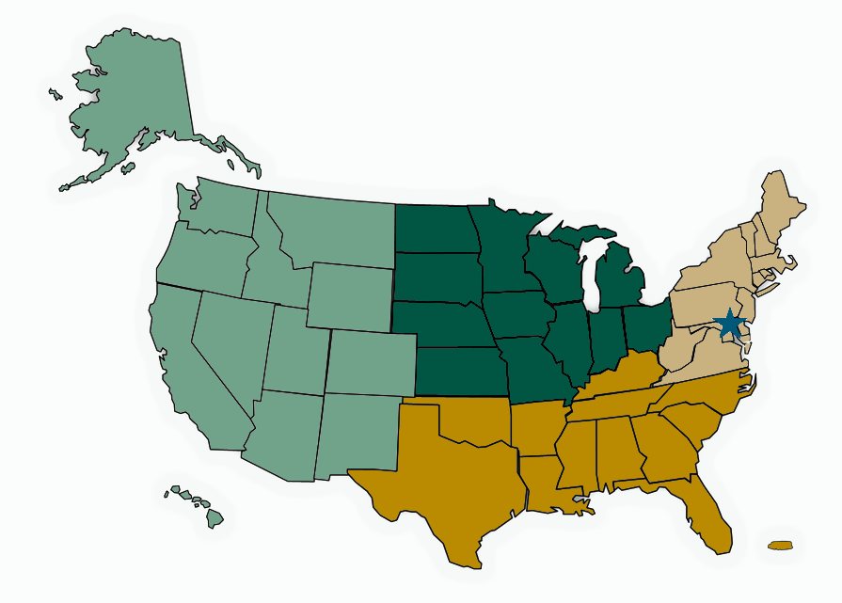
Rural Development Structure
4 Regions
47 State Offices
400 Area Offices
1 National Office in DC
Notes:
At the national level, programs and services are delivered through three agencies.

Slide 4
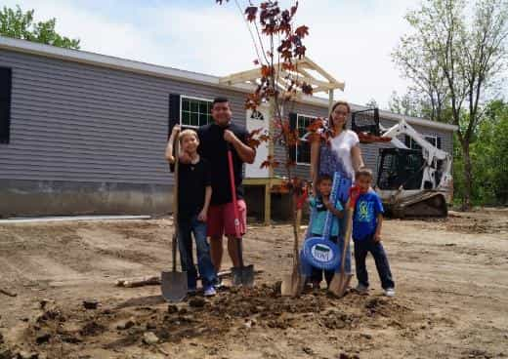
Homeownership for Individuals and Families
502 Direct Home Loan
RD makes direct loan to new homebuyers for a home.
Applicants must meet income eligibility requirements -low and very low income.
Home must meet property requirements; and
Home must be in eligible rural area—Tribal Trust lands are eligible.
Applications accepted year-round.
Benefits of program: fixed low interest rate— currently 4.375% and can be as low as 1% with subsidy, extended payback term (33-38 yrs.), no down payment required, lend up to 100% of value of home.
https://www.rd.usda.gov/programs-services/single-family-housing-direct-home-loans

Slide 5
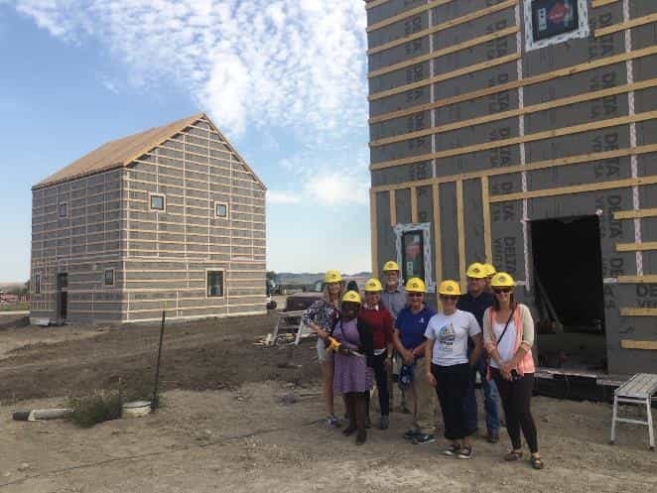
SFH 502 Native CDFI Relending Demonstration Program
FY 2023 Appropriation
$7.5 million to expand the demonstration program
A Notice of Funding Availability was published in the Federal Register on May 18, 2023, and outlines the competitive application process
Application were due by July 17, 2023

Slide 6
SFH 502 NCDFI Relending Demonstration Program FY23 Funds - $9 Million
State | NCDFI Name | FY23 Amount
AK | Haa Yakaawu Financial Corp. | $1,000,000.
HI | Hawaii Community Lending | $2,400,000.
MI | Lake Superior CDC | $500,000.
MN | White Earth | $800,000.
MT | NACDC Fin. Services | $1,000,000.
NM | Native Comm. Capital | $800,000.
SD | Mazaska | $500,000.
SD | Four Bands | $1,000,000.
WI | WINLF | $1,000,000.

Slide 7
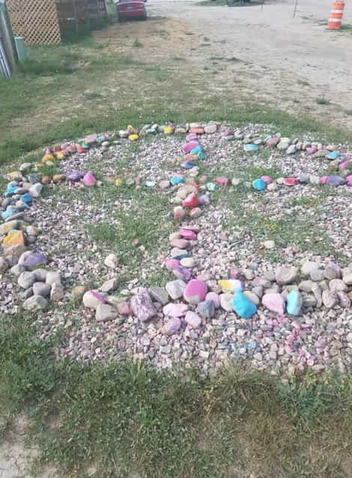
SFH 502 NCDFI Relending Demonstration Program
FY 2024 Appropriation
$5 million to expand the demonstration program
Applications were due in August
Announcements were made in October
NCDFI Relending Demonstration Program Website
Section 502 Relending Demonstration Program Training

Slide 8
SFH 502 NCDFI Relending Demonstration Program FY24 Funds - $5.5 Million
State | NCDFI Name | FY24 Amount
AK | Haa Yakaawu Financial Corporation | $876,000
HI | Hawaii Community Lending | $1,600,000
MI | Lake Superior CDC | $700,000
OK | Cherokee Nation, CNDTA Inc. | $876,000
OR | Nixwyaawii Community Financial Services | $525,000
WI | Wisconsin Native Loan Fund | $876,000.

Slide 9
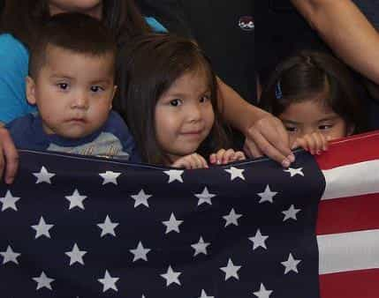
Homeownership for Individuals and Families
502 Guaranteed Home Loan
Applicant/borrower works directly with approved guaranteed lender to obtain loan.
Typical loan is 30 yr. terms with fixed interest rates.
Applicants must meet income eligibility requirements—below moderate income by area.
Home must be in an eligible rural area.
Applications accepted year-round.
Benefits of program: no down payment required, lend up to 100% of value of home, no maximum purchase price for a home, loan guaranteed by USDA 90%—attractive to lenders.
https://www.rd.usda.gov/programs-services/single-family-housing-guaranteed-loan-program

Slide 10
Single Family Housing Guaranteed Loan Program
Pilots Programs
Appraisals – making accommodations for the lack of availability of appraisers with knowledge and experience of trust land property
Repair/Rehab – making allowance for properties currently owned without liens to be treated as “purchases” for the sake of utilizing the program
Notes:
Last year, USDA launched the Tribal Property Valuation Pilot Program which provides approved lenders the opportunity to obtain desktop appraisal for mortgage transaction on tribal land which in turn decreases closing costs and eliminates potential inaccuracies in valuation for properties located on tribal land.
The Tribal Rehabilitation Pilot Program allows people to remain in their current homes by providing financing to rehabilitate and repair their homes to make them safe and bring them up to current codes.

Slide 11
Single Family Housing Guaranteed Loan Program
Memorandum of Understanding (MOU)
The Agency can make special accommodations to our delinquency and default procedures and processes to provide a lender with the flexibility they desire to provide loans on trust lands.
The first one has been signed with 1st Tribal Lending, opening their origination nationally and potential for secondary market investment for Native CDFIs.
Notes:
MOU with 1st Tribal Lending is under review with OGC. This lender is a HUD 184 lender with many years of experience. They are excited about working with our SFHGLP.
Our partnership with 1st Tribal Lending will help eliminate any barriers to secure mortgages and make it easier to purchase and repair homes on Tribal land.

Slide 12
Rehabilitation Funding For Existing Homes
504 Loan & Grant Programs
Loan Program: This program assists very-low-income homeowners with a loan to repair, improve or modernize their home.
Max. Loan: $40,000
Interest Rate Fixed: 1% - Repayment over 20 years
Loans less than $7,500 secured by note only
Grant Program: Grants to individuals (62+) very-low-income homeowners to remove health and safety hazards in their home.
Max. Grant: 10,000
May submit applications year-round
https://www.rd.usda.gov/programs-services/single-family-housing-repair-loans-grants
Notes:
Rural Disaster Home Repair Grants: Grants to individuals at or below the low-income limit with damage from a presidentially declared disaster in calendar year 2022 - Max Grant: $40,675

Slide 13
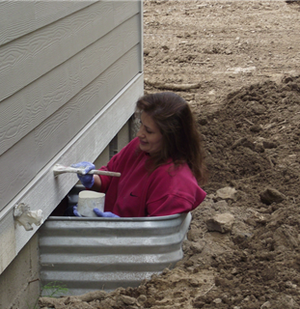
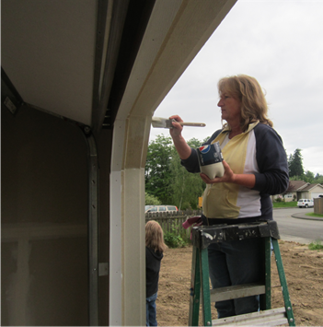
Rehabilitation Funding For Existing Homes
533 Housing Preservation Grant Program
Grants for the repair or rehabilitation of housing occupied by low and very low-income people.
Project must be in eligible rural area.
Applications are accepted on annual basis through a Notice of Funding Availability published in the Federal Register.
https://www.rd.usda.gov/programs-services/single-family-housing-programs/housing-preservation-grants

Slide 14
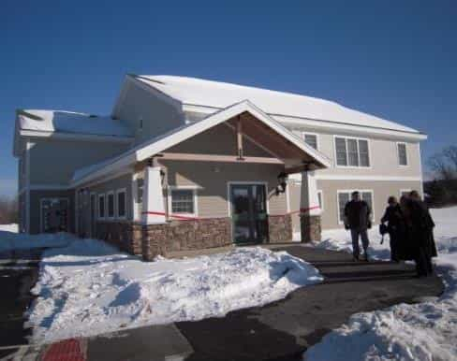
Rental Housing for Individuals & Families
538 Multifamily Housing Loan Guarantee Program
Qualified private-sector lenders provide financing to qualified borrowers. Eligible borrowers include Federally recognized Indian tribes.
Min. Term: 25 yrs.; Max Term: 40 yrs.; Interest rate fixed for life of the loan guarantee.
Housing must be in eligible area—Tribal trust lands are eligible.
Rent must be affordable (low and moderate income).
Benefits: USDA guarantees up to 90% of loan (97% for non-profits)—attractive to lenders, cap on rent.
Direct Loans to Repair Existing Properties (515)
Farm Labor Housing Direct Loans and Grants (514/516)
https://www.rd.usda.gov/programs-services/multi-family-housing-programs
Notes:
Currently Open
Year-round application process
Rental cap at 30% of 115% area median income

Slide 15
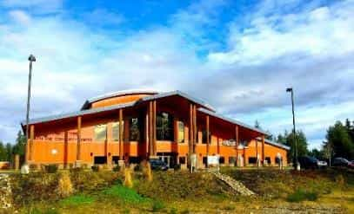
Community Facilities Programs
Program can be used to fund a wide range of essential
community facilities.
Eligible applicants include Federally Recognized Tribes
Project must be in eligible area—most Tribal Trust lands
are eligible
Direct Loans, Loan Guarantees and small grants
Low interest, long term financing through the Direct Loan Program
Current interest rate is 3.875% through December 31, 2024
Term of up to 40 years or useful life.
TCU Initiative Grants for 1994 Land Grant Institutions
CF Technical Assistance and Training Grants
For details talk to a local community programs loan specialist
https://www.rd.usda.gov/programs-services/all-programs/community-facilities-programs

Slide 16
Contact Info
USDA Rural Development State Offices
www.rd.usda.gov/contact-us/state-offices
Brian Hudson
608-697-7725
brian.hudson@usda.gov
Tedd Buelow
720-544-2911
tedd.buelow@usda.gov
www.rd.usda.gov/about-rd/tribal-relations

Slide 17
Together, America Prospers

