Slide 2
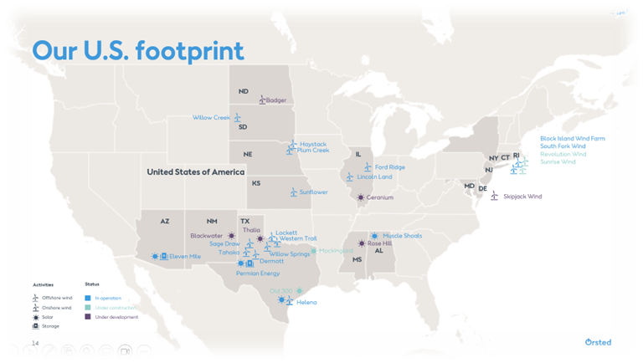
Ørsted
Renewable Energy Developer
Wind, Solar, Battery
Owned by Denmark
Largest Offshore Wind Companies
in the world
Improving Engagement with Tribal Nations
Working with THPOs, Tribal leadership
Looking to Partner with Tribes
Incorporating Community Benefits and Co-Ownership Opportunities

Slide 3
Infrastructure is Everything
Electricity Infrastructure:
Generation Projects
Transmission/Access to the Grid
Microgrids
Tribal Utilities

Slide 4
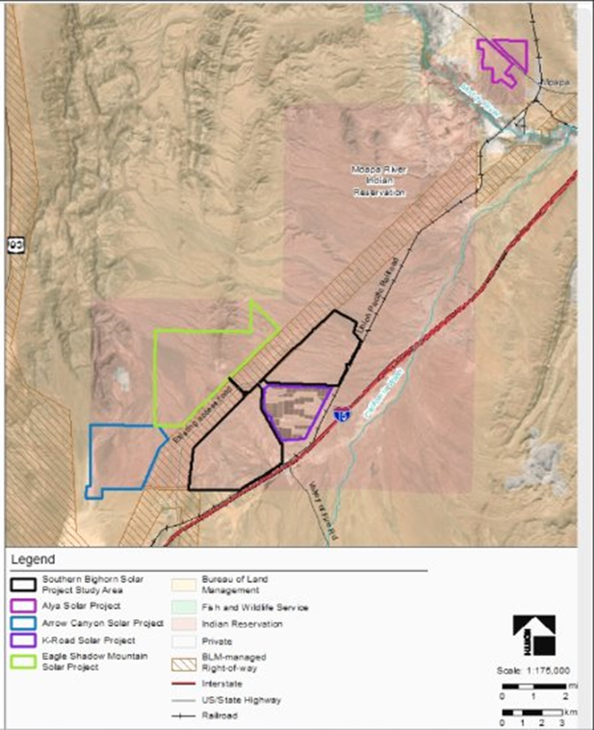
Moapa Band of Paiute Indians
Text goes here.

Slide 5
Standing Rock Sioux Tribe
Anpetu Wi Wind Farm
235 MW Wind Farm in North Dakota
Met towers Installed
Contracted Development Partners
Would double Tribe’s Annual Revenues ^{(*Project Website)}
Text goes here.

Slide 6
Funding Utility Scale Projects
Multi-Multi-Million Dollar Projects
Transmission Connection & Upgrade Costs
Power Purchase Agreements
Tax Credits/Direct Pay
Production/Investment Tax Credits
Bonus credits for Energy Community projects (closing fossil fuel projects)
Bonus credits for Indian Country or low-income community projects
Tribes eligible for Direct Payment

Slide 7
Viejas Band of Kumeyaay Indians
15 MW Microgrid + Battery
Largest EV Charging Station in Country
Provides Tribes 100% renewable energy for commercial & hospitality energy demands
Provides energy assurances for emergency services and support facilities
Utilizing DOE’s Loan Guarantee program - $73 M
First large approval in program’s history
Text goes here.

Slide 8
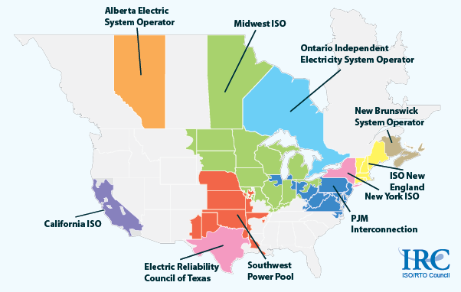
Transmission Planning Efforts
Regional Transmission Organizers

Slide 9
Transmission Planning Efforts
NCAI Resolution – #LV-24-051: Calling for Tribal Leadership and Oversight in Electric Grid Governance and Electric Transmission Planning
Be it Resolved, the National Congress of American Indians (NCAI) calls on states, regulators, utilities, electricity wholesalers, and all relevant decision makers and advocates to ensure that tribal electric utilities, tribal energy development organizations, and Tribal Nation leaders have oversight and leadership roles in formulation discussions and eventual governance of a Western Regional Transmission Organization (RTO)

Slide 10
Moapa Band of Paiute Indians

Slide 11
Federal Energy Regulatory Commission
Regulates interstate transmission and wholesale sale of electricity
As energy demand grows and renewable supply/generation grows, takes a lot more coordination and planning to connect to grid
Large project developers can have dozens of projects in the pipeline.
Requires Interconnection requests/upgrades
Requests can be speculative as development is never certain or timely
FERC “Order 2023” requires readiness deposits to stay in queue

Slide 12
Federal Energy Regulatory Commission
Tribal utility scale projects subject to the rule
Alliance for Clean Tribal Energy (similar to NAIHC role) advocating for Tribal exemptions
FERC held two consultations October and November
Comment period ended this past Monday
Waiting to see what FERC might do, but could be impacted by recent election

Slide 13
Federal Energy Regulatory Commission
Tribal utility scale projects subject to the rule
Alliance for Clean Tribal Energy (similar to NAIHC role) advocating for Tribal exemptions
FERC held two consultations October and November
Comment period ended this past Monday
Waiting to see what FERC might do, but could be impacted by recent election

