Slide 1
Bridging the Gap: Understanding Mental Health's Impact on Housing Stability
A Path to Healing and Housing Resilience in Indian Country

Slide 2
Brandi Liberty Iowa Tribe of Kansas and Nebraska/United Houma Nation
Brandi Liberty, a proud member of the Iowa Tribe of Kansas and Nebraska and descendant of the United Houma Nation, is a distinguished professional in the field of tribal consulting. As the owner and CEO of The Luak Group, she brings over 15 years of expertise to her work with Tribes and Tribal entities. Miss Liberty's career is marked by an impressive track record, securing over $103 million in grants from federal and state sources, earmarked for enhancing tribal communities. Her expertise encompasses business development, Indian housing, grant writing and management, tribal housing, human resources, technical assistance, economic development, policy development, compliance, and strategic planning.
In the literary world, Miss Liberty is the co-author of the book "Womanhood: Identity to Intimacy and Everything in Between," published in 2023. Her thought leadership extends to speaking engagements, including the notable keynote at the Healing the Circle in Our Tribal Communities Symposium by the Seminole Tribe of Florida in 2019 and participating in the Families Are Sacred Summit hosted by the Cherokee Nation in 2023. Her insights are sought after, with features in High Country News and the Associated Press. Miss Liberty's monthly column for Verite News provides readership in New Orleans with insights into the culture, challenges, and events that shape the lives of the Tribes in Louisiana and across Indian Country.
Miss Liberty's role as an MBDA Enterprising Woman of Color highlights her commitment to the advancement of women of color in business. She has been a vital member of various boards, currently serving on the Board of Directors as Treasurer for the National Indigenous Women's Resource Center and Research Wild.
Miss Liberty holds a BA in History from the University of Nebraska-Lincoln and a master's degree from the University of Kansas' Center of Indigenous Nations Studies, where she specialized in Tribal Human Resources. She obtained an Executive Leadership Certificate from Harvard Business School's program on Leading People and Investing to Build Sustainable Communities, in collaboration with the Native American Finance Officers Association (NAFOA).

Slide 3
Dustin Baird Oglala/Sicangu
Dustin Baird, a proud Lakota professional, is a seasoned Native Housing and Infrastructure Specialist with a deep understanding of cultural protocols and history. He has forged strong relationships with tribes and led transformative projects, including building the most robust E911 network on reservations in the Dakotas to enhance community safety. Dustin’s expertise spans Low-Income Housing Tax Credit projects, clean energy initiatives, resilient construction methods, and economic development for Native enterprises. His knowledge of federal funding, tribal governance, and historical trauma informs his culturally tailored housing strategies. Committed to empowering Native communities, Dustin combines tradition with innovation to deliver sustainable solutions that strengthen tribal sovereignty and self-sufficiency.

Slide 4
Eric Shepherd E.D SWO Housing Authority
Eric Shepherd serves as a dedicated leader at the Sisseton Wahpeton Housing Authority in Sisseton, South Dakota. He plays a pivotal role in advancing housing initiatives that address the unique needs of the Sisseton Wahpeton Oyate community. With a deep understanding of tribal governance, housing development, and culturally informed strategies, Eric is committed to creating sustainable, safe, and affordable housing solutions. His leadership focuses on fostering community growth while respecting traditional values and addressing the housing challenges specific to tribal lands.

Slide 5
Session Objectives
Understand how mental health impacts housing stability.
Explore culturally responsive solutions for Native communities.
Discuss actionable strategies to address housing and mental health challenges.

Slide 6
Mental Health and Housing Stability
Overcrowding impacts 16% of tribal household's vs 2.9% other households
Poor housing conditions increase rates of depression and anxiety.
Stable housing fosters resilience and improves mental health outcomes.

Slide 7
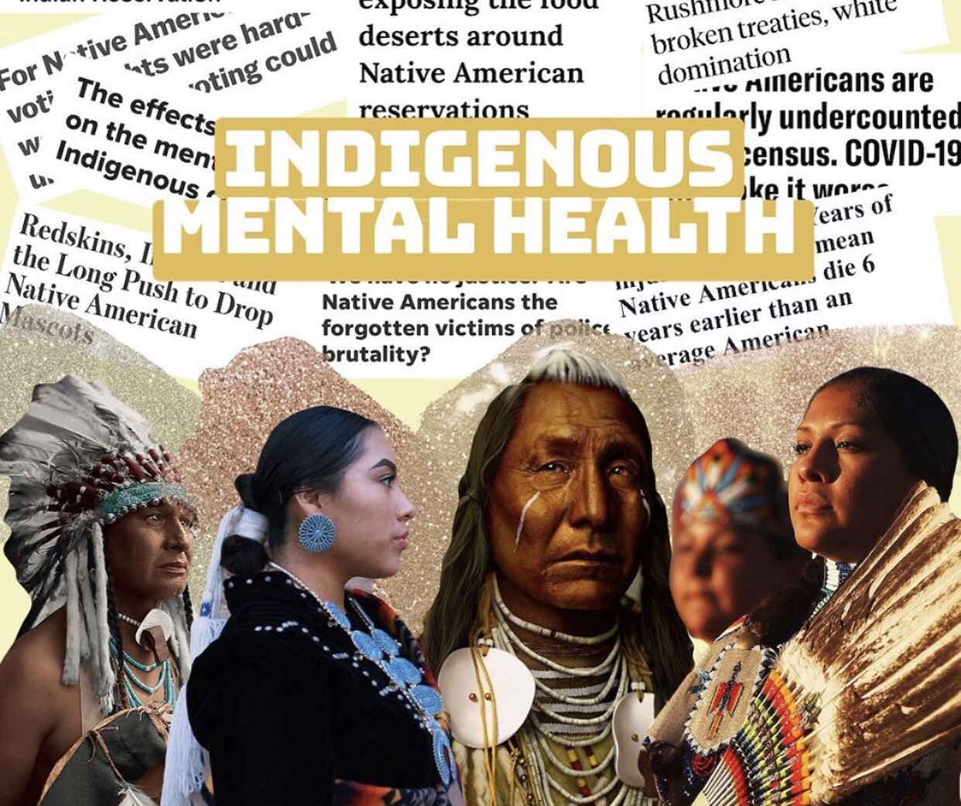
Mental Health Issues in Focus
Generational trauma
Disabilities (ADA)
Depression, anxiety, ADHD, and autism
Domestic violence without homelessness
Narcissistic abuse

Slide 8
Generational Trauma
Housing Stability
"How Experiences Change Markers in Our DNA"
Rewire Me
New York, NY (March 10, 2016) It’s a scientific fact: experiences change markers on the DNA of traumatized people, and these markers can be passed to future generations. Journalist Betsy Robinson talks to Rachel Yehuda, PhD, director of the Traumatic Stress Studies Division at the Icahn School of Medicine at Mount Sinai, and a leading researching in the genetic legacy of trauma. “I think that people are resonating with the findings,” she continues, “People do feel that somehow the experiences from their parents and generations past are meaningful in some way. Epigenetics gives us a language, a vocabulary to begin to talk about these kinds of phenomena.”

Slide 9
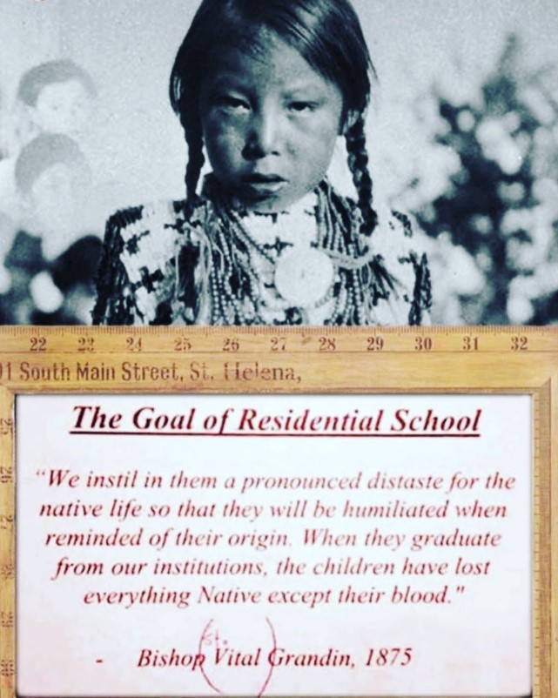
Historical Trauma in Indian Country
Boarding schools and forced relocation disrupted family structures
Intergenerational impacts: mental health disorders and housing insecurity.
Culturally informed solutions as paths to healing.

Slide 10
Legacy of Historical Trauma
“You ask any Tribal police officer on any reservation in America about the different calls that he or she responds to in our communities and the response will be mainly domestic violence issues including spouse, rape, incest, amongst others. We didn’t have these types of abuses in our communities before the boarding schools but now after a few generations of our relatives attending those schools the abuses they experienced run rampant on our reservations, so I commend the housing authority for thinking outside the box and addressing the root of those issues.”
Forced relocation, Native Boarding Schools, and land loss have intergenerational impacts
Unresolved trauma increases prevalence of mental health conditions and housing instability.
Trauma-informed approaches can break cycles of instability.

Slide 11
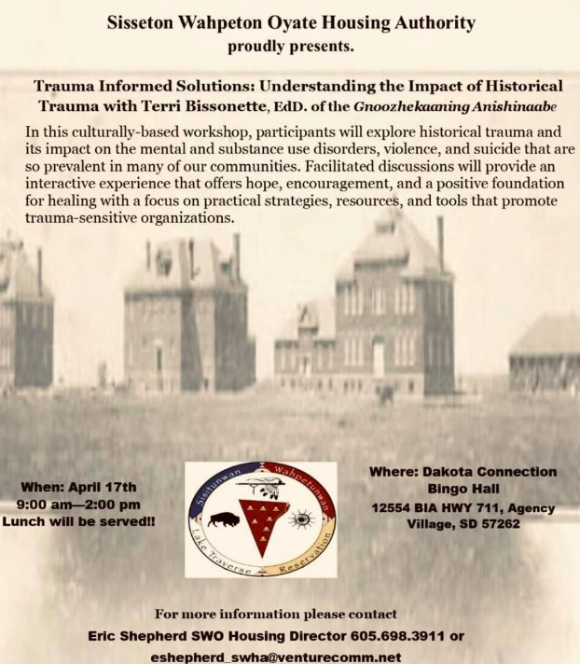
How Historical Trauma Training Benefits Housing Projects
Enhancing mental health support by linking families to resources.
Breaking cycles of poverty and housing instability with trauma-informed practices.
Advocating for policies that reflect the unique needs of Native families.

Slide 12
Key Finding 1: Historical Trauma and Mental Health
Historical trauma has left intergenerational impacts
Linked to higher rates of mental health conditions, substance use, and housing instability.

Slide 13
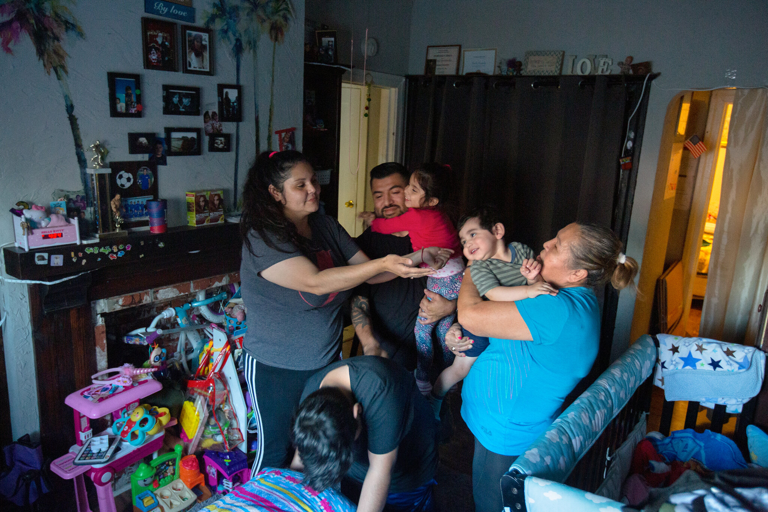
Key Finding 2: Overcrowding and Living Conditions
16% of tribal households face overcrowding
Associated with depression, family conflict, and poor educational outcomes.
chrome-extension://efaidnbmnnnibpcajpcglclefindmkaj/https://store.samhsa.gov/sites/default/files/sma14-4816.pdf

Slide 14
Key Finding 4: Homelessness and Mental Illness
Homelessness disproportionately affects Native populations.
Linked to severe mental health challenges and increased vulnerability.
Today, Native people experience the second highest rate of homelessness (10%) in the U.S., accounting for approximately 1.5% of North America’s population.
A lack of affordable housing is tied to higher rates of homelessness in general and on Tribal lands
Notes:
https://www.nlc.org/article/2023/03/15/rooted-in-trauma-homelessness-in-native-communities/

Slide 15
Potential Solution 1: Trauma-Informed Housing
Integrate trauma-informed approaches into housing policies
Create culturally sensitive, empowering spaces for residents.

Slide 16
Potential Solution 2: Supportive Housing Models
Combine affordable housing with mental health services.
Effective for reducing homelessness and improving mental health.

Slide 17
Tailored housing supports for individuals with autism and ADHD.
Policies to accommodate unique needs in housing programs.

Slide 18
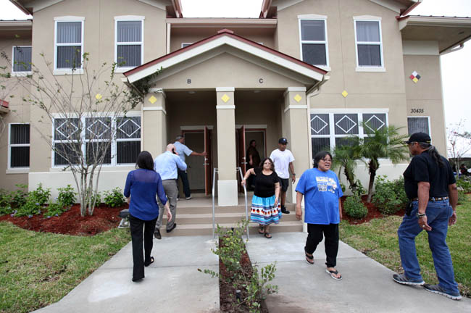
ADA and Tribal Housing
ADA does not always apply to Tribes, but Section 504 does for federally funded programs
Section 504 prohibits discrimination and mandates accessibility in new construction and rehabilitation projects.
Many Tribes voluntarily incorporate ADA principles into their housing codes.

Slide 19
COVID-19’s Impact on Mental Health and Housing
Increased depression and anxiety among Native Americans
Economic hardships intensified housing instability.
Expanded mental health resources and housing supports are critical.

Slide 20
Domestic Violence and Housing Stability
Survivors often face economic instability due to abuse
Policy gaps fail to protect survivors in stable housing but facing foreclosure.
Need for survivor-centered housing policies.

Slide 21
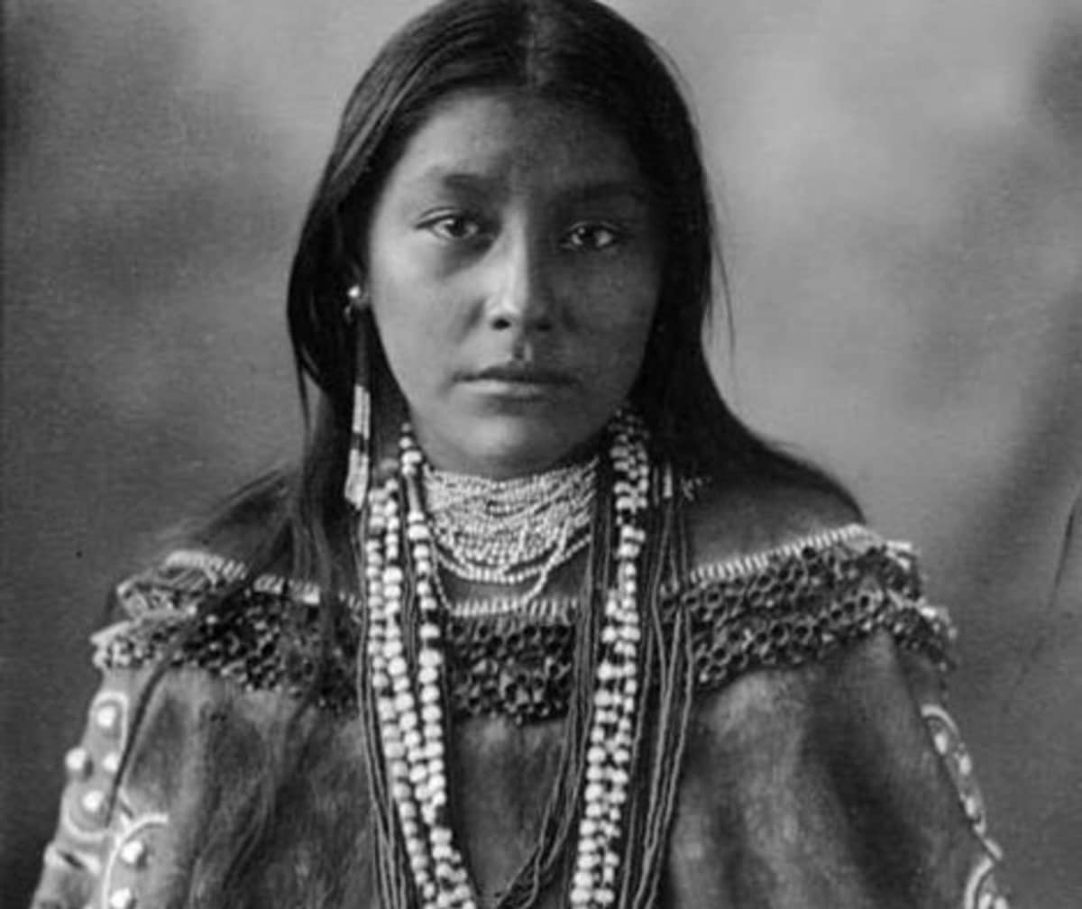
Sexual Violence and Housing Instability
Sexual violence creates immediate and long-term housing needs
11% of survivors report assaults occurred in their home
Over 50% of survivors in need of housing services did not receive them.

Slide 22
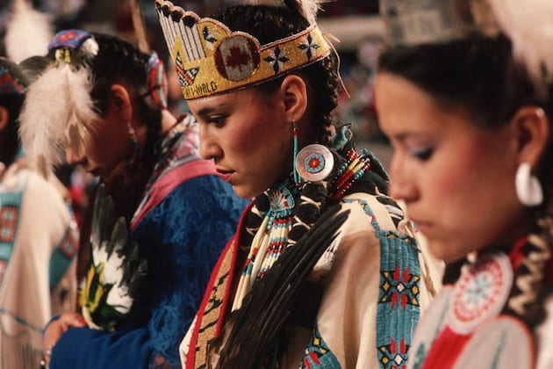
VAWA Housing Provisions
Emergency transfers for survivors fearing for their safety
Protections against eviction due to abuse.
Expanded definitions of 'homeless' to include survivors of violence.

Slide 23
Housing as a Preventative Measure for MMIW
Safe housing reduces risks of victimization linked to MMIWG.
Domestic violence survivors represent 63% of homeless women.
Housing access plays a critical role in preventing violence and supporting recovery.

Slide 24
Understanding Narcissistic Abuse
Narcissistic abuse is characterized by manipulation, control, and emotional harm.
Survivors often face diminished self-esteem and economic dependency.
Emotional abuse can lead to housing instability due to financial exploitation or isolation.

Slide 25
Housing Instability Linked to Narcissistic Abuse
Economic abuse often restricts survivors' financial autonomy.
Coercive control may prevent survivors from securing or maintaining housing.
Escaping abuse frequently results in unstable living conditions or homelessness.

Slide 26
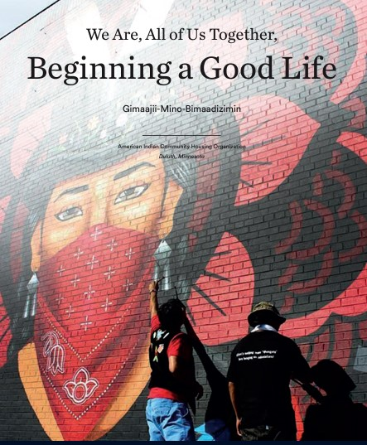
Supporting Survivors of Narcissistic Abuse
Staff training to recognize signs of narcissistic abuse.
Incorporate case management focusing on recovery and empowerment.
Ensure programs are accessible and confidential to support survivor safety.

Slide 27
Mental health and tribal communities
Breaking the barriers

Slide 28
Importance of Early Intervention
Recognizing signs of mental health struggles early can prevent evictions.
Training housing staff to identify and address mental health needs is key.

Slide 29
Trauma-Informed Housing Design
Incorporate community spaces and privacy-enhancing features
Design housing to reduce stress and support mental health recovery.

Slide 30
Policy Recommendations
Expand culturally specific housing supports
Ensure funding for trauma-informed housing programs.
Reduce barriers like credit checks and application fees.

Slide 31
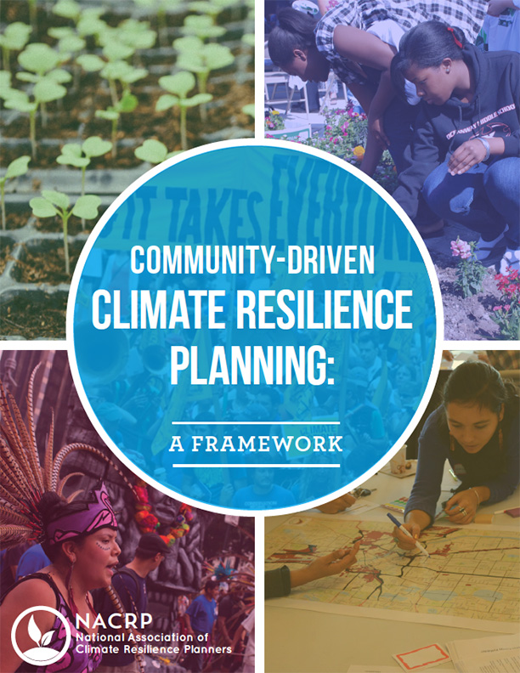
Community Engagement for Resilience
Community-driven solutions empower Native families
Incorporate cultural practices into housing policies.

Slide 32
Cultural Practices in Housing Solutions
Integrate traditional ceremonies and storytelling.
Build housing environments that reflect community values.

Slide 33
Best Practices for Tribal Housing Authorities
Hire Native property managers and diversify staff
Prioritize survivors on waitlists while maintaining confidentiality
Implement culturally appropriate and trauma-informed training programs.

Slide 34
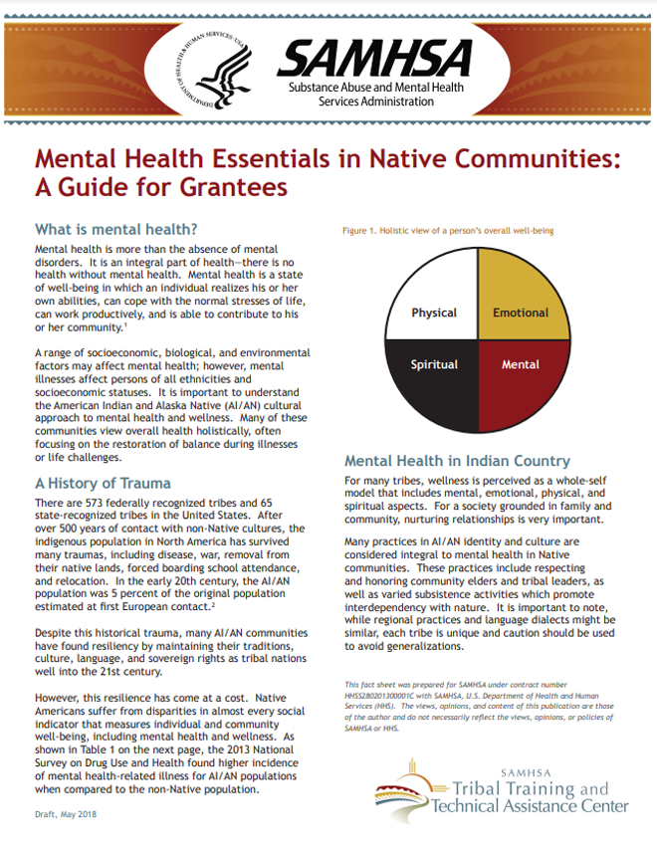
Training for Housing Staff
Mental health awareness programs for staff.
Partnerships with local mental health organizations.

Slide 35
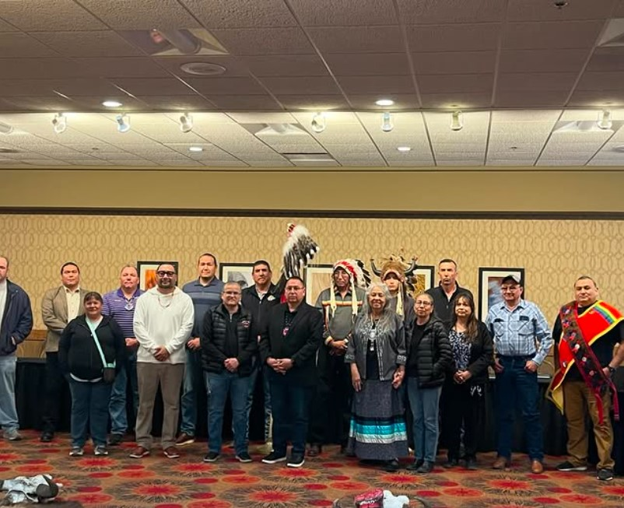
Recommendations for Tribal Councils
Fund and establish domestic violence shelters
Advocate for federal resources like Rapid Rehousing funds
Pass laws that prioritize VAWA compliance and support prevention.

Slide 36
Training and Awareness for Community Support
Educate staff and residents on domestic violence and cultural safety
Organize community-based training to address intersectional issues.
Promote mutual aid networks to foster resilience.

Slide 37
HUD’s Role in addressing mental health

Slide 38
Importance of Stable Housing for Mental Health
Stable housing is foundational for mental well-being
Homelessness and instability exacerbate mental health challenges.
Programs ensure comprehensive care addressing both housing and mental health.

Slide 39
Resources and Tools
Historical Trauma and Mental Health
https://www.ipr.northwestern.edu/news/2020/redbird-what-drives-native-american-poverty.html
https://news.harvard.edu/gazette/story/2020/05/the-impact-of-covid-19-on-native-american-communities/
NRCDV housing guides
https://safehousingpartnerships.org/
https://nrcdv.org/capacity-building
chrome-extension://efaidnbmnnnibpcajpcglclefindmkaj/https://www.csh.org/wp-content/uploads/2011/11/Gimaajii.MN_.FINAL_.pdf
National Indigenous Women’s Resource Center
https://www.enterprisecommunity.org/blog/historical-policies-shaped-housing-native-america

Slide 40
Closing Remarks
Thank you for your participation.
Together, we can bridge the gap between mental health and housing stability.

