Slide 1
Leadership in Action: Empowering Tribal Leadership to Drive Homeownership Success
A Collaborative Panel Discussion with Dustin Baird & Brandi Liberty

Slide 2
Brandi Liberty Iowa Tribe of Kansas and Nebraska/United Houma Nation
Brandi Liberty, a proud member of the Iowa Tribe of Kansas and Nebraska and descendant of the United Houma Nation, is a distinguished professional in the field of tribal consulting. As the owner and CEO of The Luak Group, she brings over 15 years of expertise to her work with Tribes and Tribal entities. Miss Liberty's career is marked by an impressive track record, securing over $103 million in grants from federal and state sources, earmarked for enhancing tribal communities. Her expertise encompasses business development, Indian housing, grant writing and management, tribal housing, human resources, technical assistance, economic development, policy development, compliance, and strategic planning.
In the literary world, Miss Liberty is the co-author of the book "Womanhood: Identity to Intimacy and Everything in Between," published in 2023. Her thought leadership extends to speaking engagements, including the notable keynote at the Healing the Circle in Our Tribal Communities Symposium by the Seminole Tribe of Florida in 2019 and participating in the Families Are Sacred Summit hosted by the Cherokee Nation in 2023. Her insights are sought after, with features in High Country News and the Associated Press. Miss Liberty's monthly column for Verite News provides readership in New Orleans with insights into the culture, challenges, and events that shape the lives of the Tribes in Louisiana and across Indian Country.
Miss Liberty's role as an MBDA Enterprising Woman of Color highlights her commitment to the advancement of women of color in business. She has been a vital member of various boards, currently serving on the Board of Directors as Treasurer for the National Indigenous Women's Resource Center and Research Wild.
Miss Liberty holds a BA in History from the University of Nebraska-Lincoln and a master's degree from the University of Kansas' Center of Indigenous Nations Studies, where she specialized in Tribal Human Resources. She obtained an Executive Leadership Certificate from Harvard Business School's program on Leading People and Investing to Build Sustainable Communities, in collaboration with the Native American Finance Officers Association (NAFOA).

Slide 3
Dustin Baird Oglala/Sicangu
Dustin Baird, a proud Lakota professional, is a seasoned Native Housing and Infrastructure Specialist with a deep understanding of cultural protocols and history. He has forged strong relationships with tribes and led transformative projects, including building the most robust E911 network on reservations in the Dakotas to enhance community safety. Dustin’s expertise spans Low-Income Housing Tax Credit projects, clean energy initiatives, resilient construction methods, and economic development for Native enterprises. His knowledge of federal funding, tribal governance, and historical trauma informs his culturally tailored housing strategies. Committed to empowering Native communities, Dustin combines tradition with innovation to deliver sustainable solutions that strengthen tribal sovereignty and self-sufficiency.

Slide 4
Overview
Objective: Equip tribal leaders with tools to foster homeownership.
Focus Areas:
Economic and cultural benefits of homeownership.
Overcoming challenges in Indian Country.
Strategies for tribal leadership.

Slide 5
The Importance of Homeownership in Tribal Communities
Key Benefits:
Economic stability.
Cultural preservation.
Community well-being.
Challenges:
Poverty and overcrowding.
Lack of basic amenities.
Complex regulatory environments.

Slide 6
Challenges in Tribal Housing
Data Highlights:
40% of reservation housing is substandard.
16% live in overcrowded homes (national average: 2.2%).
Limited infrastructure and funding.
Impact:
Reduced homeownership rates.
High development costs and poverty rates.

Slide 7
The Importance of Homeownership in Tribal Communities
Exploring Economic, Social, and Cultural Impacts

Slide 8
Economic Benefits of Homeownership
Builds generational wealth through home equity.
Provides job creation in construction, retail, and finance sectors.
Stimulates local tribal economies through increased spending.
Supports self-sufficiency and reduces reliance on federal aid.

Slide 9
Social Benefits of Homeownership
Enhances family stability and living conditions.
Strengthens ties to tribal land and culture.
Encourages community cohesion and pride.
Improves educational and health outcomes for families.

Slide 10
Cultural Benefits of Homeownership
Preserves tribal traditions and connection to the land.
Enables culturally sensitive housing designs.
Promotes intergenerational living and knowledge sharing.
Reinforces community identity and pride.

Slide 11
Challenges to Homeownership in Indian Country
Limited access to mortgage financing on trust lands.
Underfunding of tribal housing programs.
Complex legal and regulatory environment.
High poverty rates and lack of financial literacy.

Slide 12
Opportunities for Homeownership in Indian Country
Leverage federal programs like HUD Section 184 loans.
Develop partnerships with Native CDFIs.
Implement tribal policies to streamline lending and building processes.
Promote financial literacy and homebuyer education.

Slide 13
Role of Homeownership in Sustaining Tribal Economies
Increases economic activity through housing development.
Encourages tribal members to live and work within the community.
Generates revenue through property-related taxes and services.
Builds long-term economic resilience.

Slide 14
Case Study: Bristol Bay Housing Authority
Promising Practices:
Leveraged USDA loans with tribal funding to create affordable mortgages.
Prioritized culturally responsive housing designs.
Trained local workforce, boosting economic and social development.
Impact: Increased pride and financial literacy among homeowners.

Slide 15
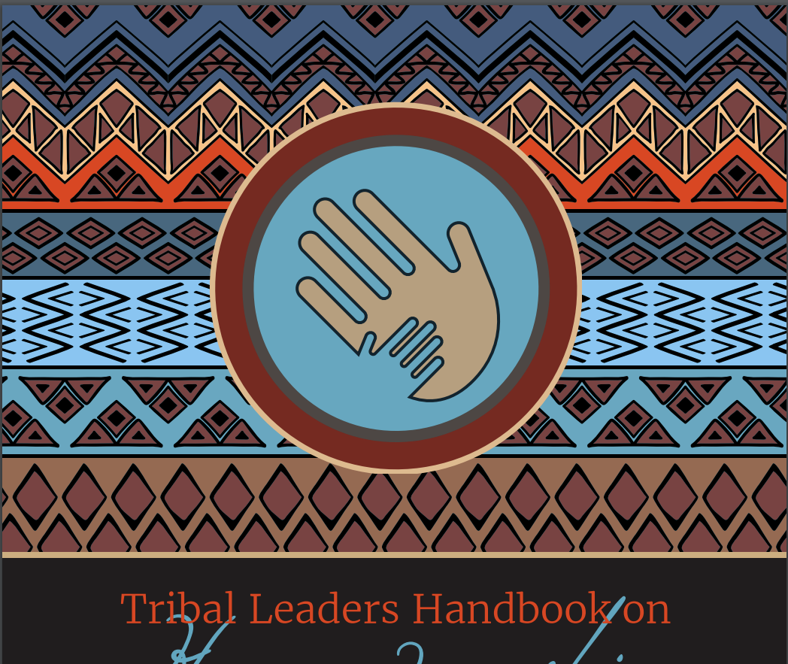
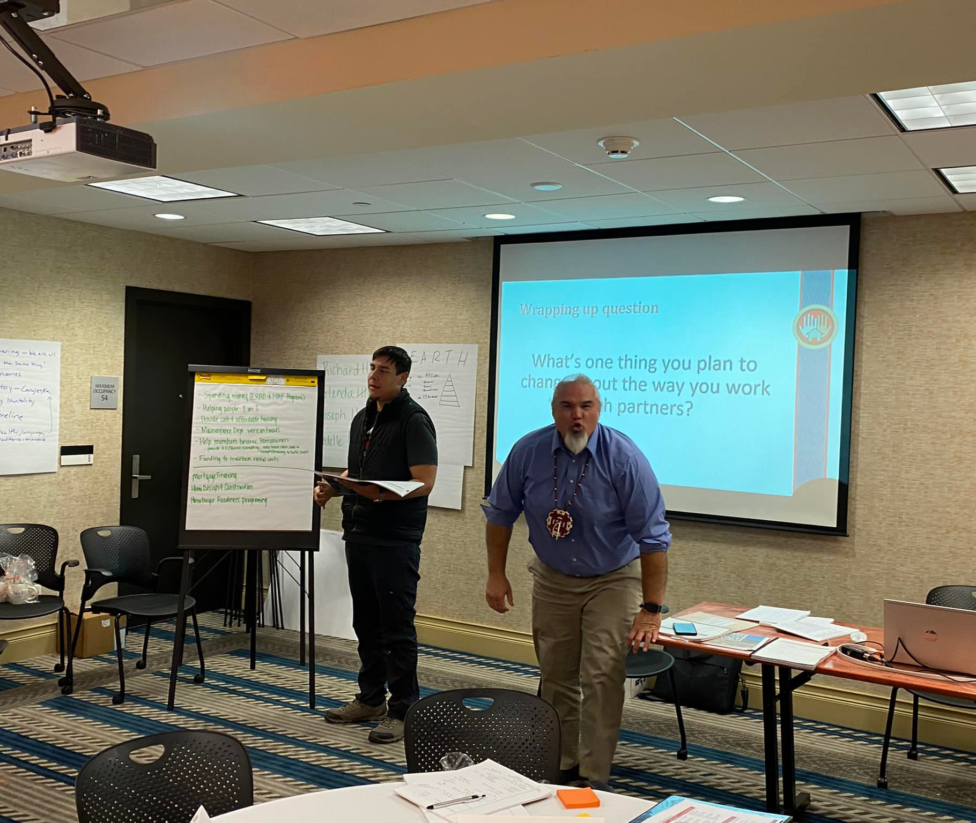
Tribal Leaders Handbook on Homeownership: The handbook is your guide to the new mortgage programs (government and private), the new kinds of lenders (loan funds, Native CDFIs), and the new energies that are transforming Indian housing.
Notes:
This photo was taken during a training session in Billings, Montana, on October 6, 2022. The trainer, a former Executive Director of Little Earth in Minneapolis and former Tribal Council member of the Kul Wicasa (Lower Brule Tribe of South Dakota), co-facilitated the multi-day event. Steve Barbier of NeighborWorks provided a glowing review of the training.

Slide 16
Key Federal Programs Supporting Homeownership
HUD Section 184 Indian Home Loan Guarantee Program.
USDA Rural Development Loan Programs.
Indian Housing Block Grant Program (NAHASDA).
VA Native American Direct Loan Program.

Slide 17
Building Capacity for Tribal Leadership
Develop tribal housing authorities and infrastructure.
Streamline land-use planning and zoning processes.
Invest in training for financial education and homeownership readiness.
Advocate for policy reforms and increased funding.

Slide 18
The Role of Tribal Leadership in Promoting Homeownership
Key Responsibilities, Vision, Policy, and Strategic Planning

Slide 19
Key Responsibilities of Tribal Leadership
Define and communicate a clear vision for homeownership.
Advocate for increased funding and federal program access.
Develop and enforce housing policies tailored to tribal needs.
Build capacity through training and education initiatives.

Slide 20
Fostering a Culture of Homeownership
Host educational workshops on financial literacy and home maintenance.
Promote community involvement through sweat equity programs.
Celebrate homeownership milestones to build community pride.
Provide incentives like down payment assistance or low-interest loans.

Slide 21
Challenges for Tribal Leadership
Navigating federal and state housing regulations.
Overcoming historical mistrust in government programs.
Addressing financial barriers like poor credit scores or lack of collateral.
Balancing short-term needs with long-term sustainability.

Slide 22
Building Capacity for Tribal Housing Authorities
Develop infrastructure to support housing initiatives.
Train staff in financial education and housing policy.
Strengthen governance by adopting clear tribal housing codes.
Foster partnerships with financial institutions and NGOs.

Slide 23
The Way Forward for Tribal Leadership
Prioritize data sovereignty for accurate housing needs assessments.
Advocate for increased access to federal and private funding.
Engage communities to ensure culturally appropriate solutions.
Set measurable goals and track progress toward homeownership targets.

Slide 24
Critical Connections: Homeownership and Tribal Economic Development
Exploring Coordination, Capacity, and Strategic Planning

Slide 25
Homeownership as Economic Development
Homeownership builds wealth within the community.
Encourages local spending, boosting tribal businesses.
Provides stability for families, reducing reliance on social services.
Supports workforce retention by offering housing near job opportunities.

Slide 26
Housing in Economic Master Planning
Economic development plans often overlook housing needs.
Housing plans should align with business and industry development.
Workforce housing ensures employees can live near workplaces.
Example: Coordination between casino development and nearby housing.

Slide 27
Need for Coordinated Planning
Lack of collaboration leads to missed opportunities.
Housing authorities must be included in economic planning.
Align Indian Housing Plans (IHPs) with tribal economic goals.
Example: A TDHE working with tribal councils for shared strategies.

Slide 28
Coordination Between TDHE and Tribal Government
Collaborative master planning for housing and economic projects.
Leverage shared resources for infrastructure and development.
Align grant applications with comprehensive tribal plans.
Promote transparency and communication between entities.

Slide 29
Challenges in Coordination
Lack of understanding of funding mechanisms like NAHASDA.
Tribal resolutions not passed due to misaligned priorities.
Housing plans ignored in broader tribal strategic plans.
Limited communication between TDHEs and tribal departments.

Slide 30
Refusal to Buy-In: A Common Obstacle
Tribal leaders may lack awareness of housing funding opportunities.
Misconceptions about NAHASDA and grant requirements.
Examples: Refusal to sign resolutions for housing projects.
Impact: Delays in critical housing developments.

Slide 31
Education and Advocacy for Tribal Leadership
Provide training on funding options like HUD programs.
Demonstrate the economic impact of housing developments.
Engage leaders in the planning process from the start.
Example: Workshops on leveraging Indian Housing Block Grants.

Slide 32
Lack of Coordination in Housing Departments
Non-TDHE housing departments often operate in silos.
Plans may conflict with tribal economic strategies.
Example: Housing development blocked due to mismatched priorities.
Solution: Create inter-departmental housing committees.

Slide 33
Addressing Capacity Gaps in Tribal Administration
Tribal finance and grants management often lack resources.
Capacity issues hinder grant applications and project execution.
Solution: Invest in training and technology for tribal staff.
Leverage partnerships with TDHEs for grant administration.

Slide 34
Building Trust and Collaboration
Establish regular meetings between tribal councils and TDHEs.
Create joint task forces for housing and economic development.
Promote shared accountability and mutual goals.
Example: MOU agreements between housing authorities and tribes.

Slide 35
Key Takeaways for Tribal Leadership
Housing is integral to economic development planning.
Collaboration between TDHEs and tribal councils is critical.
Address capacity gaps to enhance project execution.
Education and advocacy are key to gaining leadership buy-in.

Slide 36
Understanding the Tribal Homeownership Process
From Planning to Ownership

Slide 37
Overview of the Tribal Homeownership Process
Key Phases:
Planning: Assessing community needs and goals.
Preparation: Financial literacy and credit repair.
Implementation: Securing funding and constructing homes.
Ownership: Sustaining success through support programs.

Slide 38
Phase 1: Planning
Conduct a housing needs assessment.
Engage community members to identify priorities.
Develop a comprehensive housing strategy.
Align planning with tribal cultural and economic goals.
Source: Tribal Leaders Handbook on Homeownership (2023).

Slide 39
Importance of Vision in Homeownership Initiatives
A strong vision aligns community efforts toward shared goals.
Reflects cultural values and long-term sustainability.
Provides direction for funding priorities and policy development.
Example: Setting a goal to increase tribal homeownership by 25% over 10 years.

Slide 40
Role of Policy in Homeownership Initiatives
Establishes a framework for consistent decision-making.
Addresses unique challenges on tribal lands, such as trust land issues.
Encourages partnerships with federal, state, and private entities.
Example: Policies to streamline mortgage lending on tribal lands.

Slide 41
Developing Effective Housing Policies
Align policies with tribal values and economic goals.
Streamline processes for land use and mortgage approvals.
Address barriers to financing on trust lands.
Example: Policies supporting HUD Section 184 Loan Program.

Slide 42
Strategies for Policy Development
Engage
Engage stakeholders, including tribal members and housing experts.
Use
Use data from housing needs assessments to guide decisions.
Incorporate
Incorporate sustainability and cultural preservation into policies.
Review and update
Regularly review and update policies to reflect changing needs.

Slide 43
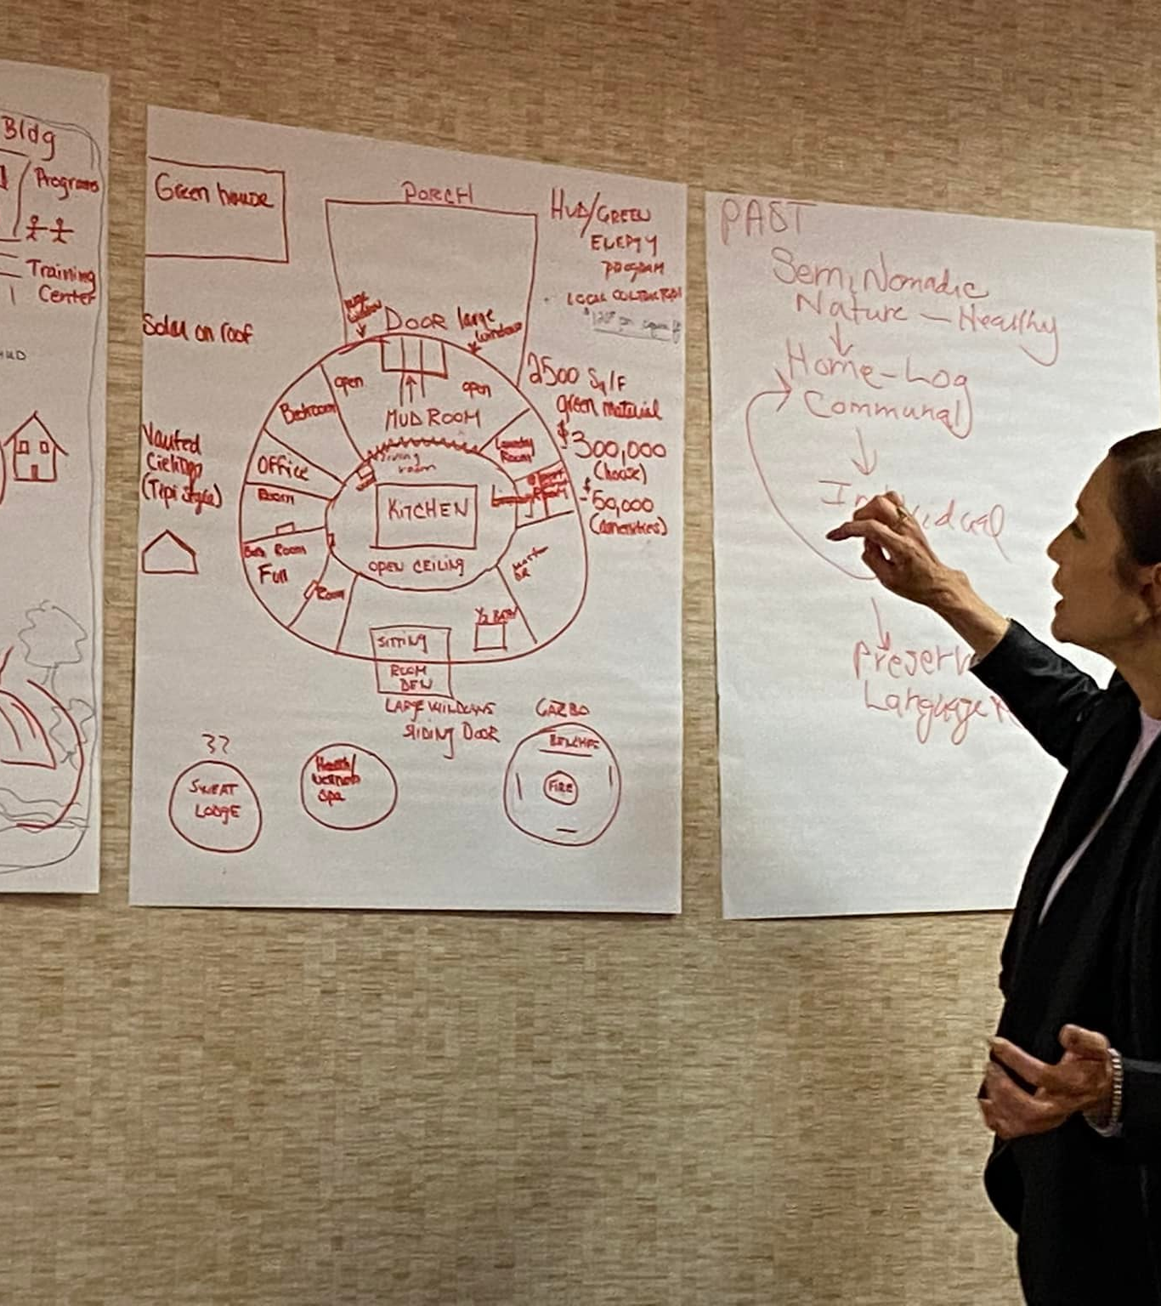
Strategic Planning for Homeownership
Aligns resources with housing goals and priorities.
Anticipates challenges and identifies mitigation strategies.
Incorporates tools like SWOT analysis for data-driven decisions.
Example: Planning phased construction projects to maximize funding.

Slide 44
Importance of Community Engagement
Builds trust and buy-in for homeownership programs.
Ensures that initiatives align with community needs and values.
Empowers members with a sense of ownership and responsibility.
Example: Hosting town halls and focus groups.

Slide 45
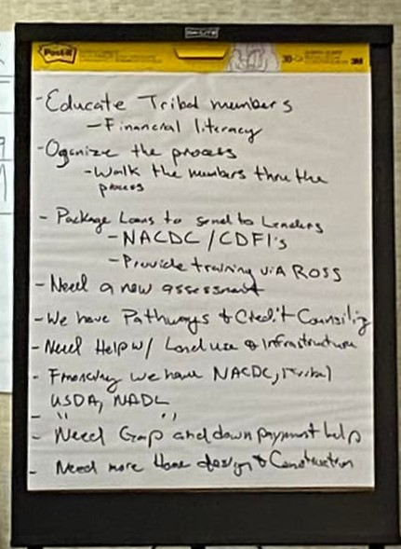
Phase 2: Preparation
Offer financial literacy workshops.
Provide resources for credit repair and savings plans.
Educate community members on mortgage options.
Collaborate with Native CDFIs for homebuyer readiness.
Source: CICD-Tribal Leaders Handbook (2023).

Slide 46
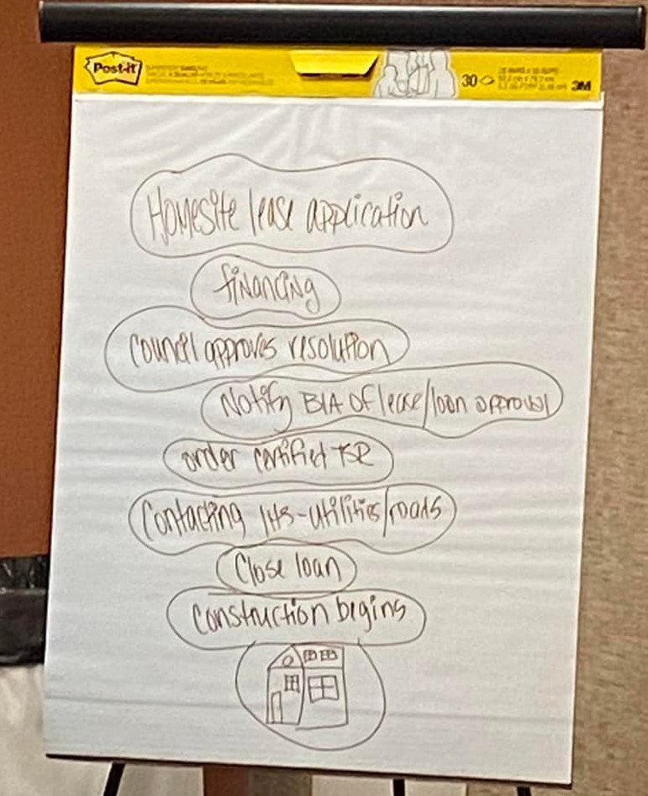
Education in Homeownership Initiatives
Provide financial literacy and credit repair workshops.
Offer training on home maintenance and budgeting.
Collaborate with schools and community centers for outreach.
Example: Financial counseling programs by Native CDFIs.

Slide 47
Phase 3: Securing Funding
Leverage federal programs like HUD Section 184 loans.
Apply for NAHASDA Indian Housing Block Grants.
Explore partnerships with banks and financial institutions.
Utilize tribal funds to supplement external resources.

Slide 48
Leveraging Resources Effectively
Combine tribal funds with external grants for maximum impact.
Collaborate with state and private entities for additional resources.
Example: Matching tribal funds with HUD Section 184 loans.
Result: Expanded housing opportunities for tribal members.

Slide 49
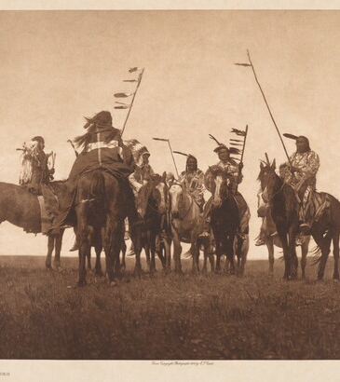
Importance of Partnerships
Partnerships bring additional resources and expertise.
Collaboration enhances program visibility and effectiveness.
Examples include partnerships with Native CDFIs and local lenders.
Successful partnerships often lead to sustainable housing initiatives.

Slide 50
Building Federal Partnerships
Utilize programs like HUD's Section 184 Loan Guarantee.
Apply for funding through NAHASDA Indian Housing Block Grants.
Engage with USDA Rural Development for housing loans.
Advocate for consistent funding and regulatory support.

Slide 51
Leveraging Federal Programs
HUD Section 184 Loan Guarantee Program:
Provides low-interest loans for Native borrowers.
USDA Rural Development Loans:
Supports homeownership in rural tribal areas.
NAHASDA Block Grants:
Funds housing development tailored to tribal needs.

Slide 52
Leveraging State and Private Partnerships
Collaborate
Collaborate with state housing finance agencies for grants and loans.
Partner
Partner with private sector companies for construction and materials.
Engage
Engage philanthropic organizations for funding and technical support.
State
Example: State loan programs tailored to rural housing needs.
Notes:
Denver Colorado: For the first time, the city is building an apartment complex for American Indians who are homeless or on the verge of losing their housing, a community that, in one small way, will attempt to make up for past wrongs.
Mercy Housing, a national affordable housing nonprofit headquartered in Denver, will build a 187-unit community centered on “recognizing the historic displacement of American Indian tribes” after presenting the winning grant proposal to the Denver Housing Authority. The project, which will begin rising in summer 2024 at 901 Navajo St., about 12 blocks southwest of the state Capitol, will target American Indians and Alaska Natives who qualify based on income. It will house the city’s Indian Health Services clinic, which has outgrown its space in the Sun Valley neighborhood.

Slide 53
Leveraging Funding and Resources
Combine tribal funds with federal and state grants.
Apply for renewable energy grants to reduce housing costs.
Use revolving loan funds to support ongoing homeownership programs.
Example: Cherokee Nation’s funding model for sustainable housing.

Slide 54
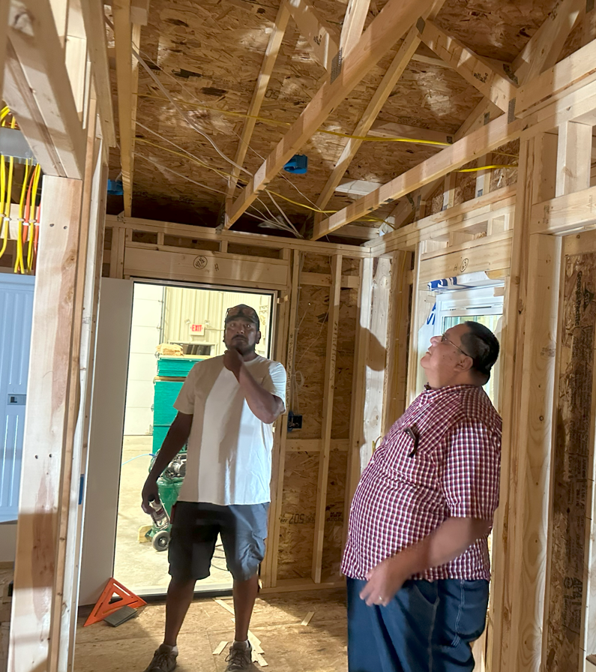
Phase 4: Construction and Development
Design homes that reflect tribal culture and needs.
Address infrastructure challenges like water and roads.
Hire and train tribal members to support local employment.
Example: Sweat equity programs to reduce construction costs.

Slide 55
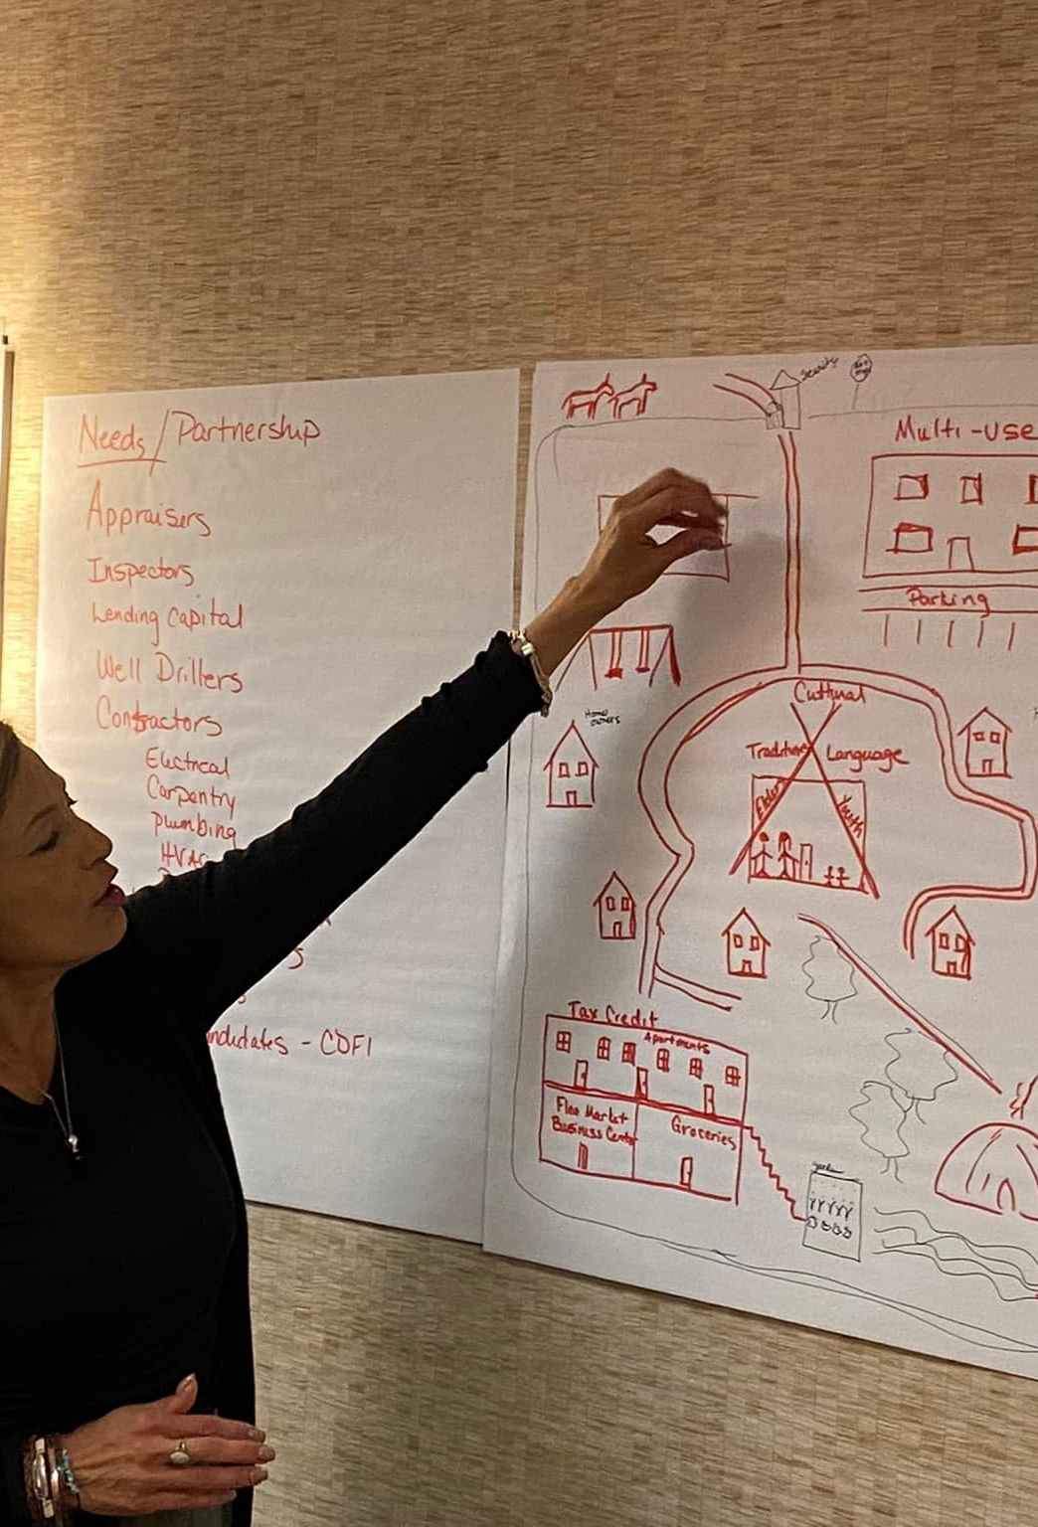
Addressing Infrastructure Challenges
Invest in essential infrastructure: roads, water, and electricity.
Partner with federal agencies to address large-scale needs.
Incorporate renewable energy solutions for cost-effective housing.
Example: Solar-powered housing projects in rural tribal areas.

Slide 56
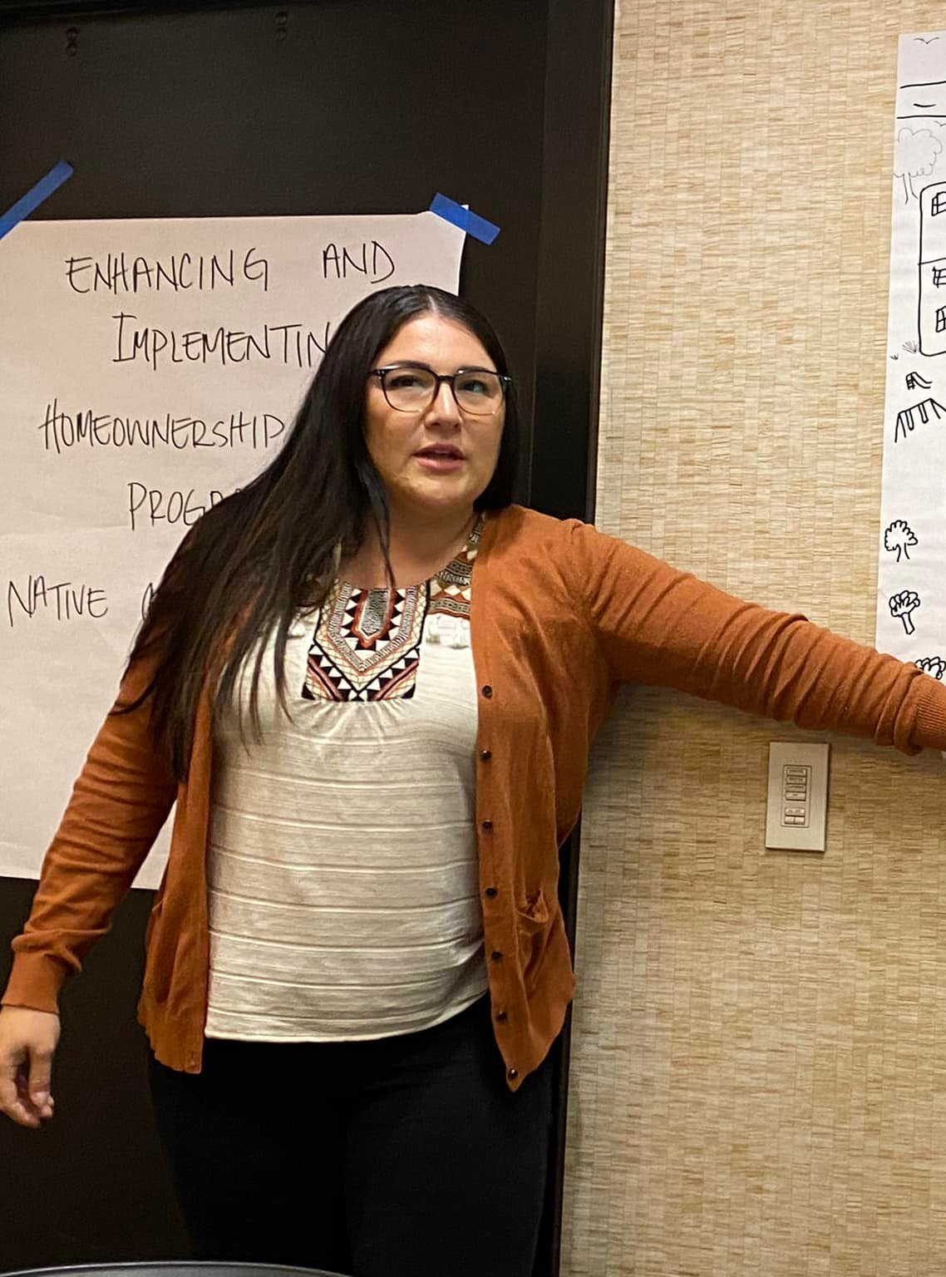
Phase 5: Homeownership and Sustaining Success
Provide ongoing support for homeowners (e.g., maintenance workshops).
Offer resources for budgeting and financial management.
Celebrate homeownership milestones to encourage community pride.
Example: Nez Perce Housing Authority's mentorship programs.

Slide 57
Addressing Barriers in the Process
Challenges:
Limited access to financing on trust lands.
Regulatory hurdles and land use issues.
Solutions:
Streamline tribal housing codes.
Advocate for policy reforms to increase funding access.

Slide 58
Measuring Success in Homeownership Programs
Track metrics like homeownership rates and program participation.
Conduct regular community surveys to assess satisfaction.
Evaluate financial outcomes such as loan repayment rates.
Use data to refine and expand successful programs.

Slide 59
Key Takeaways for Tribal Leadership
The homeownership process requires strategic planning and collaboration.
Community engagement ensures programs meet cultural and economic goals.
Leverage federal and tribal resources to address unique challenges.
Provide ongoing education and support for sustainable success.

Slide 60
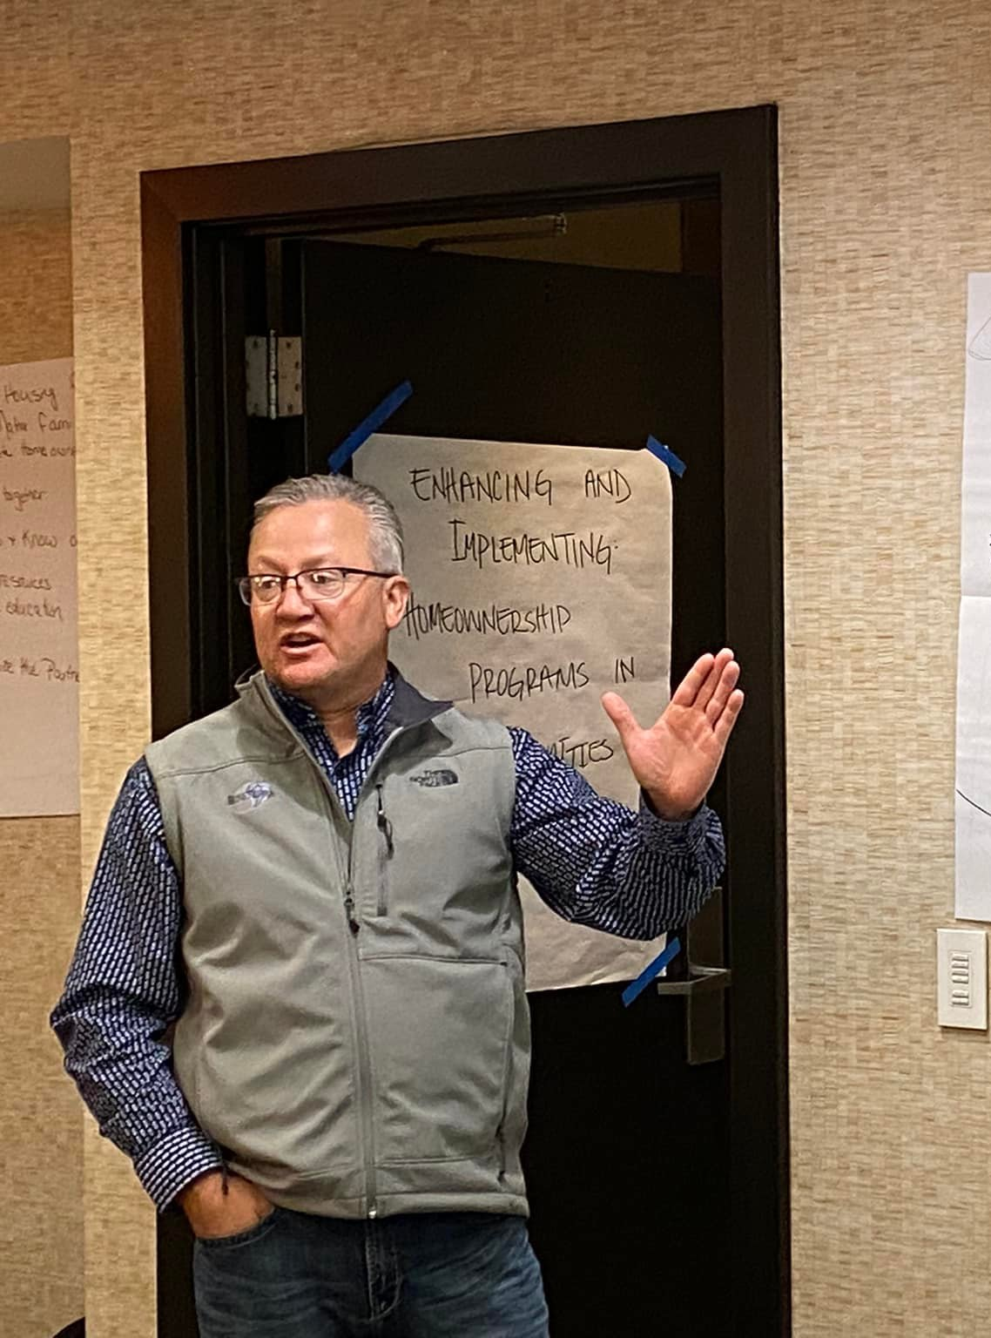
Key Takeaways for Tribal Leadership
Successful programs rely on collaboration and culturally tailored approaches.
Policies must address unique barriers to tribal homeownership.
Community engagement and education are critical for success.
Federal programs offer vital resources but require proactive advocacy.

Slide 61
Conclusion and Reflection
Homeownership is a cornerstone of economic development and community well-being.
Strategic planning must integrate housing with economic initiatives.
Collaboration between TDHEs, tribal governments, and housing authorities is critical.
Addressing capacity gaps and educating leadership can unlock opportunities.
Commitment to coordinated efforts ensures sustainable growth and resilience.

Slide 62
Questions for Reflection
1. How can your tribe ensure housing is included in economic development plans?
2. What steps can be taken to improve coordination between TDHEs and tribal councils?
3. How can tribal leadership be better educated about housing funding opportunities?
4. What strategies could address capacity gaps in tribal finance and grants management?
5. How can housing developments be aligned with cultural values and workforce needs?

Slide 63
Dustin Baird
Email: dustin@nagiservices.com
605.431.5862
248 W. Valleyview Ave
Littleton, CO
80120

