Slide 1



Slide 2


WELCOME TO OUR PRESENTATION
Ethical Governance for Housing Authority Board Members

Slide 3

INTRODUCTION
Ethical Governance
  Purpose: Explore the ethical and legal framework governing board members.
  Objectives: Equip board members with tools to navigate oversight duties, ensure accountability, and respect sovereignty.

Slide 4
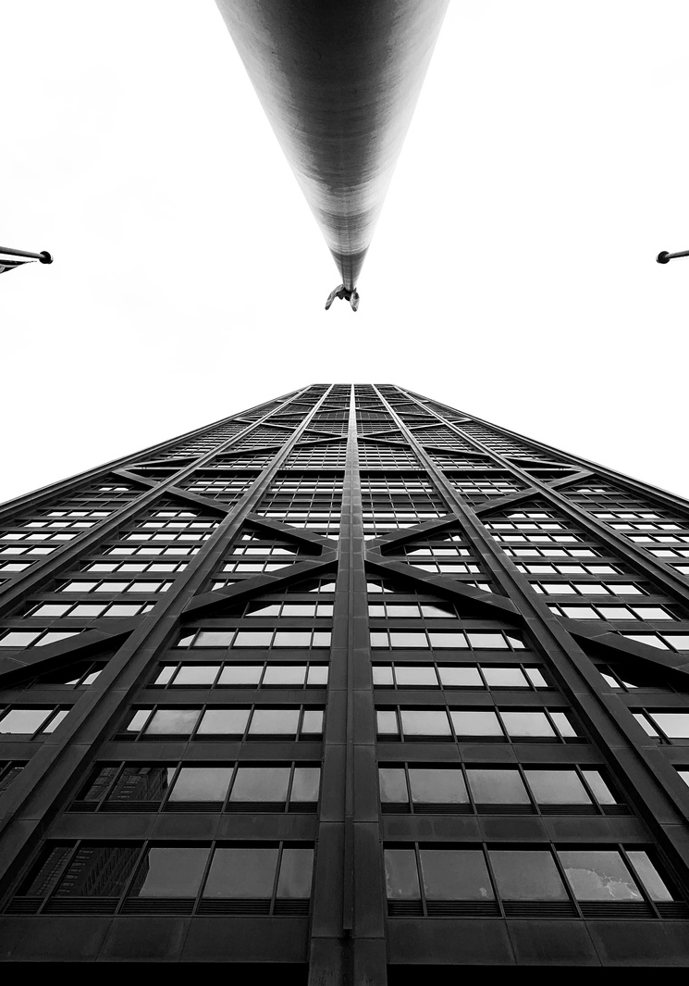
UNDERSTANDING BOARD AUTHORITY
The Role of the Board
  Governing Oversight: Setting policies and monitoring compliance.
  Independent Role: Distinguishing between governance and day-to-day operations.
  Supporting Mission: Focus on safe, affordable housing and sustainable programs.
www.hrwisellc.com

Slide 5


SOVEREIGN IMMUNITY
Protections and Limitations of Sovereign Immunity
  Sovereign immunity shields tribal entities from external lawsuits.
  Limitations:
    Individual board member liability for personal malfeasance or gross negligence.
    Contractual waivers may expose housing authorities under specific conditions.
  Best Practice: Explicit provisions in bylaws outlining immunity boundaries and indemnification protections.
www.hrwisellc.com

Slide 6

BOARD MEMBER RESPONSIBILITIES
Board Member Responsibilities
  Fiduciary Duty: Act in the best interest of the housing authority and its beneficiaries.
  Conflicts of Interest: Disclose and recuse when personal or financial interests are at play.
  Oversight Duties: Ensuring compliance with:
    Financial reporting standards.
    Regulatory requirements (e.g., HUD or other funding entities).
  Transparency: Regular public updates and adherence to governance policies.
www.hrwisellc.com

Slide 7

GOVERNANCE VS. OPERATIONS
  Role Definition:
    The Board’s responsibility is to establish policies, set strategic goals, and oversee organizational performance.
    Day-to-day operational tasks, such as managing staff or executing specific projects, are under the purview of housing authority staff.
  When to Interject:
    The Board may step into operational matters only when there is evidence of policy violations, legal concerns, or performance failures.
    Investigate within the framework of established protocols and bylaws.
  Best Practice: Maintain a balance between oversight and operational independence by fostering clear communication and accountability structures.
www.hrwisellc.com

Slide 8
POTENTIAL CONSEQUENCES OF MALFEASANCE
  Types of Violations: Negligence, fraud, or willful misconduct.
  Consequences:
    Personal liability for actions taken outside the scope of official duties.
    Legal repercussions, including potential lawsuits.
    Reputational damage and possible removal from board service.
  Mitigating Risks:
    Adhere strictly to policies and procedures.
    Document decisions thoroughly to provide a clear rationale.
    Regularly review bylaws and organizational policies to ensure compliance.
www.hrwisellc.com

Slide 9
TOOLS FOR EFFECTIVE OVERSIGHT
  Establishing Governance Policies:
    Regular bylaw reviews.
    Clear delineation of board and staff responsibilities.
  Supporting Transparency:
    Regular financial audits and public reports.
    Open lines of communication with stakeholders.
  Strengthening Ethical Compliance:
    Continuous training and awareness on governance issues.
    Implementing whistleblower protections and anti-retaliation measures.
www.hrwisellc.com

Slide 10
INTERACTIVE SCENARIOS
  Example Challenges:
    A financial discrepancy is identified.
    Staff refuses to comply with a board-mandated audit.
    Allegations of ethical misconduct arise against an executive director.
  Discussion:
    How and when to act within policy boundaries.
    Understanding investigatory powers and limits.

Slide 11


OPEN
DISCUSSION

Slide 12






CONTACT US
855-353-1035
www.hrwisellc.com
gokeefe@hrwisellc.com
8399 E Indian School Rd., Suite 102
Scottsdale, AZ 85251

