Slide 1
Funding Opportunities Through State Legislation: We did it, NOW YOU!
Annalee Trujillo, Executive Director, Pala Housing Resource Center
Moriah McGill, Deputy Director, Northern Circle IHA

Slide 2
Agenda
Introductions
CA Tribal Housing History
Partnerships and Relationship
Advocacy Efforts

Slide 3
Session Goals
Better understanding of Housing in California
Better understanding importance of Relationships
Support you in identifying the Barriers
Support you in identifying the Opportunities
We did it, NOW YOU!

Slide 4
Introductions
Who are we?

Slide 5
Introductions
Moriah McGill
Deputy Director, Northern Circle Indian Housing Authority
Grant Writer / Developer
10 years of Tribal Housing Experience
Board Member
Technical Assistance Provider

Slide 6
Introductions
Annalee Trujillo
Executive Director
Pala Housing Resource Center
20+ years of Tribal Housing Experience
Board Member
Technical Assistance Provider

Slide 7
Partner Introductions
A
California Coalition for Rural Housing
Iliana Chevez, Director of Tribal Programs
Liz Hernandez, Associate Tribal Program Manager
Gina Gradias, Tribal Programs
Mosaic
Lihbin Shiao, Principal

Slide 8
Where are you from?
Alaska
Northern Plains
Southern Plains
Hawaii
Eastern Woodlands
Northwest
Southwest*

Slide 9
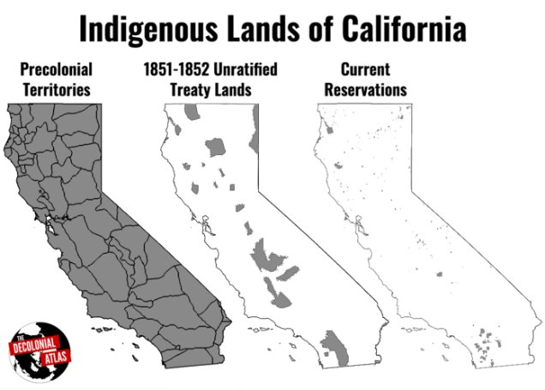
California Tribal History
174 Years of Housing Insecurities

Slide 10
174 Years of Housing Insecurities
1851: State of Address - "That a war of extermination will continue to wage between the races until the Indian Race becomes extinct." Peter Burnett, January 6, 1851
1870's: Forced Assimilation
1937: Wagner Steagall Act 1937
1856: California Indian Relocation Act – Urban relocation and assimilation into white culture
1958: Rancheria Act – 44 CA Tribes were identified for termination and promised improved water and sanitation systems

Slide 11
174 Years of Housing Insecurities
1970s
Tribes creating Housing Authorities with State Support
1983
Tillie Hardwick – Restored 17 Terminated Tribes to Federal Recognition
1986
Low Income Housing Tax Credits – Tax Reform Act
1990
HOME Investment Partnership
1992
Section 184 Native American Loan Gaurantee Program
1996
Native American Housing Assistance and Self-Determination Act

Slide 12
174 Years of Housing Insecurities
2000's
CA Tribe unable to access State Funds – A new found need to partner with fellow advocates
2011
B-10-11
2014
Low Income Housing Tax Credits (CA)
2016
HOME NOFA
2017
HOME NOFA (no award 1st round)
2019
CA Assembly Bill 1010

Slide 13
Scan for More CA Tribal History

Slide 14
2019 Assembly Bill 1010
CCRH with partnership from Tribes and TDHEs
Assembly member Eduardo Garcia
AB 1010 would allow duly constituted governing bodies of Native American reservation or Rancheria to become eligible applicants to participate in affordable housing programs
Eligibility to MOST State Housing Programs
Reconstitutes the California Indian Assistance Program (CIAP)

Slide 15
BAM! Worldwide PANDMIC!
Completely changed how we did business

Slide 16
COVID-19
Shifted the way we do business
COVID Response Funding
Homelessness Funding
New Programs
Outreach to Members
INCREASED HOUSING NEEDS

Slide 17
Partnerships & Relationship
Who's on your team?
Who else believes in the vision?

Slide 18
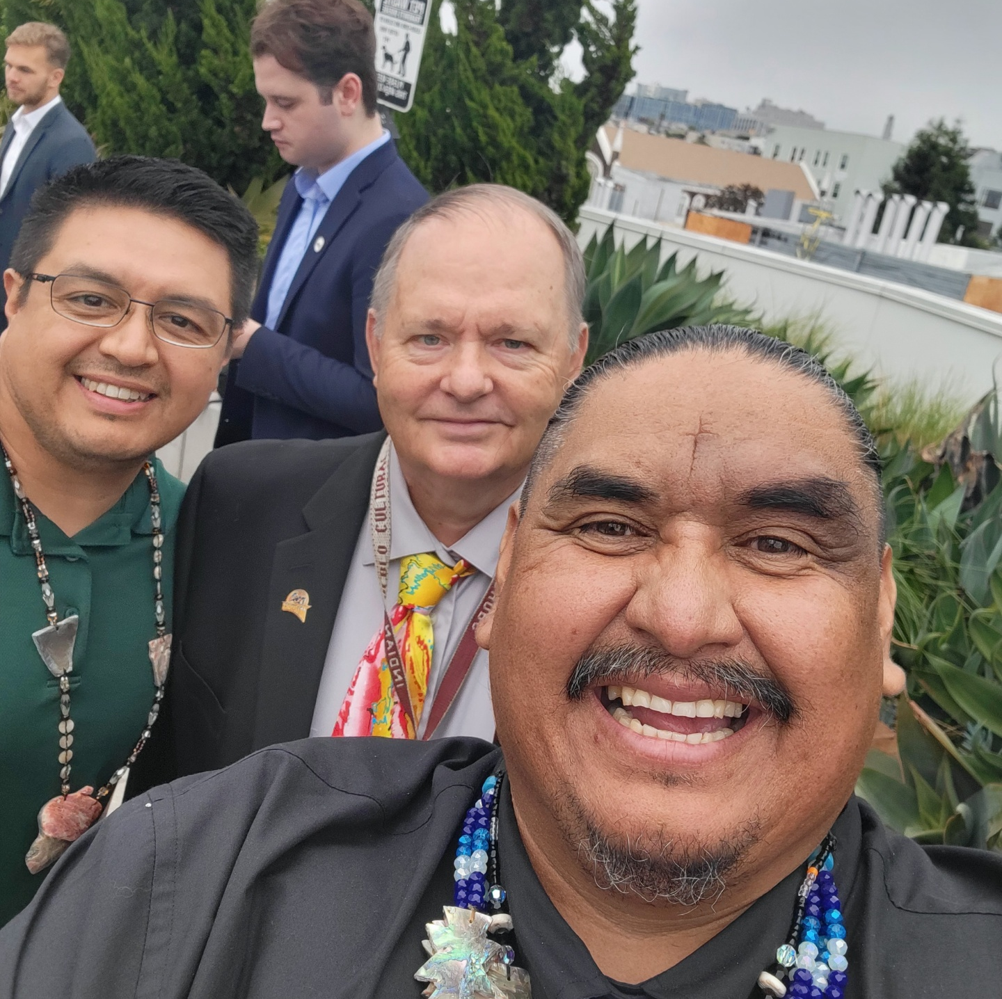
Partnerships & Relations
"Relationships Matter" - Bobby Yandell
Find your Team
Who else has you vision
"No what you know, but who you know"
Elevator Pitch
REPEAT!

Slide 19
Drafting Committee
Tribal Leaders
Tribal Housing Experts
Tribal Housing Advocates
Legal Counsel
Technical Assistance Providers
Liaisons
Legal Advisors and Champions
June 2022 - Present

Slide 20
Barriers in CA Housing
Completely new to Tribes
Completely new to the State
"Red Tape" Requirements and Affordability
Bureaucracy
Land Availability and Status
Limited Waivers of Sovereign Immunity
$130M only 5% Accessed

Slide 21
THAT Committee
Tribal Housing Action Task Force
Meeting Frequency
Identify Goals
Assign Tasks
Track and Compile Data

Slide 22
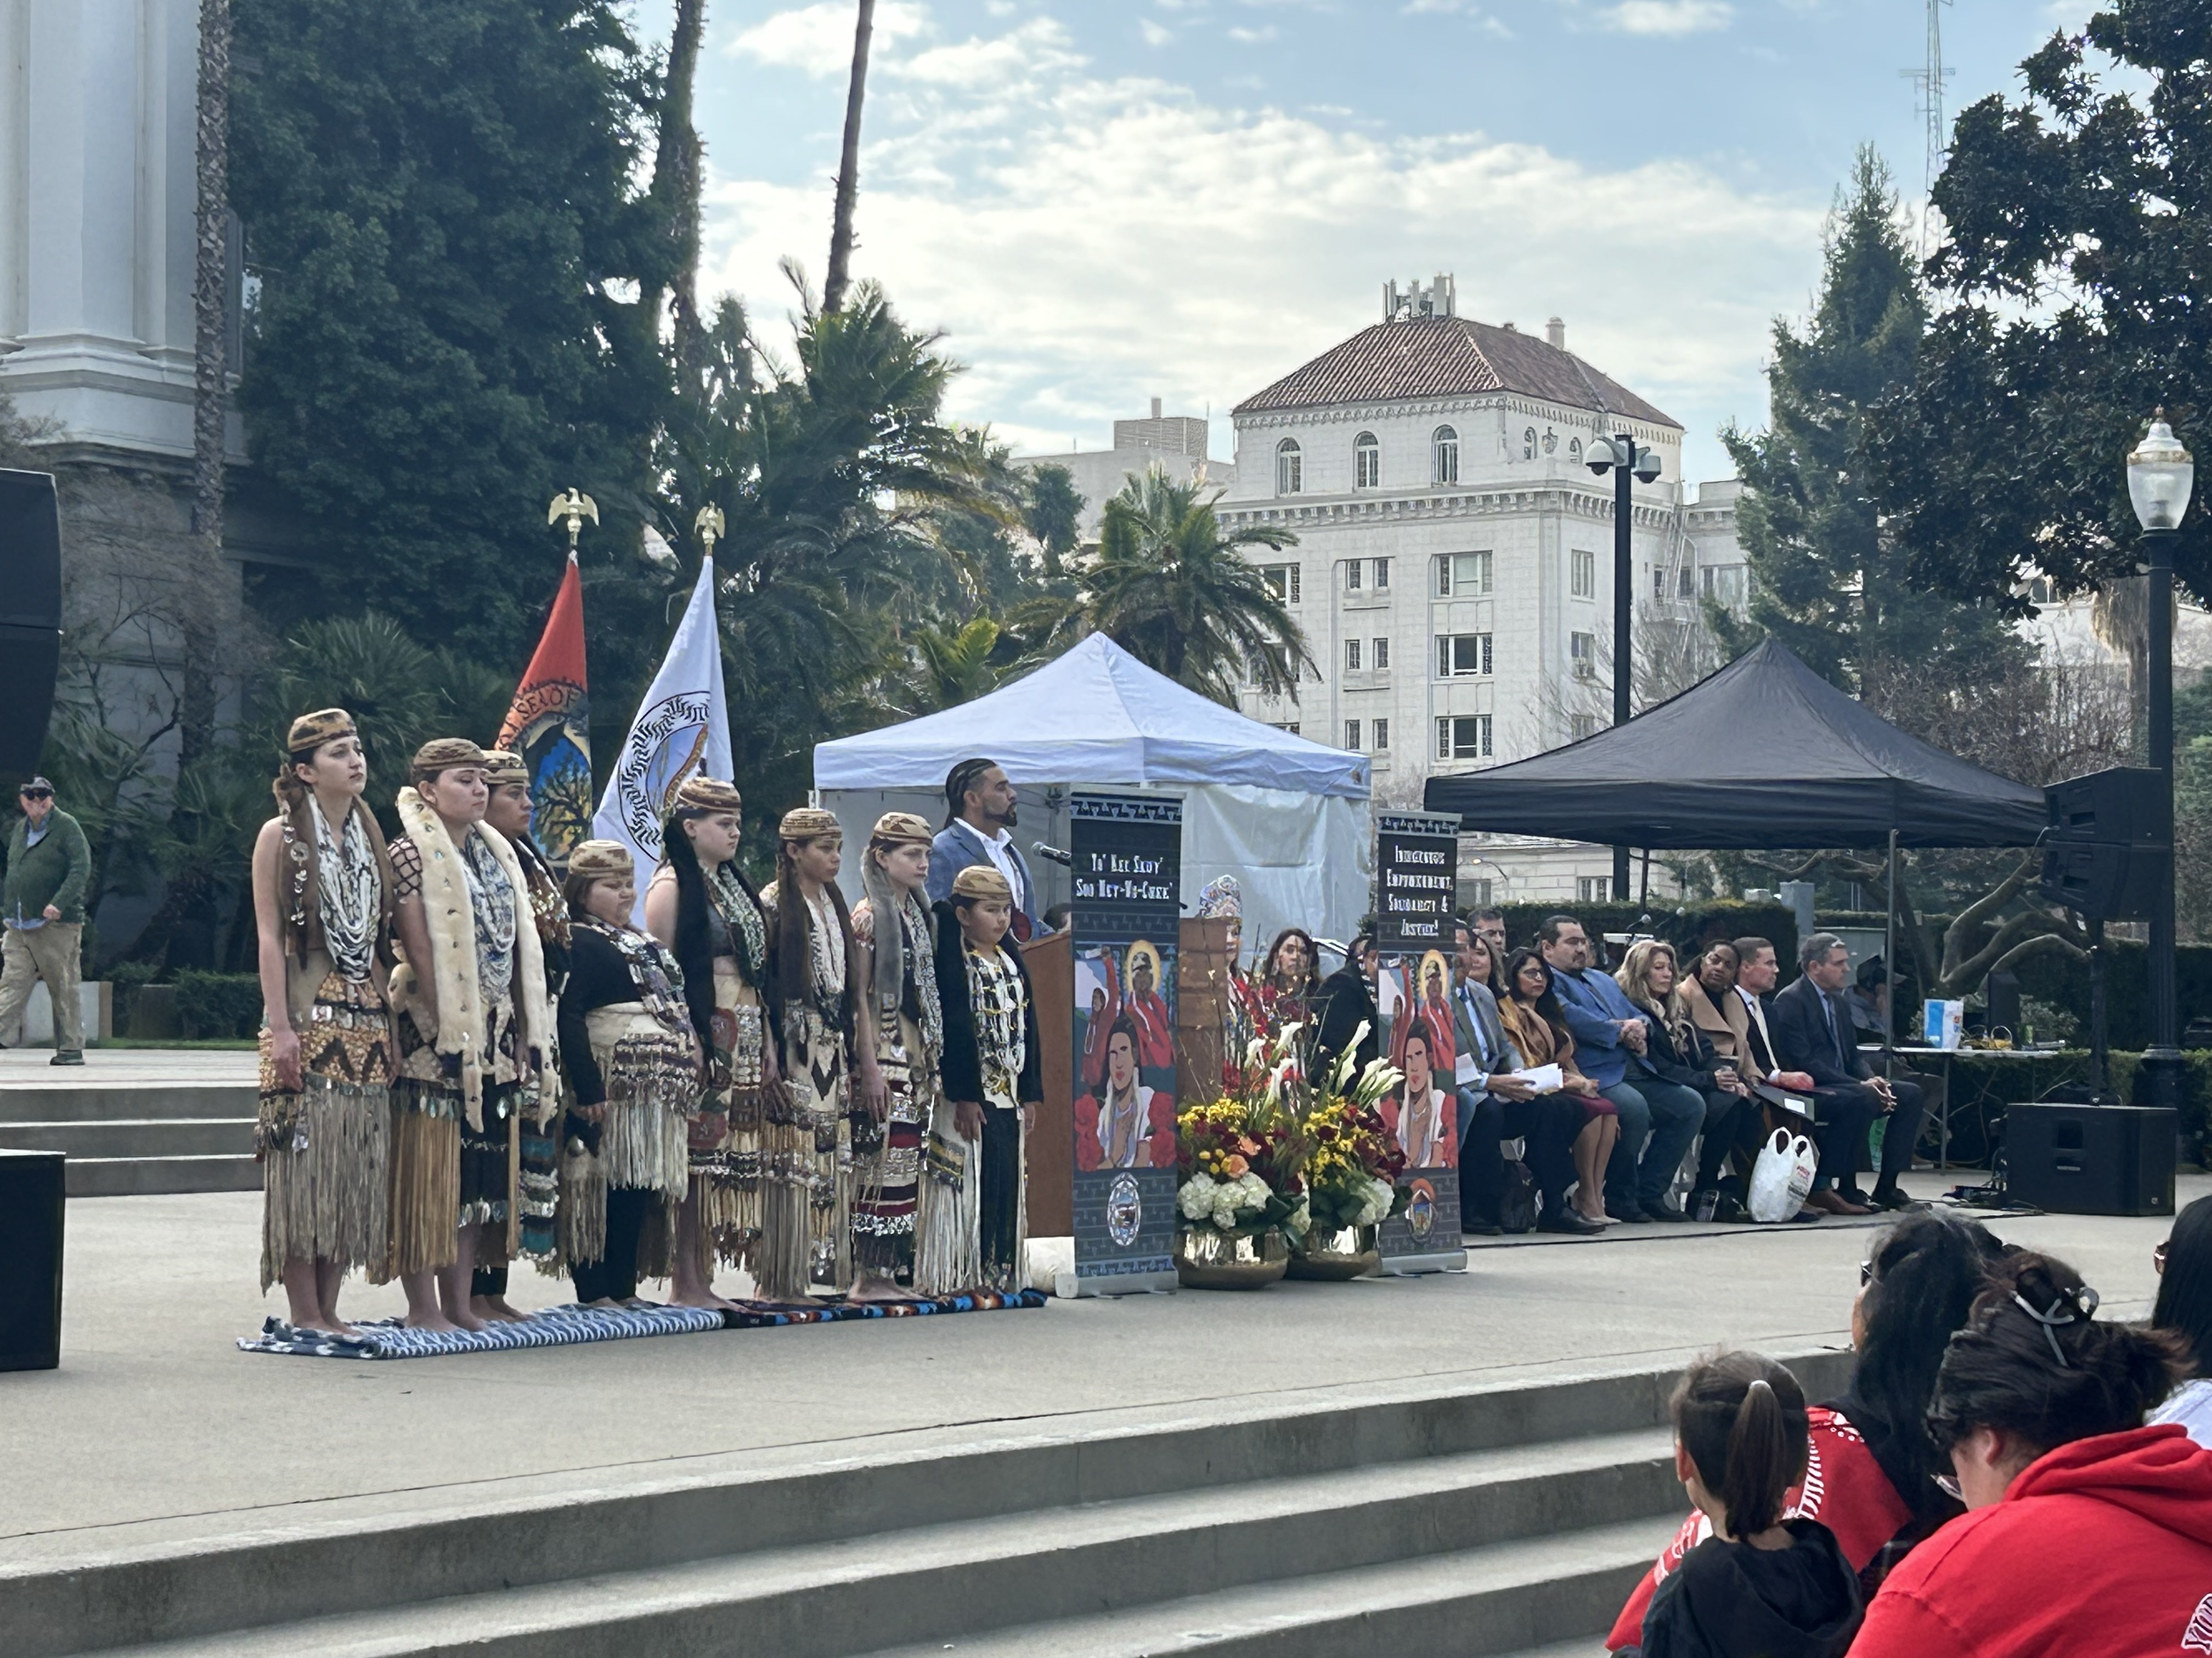
Advocacy Efforts
Advocating for your Vision!

Slide 23
Barriers in CA Housing
Completely new to Tribes
Completely new to the State
"Red Tape" Requirements and Affordability
Bureaucracy
Land Availability and Status
Limited Waivers of Sovereign Immunity
$130M only 5% Accessed

Slide 24
Threats and Opportunities
HUD Programs are not enough
No NAHASDA Reauthorization
CA Falling Behind Funding Trends
Expansion of Social Services Programs
Partners and Coalitions
Limited Utilization of CA Funds

Slide 25
Recent California Tribal Housing Bills
2019 – Assembly Bill 1010
2023 – Senate Bill 18 & Assembly Bill 371
2024 – Senate 1187 & Assembly Bill 1878

Slide 26
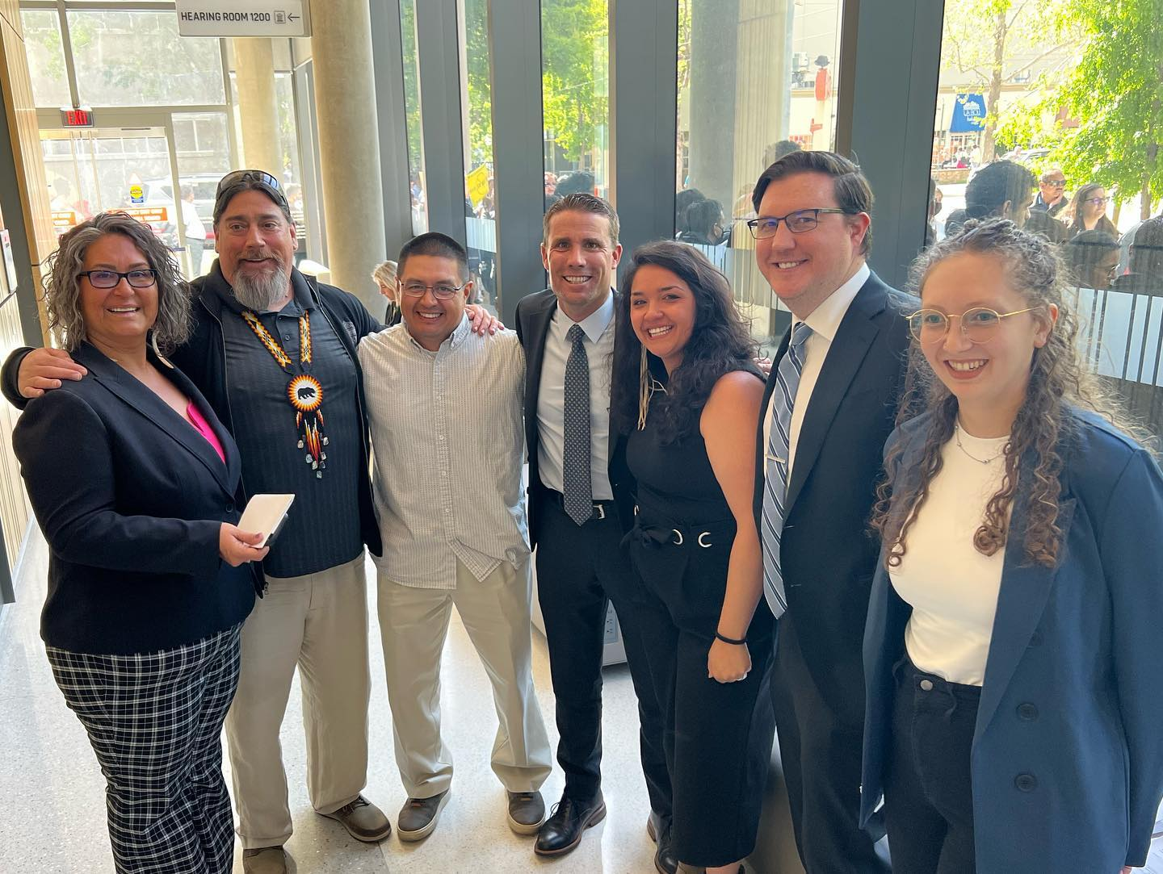
California Housing Bills
SB 18
AB 371
Senator Mike McGuire (CA)
Tribal Housing Grant Program
"California NAHASDA"
"By Tribes For Tribe"
Assembly Member Edwardo Garcia (CA)
Modifies / Waives Barriers that prevent Tribes and TDHEs from successful projects

Slide 27
2024 Tribal Housing Bills
SB 1187 Tribal Housing Reconstitution and Resiliency Act
Senator Mike McGuire (CA)
AB 1878 Housing Programs: Tribal Housing Program
Assembly Member Edwardo Garcia (CA)
Refined and Strengthen Language
More Partners and Advocates
Letters of Support
Media and Social Media

Slide 28
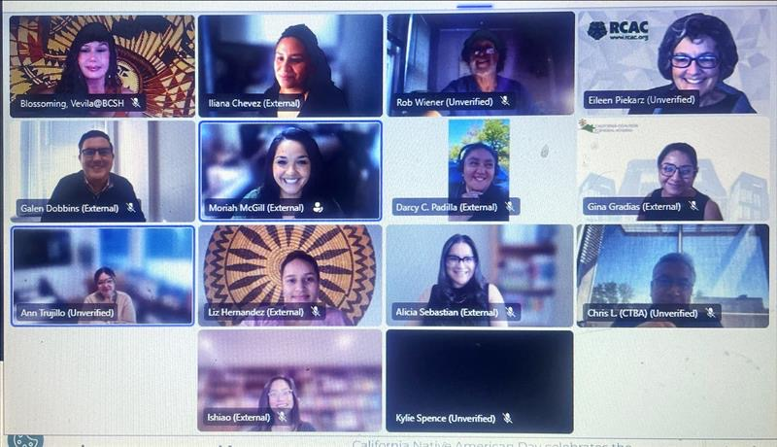
BOTH BILLS SIGNED!

Slide 29
WE DID IT!
Now you!

Slide 30
How can you do this in your State?
SWOT Analysis
Identify the Barriers in your State
What legislation exsists in your State
Collect Data
Tell your Story!

Slide 31
Identifying a Champion
"It's all about Relationships"
Tribal Advocates
Collect and Present Data
Elevator Pitch
MAKE AN IMPACT!

Slide 32
Move Fast and Efficiently
Meet Frequently
Goal Oriented Meetings
Task Assignments
One Vision, One Purpose
Show Up!

Slide 33
We are here to help
Share Information, Strategies, and Goals

Slide 34
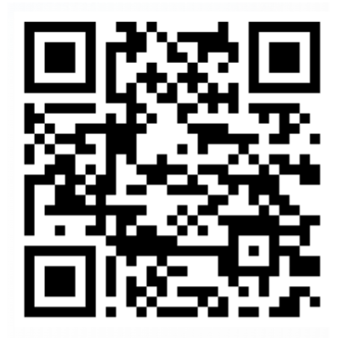
Scan Code for More Information
Tribal Housing Programs
California Tribal History

Slide 35
Thank you!
We appreciate your time and attendance

