Slide 1
California Housing Unhoused Relatives
Evelyn Immonen
Senior Program officer
December 10, 2024

Slide 2
Mission and Vision
About enterprise Community Partners
OUR VISION​​ A country where home and community ​are steppingstones to more. ​​ ​​ OUR MISSION​​ To make home and community places of pride, power and belonging, and platforms for resilience and upward mobility for all.
Increase Housing Supply
Advance Racial Equity
Build Resilience & Upward Mobility
Preserve and produce good homes that people can afford
After decades of systematic racism in housing
Support residents and strengthen communities to be resilient to the unpredictable

Slide 3
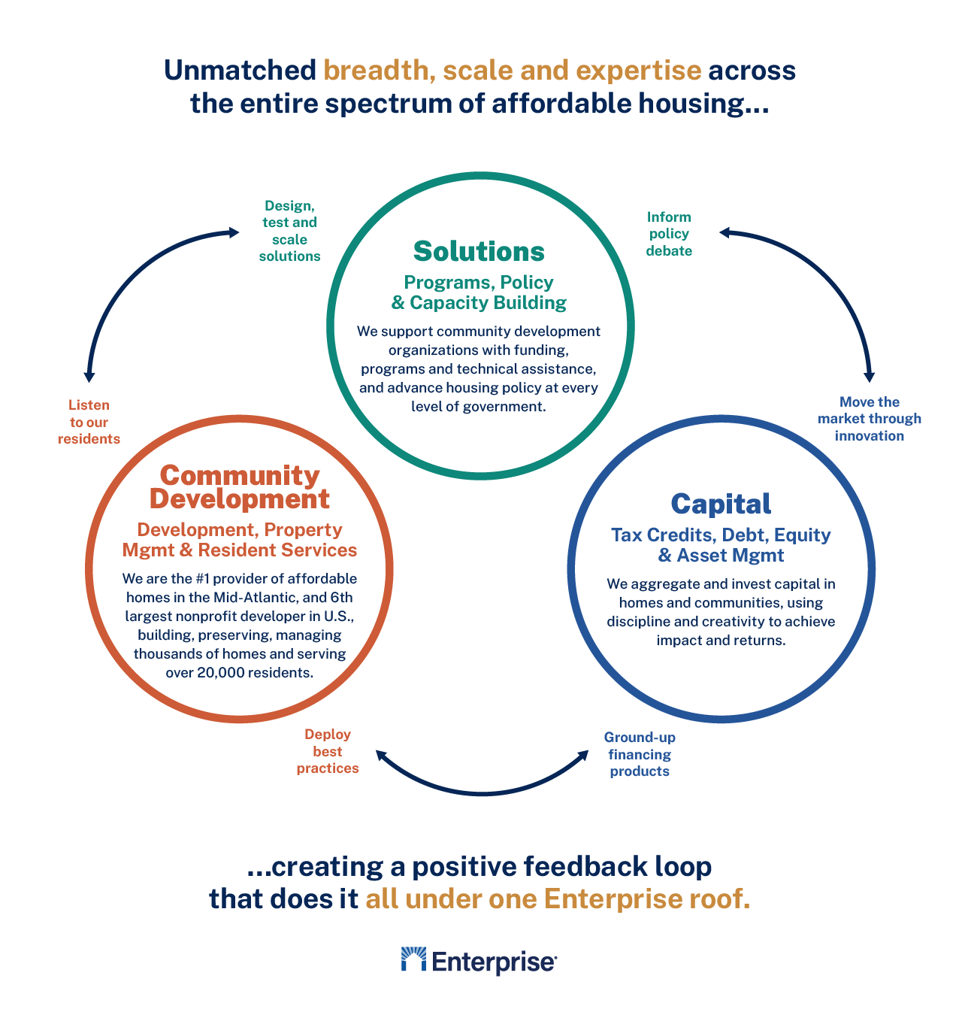
Our approach

Slide 4
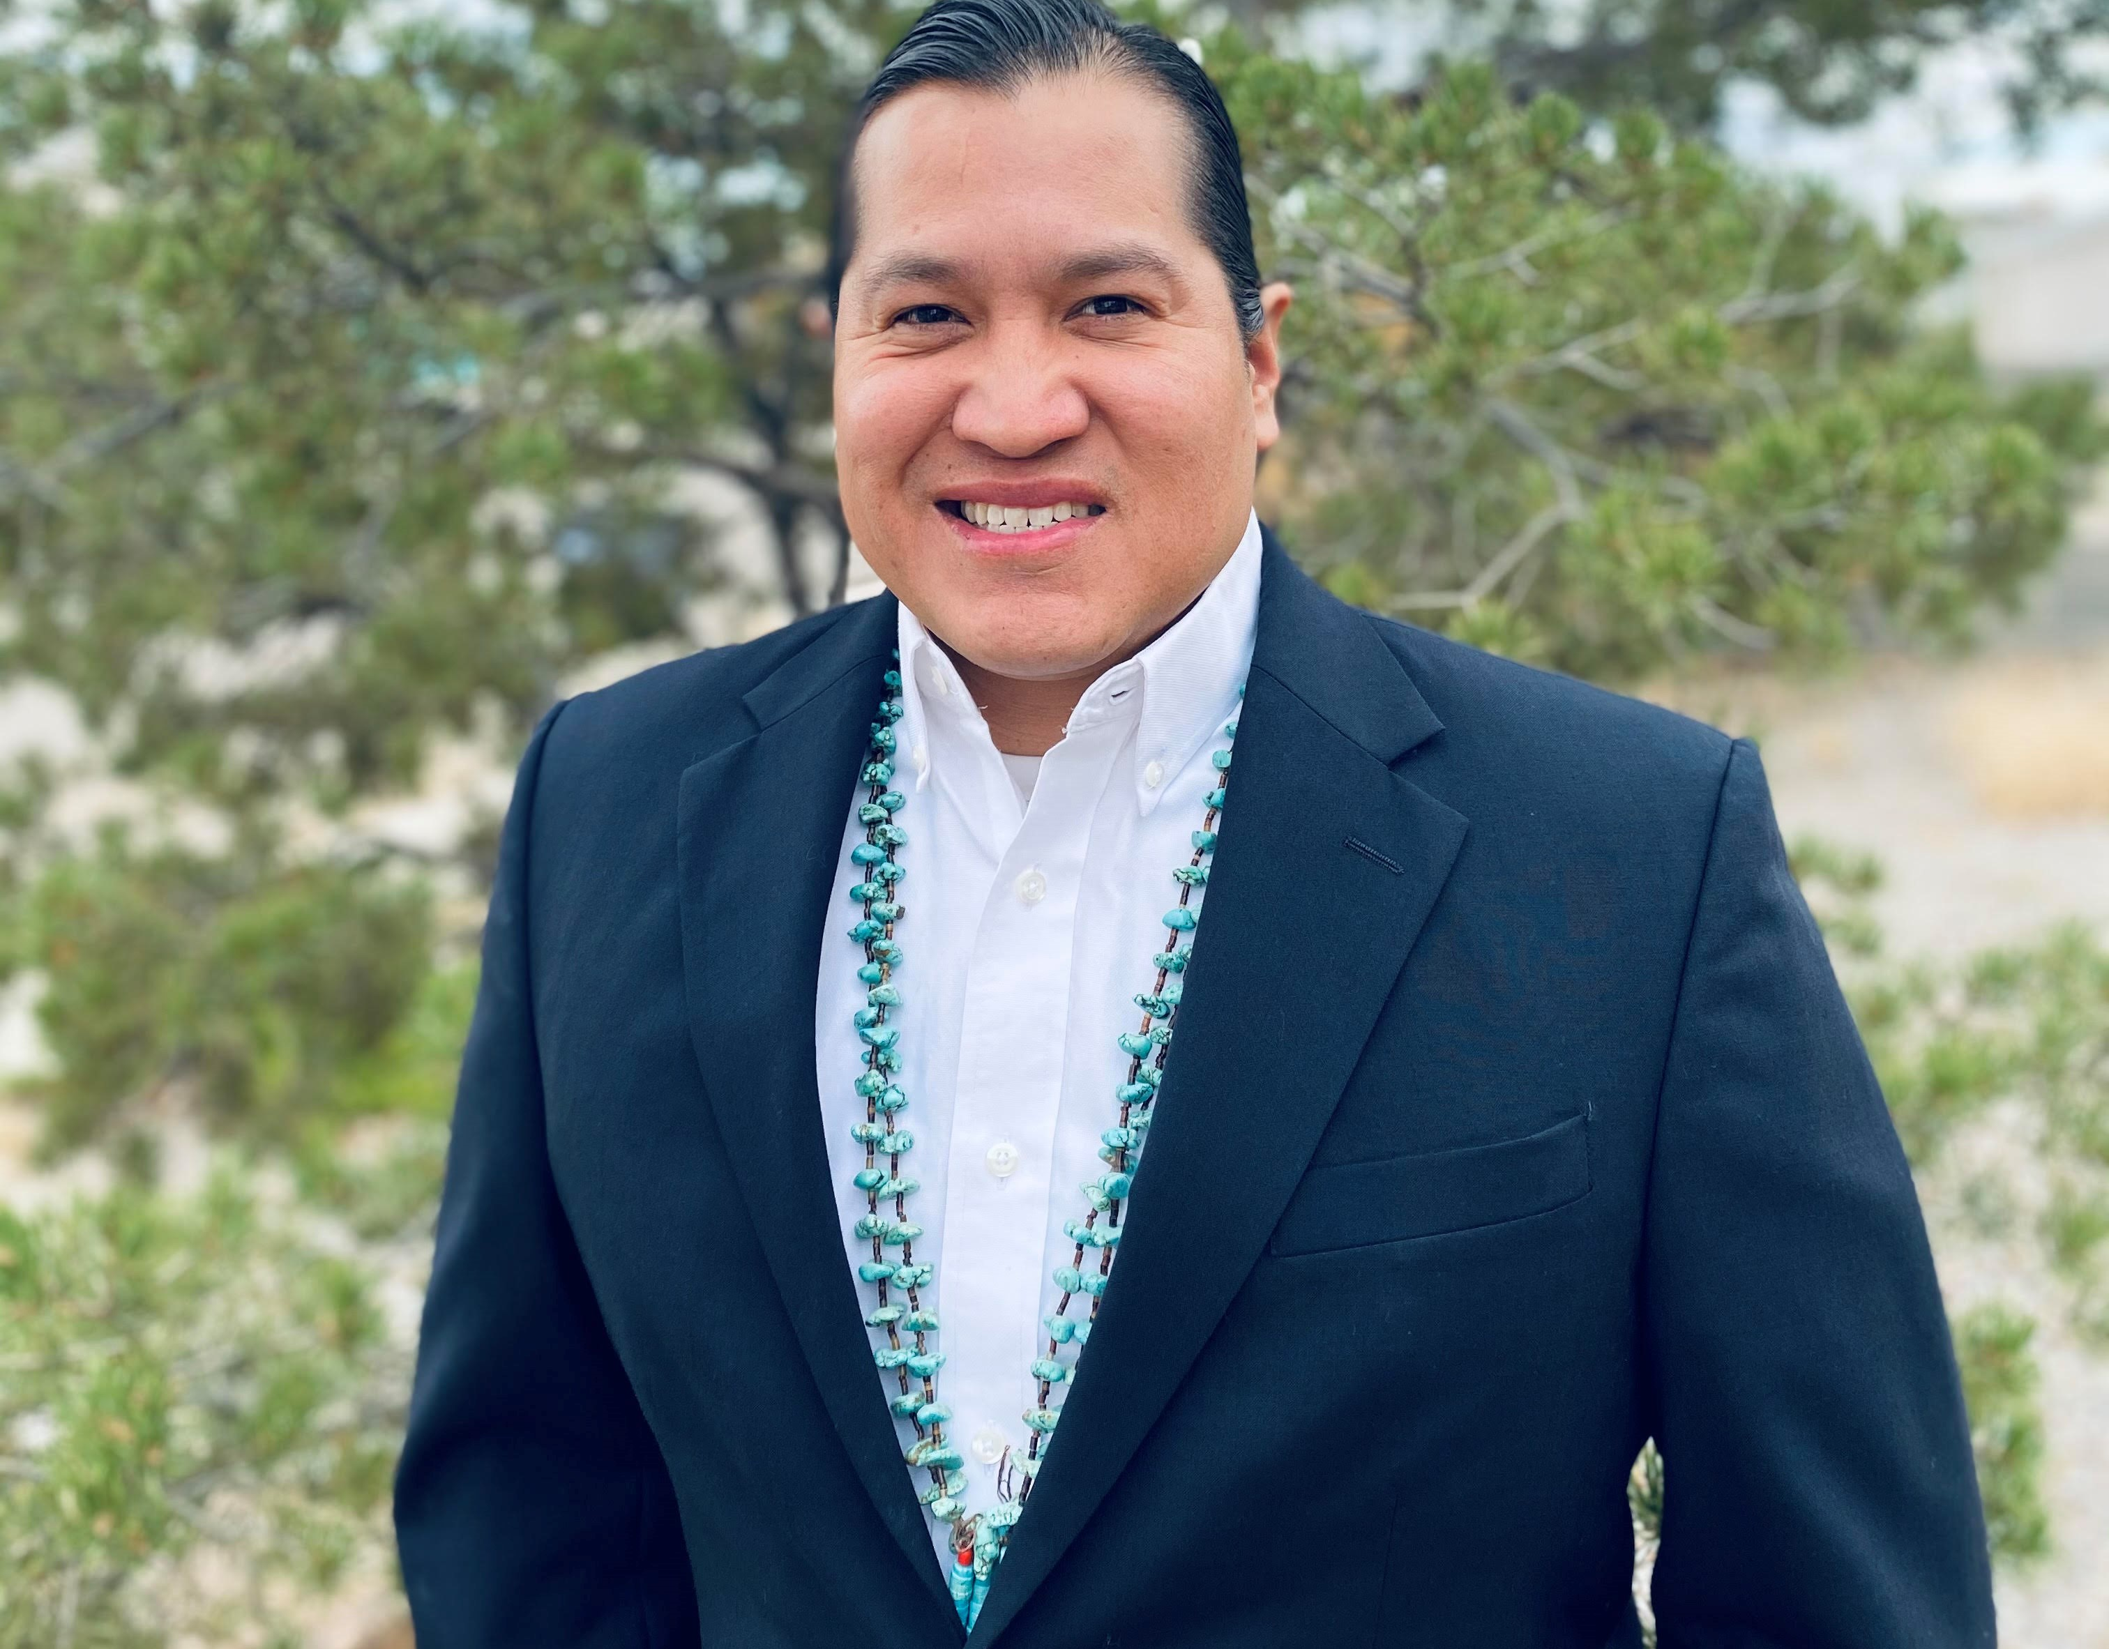
Who We Are
Enterprise Community Partners
Jennie Rodgers
VICE PRESIDENT Rocky Mountain, Tribal Nations, and Rural Communities
Jeremiah Powless
PROGRAM OFFICER
Evelyn Immonen
SENIOR PROGRAM OFFICER
eimmonen@enterprisecommunity.org

Slide 5
Agenda
Introductions
California Tribal Housing Academy
impact & what’s next
Questions for Discussion
Defining Homelessness
Limited Waiver
Enterprise opportunities

Slide 6
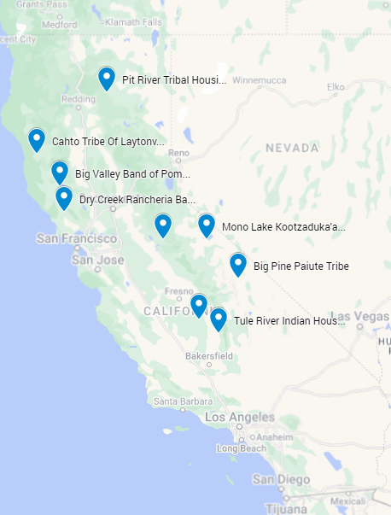
About the CA Tribal Housing Accelerator Academy
The California Tribal Housing Accelerator Academy is a training series of practitioner-driven housing development fundamentals peer-to-peer support, and technical assistance.
These training sessions and support from our technical assistance providers will aid California tribal organizations seeking to maximize state housing funds and expand your ability to address housing needs for tribal citizens.
We seek to work alongside tribes to ensure that critical housing resources are maximized and that tribal communities have equitable access to safe, decent, affordable, and culturally relevant housing.

Slide 7
Virtual Training Sessions
CA Tribal Housing Accelerator Academy
Visit this link to view all session recordings! https://www.enterprisecommunity.org/resources/california-tribal-housing-accelerator-academy-webinar-series
April 23 at 11:00 am PST | An Overview of California Housing Resources
May 28 at 11:00am PST | Strategies for Building Capacity
June 25 at 11:00am PST | Pro-Formas and Financial Feasibility Analysis CLOSED session
July 16 at 11:00am PST | Leveraging State and Federal Resources
August 13 at 11:00 am PST | State Funding and Compliance
Final in-person meeting: Tuolumne EDA Site Visit
Additional resources: https://nativedeveloperguide.enterprisecommunity.org/sampleexample-documents

Slide 8
Impact to Tribal Cohort Members
Technical Assistance
Tribe Name | Amount Requested | Applied to? | Units | Organization Status
Big Valley Band of Pomo Indians | $10 million | PRICE (federal, manufactured) | 75 | Mosaic Consulting
Dry Creek Rancheria Band of Pomo Indians | $4,250,000 total | BIA Tribal Climate Resilience Grant | 25 | LACO Associates
Mono Lake Kootzaduka’a Tribe | $100,000 | Sierra Nevada Conservatory | N/A | Beaux Simone Consulting
Tule River Indian Housing Authority | $2 million | Competitive IHBG | 10 | Mosaic Consulting
Tuolumne Economic Development Authority | $3 million | Tribal HHAP (CA HCD) | 30 | LACO Associates

Slide 9
History of Homekey
Phase 3: Securing Funding
Journey to where we are today
AB1010 passed in 2019, to address the housing needs of Native American Tribes. This requires HCD to meaningfully address tribal access and participation in HCD funding programs.
In response to COVID, California develops state-wide “roomkey” program to provide housing in hotels, motels, and other apartment buildings for people experiencing homelessness
Tribes apply to Homekey Round 2 alongside effort from Enterprise and other consultants for access to funding. 6 applicants submitted.
Roomeky becomes Homekey and the first round of state-wide funding available in 2020, though there were no tribal applicants.
Homekey Tribal NOFA released August of 2023 and 10 applicants submitted, fully subscribed as of November 2023
Additional measures taken by HCD:
Waiving the capital match for tribes Additional templates available on the website
Adjusted seniors housing plan requirements Eliminated the need for waivers

Slide 10
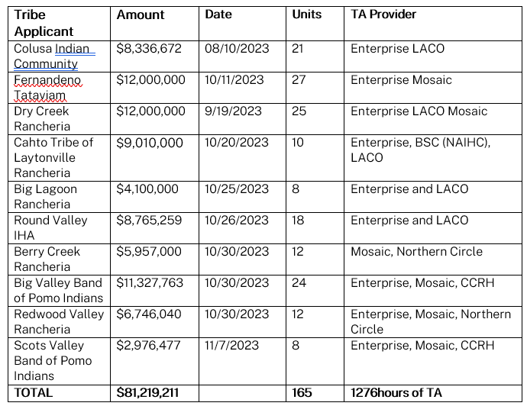
TA IMPACT: Homekey Applications 2023

Slide 11
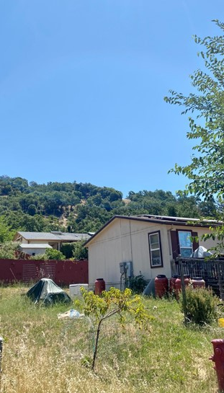
Scaling Impact
-How would bringing the model to other regions look?
-What partners ought to be involved?

Slide 12
Discussion questions

Slide 13
Defining homelessness

Slide 14
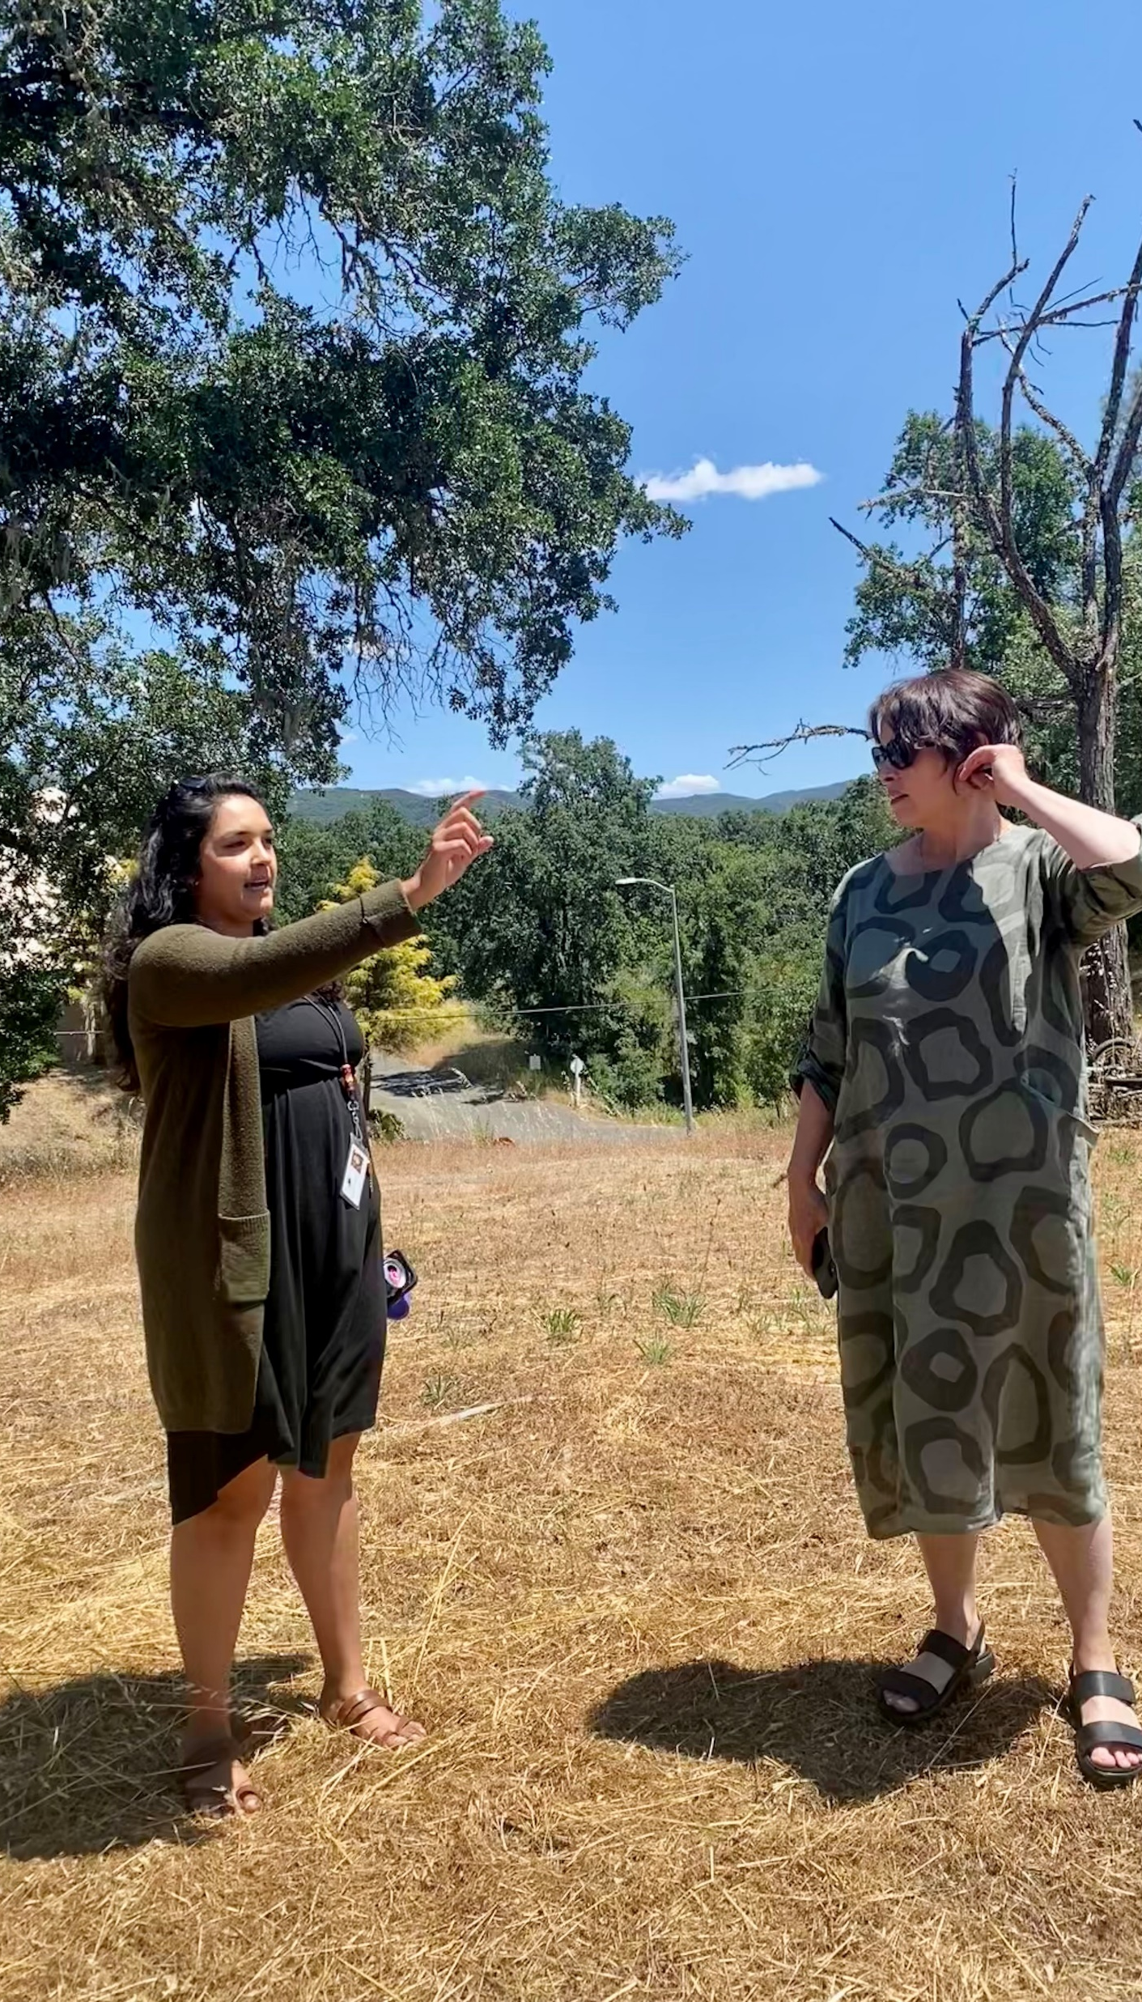
Defining Homelessness
-How did California look at fulfilling requirements for homelessness?
-Reviewing Policies for Admissions and Occupancy
-How can we flex our sovereignty, what else is possible?

Slide 15
Limited waiver of sovereign immunity

Slide 16
Defining Homelessness
-How did California look at fulfilling requirements for homelessness?
-Reviewing Policies for Admissions and Occupancy
-How can we flex our sovereignty, what else is possible?

Slide 17
Before we leave…

Slide 18
OPEN NOW Enterprise: HUD Sec 4 Capacity Building
Rural and Tribal Grant to be released Dec. 4!
We are a steward of critical Section 4 resources, providing funding, technical assistance and training to enhance the capacity and ability of Community Development Corporations (CDCs) and Community Housing Development Organizations (CHDOs) to address community needs and serve people with low incomes in urban, rural and Tribal communities.
Tribes, Tribally Designated Housing Entities (TDHEs) and Tribal Housing Authorities (THAs) are also eligible.
More info and webinar registration (Dec 11): https://www.enterprisecommunity.org/news/hud-section-4-capacity-building-grants-2024
Average award is $45,000
Can be used for:
Strategic planning
Professional development
Predevelopment costs
Building capacity for new Programs
Housing Needs Assessments
Cannot be used for:
Food or Alcohol
Most Travel Costs
Fundraising

Slide 19
Native Director Role
Before we leave
Enterprise is committed to maintaining our partnerships and bringing housing resources to Indian Country
Remote work or based in Denver, nation-wide scope
Requirements and salary available in the description
https://wd5.myworkdaysite.com/en-US/recruiting/enterprisecommunity/EnterpriseCareers/job/Remote-Location/Director--Native-American-Programs_REQ2759
Reach out to our team:
Evelyn Immonen eimmonen@enterprisecommunity.org

Slide 20
Thank You
eimmonen@enterprisecommunity.org

