Slide 1
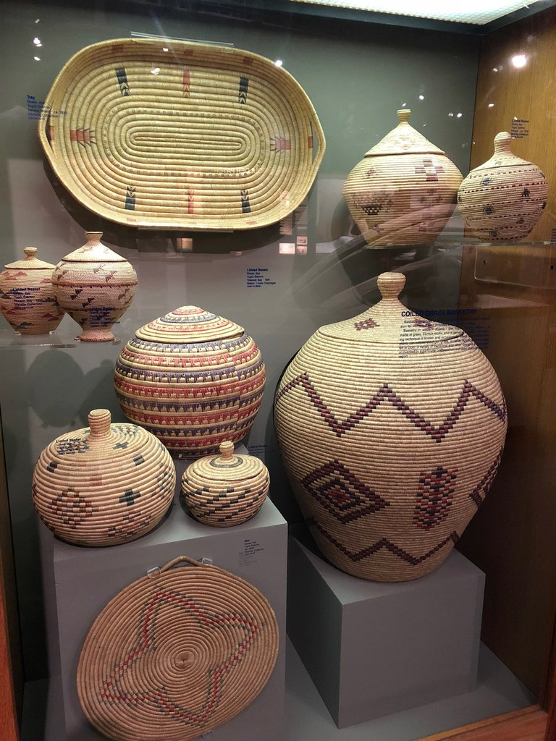
Tribal Housing and Urban Development-Veterans Affairs Supportive Housing (HUD-VASH)
Honoring Tribal veterans:
updates from VA homeless programs
Madolyn Gingell, National Coordinator, VA Legal Services for Veterans,
Meredith Malpass, HUD-VASH Regional Coordinator and Tribal HUD-VASH Subject Matter Expert
December 10, 2024
"Native Alaskan baskets" is licensed under CC BY 2.0.

Slide 2
VA Homeless Programs
Homeless Prevention Services
Supportive Services for Veteran Families (SSVF)
Outreach, Engagement, Assessment, and Referral Services
Health Care for Homeless Veterans (HCHV) Outreach
Community Resource and Referral Center (CRRC)
National Call Center for Homeless Veterans (NCCHV)
Justice-involved Veterans
Veterans Justice Outreach (VJO)
Health Care for Re-Entry Veterans (HCRV)
Residential Services
HCHV Contract Residential Services (CRS)
HCHV Low Demand Safe Haven (LDSH)
Grant and Per-Diem (GPD Transitional Housing
Permanent Housing Services
Housing and Urban Development-VA Supportive Housing (HUD-VASH)
Specialty Services
Homeless Veteran Community Employment Services (HVCES)
Homeless Patient Aligned Care Teams (HPACT)
Legal Services for Veterans (LSV) Program

Slide 3
Connect Homeless and At-Risk Veterans to VA
Veterans who are homeless or at risk of homelessness—and their family members, friends and supporters—can make the call to or chat online with the National Call Center for Homeless Veterans, where trained counselors are ready to talk confidentially 24 hours a day, 7 days a week.

Slide 4
Legal Services for Veterans
Madolyn Gingell National Coordinator, Legal Services for Veterans Homeless Programs Office
Veterans Health Administration
U.S. Department of Veterans Affairs

Slide 5
Legal Services for Veterans (LSV)
Outreach, training, and coordination designed to expand equitable access to legal services to Veterans.
Further Veteran’s legal service access through the continued growth of Medical Legal Partnership model within the Veteran Health Administration (VHA)
Establish and administer VHA’s new LSV grant programs.
LSV is a component of Veterans Justice Programs.

Slide 6
Legal Services for Veterans: Pro Bono
Medical Legal Partnership (MLP)
The legal service provider and VA team are co-located at a VA facility, with the delivery of legal services being provided on pre-determined days and times
Focus on a collaborative, Veteran-centric approach to care, which also promotes reciprocal training and discipline-specific awareness across specialties
VA Affiliated Legal Clinic
Less structured, less formal ‘legal clinics’ focusing on Veteran needs, which can occur off VA property
https://www.va.gov/HOMELESS/lsv/MLP_LC_List.pdf.

Slide 7
Legal Services for Veterans: Grants
Legal Services for Homeless Veterans and Veterans At-Risk for Homelessness Grant (LSV-H)
Legal service grants for organizations to provide specific legal services to Veterans experiencing housing instability, with dedicated funding to serve women Veterans
Maximum grant awards $300,000 per grantee
108 grants awarded, total over $26 million
Grant cycle began August 1, 2024
Legal Services for Veterans – Assistance with Access to VA Programs Grant (LSV-A)
Legal service grants for organizations to provide legal services to former US service members
Pilot program focusing on improving status of military discharge or characterization of service
Focus on equitable distribution of awards
Proposed rule is currently published in the Federal Register

Slide 8
Legal Services for Homeless Veterans and At-Risk for Homelessness Grant (LSV-H)
Authorized VA to fund legal services grants for organizations to provide specific legal services to Veterans who are experiencing homelessness or at risk of becoming homeless.
No income threshold.
108 grants awarded, covering 47 states, D.C. and V.I.
20 grantees propose to offer services to Veterans on tribal lands.
14-month grant cycle began August 1, 2024.
Availability of legal services provided by each grantee is subject to certain limitations, including their experience and available resources.

Slide 9
LSV-H Grant: Allowable Services
Allowable legal services covered under this grant program include legal services related to (38 C.F.R. 79.20):
Housing, including eviction defense, representation in landlord-tenant cases, and representation in foreclosure cases;
Family law, including assistance in court proceedings for child support and custody, divorce, estate planning, and family reconciliation;
Income support, including assistance in obtaining public benefits;
Criminal defense, including defense in matters symptomatic of homelessness such as outstanding warrants, fines, driver’s license revocation, and citations (to reduce recidivism and facilitate the overcoming of reentry obstacles in employment or housing, covered legal services relating to criminal defense also include legal assistance with request to expunge or seal a criminal record);
Requests to upgrade the characterization of discharge or dismissal of a former member of the Armed Forces and;
Protective orders and other legal matters related to IPV/DV.
Other covered legal services as the Secretary determines appropriate.

Slide 10
LSV-H Grant: Eligible Veterans
Eligible Veterans for assistance under this grant program, include:
A Veteran is defined as a person who served in the active military, naval, air, or space service and who was discharged or released therefrom under conditions other than dishonorable (as defined in 38 U.S. Code Section 101(2) and 38 CFR 79.15). Additionally, the length of service requirements set forth in 38 U.S.C. 5303A apply to this grant program.
AND
A Veteran who is homeless as that term is defined in the McKinney–Vento Homeless Assistance Act and 38 CFR 79.15(a) or;
At risk for homelessness (as defined in 38 CFR Part 79.15(b)).

Slide 11
Year 1 Findings
Grant cycle August 1, 2023, through July 31, 2024
Over 7500 Veterans received legal services through this funding source. Of those, approximately 2% identified as Native Veterans.
Top three legal services provided to Native Veterans were housing law, legal assistance with income and family law.
Majority of Native Veterans served during the first grant cycle were male, living in non-rural areas.

Slide 12
The Future of LSV-H
FY 2025 Notice of Funding Opportunity anticipated in early 2025.
Need support in engaging Tribal Governments and Native-led eligible organizations.
Applicants with a demonstrated focus on providing legal services to underserved Veterans.
Total grant funding is estimated to be over $26 million.
Anticipate grant award announcement in Summer 2025.

Slide 13
LSV Resources
VA LSV Website:
https://www.va.gov/homeless/lsv.asp
LSV-H Grantee Referral Listing:
https://www.va.gov/HOMELESS/lsv/LSV-H_Grantee_Referral-Information_508c.pdf
VA Medical Legal Partnership/Legal Clinic Listing: https://www.va.gov/HOMELESS/lsv/MLP_LC_List.pdf
Contact the LSV Program at lsv@va.gov

Slide 14
Tribal HUD-VASH
Meredith Malpass HUD-VASH Regional Coordinator and Tribal HUD-VASH Subject Matter Expert Homeless Programs Office
Veterans Health Administration
U.S. Department of Veterans Affairs

Slide 15
What is Tribal HUD-VASH?
Tribal HUD-VASH is a program developed in 2015-2016 to provide American Indian and Alaska Native Veterans with the HUD-VASH program in their tribal communities.
Standard HUD-VASH vouchers cannot be used on American Indian Reservations.
HUD’s Office of Native American Programs provides hybrid Indian Housing Block Grants (IHBG) to participating tribes for rental assistance instead of the HUD-VASH voucher provided by HUD’s Housing Choice (i.e., Section 8) voucher program.
In both programs, VA provides the case management and supportive services to Veterans in the program.
Case Managers in Tribal HUD-VASH specifically work with American Indian or Alaska Native Veterans and must have or develop cultural knowledge specific to the tribe with which they work.

Slide 16
Program Eligibility
Participants must be a Veteran as defined by section 9103 of the William M. (Mac) Thornberry National Defense Authorization Act for Fiscal Year 2021 (P.L. 116-283).
Participants must:
Be homeless or at risk of homelessness as defined by sections 103 and 401 of the McKinney-Vento Homeless Assistance Act, as Amended by S. 896, The Homeless Emergency Assistance and Rapid Transition to Housing Act of 2009.
Need case management to sustain housing.
Agree to participate in case management.
Participants must meet income guidelines as defined by HUD and not be on the lifetime sex offender registry.

Slide 17
Differences in programs
Standard HUD-VASH
Rental Assistance through HUD’s Housing Choice Vouchers (i.e., Section 8).
Housing is tenant-based or project-based in the community of the Veteran’s choice where they can reasonably receive case management.
Case management teams are dependent on program size and local needs.
Usually closer to the local VA medical center or outpatient clinic.
VA works with public housing agency (PHA) staff.
Tribal HUD-VASH
Rental Assistance through HUD’s Office of Native American Programs hybrid IHBG program.
Tribe determines where Veterans will be housed – on the reservation or with private landlords off the reservation within the service area (can be tenant or project-based).
One or two case managers for the tribe (dependent on rental assistance grants).
The distance from the VA facilities can be significant.
VA works with tribe or Tribally Designated Housing Entity (TDHE) staff.

Slide 18
Differences in Programs
Standard HUD-VASH
Vouchers are portable (i.e., they can be transferred from one city to another).
Fair Housing laws apply.
Veterans’ income must not exceed limits established by local PHAs.
Tribal HUD-VASH
Grants are not portable.
Veterans must be American Indian or Alaska Native as defined by the Native American Housing Assistance and Self-Determination Act (NAHASDA) of 1996 (P.L. 104-310). Tribes may have member preferences.
Veterans’ income must not exceed 80% of Area Median Income.
VA Service-Connected Disability payments are exempt.
This exclusion applies only to Tribal HUD-VASH and NAHASDA-funded programs (Notice PIH 2011-15).

Slide 19
Participating Tribes

Slide 20
Implementation – Getting Veterans Housed
VAMC staff and TDHE / tribe staff work together to identify roles, develop steps, and identify which agency completes each step.
Engage in outreach and marketing strategies to make Veterans and the community aware of the program.
The tribe determines where to house Veteran participants (on or off tribal lands).
Tribe / TDHE develop additional policies (e.g., Housing First policy) for Council approval.
Identify eligible Veterans and their families (if any) – VA and TDHE separate screening criteria.
Case manager and TDHE / tribe work together to house eligible Veterans and families.
Veterans moved into housing and continue to receive case management & supportive services.

Slide 21
Tribal HUD-VASH is More Than Housing
35.5 total case managers.
Case Managers may be interdisciplinary and be hired or contracted by the VAMC.
Case Management includes:
Home visits.
Independent work, usually far from other VA resources or even other community resources.
Complex work with Veterans who may have layered, serious physical and mental health concerns; long-standing, chronic substance use disorders; incarceration histories; history of self or other harm; and many barriers to stable housing.

Slide 22
Housing First
Both HUD-VASH and Tribal HUD-VASH utilize the evidence-based practice of Housing First.
Ensures those Veterans with the longest time homeless and highest service needs are provided opportunities to rapidly exit homelessness.
Low barrier admission without treatment or sobriety requirements in order to participate.
Case management provided with the expectation the Veteran will work with the case manager to sustain housing.
Focus is on housing stability and addressing threats to housing stability, and the Veteran’s recovery and personal goals which are often connected to housing stability.

Slide 23
How to Access VA Homeless Programs
A Veteran who is homeless or at imminent risk of becoming homeless can call the National Call Center for Homeless Veterans at (877) 4AID-VET (877-424-3838) for assistance.
You can also direct the Veteran to call or visit your local VA Medical Center or Community Resource and Referral Center, where VA staff are ready to help.
Explore www.va.gov/homeless to learn about VA programs for Veterans who are homeless and share that information with others.
Work with VA to prevent and end homelessness among Veterans in your community. Learn how you can help by visiting our Stakeholders page.
Listen to our podcast, Ending Veteran Homelessness, for monthly updates on resources and services. Subscribe today on Apple Podcasts, Google Podcasts, Spotify, and your podcatcher of choice!
Download posters, brochures, and other materials to reach out to Veterans and help VA end homelessness.
Print the VHA Homeless Program brochure designed for use with AI/AN Veterans.

Slide 24
Questions, Comments, and Discussion
"National Museum of the American Indian in Washington DC" by Phillip Ritz is licensed under CC BY-NC-SA 2.0.

