Slide 1
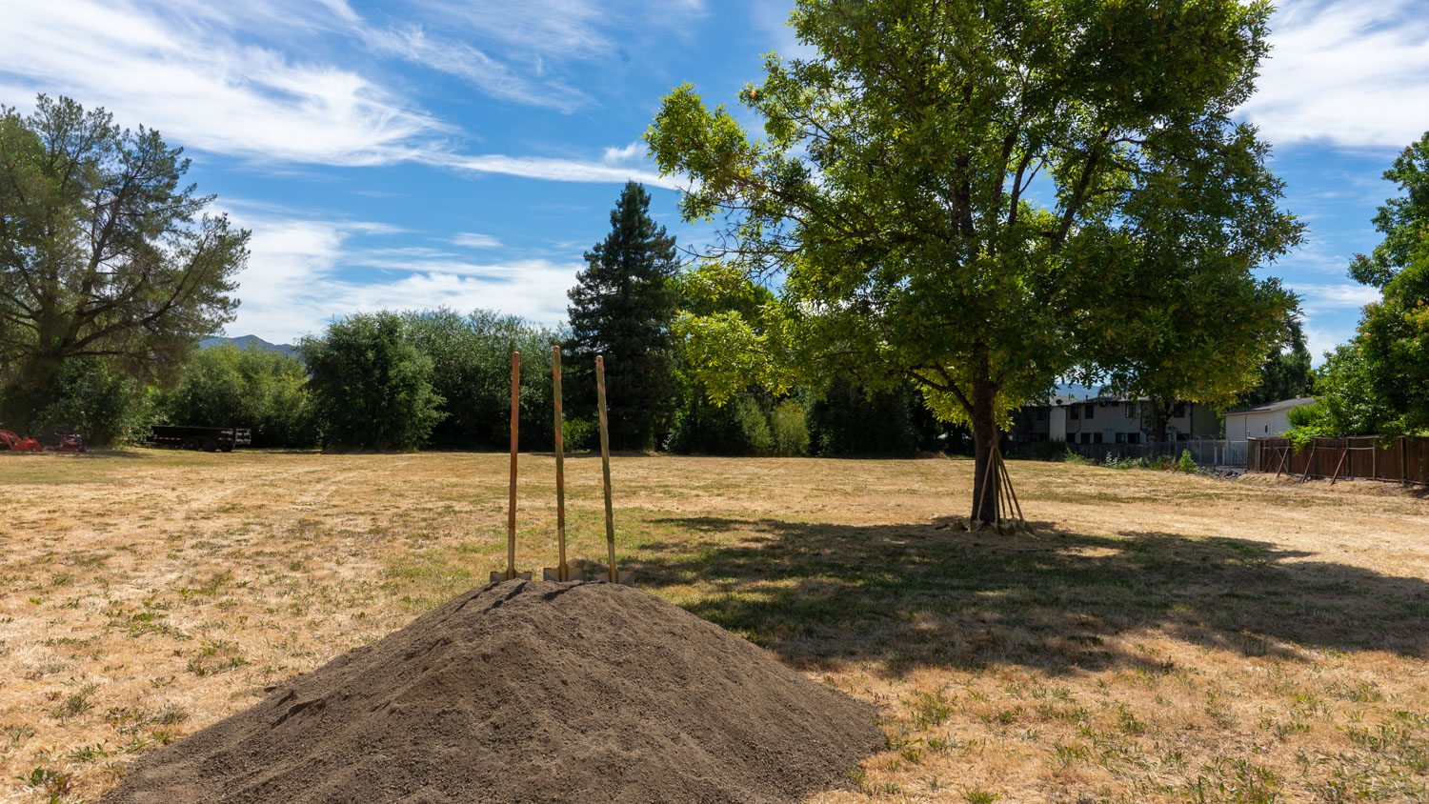
BUILDING STATE
PARTNERSHIPS
FOR TRIBAL HOUSING SUCCESS
Northern Circle Indian Housing Authority
Christine De Los Santos, Executive Director
Moriah McGill, Deputy Director
Tribal Housing HUD Summit | Breakout Session 1:30–2:45 PM
Notes:
[Sources]
- Visual on this slide was generated with Microsoft Copilot.
[/Sources]

Slide 2
WELCOME
Our 75-Minute Conversation
10 min
20 min
20 min
15 min
Welcome, introductions, and the partnership question
How access changed: LIHTC, HOME, CIAP, AB 1010
From advocacy to “By Tribes, For Tribes”: SB 1187
Project stories: Hopland 4Plex + Maidu Mountain Lion
5 min interactive
10 min Q&A
Where does your state system create friction?
Commitments, next steps, and shared learning
Goal: leave with a practical partnership model, not just a list of programs.
2 | NCIHA + California HCD
Notes:
[Sources]
- Session timing supplied by presenter.
[/Sources]

Slide 3



INTRODUCTIONS
Who We Are
Northern Circle Indian Housing Authority is a Tribally Designated Housing Entity (TDHE) serving member Tribes across Northern California.
Christine De Los Santos
Moriah McGill
NCIHA as a TDHE
Executive Director, NCIHA
Affordable housing, community development and social services executive administration, program and policy oversight and compliance, partnership building
Deputy Director, NCIHA
Grant writing, administration and compliance, affordable housing and community development, program development, advocate
Extablished in 1979; Serving 9 Federally Recognized Tribes in California and providing affordable housing, community development, and support services to its memberships
Prompt: Who is in the room, and what brought you to this session?
3 | NCIHA + California HCD

Slide 4
OUR HISTORY
NCIHA: From Vision to TDHE
1978
1979
1980
1996–98
Today
Vision formed by Mendo Lake Pomo Council leaders
Incorporated by four founding member Tribes; CIAP suports forming TDHE
Recognized by BIA and HUD; first funding reservations
NAHASDA enacted; ten Tribes stay with NCIHA as their TDHE
TDHE administering IHBG programs
NCIHA became a TDHE when NAHASDA gave Tribes authority over their own housing programs.
4 | NCIHA + California HCD

Slide 5
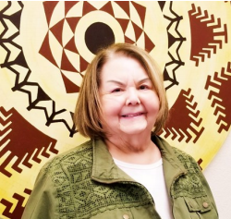
TRACK RECORD
What Four Decades Built
From the first twelve homes at Rumsey in 1984 to Federally and State Funded projects today, NCIHA has built housing across five counties.
430 new homes
1,000+ acres into trust
200 families a year
Built with member Tribes, plus 26 dilapidated homes replaced and many more rehabilitated.
Land acquired and placed into trust status for housing and community development.
Ongoing rental assistance, plus 94 families helped into private-market homeownership.
Recognized by HUD with two Sustained Excellence Awards.
5 | NCIHA + California HCD

Slide 6
CONTEXT
Why State Partnership Matters
Tribal housing systems were built around sovereignty and self-determination. Many state programs were not.
Barrier
Response
Eligibility, land status, recordation, timelines, and regulatory fit
Dialogue, technical assistance, waivers, and program redesign
Partnership principle
“Housing is more than just houses.”
Do not ask Tribes to fit a system that was not designed with them. Improve the system with Tribes.
Take Action, Build Relationships, Make Change
6 | NCIHA + California HCD
Notes:
[Sources]
- Housing Pgrm for Tribes Trifold Brochure (2).pdf, page 1.
[/Sources]

Slide 7
THE LONG VIEW
175 Years of Housing Insecurity
175 years of displacement and housing policy made without Tribes. Today's gaps are the newest chapter.
What was lost
What it costs today
Land, homelands, and the stability housing depends on.
Overcrowding, aging homes, and families waiting years.
Why it matters here
“175 years, and still building.”
State partnership is overdue repair, built with Tribes as governments.
Understand the history, change the system, build the homes
7 | NCIHA + California HCD

Slide 8
EXPANDING THE RESOURCE POOL
Braiding State and Federal Funds
Federal funds alone rarely cover a full project. Braiding state resources with IHBG, IHBG Competitive, ICDBG, and Title VI builds more homes, faster.
Build more units
Move faster
Grow partnerships
Layered funding increases project size and scope, so a handful of units can grow into a full neighborhood.
Multiple funding streams reduce waiting for a single award cycle and keep predevelopment and construction on schedule.
Each braided deal builds trust with state and local partners and strengthens the community for the next project.
Other States are using these programs successfully.
Why can't we?
8 | NCIHA + California HCD

Slide 9
THE FUNDING TOOLBOX
Solutions Already on the Table
These are the State and Federal programs we braid with IHBG dollars. Each one solves a different piece of the capital stack.
Tribal Homekey, CalHome, HOME
LIHTC + Super NOFA
Tribal Housing Grant Program
Fast acquisition and rehab for permanent supportive housing, plus emergency solutions dollars for households in crisis.
Equity for larger multifamily development and consolidated Federal competitions that fund infrastructure alongside units.
A dedicated State fund created through SB 1187 — flexible, Tribally designed, and built for how Tribal housing actually works.
Tribal Homeless Housinng, Assistance & Prevention
Expansion on a public funded response to homlessness prevention, response, and mitigation. Honoring the Tribe's soverignty and their vision for responded to homelessness in their community.
A few examples of State Programs offered to Tribes and TDHEs
9 | NCIHA + California HCD

Slide 10
FROM EXCLUSION TO ACCESS
The Access Journey
2014
2016–17
2019
2024
Next
LIHTC tribal pilot
HOME eligibility language
AB 1010 + CIAP
SB 1187 enacted
Tribal-led administration
The throughline is sustained Tribal advocacy plus State partners willing to change rules, not just explain them.
10 | NCIHA + California HCD
Notes:
[Sources]
- Federal Reserve Bank of San Francisco, Native Americans and the Low Income Housing Tax Credit Program, September 16, 2014.
- 1978.docx 30 years.docx, internal NCIHA history narrative.
- California AB 1010 (2019).
- California SB 1187, Chapter 295, Statutes of 2024.
[/Sources]

Slide 11
CALIFORNIA INDIAN ASSISTANCE PROGRAM
CIAP: Relationship Infrastructure
CIAP began as technical assistance for Tribal housing capacity and returned through AB 1010 as a platform for access, problem-solving, and sustained dialogue.
Build capacity
Remove barriers
Build trust
Technical assistance that meets Tribes where they are and helps move concepts toward fundable projects.
Identify rules, processes, and program requirements that block meaningful Tribal participation.
Consistent dialogue creates accountable, creative, adaptable policy solutions that respect sovereignty.
Discussion prompt: What makes technical assistance feel like partnership rather than compliance support?
11 | NCIHA + California HCD
Notes:
[Sources]
- California HCD, Tribal Affairs and California Indian Assistance Program, https://www.hcd.ca.gov/tribes
- Housing Pgrm for Tribes Trifold Brochure (2).pdf, page 2.
[/Sources]

Slide 12
POLICY CHANGE
AB 1010: Opening the Door
1. Eligibility
2. CIAP reauthorized
3. Waiver pathway
Made Tribes and Tribally Designated Housing Entities explicitly eligible for many State housing programs.
Reconstituted the G. David Singleton California Indian Assistance Program to provide comprehensive technical assistance.
Created a route to request limited waivers when State regulations hinder Tribal access, while respecting sovereignty.
Eligibility was necessary. Implementation partnership is what turns eligibility into homes.
12 | NCIHA + California HCD
Notes:
[Sources]
- California AB 1010 (2019).
- California HCD, Tribal Affairs and California Indian Assistance Program, https://www.hcd.ca.gov/tribes
[/Sources]

Slide 13
ACCESS GAPS
Programs Widely Used Elsewhere, Late to Reach California Tribes
Low-Income Housing Tax Credits
HOME Investment Partnerships
2014: California created a Native American pilot apportionment. The first Tribal award demonstrated that regulatory design and a targeted set-aside could change outcomes.
2016 advocacy led to revised eligibility language; funding access began with subsequent NOFAs. Eligibility alone did not eliminate capacity, timing, and program-fit barriers.
Lesson: “Available” is not the same as “accessible.”
13 | NCIHA + California HCD
Notes:
[Sources]
- Federal Reserve Bank of San Francisco, Native Americans and the Low Income Housing Tax Credit Program, September 16, 2014.
- HUD, Karuk Tribe of California, February 2016.
- 1978.docx 30 years.docx, internal NCIHA history narrative.
[/Sources]

Slide 14
PARTNERSHIP MODEL
How the NCIHA–HCD Relationship Works
1
2
3
4
5
Listen
Translate
Test
Adapt
Repeat
Tribal priorities and lived barriers
Between sovereignty, program rules, and funder requirements
Use real projects to identify friction
Waivers, clarifications, technical assistance, program changes
Trust grows through consistent follow-through
Our mentors opened the door. We walked up to the Table.
Now, we have a permanent seat.
14 | NCIHA + California HCD
Notes:
[Sources]
- Partnership model synthesized from presenter-provided session goals and NCIHA internal presentations.
[/Sources]

Slide 15
TRIBAL HOUSING RECONSTITUTION AND RESILIENCY ACT
SB 1187: From Program Access to Tribal-Led Design
A Tribal-led drafting effort, supported by Tribal housing experts and the California Coalition for Rural Housing, advanced a dedicated State Tribal Housing Grant Program Trust Fund.
By Tribes
For Tribes
With Tribes
Tribal leaders and housing practitioners shaped the language around actual community needs and sovereign realities.
Eligible uses span housing, infrastructure, planning, services, management, and capacity building.
An advisory committee is intended to guide administration and the future direction of the fund.
The shift: from competing inside general programs to co-designing a durable Tribal housing system.
15 | NCIHA + California HCD
Notes:
[Sources]
- California SB 1187, Chapter 295, Statutes of 2024.
- California Senate Housing Committee analysis of SB 1187, April 2, 2024.
- Presenter-provided drafting committee narrative.
[/Sources]

Slide 16
GOVERNANCE
The Advisory Committee Opportunity
What good advice should protect and promote
Interactive discussion
● Sovereignty and government-to-government engagement
● Equitable allocation and geographic reach
If you were advising the State, what is one non-negotiable design principle for a Tribal housing grant program?
● Flexible eligible uses and realistic timelines
● Low-barrier application and reporting
● Technical assistance and capacity investment
● Learning loops grounded in Tribal experience
16 | NCIHA + California HCD
Notes:
[Sources]
- California SB 1187, Chapter 295, Statutes of 2024.
- Presenter-provided advisory committee description.
[/Sources]

Slide 17
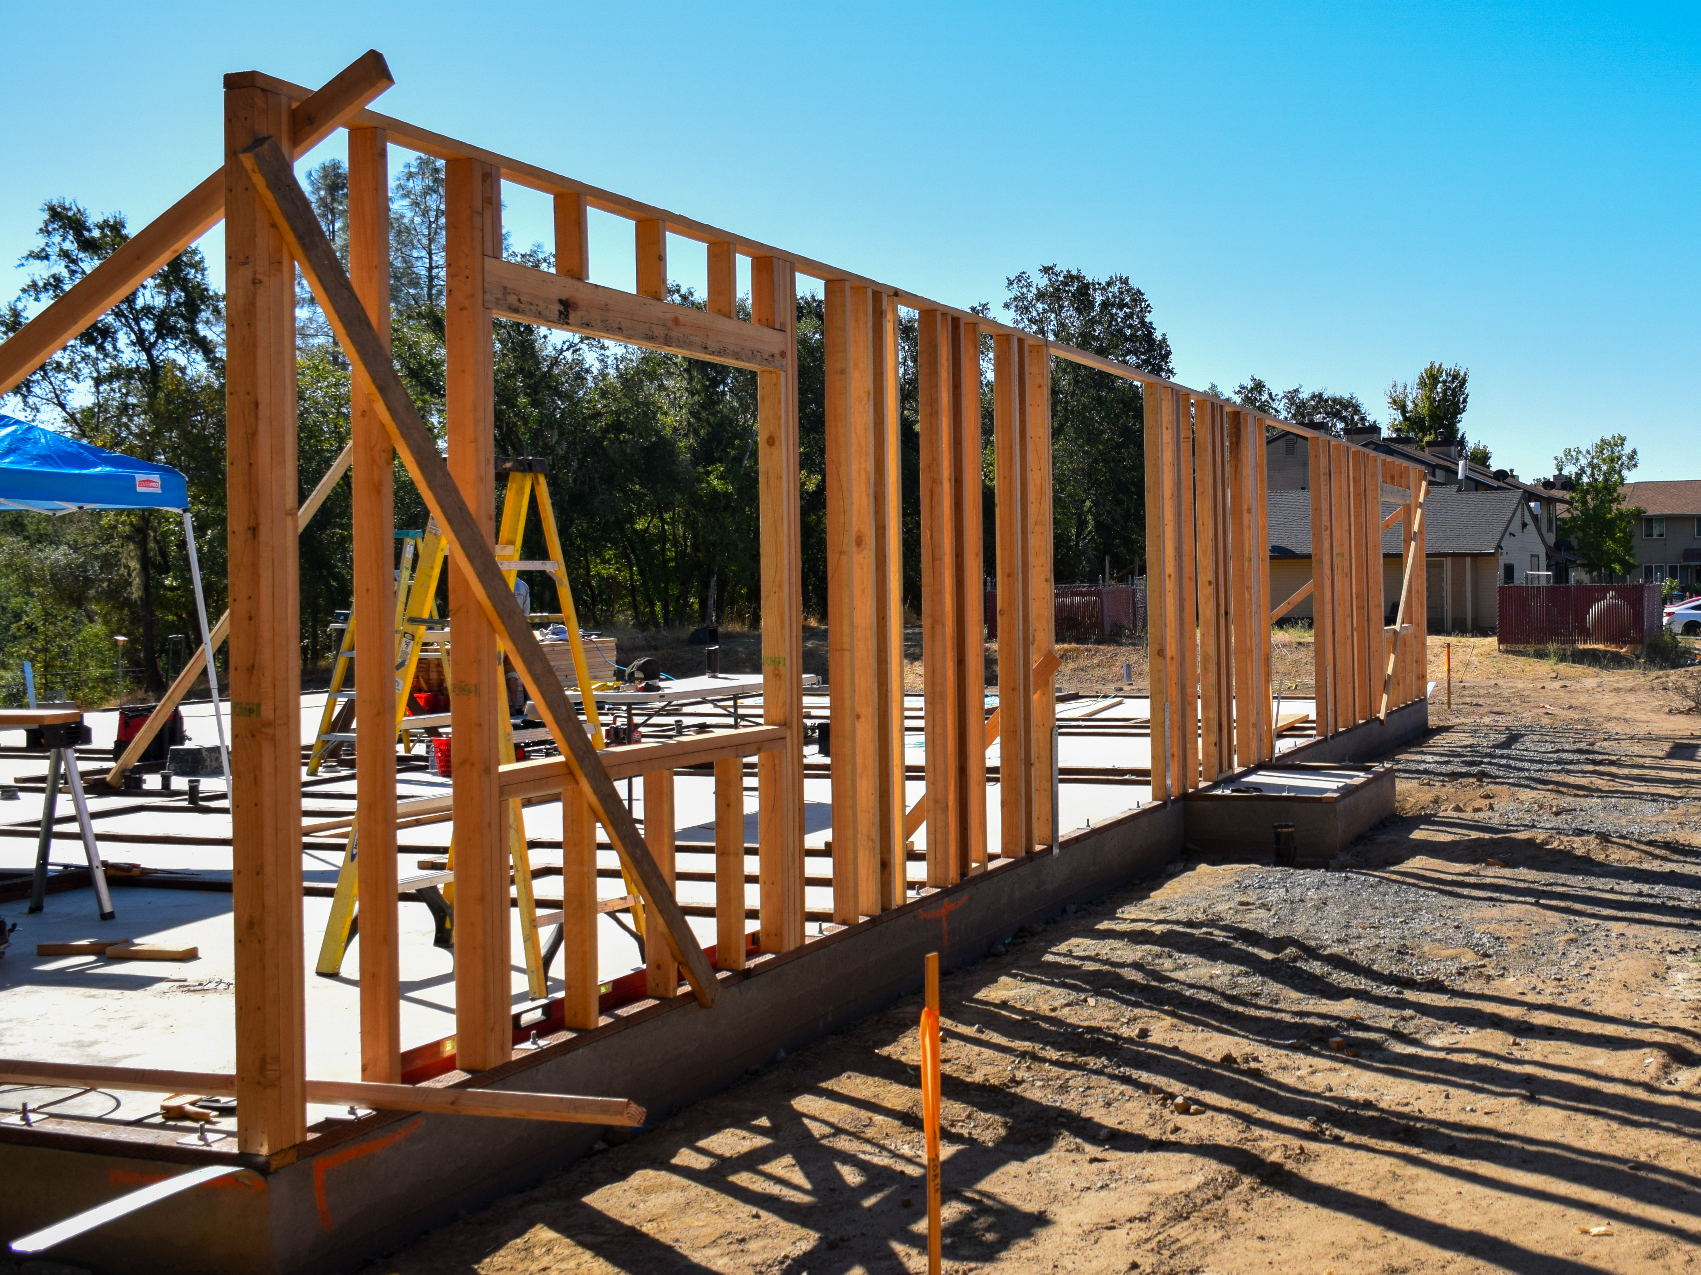
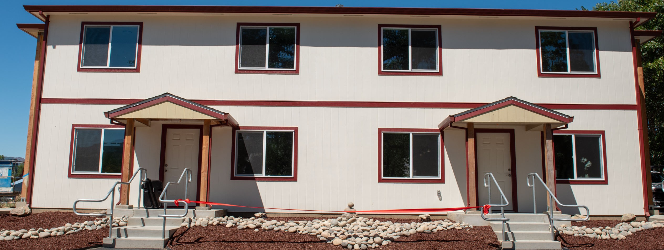
PARTNERSHIP IN PRACTICE
Project Spotlight: Hopland 4Plex
Outcome
Four permanent affordable units for chronically homeless Tribal families; completed in 2025.
Partnership story
Add the HCD program, key barrier, waiver or adaptation, and the moment the partnership changed the project.
Lesson to carry forward
Add one replicable lesson for other Tribes and State agencies.
17 | NCIHA + California HCD
Notes:
[Sources]
- Narrative - BCR Application.docx, internal NCIHA project narrative, line 71.
[/Sources]

Slide 18
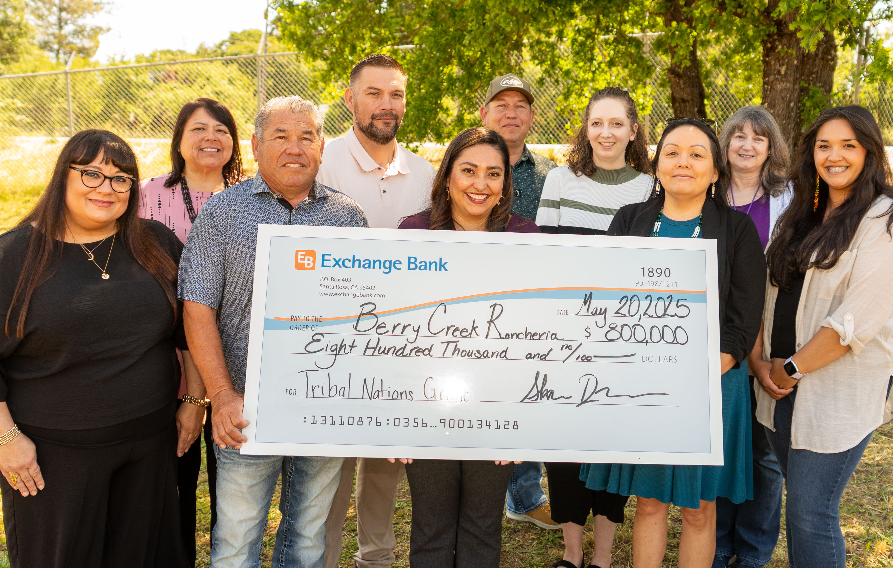
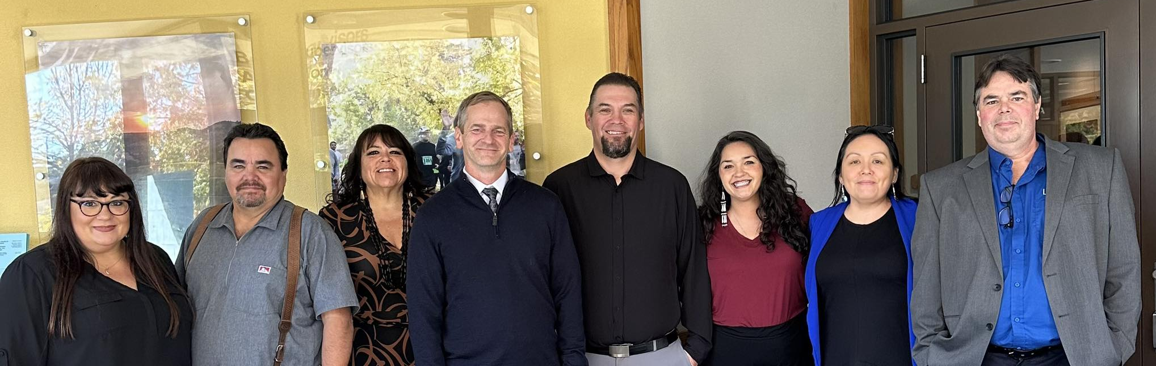
PARTNERSHIP IN PRACTICE
Project Spotlight: Maidu Mountain Lion
22 planned homes
12 single-family homes for families plus 10 ADA-accessible elder homes in duplexes.
Braided resources
State, Federal, Tribal, and philanthropic resources support a complex capital stack.
More than housing
Wildfire resilience, infrastructure, cultural continuity, and pathways for families to come home.
18 | NCIHA + California HCD
Notes:
[Sources]
- Narrative - BCR Application.docx, internal NCIHA project narrative, lines 14–18, 23–27, 44–61.
[/Sources]

Slide 19
PRACTICE
What Successful State–Tribal Partnership Requires
Start with sovereignty
Fund the bridge
Design for reality
Treat Tribes as governments and decision-makers, not as another applicant category.
Invest in technical assistance, staffing, predevelopment, infrastructure, and development capacity.
Account for trust and fee land, rural costs, limited markets, layered reviews, and different timelines.
Use projects to learn
Institutionalize progress
Create direct feedback loops between program staff and Tribal project teams.
Put consultation, waivers, advisory roles, and dedicated funding into durable policy.
19 | NCIHA + California HCD
Notes:
[Sources]
- Synthesis of NCIHA internal presentations, HCD CIAP materials, AB 1010, and SB 1187.
[/Sources]

Slide 20
INTERACTIVE
Table Discussion: Build Your Partnership Map
Choose one housing goal. In small groups, fill in the four boxes.
1. Goal
2. Barrier
3. Partner
4. First move
What housing or community development outcome matters most?
Where does eligibility, policy, process, capacity, or timing create friction?
Who has the authority, knowledge, relationship, or flexibility to help?
What conversation, data, consultation, or small test can start progress?
Share-out: one barrier + one partnership move
20 | NCIHA + California HCD
Notes:
[Sources]
- Facilitated exercise developed for this session.
[/Sources]

Slide 21
CLOSING + Q&A
From Access to Shared Success
The strongest partnerships do more than open a funding round.
They change who helps design the system, how barriers are solved, and whether Tribal communities can turn resources into lasting homes.
BY TRIBES • WITH TRIBES • FOR TRIBAL COMMUNITIES
Questions & discussion
Moriah McGill | Deputy Director | Northern Circle Indian Housing Authority
21 | NCIHA + California HCD
Notes:
[Sources]
- Closing message synthesized from presenter-provided session purpose.
[/Sources]

Slide 22
CLOSING + Q&A
Contact US
Feel free to contact!
Christine De Los Santos
NCIHA Executive Director
Christine@nciha.org
Moriah McGill
NCIHA Deputy Director
Moriah@nciha.org
Visit our Website
www.nciha.org
Moriah McGill | Deputy Director | Northern Circle Indian Housing Authority
21 | NCIHA + California HCD
Notes:
[Sources]
- Closing message synthesized from presenter-provided session purpose.
[/Sources]

