Slide 1




Is the Continuum of Care (CoC) Program Right for Your Tribe?
Exploring Opportunities to Address Homelessness
September 3, 2026
HUD Tribal Housing Summit

Slide 2

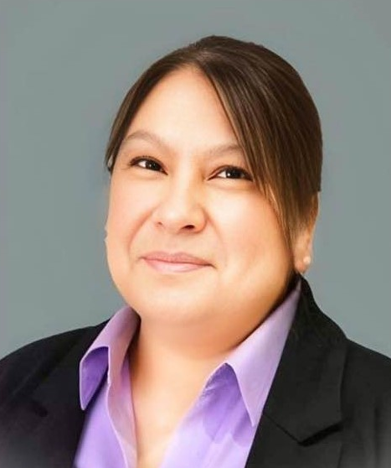
Welcome and Introductions
_________________________________________________
Chamisa Radford, ICF
Lead Tribal Training and TA Specialist
Chamisa.Radford@icf.com

Slide 3
Today’s Agenda
What is the Continuum of Care (CoC) Program?
CoC Program Resources for Tribal Communities
    Exploring Homelessness in your Community
Tribal Homelessness Network

Slide 4
Questions?
What is the Continuum of Care (CoC) Program?
https://www.hudexchange.info/programs/coc/tribal-communities/

Slide 5
In Summary
CoC Program at a Glance
A CoC’s primary purpose is to coordinate housing and services funding for households who are homeless or at-risk of homelessness.
A CoC is an official designation from HUD. It covers a unique geographic area.
The CoC can serve people who are homeless but there are specific categories of homelessness to consider.
HUD expects (and for some, requires) CoCs to conduct activities related to being a CoC.
Program funding is competitive and there is a match requirement for CoC funds.
CoCs request funding from HUD to conduct housing and services to serve people who are homeless.

Slide 6
• CoC 101 – 2 sessions B
Eligible Program Participants
Homeless Individuals and households
  Category 1 (literally homeless)
  Category 2 (imminent risk of homelessness)
  Category 3 (those who do not otherwise qualify as homeless)
  Category 4 (individuals fleeing a domestic violence or human trafficking situation)

Slide 7
Eligible Activities
Eligible Activities
CoC Program Interim Rule – governing regulations
Acquisition, rehabilitation, new construction (for transitional or permanent housing)
Rent subsidies
Supportive services
Operating housing
Homeless Management Information System (HMIS)
Project administration

Slide 8
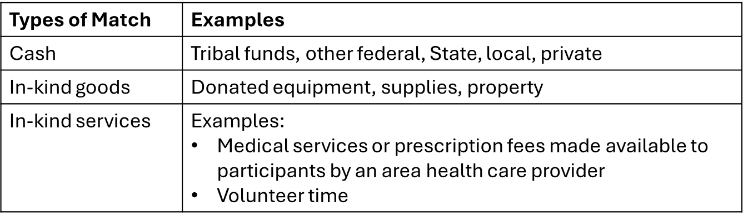
Match: What It Is
Match
Required: 25% (does not apply to leasing)
Types

Slide 9
Fair housing
Fair Housing
Currently, all CoC grant awards must abide by the Fair Housing Act, which prohibits housing discrimination on the basis of any “protected class”
  Protected classes include race, color, religion, sex, sexual orientation, gender identity, disability, familial status, and national origin
No Tribal or Indian preference for housing or services
CoC program funds cannot serve Tribal citizens exclusively – must be willing and able to serve anyone that seeks services

Slide 10
Questions?B
Discussion

Slide 11
Questions?B
CoC Program Resources for Tribal Communities
https://files.hudexchange.info/resources/documents/Tribal-Communities-CoC-Program-Resources-Decision-Making-Approach.pdf

Slide 12

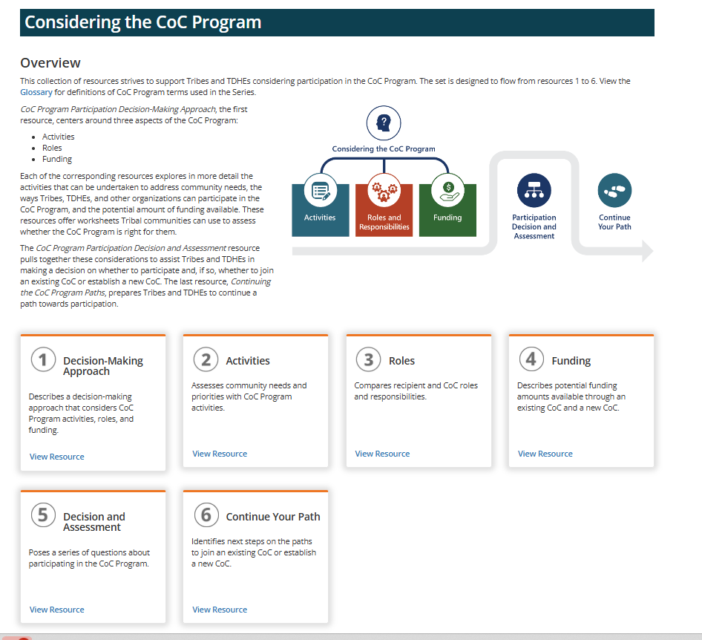
Thank you!
CoC Program Resources for Tribal Communities
CoC Program Resources for Tribal Communities

Slide 13
Questions?B
Exploring Homeless in Your Community
https://www.hudexchange.info/programs/coc/tribal-communities/
https://files.hudexchange.info/resources/documents/Tribal-Communities-CoC-Program-Resources-Connecting-Activities.pdf

Slide 14
Determine Individual and Family Homeless
Situations
Are individuals and families within my community:
Living in an unsheltered situation?
Living in a shelter that provides temporary living arrangements?
Exiting an institution where they lived for up to 90 days?
Losing their residence within 2 weeks?
Leaving or trying to leave where they live due to domestic violence, dating violence, sexual assault, stalking, human trafficking, or other dangerous or life-threatening situation?

Slide 15
Assess and Prioritize Homeless Situations
Assess Prevalence and Severity of Homeless Situations
Living in an unsheltered situation
Living in a shelter that provides temporary living arrangements
Exiting an institution where they lived for up to 90 days
Losing their residence within 2 weeks
Leaving or trying to leave where they live due to domestic violence, dating violence, sexual assault, stalking, human trafficking, or other dangerous or life-threatening situation within the primary nighttime residence

Slide 16
Assess and Prioritize Homeless Situations
Prioritize Homeless Situations
Living in an unsheltered situation
Living in a shelter that provides temporary living arrangements
Exiting an institution where they lived for up to 90 days
Losing their residence within 2 weeks
Leaving or trying to leave where they live due to domestic violence, dating violence, sexual assault, stalking, human trafficking, or other dangerous or life-threatening situation within the primary nighttime residence

Slide 17
Identify Activities that Need Funding
Does your community need more places for people to live?
Does your community need funding to assist people with their rent payments?
Does your Tribal community need funding to pay for services that support individuals and families?
Does your Tribal community need funding to operate, repair, and/or maintain existing housing structures?
Does your Tribal community need funding to develop and maintain a database that measures the use of homeless and housing services?
Does your Tribal community need funding to conduct administrative tasks related to any new or expanded housing projects?

Slide 18
Identify a Funding Priority
Prioritize Activities that Need Funding
Housing units (apartments or a house with multiple bedrooms that could serve multiple people)
Rental subsidies
Supportive services
Operating housing

Slide 19
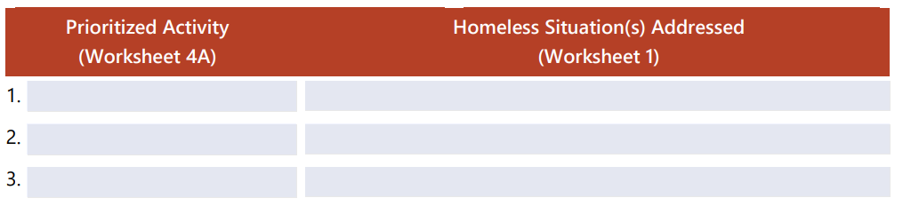
Identify a Funding Priority
Assess Prioritized Activities and the Homeless Situations They Address

Slide 20
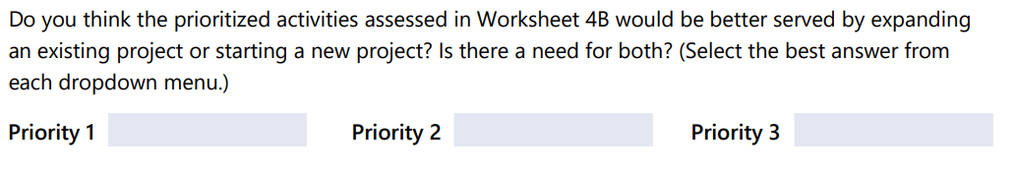
Identify a Funding Priority
Prioritize the Funding Need

Slide 21
Fair housing
Reviewing Your Decision
Not participate in the CoC Program
Prioritize increasing housing units available for people experiencing homeless situations
Prioritize rental subsidies
Prioritize supportive services
Prioritize housing operations

Slide 22
Questions?B
Discussion

Slide 23
Questions?B
Tribal Homelessness Network

Slide 24
• CoC 101 – 2 sessions
Tribal Homelessness Network
Back to Basics Sessions (2026)
  CoC Program Foundations
  CoC Program Requirements and Eligible Activities
  Pathways for Tribal Participation in the CoC
  September 23rd, 12-1:30pm ET
  From Learning to Action: Tribal Homelessness Network (THN) Office Hours
TBD (content will be based on participant feedback- THN@icf.com)
  October 21st, 1-2:30pm ET
  November 18th, 12-1:30pm ET
  December 16th, 1-2:30pm ET

Slide 25
On-call TA
THN On-call TA
What is it?
  Virtual conversations with a HUD TA Provider about the CoC Program so you can ask questions about how the CoC Program could benefit your community.
  Up to 32 hours of TA (remote).
How can you access it?
  Simply email THN@icf.com and make the request. We will take it from there!

Slide 26

Thank you!
Thank you!
Please contact us with questions and comments at:
THN@icf.com
CoC Program Resources:
CoC Resources for Tribal Communities
CoC Virtual Binder

