Slide 1

OREGON HOUSING AND COMMUNITY SERVICES
Tribal Housing Grant Fund:
From Concept to Implementation
Sept. 3, 2026
Mike Savara, Special Initiatives Advisor, Executive Director’s Office

Slide 2
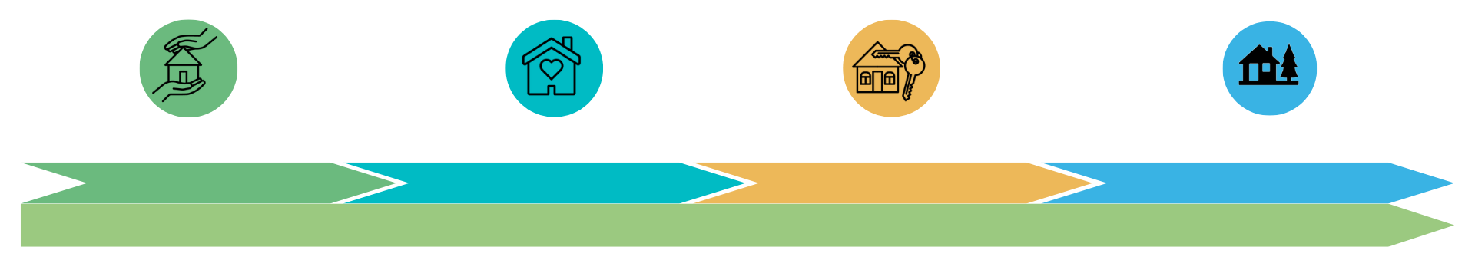
Serving Oregonians Across the Housing Continuum
Housing Stabilization
Affordable Rental Housing
Homeownership
Disaster Recovery and Resilience

Slide 3
OHCS Tribal Engagement
1-on-1s
Consultation
Tribal Housing Work Group – monthly subgroup of Legislative Commission on Indian Services (LCIS)
Programmatic Office Hours
LCIS and its cluster meetings
  Health and Human Services meetings
  Economic Development meetings
Full-time tribal liaison

Slide 4
Monthly Tribal Housing Work Group (THWG)
Formed in 2021
Monthly online space for the nine federally recognized tribes of Oregon to meet with OHCS and other agencies to discuss tribal housing, funding opportunities, and provide feedback
Critical in the success of increased tribal participation in OHCS and other agency programs
Notes:
Online meeting space
Facilitated by ohcs but tribes are drivers of the space
1.5 hours long
Try to ensure state employees do not crowd the space/more tribal attendees than state
Not recorded and not subject meeting requirements
Coordinate with GO
Other groups to attend are agencies like OHA, ODOE, ODE, DELC, non-profits like NAYA, and private entities that the tribes approve presenting – eg Wells Fargo loan products
No one non-OHCS entity can present without tribal approval and presentations are screened and feedback provided before they are able to attend

Slide 5
Funding Barriers
Historic barriers to funding include:
  Infringement on tribal sovereignty
  Lack of deep relationship with tribes
  Complex, competitive, expensive and time-consuming applications
  Lack of tribal space
  Lack of government-to-government relationships
Notes:
Contracts used to all infringe on tribal sovereignty
Did not honor NICRAs
Cluster meetings were the main method of holding tribal space and relationships
CAAs and their role in HSD funding

Slide 6
By and For Initiative - Native American Tribes of Oregon (BAFI-NATO)
    In 2019, data showed that Native Americans were four times more likely to experience unsheltered homelessness in Oregon.
    In 2022, HSD designed BAFI-NATO to provide investments to Tribal Nations to address homelessness response and prevention in their communities.
      Successfully removed barriers to participation in funding
    All Nine Federally Recognized Tribes in Oregon participated in a housing program, the first time in over 30 years at OHCS.
Notes:
Removed Barriers:
Removed infringements on sovereignty.
Honored Tribal Negotiated Indirect Cost Rate Agreements (NICRAs).
Used consensus decision making.
Funding was non-competitive.

Slide 7
OHCS and the Nine Federally Recognized Tribes of Oregon : Recent Work
  OHCS continues to grow and deepen relationships with 9 federally recognized tribes
    Hosting monthly meetings between agency staff and tribal housing and health and human services staff and leaders
  Development of By and For Initiative: Native American Tribes of Oregon (BAFI-NATO) program in 2022
  Project Turnkey 2.0 in 2022
  Deploying Homeownership Development Incubator Program (HDIP) funding in 2023
  ORCA Process and native nations set aside
  Tribal funding recommendation work group in 2023
  Tribal Housing Grant Fund (THGF)goes from agency request budget, to Governor's Recommended Budget to legislative priority
Notes:
Expand on each program a bit
BAFI-NATO and gov to gov work
PTK2.0 – flexibility and trust 2 successful apps
HDIP – very popular HO program

Slide 8
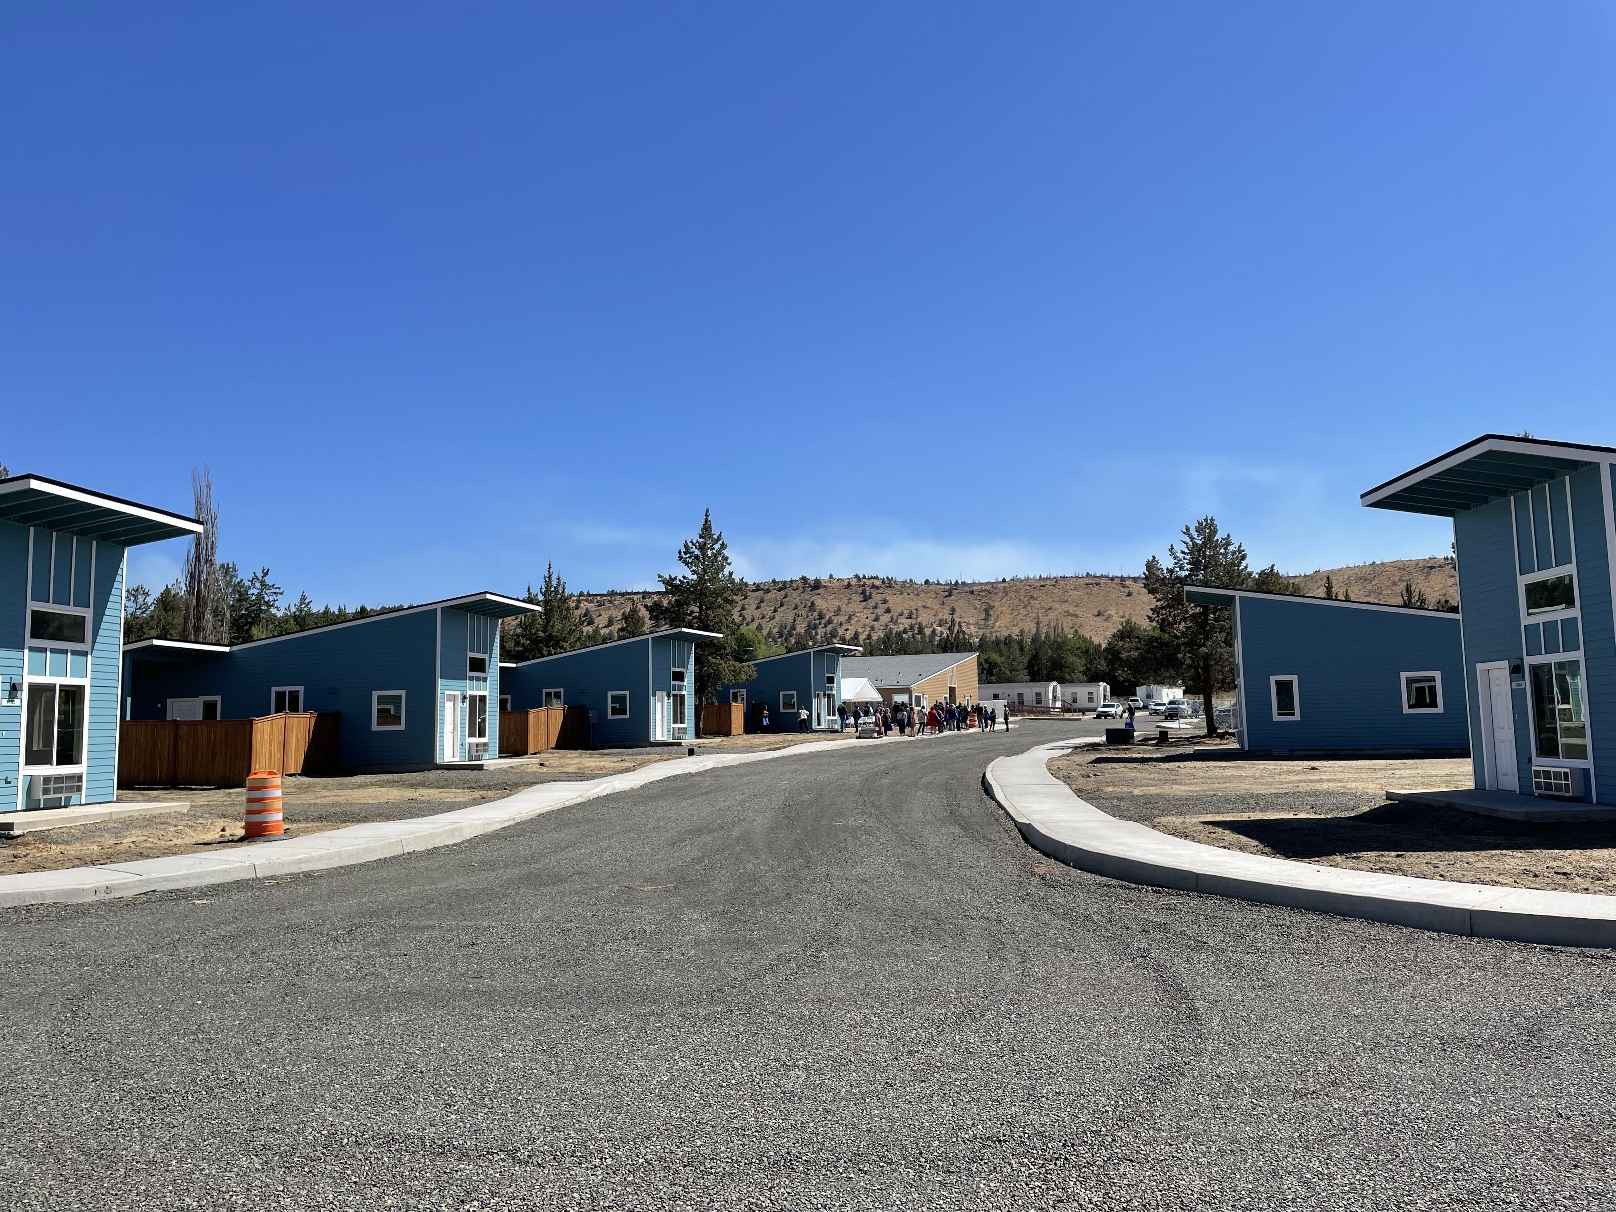
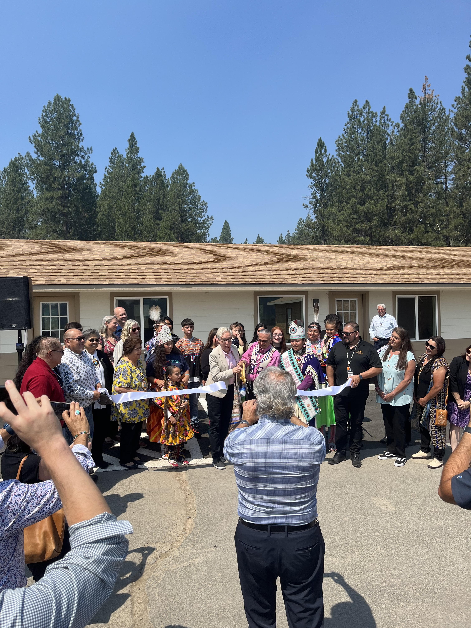
Example of Recent Tribal Developments
Former Melita's Hotel & Restaurant property blended BAFI-NATO funding and Project Turnkey 2.0 funding to create 26 Supportive Housing units for tribal elders
Warm Springs completes 10-unit Permanent Supportive Housing (PSH) project
Notes:
Melitas blended 2 ohcs programs really well – bafi-nato and ptk2.0
PSH program

Slide 9
Tribal Housing Grant Fund (THGF)
Funding recommendation from year-long workgroup - 2023
Included tribal housing leaders, health and human services leaders, and tribal council members
OHCS facilitated tribal-led funding recommendation, calling for dedicated, ongoing, flexible fund for tribes
Notes:
Concept was first discussed at NAIHC between myself and Sami Jo Difuntorum – the need to create a framework for funding that works for the tribes
Year long work group to make recommendations
-made up of tribal housing directors, health and human services directors and tribal council members
-met monthly with different topics – brought SMEs from ARH/HO/HSD + other groups like gov relations, data and procurement
Came up with dedicated, flexible and on-going fund for tribes
HB2139 failed but the program was passed via budget bill (this limited us on things like other funds)
State has responsibility to the tribes - as both sovereign nations and as oregonians.

Slide 10
HB5011 Budget Bill
  During the 2025-27 Oregon Legislative Session, HB 5011 allocated $10 million from the General Fund to OHCS to:
    Expand the housing resources to include Affordable Rental Housing (ARH) and Homeownership (HO) projects
    Maintain the By and For Initiative- Native American Tribes of Oregon (BAFI-NATO) investments
  $5 million is designated as current service level (CSL) dollars through 2034, and $5 million is one-time funding.

Slide 11
Tribal Housing Grant Fund (THGF) Implementation
OHCS convened subject matter experts from three main divisions – Affordable Rental Housing, Homeownership, and Housing Stabilization Divisions
Implementation over several months, from August 2025 to February of 2026
  Included designing new reporting templates, housing plan templates and a new program guidance and tribal consultation
Notes:
Because it was just a budget bill we lost some things like the Other Funds Account
A big challenge of a program that expands the entire agency is that SMEs wanted to bring their relevant divisions policies to the THGF. It took awhile to divorce some of those feelings/poliie from the program.
DTLL went out in September – met with combination of housing directors and tribal council
Funding formula was the most discussed topic and most contentious.
Ended up not having total consensus but majority
Implementation was also complicated by some tribes internal politics
120% ami limit for HO/ARH work and no ami limit for HSD activities
50% of funding advanced in first year but tribes can request their entire investment upfront
Funding through 2034 - $5m CSL and $5m in 1 time funding – have requested recapitalization in POP
DOJ and procurement were lengthy process
Reviewed by subject matter experts in ARH, HSD and HO divisions.
Any single tribal development project using $1M or more in THGF funds requires HSC approval.

Slide 12
Program Structure
  Close alignment with the Federal Indian Housing Block Grant (IHBG)
  Formula funding for the allocation and advance of funds structure
  Every biennium, grantees submit housing plan.
    2025-27 will differ because of late start date for deadlines to submit housing plans
  Every fiscal year, grantees will be required to complete annual progress report (APR), due 90 days after biennium closes
    For 2025-27, only one APR will be due (Sept. 30, 2027).
Notes:
Allocations are based on formula funding.
For 2025-27, the formula proposed is based on high base amount of $700k and Tribal enrollment numbers.
Funding will be distributed after approval of the housing plan.
Payments will come in the form of advances.
Advances in years one and two will be split 50/50, except for the 2025-27 biennium.
For every fiscal year after, documentation on expenditures will be required as part of the APR.

Slide 13
Program Eligible Activities
Homelessness Response and Prevention Programs (Shelter, Transitional, Homelessness Prevention, Housing-Focused Activities) | Operations and Maintenance of Existing Affordable Housing Sites, Shelter and Transitional housing projects
Affordable Rental Housing (Operations, Preservation, Support Services, Rental Assistance) | Financial Assistance and Support Services for Households that qualify (Rental Assistance, Housing payments, Case Management)
Homeownership Programs (Down Payment Assistance, Mortgage Assistance, Home Repairs) | Capacity building
Land acquisition, infrastructure, development, rehabilitation and conversion of emergency shelter/transitional, affordable rental and homeownership projects | Administrative Costs (includes Data collection) Use of NICRAs or 15% admin

Slide 14
Household Program Eligibility
Homelessness Response and Prevention Programs based on housing status.
  Category 1: Literally Homeless—Individual or family who lacks a fixed, regular, and adequate nighttime residence, meaning:
  Category 2: Imminent Risk of Homelessness—Individual or family who will imminently lose their primary nighttime residence.
  Category 3: Homeless Under Other Federal Statutes
  Category 4: Fleeing/Attempting to Flee Domestic Violence
  Category 5: Unstably Housed—Individual or family who is at risk of losing their housing and does not otherwise qualify as homeless under the above listed (1-4) categories.
Household income must be equal to or less than 120% of area median income for ARH and HOD projects

Slide 15
THGF Tribal Engagement and Consultation
2023 – Funding recommendation group created
  Made up of Tribal representatives, including housing directors, health and human services directors, grant managers, and Tribal council members.
  Met with each section to discuss barriers and policies.
  Recommended creation of a dedicated, flexible, and ongoing fund for Tribes.
Consultation and engagement on Program Design from Sept.-Nov. 7, 2025.
  Dear Tribal Leader letters sent out requesting consultation.
  Met with Tribes 1:1 and Tribal representatives.
Funding formula was the most discussed topic.
  Most Tribes wanted to maintain the BAFI-NATO formula, which included a high ($700K) base amount and then total Tribal enrollment as the other factor.
  Tribes were pleased with the thoughtful, intentional, and collaborative approach we had taken with the creation and implementation of the THGF.

Slide 16
Current Implementation Status
Program roll out began in February 2026; as of July 2026:
8 of 9 grant agreements executed
9 of 9 housing plans received
7 of 9 housing plans approved
2 of 9 housing plans under revision
7 of 9 awards disbursed
Grant agreement execution not contingent on housing plan approval. After plan is approved, funding can be disbursed.

Slide 17
THGF Projects Proposed for 25-27 Biennium
217 households to be served by Homelessness Response and Housing Stabilization funding
58 shelter beds maintenance/operations
48 households to be served by Homeownership programs
368 units supported with Maintenance/Operations/Rehab for ARH/HO sites
24 new ARH Units supported through development and infrastructure costs
3 lots for land acquisition slated for future development of HO/ARH sites
1 capacity-building project focusing on policy and compliance
3 ARH projects in the pre-development phase
6 FTE staff
Notes:
$10M will pay for the above projects and admin

Slide 18
Development Timeline
January 2023 - Begin to work group with tribes on funding recommendations
December 2023 -Recommendations given to agency leadership
January 2024 - THGF POP Created
August 2024 – THGF in ARB
December 2024 – THGF in GRB
January 2025 – THGF is a legislative priority of Governor Kotek
February 2025 - Passes House Housing Committee and sits in Ways and Means
June 2025 – Bills fails but program funded through budget bill HB5011
September 2025 Consultation and implementation work
February 2026 – Grant agreements and housing templates go out to the tribes
March and April – Tribes begin to submit housing plans and execute grant agreements
May 2026 First tribal housing plan is fully approved and funds are dispersed

Slide 19
What's Next? On-going Barriers?
Reviewing possible program adjustments
  AMI
  Other Funds Account
  Streamlining review process and template design
Review existing program and policies for better alignment with tribal goals and the THGF
Ensure tribal voices are in decision-making spaces
Notes:
The signature on the application is a barrier
Better examples of outcomes and to include a sample application
Bottle necked ourselves via the review process
-went from discussed every aspect of submitted plans to focusing on areas flagged for concern from SMEs
Data sovereignty agreements – have initiated conversation and DTLL -
Looking at the ORCA/other programs
Makeup of HSC – want to help ensure at least some tribal voices continue to be on council
Exempt tribal projects from the HSC – focus on g2g
At this point want to both ensure tribes that they have access to all the same resources as developers and other entities and move leadership into the mindset that tribes should be getting things that other entities don’t have access to.

Slide 20
Questions?
Judy Hui-Pasquini, Senior Local and Tribal Policy Analyst
Judy.Hui-Pasquini@hcs.Oregon.gov
Colt Sray, Homeless Services Program Coordinator
Colt.Sray@hcs.Oregon.gov
Tim Mahern-Macias, OHCS Tribal Liaison
Timothy.Mahern-Macias@hcs.Oregon.gov

