Slide 1
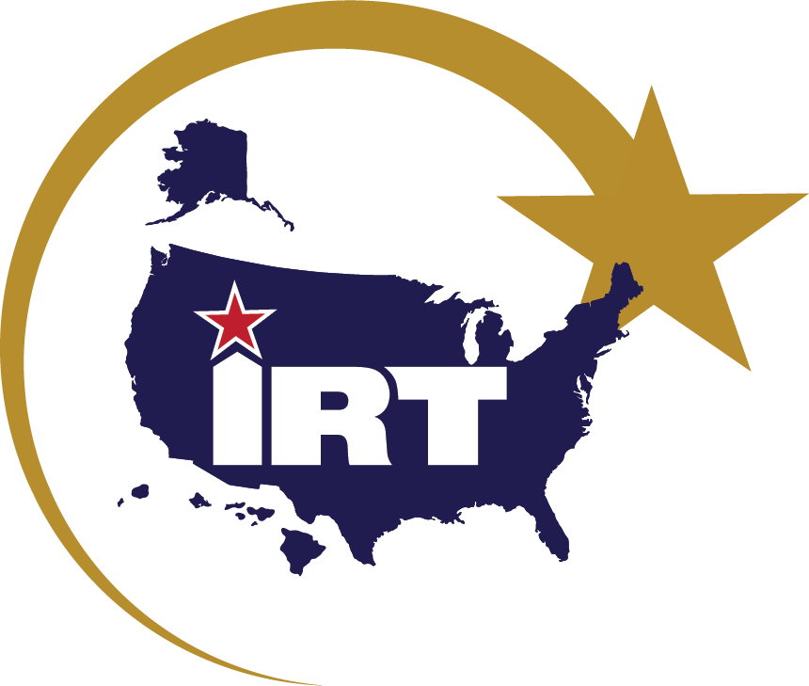
Innovative Readiness Training 101 Brief
Website: IRT.Defense.gov
Email: OSD.IRT@mail.mil

Slide 2
Understanding IRT
Origin and Background of the IRT program
Governing Authorities
Restrictions
IRT Aligns to the Secretary of War’s Priorities
Multi-Component Joint Force
Joint Military Training
Civil-Military Excellence
IRT Battle Rhythm
2026 IRT Snapshot (Funded and Non-OSW Funded Missions)

Slide 3

Origin and Background of the IRT Program
What if the Best Military Training Led to Ready Forces and Thriving American Communities?
Authorized Under Title 10 U.S. Code § 2012
IRT is led by the Director, Innovative Readiness Training, in the Office of the Deputy Assistant Secretary of War for Reserve Integration.
IRT includes opportunities for Active, Guard, and Reserve Service members to integrate as a joint and whole-of- society team to train and serve American communities
Department of War Response to 1992 “Rebuild America” Initiative
“The American people have made an enormous investment in developing the skills, capabilities, and resources of the Armed Forces. These resources, if properly matched to local needs and coordinated with civilian efforts, can be a useful contribution to addressing the serious domestic needs of the United States." - 1993 Senate Armed Services Committee Report

Slide 4
Governing Authorities
Title 10 U.S. Code § 2012: Support and Services for Eligible Organizations and Activities Outside DoW – Authority to provide services and support, if it is incidental to military training, to non-DoW organizations, including:
  Any Federal, regional, State, or local governmental entity (including Federally-recognized tribal entities)
  Youth and charitable organizations specified in Title 32 U.S. Code § 508: Assistance for certain youth and charitable organizations
  Owners and operators of critical infrastructure, as defined in Title 42 U.S. Code § 5195c: Critical infrastructures protection
  Any other entity as may be approved by OSW on a case-by-case basis
Department of War Instruction (DoWI) 1100.24 – Innovative Readiness Training (IRT): Support and Services for Eligible Organizations and Activities Outside DoW
Military Service Instructions & Policies

Slide 5
Restrictions
Must accomplish mission-essential military training
Must not compete with the private sector, non-competition clause
Military members will ONLY do tasks within their military occupational specialty
IRT authorities cannot be used for response to natural or manmade disasters (though can be used to restore an area after a natural disaster)
Must not include commercial development (CE Only)
Military members cannot provide law enforcement during an IRT support activity

Slide 6
IRT Aligns to the Secretary
of War’s Priorities
SecWar Priorities | IRT Strategic Outcomes
Restore the Warrior Ethos | Unity of Purpose: IRT strengthens Joint coordination and hands-on military training that ensures real-world readiness and mission success in complex contingency environments.
Matching Threats to Capabilities | Accountability and Innovation: IRT increases fiscal discipline; ensuring best use of DoW resources for cutting-edge military training and threat resilience for American communities.
Reestablish Deterrence | Readiness and Leadership: IRT develops strong military leaders who are prepared to meet the challenges of deployment, mission success, and deterrence.

Slide 7
Alignment to OASW(M&RA) IRT Readiness Objectives
Readiness Objectives | IRT Working Definitions
Homeland Defense | Protection of US sovereignty, territory, population, and defense infrastructure against external threats or aggression. Activities that build domestic resilience and readiness, including public health, emergency management, and critical infrastructure protection.
Cybersecurity | Prevention, protection, and restoration from damage to computers, communications, and information to ensure critical infrastructure architecture and non-repudiation Activities that strengthen defensive cyber readiness across critical infrastructure, and public institutions.
Deterrence | Prevention of hostile actions or attacks against U.S. interests through credible demonstration of capability, capacity, and resolve. Discouraging potential adversaries from taking actions that could harm U.S. national security interests, achieved through demonstrable readiness and capability within IRT projects.
Port Operations | Interchange of Department of War cargo between land and water/air. All logistics/cargo-handling at military or strategic ports to support deployment and sustainment. Activities that build & enable maritime or airport access, facilities, throughput, or waterfront response capabilities.
Setting the Theater | Activities that shape conditions in areas for mission execution, including prepositioning, preparing, or connecting infrastructure, logistics, and command relationships Enabling rapid force employment in likely operating theaters including infrastructure, port operations, sustainment, and movements therein.

Slide 8
IRT Mission, Vision, Director’s Intent
IRT Mission: To produce mission-ready forces through military training opportunities that provide key services for American communities.
IRT Vision: A secure and prosperous America supported by strong civil-military relations.
IRT Director’s Intent: Become the leading option for real-world military training through a culture of trust, transparency, and consistency.

Slide 9
Multi-Component
Joint Force
OSW
Department Responsible Officials
AIR FORCE
NAVY
ARMY
RESERVE
GUARD
NAVY RESERVE
MARINE RESERVE
RESERVE
GUARD
ACTIVE
ACTIVE
ACTIVE
Senior Responsible Officials & Program Managers

Slide 10








Joint Military Training
IRT Training Types + Austere Environments = Military Skills
Civil Engineering
Vertical & Horizontal Construction
Electrical
HVAC
Utilities
Paving
Joint Synchronization
Medical
Health Exams
Dental
Optometry
Veterinary
Education
Leadership Development
Complex Mission Planning
Cybersecurity
Computer Network Defense
Cyber Resilience Reviews
Risk & Vulnerability Assessments
Other
Force Support
Public Affairs
Chaplain
Transportation
Communications
Aerial Spray
Diving
Unit Training Assurance

Slide 11
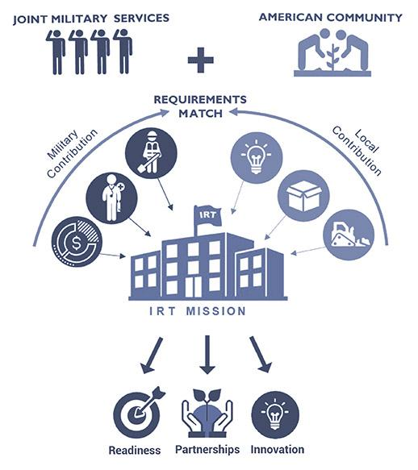
Civil-Military Excellence
IRT Readiness Outcomes
Hands-on training promotes mission readiness
Enhanced mission-essential skills in complex environments
Real world experience for deployment readiness
Joint environment improves synchronization and coordination
Junior officer/enlisted leadership opportunities in a joint environment
Increased public service and job satisfaction
Esprit de corps and applied collaboration skills

Slide 12











IRT Battle Rhythm
Standard OSW Funded
Non-OSW Funded
Community request for assistance due
Community request for assistance done in coordination with military unit
30 Sept
Month 1
Military units match training requirements to community requests
Military application complete and routed
Nov - Feb
Month 2
Military applications due
1 May
Military application approved
DoW notifies communities of selection
Month 3-4
Sep - Oct
Funding provided by Military Department
Initial planning meetings begin between units & community
Month 5-6
Oct - Dec
Training missions accomplished
Training mission begins
Apr - Aug
Month 6+

Slide 13
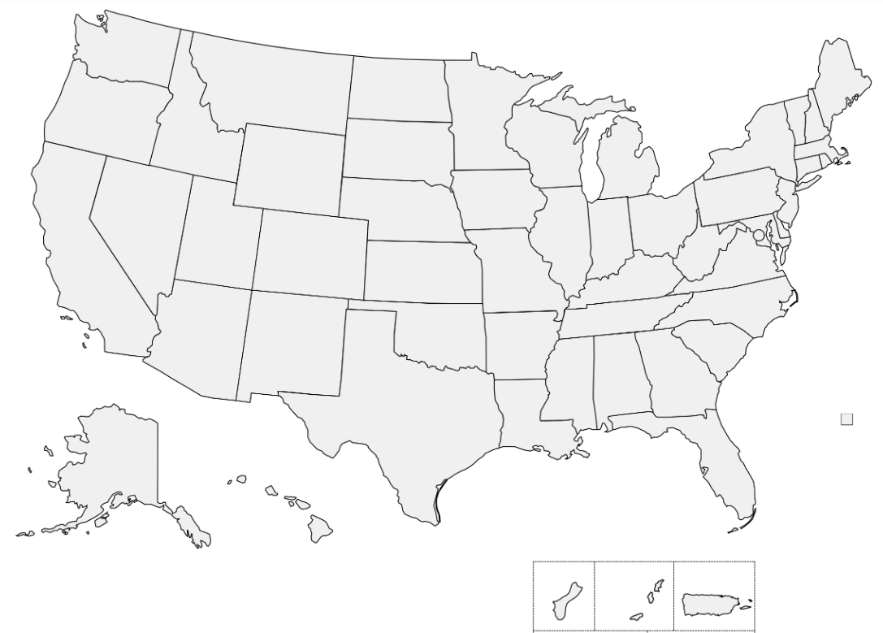









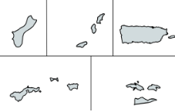
2026 IRT Snapshot
OSD Funded
20 Missions
14 States & Territories
11 Joint + 10 Non-Joint Missions
Mission Type Legend
Civil Engineering (6)
Medical (6)
Civil Affairs (2)
Cybersecurity (5)
Dive (1)
Updated: 10 August 2026

Slide 14
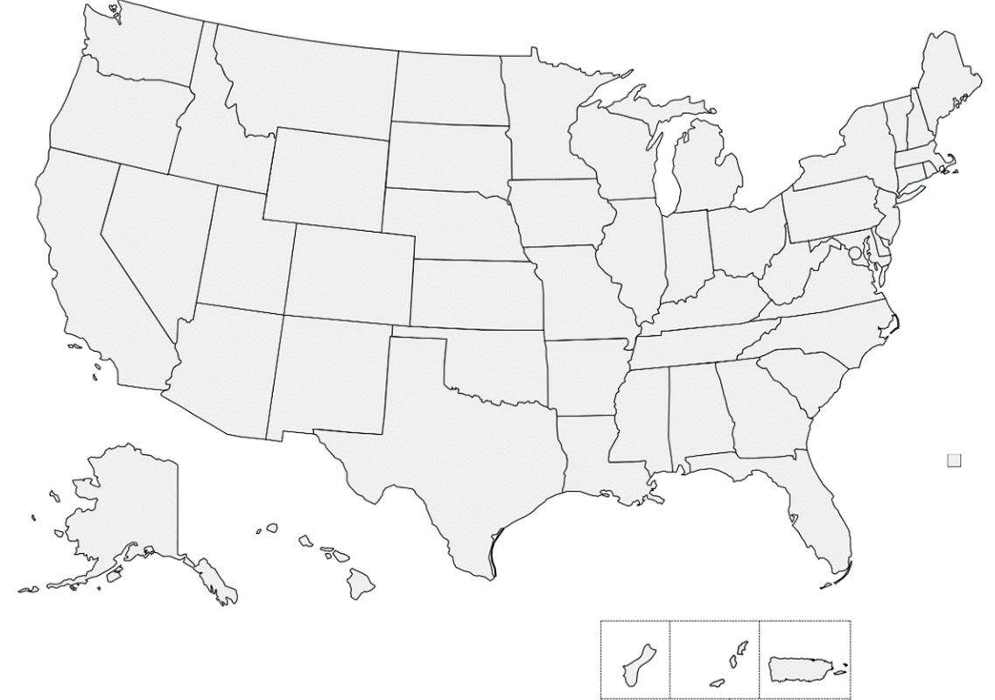

2026 IRT Snapshot
Non-OSD Funded
17 Missions
12 States & Territories
0 Joint + 17 Non-Joint Missions
Mission Type Legend
Civil Engineering (9)
Transportation (1)
Aerial Spray (1)
Medical (2)
Cybersecurity (4)
Updated: 26 May 2026

Slide 15
Questions?
Website: IRT.Defense.gov
Email: OSD.IRT@mail.mil

