Slide 1



Rooted in Tradition:
Rising in Resilience

Slide 2
Welcome
Section 184 as a Housing Development Finance Tool.
September 1-3, 2026
Doubletree by Hilton Hotel Washington DC - Crystal City in Arlington, Virginia

Slide 3
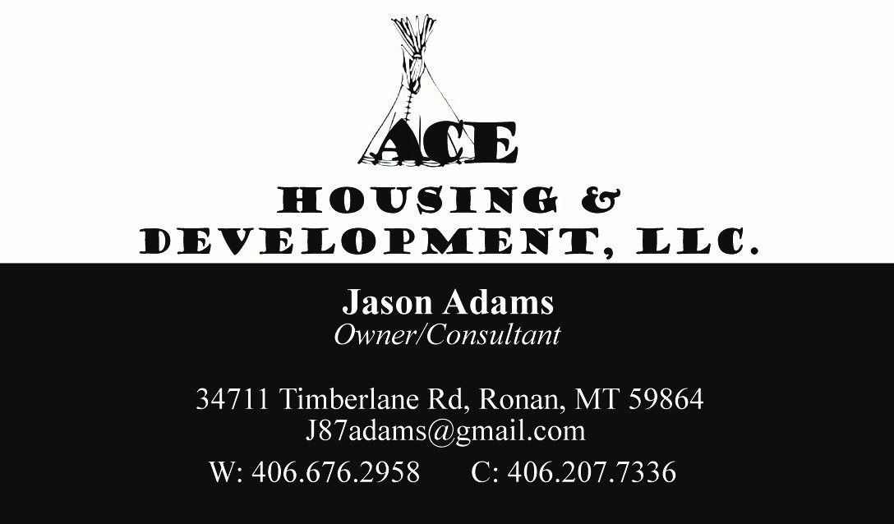
Presenter:
Jason Adams
September 1-3, 2026
Doubletree by Hilton Hotel Washington DC - Crystal City in Arlington, Virginia

Slide 4

Introductions
Name.
Organization.
Length of time at the organization.
What you hope to learn today.
September 1-3, 2026
Doubletree by Hilton Hotel Washington DC - Crystal City in Arlington, Virginia

Slide 5
Purpose of Program
To increase the availability of mortgage lending to Native Americans and Native American Communities.
September 1-3, 2026
Doubletree by Hilton Hotel Washington DC - Crystal City in Arlington, Virginia

Slide 6
184 Loan Program overview:
1992 Housing and Community Development Act
Nationwide Homeownership, New Construction and Rehabilitation Loan Program
100% Guaranteed Funds for lenders
Up to 30-year mortgage
Low down payment with no mortgage insurance
Available to Enrolled Tribal Members
Originally intended to make market rate loans on Tribal and Individual Trust Land.
September 1-3, 2026
Doubletree by Hilton Hotel Washington DC - Crystal City in Arlington, Virginia

Slide 7
184 Loan Program Overview:
Section 184 is authorized under the Housing and Community Development Act
Section 184 is not under NAHASDA and is fundamentally different
  Not restricted to NAHASDA recipients
  Not restricted by income limits
  Not tied to administrative requirements
September 1-3, 2026
Doubletree by Hilton Hotel Washington DC - Crystal City in Arlington, Virginia

Slide 8
Why Use the Section 184 Loan?
Low Down Payment: 2.25% on loans over $50,000 and only 1.25% on loans under $50,000
Fixed Interest Rates: based on market rates, not on applicant’s Credit Scores
Manual Underwriting: The Program utilizes a hands-on approach to underwriting and approval opposed to automated decision-making tools.
Growing National Network of Approved Lenders: network of approved lenders includes national companies, local banks and CDFI’s. The Lenders have also been trained on the unique circumstances of Native homeownership.
September 1-3, 2026
Doubletree by Hilton Hotel Washington DC - Crystal City in Arlington, Virginia

Slide 9
Why Use the Section 184 Loan?
Section 184 Upfront Loan Guarantee Fee: A one-time 1.0% up front guarantee fee is paid at closing or can be financed into the loan.
Protection from predatory lending: The Program monitors the fees approved lenders can charge Native borrowers. Section 184 loans cannot be used for Adjustable Rate Mortgages (ARMs).
Knowledgeable Staff: The staff understands the unique circumstances associated with lending on Native Lands and they work with borrowers to achieve home ownership and to avoid default and foreclosure.
September 1-3, 2026
Doubletree by Hilton Hotel Washington DC - Crystal City in Arlington, Virginia

Slide 10
What can 184 loans be used for?
Purchase an Existing Home
Construct a New Home
Rehabilitate a Home
Purchase and Rehabilitate a Home
Refinance a Home
September 1-3, 2026
Doubletree by Hilton Hotel Washington DC - Crystal City in Arlington, Virginia

Slide 11
What can 184 loans be used for?
Cash out refinance – Max $25K (will be changing with updated guidelines.)
Consolidate debt.
Can build manufactured/modular/stick-built homes.
Skilled workers housing.
No commercial structures or apartment buildings.
September 1-3, 2026
Doubletree by Hilton Hotel Washington DC - Crystal City in Arlington, Virginia

Slide 12
What can 184 loans be used for?
Housing structures consisting of 1 to 4 units and associated site improvements
Tribe/TDHE can get multiple loans, one for each structure
  Must meet with construction and safety standards
  Homeownership
  Rental
September 1-3, 2026
Doubletree by Hilton Hotel Washington DC - Crystal City in Arlington, Virginia

Slide 13
Eligible Borrowers
Members of Tribes
Tribes
Tribally Designated Housing Entities
September 1-3, 2026
Doubletree by Hilton Hotel Washington DC - Crystal City in Arlington, Virginia

Slide 14

LOAN FEATURES
Assumable (qualified) to other Native Americans
  No down payment required
  Maximum fee for standard assumption is $500
  Doc fee
  Title fees
September 1-3, 2026
Doubletree by Hilton Hotel Washington DC - Crystal City in Arlington, Virginia

Slide 15
Doubletree by Hilton Hotel Washington DC - Crystal City in Arlington, Virginia
September 1-3, 2026
What does HUD and the Lender look at if the borrower is a Tribe or TDHE?
Land status and jurisdiction.
Audited Financial statements (current and previous year).
Demonstration of development skills.
Assets analysis (proving sufficient debt coverage).
Demonstration of sufficient market.
Marketing plan (sales project).

Slide 16
Doubletree by Hilton Hotel Washington DC - Crystal City in Arlington, Virginia
September 1-3, 2026
What does HUD and the Lender look at if the borrower is a Tribe or TDHE?
Demonstration of property management skills (rental projects).
Project pro-forma (rental projects).
Rental & Maintenance plan (rental projects).
Evidence of authority to borrow.
Evidence of ability to obtain deficiency judgment.

Slide 17
Doubletree by Hilton Hotel Washington DC - Crystal City in Arlington, Virginia
September 1-3, 2026
What does HUD and the Lender look at if the borrower is a Tribe or TDHE?
Environmental Assessment applications for 5 or more homes must include an assessment under the NEPA and compliance with regulations.
What lease and sublease the Tribe would be using for each 184 loan. HUD will review and approve all leases.
For trust land, Title Status Report (with recorded lease(s) and Leasehold instrument (with all signatures as required).

Slide 18
Does the Tribe or TDHE need to set up a separate entity for these units?
The technical answer is no, but they can if they want to.
September 1-3, 2026
Doubletree by Hilton Hotel Washington DC - Crystal City in Arlington, Virginia

Slide 19
Housing Development Finance Tool
Examples:
Purchase of 4-Plexes.
New rental housing units.
New homeownership units.
Remodel/Update existing paid off Mutual Help units.
What is your need?
Skilled Workers Demonstration – Dear Lender Letter 2022-06
September 1-3, 2026
Doubletree by Hilton Hotel Washington DC - Crystal City in Arlington, Virginia

Slide 20
Housing Development Finance Tool
Pro’s to use as finance tool:
Plenty of funds as long as you qualify.
Con’s of using as a finance tool:
You have to be able to afford the payments on the loan(s).
Tribe also have to have policies and ordinances allowing for foreclosure and eviction, can’t lend if these are not in place.
Some tribes don’t want lenders to lend on their lands.
September 1-3, 2026
Doubletree by Hilton Hotel Washington DC - Crystal City in Arlington, Virginia

Slide 21
Housing Development Finance Tool
Revenue from these properties helps fund affordable housing programs while the equity builds unrestricted assets for the tribe.
September 1-3, 2026
Doubletree by Hilton Hotel Washington DC - Crystal City in Arlington, Virginia

Slide 22
Thank you!
Any questions Please contact me.
September 1-3, 2026
Doubletree by Hilton Hotel Washington DC - Crystal City in Arlington, Virginia

