Slide 1

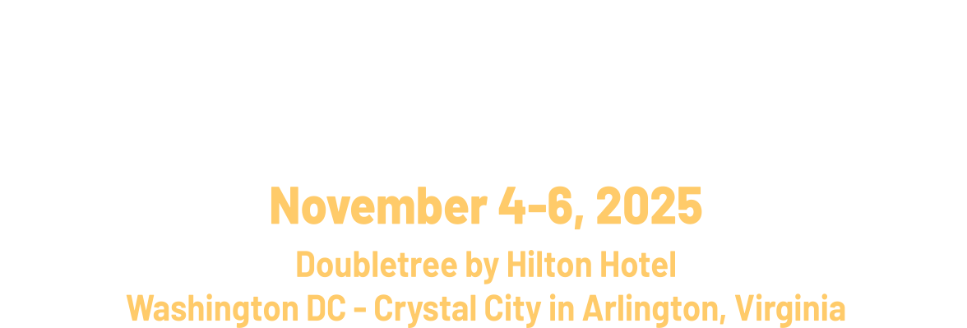

Rooted in Tradition:
Rising in Resilience

Slide 2
Welcome
Building Sustainable Homeownership Programs.
September 1-3, 2026
Doubletree by Hilton Hotel Washington DC - Crystal City in Arlington, Virginia

Slide 3
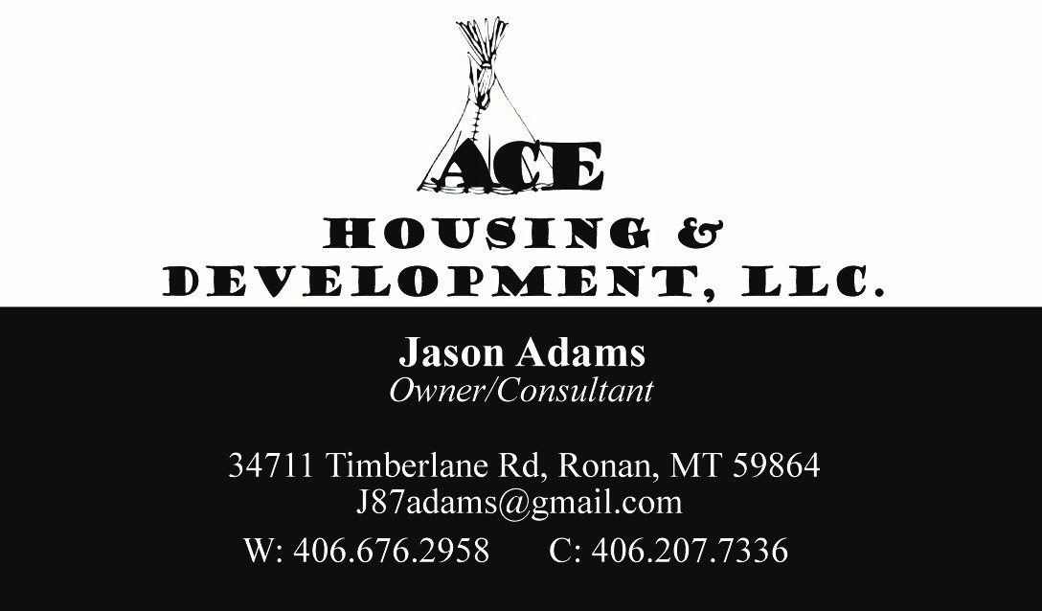
Presenter:
Jason Adams
September 1-3, 2026
Doubletree by Hilton Hotel Washington DC - Crystal City in Arlington, Virginia

Slide 4

Introductions
Name.
Organization.
Length of time at the organization.
What you hope to learn today.
September 1-3, 2026
Doubletree by Hilton Hotel Washington DC - Crystal City in Arlington, Virginia

Slide 5
We will cover items that need to be in place to have a sustainable homeownership program.
We will cover recommended steps you can take to develop your homeownership program.
Building Sustainable Homeownership Programs.
September 1-3, 2026
Doubletree by Hilton Hotel Washington DC - Crystal City in Arlington, Virginia

Slide 6
What housing programs and services to you current provide?
It is important to analysis where your organization is today.
If you have a rental housing program, is it being run effectively?
Do you have other funding sources that are assisting your organization with it goals of providing affordable housing services to your tribal membership?
September 1-3, 2026
Doubletree by Hilton Hotel Washington DC - Crystal City in Arlington, Virginia

Slide 7
What housing programs and services to you current provide?
Do you have up-to-date policies and procedures and are they adhered to?
Do you have a rental structure that is at or close to 30 % of adjust Income?
Are your TARS low?
When was the last Housing Needs Assessment completed?
September 1-3, 2026
Doubletree by Hilton Hotel Washington DC - Crystal City in Arlington, Virginia

Slide 8
Why the analysis?
It is critical to review our current operations and firm up those areas before we move ahead with other programs for our clients.
A review of operations will lead to greater success for your organization and clients in the future.
Will allow for partnerships and leverage for new programs and services.
What is the data telling us?
September 1-3, 2026
Doubletree by Hilton Hotel Washington DC - Crystal City in Arlington, Virginia

Slide 9
What Homeownership services should we plan for:
We will look at what steps your organization should plan for to provide a clear path for homeownership success for your clients.
The steps will be to prepare for, achieve and sustain homeownership.
September 1-3, 2026
Doubletree by Hilton Hotel Washington DC - Crystal City in Arlington, Virginia

Slide 10
Steps to consider for your homeownership program.
Rental analysis and reporting.
Housing Counseling services.
Building Financial Capacity.
Home Maintenance.
Foreclosure Prevention.
September 1-3, 2026
Doubletree by Hilton Hotel Washington DC - Crystal City in Arlington, Virginia

Slide 11
Rental Analysis & Reporting
What data do you have?
What does data do for you?
What different types of data are available?
Do you need a full Housing Needs Assessment?
Does your tribe have its own data or a process to get data?
September 1-3, 2026
Doubletree by Hilton Hotel Washington DC - Crystal City in Arlington, Virginia

Slide 12
Rental Analysis & Reporting
How do you look at your current rental housing tenants?
What is the history of homeownership in your tribe?
What is your policy for over-income tenants? Are you in compliance with NAHASDA regulations on this issue?
Good data will help ensure success of your program and help with bringing in new funders.
September 1-3, 2026
Doubletree by Hilton Hotel Washington DC - Crystal City in Arlington, Virginia

Slide 13
Housing Counseling Services
Homebuyer Education.
Do you need to create, or can you partner with an existing organization?
If you create, what curriculum should you use? Do you have staff or will they need to be hired? How to pay for this? Policy?
September 1-3, 2026
Doubletree by Hilton Hotel Washington DC - Crystal City in Arlington, Virginia

Slide 14
Housing Counseling Services
What does Homebuyer Education cover:
Budgeting.
Evaluating credit.
Finding a home.
Working with a lender and applying for a home loan.
Protecting the asset.
Homebuyer Education leads to success!
September 1-3, 2026
Doubletree by Hilton Hotel Washington DC - Crystal City in Arlington, Virginia

Slide 15
Building Financial Capacity
Your program will assist you tribal members, your community, and your tribe.
Helps build assets.
Keeps money in your community, i.e. tribal banks, tribal contractors, tribal stores, etc.
September 1-3, 2026
Doubletree by Hilton Hotel Washington DC - Crystal City in Arlington, Virginia

Slide 16
Home Maintenance
A huge part of the education process.
Do you have classes for rental tenants?
Gives homeowners pride and confidence.
Help with keeping value of the asset.
How to plan for the issues that will come up.
September 1-3, 2026
Doubletree by Hilton Hotel Washington DC - Crystal City in Arlington, Virginia

Slide 17
Foreclosure Prevention
Needs to be a part of your Homebuyer education class.
Preparing for when life happens.
Help your clients to understand to run to their lender.
What assist can your program offer?
Why should you assist with this?
September 1-3, 2026
Doubletree by Hilton Hotel Washington DC - Crystal City in Arlington, Virginia

Slide 18
Additional issues to consider
How will you fund your program?
Will your program be a revolving and self-sustaining program?
What are your land and infrastructure considerations?
What lenders are available to you and your clients?
Should you have a policy? What should it cover?
September 1-3, 2026
Doubletree by Hilton Hotel Washington DC - Crystal City in Arlington, Virginia

Slide 19
Wrap up
Where are you in this process?
What is your current or potential housing market?
Do you need assistance to move forward?
What are your challenges?
Many issues to consider, but don’t be overwhelmed, small steps and achievable goals.
As we learn we tell our clients, “It is never no, just not yet!”
September 1-3, 2026
Doubletree by Hilton Hotel Washington DC - Crystal City in Arlington, Virginia

Slide 20
Thank you!
Any questions Please contact me.
September 1-3, 2026
Doubletree by Hilton Hotel Washington DC - Crystal City in Arlington, Virginia

