Slide 1

HUD’S NATIONAL
TRIBAL HOUSING SUMMIT
September 1-3, 2026
Rooted in Tradition:
Rising in Resilience

Slide 2


Creating Your Tribal Legal Infrastructure for Mortgage Lending
Denise Zuni, Attorney/Owner
Sh’eh Wheef Law Offices, PC

Slide 3
Agenda
Historical context of housing on Indian Lands
Challenges with Lending on Indian Lands
Building the Tribal Legal Infrastructure
Default
Coordinating the Lending Process
Building Tribal Capacity
Best Practices
Should my tribe implement HEARTH?
Using Tribal Sovereignty to remove barriers to lending

Slide 4
Tribes are New to Mortgaging
(30 years)
Prior to 1963 – homes built by families
1963 – HUD funded homes, some BIA-HIP
1980s – some VA and FHA homes
1992 – HUD Section 184 Indian Home Loan Program
2010 – Native CDFIs
2020 – The return of conventional lending

Slide 5
And New to Managing Land Conducive to Mortgage Lending
Who’s recording my land assignment?
What tribal office do I go to to get a residential lease?
Can I sell my home without tribal approval?
Where is my quitclaim deed recorded?
Can I transfer my land assignment? Where do I go to do this?
Notes:
No written laws that induce lending -

Slide 6
No Clear Land Processes in Place
Recording Office. Any State County Recording Office:
Contains all land records in the County
Owner, address of property (and all former owners)
Maps of all lands in the county
taxes paid, liens, mortgages
Records permanently preserved
Anyone can access

Slide 7
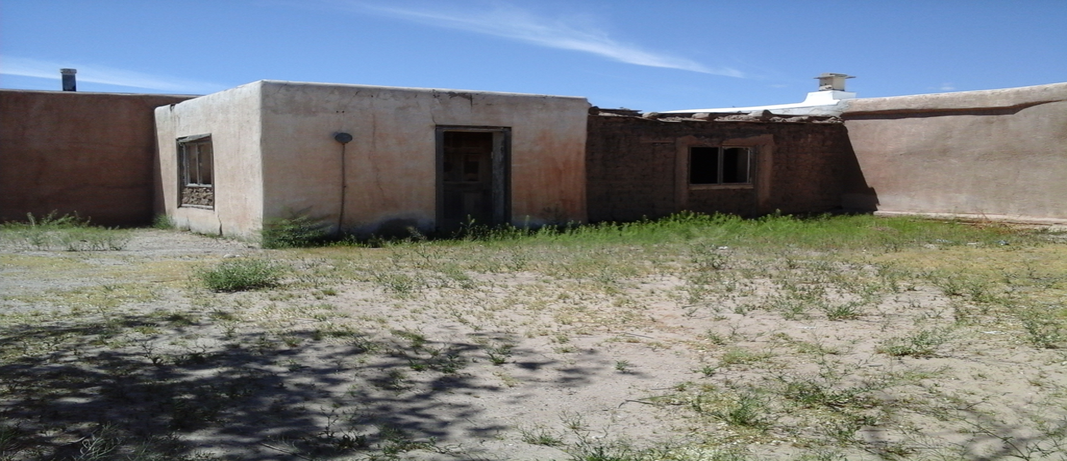
Mortgage Lending on Tribal Lands Has Changed the Landscape

Slide 8
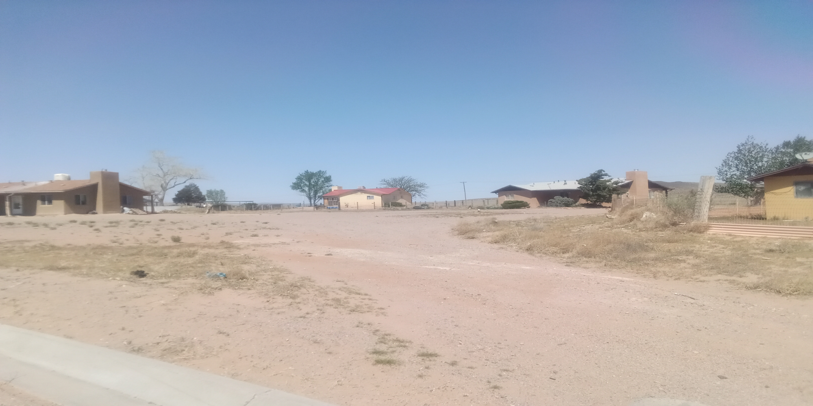
Indian Country Subdivision Housing

Slide 9
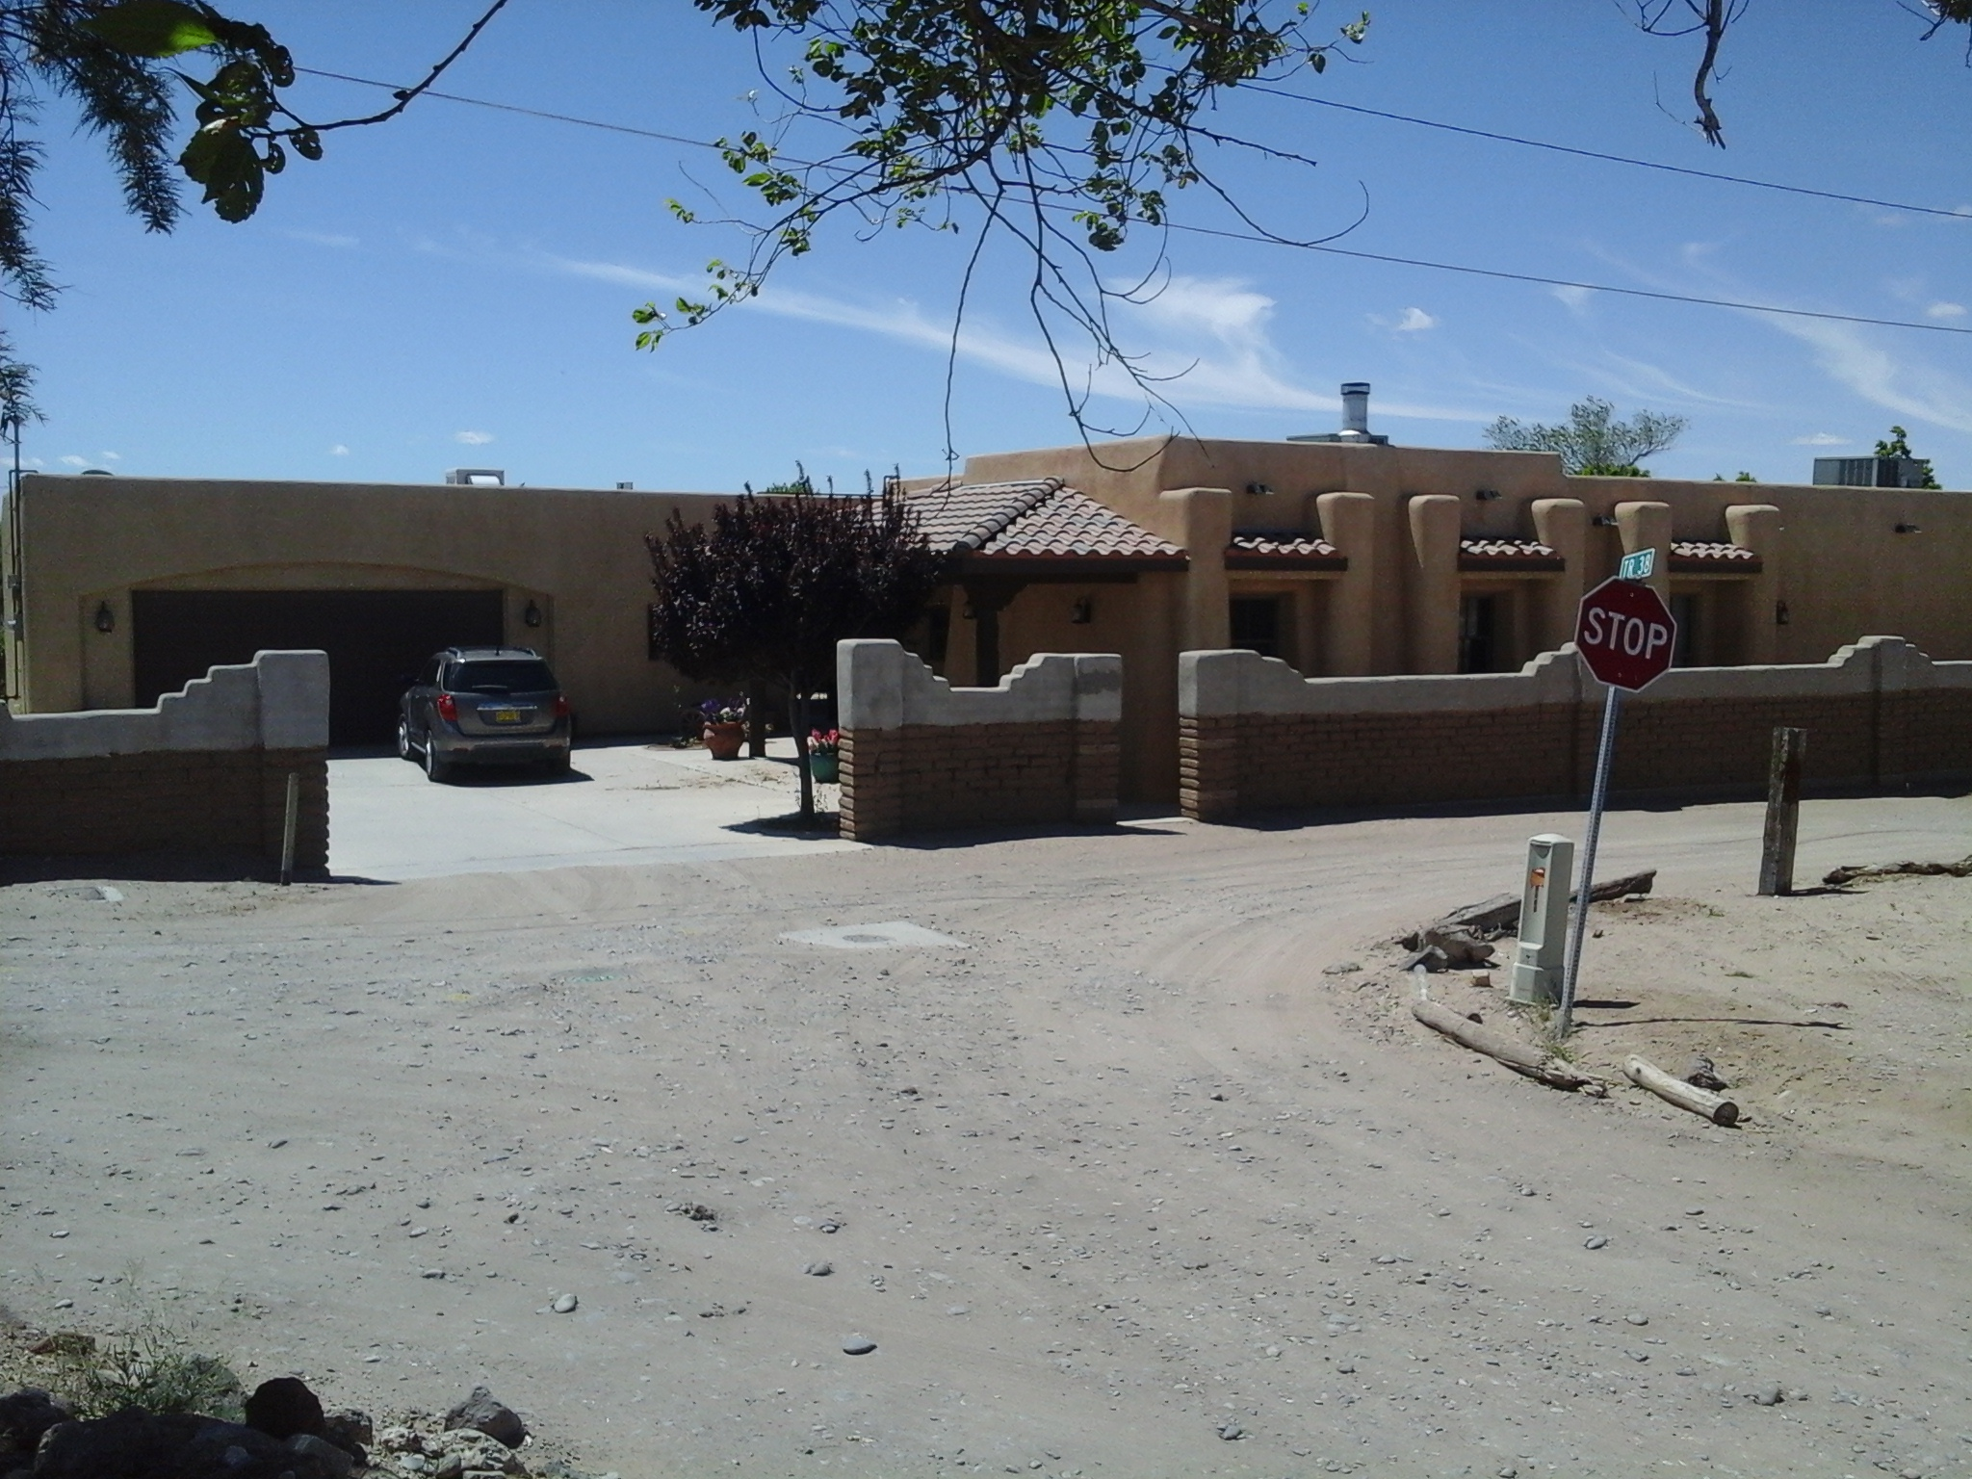
Section 184 Home

Slide 10
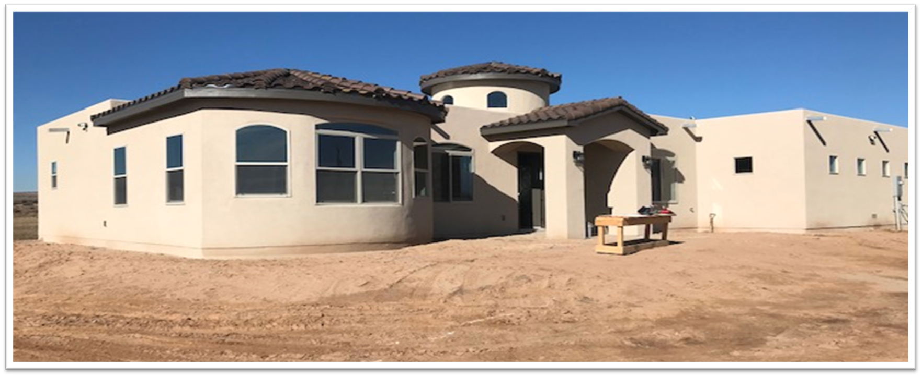
Tiwa Lending Services, a Native CDFI

Slide 11

The Mortgage Process outside Indian Country
Deed
Mortgage
$

Slide 12

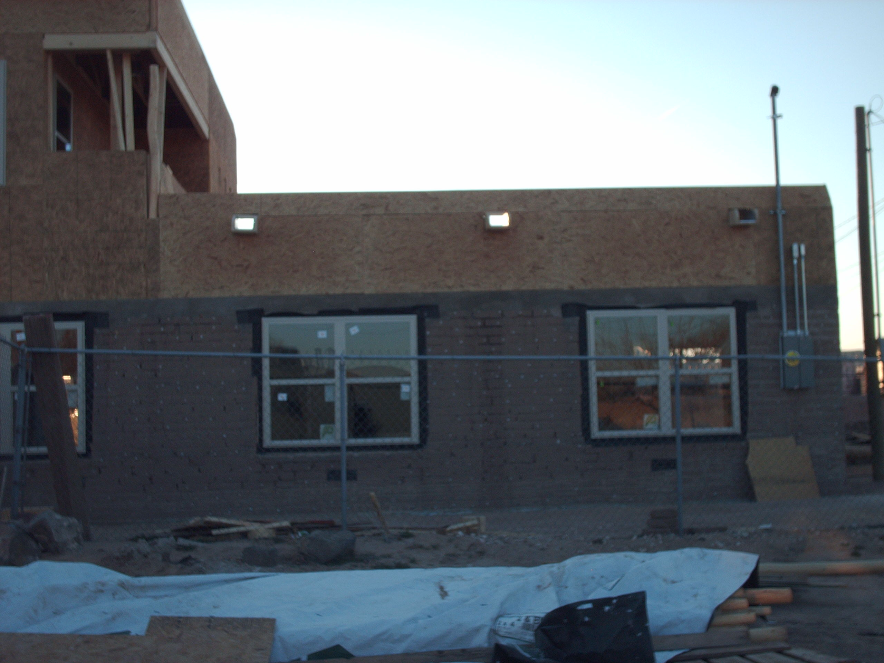
The Mortgage Process in Indian
Country
Tribal approval required BIA approval required
Land Assignment
Residential Lease
Leasehold
Mortgage
$

Slide 13
The Unique Status of Indian Trust Lands Impacts Lending
Title is held by U.S. government.
Lands not freely alienable
Can’t encumber without federal approval – 25 CFR 84
§ 84.003 What types of contracts and agreements require Secretarial approval under this part?
Unless otherwise provided in this part, contracts and agreements entered into by an Indian tribe that encumber tribal lands for a period of seven or more years require Secretarial approval under this part.
Regulations at 25 CFR 162
Land records held at Bureau of Indian Affairs (BIA)
  Because U.S. is trustee of Indian Lands
  No concept of a state records office
  lenders/TDHEs/tribal members can’t easily file or access land records
Tribes in learning phase of organizing records
    Many tribal land holders are without a written record

Slide 14
Who’s Lending on Indian Trust Lands?
Available Home Loan Products in Indian Country
  HUD Section 184 Indian Loan Guaranteed Program
  VA Native American Direct Loan Program
  USDA Loan Program
  Native CDFIs
  Conventional Lenders (Fannie Mae & Freddie Mac Loan Products)
  Tribally Designated Housing Entities

Slide 15
Data – Indian Homeowners
574 federally recognized tribes
23 tribes in NM – 19 Pueblos, Navajo, 3 Apache tribes
Majority of our lands are held in trust by the U.S. government
51.6% of Native Americans are homeowners, compared to 70.5% of Anglo Americans. 2020 US Census
A large part of Native American homeowners are in a lease to purchase arrangement with their tribal housing departments/entities.
Native Americans having to leave their homelands to own a home is creating a brain drain on Indian reservations, and a loss of culture
Notes:
4th bullet – US Census

Slide 16
Building the Legal Infrastructure
Mortgage laws
MOU/MOA
  with each federal lending/guarantor agency – USDA, VA, HUD, FNMA, Freddie Mac
Residential Lease form
  approved by each lending/guarantor agency.

Slide 17
Lender Requirements
Lenders/fed agencies require the following before it will approve a loan on tribal trust lands:
  Tribal mortgage law or adoption of state mortgage laws
  Residential lease form
  Tribal Council resolution approving implementation of the federal agency’s Program or MOA with federal agency
  Certification from the Governor/Chairperson/President of the Tribe certifying that it has the necessary laws in place to implement the Program and that it will enforce those laws.
    Can be in MOA

Slide 18
Legal Infrastructure Required
STEP | DONE
Adoption of Mortgage Law | 
Tribal Council resolution: approving implementation of Section 184 Program; or MOU with federal agency (HUD, VA, USDA) | 
Certification from Tribal Governor/President/Chair (Sec. 184) | 
Approval of residential lease form | 

Slide 19
Mortgage Laws
  Leasing of tribal trust land (or other restricted or allotted lands)
  Mortgage of leasehold
  Priority of lien (Leasehold mortgage is 1st priority lien)
  Recording of leasehold mortgage
  Foreclosure
  Eviction
  Tribal Court jurisdiction (maybe federal court jurisdiction)

Slide 20
Tribal Mortgage Codes
Purpose – The mechanism to obtain a lease and mortgage the lease for a home loan.
Land assignment – Some tribal laws require a tribal member to obtain a land assignment in accordance with tribal laws.
Lease - The law allows a tribal member to obtain a lease on top of, in place of, or without a land assignment. Most codes require Tribal Council approval of the lease.
Mortgage - allows tribal member to mortgage the lease to obtain a home loan.
  Some tribes limit mortgaging only for home loan purposes, i.e., can’t obtain equity loan or business loan.

Slide 21
Cont. – Tribal Mortgage Codes
First Priority - gives the mortgage first priority over any other liens that might exist on the leasehold.
Recording - The law provides for recording of the lease and mortgage.
  At BIA
  At tribal level
  At county recorders office, if requested by lender
Foreclosure & Eviction - allows the lender to foreclose on the home upon default and evict borrower.

Slide 22
Unique Components of Tribal Mortgage Codes
  Jurisdiction - Gives Tribal Courts exclusive jurisdiction over all foreclosure actions on tribal lands. Post April 2016, HUD requiring concurrent federal jurisdiction.
  Land assignments – (Not required but may include) Sets forth the tribal laws under which a tribal member can obtain a land assignment.
  Exempt lands - Some tribes prohibit the obtaining of a lease on certain sites.
  Pre-foreclosure notices – Requires notice to Tribe and TDHE prior to foreclosure.
      Allows Tribe or TDHE to work with the borrower regarding the default
  Limited waiver of sovereign immunity – Applies if Tribe assumes loan and does not carry out the obligations of the loan – to pay the monthly payments.

Slide 23
Memorandum of Understanding (MOU)
  Tribal Council Resolution approving MOU
  MOU memorializes support of lending by Tribe
    Mortgage Laws exist & tribe will enforce
    Tribe will allow access to Lenders (to service properties)
    Tribe will use approved Residential Lease
    Tribe won’t terminate lease without Lender’s consent if a mortgage exists
    Tribe will assist with recording leases and mortgages
    Tribe will assist in finding qualified borrower in event of default
    Tribe will support enforcement of foreclosure and evictions in event of default

Slide 24
The Residential Lease
  A possessory interest in the land
  Differs from land assignment – has specific terms & conditions
  BIA regulations at 25 CFR Part 162 govern leases on tribal trust lands
  All federal agencies who lend (VA, HUD, USDA) must approve lease form
  Governed by applicable federal & tribal law
  Should allow for assignment of the lease by lessee (the borrower) before foreclosure.
  Should allow for subleasing and assignment without further tribal and BIA approval

Slide 25
RESIDENTIAL LEASE
One-stop Lease
  At HUD Section 184 website
    www.hud.gov/section184-leasing
    DON’T REINVENT THE WHEEL

Slide 26
Making a Residential Lease more Efficient
  All federal agencies who lend (VA, HUD, USDA) approve lease form
  Delegate lease approval to a department
  Allow for assignment of the lease by lessee (the borrower) before foreclosure
  Allow for subleasing and assignment without further tribal and BIA approval

Slide 27
What happens if Borrower defaults?
Bank notifies borrower, TDHE (sometimes) and Tribe
Tribe (or TDHE) may assume loan (called right of 1st refusal)
Another eligible tribal borrower may assume
Lender & Tribe may work with borrower
Guaranteed loan - Bank may assign the mortgage to federal agency
NO CURE = Foreclosure

Slide 28
Borrower Default
  Borrower may agree to have another borrower take over the loan and agree to assign the lease to the new borrower; or
  The Tribe or TDHE may take over the loan and find another borrower to purchase the home; or
  Lender will foreclose on the home and sell the home to another tribal member.
New borrower
Borrower
Tribe or TDHE
New borrower
HUD

Slide 29
What happens if Fed Agency gets the Home?
Fed agency will be required to find another tribal member to purchase the home
The home may be subleased for up to one year at a time until a borrower is found.
Or the Tribe or TDHE may sublease or purchase the home.
New TM
HUD
Sublease to TM
Purchase by Tribe/TDHE

Slide 30
WILL TRIBE LOSE THE LAND IF BORROWER DEFAULTS?
No, the Tribe never risks losing the land. The land never leaves its trust status
A tribal member who defaults on a loan risks losing his/her residential lease.

Slide 31
Creating a Mortgage Lending Environment
Build partnerships with Lenders
Coordinate the leasing/mortgage process
  Between Tribal Departments
  TDHE & Realty Office
  With Lending Partners
  with BIA
      Lease approval, TSRs, Recording
      Access TAAMS
Adopt US property concepts
  Make lands freely alienable between tribal members
  Record land conveyances- First to record has best title
  Probate land holdings

Slide 32
A Need to Collaborate
Tribe/TDHE needs to collaborate on the following:
  Where will tribal members go if they are interested in a home mortgage or to find a lender.
  Who will coordinate the process between a prospective lender and prospective borrower.
  Who will coordinate/provide homebuyer education.
  Who will coordinate the survey process
  Who will do the environmental review
  Who will obtain title status reports from BIA
  Who will prepare the residential lease and coordinate the approvals of the lease and mortgage from the tribe and BIA.
  Who will coordinate the infrastructure (utilities, sanitation, water)
  Will there be down payment assistance? Where will it come from?
    IHBG
    ICDBG
    Other
  Who will submit lease to BIA and the Tribal Recording Office for recording.

Slide 33
Tribal Trust Land Homeownership Act of 2025
Signed into law – May 2026
Reduces BIA delays:
  Residential leasehold mortgages
    10 days to verify that all documents are included
    2 days from review to notify lender of missing documents
    20 days from receipt of all completed documents - for BIA to approve or disapprove
  Certified TSRs
    10 days from approval of leasehold mortgage to provide CTSR
    14 days from request to provide CTSR
  Access to TAAMS – Tribes & fed agencies get access (read-only) to TAAMS.

Slide 34
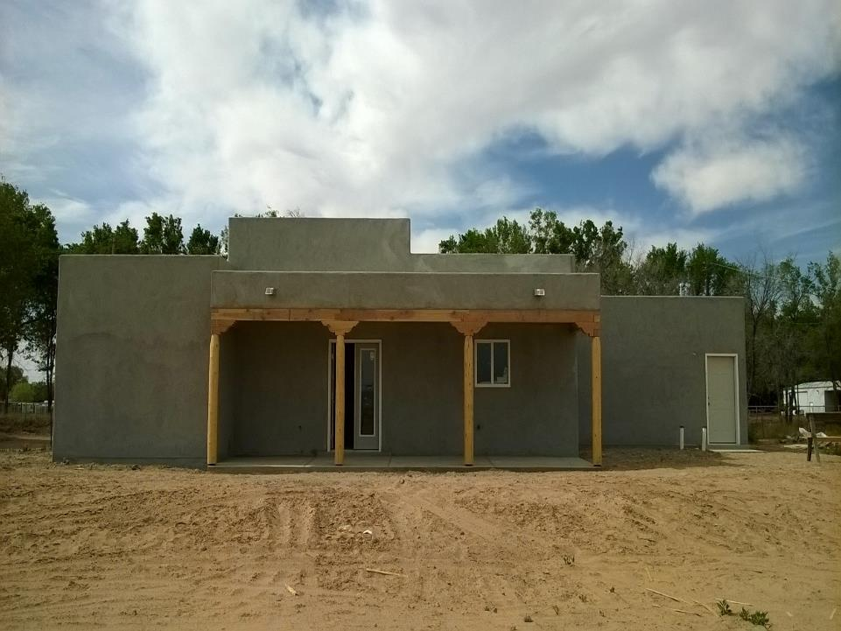
How well a tribe coordinates the lending process determines the success of mortgage lending within a tribe.

Slide 36
BEST PRACTICES – TRIBAL MORTGAGING
1. PUEBLO DE SAN ILDEFONSO & SAN ILDEFONSO HOUSING AUTHORITY
  Tribe amended mortgage law to give leasing approval authority to TDHE
  TDHE approves residential leases to tribal members
    No need for TC resolution for each lease
2. Tribe – master lease to TDHE. Lease allows for subleasing without
further tribal or BIA approval.
  TDHE subleases to tribal members without further tribal or BIA approval
3. Partnership with FNMA approved lender to sell homes to tribal members

Slide 37
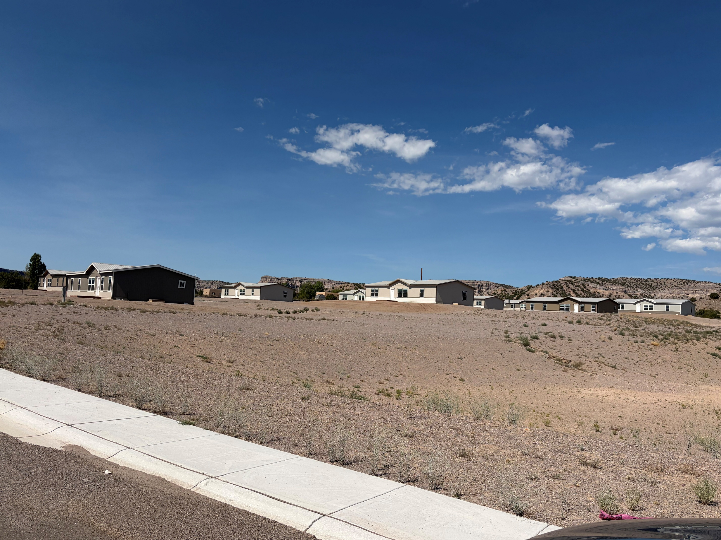

Slide 38
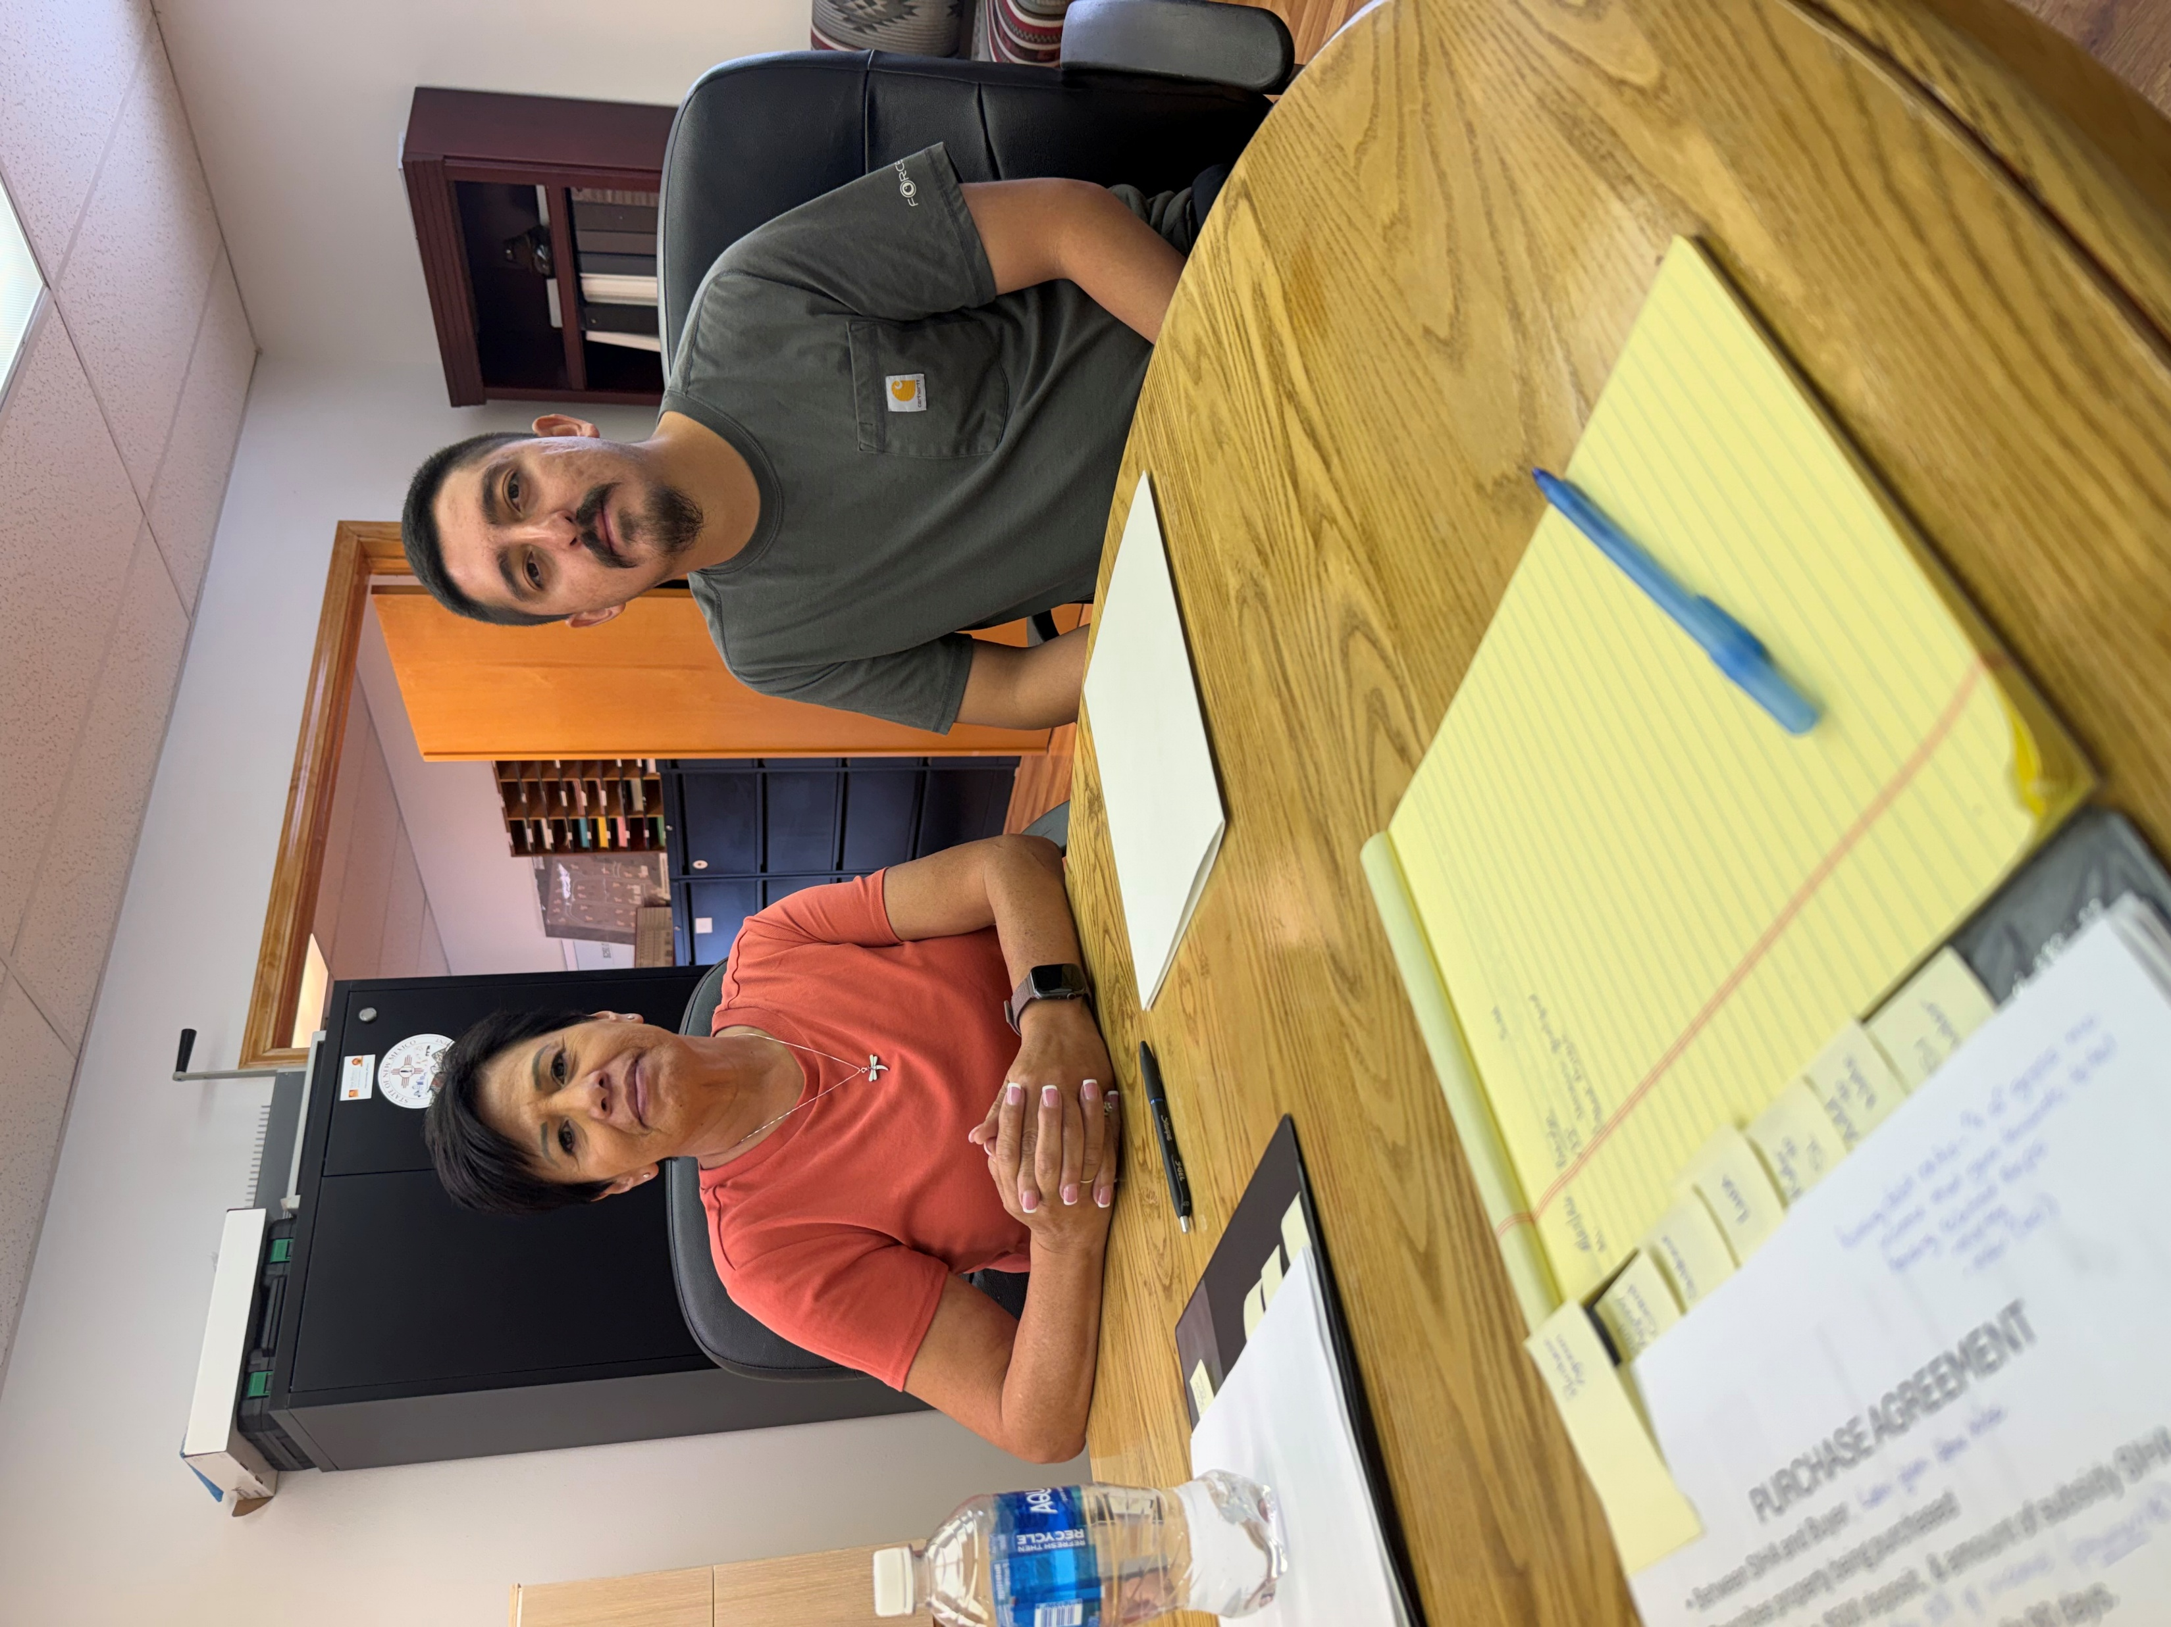

Slide 39
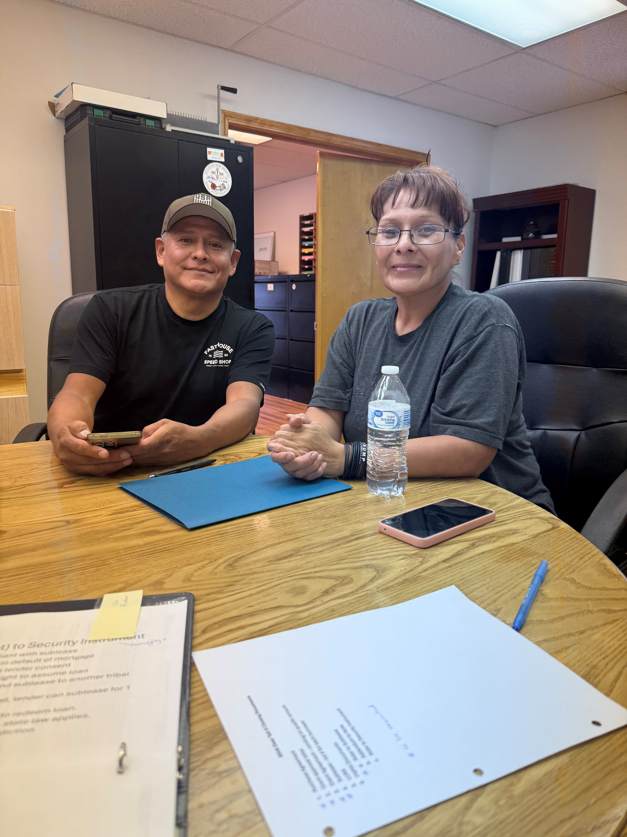
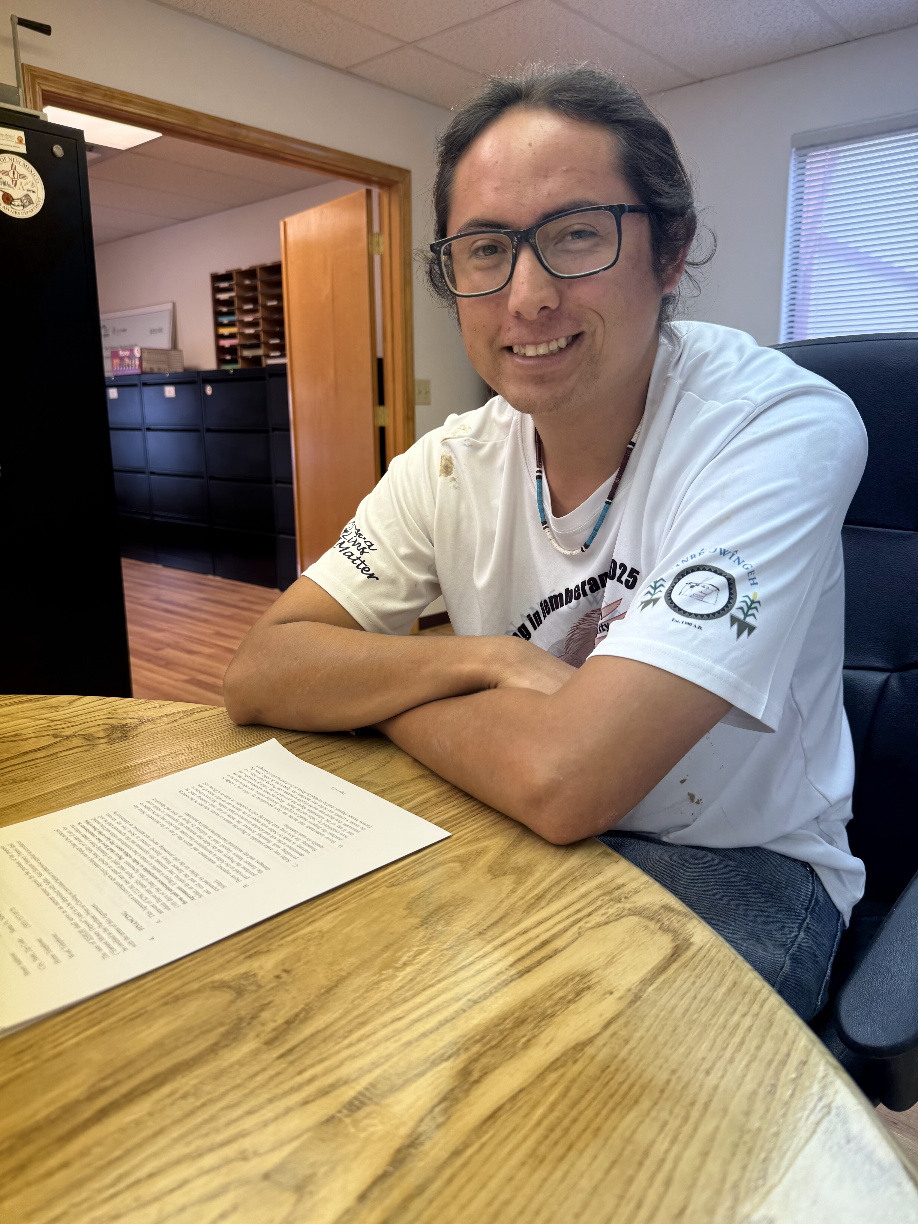

Slide 40
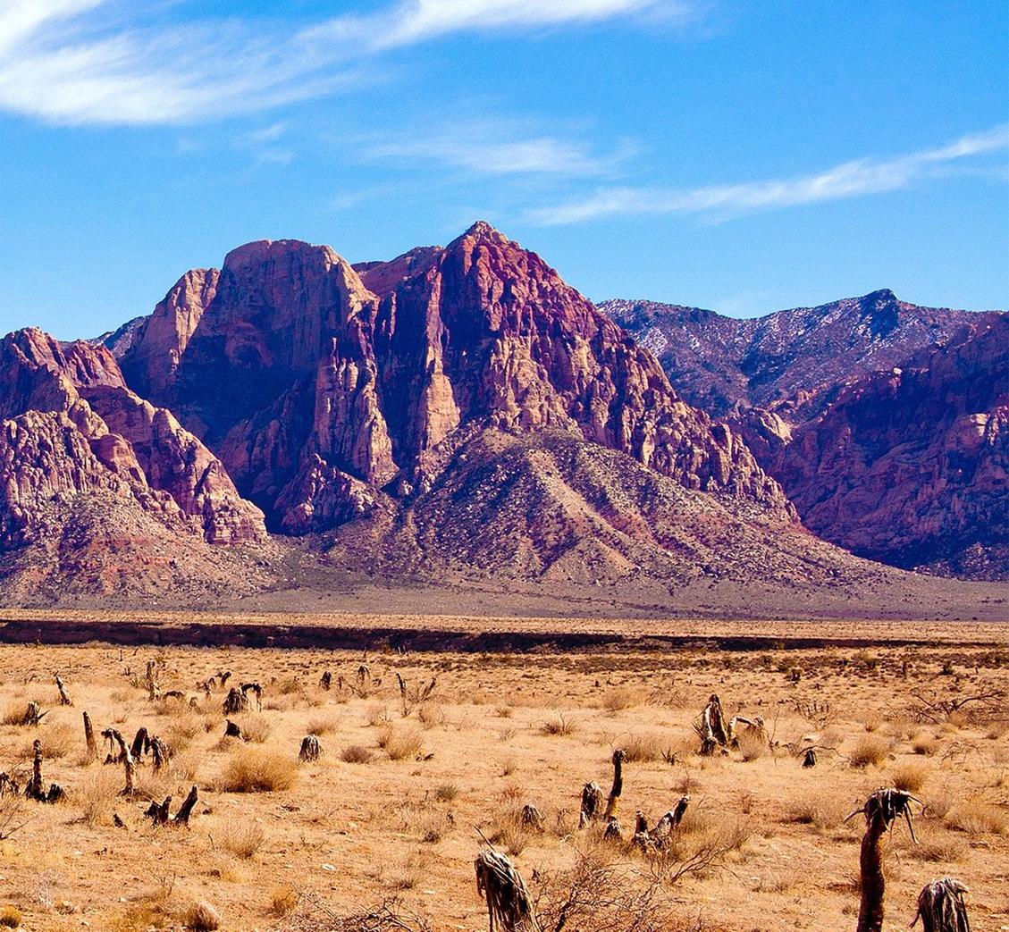
Is HEARTH a Solution to Faster Loan Closings?
Let’s talk about
HEARTH

Slide 41
HEARTH
Helping Expedite & Advance Responsible Tribal Homeownership Act of 2012 – 25 USC 415
Amended federal Long Term Leasing Act of 1955 to allow tribes to lease lands without BIA approval
Adopted July 17, 2012
Extended lease term from 50 years to 75 for residential leasing

Slide 42
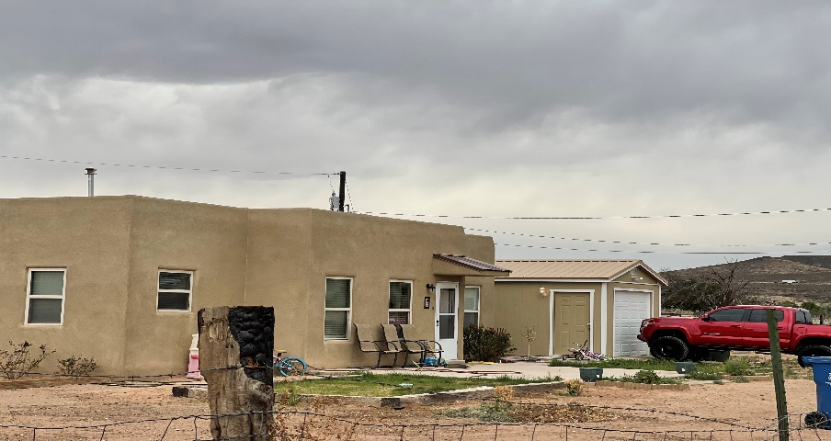
STATEMENT OF GOVERNOR QUETAWKI
PUEBLO OF ZUNI
HEARTH Congressional Hearing
HEARTH recognizes the sovereign right of Indian tribes to make their own laws and be governed by them. These are our lands. We should be able to say who can live and do business on them.

Slide 43
What Does HEARTH Do?
Tribes that want to, can now:
Draft tribal leasing laws for the leasing of tribal trust lands
For any of the following purposes:
  Business
  Agricultural
  Public, Religious, Education, Recreational Uses
  Wind and Solar (WSR)
  Wind Energy Evaluation (WEEL)
  Residential
Effect: No longer have to take leases to BIA for approval.
Removal of time delays

Slide 44
Synopsis
Indian tribe – must be a federally recognized Indian tribe.
Act doesn’t apply to allotted lands (lands held in trust for individual Indians).
BIA must approve tribal leasing laws.
Business or agricultural leases – can’t exceed 25 years, but may include an option to renew for up to 2 additional terms of no more than 25 years each.
Public, educational, recreational, and residential leases – can’t exceed 75 years.

Slide 45
Does the Law Require anything else?
Yes. Tribe must provide following documents to the BIA:
  Copies of all leases and amendments to BIA for recording.
  Copies of all encumbrances (mortgages) for recording.
  Evidence of lease payments.

Slide 46
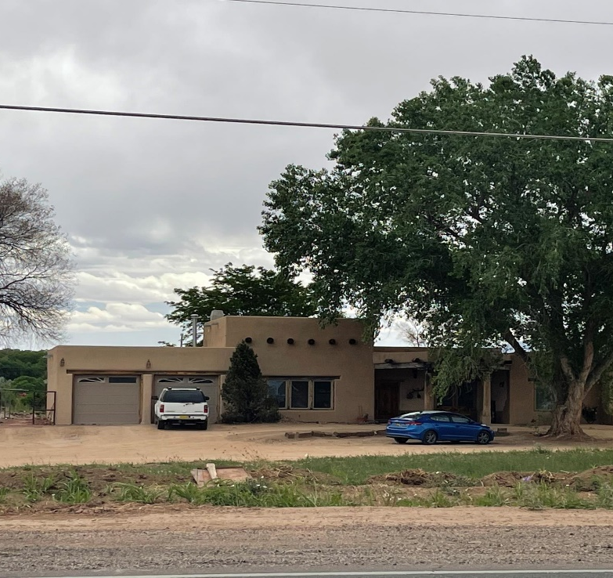
Will BIA Still Approve Mortgages?
Answer: No, if tribal leasing law doesn’t require BIA approval.
NO, if Lease states that BIA approval not required.
Note: BIA regulations give BIA 20 days to approve or disapprove mortgages. 25 CFR 162.359

Slide 47
Tribes with Leasing Laws under
HEARTH
As of April 29, 2026
  BIA approved 118 Tribal Leasing laws
  49 (apprx) Tribes have residential leasing laws
  NM – 6 out of 23 tribes have leasing laws
574 Federally Recognized Tribes
  As of April 29, 2026

Slide 48
What will BIA look at in approving a Tribal Leasing Law?
Tribal Leasing Law must be consistent with BIA leasing regulations.
  Advantage is that we know what BIA regulations look like, and we can use them as a model.
  Many tribes have adopted leasing laws (98)
Tribal Leasing Law must provide for Environmental Review (ER) process that mirrors federal requirements –
  Identifies and evaluates significant effects on the environment
  Allows for public comments
  Tribe provides responses to public comments
  But tribes can continue using ER process for federally funded projects

Slide 49
BIA Approval of Tribal Leasing Law
BIA has 120 days (4 months) to approve or disapprove tribal leasing law.
  But BIA may extend timeline
  If disapprove, BIA has to give written notice of basis for disapproval
Your law is effective the date of BIA approval.
  BIA’s approval will publish in the federal register

Slide 50
What is BIA’s Role With Respect to HEARTH Leases?
Recording:
  Tribe submits leases, mortgages to BIA for recording
Lease Enforcement
  Upon tribal request, Secretary may enforce lease or cancel a lease.
Tribal Compliance with its leasing law
  After exhausting tribal remedies, a Lessee may petition the Secretary to review a tribe’s compliance with its leasing law.

Slide 51
Can I Still Submit a Lease under 25 CFR Part 162?
YES
  A HEARTH tribe may submit a specific lease to BIA for approval if it thinks the lease would be better supported under 25 CFR Part 162.

Slide 52
Challenges
Expensive to implement. Need staff, training, TA
No federal funding to implement
Some TDHEs no longer want to be the one stop shop
People matter – the importance of go getters

Slide 53
Weigh the Benefits Against the Costs
ADVANTAGES | COSTS
Faster loan closing – No BIA approval of lease & mortgage | No funding made available to help tribes implement tribal leasing laws
Tribe takes initiative in lease preparation, surveys, ERs | If tribe not ready, leases will not get done. May not have staff capacity and resources. Ex. Who will do ERs?
Do not have to wait for BIA availability to do surveys, ERs, approval | May not have staff to perform services
 | Coordination required within tribal depts – Housing, Realty, Governor, Tribal Council. This may be difficult to accomplish

Slide 54
Is My Tribe Ready?
Questions to ask:
  1. How long does it currently take BIA to approve leases?
  2. What will be the administrative and financial burden on the tribe?
    Leasing officer, costs of staff
  3. Do we have capable people to process, approve and record leases? Look at Realty Offices, Land Offices, TDHE, other depts within tribe.
Start talking to the Tribe – Governor, Tribal Council, Realty or Land Dept. personnel. Are they willing to take on the responsibility of approving leases?
  Will it be done timely?

Slide 55
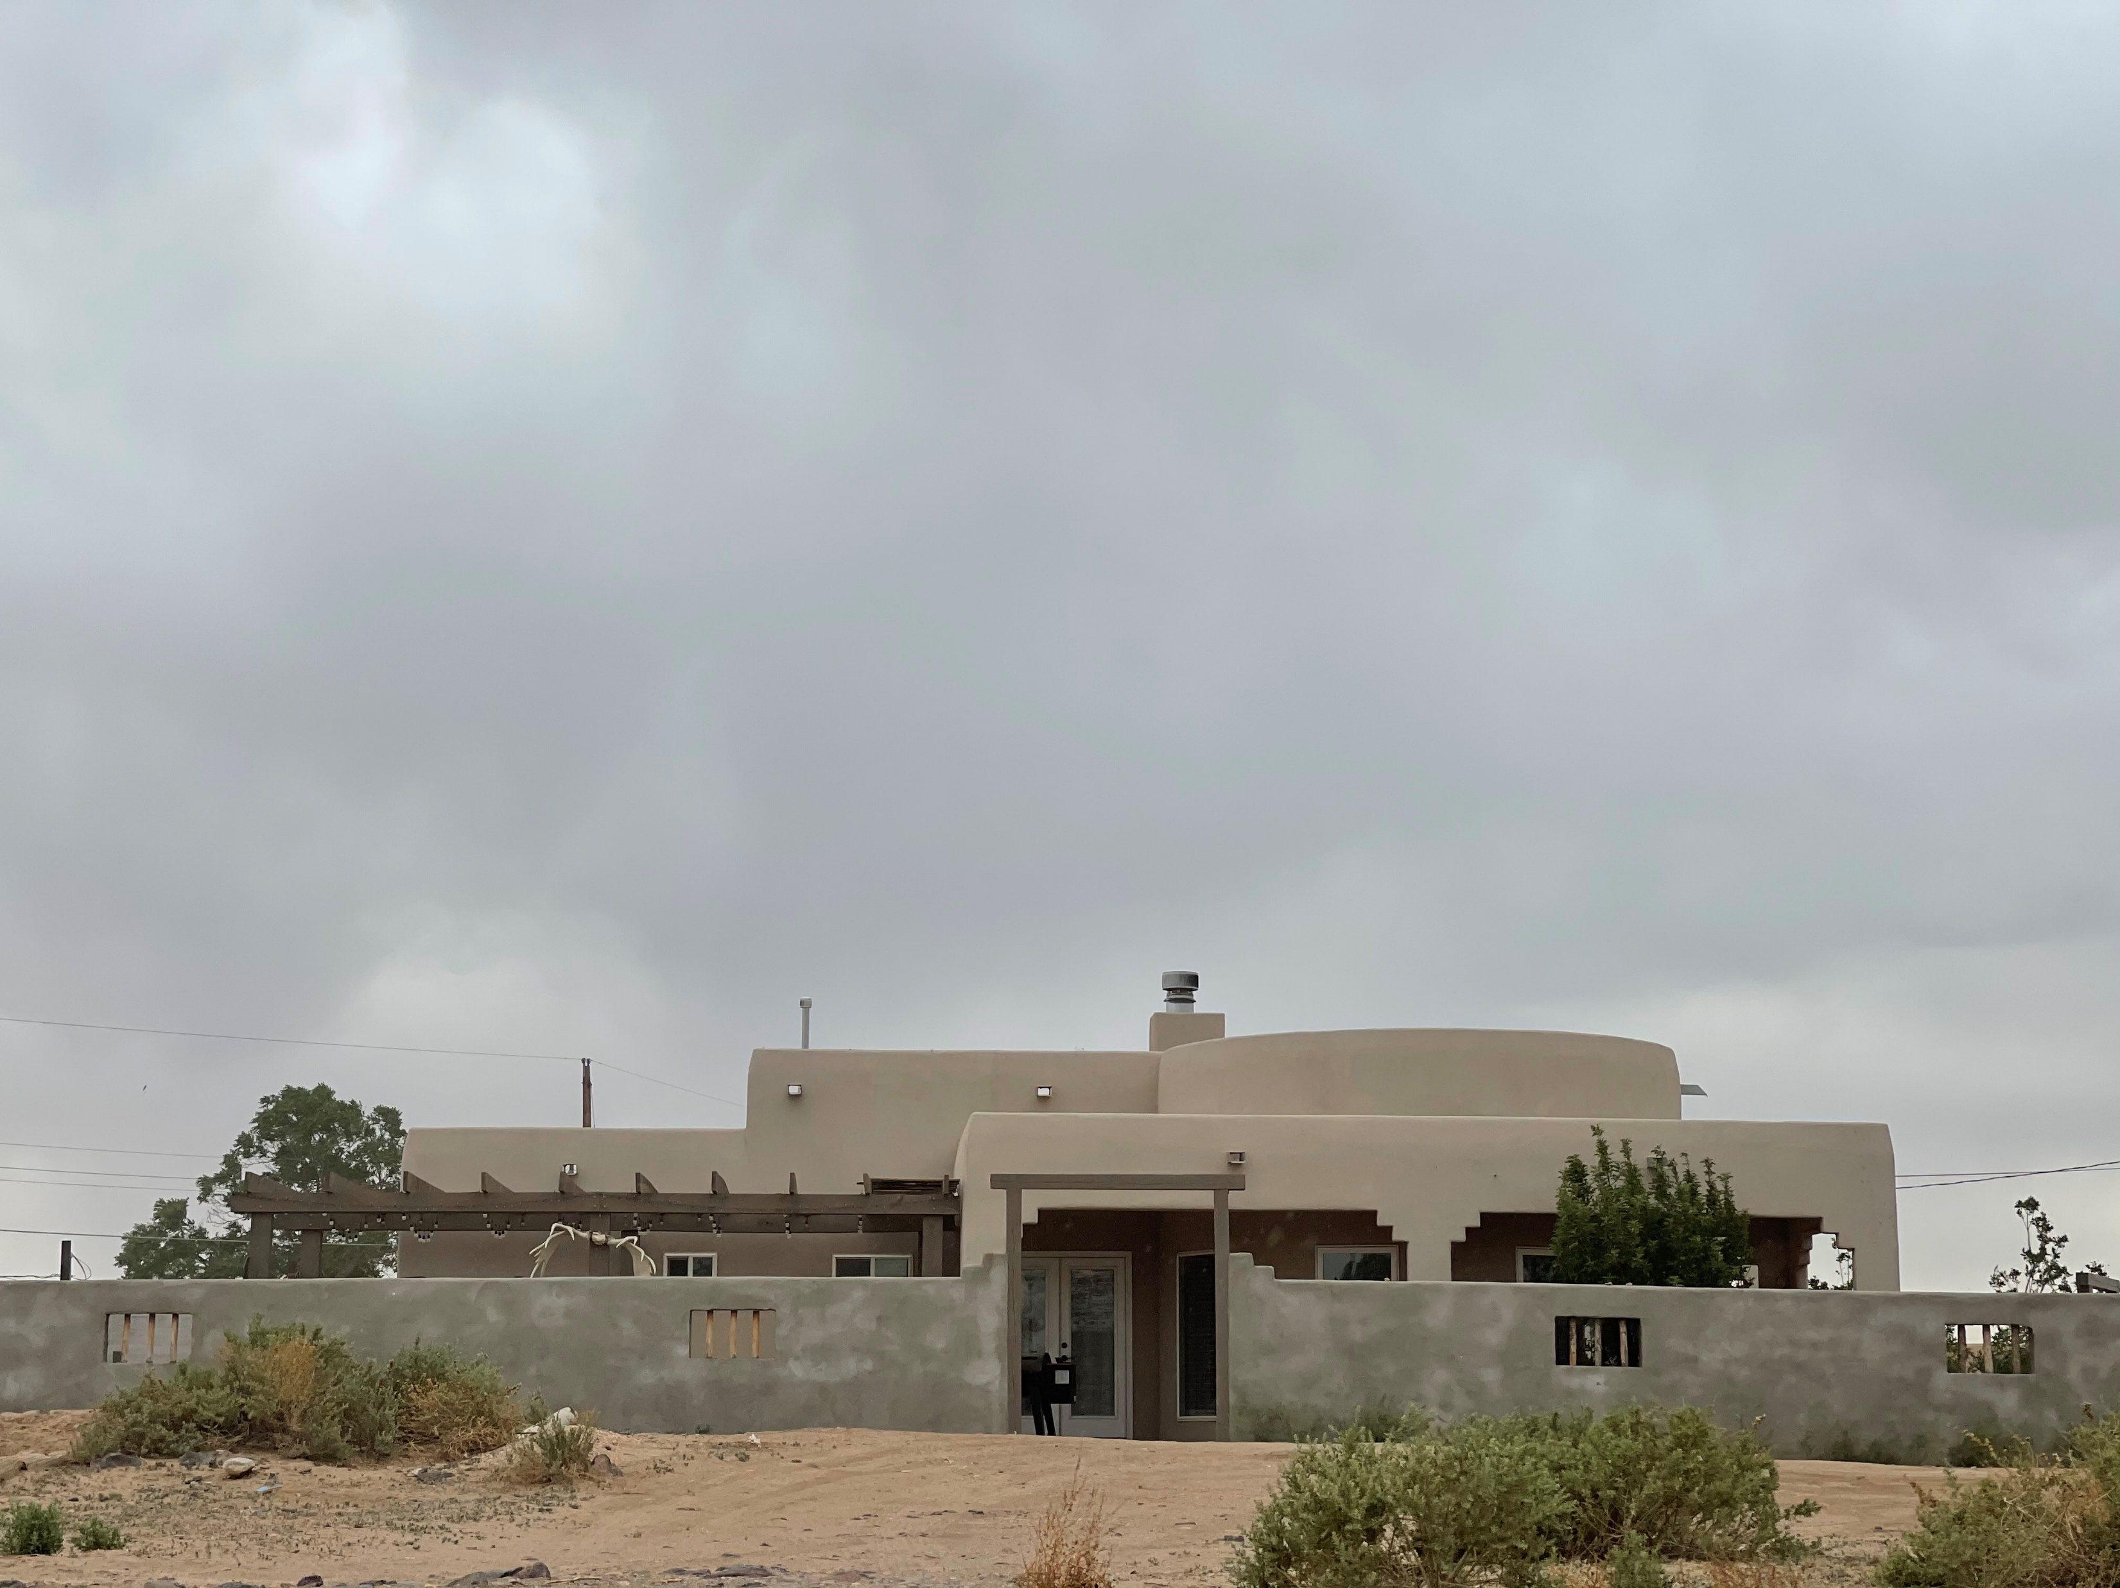
We’re Ready! Where do we Start?
1. Develop Processes – how will the leasing process work? Form a Working Committee
    What department/staff will prepare the lease?
    Who will do the ERs?
    Who will do the Surveys?
    Will we have a reviewer?
    Who will take lease to Tribal Council?
    Where will it get recorded internally?

Slide 56
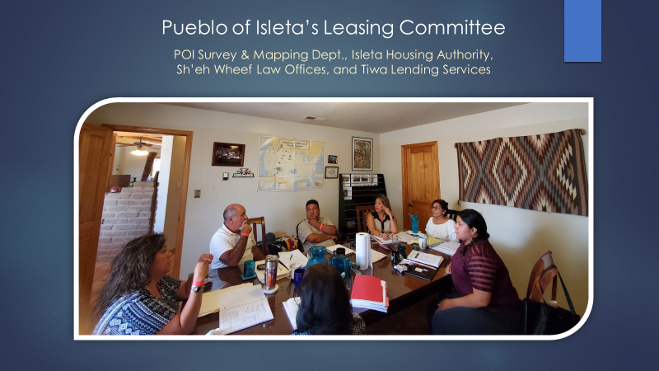
Why HEARTH: Working Group – November 2019

Slide 57
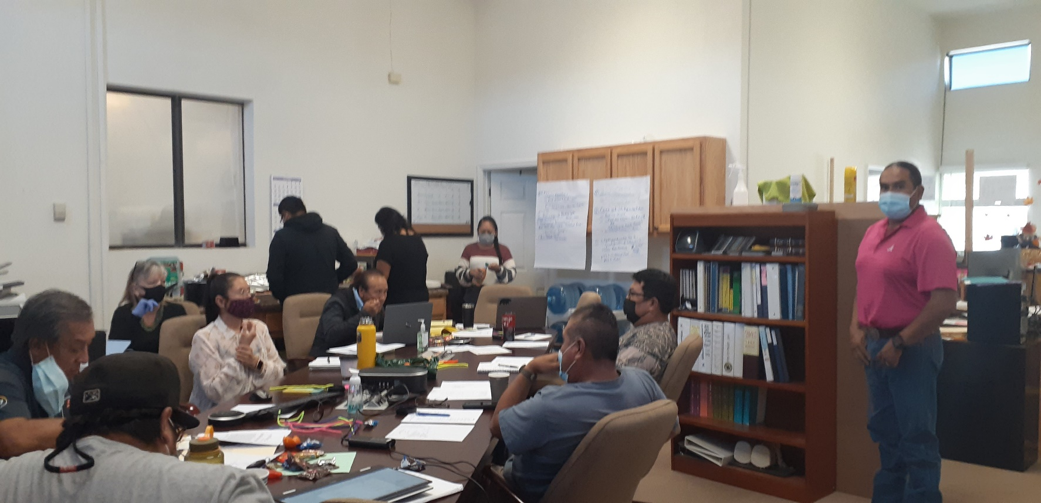
Work Session: Pueblo of Jemez HEARTH
Leasing Law and Lease Review
October 2021

Slide 58
What Should my Tribes Residential Leasing Law Look Like?
Things to Consider:
  Must meet Part 25 CFR Part 162.
  BIA & HUD HEARTH lease
The HEARTH law and BIA approved tribal leasing laws can be found at:
  https://www.bia.gov/service/hearth-leasing

Slide 59
Developing your Leasing Law
1. Don’t re-invent the wheel
2. Look at a minimum of 2 laws
    BIA website has copies
    Ask other tribes for copy of their law
3. Make it reader-friendly
4. Form working group
    TDHE, Realty, Native CDFI in your community, Attorney

Slide 60
Tips
Remember, the goal is to make leasing & mortgaging more efficient and effective
  Don’t add burdensome tribal processes that create delays:
    EX: Provision which requires Lessee to obtain Tribal approval of assignments and subleases.
    EX: Tribal site approval process
    EX: Allow leasing officer to make corrective amendments

Slide 61
HEARTH – BEST PRACTICES
Pueblo of Isleta - working committee made up of Native CDFI and Tribal Office to implement HEARTH
Native CDFI & Tribal Surveying Office | Native CDFI | Tribal Surveying Office
Created HEARTH residential lease & checklist | Prepares lease, assists tribal member w tribal site development process | Prepares survey
Created process for lease approval, recording at tribal level, & submittal to BIA | Prepares ER | Takes lease to Tribal Council for approval, records at Surveying Office, to BIA for recording
Coordinates leasing & mortgaging process | Requests TSR
Meets informally to address unique situations | Closes on loan, submits to Tribal Surveying for recording at Tribe and BIA | Records mortgage & submits to BIA for recording.

Slide 62
BIA National Policies
Title Status Reports (TSRs):
A request for a certified TSR has to go to the BIA Agency. BIA has 15 days to provide a TSR to a lender or tribe requesting one.
LTRO can’t email TSRs due to privacy issues. They can however fax them. BIA reviewing the use of encrypted documents to be able to email in the future.

Slide 63
Cont. BIA National Policies
Leases approved prior to Tribal Leasing Law:
BIA approval of mortgage required if the mortgage is on a lease approved by BIA prior to the adoption of a tribe’s leasing law.
Any action on a BIA-approved lease (i.e., amendment, assignment, sublease, mortgage) requires BIA approval, even if the tribe is a HEARTH tribe. The other option would be to cancel the BIA lease and approve a new lease under HEARTH.

Slide 64
Need More Information?
HEARTH and BIA approved leasing codes can be found at:
  https://www.bia.gov/service/hearth-leasing

Slide 65
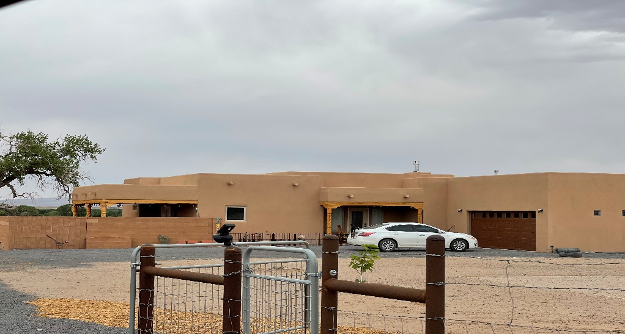
STATEMENT OF GOVERNOR EDWARD PAUL TORRES,
PUEBLO OF ISLETA
HEARTH Congressional Hearings
HEARTH recognizes the sovereign right of tribes to enact their own residential and business laws. We know best what should occur on our lands.

Slide 66
Does My Tribe Have to Record Land Transactions?
No
But you should
Why should tribes record their land transactions if BIA is recording them?
  Efficiency
  Internal records
  Lender might not have sent a satisfaction of mortgage to BIA for recording

Slide 67
Creating a Lending Environment –
Should I Record my Land Transactions?
Tribes should record their land transactions
  Land Assignments
  Leases
  Mortgages
  Other – permits, easements, rights of way

Slide 68
Benefits to Having a Tribal Recording Policy
Preservation of land records
Provides for the orderly transfer of and recording of land interests
Everyone knows where the land records are
Everyone knows what constitutes a valid conveyance of a land interest
A place to record judicial decisions and other tribal decisions regarding land

Slide 69
What Should my Recording Policies Look Like
SAMPLE RECORDING PROCEDURES FOR RECORDING OFFICER
(Who Records? What gets recorded?)
1. The Tribal Recording Office shall be maintained in the XXX Realty Dept.
2. The Tribal Recording Office shall be responsible for the recording of all land assignments, land leases, mortgages and other land transactions.

Slide 70
Recording Policies, Cont.
XXX TRIBE
TRIBAL RECORDING OFFICE
RECORDING LOG
File # | Date Recorded | Time Recorded | Document Type | Lessor Grantor Mortgagee | Lessee Grantee Mortgagor | Recorder Personnel
Document Type: AS = Land Assignment
DE = Deed
LE = Lease
MO = Mortgage
OT = Other

Slide 71
Sovereignty Means
Making tribal trust lands more easily accessible to tribal members:
  Using our powers of eminent domain to obtain road & utility easements and to establish land abandonment.
  Set aside land for housing
Making land freely transferable among tribal members
Removing burdensome administrative processes to land interest ownership and housing development
Real Property laws/policies:
A Land Records Office
Clear & concise Residential lease process
Everyone knows what office to go to.
Build capacity within the Tribe
Address unprobated lands

Slide 72
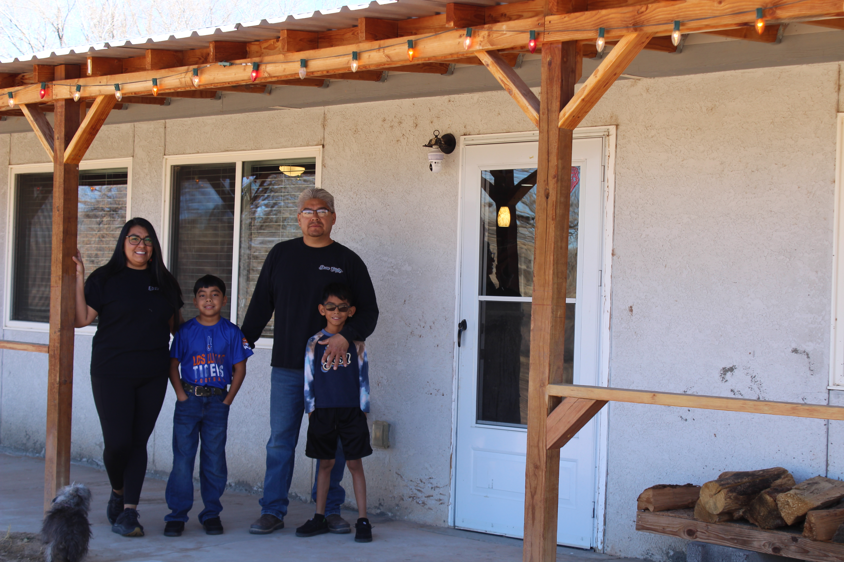
Let’s bring our tribal members home!

Slide 73
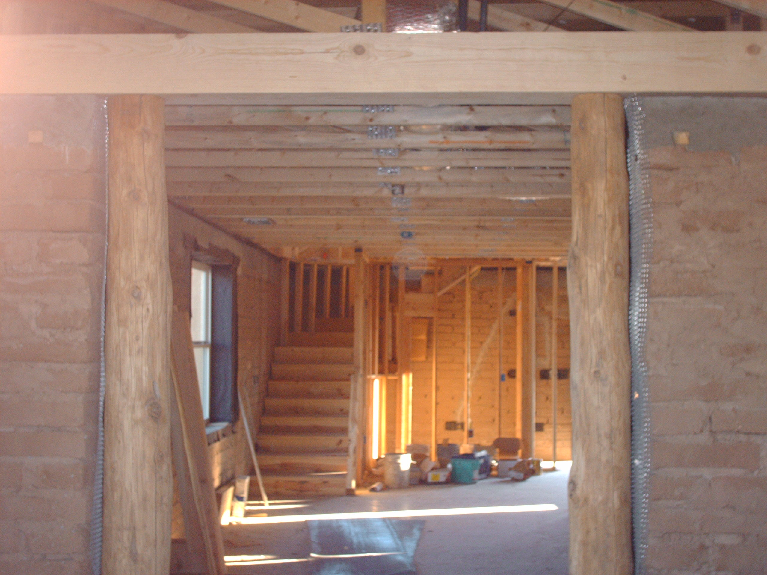
Contact Info: Denise Zuni, Sh’eh Wheef Law Offices, P.C.
dzuni@live.com

