Slide 1

HUD’S NATIONAL
TRIBAL HOUSING SUMMIT
September 1-3, 2026
Doubletree by Hilton Hotel
Washington DC - Crystal City in Arlington, Virginia
Rooted in Tradition:
Rising in Resilience

Slide 2
The Turtle Mountain Housing Authority’s Tribal HUD-VASH program is a collaborative initiative between the U.S. Department of Housing and Urban Development (HUD) and the Department of Veterans Affairs (VA), specifically designed to support Native American Veterans who are homeless or at risk of homelessness.
TMHA
THUD VASH
CHALLENGES & SUCCESSES
September 1-3, 2026
Doubletree by Hilton Hotel Washington DC - Crystal City in Arlington, Virginia

Slide 3
TURTLE MOUNTAIN HOUSING AUTHORITY
Program Overview
Through a HUD grant, rental assistance and supportive housing services are provided to tribal veterans.
VA Case Manager delivers case management and clinical services directly (on-site and/or in the home) to the tribal veterans participating in the THUD program.
THUD VASH assists Native American Veterans living on or near reservations or other Indian areas.
Tribal HUD Veterans Administration Supportive Housing (VASH)
September 1-3, 2026
Doubletree by Hilton Hotel Washington DC - Crystal City in Arlington, Virginia

Slide 4
Doubletree by Hilton Hotel Washington DC - Crystal City in Arlington, Virginia
September 1-3, 2026
Key Features
Launched in 2015 with $5.9 million in funding.
Initially awarded to 26 tribes and TDHEs across the U.S.
Allowed use of Indian Housing Block Grant (IHBG) units and other tribal housing resources.
VA adapted its service delivery model to reach Veterans in remote or rural tribal lands.

Slide 5

The Tribal HUD-VASH Pilot Program was the initial launch of a groundbreaking federal initiative aimed at addressing homelessness among Native American Veterans. It was a collaborative effort between the U.S. Department of Housing and Urban Development (HUD) and the Department of Veterans Affairs (VA), tailored specifically for tribal communities.
Purpose of the Pilot
Test the feasibility of combining HUD rental assistance with VA case management in tribal areas, where traditional HUD-VASH programs were not reaching.
Provide permanent supportive housing to Native American Veterans who were homeless or at risk of homelessness.
Empower tribes and Tribally Designated Housing Entities (TDHEs) to administer housing assistance directly.
September 1-3, 2026
Doubletree by Hilton Hotel Washington DC - Crystal City in Arlington, Virginia

Slide 6
Goals of TMHA VASH
Reduce homelessness among Turtle Mountain tribally enrolled Veterans.
Offer stable housing and access to health and social services to our tribal veterans.
Strengthen TMHA’s capacity to serve its veteran population.
September 1-3, 2026
Doubletree by Hilton Hotel Washington DC - Crystal City in Arlington, Virginia

Slide 7
Doubletree by Hilton Hotel Washington DC - Crystal City in Arlington, Virginia
September 1-3, 2026
Funding & Support
HUD awards annual renewal grants, subject to federal appropriations.
Guidance and training are available to help tribes administer the program effectively

Slide 8
Ongoing Use of VASH Vouchers
The Turtle Mountain tribal community has relied on VASH rental assistance vouchers since 2015. Local tribally-enrolled veterans have used these vouchers to secure scarce rental units in in TMHA’s service area of Rolette County, ND, where market vacancies are limited and competition for low-income housing is high.
TMHA received expansion grant for additional vouchers in 2026.
September 1-3, 2026
Doubletree by Hilton Hotel Washington DC - Crystal City in Arlington, Virginia

Slide 9
What VASH means to the Turtle Mountain community
TMHA’s VASH pilot project did more than prove a concept — it clarified how the Turtle Mountain Band of Chippewa Indians can work in true partnership with HUD and the VA to serve its Native Veterans to ensure they receive services grounded in dignity and cultural respect.
September 1-3, 2026
Doubletree by Hilton Hotel Washington DC - Crystal City in Arlington, Virginia

Slide 10
Doubletree by Hilton Hotel Washington DC - Crystal City in Arlington, Virginia
September 1-3, 2026
Tribal HUD-VASH at Turtle Mountain
Under the Tribal HUD-VASH program, Turtle Mountain Band-Chippewa veterans experiencing or at risk of homelessness can combine HUD rental subsidies with VA case management.
North Dakota Senator Hoeven has championed legislation to make this set-aside permanent, ensuring at least 5 percent of HUD-VASH resources flow to tribal housing authorities like Turtle Mountain’s to sustain outreach and supportive services.

Slide 11
Senator John Hoeven
Major role in establishing and protecting the Tribal HUD‑VASH set‑aside for Native American veterans as one of the key federal champions who pushed HUD and VA to permanently authorize the program and ensure tribes— including Turtle Mountain — received dedicated vouchers.
Co‑author of the Tribal HUD‑VASH Act — Hoeven co‑introduced bipartisan legislation with Senators Tester, Udall, and Isakson to formally authorize Tribal HUD‑VASH and require that at least 5% of all HUD‑VASH funding be set aside for tribes.
Chairman of the Senate Indian Affairs Committee — In this role, he advanced the bill, publicly argued that Native veterans face disproportionate homelessness, and pushed for permanent authorization rather than temporary pilots.
What This Means in Practice
Tribal HUD‑VASH moved from a short‑term demonstration to a permanent, authorized program.
Tribes received a protected funding set‑aside, preventing competition with large urban housing authorities.
Turtle Mountain’s VASH pilot was positioned as a model for federal‑tribal partnership.
HUD’S NATIONAL
TRIBAL HOUSING SUMMIT
September 1-3, 2026

Slide 12
Eligibility
Only Indian tribes and Tribally Designated Housing Entities (TDHEs) are eligible to apply for funding under the Tribal HUD VASH program.
Applicants must provide tribal resolutions or certifications authorizing participation.
September 1-3, 2026
Doubletree by Hilton Hotel Washington DC - Crystal City in Arlington, Virginia

Slide 13
Doubletree by Hilton Hotel Washington DC - Crystal City in Arlington, Virginia
September 1-3, 2026
To Apply
To apply or learn more about the program, Tribal Veterans can contact the Turtle Mountain Housing Authority or the local VA homeless program coordinator at the VA in Fargo, ND.
Additionally, Veterans Service Officers at the VFW of Rolette County provide free assistance with benefits claims.
TMHA works closely with the Veteran organizations in the county to stay engaged and help secure additional units and support services.

Slide 14
Doubletree by Hilton Hotel Washington DC - Crystal City in Arlington, Virginia
September 1-3, 2026
Applicant: TURTLE MOUNTAIN HOUSING AUTHORITY
UEI: JHERGMQK8VV8
Project Description
The Turtle Mountain Housing Authority (TMHA) has been administering VASH vouchers for several years. Turtle Mountain Housing Authority is requesting an expansion of 10 vouchers under this In January 2015, when the U.S. Department of Housing and Urban Development (HUD) and the U.S. Department of Veterans Affairs (VA) announced a demonstration program to offer a permanent home and supportive services to Native American Veterans who are experiencing or at risk of experiencing homelessness, TMHA was invited to apply for the program. TMHA’s Tribal HUD-VA Supportive Housing program (THUD-VASH) has successfully provided rental assistance and supportive services to Turtle Mountain enrolled Native American veterans who were Homeless/At Risk of Homelessness in our reservation service area since 2016.
TMHA’s THUD-VASH program provides permanent supportive housing for eligible homeless Veterans who are single or eligible homeless Veterans with families who be able to complete activities of daily living and live independently in the community with case management and supportive services.
TMHA’s HUD-VASH program has an allocation of twenty (20) vouchers, in which TMHA would currently utilizes 14 to 18 of these vouchers annually. Consistently, TMHA has reported that a major obstacle in implementing the program was, in part, because there is a lack of affordable rental housing in TMHA’s service area of Rolette County. Further, there is a limited number of private landlords. Coupled with the issues of a lack of affordable housing and private landlords, there is also an unwillingness for the tribal veterans to move to other or non-Native communities to access housing. To address these issues, TMHA is in process of completing a new construction project that will provide rental housing for Veteran’s in the reservation community. Deemed the “Veteran’s Village”, the project will consist of twenty (20) one- and two-bedroom units. Vets Village is in the final stages of construction and will be non-1937 Housing Act multifamily rental property, owned and managed by a TMHA partnership as a low-income housing tax credit project.
The long-range plan is that eventually all the units in Vets Village will be designated as a VASH project with project-based vouchers. The intention is that this project be available for Veteran housing well into the future and allow for TMHA to utilize the VASH program to the fullest extent. With the development of the veteran’s village, there is a need for more vouchers to assist with rental subsidy of the units. Currently there are twelve (12) veterans on TMHA’s wait list for renting a unit at Vets Village. With marketing, TMHA is anticipating all 20 units occupied within the first 6 months. This will potentially obligate all the VASH vouchers that the TMHA currently administers, as well as the ten (10) that TMHA anticipates receiving through this application.

Slide 15
Doubletree by Hilton Hotel Washington DC - Crystal City in Arlington, Virginia
September 1-3, 2026
TMHA will provide an office within the Vets Village building to ensure that the participants will have easy access to the program manager for case management and assistance. The Vets Village will also provide office space to veteran organizations, such as the local VFW, VFW Auxiliary, and the American Legion, and will have two telemedicine cubicles for the participants use. A key component of TMHA’s Tribal HUD-VASH is the close collaboration between TMHA and the VA staff assigned to the Turtle Mountain area to provide supportive services to Tribal veterans to obtain and sustain permanent housing and engage in needed treatment and other supportive services that improve Veterans’ quality of life and end their homelessness. Case Management, including TMHA’s provision of housing services, is a requirement for participation in the VASH voucher program. The VA provides an outreach case manager to the Turtle Mountain area who works closely with TMHA staff to implement the program, as well as one-on-one with the Veterans that participate in the program. The case manager determines clinical eligibility for the program on a case-by-case basis. TMHA is responsible to determine if the Veteran participant meets HUD’s regulations for this program and determines eligibility based on income limits. An exception to TMHA providing housing services includes if the Veteran, or any member of the household, is required to maintain Lifetime Sexual Offender Registry status — then, that veteran or veteran family is not eligible to participate in the VASH program.
Veterans who are appropriate for this program must be VA health care eligible Veterans. VA eligibility makes this determination. Veterans must also meet the definition of homelessness defined in The McKinney Homeless Assistance Act as amended by S. 896 The Homeless Emergency Assistance and Rapid Transition to Housing (HEARTH) Act of Veterans who are appropriate candidates for this program demonstrate the most need or vulnerability and must need case management services in order to obtain and sustain independent community housing.
To apply for TMHA’s VASH program, veterans can contact TMHA or the VA case manager who works out of TMHA’s offices weekly.
Rent Determination
In accordance with TMHA’s policies and procedures and NAHASDA regulation, tenants will be charged no more than 30% of their adjusted gross income on rent was determined on multiple factors, the first being the gross rent limits established by the North Dakota Housing Finance Agency. Project rents were also determined by the area median incomes in the Belcourt ND. The project consists of 1- and 2-bedroom units that utilize the square footage allowance determined by North Dakota Housing Finance Agency limits. The rent determination is based on the bedroom size 2025 Fair Market Rent Documentation System for Rolette County. One-bedroom rent will be $778 per month. Two-bedroom units rent will be $1,021 per month.

Slide 16
Program Budget
VASH rental assistance $103,740.00 ` `
Administrative expenses $ 13.800.00
Total $117,540.00
TMHA is requesting through this application 10 additional vouchers to assist with the rental subsidy and case management of our newly constructed Veterans Village which will be opening in late September. The Veterans Village will consist of fifteen (15) one-bedroom and five (5) two-bedroom units.
The Administrative cost will cover TMHA’s program administration, including occupancy/maintenance staff and/or any finance expenses related to the program, such as bookkeeping, accounts payable, and auditing.
September 1-3, 2026
Doubletree by Hilton Hotel Washington DC - Crystal City in Arlington, Virginia

Slide 17
Doubletree by Hilton Hotel Washington DC - Crystal City in Arlington, Virginia
September 1-3, 2026
Foundations
What is the difference between “at risk of homelessness” and “homelessness”?
For purposes of Tribal HUD–VASH, HUD is adopting the definitions of ‘‘Homeless’’ in Section 103(a) of the McKinney-Vento Homeless Assistance Act (42 U.S.C. 11302(a)) and ‘‘At Risk of Homelessness’’ in Section 401(1) of the McKinney-Vento Homeless Assistance Act (42 U.S.C. 11360(1)). However, the income provision at 42 U.S.C. 11360(1)(A) does not apply to the Tribal HUD–VASH program. Instead, HUD is adopting the low-income eligibility requirements in Section 4(14) of the Native American Housing Assistance and Self-Determination Act of 1996 (NAHASDA). Accordingly, a veteran will be eligible for this program if he or she otherwise meets the definition of ‘‘Homeless’’ or ‘‘At Risk of Homelessness,’’ and is a low-income Indian, as defined in NAHASDA (i.e., has an income that is no more than 80 percent of area median income for the Indian area as determined by HUD)
2. What are eligible uses of the administrative fees?
You can only use the administrative fees to pay for administrative and planning expenses related to this program, which include, but are not limited to:
  eligibility determinations
  intake and briefings
  owner outreach efforts
  unit inspections
  rent negotiations
  annual and interim reexaminations
  tenant fraud investigations and hearings
  processing subsequent moves
  the costs associated with making rental assistance payments to owners
  complying with reporting requirements.
You can find more information under Section (VI)(M) “Administrative Fee and Reserve Accounts” at: Tribal HUD-VA Consolidation Notice.

Slide 18
Doubletree by Hilton Hotel Washington DC - Crystal City in Arlington, Virginia
September 1-3, 2026
3. Can you use administrative fees for rental assistance?
Yes. If, after you have paid all of your Tribal HUD-VASH administrative expenses, you can use the remaining amount to help pay for the rental assistance provided by the Tribal HUD-VASH program.
4. Tribal HUD-VASH grantees provided the number of bedrooms in each housing unit in their original application. Can you change the number later on?
Yes. You can change the number of bedrooms in a housing unit during the renewal process. Please make sure to include such a change in your renewal application.
5. Can I request a higher Fair Market Rent (FMR)? What is the approval process?
Yes. The Consolidation Notice states, “If a tribe/Tribally Designated Housing Entities (TDHE) deems it necessary to charge more than 110 percent of FMR (or to place a Veteran in a privately owned unit with a rent that exceeds 110 percent of FMR), it must obtain HUD’s prior approval to do so.”
Please submit your request to your assigned AONAP Grants Management Specialist. When you submit your request:
  You must deem it necessary to charge more than 110 percent.
  You must provide a justification on why more than 110 percent must be charged, such as:
    Rental market conditions. This may include limited availability of housing stock, local rental market conditions, unit operating costs, or other market conditions.
    To address a request for reasonable accommodation for a person with disabilities.

Slide 19
Doubletree by Hilton Hotel Washington DC - Crystal City in Arlington, Virginia
September 1-3, 2026
6. What types of housing can the Tribal HUD-VASH program support?
The Tribal HUD-VASH program is intended to provide rental assistance for Veterans, no matter the type of housing. As such, that can include permanent housing with a lease, such as single-family housing units and housing units in a multi-unit complex, as well as single room occupancy; congregate housing; a group home; shared housing; cooperative housing, and residential treatment housing.
Please note that you can only use the Tribal HUD-VASH grant to pay for rental assistance. If there are other costs associated with housing the Veteran (e.g., medical care in an assisted living facility), then these costs must be paid from other sources.
Please note additionally that you should consider whether the housing is covered by insurance, such as residential treatment housing, before determining to use Tribal HUD-VASH rental assistance.
7. How can Tribes and TDHEs apply for a Tribal HUD-VASH grant?
Contingent on appropriations, funding is available every year to existing grantees for renewal grants. Tribes and TDHEs that are not already Tribal HUD-VASH grantees cannot apply for renewal grant awards. Information on the renewal process, including example and template documents, are posted on the Tribal HUD-VASH website.
Funding is not regularly available for new grantees. If funding becomes available, HUD will publish a notice with details of how to apply. Subscribe to Codetalk for the latest updates.

Slide 20
Doubletree by Hilton Hotel Washington DC - Crystal City in Arlington, Virginia
September 1-3, 2026
Training
8. Are training and technical assistance available for the Tribal HUD-VASH program?
Yes. Both training and technical assistance are available. The Office of Native American
Programs hosts different training sessions throughout the year. You can find recordings of prior training sessions by visiting Tribal HUD-VASH and selecting the link “Training and Webcasts.”
Technical assistance is available upon request. Please complete the “Technical Assistance Request Form,” which you can find by visiting Training, and submit it to your Area ONAP.
Program Administration
9. What are the administrative requirements for the Tribal HUD-VASH program?
All statutory and regulatory requirements under the Native American Housing and Self-
Determination Act of 1966 (NAHASDA) and the Indian Housing Block Grant (IHBG) program apply unless the requirements conflict with the requirements provided in Section VI of the Tribal
HUD-VASH Consolidation Notice. If there is a conflict, the requirements in Section VI of the Tribal HUD-VASH Consolidation Notice prevail. Section VI of the Tribal HUD-VASH
Consolidation Notice provides requirements that apply in addition to or instead of the existing IHBG and NAHASDA requirements (e.g., screening and selection, income verification, background check requirements, record-keeping, reporting, use of program income, etc.). It is important that you are familiar with and rely on Section VI of the Tribal HUD-VASH Consolidation Notice for the specific modification of administrative requirements that apply in the Tribal HUD-VASH program.

Slide 21
10. Is the Tribe/TDHE required to review the lease agreement between the Native American Veteran and the private landlord?
Yes. You must review the lease agreement between the Native American Veteran and the private landlord to ensure that it complies with Section 207 of the Native American Housing Assistance and Self-Determination Act of 1996. A copy of the executed lease should be maintained in the Native American Veteran’s Tribal HUD-VASH records.
Eligibility
Who is an eligible “Veteran” under the Tribal HUD-VASH program?
The U.S. Department of Veterans Affairs (VA) determines initial eligibility for Veterans in the program. Veterans must be eligible for VA health care (among other criteria such as homelessness, income and the need for case management services). It is worth noting that the definition of Veteran was expanded recently to include Veterans with other than honorable discharges. Contact the VA for more information at: (877) 424-3838.
12. Can a Tribal HUD-VASH grantee serve more Veterans than their allocation is based on?
Yes. Under the Tribal HUD-VASH Consolidation Notice, a grantee can “… provide assistance to additional Native American Veterans if there are funds remaining from the initial grant, and the VA is able to provide Case Management support at no additional cost.” Please work with your Area ONAP as well as the VA Case Manager to explore the viability of serving more Veterans.
VA can also be contacted locally. Visit their website at https://www.va.gov/homeless/hud-vash.asp
September 1-3, 2026
Doubletree by Hilton Hotel Washington DC - Crystal City in Arlington, Virginia

Slide 22
Doubletree by Hilton Hotel Washington DC - Crystal City in Arlington, Virginia
September 1-3, 2026
Income Requirements
Must a family be income qualified to be eligible for Tribal HUD-VASH assistance?
Yes. The Tribe or TDHE must determine whether a family is income-eligible prior to providing Tribal HUD-VASH assistance. If the family is over-income based on the most recently published income limits for the family size, the family is ineligible for admission to the Tribal HUD-VASH program. After admission, Native American Veterans can continue to participate in the program even if their income increases, in accordance with the grantee’s admission and occupancy polices and the Indian Housing Block Grant program regulation at 24 CFR 1000.110.
14. How is income calculated for the Tribal HUD-VASH program?
To be eligible, a Native American Veteran household’s annual income must be no more than 80 percent of the median income. The definitions of annual income and median income for the IHBG program that are in 24 CFR 1000.10 apply. Income limits are updated annually and posted to the Office of Native American Programs Codetalk website. Recipients may follow their existing IHBG policies on calculating income or may establish new policies for the Tribal HUDVASH program. The income determination is calculated at the time the Native American Veteran enters the program.
15. Is a Native American Veteran’s disability income included when calculating household income?
No. Any amounts received by any member of the family as disability compensation under
Chapter 11 of Title 38, United States Code, or dependency and indemnity compensation under
Chapter 13 of such title, are excluded from income. This relates to amounts received from the U.S. Department of Veterans Affairs by a family for service-related disabilities of a member of the family and survivor benefits. This exclusion applies only to Tribal HUD-VASH and NAHASDA-funded programs (see Notice PIH 2024-07).

Slide 23
16. Could a Native American Veteran be income-eligible for the Tribal HUD-VASH program but over-income for the Low-Income Housing Tax Credit (LIHTC) program?
Yes, the LIHTC program has more restrictive income requirements. Therefore, a Native American Veteran who is eligible for the Tribal HUD-VASH program may be over-income for a LIHTC unit.
Participants
May a Tribe limit their Tribal HUD-VASH program to only members of that Tribe?
Tribes and TDHEs will not be allowed to deny assistance to an otherwise eligible Native American veteran who has been referred by the case manager on any grounds other than preferences based on tribal membership in accordance with the tribe/TDHE’s written admissions and occupancy policies. Where a tribe/TDHE has adopted a tribal preference policy on admissions and occupancy that provides that the tribe/TDHE will assist a tribal member before members of other Indian tribes, the tribe/TDHE may prioritize assistance under this program to tribal members. If a tribe/TDHE has remaining grant funds after serving its tribal member veterans, it must serve other referred Native American veterans that are members of other Indian tribes until all grant funds under this program have been fully spent and may not refuse to provide such assistance.
18. How are Native American Veterans determined to be eligible for the Tribal HUDVASH program?
Native American Veterans are determined eligible through the following process:
  U.S. Department of Veterans Affairs (VA) Screening: Native American Veterans are first screened by the VA to determine if:
    the Native American Veteran is eligible for VA health care,
    the Native American Veteran is homeless or at risk of homelessness,
    the Native American Veteran has a need for case management services; and,
    iv. the Native American Veteran agrees to participate in VA case management.
  Tribe/TDHE Screening: Native American Veterans found to be eligible by VA are then referred to and screened by the Tribe/TDHE to determine if:
    the Native American Veteran is an Indian as defined by NAHASDA,
    the Native American Veteran is income eligible for the Program, and
    the Native American Veteran is not registered as a lifetime sex offender.
September 1-3, 2026
Doubletree by Hilton Hotel Washington DC - Crystal City in Arlington, Virginia

Slide 24
Doubletree by Hilton Hotel Washington DC - Crystal City in Arlington, Virginia
September 1-3, 2026
19. What restrictions on sex offenders apply to the Tribal HUD-VASH program?
Any Native American Veteran or any member of a household that is subject to the lifetime registration requirement (Tier III offense) under any State sex offender registration program is not eligible for the Tribal HUD-VASH program.
20. What happens if a household member of the Veteran is subject to a lifetime registration requirement under a state sex offender registration program?
From Section (VI)(B)(4)(c) of the Consolidation Notice: “HUD is applying the screening requirements similar to 24 CFR 982.553(a)(2) relating to registered lifetime sex offenders. Tribes/TDHEs are required to establish written standards that prohibit admission if the veteran or any member of the household is subject to a lifetime registration requirement (Tier III offense) under any state sex offender registration program. As part of the eligibility screening process, a tribe/ TDHE must perform a background check to see if the referred veteran or any household member is subject to a lifetime sex offender registration requirement in the state where the housing is located and in other states where the household members are known to have resided.
If a household member other than the Homeless or At Risk of Homelessness veteran (which would result in denial of admission for the household) is subject to lifetime registration under a state sex offender registration, the remaining household members may be served if the veteran agrees to remove the sex offender from its household composition. This requirement is necessary to ensure consistent policy across the HUD-VASH programs relating to providing assistance to registered sex-offenders.”
21. Would a debt to the housing department or a status of “not in good standing” from a previous tenancy in housing units be a reason for a Tribe/TDHE to deny assistance through the Tribal HUD-VASH Program?
No. Delinquent back rent or not in good standing with the TDHE are not reasons for denial.

Slide 25
22. If a Tribal HUD-VASH-assisted Native American Veteran passes away, must the remaining family members vacate the unit?
If a Native American Veteran being housed under the Tribal HUD-VASH program passes away, the remaining family members are not eligible to receive rental assistance under the Tribal HUDVASH program. However, the Tribe or TDHE may continue to house the family in accordance with their occupancy policies and can use IHBG program funds (or other housing funds) to assist the family if they are eligible for the IHBG program.
Case Management
Can the Veteran still receive VA case management even if they no longer need rental assistance?
Yes. The Native American Veteran may remain in the program and receive case management services from the U.S. Department of Veterans Affairs even if they are not receiving Tribal HUD-VASH rental assistance.
24. If a Tribal HUD-VASH participant becomes over-income, would they remain eligible to continue case management services through the VA?
Yes. The Native American Veteran may still receive case management services from the U.S. Department of Veterans Affairs even if they no longer need the Tribal HUD-VASH rental assistance.
If a Tribal HUD-VASH participant graduates from case management, can they still receive rental assistance?
Yes. Per Section (VI)(E) of the Consolidation Notice, if the assisted Native American Veteran has graduated from case management, the Native American Veteran may still receive rental assistance under the Tribal HUD-VASH program. However, HUD encourages the Tribe or TDHE to use Indian Housing Block Grant or other funds to support the Native American Veteran, so the rental assistance may go to another homeless Native American Veteran in need of case management.
September 1-3, 2026
Doubletree by Hilton Hotel Washington DC - Crystal City in Arlington, Virginia

Slide 26
Doubletree by Hilton Hotel Washington DC - Crystal City in Arlington, Virginia
September 1-3, 2026
26. Where can a Native American Veteran find information about participation in the Tribal HUD-VASH program?
The Native American Veteran should contact the U.S. Department of Veterans Affairs Homeless Veterans Helpline at (877) 424-3838.
27. Where are VA caseworkers located?
The location of caseworkers is negotiated between the Tribe or TDHE and the U.S. Department of Veterans Affairs (VA). Possible locations may include a VA Medical Center or Community Based Outreach Clinics (CBOC) or onsite at a Tribal location or TDHE office. Additionally, the VA may contract with the Indian Health Service or directly with the Tribe for the Tribe to provide caseworkers.
28. If a Veteran has PTSD or night terrors and cannot sleep in the same room as their spouse/partner, can they be accommodated with more bedrooms than necessary for family size according to the Consolidation Notice?
Yes, this may be a reasonable accommodation that can be made.

Slide 27
Environmental Review
What are environmental requirements under the Tribal HUD-VASH program?
All Tribal HUD-VASH programs undergo an environmental review pursuant to 24 CFR Part 58 or 24 CFR Part 50. Refer to PIH Notice 2024-24 for additional information. Tribes and TDHEs may rely upon PIH Notice 2024-24 to document compliance with environmental requirements for tenant-based rental assistance and do not need to complete a HUD Part 58 environmental review. Note this streamlined process only applies to tenant-based rental assistance. If you have project-based units in your Tribal HUD-VASH program, you must complete an additional environmental review (see Section 3.b. of PIH Notice 2024-24 for instructions on the appropriate review for project-based units). Please contact your Area ONAP Grants Management Specialist if you need assistance.
30. What environmental review requirements apply to project-based Tribal HUD-VASH units?
When the Tribe or TDHE attaches rental assistance to a specific unit, this is considered project based rental assistance. If the project-based rental assistance activities do not include any associated repairs, rehabilitation, new construction, or other activities with physical impacts, then the project requires a “limited scope” of Categorically Excluded Subject to 58.5 (CEST) environmental review.
If project-based rental assistance includes activities such as rehabilitation, new construction, conversion of land use, or demolition, then the project will require either an Environmental Assessment or a finding and documentation of Categorically Excluded Subject to 58.5 (CEST). Refer to page 2-3 of PIH Notice 2024-24.
Tribes and TDHEs can find format and instructions for any level of review at https://www.hud.gov/program_offices/public_indian_housing/ih/codetalk/resources.
September 1-3, 2026
Doubletree by Hilton Hotel Washington DC - Crystal City in Arlington, Virginia

Slide 28
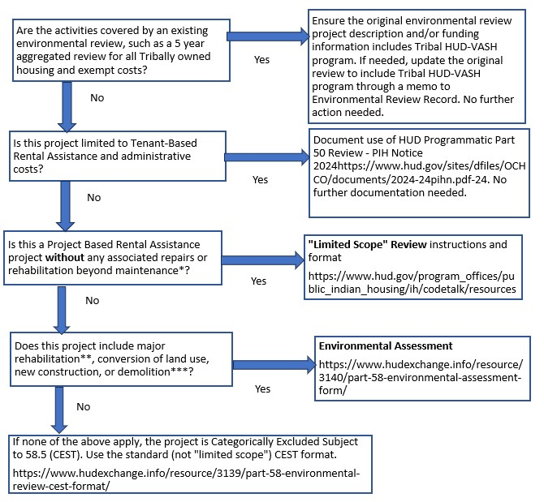
* Routine maintenance for purposes of environmental review is defined in
https://www.hudexchange.info/resources/documents/Guidance-Categorizing-Activity-asMaintenanceEnvironmental-Regulations-24-CFR-Parts-50-and-58.pdf
** For purposes of determining level of review, “major rehabilitation” is rehabilitation that does not conform to the limitations listed in 24 CFR 58.35(a)(3).
*** Select “yes” if new construction or demolition falls outside the definition of an “individual action” in 24 CFR
58.35(a)(4). If proposed construction or demolition conforms to the requirements in that section, select “no.”
September 1-3, 2026
Doubletree by Hilton Hotel Washington DC - Crystal City in Arlington, Virginia

Slide 29
Doubletree by Hilton Hotel Washington DC - Crystal City in Arlington, Virginia
September 1-3, 2026
31. When using project-based Tribal HUD-VASH funding on an assisted unit, can a previously conducted environmental review be used?
Yes, in certain circumstances. 24 CFR Part 58.35(b)(7) allows for supplemental assistance to be exempt from environmental review. If you previously performed a Categorically Excluded Subject to 58.5 (CEST) or Environmental Assessment review for your project-based rental assistance project (for example, because you purchased, constructed, or rehabbed units for Tribal HUD-VASH), you can use this exemption if:
  The Responsible Entity (RE; this is the Tribe) determines that the project was previously approved under Part 58, and
  The approval will be made by the same RE that approved the previous review, and
  Re-evaluation under 24 CFR Part 58.47 is not required.
If the exemption applies, you should update the environmental review checklist to reflect the additional funding and maintain the record of the exemption in your Tribal HUD-VASH files.
Please note that HUD generally advises recipients that environmental reviews “last” five years. Contact your Area ONAP for additional guidance.
Program Implementation
32. Can a Native American Veteran rent a unit owned by another Tribe or TDHE?
Yes, a Native American Veteran can rent a unit owned by a Tribe or TDHE that is not the Tribal HUD-VASH grantee. The lessor would be considered a private owner/landlord. There would be a Rental Assistance Payment Contract in place between the Tribal HUD-VASH recipient providing rental assistance and the unit owner. The Native American Veteran would also have a Lease Agreement with the owner.

Slide 30
Inspections
33. Are housing inspections required for units assisted by the Tribal HUD-VASH program?
Yes. Once a unit is located or ready to be occupied by a Native American Veteran, the Tribe or TDHE must make a determination that the unit meets applicable local housing codes and quality standards in accordance with section 207(a) (2) of NAHASDA. The cost of this inspection can be covered by the Tribal HUD-VASH administrative fee.
Note that Housing Quality Standards (HQS) or National Standards for the Physical Inspection of Real Estate (NSPIRE) are not required, unless they are part of the local housing codes and quality standards.
Types of Tribal HUD-VASH Rental Assistance (PBRA vs. TBRA)
Please clarify the difference between tenant-based rental assistance (TBRA) and project-based rental assistance (PBRA).
In a TBRA program, the Veteran generally chooses their unit and if they move, the assistance follows them to the new unit. In a PBRA program, the assistance remains with the unit.
35. Can the PBRA be converted to TBRA and vice versa?
Yes, you can convert from PBRA to TBRA and vice versa. If you convert from TBRA to PBRA, you will need to comply with the project-based rental assistance submission requirements as outlined in the Consolidation Notice. See paragraph V.C.5 and note the submission requirements to HUD prior to the conversion.
36. In a PBRA Program, what are examples of the term “structure?”
This term refers to the type of housing the PBRA is attached to, e.g., Single Family Detached, semi-detached, Rowhouse/Townhouse, Low-rise, High Rise Elevator, Manufactured Home.
September 1-3, 2026
Doubletree by Hilton Hotel Washington DC - Crystal City in Arlington, Virginia

Slide 31
Doubletree by Hilton Hotel Washington DC - Crystal City in Arlington, Virginia
September 1-3, 2026
37. In a TBRA Program, may a Native American Veteran choose to rent a privately-owned unit?
Yes.
38. Can the Tribe serve Native American Veterans outside of their formula area or Indian area?
The Consolidation Notice states that Tribes and TDHEs participating in this program must house Native American Veterans either on or near reservations, or within NAHASDA-authorized Indian areas, with the exception of units developed to house Homeless veterans on the grounds of a VA facility. Indian Area is defined under the regulations very broadly to mean “the area within which an Indian Tribe operates affordable housing programs or the area in which a TDHE, as authorized by one or more Indian Tribes, operates affordable housing programs.” This means that a Veteran assisted under the program can live in a unit that is not on a reservation and is located on fee simple land. The U.S. Department of Veterans Affairs must be able to provide case management services.
Rent
Could rent for Native American Veterans be less than thirty percent (30%) of the
household’s monthly adjusted income?
Eligible Native American Veterans and their families are to make a monthly tenant rent contribution payment that is no more than 30 percent of their monthly adjusted income. If a Tribe or TDHE decides to charge less than 30 percent, the recipient can use Tribal HUD-VASH funds to cover the remainder, up to 110 percent of the Fair Market Rent (FMR) for the unit. IHBG funds may be used to cover additional costs related to housing Native American Veterans and their families, under this Program (see VI.I of the Consolidation Notice). IHBG funds can be used for rent, security deposits, utilities, or admin costs for THV. Additionally, IHBG funds could be used for other supportive services (beyond what’s provided by THV), and other costs could be contemplated on a case-by-case basis.
*Please note that Program Guidance 2018-01 states that IHBG funds are not allowed to cover rental costs, security deposits, utilities, or administration costs for the Tribal HUD-VASH program. However, ONAP intends to rescind and/or replace Program Guidance 2018-01.

Slide 32
40. Can a Tribe/TDHE with ceiling rents that are lower than FMR charge Tribal HUDVASH rents that are higher than the ceiling rents?
Yes. Tribal HUD-VASH funds can be used to subsidize rents in eligible units up to 110 percent of the Fair Market Rent for the locality. However, the Tribe or TDHE should have a specific rental policy in place that clearly delineates this practice and rationale in relation to the Tribal HUD-VASH program and related ceiling rents for such units. A Tribe or TDHE should consider and balance the benefits of collecting additional rents versus serving additional Native American Veterans. Furthermore, the general practice of having standard ceiling rents set well below fair market amounts should be periodically reviewed to assure that this practice is financially feasible.
41. How is rent structured when Native American Veterans live together in a shared housing arrangement?
In a shared living arrangement, where a Native American Veteran is living with other Veterans or persons not in their household, each household in the unit should have a separate lease with the landlord stipulating each tenant’s share. The Native American Veteran’s rent contribution would then be calculated based on the rent amount specified in the Veteran’s lease. Each Veteran would get separate rental assistance from their Tribe or TDHE’s Tribal HUD-VASH program.
42. Under what conditions can a formula current assisted stock (FCAS) unit be used in the Tribal HUD-VASH Program?
If a Tribe or TDHE wishes to use any of its low rent FCAS units for the Tribal HUD-VASH program, they must contact the IHBG Formula Customer Service Center by calling 1-800-4108808 and temporarily remove the FCAS units from the IHBG funding formula during the time the unit will be receiving Tribal HUD-VASH assistance. Additional guidance is found in Program Guidance No. 2018-01.
September 1-3, 2026
Doubletree by Hilton Hotel Washington DC - Crystal City in Arlington, Virginia

Slide 33
Doubletree by Hilton Hotel Washington DC - Crystal City in Arlington, Virginia
September 1-3, 2026
43. If a service area covers multiple counties, which Fair Market Rents (FMR) would apply? Does FMR include utilities?
When a service area covers multiple counties, you may use the county with the highest FMR. FMR, as calculated by HUD, includes the cost of rent and utilities.
44. Can we get an FMR waiver for our entire Tribal HUD-VASH program?
ONAP cannot authorize blanket/program-wide waivers. Waivers must be given on a case-by-case basis given the language in the Consolidation Notice, which refers to an individual Veteran or unit.
45. Can small area FMRs be used to inform approvals of individual FMR waivers?
For purposes of the Tribal HUD-VASH program, you must use the area-wide FMR unless you receive approval from HUD to use a higher amount for a specific unit. You may use the Small Area Fair Market Rents (SAFMR) as part of your justification for the need for the FMR waiver.
HUD published the SAFMR Final Rule, which calculates rental assistance payment standards at the ZIP code level, rather than a metropolitan area-wide FMR. SAFMRs allow for payment standards to be established that more accurately reflect the local market. This can be helpful in providing voucher holders greater access to low-poverty and/or high-opportunity neighborhoods.
Use of Funds
Can Tribal HUD-VASH funds be used to address health and safety issues on a home a Native American Veteran wishes to rent?
No. Tribal HUD-VASH funds can only be used to pay rent on behalf of an eligible Native American Veteran. The unit must meet local housing codes and quality standards in accordance with section 207(a)(2) of NAHASDA prior to occupancy.

Slide 34
47. Can Tribal HUD-VASH funds be used to make loan payments for homeowners?
No, funds cannot be used to make loan payments.
48. If a Tribal HUD-VASH-eligible Native American Veteran cannot afford the required security deposit for an apartment, could IHBG funds be used to supplement the Native American Veteran’s security deposit?
*Yes, IHBG funds may be used to supplement a security deposit for a Tribal HUD-VASH eligible Native American Veteran who cannot afford the required security deposit. Additionally, Tribal HUD-VASH funds, SSVF funds, recipient’s program income, or alternative funding may be used to supplement the Native American Veteran’s security deposit. Using Tribal HUDVASH funds to supplement the Native American Veteran’s security deposit would reduce the assistance available for rent.
*Please note that Program Guidance 2018-01 states that IHBG funds are not allowed to cover rental costs, security deposits, utilities, or administration costs for the Tribal HUD-VASH program. However, ONAP intends to rescind and/or replace Program Guidance 2018-01.
49. Can Tribal HUD-VASH rental assistance be used for a unit funded by the USDA Rural Rental Loan Program (Section 515) or the Rural Rental Housing Guaranteed Loan Program (Section 538)?
Yes, Tribal HUD-VASH rental assistance can be used on debt service for the affordable housing unit, including those financed by the USDA.
September 1-3, 2026
Doubletree by Hilton Hotel Washington DC - Crystal City in Arlington, Virginia

Slide 35
Doubletree by Hilton Hotel Washington DC - Crystal City in Arlington, Virginia
September 1-3, 2026
50. How should admin funds be expensed during a grant period? What type of expenses are eligible for administrative related activities?
Administrative fees are included in each Tribal HUD-VASH grant and are available for eligible administrative and planning activities. Administrative fees are a flat amount based on the number of units in your Tribal HUD-VASH unit allocation. Eligible administrative expenses include but are not limited to:
  eligibility determinations
  intake and briefings
  owner outreach efforts
  unit inspections
  rent negotiations
  annual and interim reexaminations
  tenant fraud investigations and hearings
  processing subsequent moves
  the costs associated with making rental assistance payments to owners
  complying with reporting requirements.
Please note that administrative funds should be used within the period of performance reflected on the grant agreement.
Utilities
51. Can a landlord include utilities in the total rent charged for a unit?
Yes, but including utilities in the total rent is not required. Utilities are an eligible use of Tribal HUD-VASH grant funds. However, when charging rent, the inclusion of utilities is at the discretion of the landlord. If a landlord is not going to include utilities, the landlord should explicitly state that in the Lease Agreement. This data will also need to be represented and noted in the HIP reporting tool. Note that if the utilities are not included in the total rent charged, a Tribe or TDHE may set the THV tenant’s rent contribution at lower than the 30% of adjusted income limit, and then the THV tenant would put that reduction toward the utility payments. *Please note that Program Guidance 2018-01 states that IHBG funds are not allowed to cover rental costs, security deposits, utilities, or administration costs for the Tribal HUD-VASH program. However, ONAP intends to rescind and/or replace Program Guidance 2018-01.

Slide 36
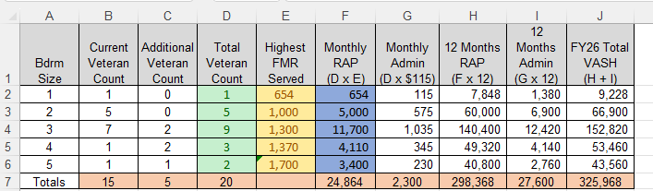
Estimating Need

Slide 37
Reporting
Do the Tribal HUD-VASH program grant funds get reported annually in the Tribe/TDHE’s IHP/APR?
Yes, Tribal HUD-VASH program grant funds must be reported annually in the Indian Housing Plan, Annual Performance Report, and on the Federal Financial Report (SF-425), which is done in the Grants Evaluation and Management System, GEMS. Grantees must also report their tenant data, as noted in the Consolidation Notice and Program Guidance 2016-05. The current form is the HUD-50925 available on HUDClips, or grantees may use the electronic reporting tool provided by the Housing Information Portal (HIP) system. HUD encourages but does not yet require the use of the HIP system.
September 1-3, 2026
Doubletree by Hilton Hotel Washington DC - Crystal City in Arlington, Virginia

Slide 38
Doubletree by Hilton Hotel Washington DC - Crystal City in Arlington, Virginia
September 1-3, 2026
Tribal HUD-VASH Leasing Performance Report
Grantee Name (Tribe/TDHE):
OMB Approval No. 2577-0169
(exp. 04/30/2026)
Unique Identity | Lease Start Date | Lease End Date | Rental Assistance Type | Property Type | Months Leased | Family Size | Bedroom Size | Total Rent Amount | Tenant Rent Contribution | Contributing Funds | Monthly RAP | Total RAP
EX: 1 | 1/1/2023 | 12/31/2024 | Tenant Based | Tribe | 24 | 4 | 3 | $ 1,200.00 | $ 200.00 | $ 100.00 | $ 900.00 | $ 21,600.00
 |  |  |  |  |  |  |  |  |  | TOTAL | $ 900.00 | $ 21,600.00
OMB Burden Statement. The public reporting burden for this information collection is estimated to be 0.5 hours, including the time for reviewing, searching existing data sources, gathering and maintaining the data needed, and completing and reviewing the collection of information. Collection of information about leasing is required for program management and funding. Assurances of confidentiality are not provided under this collection. Send comments regarding this burden estimate or any other aspect of this collection of information, including suggestions to reduce this burden, to the Office of Public and Indian Housing, US. Department of Housing and Urban Development, Washington, DC 20410. HUD may not conduct and sponsor, and a person is not required to respond to, a collection of information unless the collection displays a valid control number.
Previous editions obsolete form HUD-5980 (5/2020)

Slide 39
53. If a grantee owns and operates a housing unit and rents to a Tribal HUD-VASH recipient, what program income and SF-425 reporting considerations apply?
Section VI.K of the Consolidation Notice states that “Amounts paid to the tribe/TDHE to cover the rental assistance payment of Native American veterans and their families in tribe/TDHEowned or operated housing; tenant rent contribution payments collected under this program; and any other income earned from the disbursement of grant funds, including income earned on funds received from such payments; will be considered program income, and must be spent on affordable housing activities, which will be subject to the requirements of NAHASDA . . . such income may not be spent on housing-related activities, as that term is defined in 24 CFR
1000.10.”
To further explain:
Amounts paid to the tribe/TDHE to cover the rental assistance payment of Native American veterans and their families in tribe/TDHE-owned or operated housing is considered program income. This refers to the Tribal HUD-VASH grant funds themselves. Once deposited into the grantee’s account, the THV funds must be reported on line 10l-o of the SF-425.
Regardless of the source of the program income, THV program income may only be used for affordable housing activities (not “housing-related” as permitted under the Indian Housing Block Grant program) that are then subject to the requirements of NAHASDA.
HUD encourages grantees to use program income to assist eligible Native American Veterans first, before providing assistance to other low-income Native American families.
September 1-3, 2026
Doubletree by Hilton Hotel Washington DC - Crystal City in Arlington, Virginia

Slide 40
Doubletree by Hilton Hotel Washington DC - Crystal City in Arlington, Virginia
September 1-3, 2026
Closeouts
What are the next steps if all the grant funds are expended?
ONAP will close the Tribal HUD-VASH grant when it determines that Tribal HUD-VASH grants have been fully expended or the grant is at the end of the approved Period of Performance (POP), whichever occurs first. A grantee must liquidate all financial obligations incurred under the ONAP grant award prior to the end date of the period of performance as specified in the grant agreement. If funds remain after the POP expires, the funds will be de-obligated and returned to HUD to be utilized for future renewal awards within the Tribal HUD-VASH program.
55. How do I close out a grant?
Please referred to the Notice PIH 2023-02 for Closeout Instructions for the THV Grant Program.
56. What does De-Obligation of Grant Funds mean and what is the process?
Please referred to the Notice PIH 2023-02 for Closeout Instructions for the THV Grant Program.
57. What do I do if I need to amend my Period of Performance (POP) End Dates?
Grantees should do their best to draw down the grant funds before the POP end date.
If a grantee needs more time to draw down funds, HUD may grant an extension to the POP if justified and allowable. See Notice PIH 2023-02.

Slide 41
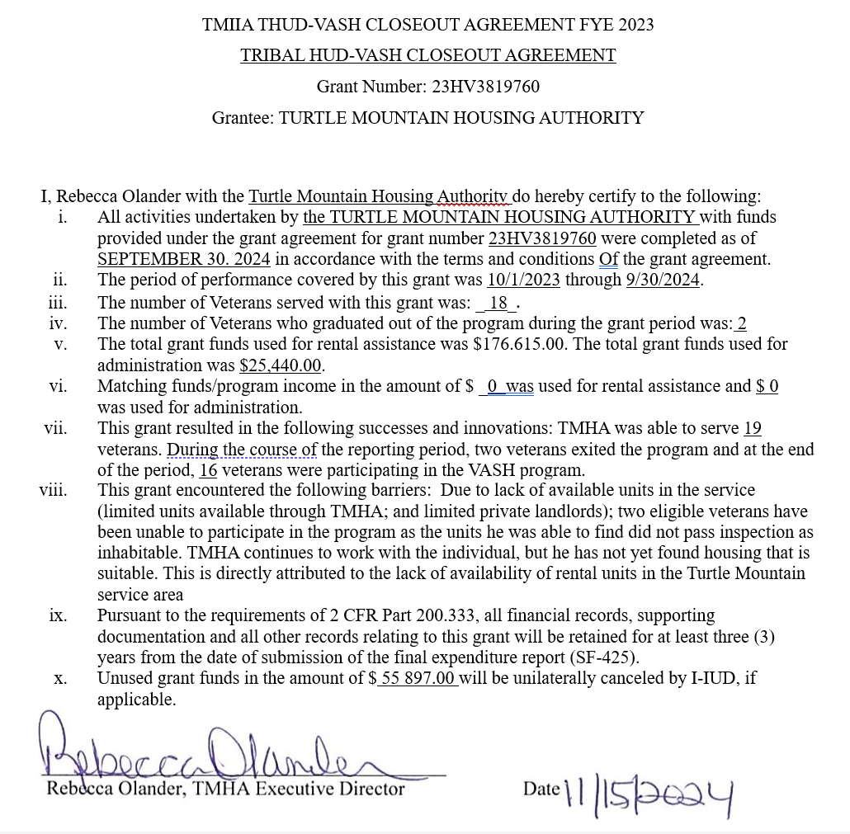
Doubletree by Hilton Hotel Washington DC - Crystal City in Arlington, Virginia
September 1-3, 2026
CLOSEOUT AGREEMENT

Slide 42
Supportive Services for Veterans and Families (SSVF)
58. Is a Native American Veteran eligible to receive Supportive Services for Veterans and Families (SSVF) services?
Yes, if they meet the SSVF eligibility criteria for the specific assistance being requested. As background, SSVF is a grant-based program where non-profit organizations and consumer cooperatives are awarded a SSVF grant. The focus of the grant program is to assist very low-income Veteran families with prevention and rapid-rehousing services. These services include outreach, housing case management, connection to VA resources, and connection to mainstream resources. Temporary Financial Assistance (TFA) for things like security deposits and moving costs might also be available; these determinations are made on a case-by-case basis depending on need. The goal of all services is to promote housing stability. Native American Veterans in HUD-VASH receive case management from the HUD-VASH Case Manager, not the SSVF Case Manager. More information about SSVF can be found at: https://www.va.gov/homeless/ssvf/.
September 1-3, 2026
Doubletree by Hilton Hotel Washington DC - Crystal City in Arlington, Virginia

Slide 43
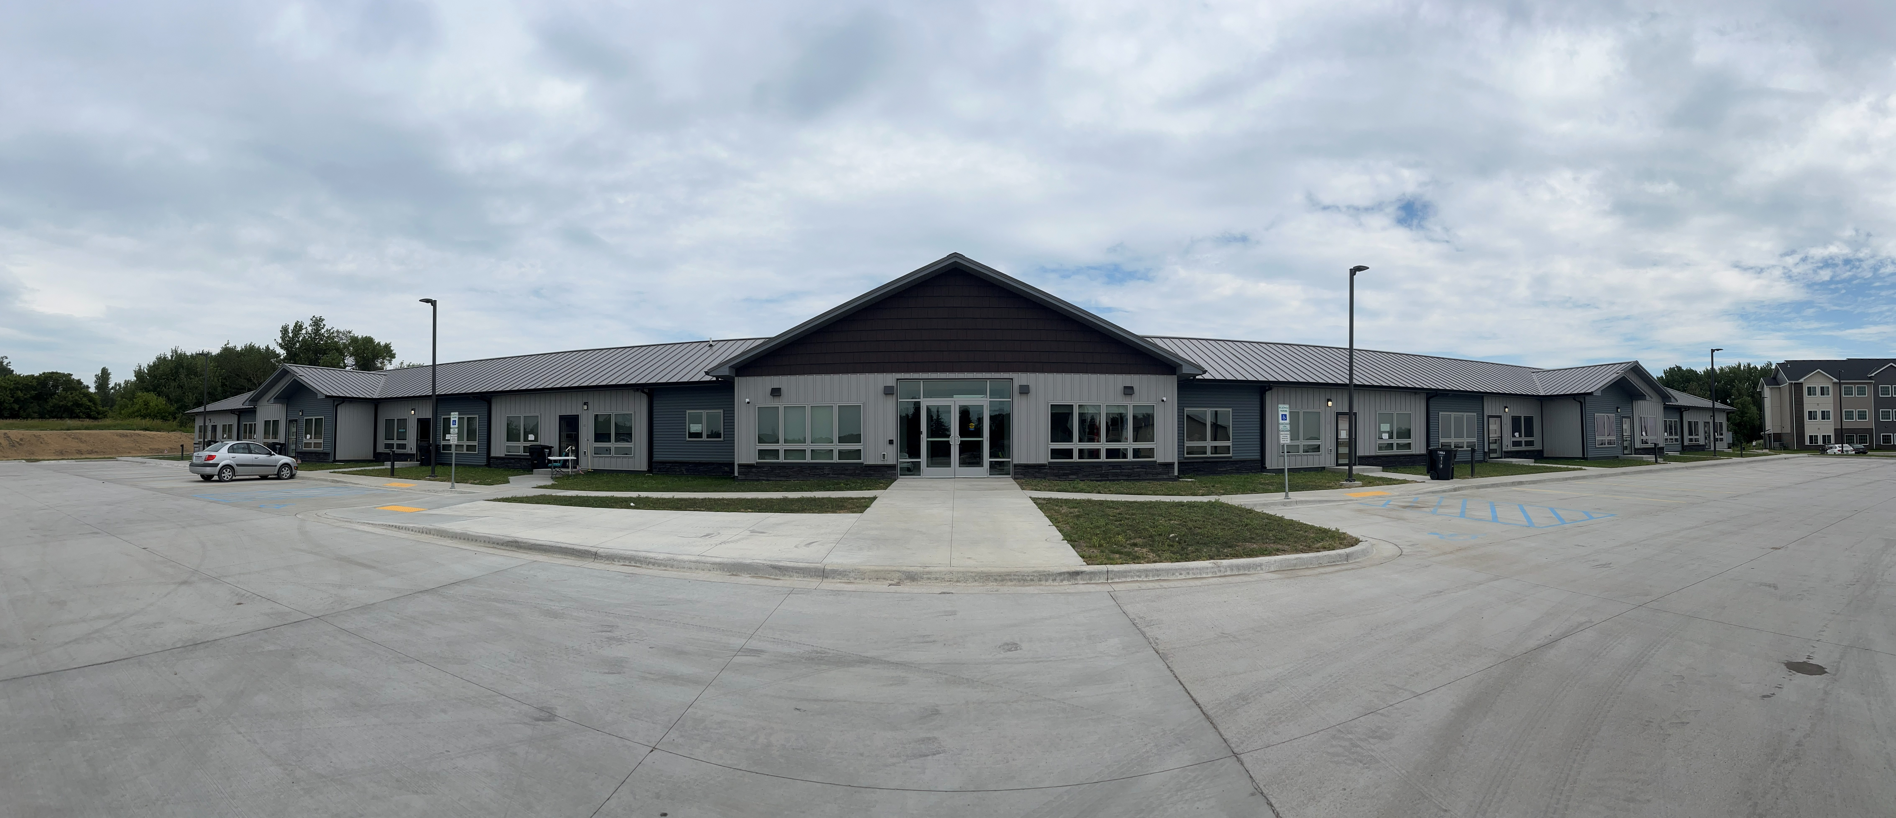
TURTLE MOUNTAIN HOUSING AUTHORITY
VETERANS VILLAGE
September 1-3, 2026
Doubletree by Hilton Hotel Washington DC - Crystal City in Arlington, Virginia

Slide 44
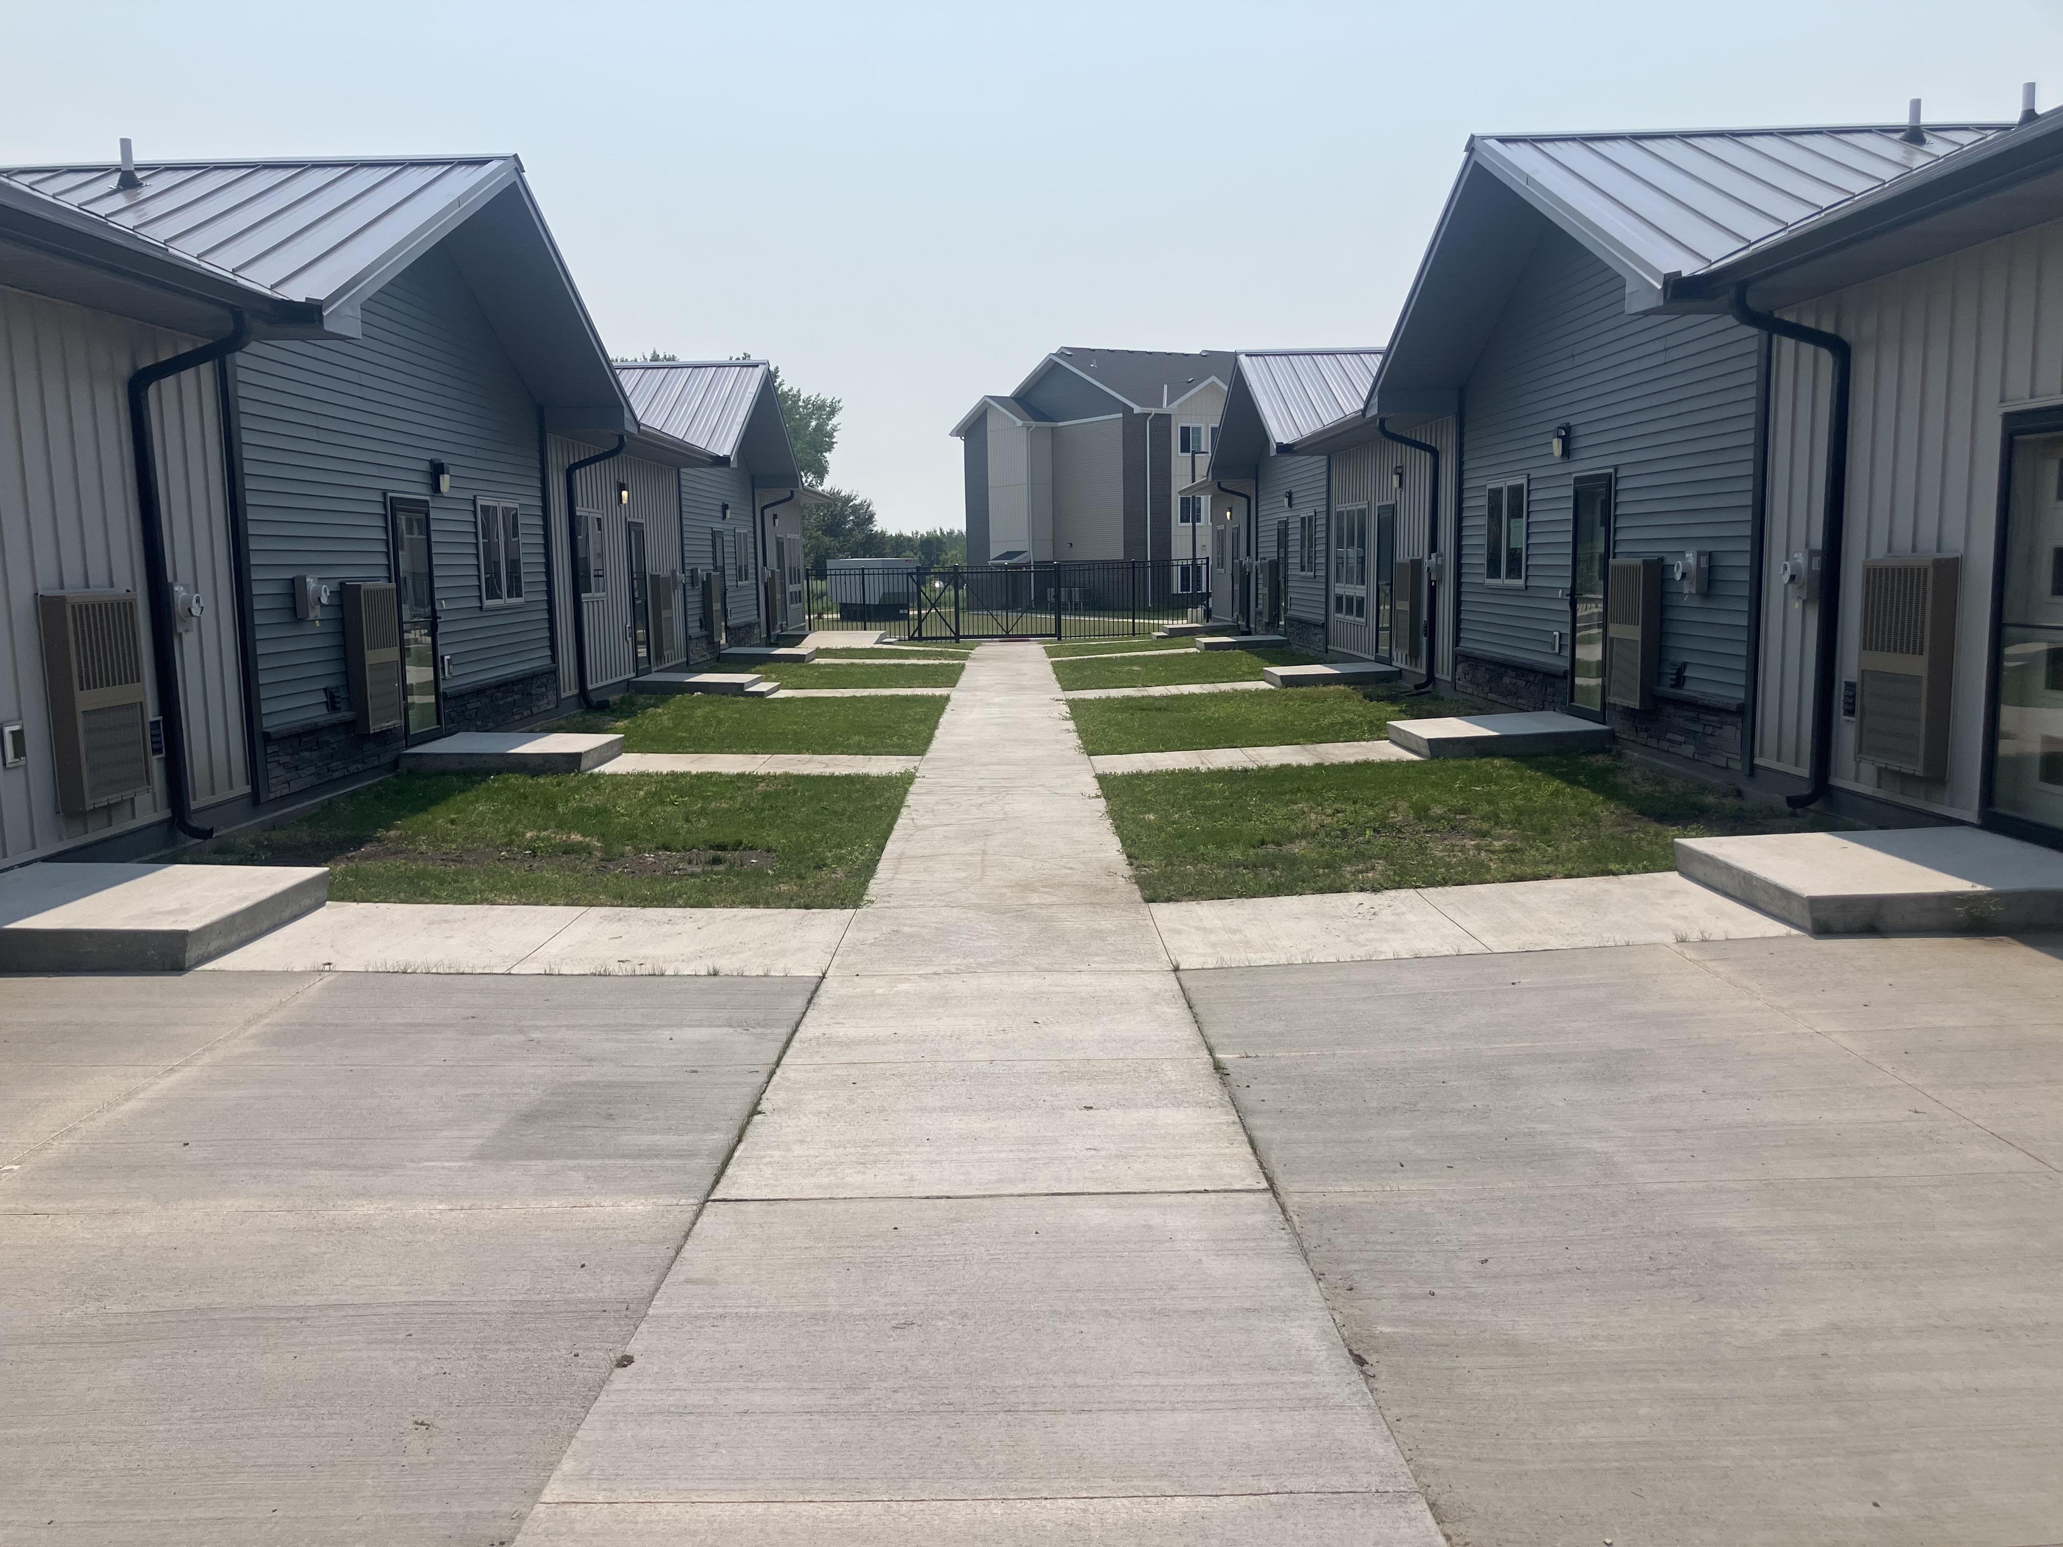
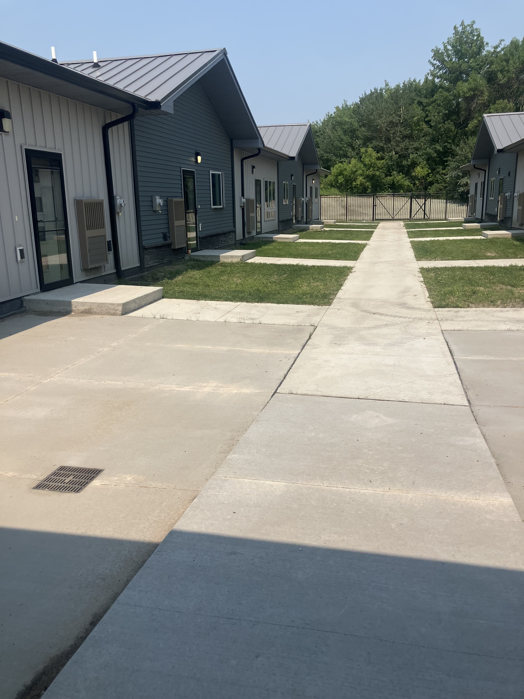

Slide 45
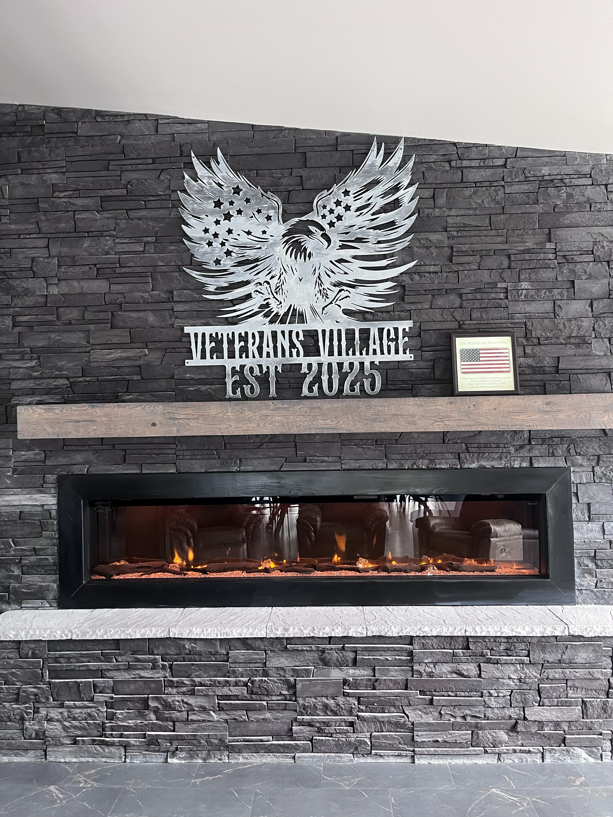
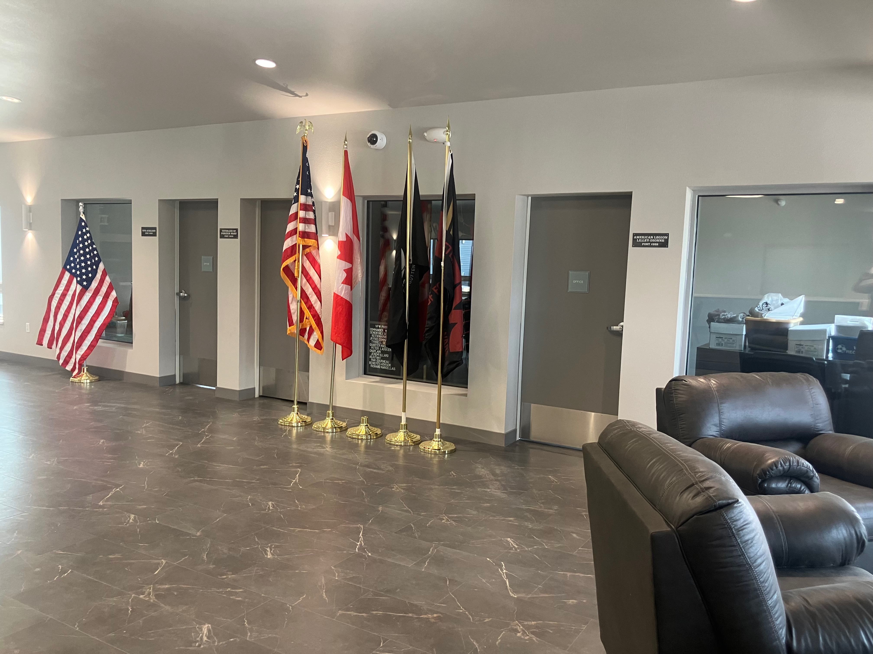
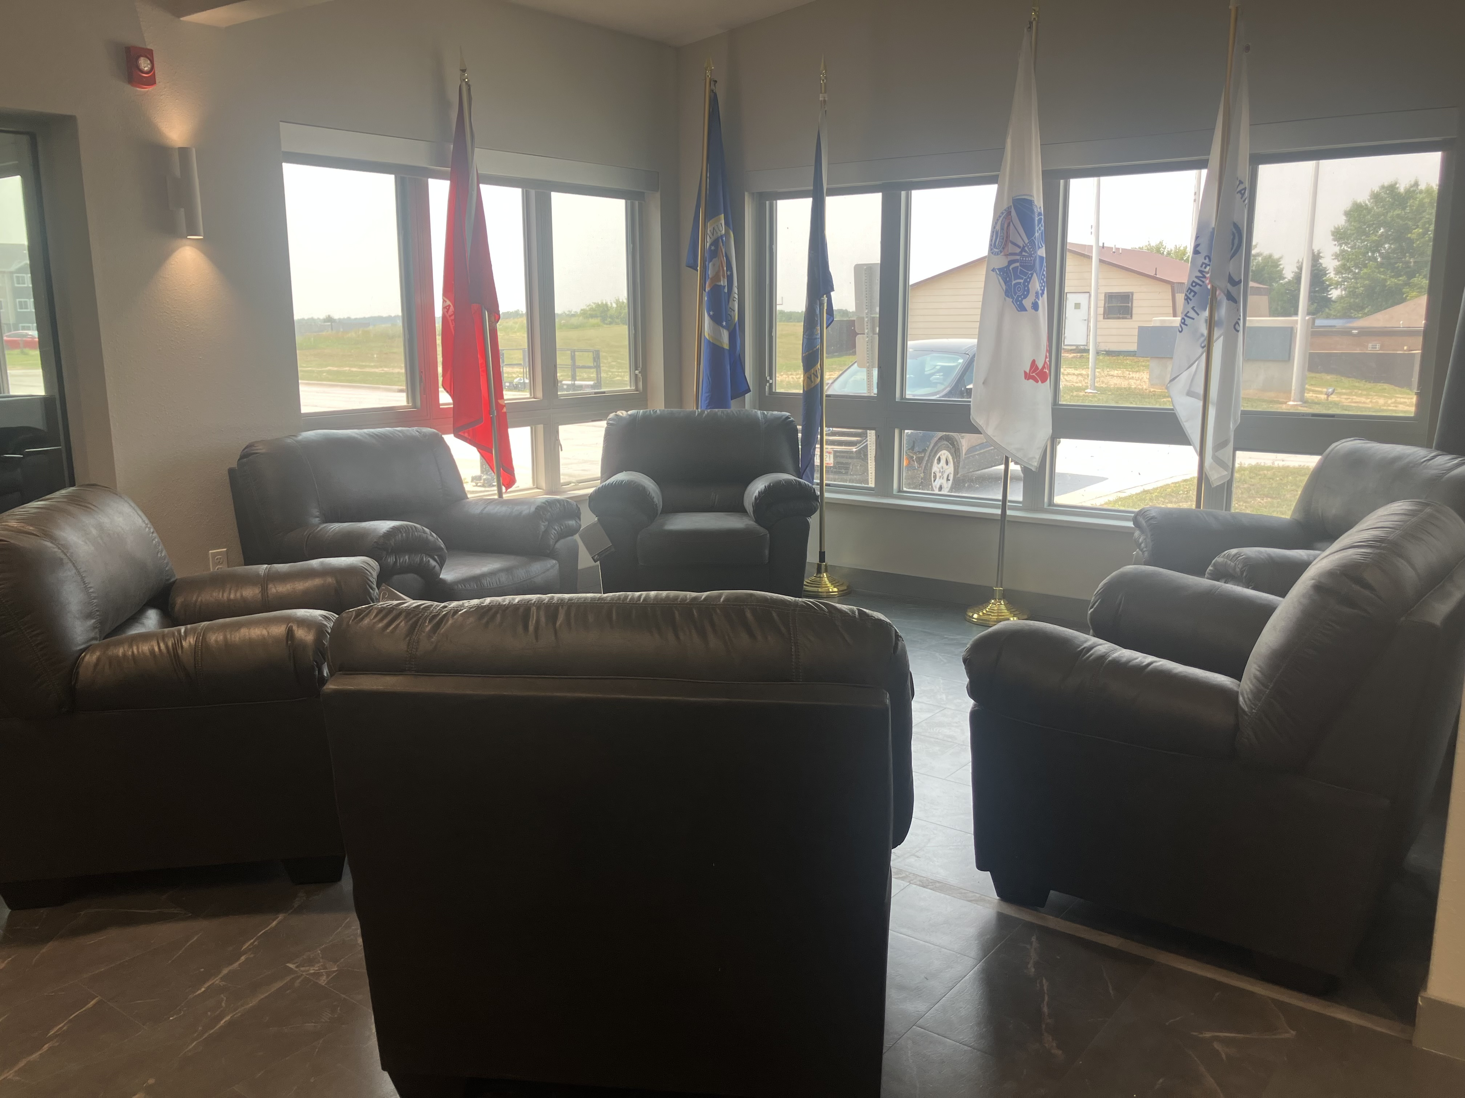

Slide 46
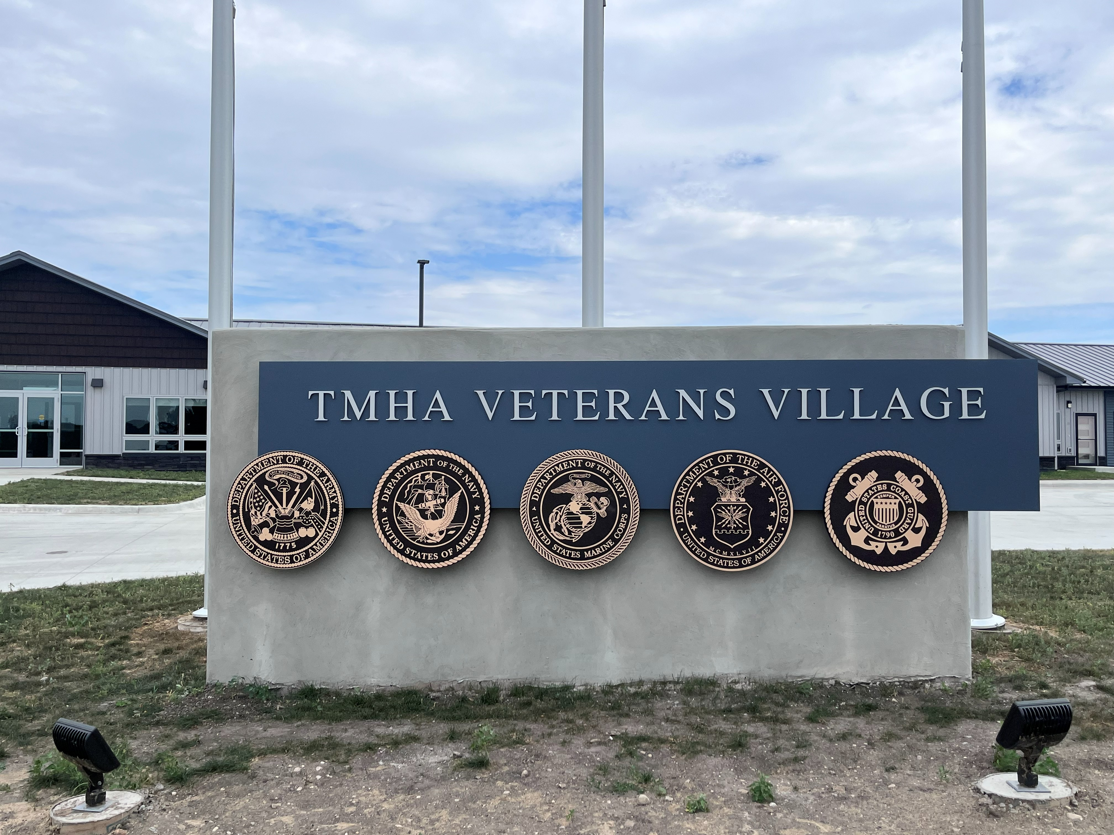

Slide 47


Slide 48
CONTACT INFO:
Rebecca Olander
phelps_58316@yahoo.com
Heather Tetrault
htetrault @tmhousing.net
Sara Weiderholdt
sara.wiederholt@va.gov

Slide 49
This material is based upon work supported by funding under an award with the U.S. Department of Housing and Urban Development. The substance and findings of the work are dedicated to the public. Neither the United States Government, nor any of its employees, makes any warranty, express or implied, or assumes any legal liability or responsibility for the accuracy, completeness, or usefulness of any information, apparatus, product, or process disclosed, or represents that its use would not infringe privately-owned rights. Reference herein to any specific commercial product, process, or service by trade name, trademark, manufacturer, or otherwise does not necessarily constitute or imply its endorsement, recommendation, or favoring by the U.S. Government or any agency thereof. Opinions expressed in this document are those of the authors and do not necessarily reflect the official position of, or a position that is endorsed by, HUD or by any HUD program.
September 1-3, 2026
Doubletree by Hilton Hotel Washington DC - Crystal City in Arlington, Virginia

