Slide 1


VA Loan Guaranty Service
Native American Direct Loan (NADL)
Program Overview

Slide 2
What is A VA Direct Loan?
The VA is the principal lender and directly lends funds to eligible Native American Veterans or Veterans married to Native American non-Veterans for the purpose of purchasing, constructing or improving a home on trust lands.

Slide 3
Benefits of the NADL Program
Borrower Benefits
No down-payment required
No private mortgage insurance
Minimal closing/transactions costs
Low, fixed-rate mortgage, 30-year term
Assumable for qualified borrowers
Continued support after closing
Tribal Benefits
Frees up tribal funds to use in other areas
Supports local economy (builders, inspectors, and workers)

Slide 4
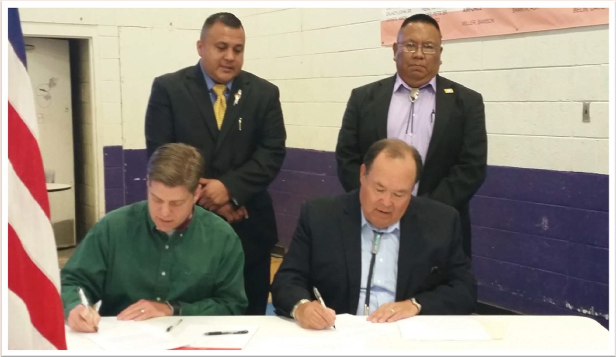
Memorandum of Understanding (MOU)
Prior to VA making a loan, the law requires that the Federally Recognized Tribe and VA sign a Memorandum of Understanding
113 MOUs have been made with Federally Recognized Tribes and VA
1,243 loans as of February 2024 have been made with Native American Veterans totaling $179.8 million
Mescalero Apache (NM) MOU signing

Slide 5
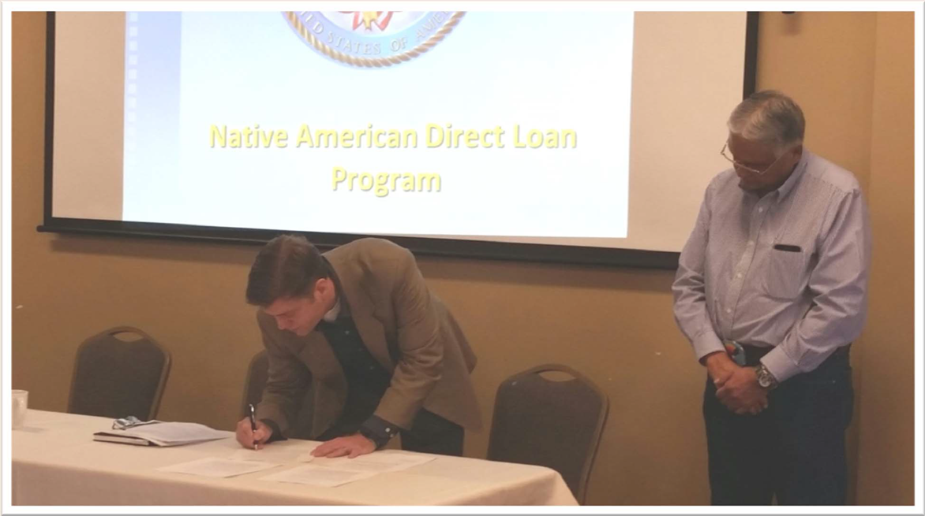
Memorandum of Understanding (MOU), Cont’d
Tribe must adopt foreclosure, eviction, priority of lien procedures, and leasing procedures
Tribal court must acknowledge that the tribe has enacted the required legal procedures and that it will enforce these procedures
Must provide for the acquisition by the Veteran of a meaningful interest in the lot and/or dwelling on trust land
Must provide for conveyance of the Veteran’s meaningful interest as security for the loan
Ute Indian Tribe (UT) MOU signing

Slide 6
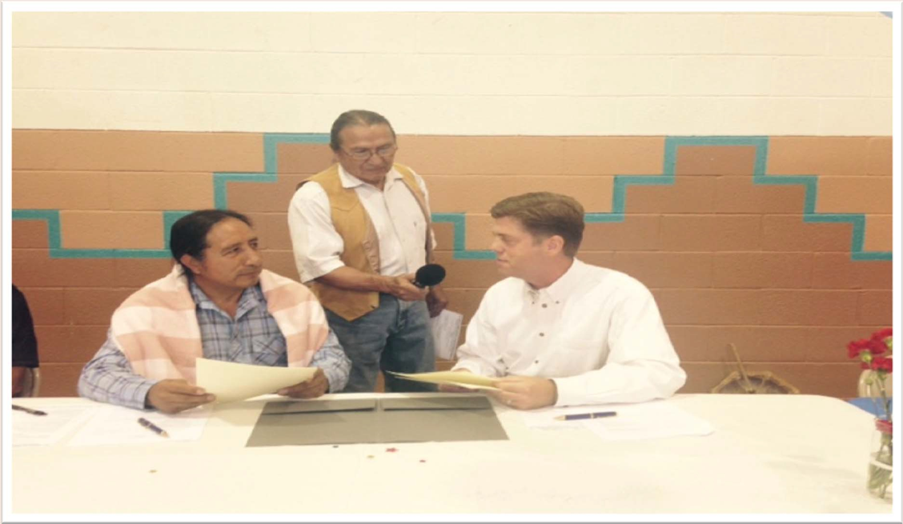
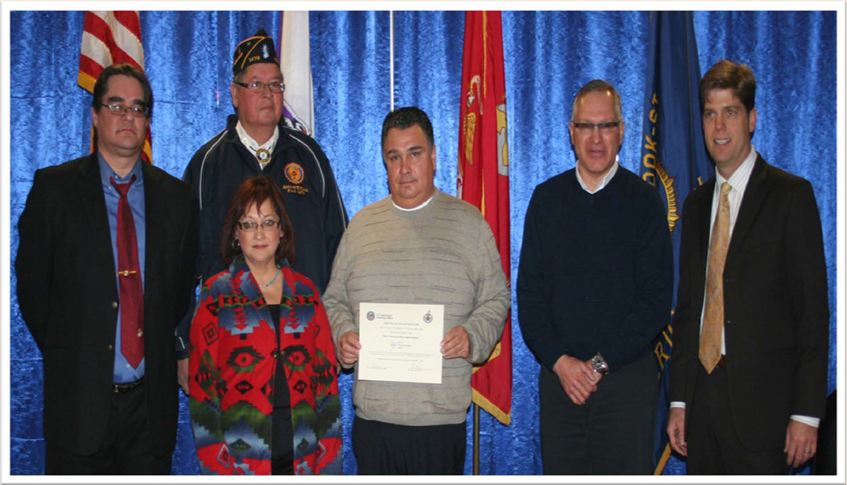
MOU Procedures
The Tribe submits an MOU Inquiry to VA at NADL@va.gov
VA Central Office assists the Tribe through the MOU approval process
VA Central Office gives final approval and signatures
The NADL Team begins taking new loan applications
Taos Pueblo (NM) MOU signing
St. Regis Mohawk (NY) MOU signing

Slide 7
Overview of the Loan Process
Think of VA as the lender
Determine eligibility
Qualify the borrower
Determine property value
Conduct the closing

Slide 8
Determining Eligibility
The Tribal organization must have a signed MOU with VA
The Native American Veteran must have a meaningful interest in the leasehold/allotted land and be an active member of the tribe
Native American Veterans must have sufficient length of service and character of service

Slide 9
Requirement for Loan Preapproval
Request VA loan application at NADL@va.gov
Provide financial documents: pay stubs, W2s, award letters, bank statements and tax returns, if applicable
Provide or apply for homesite lease assignment with the tribal housing or land management office
Provide evidence of Tribal Membership: Tribal ID or Certification of Indian Blood

Slide 10
VA Underwriting Review
Income – Stable, reliable, and expected to continue
Credit – Most recent 12-month history of timely payments on credit obligations (credit cards, loans, etc.)
Debt-to-Income (DTI) – Current expenses and new housing payment compared to gross income. Ideal DTI ratio of <41%
Assets – Fees Paid Before Closing
  Appraisal Fee
  Construction Compliance Inspection Fees

Slide 11
Requirements for VA Appraisal
Purchase Agreement
Construction Contract
Construction Exhibits
  Building Permits
  Plans and Specs
  Description of Materials
Lease Agreement or Deed of Trust
Title Status Report (TSR)
Water/Sewage Report from Indian Health Services (IHS)
Gas/Electrical Installation Contract

Slide 12
Requirements for Final Loan Approval
The loan must be for an eligible purpose
The Veteran intends to occupy the home as his/her primary residence. Rentals and/or investment properties are not allowed.
The Veteran and spouse (if applicable) are satisfactory credit risks.
The Veteran and spouse (if applicable) have stable and reliable income sufficient to meet payment obligations and provide enough leftover residual income for family support.

Slide 13
Requirements for Final Loan Approval, Cont’d
Fixed interest rate (current interest rate is 2.50%)
Maximum loan term of 30 years
Leasehold term remaining must be 14 years plus length of loan, at a minimum
Homeowner’s Insurance and Hazard Insurance
    12-month homeowner insurance policy is required
    12-month hazard insurance is policy required
  Performance Bond / Construction Risk Insurance
    Construction risk insurance is required to protect the home during the construction phase

Slide 14
Closing Costs
Fees Paid At Closing
  Processing Fee
  Settlement/Escrow Company Fee
  Title Fees and Recording Fees
  Homeowners Insurance Premium (3 Months)
  Hazard Insurance Premium (3 Months)
  Property Taxes
  Prepaid Interest

Slide 15
Closing Costs
Fees Paid Before Closing
  Appraisal Fee
  Compliance Inspection Fees
  Homeowners Insurance Premium (12 Months)
  Hazard Insurance Premium (12 Months)
  Performance Bond / Construction Risk Insurance

Slide 16
Closing Costs
Fees Financed Into The Loan At Closing
  VA Funding Fee
    Purchase/Construction = 1.25% of loan amount
    Interest Rate Reduction Refinance = 0.5% of loan amount
    VA Funding Fee can be paid at closing
    Veterans in receipt of service-connected disability compensation are exempt from paying the funding fee
    Surviving spouse in receipt of dependency and indemnity compensation are exempt from paying the funding fee

Slide 17
VA NADL Coordinators and Contact Information
Phone: 1-888-349-7541
General Email: NADL@va.gov
Name | Extension | Email Address
James Lewis | 221462 | james.lewis2@va.gov
Casandra Kelting | 221286 | casandra.kelting@va.gov
Craig Filbeck | 221426 | craig.filbeck@va.gov
Arthur Valdez | 221375 | arthur.valdez@va.gov
Karl Covert | 221621 | karl.covert@va.gov
Dorian Smith | 221292 | dorian.smith@va.gov
Cherie Castanares (Supervisor) | 221455 | cherie.castanares@va.gov
General Loan Guaranty Service Phone Number: 1-877-827-3702

Slide 18
Reference Information
Important websites:
Native American Direct Loan Program https://www.va.gov/housing-assistance/home-loans/loan-types/native-american-direct-loan/
VA-Guaranteed Home Loan Program https://www.va.gov/housing-assistance/#get-va-home-loan-benefits

Slide 19

Questions?

Slide 20
THANK YOU!

