Slide 1
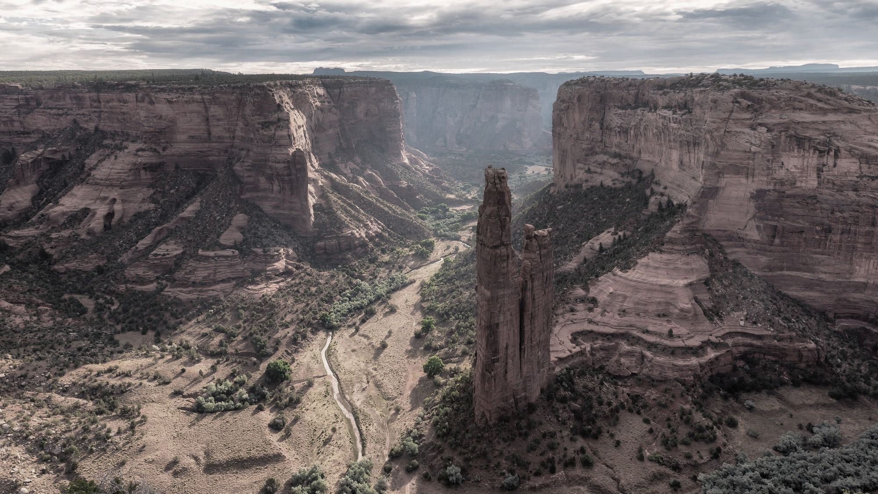

Weaving and Honoring Culture into
Design
2 SEPTEMBER 2026

Slide 2

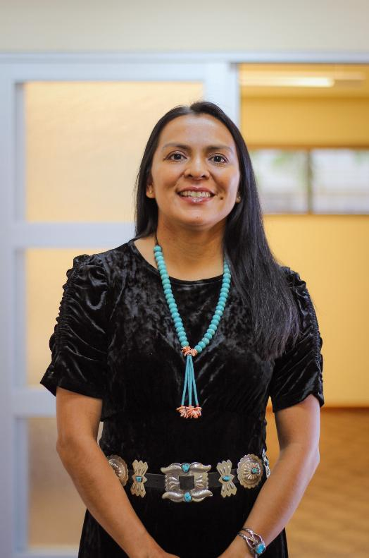
Tamarah Begay
Principal / CEO of Indigenous Design + Architecture.
AIA, NCARB, AICAE, CDT, LEED AP BD+C​​
Tamarah Begay, founder of Indigenous Design Studio + Architecture, leads a 100% Native American Woman-Owned architecture and planning firm. A proud member of the Navajo Nation and the first Navajo woman registered architect, Ms. Begay brings over 19 years of experience collaborating with Native American tribes across the country. Her work is rooted in the belief that culture, language, and tradition should be at the heart of design. Built on the principles of deep listening to the stories of the people, land, and community, her firm weaves meaningful engagement into every stage of the design process.
K’é - Navajo Kinship - Clans
Naakaii Dine’e’ nishli
(Mexican People)
Kinyaa’ a’anii ba’shishchiin
(Towering House People)
A’shiihi’ dashicheii aadoo
(Salt People)
Hona’gha’ahnii dashinali
(One Walks-Around)

Slide 3
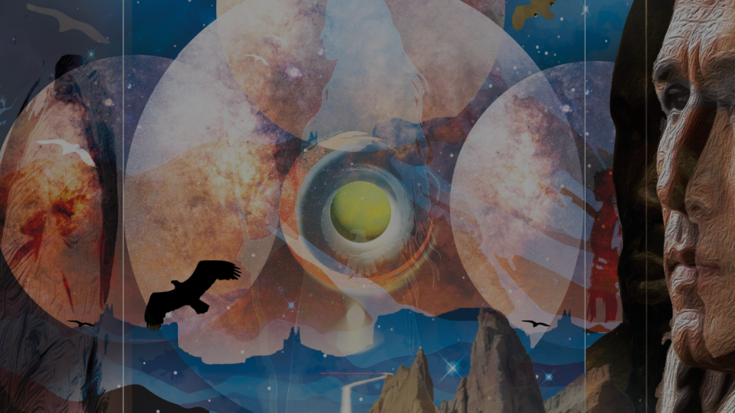
Design Principle Process

Slide 4

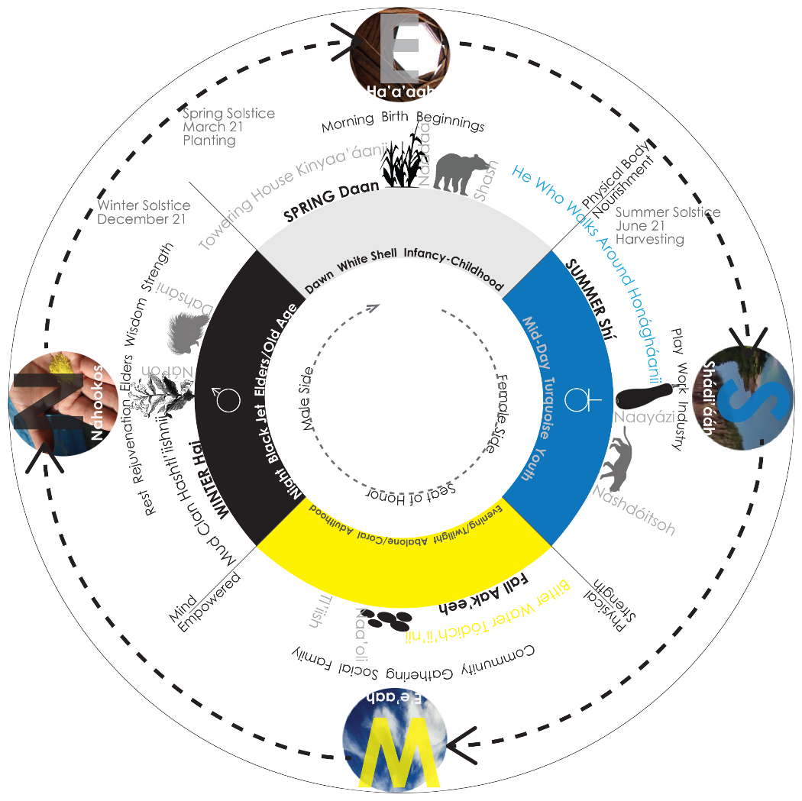
Guided by Indigenous Worldview
Without the written permission of Indigenous Design Studio + Architecture, LLC; it is prohibited to integrate in whole, or in part, any of the published materials into another program or to use them by any other means
Notes:
Working in cooperation with the natural world
Connecting to the sky, land and water
Honoring the land as a living being, not a resource
Respect for not just 2 legged beings but also the 4 legged beings
Thinking and Planning for future generations
Centering community agreement in decision-making

Slide 5
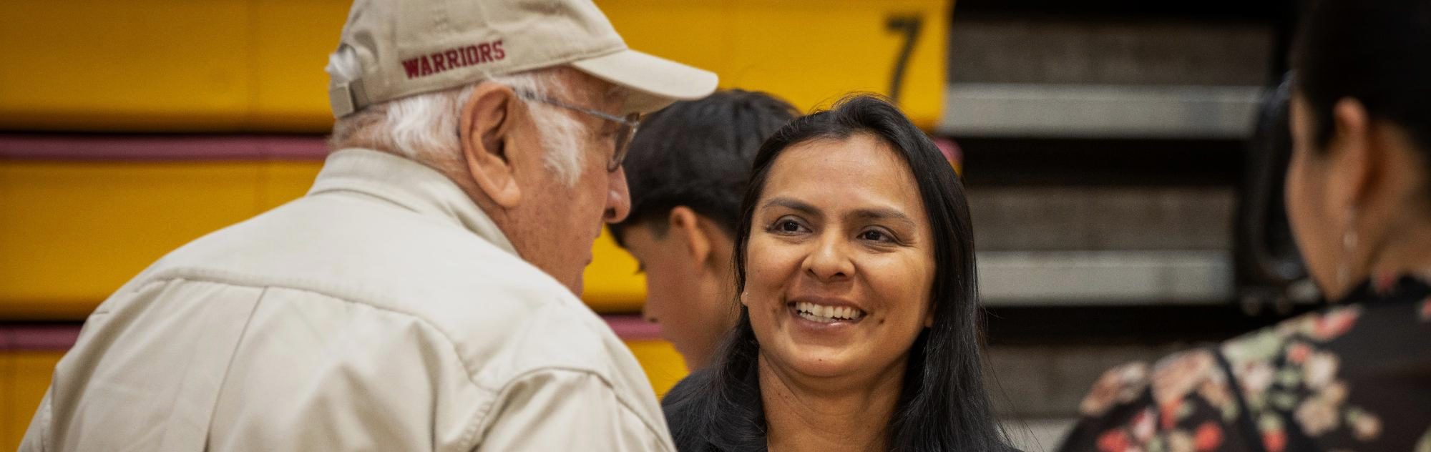
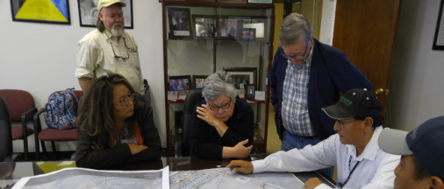
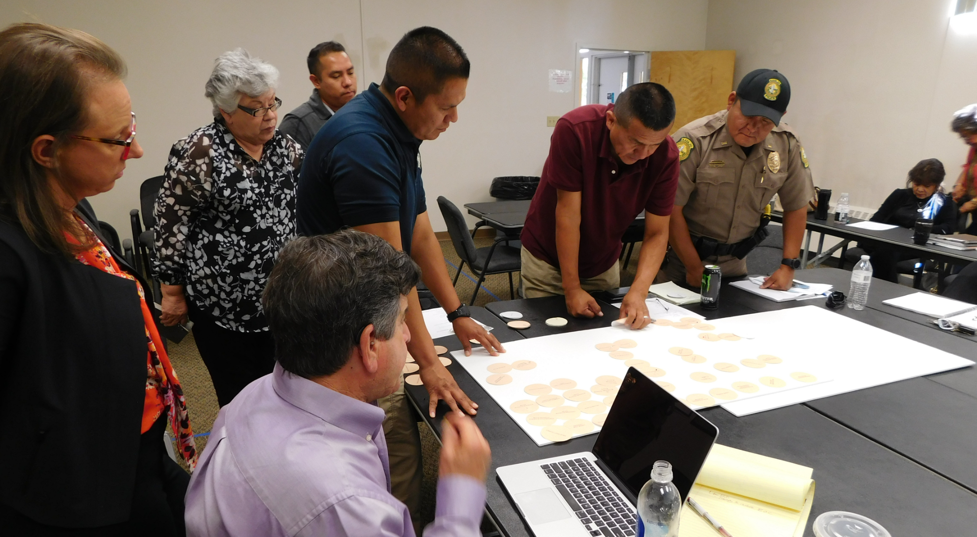
Listening Before Designing
Notes:
Takes several months to receive input from as many people as possible
Methods
Community workshops
Elder discussions
Youth engagement
Staff workshops
Site walks
Storytelling sessions

Slide 6

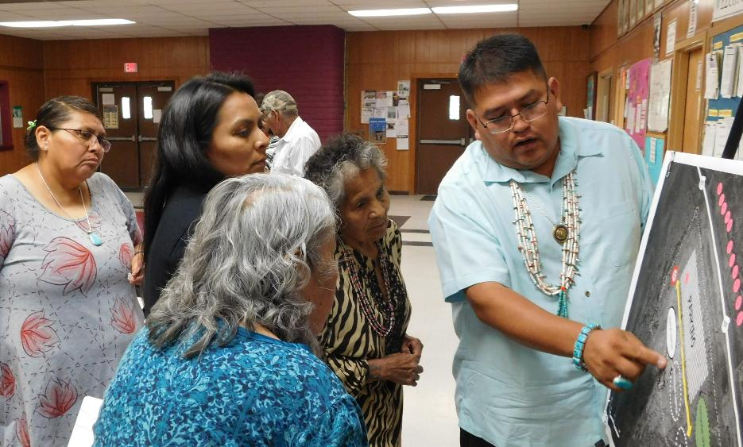
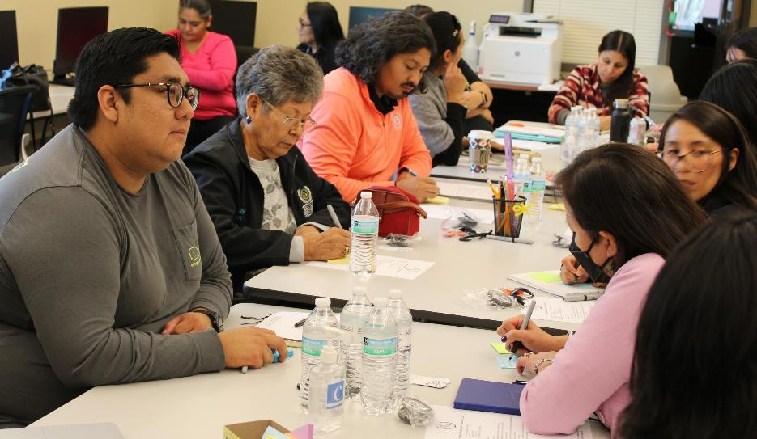
Voices that Shape the Vision
Community Voices
Tribal Leadership
Families
Elders
Youth
Traditional Healers
Community Organizations

Slide 7
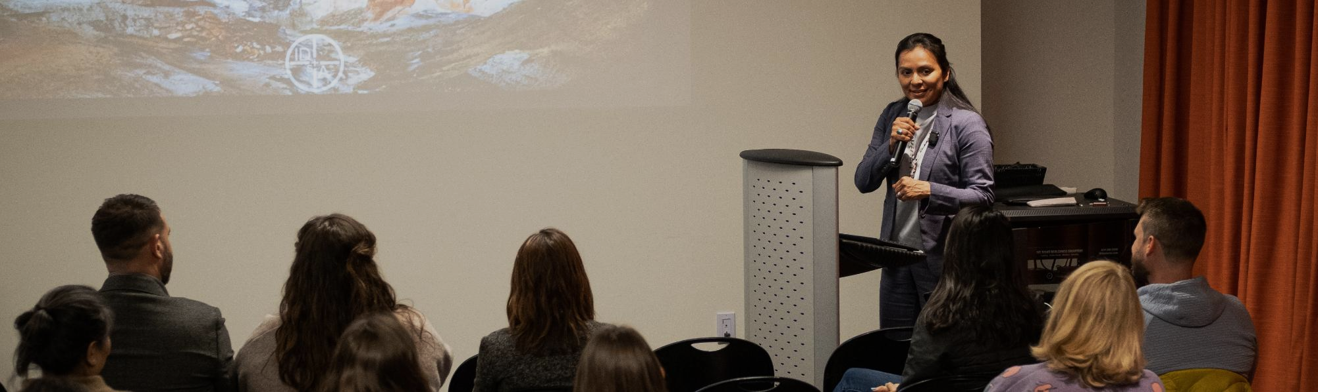
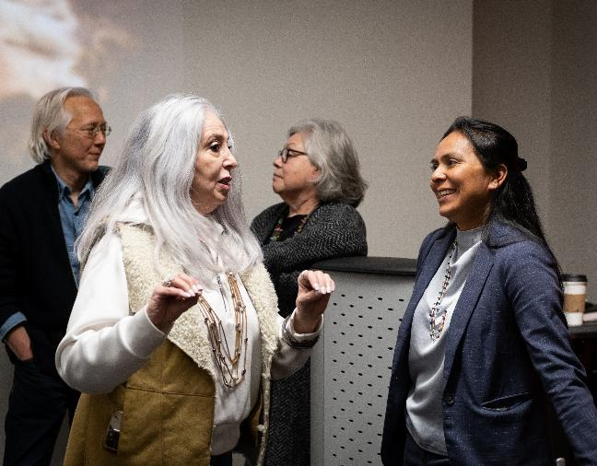
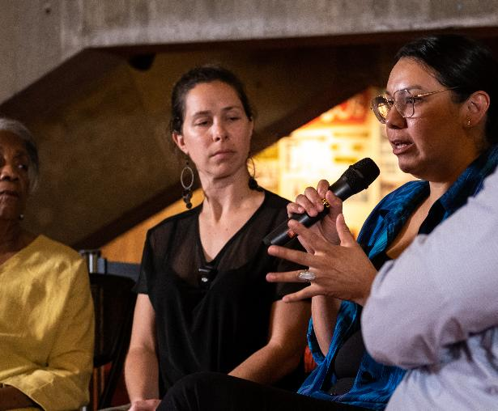
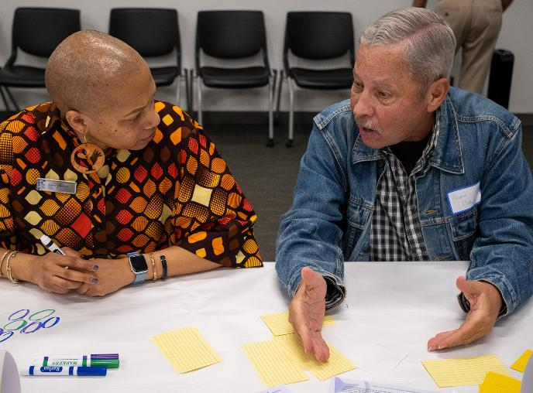
Re-imagining Columbus
Community Engagement

Slide 8

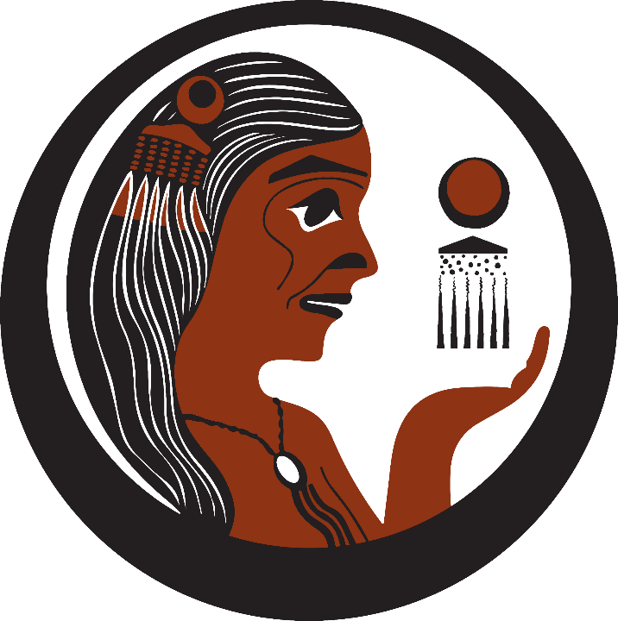
  “It will be us, the Native people, who will
  ensure that we have the services and care
  needed to live healthy and happy lives”
  Esther Lucero (Diné), President and CEO
What are your stories?
Community Values & Stories
SIHB Values
Indigenous Self-determination
Holistic healing
Restorative Social Justice
Treating clients and patients as relatives
SIHB values
  Indigenous Self-determination
  Holistic healing
  Restorative Social Justice
  Treating clients and patients as relatives
  “For the Love of Native People”
IDS+A

Slide 9

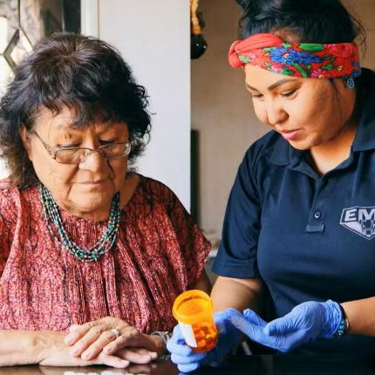
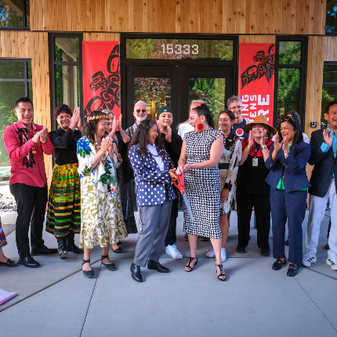
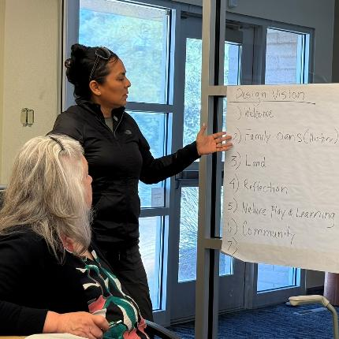
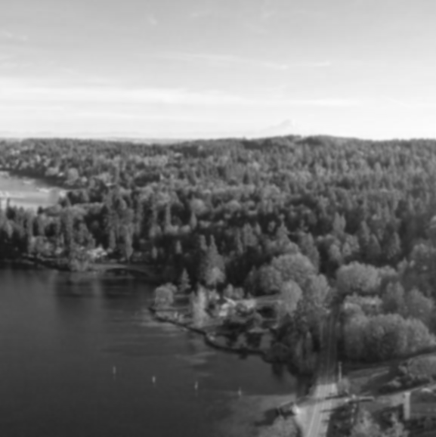
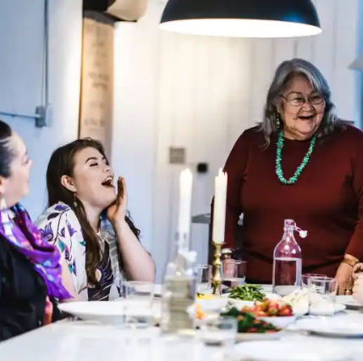
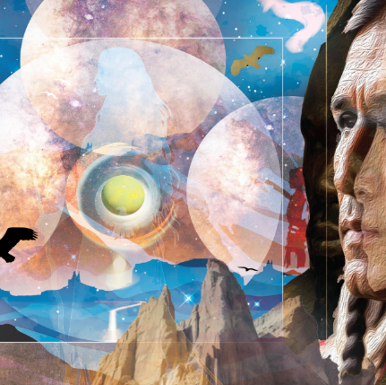
Development of the Design Principle
Community Stories
Design
Principle
+
Community Values
Shared
Themes
Design
Decisions
IDS+A

Slide 10
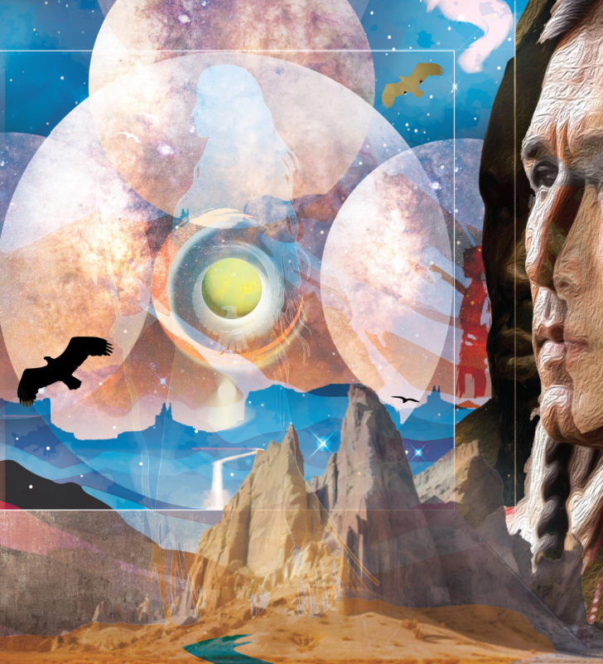
Re-imagining Columbus
Design Principle
I feel the Earth beneath my feet, I feel mother earth.
I could feel her heartbeat.
I feel the breeze, I see the water.
I hear the birds, I hear the insects,
my connection to mother earth, is what I feel.
She believes in me, she listens to me, she understands me,
her stories are told throughout my body.
My connection is through my people,
my connection is to the earth and the sky.
I feel her seasons.
I learn from her stories, her stories about how she began.
Her stories are about who they are.
My existence, to this earth is through myself,
my community, my family.
I look to the east in the morning, I watch the sunset in the evenings
I think about the three generations before me
and the three generations after me.
I learn through my stories.
Everything around me has a purpose and an existence.
The cardinal directions, the transparency and reflection of who I am,
The memories and the emotions
She dances, she performs, she laughs, she cries, she sings, she dances.
It’s with her, I view the world in peace, in harmony.
She endures the struggles, she tells the truth, she’s prideful
She has balance, she has harmony.
She has a feeling of form and forms her movement,
she’s free, she’s home.
This is her home, her children will learn from her stories,
the elder will pass on the stories from generation to generation.
This is home, a place of story
IDS+A

Slide 11
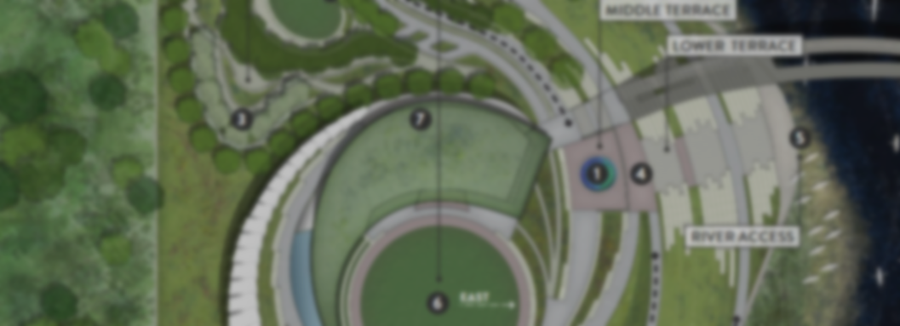
Re-Imagining Columbus
Community Space Experience
Mother Earth Connection
Centering our bond with nature
Time Continuum
Bridging past, present, and future generations
Natural Alignment
Harmonizing elements, seasons, and directions
Shared Truths
Honoring universal struggle and resilience
Ancestral Belonging
Evoking a sense of returning home
IDS+A

